Slide 1
WELCOME TO THE MOB!
All Scripture is breathed out by God and profitable for teaching, for reproof, for correction, and for training in righteousness, that the man of God may be complete, equipped for every good work.
2 Timothy 3:16-17 (ESV)

Slide 2
Welcome To The MOB!
MOB Website & Resources: www.ibcmob.net
Assist Pregnancy Center’s Fundraising Vision Dinner, Friday, Oct. 13, 2023, 6:30-9:00 PM, Fairview Park Marriott
Christian Embassy Fellowship Dinner Fundraiser, Friday, Oct. 20, 2023, 6:30-8:30 PM, Fairview Park Marriott
IBC Fall Outreach Festival Oct. 28, 1-4 PM
https://immanuelbible.church/visit/fall-outreach-fest

Slide 3
Please Rise
Invocation/Prayer
Song:

Slide 4
How Firm A Foundation
1 of 5
How firm a foundation, you saints of the Lord,
is laid for your faith in his excellent Word!
What more can he say than to you he has said,
to you who for refuge to Jesus have fled?

Slide 5
How Firm A Foundation
2 of 5
Fear not, I am with you, O be not dismayed,
for I am your God and will still give you aid;
I'll strengthen you, help you, and cause you to stand,
upheld by my righteous, omnipotent hand.

Slide 6
How Firm A Foundation
3 of 5
When through the deep waters I call you to go,
the rivers of sorrow shall not overflow;
for I will be with you, your troubles to bless,
and sanctify to you, your deepest distress.

Slide 7
How Firm A Foundation
4 of 5
When through fiery trials your pathway shall lie,
my grace, all sufficient shall be your supply;
the flame shall not hurt you, I only design
your dross to consume, and your gold to refine.

Slide 8
How Firm A Foundation
5 of 5
The soul that on Jesus still leans for repose,
I will not, I will not desert to its foes;
that soul, though all hell should endeavor to shake,
I'll never, no never, no never forsake!

Slide 9
Our Study of Isaiah
Last Meeting:
Isaiah 40:21-31
Memory Verse: Isaiah 40:31
Dr. Constable’s Notes, 2023 Ed., pp. 267-272; Motyer, pp. 305-308.
This Meeting:
Isaiah 41:1-20
Memory Verse: Isaiah 41:10
Dr. Constable’s Notes, 2023 Ed., pp.272-279; Motyer, pp.308-312.
Refreshment Host: C

Slide 10
Memory Verse
Isaiah 41:10 (ESV)
“fear not, for I am with you; be not dismayed for I am your God; I will strengthen you, I will help you, will uphold you with my righteous right hand.”
Isaiah 41:10 (ESV)
Notes:
It really is a great verse. A lot packed into the application of Isaiah that we’ll touch on.

Slide 11
Isaiah Outline
Focus | Prophecies of Condemnation |  |  |  |  |  |  |  | Historical Parenthesis |  | Prophecies of Comfort
 | 1:1 |  |  |  |  |  |  | 35:10 | 36:1 | 39:8 | 40:1 |  |  |  |  |  | 66:24
Divisions | Prophecies Against Judah |  | Prophecies Against the Nation |  | Prophesies Against the Day of the Lord |  | Prophesies of Judgement and Blessing |  | Sickness and Sin | Hezekiah’s Salvation | Israel’s Deliverance |  |  | Israel’s Deliverer |  | Israel’s Glorious Future
 | 1:1 | 12:6 | 13:1 | 23:18 | 24:1 | 27:13 | 28:1 | 35:10 | 36:1 | 39:8 | 40:1 | 48:22 |  | 49:1 | 57:21 | 58:1 | 66:24
Topics | Prophetic |  |  |  |  |  |  |  | Historic |  | Messianic
 | Judgement |  |  |  |  |  |  |  | Transition |  | Hope
Place | Israel & Judah
Time | 740 - 680 B.C.
Bruce Wilkinson and Kenneth Boa, Talk Thru the Bible (Nashville: T. Nelson, 1983), 189.

Slide 12
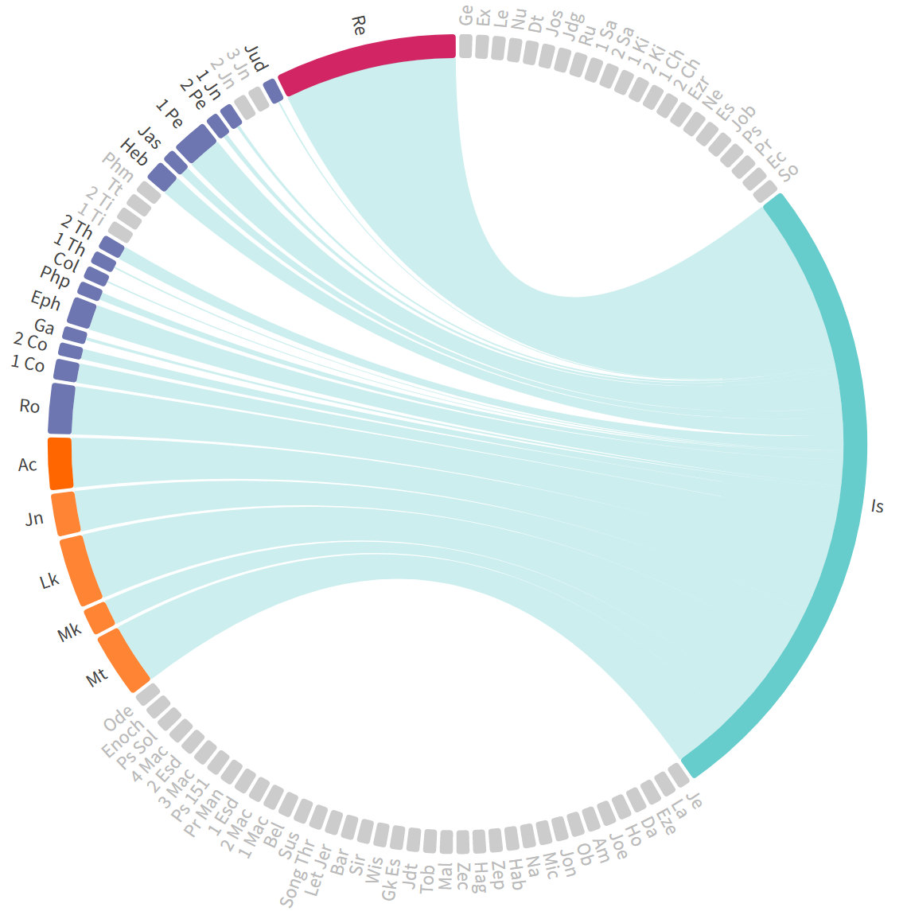
New Testament Use of Isaiah
412 times there are references to the book and prophet Isaiah
162 times within the gospels and Acts
66x Isaiah a source for Jesus
100 times by Paul
32x in Romans (22 quotes/citations)
115 times in Revelation
Chord Graph

Slide 13
Review
Book of Salvation (Chap. 40-66):
Ch. 40-48: God’s Grace To Israel
King Cyrus delivers Israel from Babylonian captivity in Babylon.
Ch. 49-55: God’s Atonement
The rejection and restoration of the Suffering Servant, the deliverer.
Ch. 56-66: A Glorious Future
God’s restoration and transformation of Israel and the world.

Slide 14
¹ Listen to me in silence, O coastlands; let the peoples renew their strength; let them approach, then let them speak; let us together draw near for judgment.
² Who stirred up one from the east whom victory meets at every step? He gives up nations before him, so that he tramples kings underfoot; he makes them like dust with his sword, like driven stubble with his bow.
³ He pursues them and passes on safely, by paths his feet have not trod.
⁴ Who has performed and done this, calling the generations from the beginning? I, the Lord, the first, and with the last; I am he.
⁵ The coastlands have seen and are afraid; the ends of the earth tremble; they have drawn near and come.
⁶ Everyone helps his neighbor and says to his brother, “Be strong!”
⁷ The craftsman strengthens the goldsmith, and he who smooths with the hammer him who strikes the anvil, saying of the soldering, “It is good”; and they strengthen it with nails so that it cannot be moved.
⁸ But you, Israel, my servant, Jacob, whom I have chosen, the offspring of Abraham, my friend;
⁹ you whom I took from the ends of the earth, and called from its farthest corners, saying to you, “You are my servant, I have chosen you and not cast you off”;
¹⁰ fear not, for I am with you; be not dismayed, for I am your God; I will strengthen you, I will help you, I will uphold you with my righteous right hand.
¹¹ Behold, all who are incensed against you shall be put to shame and confounded; those who strive against you shall be as nothing and shall perish.
¹² You shall seek those who contend with you, but you shall not find them; those who war against you shall be as nothing at all.
¹³ For I, the Lord your God, hold your right hand; it is I who say to you, “Fear not, I am the one who helps you.”
¹⁴ Fear not, you worm Jacob, you men of Israel! I am the one who helps you, declares the Lord; your Redeemer is the Holy One of Israel.
¹⁵ Behold, I make of you a threshing sledge, new, sharp, and having teeth; you shall thresh the mountains and crush them, and you shall make the hills like chaff;
¹⁶ you shall winnow them, and the wind shall carry them away, and the tempest shall scatter them. And you shall rejoice in the Lord; in the Holy One of Israel you shall glory.
¹⁷ When the poor and needy seek water, and there is none, and their tongue is parched with thirst, I the Lord will answer them; I the God of Israel will not forsake them.
¹⁸ I will open rivers on the bare heights, and fountains in the midst of the valleys. I will make the wilderness a pool of water, and the dry land springs of water.
¹⁹ I will put in the wilderness the cedar, the acacia, the myrtle, and the olive. I will set in the desert the cypress, the plane and the pine together,
²⁰ that they may see and know, may consider and understand together, that the hand of the Lord has done this, the Holy One of Israel has created it.

Slide 15
Isaiah 41:1-1
¹Listen to me in silence, O coastlands;
let the peoples renew their strength;
let them approach, then let them speak;
let us together draw near for judgment.
God is calling all the nations to come and hear what He is about to say; “renew their strength” is like 40:31 for Israel
The description given here is an understanding of the then know world around the Mediterranean
Many think this is not a calling but a coming to judgement which is in the next few verses

Slide 16
Isaiah 41:2-4
² Who stirred up one from the east
whom victory meets at every step?
He gives up nations before him,
so that he tramples kings underfoot;
he makes them like dust with his sword,
like driven stubble with his bow.
³ He pursues them and passes on safely,
by paths his feet have not trod.
⁴ Who has performed and done this,
calling the generations from the beginning?
I, the Lord, the first,
and with the last; I am he.
v.2-3, is an intro to Cyrus, whose name is used in verses 44:28; 45:1, trampling the nations he overruns
v.4, Even though Cyrus doesn’t know it, he is carrying out God’s purpose. This doesn’t make Cyrus righteous but shows that even in this war torn area of Assyria and Babylon, our Heavenly Father is in control. It is the same today!

Slide 17
Isaiah 42:5-6
⁵ The coastlands have seen and are afraid;
the ends of the earth tremble;
they have drawn near and come.
⁶ Everyone helps his neighbor
and says to his brother, “Be strong!”
⁷ The craftsman strengthens the goldsmith,
and he who smooths with the hammer him who strikes the anvil,
saying of the soldering, “It is good”;
and they strengthen it with nails so that it cannot be moved.
v.5, These new invasions are terrifying to the nations not yet involved
v.6, Those nations are depending on each other
v.7, The result is not to listen to the God of the universe but to do what they have always done, make more idols and trust in them

Slide 18
Isaiah 41:8-10
⁸ But you, Israel, my servant,
Jacob, whom I have chosen,
the offspring of Abraham, my friend;
⁹ you whom I took from the ends of the earth,
and called from its farthest corners,
saying to you, “You are my servant,
I have chosen you and not cast you off”;
¹⁰ fear not, for I am with you;
be not dismayed, for I am your God;
I will strengthen you, I will help you,
I will uphold you with my righteous right hand.
v.8, Now the addressee is Israel, God’s people, and he is showing them His redemption from here to v.20 (Motyer)
v.9, They are His chosen people, and He will not abandon then
v.10, Even though they get “dismayed”, God will “uphold” them. It is the same with us today

Slide 19
Isaiah 41:11-13
¹¹ Behold, all who are incensed against you
shall be put to shame and confounded;
those who strive against you
shall be as nothing and shall perish.
¹² You shall seek those who contend with you,
but you shall not find them;
those who war against you
shall be as nothing at all.
¹³ For I, the Lord your God,
hold your right hand;
it is I who say to you, “Fear not,
I am the one who helps you.”
v.11, None of the other nations have the living God and they will all perish.
v.12, No matter what happens, God will take care of them
v.13, This verse is basically a restatement of our memory verse. Any restatement in the Scriptures like this means it is very important

Slide 20
Isaiah 41:14-16
¹⁴ Fear not, you worm Jacob, you men of Israel!
I am the one who helps you, declares the Lord;
your Redeemer is the Holy One of Israel.
¹⁵ Behold, I make of you a threshing sledge,
new, sharp, and having teeth;
you shall thresh the mountains and crush them,
and you shall make the hills like chaff;
¹⁶ you shall winnow them, and the wind shall carry them away,
and the tempest shall scatter them.
And you shall rejoice in the Lord;
in the Holy One of Israel you shall glory.
v.14, Here the term “worm” was for weakness. The remedy is “the Holy One of Israel” the “Redeemer”. This is the first of 3 times this is used in this passage and in Isaiah more than any other prophet
v.15, God would make them like a “threshing sledge” only much stronger. Here it would work on “mountains”, not just crops
v.16, Constable says this sledge would work against the nations and cause Israeli people to rejoice in the “Holy One of Israel”

Slide 21
Isaiah 41:17-20
¹⁷ When the poor and needy seek water,
and there is none, and their tongue is parched with thirst, I the Lord will answer them;
I the God of Israel will not forsake them.
¹⁸ I will open rivers on the bare heights, and fountains in the midst of the valleys. I will make the wilderness a pool of water, and the dry land springs of water.
¹⁹ I will put in the wilderness the cedar, the acacia, the myrtle, and the olive. I will set in the desert the cypress, the plane and the pine together,
20 that they may see and know, may consider and understand together, that the hand of the Lord has done this, the Holy One of Israel has created it.
v.17, This 3rd section is how God will help those who thirst, obviously, in a wilderness. God will not forsake Israel or us
v.18, God will supply all types of water in this situation.
v.19, He will also provide shade for them with these 7 trees that don’t grow in the wilderness of Israel
v.20, All of this is to let them know that this all comes from the “Holy One of Israel”

Slide 22
Summary
Constable has this chapter as part of the intent of God’s assurance to Israel, 41:1-42:9, that He would always be with them.
v.1-7 are near prophesy
v.8-20 are in the future for Israel’s final deliverance

Slide 23
Questions & Application Lowell’s Questions
Who are the “coastland” nations cited in this text and why did a fearful Israel not need to fear them?
Who did God “arouse from the east,” and how did God use him to accomplish His purpose?
What are some other examples in the Bible of how God raised up unbelieving world leaders to accomplish His purpose? Do you think He might be doing this in our day?
How does the “I am He” of verse 4 relate to its use in Exodus 3:14?
How did the coastlands respond to God’s message for them and what’s so “pathetic” about it?
What’s the significance of being called “a servant” and “a friend” of God and where else in the Bible are these designations used?

Slide 24
Questions & Application Lowell’s Questions
What’s the context and application for believers today of Isaiah 41:10 (which also happens to be our memory verse for this lesson)?
Why would Isaiah refer to Jacob, in verse 14, as a “worm”—and how would it be transformed and used by God?
What’s the significance of Isaiah’s reference in verse 14 to the Holy One of Israel being their “Redeemer”?
How would God “work wonders” in changing the drought-like conditions of the land into a “paradisiacal garden-like existence? And what would His people “see and recognize” through it?
What bottom line message and other key insights will you take away from this passage?

Slide 25
Next Meeting
Review:
Isaiah 41:1-20
Memory Verse: Isaiah 41:10
Dr. Constable’s Notes, 2023 Ed., pp. 272-279; Motyer, pp. 308-312
Study:
Isaiah 41:21-29
Memory Verse: Isaiah 41:23-24
Dr. Constable’s Notes, 2023 Ed., pp. 279-281; Motyer, pp.312-318
Refreshment Host: D

Slide 26
Closing
Benediction
Small Groups

Slide 28
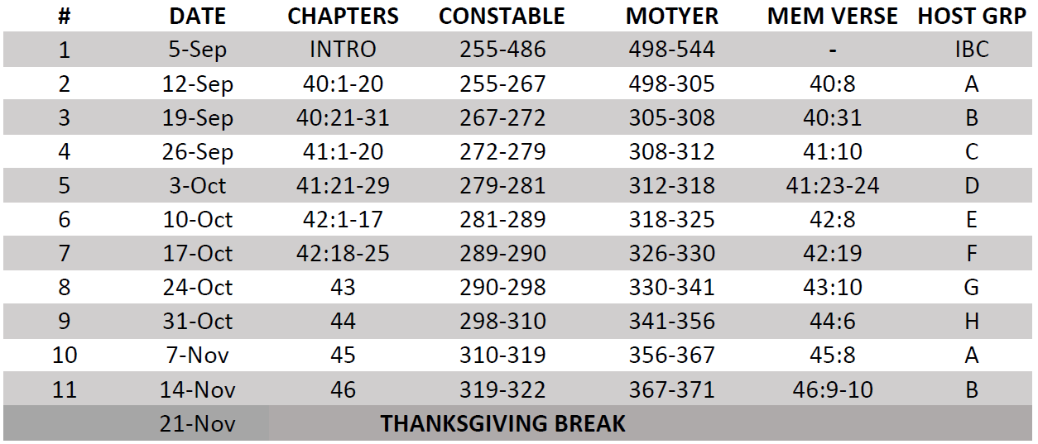
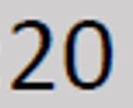
Isaiah Bible Study Schedule for Fall 2023 – Spring 2024 as of September 5, 2023

Slide 29
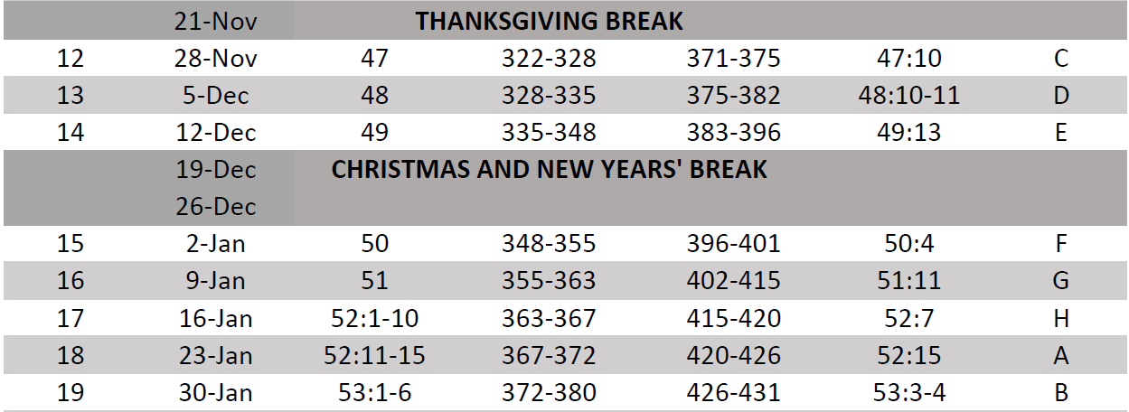
Isaiah Bible Study Schedule for Fall 2023 – Spring 2024 as of September 5, 2023

Slide 30
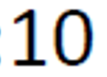
Isaiah Bible Study Schedule for Fall 2023 – Spring 2024 as of September 5, 2023

Slide 31
Isaiah Bible Study Schedule for Fall 2023 – Spring 2024 as of September 5, 2023

