Slide 1
WELCOME TO THE MOB!
All Scripture is breathed out by God and profitable for teaching, for reproof, for correction, and for training in righteousness, that the man of God may be complete, equipped for every good work.
2 Timothy 3:16-17 (ESV)

Slide 2
Welcome To The MOB!
MOB Website & Resources: www.ibcmob.net
Assist Pregnancy Center’s Fundraising Vision Dinner, Friday, Oct. 13, 2023, 6:30-9:00 PM, Fairview Park Marriott
Christian Embassy Fellowship Dinner Fundraiser, Friday, Oct. 20, 2023, 6:30-8:30 PM, Fairview Park Marriott
IBC Fall Outreach Festival Oct. 28, 1-4 PM
https://immanuelbible.church/visit/fall-outreach-fest

Slide 3
Please Rise
Invocation/Prayer
Song: Turn Your Eyes Upon Jesus

Slide 4
Turn Your Eyes Upon Jesus
1 of 6
O soul, are you weary and troubled? No light in the darkness you see? There’s light for a look at the Savior, And life more abundant and free.

Slide 5
Turn Your Eyes Upon Jesus
2 of 6
Turn your eyes upon Jesus, Look full in His wonderful face, And the things of earth will grow strangely dim, In the light of His glory and grace.

Slide 6
Turn Your Eyes Upon Jesus
3 of 6
Through death into life everlasting He passed, and we follow Him there; O’er us sin no more hath dominion For more than conqu’rors we are!

Slide 7
Turn Your Eyes Upon Jesus
4 of 6
Turn your eyes upon Jesus, Look full in His wonderful face, And the things of earth will grow strangely dim, In the light of His glory and grace.

Slide 8
Turn Your Eyes Upon Jesus
5 of 6
His Word shall not fail you, He promised; Believe Him and all will be well; Then go to a world that is dying, His perfect salvation to tell!

Slide 9
Turn Your Eyes Upon Jesus
6 of 6
Turn your eyes upon Jesus, Look full in His wonderful face, And the things of earth will grow strangely dim, In the light of His glory and grace.

Slide 10
Our Study of Isaiah
Last Meeting:
Isaiah 41:21-29
Memory Verse: 41:23-24
Dr. Constable’s Notes, 2023 Ed., pp. 279-281; Motyer, pp. 312-318.
Refreshment Host: D
This Meeting:
Isaiah 42:1-17
Memory Verse: 42:8
Dr. Constable’s Notes, 2023 Ed., pp. 281-289; Motyer, pp. 318-325
Refreshment Host: E

Slide 11
Memory Verse
Isaiah 42:8 (ESV)
⁸ I am the LORD; that is my name;
my glory I give to no other,
nor my praise to carved idols.

Slide 12
Isaiah Outline
Focus | Prophecies of Condemnation |  |  |  |  |  |  |  | Historical Parenthesis |  | Prophecies of Comfort
 | 1:1 |  |  |  |  |  |  | 35:10 | 36:1 | 39:8 | 40:1 |  |  |  |  |  | 66:24
Divisions | Prophecies Against Judah |  | Prophecies Against the Nation |  | Prophesies Against the Day of the Lord |  | Prophesies of Judgement and Blessing |  | Sickness and Sin | Hezekiah’s Salvation | Israel’s Deliverance |  |  | Israel’s Deliverer |  | Israel’s Glorious Future
 | 1:1 | 12:6 | 13:1 | 23:18 | 24:1 | 27:13 | 28:1 | 35:10 | 36:1 | 39:8 | 40:1 | 48:22 |  | 49:1 | 57:21 | 58:1 | 66:24
Topics | Prophetic |  |  |  |  |  |  |  | Historic |  | Messianic
 | Judgement |  |  |  |  |  |  |  | Transition |  | Hope
Place | Israel & Judah
Time | 740 - 680 B.C.
You Are Here!
Bruce Wilkinson and Kenneth Boa, Talk Thru the Bible (Nashville: T. Nelson, 1983), 189.

Slide 13
How To Interpret Scripture The Immanuel Way
Normal - understanding the words of Scripture in their common usage unless otherwise indicated by the context.
Literal - understanding the meaning of Scripture in its ordinary sense unless the context requires a figurative interpretation.
Grammatical - using the recognized rules of grammar to interpret the text.
Historical - understanding the words of Scripture in the context of the times in which they were written.
Systematic - categorizing and comparing the teaching of the Scriptures with the whole of Scripture in view.

Slide 14
Outline
Matthew Henry Commentary

Slide 15
“Behold” Statements
41:24 BEHOLD you are nothing, and your work is less than nothing..
41:29 BEHOLD, they are all a delusion; their works are nothing; their metal images are empty wind
Behold My Servant

Slide 16
The Lord’s Chosen Servant
42 Behold my servant, whom I uphold, my chosen, in whom my soul delights;
I have put my Spirit upon him; he will bring forth justice to the nations.
² He will not cry aloud or lift up his voice, or make it heard in the street;
³ a bruised reed he will not break, and a faintly burning wick he will not quench;
he will faithfully bring forth justice.
⁴ He will not grow faint or be discouraged till he has established justice in the earth;
and the coastlands wait for his law.
⁵ Thus says God, the Lord, who created the heavens and stretched them out, who spread out the earth and what comes from it, who gives breath to the people on it and spirit to those who walk in it:
⁶ “I am the Lord; I have called you in righteousness; I will take you by the hand and keep you;
I will give you as a covenant for the people, a light for the nations,
⁷ to open the eyes that are blind, to bring out the prisoners from the dungeon, from the prison those who sit in darkness.
⁸ I am the Lord; that is my name; my glory I give to no other, nor my praise to carved idols.
⁹ Behold, the former things have come to pass, and new things I now declare; before they spring forth I tell you of them.”

Slide 17
My Servant
^{Verses 1-4}
^{“Of”}
^{Verses 5-9}
^{“To”}

Slide 18
Isaiah 42:1
Spirit upon him – see 11:1-5
Justice to the nations – it is not only Israel in view here
The Lord’s Chosen Servant
1 Behold my servant, whom I uphold,
my chosen, in whom my soul delights;
I have put my Spirit upon him;
he will bring forth justice to the nations.

Slide 19
Isaiah 42:2-4
“In verse 1 we met the quintessential servant; here is quintessential service.” (Motyer)
Bruised reed? Burning wick?
Matthew 12:15-21
² He will not cry aloud or lift up his voice,
or make it heard in the street;
³ a bruised reed he will not break,
and a faintly burning wick he will not quench;
he will faithfully bring forth justice.
⁴ He will not grow faint or be discouraged
till he has established justice in the earth;
and the coastlands wait for his law.
One who united thus the attributes of divine power with such entire freedom from the ostentation of ambition could be none other than the true ideal King.
Ellicott’s Commentary for English Readers

Slide 20
Isaiah 42:5-7
“The Servant’s ministry will fulfill the Creator’s original intention for the earth.” -- Motyer
Covenant for the people – a “world-wide covenantal task”
The Messiah demonstrated power and authority over all realms - and ultimately power to conquer sin and death.
⁵ Thus says God, the Lord,
who created the heavens and stretched them out,
who spread out the earth and what comes from it,
who gives breath to the people on it and spirit to those who walk in it:
⁶ “I am the Lord; I have called you in righteousness;
I will take you by the hand and keep you;
I will give you as a covenant for the people,
a light for the nations,
⁷ to open the eyes that are blind,
to bring out the prisoners from the dungeon,
from the prison those who sit in darkness.

Slide 21
Isaiah 42:8-9
⁸ I am the Lord; that is my name;
my glory I give to no other,
nor my praise to carved idols.
⁹ Behold, the former things have come to pass,
and new things I now declare;
before they spring forth
I tell you of them.”
The LORD – Yahweh – He will keep his covenant with Israel
Once again calling out the inferiority of idols
Former things – new things?
A concluding “behold” for this passage
First of six times God claimed the ability to predict the future in Isaiah. -- Constable

Slide 22
Sing to the Lord a New Song
¹⁰ Sing to the Lord a new song, his praise from the end of the earth, you who go down to the sea, and all that fills it, the coastlands and their inhabitants.
¹¹ Let the desert and its cities lift up their voice, the villages that Kedar inhabits; let the habitants of Sela sing for joy, let them shout from the top of the mountains.
¹² Let them give glory to the Lord, and declare his praise in the coastlands.
¹³ The Lord goes out like a mighty man, like a man of war he stirs up his zeal; he cries out, he shouts aloud, he shows himself mighty against his foes.
¹⁴ For a long time I have held my peace; I have kept still and restrained myself; now I will cry out like a woman in labor; I will gasp and pant.
¹⁵ I will lay waste mountains and hills, and dry up all their vegetation; I will turn the rivers into islands, and dry up the pools.
¹⁶ And I will lead the blind in a way that they do not know, in paths that they have not known I will guide them. I will turn the darkness before them into light, the rough places into level ground. These are the things I do, and I do not forsake them.
¹⁷ They are turned back and utterly put to shame, who trust in carved idols, who say to metal images, “You are our gods.”

Slide 23
Isaiah 42:10-12
Sing to the Lord a New Song
¹⁰ Sing to the Lord a new song,
his praise from the end of the earth,
you who go down to the sea, and all that fills it,
the coastlands and their inhabitants.
¹¹ Let the desert and its cities lift up their voice,
the villages that Kedar inhabits;
let the habitants of Sela sing for joy,
let them shout from the top of the mountains.
¹² Let them give glory to the Lord,
and declare his praise in the coastlands.
”New song” – a “new manifestation of God’s grace” – MacArthur
The groans of creation in Romans 8 turn to song.
Ends of the earth, Coastlands – the words paint a picture of a worldwide praise

Slide 24
Isaiah 42:13-14
¹³ The Lord goes out like a mighty man,
like a man of war he stirs up his zeal;
he cries out, he shouts aloud,
he shows himself mighty against his foes.
¹⁴ For a long time I have held my peace;
I have kept still and restrained myself;
now I will cry out like a woman in labor;
I will gasp and pant.
Mighty man – “shouts aloud” – a stark contrast from verse 2
Zechariah 14:3 Then the LORD will go out and fight against those nations as when he fights on a day of battle.
Long time = From Eternity Past

Slide 25
Isaiah 42:15-17
¹⁵ I will lay waste mountains and hills,
and dry up all their vegetation; I will turn the rivers into islands, and dry up the pools.
¹⁶ And I will lead the blind in a way that they do not know, in paths that they have not known I will guide them. I will turn the darkness before them into light,
the rough places into level ground. These are the things I do, and I do not forsake them.
¹⁷ They are turned back and utterly put to shame,
who trust in carved idols, who say to metal images,
“You are our gods.”
Destruction contrasted with restoration
In verse 16, “The destroyer turned rescuer” – Motyer
Another scoff at idols – “utterly put to shame”

Slide 26
Conclusion
Idols -> Messiah
Safety vs destruction
What strengthens your faith?

Slide 27
Next Meeting
Review:
Isaiah 42:1-17
Memory Verse: Isaiah 42:8
Dr. Constable’s Notes, 2023 Ed., pp. pp. 281-289; Motyer, pp. 318-325
Study:
Isaiah 42:18-25
Memory Verse: Isaiah 42:19
Dr. Constable’s Notes, 2023 Ed., pp. 289-290; Motyer, pp. 326-330
Refreshment Host: F

Slide 28
Questions & Application
In verse 1 of chapter 42, what are we called to “behold”? In our lives today, do we often lose our proper focus on our Savior? If so, how can we combat that?
In what ways does it become clear that the servant being described in chapter 42 is the Messiah?
How does the LORD defend His position to commission His Servant?
In 42:8, God says “my glory I give to no other”. How would you describe the jealous nature of God? What scripture comes to mind?
What are the “former things” and the “new things” spoken of in verse 9?
Verse 13 speaks of a “mighty man”, one who “shouts aloud” and “shows himself might against his foes”. What might this be referencing? When might it come to pass?

Slide 29
Closing
Benediction
Small Groups

Slide 31
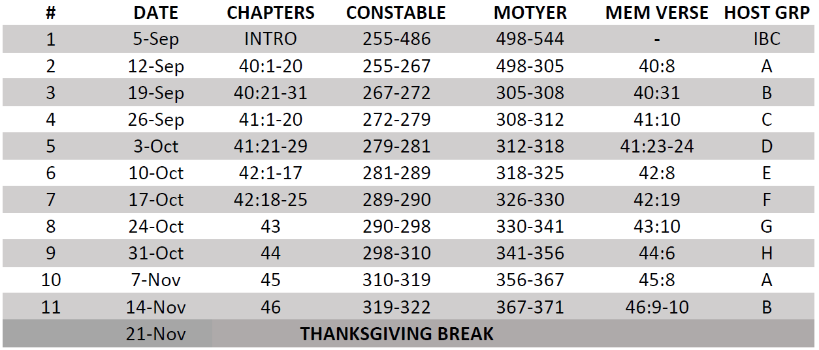
Isaiah Bible Study Schedule for Fall 2023 – Spring 2024 as of September 5, 2023

Slide 32
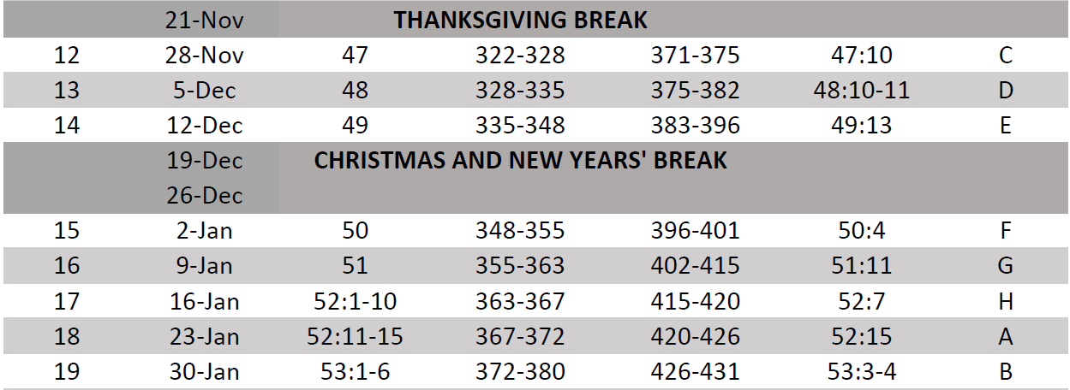
Isaiah Bible Study Schedule for Fall 2023 – Spring 2024 as of September 5, 2023

Slide 33
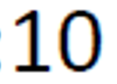
Isaiah Bible Study Schedule for Fall 2023 – Spring 2024 as of September 5, 2023

Slide 34
Isaiah Bible Study Schedule for Fall 2023 – Spring 2024 as of September 5, 2023

