Slide 1
WELCOME TO THE MOB!
All Scripture is breathed out by God and profitable for teaching, for reproof, for correction, and for training in righteousness, that the man of God may be complete, equipped for every good work.
2 Timothy 3:16-17 (ESV)
Notes:
Who I am

Slide 2
Announcements
Welcome to the MOB!
MOB Website & Resources: www.ibcmob.net
Thanksgiving Day Service, Nov. 24 at 1000 AM.
Come Behold Your King, Christmas Concert, Dec. 8-11.

Slide 3
On Your Feet Men!
Invocation/Prayer
Song:
“Crown Him With Many Crowns

Slide 4
Crown Him With Many Crowns 1 of 4
Crown Him with many crowns, The Lamb upon His throne; Hark! How the heav’nly anthem drowns All music but its own! Awake, my soul and sing Of Him Who died for thee, And hail Him as thy matchless King Through all eternity.

Slide 5
Crown Him With Many Crowns 2 of 4
Crown Him the Lord of love! Behold His hands and side— Rich wounds, yet visible above, In beauty glorified. No angel in the sky Can fully bear that sight, But downward bends His wond’ring eye At mysteries so bright.

Slide 6
Crown Him With Many Crowns 3 of 4
Crown Him the Lord of life! Who triumphed o’er the grave, Who rose victorious in the strife For those He came to save. His glories now we sing, Who died, and rose on high, Who died eternal life to bring, And lives that death may die.

Slide 7
Crown Him With Many Crowns 4 of 4
Crown Him the Lord of heav’n! One with the Father known, One with the Spirit through Him giv’n From yonder glorious throne, To Thee be endless praise, For Thou for us hast died; Be Thou, O Lord, through endless days Adored and magnified.
Love, Life & Heav’n

Slide 8
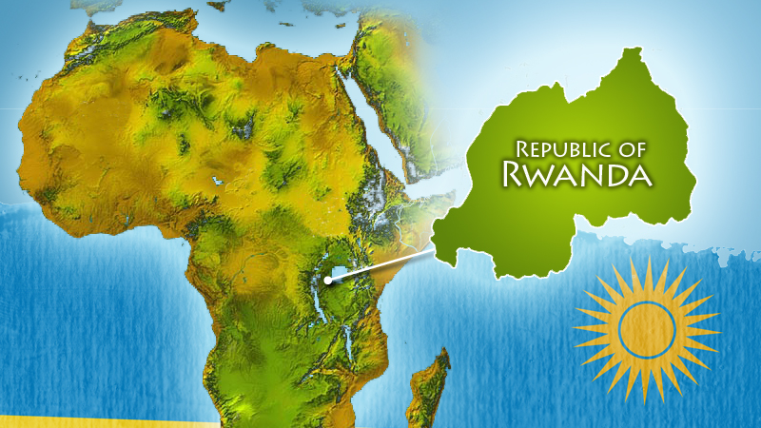

Slide 9
Immanuel Men in Rwanda

Slide 10
Immanuel Men in Rwanda

Slide 11
Immanuel Men in Rwanda

Slide 12
Immanuel Men in Rwanda

Slide 13
Immanuel Men in Rwanda

Slide 14
Immanuel Men in Rwanda

Slide 15
Immanuel Men in Rwanda

Slide 16
Immanuel Men in Rwanda

Slide 17
Memory Verse
Jeremiah 32:17(ESV)
“Ah Lord God! It is You who have made the heavens and the earth by Your great power and Your outstretched arm! Nothing is too hard for you!”
Jeremiah 32:17(ESV)

Slide 18
Our Study of Isaiah
Last Meeting:
Isaiah 9, For Unto Us A Child Is Born
Memory Verse: Isaiah 9:6
Dr. Constable’s Notes, 2022 Ed., pp. 86-95; Motyer, pp. 98-110.
This Meeting:
Isaiah 10, Judgement on Arrogance and Oppression
Memory Verse: Jeremiah 32:17
Dr. Constable’s Notes, 2022 Ed., pp.95-101; Motyer, pp.110-120.
Refreshment Host: Small Group F

Slide 19
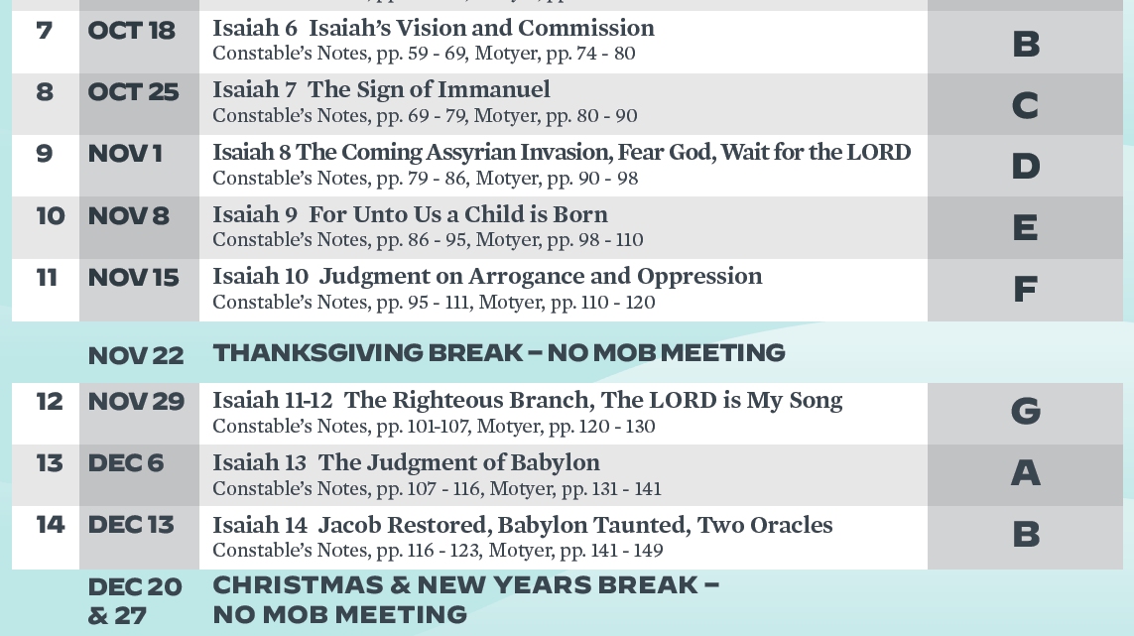
Isaiah Bible Study Schedule for Fall 2022 – Spring 2023 as of September 6, 2022

Slide 20
Isaiah Outline
Focus | Prophecies of Condemnation |  |  |  |  |  |  |  | Historical Parenthesis |  | Prophecies of Comfort
 | 1:1 |  |  |  |  |  |  | 35:10 | 36:1 | 39:8 | 40:1 |  |  |  |  | 66:24
Divisions | Prophecies Against Judah |  | Prophecies Against the Nation |  | Prophesies Against the Day of the Lord |  | Prophesies of Judgement and Blessing |  | Sickness and Sin | Hezekiah’s Salvation | Israel’s Deliverance |  | Israel’s Deliverer |  | Israel’s Glorious Future
 | 1:1 | 12:6 | 13:1 | 23:18 | 24:1 | 27:13 | 28:1 | 35:10 | 36:1 | 39:8 | 40:1 | 48:22 | 49:1 | 57:21 | 58:1 | 66:24
Topics | Prophetic |  |  |  |  |  |  |  | Historic |  | Messianic
 | Judgement |  |  |  |  |  |  |  | Transition |  | Hope
Place | Israel & Judah
Time | 740 - 680 B.C.
You Are Here!

Slide 21
Today’s Lesson
In this section, God condemns the corrupt leaders. The King of Assyria is the tool of God but He will bring low their king. God Also declares that He will leave a remnant in Israel.
The poem that God begins in Chapter 9 continues into Chapter 10.
Jesus…Jesus…Jesus.
God uses situations for his purposes.
But…There will be a remnant remaining.
Notes:
Crown Him With Many Crowns
No Sermons on this chapter…MacArthur, Piper, RC Sproul
Jesus in this set of verses…chapter 7…Chapter 9…
God uses evil for his purposes…
There will be a Remnant.

Slide 22
Lesson Overview Isaiah Chapter 10
God Despises Corrupt Leaders/Deals with the Assyrian Arrogance
The Moral Perversion of the Leaders (10:1-4)
God’s Judgement on Arrogant Assyria (10:5-11)
The Pride And Arrogance of the King of Assyria (10:12-14)
God’s Judgement on Arrogant Assyria (10:15-19)
The Remnant of Israel Will Return (10:20-34)

Slide 23
Isaiah 10:1-4 The Moral Perversion of the Leaders
¹ Woe to those who decree iniquitous decrees, and the writers who keep writing oppression,
² to turn aside the needy from justice and to rob the poor of my people of their right, that widows may be their spoil, and that they may make the fatherless their prey!
Notes:
The four clauses fall into two pairs.
J. A. Motyer, (Downers Grove, IL: InterVarsity Press, 1996), 111.
J. A. Motyer, The Prophecy of Isaiah: An Introduction & Commentary (Downers Grove, IL: InterVarsity Press, 1996), 111.
5:1–24; 25; 9:7 (8)–10:4; 5:26–30. Sermons delivered at the beginning of the reign of Ahaz, 735.
Maximilian Lindsay Kellner, (Boston: Damrell & Upham, 1900), 12.
Maximilian Lindsay Kellner, The Assyrian Monuments Illustrating the Sermons of Isaiah (Boston: Damrell & Upham, 1900), 12.

Slide 24
Isaiah 10:1-4 The Moral Perversion of the Leaders
³ What will you do on the day of punishment, in the ruin that
will come from afar? To whom will you flee for help, and where will you leave your
wealth? ⁴ Nothing remains but to crouch among the prisoners or fall
among the slain. For all this his anger has not turned away, and his hand is
stretched out still.

Slide 25
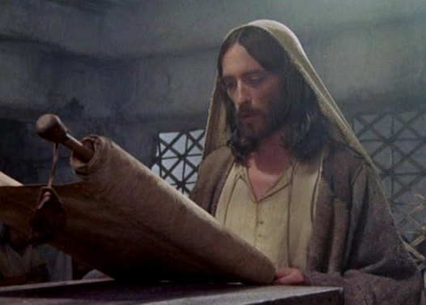
Isaiah 10:1-4 The Moral Perversion of the Leaders
References
Isaiah 61
Luke 4:16-19
Isaiah 7:14
Isaiah 9:6-7
Matthew 24:45-51
It’s all about Jesus…
During the Time of Ahaz?
Accents of Amos
The Day of Punishment?
Hand Stretched Out…
Anger…Hebrew = ap…Nose or Nostrils
“It is not Assyria’s overwhelming power which dictates the future of Ephraim and Judah; it is their failure to submit to God and to live in accordance with his principles.” – Oswalt
Notes:
The four stanzas show a coherent development:
1. National disaster (8–12〈7–11〉). The Lord’s word has been rejected in self-sufficient pride. Internal set-backs (10〈9〉) will be followed by external attack (11〈10〉).
2. Political collapse (13–17〈12–16〉). Since there has been no repentance (13〈12〉), the Lord will undermine the leadership (14–16〈13–15〉). There will be widespread suffering (17〈16〉).
3. Social anarchy (18–21〈17–20〉). Divine wrath manifests itself in a spirit of total self-concern (19〈18〉) bringing with it no satisfaction (20〈19〉). The nation tears itself apart, united only in hostility to Judah (21〈20〉).
4. Moral perversion (10:1–4). The basis of morality, safeguarded by law, is overturned. The suffering of the helpless (2) brings as its reward the helplessness of its perpetrators in the day of judgment (3–4).
J. A. Motyer, (Downers Grove, IL: InterVarsity Press, 1996), 106.
J. A. Motyer, The Prophecy of Isaiah: An Introduction & Commentary (Downers Grove, IL: InterVarsity Press, 1996), 106.
Isaiah 61 The Spirit of the Lord God is upon me, because the Lord has anointed me to bring good news to the poor;^{[a]} he has sent me to bind up the brokenhearted, to proclaim liberty to the captives, and the opening of the prison to those who are bound;^{[b]} ² to proclaim the year of the Lord's favor, and the day of vengeance of our God; to comfort all who mourn;
Luke 4 Jesus Rejected at Nazareth
16 And he came to Nazareth, where he had been brought up. And as was his custom, he went to the synagogue on the Sabbath day, and he stood up to read.
17 And the scroll of the prophet Isaiah was given to him. He unrolled the scroll and found the place where it was written,
18 “The Spirit of the Lord is upon me,
because he has anointed me
to proclaim good news to the poor.
He has sent me to proclaim liberty to the captives
and recovering of sight to the blind,
to set at liberty those who are oppressed,
19 to proclaim the year of the Lord’s favor.”
20 And he rolled up the scroll and gave it back to the attendant and sat down. And the eyes of all in the synagogue were fixed on him.
21 And he began to say to them, “Today this Scripture has been fulfilled in your hearing.”
(Wheaton, IL: Crossway Bibles, 2016), Lk 4:1621.
The Holy Bible: English Standard Version (Wheaton, IL: Crossway Bibles, 2016), Lk 4:16–21.
Isaiah 7:14 Therefore the Lord himself will give you a sign. Behold, the virgin shall conceive and bear a son, and shall call his name Immanuel.
(Wheaton, IL: Crossway Bibles, 2016), Is 7:14.
The Holy Bible: English Standard Version (Wheaton, IL: Crossway Bibles, 2016), Is 7:14.
Isaiah 9:6
6 For to us a child is born,
to us a son is given;
and the government shall be upon his shoulder,
and his name shall be called
Wonderful Counselor, Mighty God,
Everlasting Father, Prince of Peace.
(Wheaton, IL: Crossway Bibles, 2016), Is 9:6.
The Holy Bible: English Standard Version (Wheaton, IL: Crossway Bibles, 2016), Is 9:6.
45 “Who then is the faithful and wise servant, whom his master has set over his household, to give them their food at the proper time?
46 Blessed is that servant whom his master will find so doing when he comes.
47 Truly, I say to you, he will set him over all his possessions.
48 But if that wicked servant says to himself, ‘My master is delayed,’
49 and begins to beat his fellow servants and eats and drinks with drunkards,
50 the master of that servant will come on a day when he does not expect him and at an hour he does not know
51 and will cut him in pieces and put him with the hypocrites. In that place there will be weeping and gnashing of teeth.
(Wheaton, IL: Crossway Bibles, 2016), Mt 24:4451.
The Holy Bible: English Standard Version (Wheaton, IL: Crossway Bibles, 2016), Mt 24:44–51.
5:1–24; 25; 9:7 (8)–10:4; 5:26–30. Sermons delivered at the beginning of the reign of Ahaz, 735. Vss. 15–16 are an editorial gloss, and 25 is mainly editorial, as is also 9:14 (15).
Maximilian Lindsay Kellner, (Boston: Damrell & Upham, 1900), 12.
Maximilian Lindsay Kellner, The Assyrian Monuments Illustrating the Sermons of Isaiah (Boston: Damrell & Upham, 1900), 12.
Mauchline (in loc.) fittingly refers to this section as “the accents of Amos,” for the OT reader is often reminded of Isaiah’s older contemporary here. There is nothing strange about this, for Amos was a southern prophet who addressed the north; and this is the role adopted at this point by Isaiah, for these verses are the conclusion of the oracle against Israel that commenced at 9:8 (see esp. Amos 2:6–7; 5:11–12; 8:4–6):
Geoffrey W. Grogan, in The Expositors Bible Commentary: Isaiah, Jeremiah, Lamentations, Ezekiel, ed. Frank E. Gaebelein, vol. 6 (Grand Rapids, MI: Zondervan Publishing House, 1986), 78.
Geoffrey W. Grogan, “Isaiah,” in The Expositor’s Bible Commentary: Isaiah, Jeremiah, Lamentations, Ezekiel, ed. Frank E. Gaebelein, vol. 6 (Grand Rapids, MI: Zondervan Publishing House, 1986), 78.
^{Amos 2:6-7} Thus says the Lord:
“For three transgressions of Israel, and for four, I will not revoke the punishment, because they sell the righteous for silver, and the needy for a pair of sandals— ⁷ those who trample the head of the poor into the dust of the earth and turn aside the way of the afflicted;
Amos 5:11-12
English Standard Version
¹¹ Therefore because you trample on^{[a]} the poor and you exact taxes of grain from him, you have built houses of hewn stone, but you shall not dwell in them; you have planted pleasant vineyards, but you shall not drink their wine. ¹² For I know how many are your transgressions and how great are your sins— you who afflict the righteous, who take a bribe, and turn aside the needy in the gate.
God’s Anger…on the leadership and on Senacharib…Nose
Hand Stretched Out…What does this mean?
Slapping by hand? A grave act of shame…

Slide 26
Isaiah 10:5-11 God’s Judgement on Arrogant Assyria
⁵ Woe to Assyria, the rod of my anger; the staff in their hands is my fury! ⁶ Against a godless nation I send him, and against the people of my wrath I command him, to take spoil and seize plunder, and to tread them down like the mire of the streets. ⁷ But he does not so intend, and his heart does not so think; but it is in his heart to destroy, and to cut off nations not a few;
Notes:
10:5–15; 14:24–27; 10:16–11:9. Prophecies against Assyria’s Arrogance, 701.
Maximilian Lindsay Kellner, (Boston: Damrell & Upham, 1900), 12.
Maximilian Lindsay Kellner, The Assyrian Monuments Illustrating the Sermons of Isaiah (Boston: Damrell & Upham, 1900), 12.
7 Isaiah points out the disparity between Assyria’s motives and the Lord’s.
J. A. Motyer, (Downers Grove, IL: InterVarsity Press, 1996), 114.
J. A. Motyer, The Prophecy of Isaiah: An Introduction & Commentary (Downers Grove, IL: InterVarsity Press, 1996), 114.

Slide 27
Isaiah 10:5-11 God’s Judgement on Arrogant Assyria
for he says:
“Are not my commanders all kings? ⁹ Is not Calno like Carchemish? Is not Hamath like Arpad? Is not Samaria like Damascus? ¹⁰ As my hand has reached to the kingdoms of the idols, whose carved images were greater than those of Jerusalem and Samaria, ¹¹ shall I not do to Jerusalem and her idols as I have done to Samaria and her images?”

Slide 28
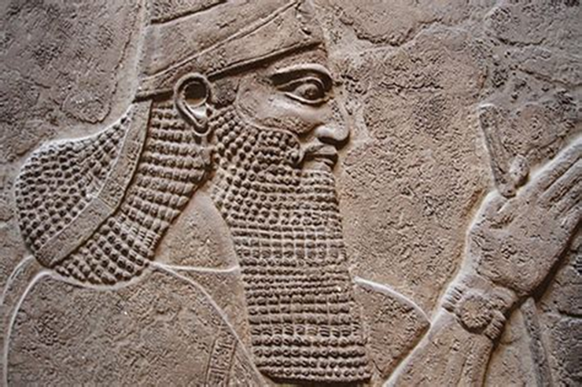
Isaiah 10:5-11 God’s Judgement on Arrogant Assyria
During Hezekiah’s Reign?
God uses the most violent and tyrannical King and nation to punish his people
Two Sovereignties: God vs. Sennacherib
Different Intentions…
The Lord is sovereign, but his instruments are morally responsible agents - Montyer
References
Habakkuk 1:1-13
2 Kings 19:35
Nahum
Notes:
10:5–15; 14:24–27; 10:16–11:9. Prophecies against Assyria’s Arrogance, 701.
Maximilian Lindsay Kellner, (Boston: Damrell & Upham, 1900), 12.
Maximilian Lindsay Kellner, The Assyrian Monuments Illustrating the Sermons of Isaiah (Boston: Damrell & Upham, 1900), 12.
Anger…Again
Rod…Hebrew = sebet…Like a club
Staff…Hebrew = mate…Branch
Fury…Hebrew = za’am…Froth at the Mouth
Wrath…Hebrew = ebra…rage
Is God’s anger a major part of his character? See Gentle and lowly
Hab 1:1 The oracle that Habakkuk the prophet saw.
Habakkuk’s Complaint
2 O Lord, how long shall I cry for help,
and you will not hear?
Or cry to you “Violence!”
and you will not save?
3 Why do you make me see iniquity,
and why do you idly look at wrong?
Destruction and violence are before me;
strife and contention arise.
4 So the law is paralyzed,
and justice never goes forth.
For the wicked surround the righteous;
so justice goes forth perverted.
The Lord’s Answer
5 “Look among the nations, and see;
wonder and be astounded.
For I am doing a work in your days
that you would not believe if told.
6 For behold, I am raising up the Chaldeans,
that bitter and hasty nation,
who march through the breadth of the earth,
to seize dwellings not their own.
7 They are dreaded and fearsome;
their justice and dignity go forth from themselves.
8 Their horses are swifter than leopards,
more fierce than the evening wolves;
their horsemen press proudly on.
Their horsemen come from afar;
they fly like an eagle swift to devour.
9 They all come for violence,
all their faces forward.
They gather captives like sand.
10 At kings they scoff,
and at rulers they laugh.
They laugh at every fortress,
for they pile up earth and take it.
11 Then they sweep by like the wind and go on,
guilty men, whose own might is their god!”
Habakkuk’s Second Complaint
12 Are you not from everlasting,
O Lord my God, my Holy One?
We shall not die.
O Lord, you have ordained them as a judgment,
and you, O Rock, have established them for reproof.
13 You who are of purer eyes than to see evil
and cannot look at wrong,
why do you idly look at traitors
and remain silent when the wicked swallows up
the man more righteous than he?
(Wheaton, IL: Crossway Bibles, 2016), Hab 1:113.
The Holy Bible: English Standard Version (Wheaton, IL: Crossway Bibles, 2016), Hab 1:1–13.
Sennacherib Defies the Lord
8 The Rabshakeh returned, and found the king of Assyria fighting against Libnah, for he heard that the king had left Lachish.
9 Now the king heard concerning Tirhakah king of Cush, “Behold, he has set out to fight against you.” So he sent messengers again to Hezekiah, saying,
10 “Thus shall you speak to Hezekiah king of Judah: ‘Do not let your God in whom you trust deceive you by promising that Jerusalem will not be given into the hand of the king of Assyria.
(Wheaton, IL: Crossway Bibles, 2016), 2 Ki 19:810.
The Holy Bible: English Standard Version (Wheaton, IL: Crossway Bibles, 2016), 2 Ki 19:8–10.
35 And that night the angel of the Lord went out and struck down 185,000 in the camp of the Assyrians. And when people arose early in the morning, behold, these were all dead bodies.
(Wheaton, IL: Crossway Bibles, 2016), 2 Ki 19:35.
The Holy Bible: English Standard Version (Wheaton, IL: Crossway Bibles, 2016), 2 Ki 19:35.
Nahum Introduction
When Jonah preached repentance on the streets of Nineveh, the capital of Assyria, the people responded and were spared. A century later, sometime between 663 and 612 b.c., Nahum preached in a time when Nineveh would not repent. Nineveh, which had destroyed Israel’s northern kingdom in 722, itself fell to Babylon in 612—just a few years after Nahum’s warning. The Assyrians were notorious for the brutality of their treatment of other nations. Nahum declared, however, that God is sovereign: he punishes whom he will, and they are powerless to stop him. Much of Nahum’s prophecy was directed to the people of Judah, who could rejoice at the good news (1:15) of Nineveh’s impending fall.
(Wheaton, IL: Crossway Bibles, 2016), Na.
The Holy Bible: English Standard Version (Wheaton, IL: Crossway Bibles, 2016), Na.
Assyria was the chief instrument God used in Isaiah’s day. The word “godless” (v.6) must have been as shocking as the names “Sodom” and “Gomorrah” (1:10) to those who were fastidious and even excessive in their observance of religious ritual (1:10–17; cf. Mic 6:6–7).
Geoffrey W. Grogan, in The Expositors Bible Commentary: Isaiah, Jeremiah, Lamentations, Ezekiel, ed. Frank E. Gaebelein, vol. 6 (Grand Rapids, MI: Zondervan Publishing House, 1986), 80.
Geoffrey W. Grogan, “Isaiah,” in The Expositor’s Bible Commentary: Isaiah, Jeremiah, Lamentations, Ezekiel, ed. Frank E. Gaebelein, vol. 6 (Grand Rapids, MI: Zondervan Publishing House, 1986), 80.
For all the Assyrian self-assertion of verses 7–11, it is nevertheless the Lord whose purpose controls all.
J. A. Motyer, (Downers Grove, IL: InterVarsity Press, 1996), 115.
J. A. Motyer, The Prophecy of Isaiah: An Introduction & Commentary (Downers Grove, IL: InterVarsity Press, 1996), 115.
The Assyrian Army
Ponzi scheme
New inventions…footwhere…iron works…
Fighting for Ashur…
Assimilated the concurred lands…Moved people in…Moved People out
God had to deal with them…
maintenance of the line of David.
Assimilation of the people…very effective…wiped out the Northern Kingdom
Asshur would become the primary God.

Slide 29
Isaiah 10:12-14 The Pride And Arrogance of the King of Assyria
¹² When the Lord has finished all his work on Mount Zion and on Jerusalem, he will punish the speech of the arrogant heart of the king of Assyria and the boastful look in his eyes. ¹³ For he says:
“By the strength of my hand I have done it, and by my wisdom, for I have understanding; I remove the boundaries of peoples, and plunder their treasures; like a bull I bring down those who sit on thrones. ¹⁴ My hand has found like a nest the wealth of the peoples; and as one gathers eggs that have been forsaken, so I have gathered all the earth and there was none that moved a wing or opened the mouth or chirped.”
Notes:
Typical writing of Kings of the Day…Isaish seems to be familiar
In its present setting, v. 12 functions as a transitional element making it plain that what is done to Jerusalem and Samaria (and their idols) (vv. 8–11) is not done in spite of Yahweh but because of him, and that the coming punishment upon Assyria is fully justified by her rapacious and arrogant attitude (vv. 13, 14).
John N. Oswalt, , The New International Commentary on the Old Testament (Grand Rapids, MI: Wm. B. Eerdmans Publishing Co., 1986), 266.
John N. Oswalt, The Book of Isaiah, Chapters 1–39, The New International Commentary on the Old Testament (Grand Rapids, MI: Wm. B. Eerdmans Publishing Co., 1986), 266.

Slide 30
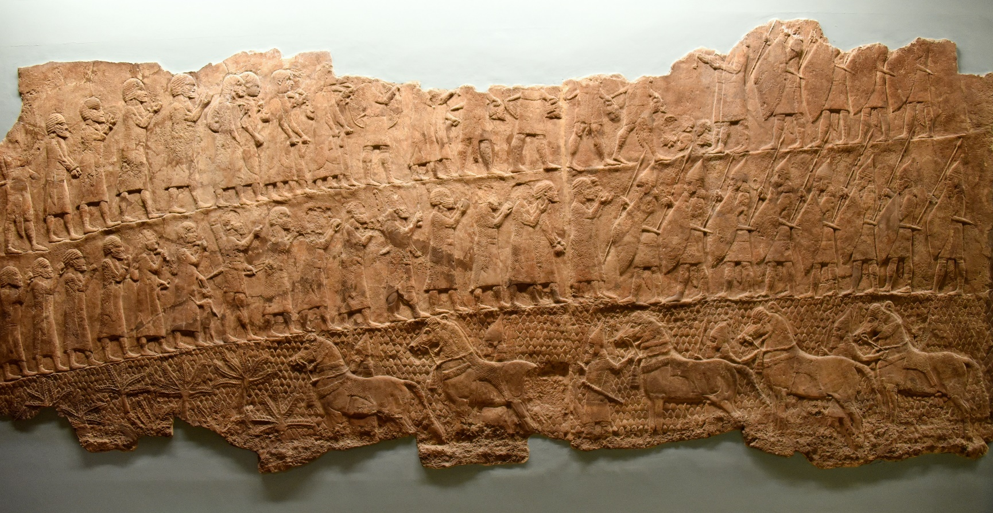
Isaiah 10:12-14 The Pride And Arrogance of the King of Assyria
References
Habakkuk 1:1-13
2 Kings 19:35
Nahum
The Lachish Relief
God’s Punishment is Justified by Assyria’s Rapacious Attitude
Sennacherib’s Arrogance Was Typical of the Day
What He Had Done To Date Supported His Pride
Superior skills and abilities are a gracious gift from God given for his purposes… not an innate superiority
Oswalt
Notes:
Typical
Thus, when the Sovereign has finished his work on Mount Zion (not Assyria accomplishing her rapacious intent), then Assyria herself will come under the judgment of God, a judgment which will make it plain that her boasting pride was unwarranted.
John N. Oswalt, , The New International Commentary on the Old Testament (Grand Rapids, MI: Wm. B. Eerdmans Publishing Co., 1986), 266.
John N. Oswalt, The Book of Isaiah, Chapters 1–39, The New International Commentary on the Old Testament (Grand Rapids, MI: Wm. B. Eerdmans Publishing Co., 1986), 266.

Slide 32
Isaiah 10:15-19 God’s Judgement on Arrogant Assyria
¹⁵ Shall the axe boast over him who hews with it, or the saw magnify itself against him who wields it? As if a rod should wield him who lifts it, or as if a staff should lift him who is not wood! ¹⁶ Therefore the Lord God of hosts will send wasting sickness among his stout warriors, and under his glory a burning will be kindled, like the burning of fire.

Slide 33
Isaiah 10:15-19 The Pride And Arrogance of the King of Assyria
¹⁷ The light of Israel will become a fire, and his Holy One a flame, and it will burn and devour his thorns and briers in one day. ¹⁸ The glory of his forest and of his fruitful land the Lord will destroy, both soul and body, and it will be as when a sick man wastes away. ¹⁹ The remnant of the trees of his forest will be so few that a child can write them down.

Slide 34
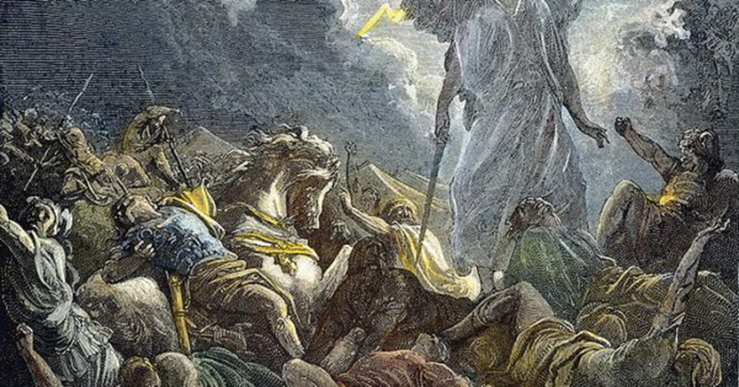
Isaiah 10:15-19 The Pride And Arrogance of the King of Assyria
The Assyrians marching triumphantly on Jerusalem are in reality jumping into a fire.
Motyer
Holy Light is felt by an arrogant conqueror as a fire of judgment
Grogan
Will God Leave an Assyrian Remnant?
References
Isaiah 19:23-25
Nahum
Habakkuk
2 Chronicles 32
Notes:
2 Chronicles 32…God Deals with Sennacherib…Goes home…his sons kill him.
If God used Assyria for his purposes…how can God hold Assyria responsible?

Slide 35
Isaiah 10:20-34 The Remnant of Israel Will Return
²⁰ In that day the remnant of Israel and the survivors of the house of Jacob will no more lean on him who struck them, but will lean on the Lord, the Holy One of Israel, in truth.
²¹ A remnant will return, the remnant of Jacob, to the mighty God.
²² For though your people Israel be as the sand of the sea, only a remnant of them will return. Destruction is decreed, overflowing with righteousness.
²³ For the Lord God of hosts will make a full end, as decreed, in the midst of all the earth.

Slide 36
Isaiah 10:20-34 The Remnant of Israel Will Return
²⁴ Therefore thus says the Lord God of hosts: “O my people, who dwell in Zion, be not afraid of the Assyrians when they strike with the rod and lift up their staff against you as the Egyptians did. ²⁵ For in a very little while my fury will come to an end, and my anger will be directed to their destruction. ²⁶ And the Lord of hosts will wield against them a whip, as when he struck Midian at the rock of Oreb. And his staff will be over the sea, and he will lift it as he did in Egypt. ²⁷ And in that day his burden will depart from your shoulder, and his yoke from your neck; and the yoke will be broken because of the fat.”
Notes:
26 The Gideon and exodus motifs are cleverly chosen. The reference to Midian and Oreb (Jdg. 7:25) focuses on the destruction of foes, especially their leaders; the reference to waters and Egypt emphasizes the deliverance of God’s people. Lash them with a whip is (lit.) ‘rouse up a whip’ and the general use of √‛ûr suggests the rousing of some agent of chastisement, in this case Sennacherib’s son and assassin (37:38). Whip (šōṭ) is used here ironically. Its only other occurrence in Isaiah (28:15, 18) describes the Assyrians as the scourge of Judah! The Assyrians took the whip and perished by the whip! The rock of Oreb (Jdg. 7:25) was named after the Midianite prince Oreb who escaped death in the battle but was killed when he fled. It is an apt allusion for Sennacherib who did not perish with his army but after he reached home.
J. A. Motyer, (Downers Grove, IL: InterVarsity Press, 1996), 118.
J. A. Motyer, The Prophecy of Isaiah: An Introduction & Commentary (Downers Grove, IL: InterVarsity Press, 1996), 118.

Slide 37
Isaiah 10:20-34 The Remnant of Israel Will Return
³³ Behold, the Lord God of hosts will lop the boughs with terrifying power; the great in height will be hewn down, and the lofty will be brought low. ³⁴ He will cut down the thickets of the forest with an axe, and Lebanon will fall by the Majestic One.

Slide 38
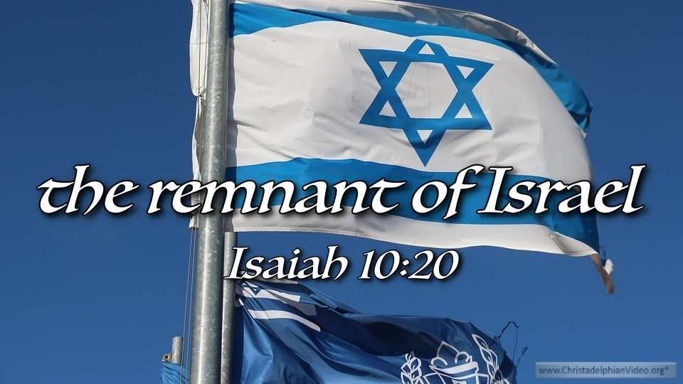
Isaiah 10:20-34 The Remnant of Israel Will Return
References
Isaiah 19:23-25
Isaiah 17:3
Nehemiah 8
Leaning on the Aram-Ephraimite Alliance
Now…Lean on God!
Shear-jashub…Isaiah’s Son…A Remnant Will Return
Reference to Midian and Oreb…
In Nehemiah…Ezra Reads the Law
A Full End…
Notes:
20 The background to this verse is the Aram-Ephraimite alliance. Threatened by the rising power of Assyria, the northern kingdom (Israel … Jacob) had turned for strength to one who had for a century been an enemy (see on 9:12〈11〉). But in that day such folly will be renounced and the remnant … will truly rely on the Lord.
J. A. Motyer, (Downers Grove, IL: InterVarsity Press, 1996), 117.
J. A. Motyer, The Prophecy of Isaiah: An Introduction & Commentary (Downers Grove, IL: InterVarsity Press, 1996), 117.
the remnant of Israel. The concept of a remnant seems to have been part of Isaiah’s understanding from the beginning of his ministry, for it is already there in the call narrative (6:13). Likewise, it appears in the name of his son Shear-jashub, “a remnant will return.” As noted above, there is a negative overtone to this name as it applies to Ahaz. It points to a destruction from which only a portion of Ahaz’s people will return. Yet it has also a positive connotation in its promise that some will survive. In this sense, while the term “remnant” does not appear again after 17:3, it is still perhaps the most apt summary of the entire book, since it captures the interwoven themes of redemption and judgment that prevail from beginning to end.
John N. Oswalt, , The New International Commentary on the Old Testament (Grand Rapids, MI: Wm. B. Eerdmans Publishing Co., 1986), 269.
John N. Oswalt, The Book of Isaiah, Chapters 1–39, The New International Commentary on the Old Testament (Grand Rapids, MI: Wm. B. Eerdmans Publishing Co., 1986), 269.
remnant of Jacob seems to be a specific attempt to highlight the continuity within God’s people. Though it will be but a remnant, nonetheless it will be an authentic representative of the ancient promises, the long history. Its significance will not be narrowly Judean, but rather the germ of the people as a whole will be present in it.
John N. Oswalt, , The New International Commentary on the Old Testament (Grand Rapids, MI: Wm. B. Eerdmans Publishing Co., 1986), 270271.
John N. Oswalt, The Book of Isaiah, Chapters 1–39, The New International Commentary on the Old Testament (Grand Rapids, MI: Wm. B. Eerdmans Publishing Co., 1986), 270–271.
I omitted most of these verses…..28–32 The discovery of Sennacherib’s annals (as well as the report in 2 K. 19 and Isa. 36:2) makes it plain that this is neither a prophecy nor a report of Sennacherib’s attack in 701 B.C. (contra Calvin). That attack came up from Lachish southwest of Jerusalem. Scott suggests it is actually Israel’s approach to Judah during the Syro-Ephraimite War, but the lack of any connection with the present context makes that suggestion suspect. Skinner points out with some cogency that Sargon, after destroying Samaria, may have ordered a raid as far as the walls of Jerusalem for the purpose of terrorizing the Judeans. However, no literal attack is necessary for this account to serve its purpose in this setting. By means of short, hard-hitting phrases it depicts an army’s relentless progress southward from a point some fifteen miles north of Jerusalem until it finally stands overlooking the Holy City.
John N. Oswalt, , The New International Commentary on the Old Testament (Grand Rapids, MI: Wm. B. Eerdmans Publishing Co., 1986), 274.
John N. Oswalt, The Book of Isaiah, Chapters 1–39, The New International Commentary on the Old Testament (Grand Rapids, MI: Wm. B. Eerdmans Publishing Co., 1986), 274.
A Remnant for Assyria – Isaiah 19:23-25
23 In that day there will be a highway from Egypt to Assyria, and Assyria will come into Egypt, and Egypt into Assyria, and the Egyptians will worship with the Assyrians.
24 In that day Israel will be the third with Egypt and Assyria, a blessing in the midst of the earth,
25 whom the Lord of hosts has blessed, saying, “Blessed be Egypt my people, and Assyria the work of my hands, and Israel my inheritance
(Wheaton, IL: Crossway Bibles, 2016), Is 19:2325.
The Holy Bible: English Standard Version (Wheaton, IL: Crossway Bibles, 2016), Is 19:23–25.
Isiah 17:3 The fortress will disappear from Ephraim,
and the kingdom from Damascus;
and the remnant of Syria will be
like the glory of the children of Israel,
declares the Lord of hosts.
(Wheaton, IL: Crossway Bibles, 2016), Is 17:3.
The Holy Bible: English Standard Version (Wheaton, IL: Crossway Bibles, 2016), Is 17:3.

Slide 39
Conclusion
God is Sovereign
Scripture Points to Jesus
God Hates Pride….But Will Use the Prideful
God Will Honor His Covenants
Where is the Bible?
Notes:
Preserves the Davidic covenant
Preserves the Bible/Torah
The Bible/Torah is read by Ezra when the remnant returns…

Slide 40
Next Meeting – 29 Nov
Review:
Isaiah 10 – Judgment on Arrogance and Oppression
Memory Verse: Jeremiah 32:17
Dr. Constable’s Notes, 2022 Ed., pp. 95-101; Motyer, pp. 110-120.
Study:
Isaiah 11-12- The Righteous Branch, The LORD is My Song
Memory Verse:
Dr. Constable’s Notes, 2022 Ed., pp. 101-107; Motyer, pp. 120-130.
Refreshment Host: Group G

Slide 41
Discussion & Application
1 of 2
What’s the fourth “calamity,” noted in verses 1-4, that went unheeded by Israel and “angered” God--that He would judge?
How do the four questions raised by Isaiah in verse 4 pose a grim dilemma for Israeli leaders, and how might you respond if they were directed to you?
How are “rod and staff” used here in contrast with how this term is used in other parts of Scripture?
How would you describe the Assyrian leaders’ misunderstanding of who they were, and of the role they were to play as an instrument of God’s judgment against Israel and Judah, and with what consequences?
How can you explain the eventual return of a “righteous remnant” in the midst of a national apostasy?

Slide 42
Discussion & Application
2 of 2
Why did God tell “the people who dwell in Zion” not to fear the approaching Assyrian army?
How does Isaiah liken the “yoke of bondage” of the Assyrians to that earlier imposed on the children of Israel by Egypt and Midian, and with what results?
What’s the connection Isaiah makes between the Assyrians and Lebanon?
How would you “sum up” this passage in the context of everything else you’ve learned so far in your study of Isaiah—with what “takeaways”?

Slide 43
Closing
Benediction
Small Groups

Slide 45
Book of Isaiah
Title: “The LORD is Salvation”
Author: Isaiah, Son of Amoz
Date: ~740 B.C. to 686 B.C.
Setting:
Prophesied in 4 kings’ reigns
Married, Two Sons
Key Details:
N.T. 65x; Name said 20x
Elevates God, Reveals Messiah
Overview of Vision (Chap. 1-39):
Ch. 1-6: Judah’s Sin, Isaiah’s Call
Ch. 7-12: Sign of Immanuel
Ch. 13-23: Oracles About Nations
Ch. 24-27: World Redemption
Ch. 28-35: Six Woes
Ch. 36-39: Historical Interlude
Ch. 40-66: Hope of Salvation

Slide 46
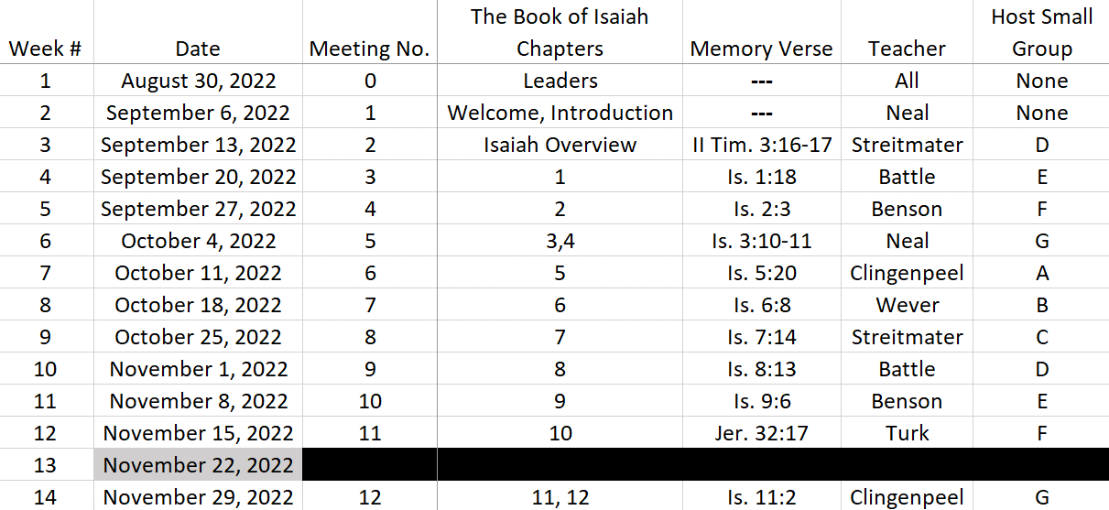
Isaiah Bible Study Schedule for Fall 2022 – Spring 2023

Slide 47
Isaiah Bible Study Schedule for Fall 2022 – Spring 2023 as of September 6, 2022

Slide 48
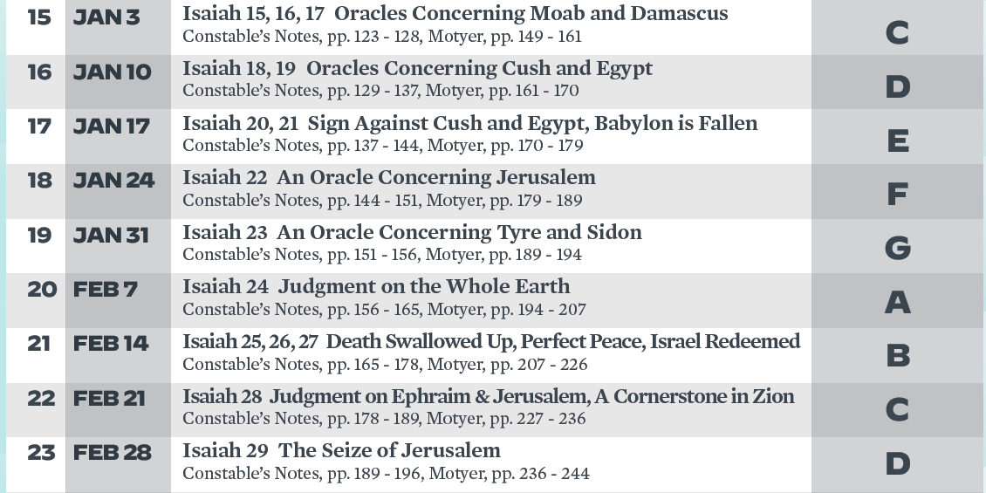
Isaiah Bible Study Schedule for Fall 2022 – Spring 2023 as of September 6, 2022

Slide 49
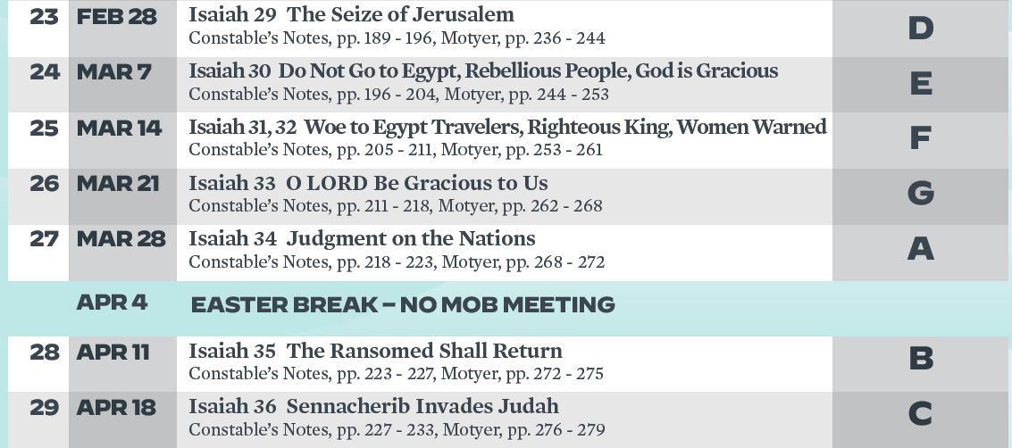
Isaiah Bible Study Schedule for Fall 2022 – Spring 2023 as of September 6, 2022

Slide 50
Isaiah Bible Study Schedule for Fall 2022 – Spring 2023 as of September 6, 2022

