Slide 1
WELCOME TO THE MOB!
All Scripture is breathed out by God and profitable for teaching, for reproof, for correction, and for training in righteousness, that the man of God may be complete, equipped for every good work.
2 Timothy 3:16-17 (ESV)
Notes:
Who I am

Slide 2
Announcements
Welcome to the MOB!
MOB Website & Resources: www.ibcmob.net
“Come Behold Your King,” Christmas Concert, Dec. 8-11

Slide 3
On Your Feet!
Invocation/Prayer
Song:
“Be Thou My Vision”

Slide 4
Be Thou My Vision 1 of 5
Be Thou my Vis-ion, O Lord of my heart;
Naught be all else to me, save that Thou art –
Thou my best thought, by day or by night,
Waking or sleep-ing, Thy pre-sence my light.

Slide 5
Be Thou My Vision 2 of 5
Be Thou my Wis-dom and Thou my true Word;
I e-ver with Thee and Thou with me, Lord:
Thou my great Fa-ther, I Thy true son;
Thou in me dwel-ling, and I with Thee one.

Slide 6
Be Thou My Vision 3 of 5
Be Thou my battle-shield, sword for the fight;
Be Thou my dig-ni-ty, Thou my de-light,
Thou my soul’s shel-ter, Thou my high tow-er:
Raise Thou me heav’n-ward, O Power of my power.

Slide 7
Be Thou My Vision 4 of 5
Rich-es I heed not, nor man’s emp-ty praise;
Thou mine in-her-i-tance, now and al-ways:
Thou and Thou on-ly first in my heart,
High king of heav-’n, my treasure Thou art.

Slide 8
Be Thou My Vision 5 of 5
High King of heav-en, aft-er vic-tor-y won,
May I reach heav’n’s joys, O bright heav-en’s Sun!
Heart of my own heart, what-e-ver be-fall,
Still be my Vis-ion, O Ruler of all.

Slide 9
Memory Verse

Slide 10
Memory Verse
2 Peter 3:10 (ESV)
“But the day of the Lord will come like a thief in the night, and then the heavens will pass away with a roar, and the heavenly bodies will be burned up and dissolved, and the earth and the works that are done in it will be exposed!”

Slide 11
Our Study of Isaiah
Last Meeting:
Isaiah 11-12, The Righteous Branch, The LORD is My Song
Memory Verse: Isaiah 11:2
Dr. Constable’s Notes, 2022 Ed., pp. 101-107; Motyer, pp. 120-130
Tonight:
Isaiah 13, The Judgment of Babylon
Memory Verse: 2 Peter 3:10
Dr. Constable’s Notes, 2022 Ed., pp. 107-116; Motyer, pp.131-141
Refreshment Host: Small Group A

Slide 12
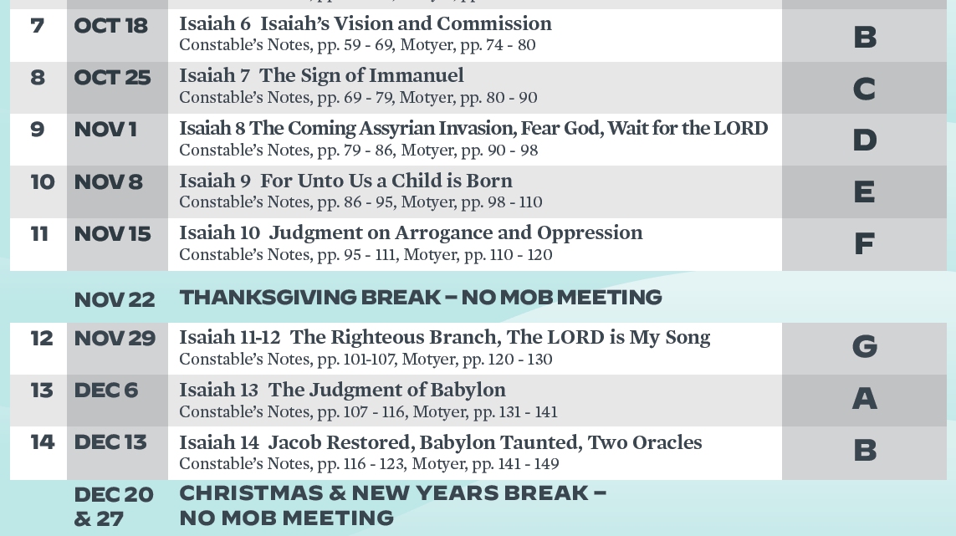
Isaiah Bible Study Schedule for Fall 2022 – Spring 2023 as of September 6, 2022

Slide 13
Isaiah Outline
Focus | Prophecies of Condemnation |  |  |  |  |  |  |  | Historical Parenthesis |  | Prophecies of Comfort
 | 1:1 |  |  |  |  |  |  | 35:10 | 36:1 | 39:8 | 40:1 |  |  |  |  | 66:24
Divisions | Prophecies Against Judah |  | Prophecies Against the Nations |  | Prophesies Against the Day of the Lord |  | Prophesies of Judgement and Blessing |  | Sickness and Sin | Hezekiah’s Salvation | Israel’s Deliverance |  | Israel’s Deliverer |  | Israel’s Glorious Future
 | 1:1 | 12:6 | 13:1 | 23:18 | 24:1 | 27:13 | 28:1 | 35:10 | 36:1 | 39:8 | 40:1 | 48:22 | 49:1 | 57:21 | 58:1 | 66:24
Topics | Prophetic |  |  |  |  |  |  |  | Historic |  | Messianic
 | Judgement |  |  |  |  |  |  |  | Transition |  | Hope
Place | Israel & Judah
Time | 740 - 680 B.C.
We are here!
Notes:
The second section of the book’s first main unit contains a series of judgment oracles pronounced against Gentile nations. The LORD pronounced judgment against the nations for their pride, but offered salvation for Israel if she would trust the LORD. These oracles assured God’s people of His sovereignty over the nations to encourage them to rely on the LORD. It would be foolishness to trust any nation God had doomed.

Slide 14
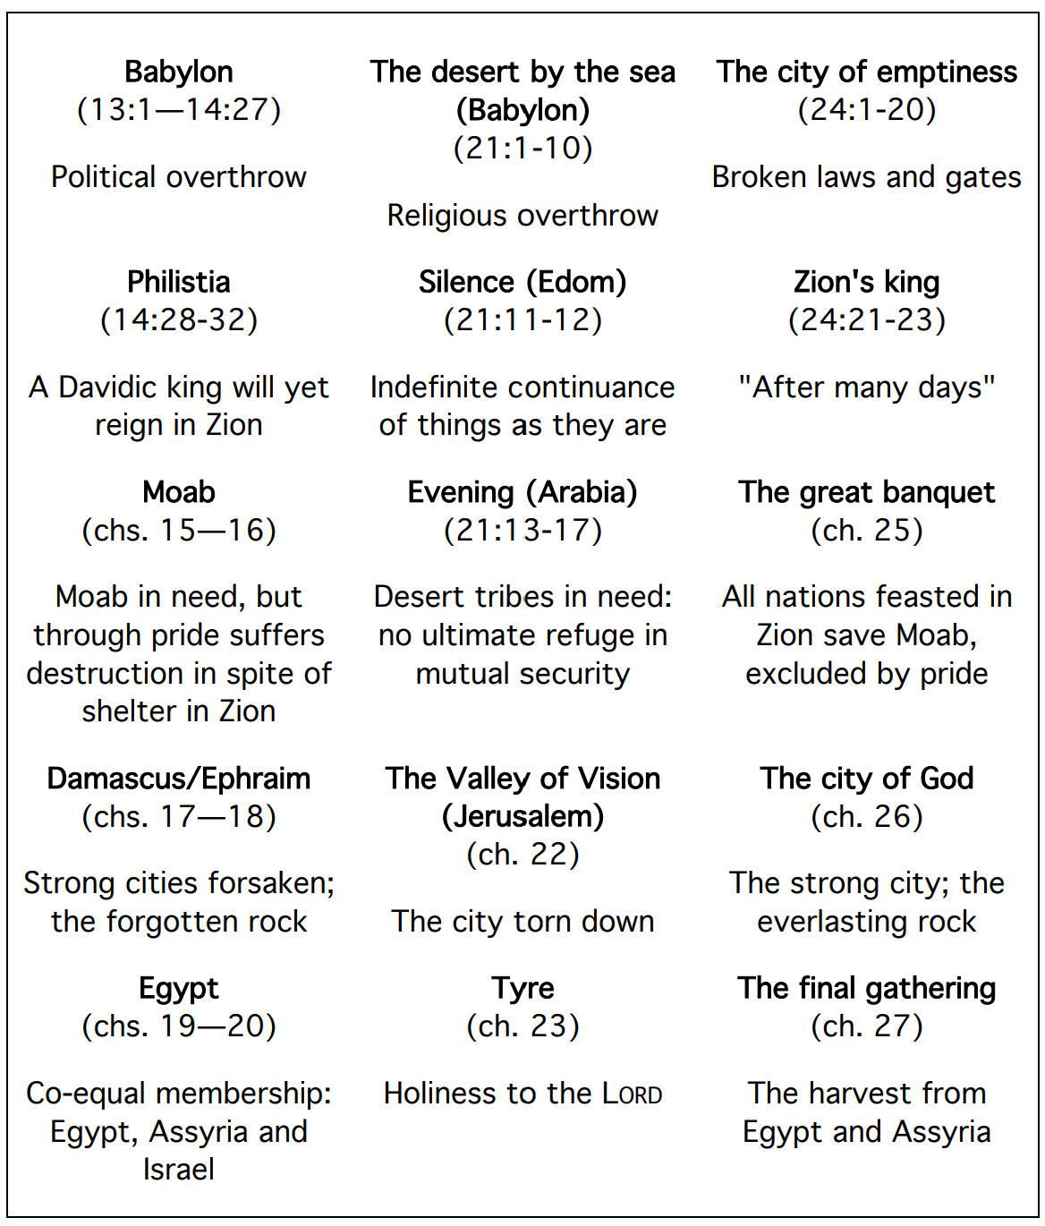
Overview | Isaiah 13-23
“The selection of these nations, in the literary structure of the passage, suggests that Israel occupies the central place in God’s plans, and the surrounding nations are vulnerable.” - Motyer
Notes:
Judgment of the Nations
Diagram from page 109 of Motyer

Slide 15
Overview | Isaiah 13-23
The fall of nations! The LORD pronounces judgment against the nations because of their pride, but offers salvation for Israel if she would trust the LORD. These oracles assure God’s people of His sovereignty over the nations and to encourage her to rely on Him. It would be foolish to trust any nation God has doomed.
Babylon
(N)
Babylon
(N)
Philistia
(W)
Israel
Moab
(E)
Tyre
(W)
Israel
Arabia
(E)
Egypt
(S)
Edom
(S)
Notes:
God placed Israel at the center of His dealings with Gentile nations.

Slide 16
Overview | Isaiah 13
Burden of Babylon – destruction in the Day of the Lord, and in the immediate future
Punishment of Babylon in the Day of the Lord – the Great Tribulation (Isaiah 13:1-16)
Destruction of Babylon in the Day of Man – Ancient history fulfilled (Isaiah 13:17-22)
“In Isaiah’s time it (Babylon) was far from being a mere provincial town within the Assyrian Empire… it constituted a major threat to the Assyrian overlord and, politically speaking, a Babylonian Empire in Isaiah’s lifetime was a real probability.” – Motyer

Slide 17
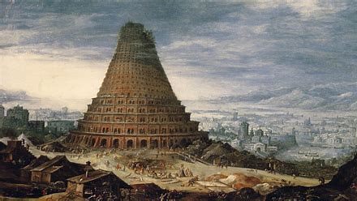
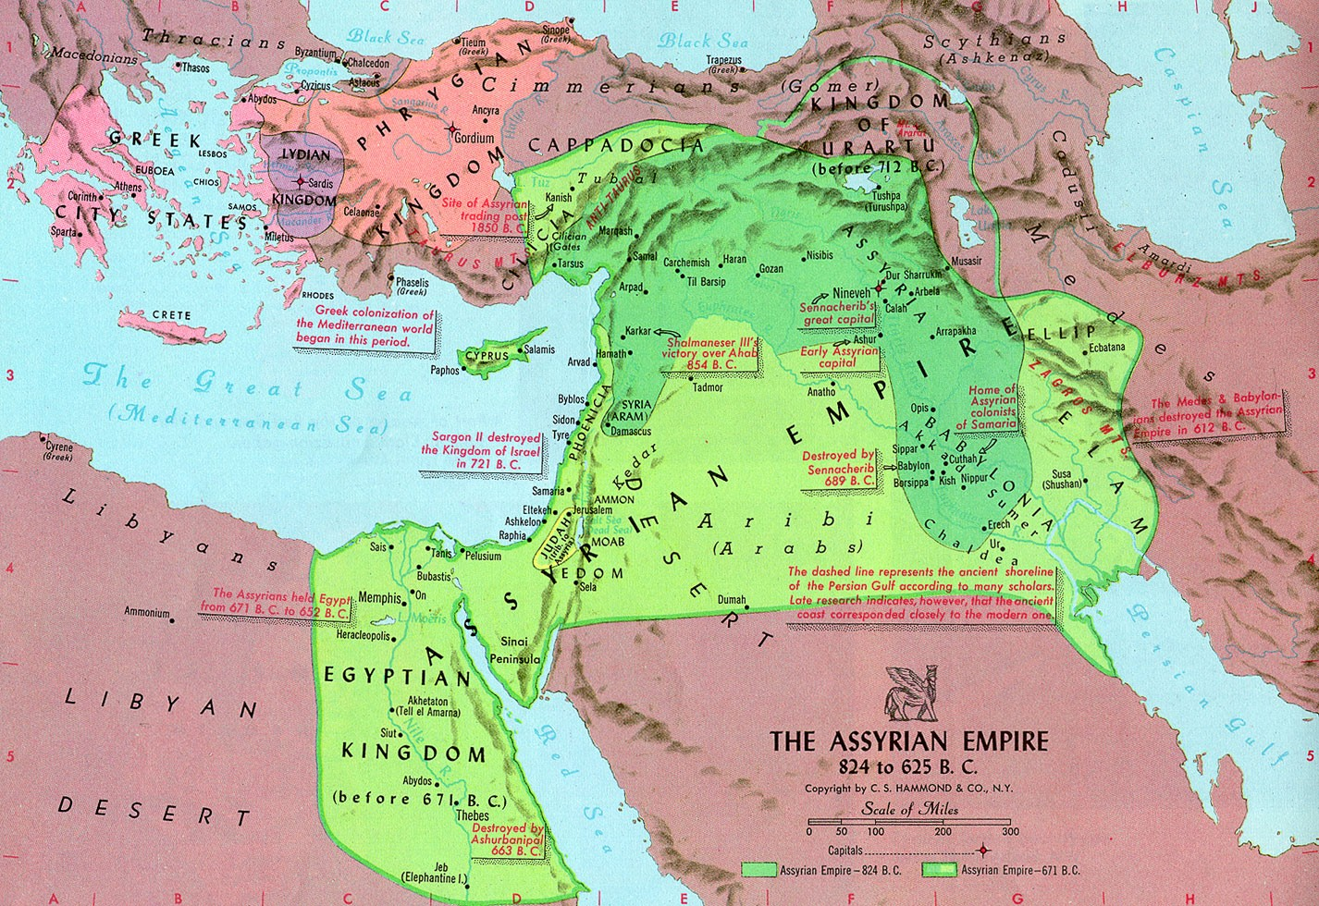
Isaiah 13:1
¹ The oracle concerning Babylon which Isaiah the son of Amoz saw.
Declaration – lifting up (of the voice)
Babylon mentioned from Genesis to Revelation
Four ways to think of Babylon
Historical city founded by Nimrod (Genesis 10: 8-10)
that rebelled against God (Genesis 11:1-9)
Kingdom of Babylon ruled by Nebuchadnezzar
City reconstructed in the last days (Rev 14,17,18)
The enemies counterfeit system of faith, a religion of lies, Babylon personifies false religion in any form
Notes:
When Isaiah wrote, Babylon was a town within the Assyrian Empire that was asserting itself and was a real threat to Assyrian supremacy. Isaiah is prophesying the fall of the Assyrian Empire in 100 years and then the rise of the Babylonian Empire before its fall.
Assyria -> Babylonian -> Medes/Persians -> Greeks -> Roman
City against God, Babylon is the city man wants to create and is contrasted against the city God wants to create, Zion. Babel, even after God’s judgment, didn’t scatter, they stayed put.

Slide 18
Isaiah 13 God’s Judgment of Babylon
“Much confusion exists in scholarly interpretation of the prophecies of Babylon because of the varied references to the city of Babylon as Babylon, to the empire as Babylon, and to the religions of Babylon as Babylon. Each of these areas has its own line of prophecy and fulfillment.” – John F. Walvoord

Slide 19
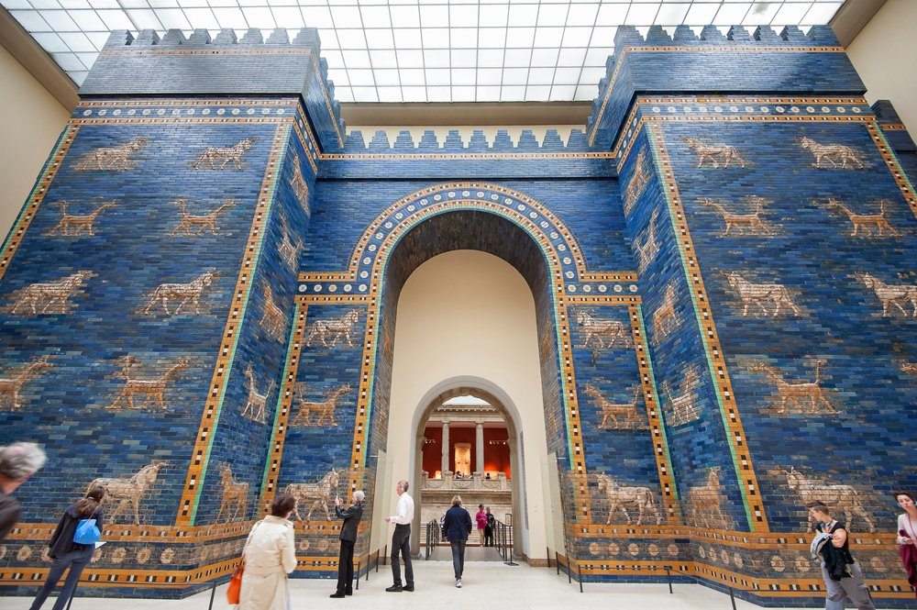
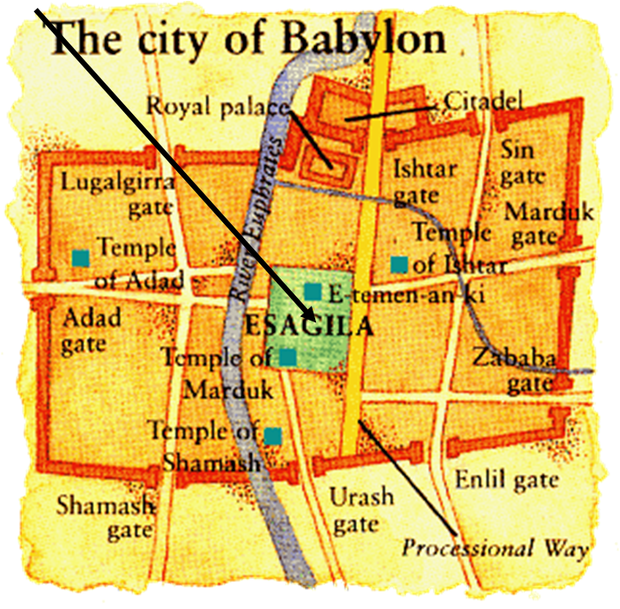
Babylon | Isaiah 13:1
Founded by Nimrod ~3,000 B.C.
Babylon is the capital city of Shinar, later called Chaldea
Became a powerful city-state and later capital city and namesake of one of the greatest empires in history
Ishtar Gate, on the northern side of the city was constructed of glazed bricks decorated with alternating rows of idols - reliefs of wild ox (the god Adad) and dragons (the god Marduk)
Massive city walls were well fortified: 40’ – 320’ high and 25’ thick with ~250 guard towers for archers and soldiers and a ditch that could be flooded to hinder attacks against the exterior wall
Ezekiel and Daniel, both deportees from Judah, ministered in Babylon
Jeremiah devoted 110 verses to the fall of Babylon, important topic
Daniel 5 foretells the fall of Babylon to the Medes and the Persians
Babylon is both a city and a system
Notes:
Excavated from 1902-1914, Ishtar Gate was moved to Pergamon Museum in Berlin, Germany 1930
Adad was the weather god and Marduk the chief god of the city of Babylon – presided over justice, compassion, healing, regeneration, magic, and fairness
When Isaiah wrote, Babylon was a town within the Assyrian Empire that was asserting itself and was a real threat to Assyrian supremacy, but not the empire it would later be.
Ishtar, in Mesopotamian religion, was the goddess of war and sexual love. Isaiah prophesied this before the Babylonian Empire existed.

Slide 20
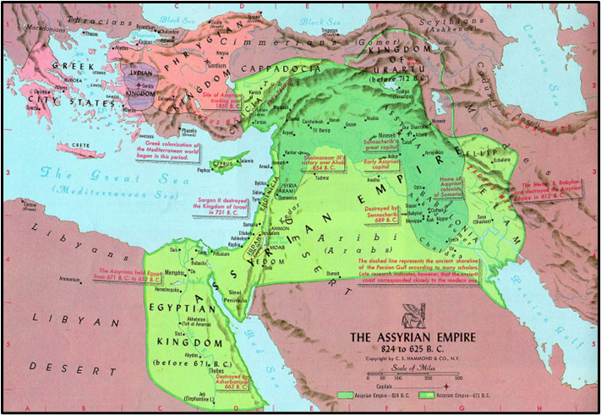
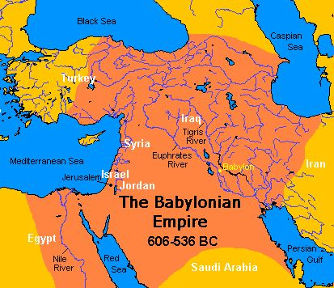
Babylon | Isaiah 13:1
Notes:
When Isaiah wrote, Babylon was a town within the Assyrian Empire that was asserting itself and was a real threat to Assyrian supremacy, but not the empire it would later be.
Ishtar, in Mesopotamian religion, was the goddess of war and sexual love. Isaiah prophesied this before the Babylonian Empire existed.

Slide 21
Isaiah 13:2-5
²On a bare hill raise a signal; cry aloud to them; wave the hand for them to enter the gates of the nobles.³I myself have commanded my consecrated ones, and have summoned my mighty men to execute my anger, my proudly exulting ones. ⁴The sound of a tumult is on the mountains as of a great multitude! The sound of an uproar of kingdoms, of nations gathering together! The LORD of hosts is mustering a host for battle. ⁵They come from a distant land, from the end of the heavens, the LORD and the weapons of his indignation, to destroy the whole land.

Slide 22
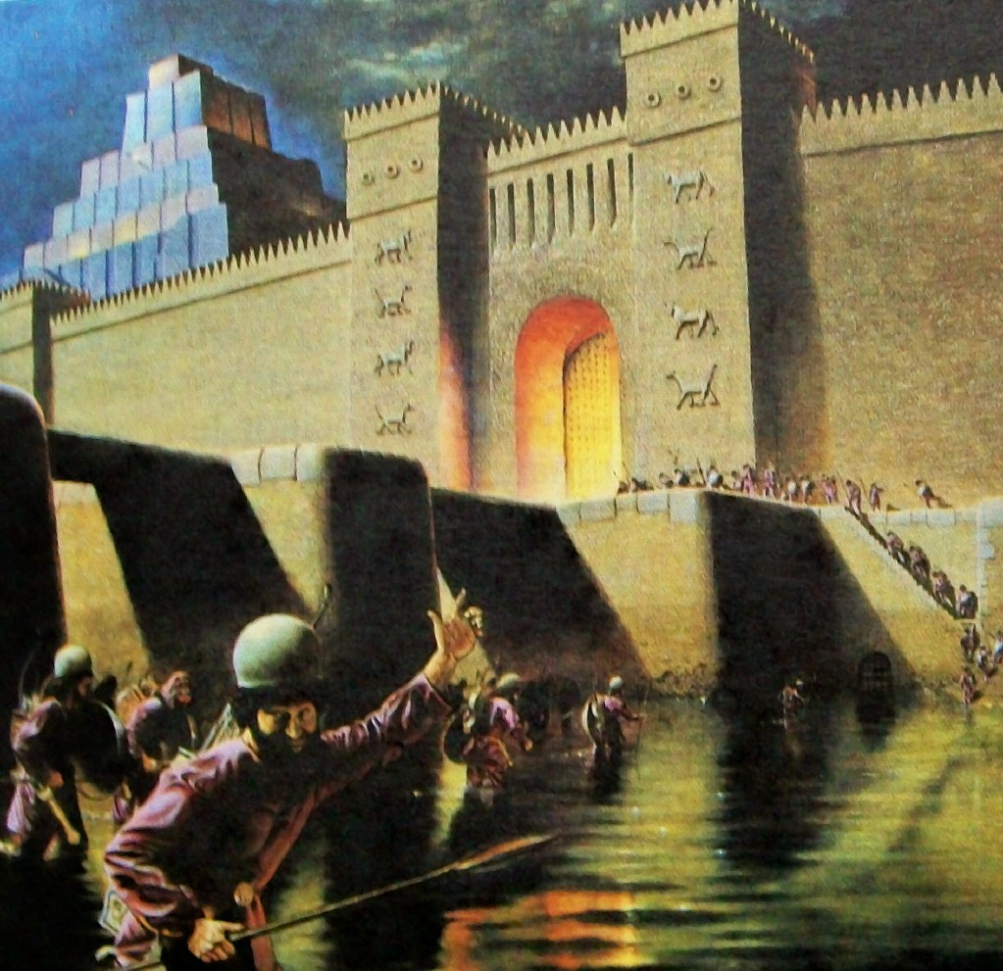
Isaiah 13:2-5 God’s Judgement of Babylon
Banner – A call, cry, shout to arms
Summon the LORD’s chosen, consecrated, or sanctified (set apart) army
LORD beckons His sanctified ones, His warriors, to execute His wrath
Describes “double fulfillment” or “dual fulfillment” prophecy
References
Psalm 60:4; Isaiah 5:26, 10:5; Joel 2:1-11; 3:11,14

Slide 23
Isaiah 13 Double Fulfillment or Dual Fulfillment
“Double fulfillment or dual fulfillment of Bible prophecy means the prophecy has both a short-term and long-term fulfillment. A prophecy is made, and the first fulfillment comes to pass relatively soon thereafter. Later, there is a second fulfillment of the prophecy, and that second fulfillment is usually fuller and more literal. So, there is a “near” and a “far” fulfillment. A prophecy having a dual fulfillment helps to unify Scripture and emphasizes God’s masterful control of events.” – Got Questions
“The doom that fell upon Babylon of old was an illustration of the terrible fate that awaits the godless Gentile powers who will be taken in red-handed rebellion against the Lord and His Anointed in the last days.” – Harry Ironside
“Thus the student may find a prophecy having all the external marks of literary unity, yet referring to some event in the near future connected with the historical phase of the Kingdom and also to some far-off event connected with the Messiah and His Millennial Kingdom.” Alva McClain
“While this section, for the most part, is yet future: nevertheless, the chief characteristic is that much has been fulfilled and stands today as an evidence of fulfilled prophecy.” – J. Vernon McGee

Slide 24
Isaiah 13:6-10
⁶Wail, for the day of the LORD is near; as destruction from the Almighty it will come! ⁷Therefore all hands will be feeble, and every human heart will melt. ⁸They will be dismayed: pangs and agony will seize them; they will be in anguish like a woman in labor. They will look aghast at one another; their faces will be aflame. ⁹Behold, the day of the LORD comes, cruel, with wrath and fierce anger, to make the land a desolation and to destroy it sinners from it. ¹⁰For the stars of the heavens and their constellations will not give their light; the sun will be dark at its rising, and the moon will not shed its light.
Notes:
The phrase “day of the Lord” usually identifies events that take place at the end of history (Isaiah 7:18-25) and is often closely associated with the phrase “that day.” One key to understanding these phrases is to note that they always identify a span of time during with God personally intervenes in history, directly or indirectly, to accomplish some specific aspect of His plan.
The ultimate of final fulfillment of the prophecies concerning the day of the Lord will come at the end of history when God, with wondrous power, will punish evil and fulfill all His promises.

Slide 25
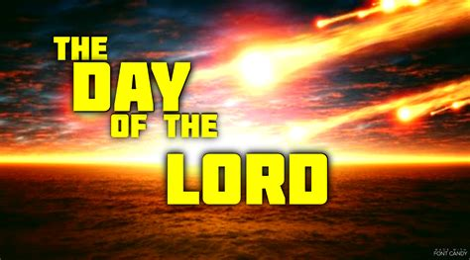
Isaiah 13:6-10 God’s Judgment of Babylon
Associated with a period of time or special day that will occur when God’s will and purpose for His creation are fulfilled
Point at which sin comes face-to-face with holiness and sinners are destroyed (Motyer)
O.T. passages convey sense of imminence, close by, nearness, and expectation
O.T. passages often speak of both a near and far fulfillment
N.T. passages calls it a day of “wrath” or day of “visitation” or “great day of God Almighty”
References
Isaiah 2:12; 13:6,9; Ezekiel 13:5, 30:3; Joel 1:15, 2:1,11,31; 3:14; Amos 5:18,20; Obadiah 15; Zephaniah 1:7,14; Zechariah 14:1; Malachi 4:5
Acts 2:20; 1 Corinthians 4:4; 2 Corinthians 1:14
1 Thessalonians 5:2, 2 Thessalonians 2:2
2 Peter 3:10; and alluded to in Revelation 6:17; 16:14

Slide 26
Isaiah 13:6-10 God’s Judgment of Babylon
Joshua 2:11; Psalm 48:6; Isaiah 9:19; Ezekiel 21:7, 32:7,8; Amos 5:16-17; Matthew 24:29; Mark 13:24; Acts 2:20; 1 Thessalonians 5:3
Hands and heart
Organs of personal action and reflection
Symbolize inner and outer, totality
Paralyzed by the terrors of the day
Pain like a woman in labor
Sudden, inevitable, and inescapable
End result of a process that cannot now be stopped
Overflowing anger that can no longer be contained
Environment caught up in human sinfulness
World bears the consequences of man’s sin
Visitation of wrath on a whole creation corrupted by sin
Denies sinners the benefits of creation, symbolized by light
Withdrawal of light, symbolizes divine judgment

Slide 27
Isaiah 13:11-16
¹¹I will punish the world for its evil, and the wicked for their iniquity; I will put an end to the pomp of the arrogant, and lay low the pompous pride of the ruthless. ¹²I will make people more rare than fine gold, and mankind than the gold of Ophir. ¹³Therefore I will make the heavens tremble, and the earth will be shaken out of its place, at the wrath of the LORD of hosts in the day of his fierce anger. ¹⁴And like a hunted gazelle, or like sheep with none to gather them, each will turn to his own people, and each will flee to his own land. ¹⁵Whoever is found will be thrust through, and whoever is caught will fall by the sword. ¹⁶Their infants will be dashed in pieces before their eyes; their houses will be plundered and their wives ravished.

Slide 28
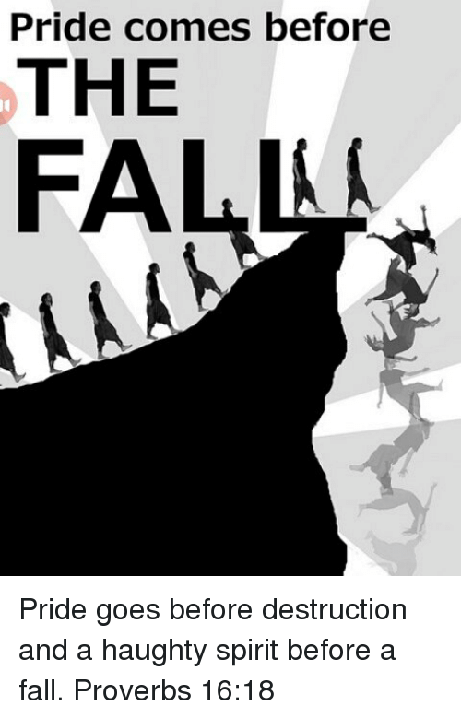
Isaiah 13:11-16 God’s Judgement of Babylon
“World” could also mean Babylonian empire
Luke 2:1 “World” means Judea
Acts 11:28 “World” means Roman empire
Babylonia was most mighty empire then on earth, and might be said to comprehend the whole world
Image of extermination, people are scarce, like the fine gold of Ophir
Ordered movement of the heavens, and stability of earth, will be undone in judgment
The LORD as their enemy, and losing him as their shepherd, mankind’s helpless & hopeless with no protection, no escape, and no mercy
References
1 Kings 9:28; Job 9:6, 28:16, 40:12; Psalm 137:8,9; Isaiah 2:11,17

Slide 29
Isaiah 13:11-16 God’s Judgement of Babylon
“Should any reach home it will be only to see all they held dear destroyed: the children they begat, the homes they built, the wives they loved. How is all this to be understood as the day of the LORD? In a word, the answer is that this is what people are like to each other… we must not think of human beings as puppets with the LORD as their puppet-master. On the contrary, they are being themselves to the full, with their natural acts fulfilling his supernatural purposes. In a very real sense, therefore, what the Bible speaks of as ‘the stretching out of his hand’ would be more easily understood if we thought of it as the withdrawing of his hand – to leave sinners to implement all the inhumane savagery of fallen human nature, bereft of the restraining, humanizing efficacy of common grace.” Motyer

Slide 30
Isaiah 13:17-19 God’s Judgement of Babylon
¹⁷Behold, I am stirring up the Medes against them, who have no regard for silver and do not delight in gold. ¹⁸Their bows will slaughter the young men; they will have no mercy on the fruit of the womb; their eyes will not pity children. ¹⁹And Babylon, the glory of kingdoms, the splendor and pomp of the Chaldeans, will be like Sodom and Gomorrah when God overthrew them.

Slide 31
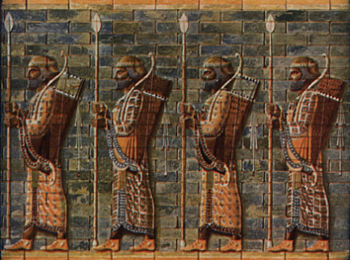
Isaiah 13:17-19 God’s Judgement of Babylon
References
2 Kings 8:12; Psalm 137:9; Daniel 5:30, 6:8,12,15; Jeremiah 50:40
Day of the LORD has interim fulfillments
Fall of Babylon (Isaiah 13:17-22)
Fall of Assyrians (Isaiah14:14-27)
“Each soon-coming judgment on a particular segment of humanity foreshadows the great eschatological judgment that will fall on the whole human race in the Tribulation” (Constable)
“… the same principles that operate in that climactic day of history operate throughout. The God whom that day reveals is the God who directs history now.” (Motyer)
Medes could not be bribed; motivated by conquest
Chaldeans were the ruling class responsible for the supremacy of Babylon
Experience same fate as Sodom and Gomorrah – destruction from the LORD’s hand

Slide 32
Isaiah 13:20-22
²⁰It will never be inhabited or lived in for all generations; no Arab will pitch his tent there; no shepherds will make their flocks lie down there. ²¹But wild animals will lie down there, and their houses will be full of howling creatures; there ostriches will dwell, and there wild goats will dance. ²²Hyenas will cry in its towers, and jackals in the pleasant palaces; its time is close at hand and its days will not be prolonged.

Slide 33
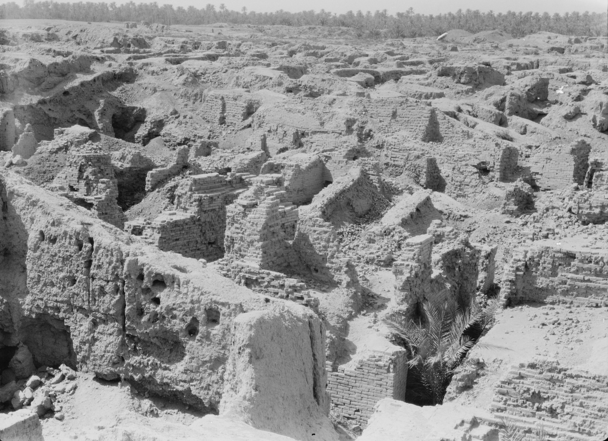
Isaiah 13:20-22 God’s Judgement of Babylon
“… at last that one-time proud city was leveled to the dust, its palaces destroyed, its hanging gardens ruined, and its destruction so complete that in all the centuries since it has never been able to rise again.” – Ironside
There no shepherds will rest their flocks – endless, total abandonment
No human, friendly, domestic use but one terrifying to people
“Wild goats” would be better translated “goat-demons” - Motyer
References
Daniel 2, 5:31; Jeremiah 50-51

Slide 34
Conclusion
God judges Babylon in all its forms
World rulers are subject to the word of God proves that we are too
Notes:
Preserves the Davidic covenant
Preserves the Bible/Torah
The Bible/Torah is read by Ezra when the remnant returns…

Slide 35
Next Meeting – 13 Dec
Review:
Isaiah 13 – The Judgment of Babylon
Memory Verse: 2 Peter 3:10
Dr. Constable’s Notes, 2022 Ed., pp. 107-116; Motyer, pp. 131-141
Next Week:
Isaiah 14 – Jacob Restored, Babylon Taunted, Two Oracles
Memory Verse: Isaiah 14:12
Dr. Constable’s Notes, 2022 Ed., pp. 116-123; Motyer, pp. 141-149
Refreshment Host: Group B

Slide 36
Discussion & Application
1 of 2
In Isaiah 13, God reveals His judgment against Babylon, who was Israel’s clear military threat at the time and why would prophesying Babylon’s judgement seem odd?
Babylon is references throughout Scripture, from Genesis to Revelation, what are the different ways Scripture uses the name “Babylon?”
In verses 4-5, God musters an army for war. From Scripture, what do we know about the army of God? (2 Samuel 18:7-8; 2 Kings 6:16-17, 7:3-6)
What future Biblical prophecy gives you hope, peace, or stability today?
Where in Scripture does God use natural disasters to accomplish His sovereign plan and purpose?

Slide 37
Discussion & Application
2 of 2
What fulfilled Biblical prophecy gives you hope, peace, or stability today?
God judges Babylon because of her sin, where else in the Bible does God clearly judge sin?
Deuteronomy 10:18 reads, “He executes justice for the fatherless and the widow, and loves the sojourner, giving him food and clothing.” How do we reconcile Deuteronomy 10:18 with Isaiah 13:16,18?
What sin in your life needs to be attacked and utterly destroyed so that it cannot return to occupy a place in your heart?

Slide 38
Closing
Benediction
Small Groups

Slide 40
Book of Isaiah
Title: “The LORD is Salvation”
Author: Isaiah, Son of Amoz
Date: ~740 B.C. to 686 B.C.
Setting:
Prophesied in 4 kings’ reigns
Married, Two Sons
Key Details:
N.T. 65x; Name said 20x
Elevates God, Reveals Messiah
Overview of Vision (Chap. 1-39):
Ch. 1-6: Judah’s Sin, Isaiah’s Call
Ch. 7-12: Sign of Immanuel
Ch. 13-23: Oracles About Nations
Ch. 24-27: World Redemption
Ch. 28-35: Six Woes
Ch. 36-39: Historical Interlude
Ch. 40-66: Hope of Salvation

Slide 41
Isaiah Bible Study Schedule for Fall 2022 – Spring 2023 as of September 6, 2022

Slide 42
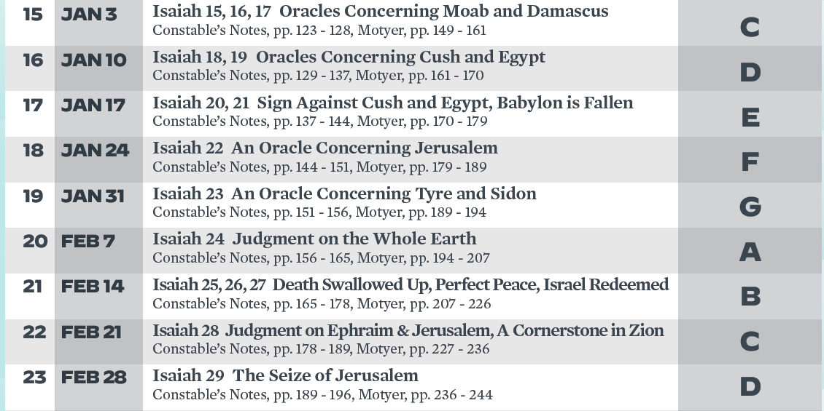
Isaiah Bible Study Schedule for Fall 2022 – Spring 2023 as of September 6, 2022

Slide 43
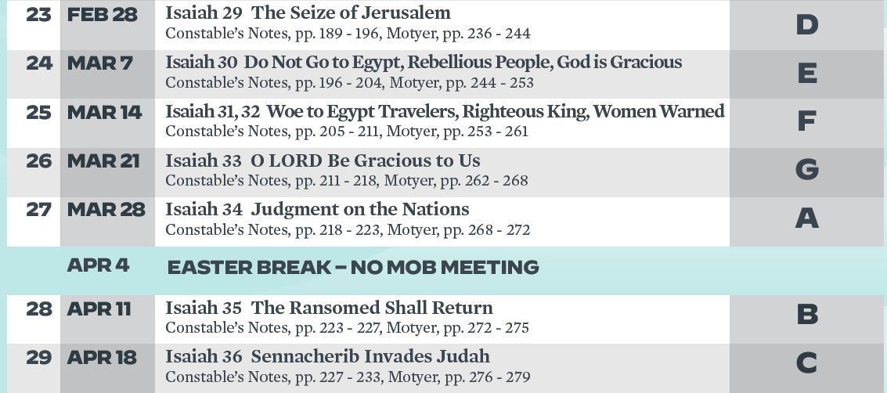
Isaiah Bible Study Schedule for Fall 2022 – Spring 2023 as of September 6, 2022

Slide 44
Isaiah Bible Study Schedule for Fall 2022 – Spring 2023 as of September 6, 2022

