Slide 1
WELCOME TO THE MOB!
All Scripture is breathed out by God and profitable for teaching, for reproof, for correction, and for training in righteousness, that the man of God may be complete, equipped for every good work.
2 Timothy 3:16-17 (ESV)

Slide 2
Announcements
Welcome to the MOB!
MOB Website & Resources: www.ibcmob.net
Merry Christmas!
NEW Location – 3 Jan

Slide 3
On Your Feet Men!
Invocation/Prayer
Song:
“A Mighty Fortress”

Slide 4
A Mighty Fortress 1 of 4
A mighty fortress is our God,
a bulwark never failing; Our helper he, amid the flood
of mortal ills prevailing. For still our ancient foe
does seek to work us woe; His craft and power are great,
and armed with cruel hate, on earth is not his equal.

Slide 5
A Mighty Fortress 2 of 4
Did we in our own strength confide,
our striving would be losing, Were not the right Man on our side,
the Man of God's own choosing. You ask who that may be?
Christ Jesus, it is he; Lord Sabaoth his name,
from age to age the same; and he must win the battle.

Slide 6
A Mighty Fortress 3 of 4
And though this world, with devils filled, should threaten to undo us, we will not fear, for God has willed his truth to triumph through us. The prince of darkness grim, we tremble not for him; his rage we can endure, for lo! his doom is sure; one little word shall fell him.

Slide 7
A Mighty Fortress 4 of 4
That Word above all earthly powers no thanks to them abideth; The Spirit and the gifts are ours through him who with us sideth. Let goods and kindred go, this mortal life also; The body they may kill: God's truth abideth still; his kingdom is forever!

Slide 8
Memory Verse
Isaiah 14:12 (ESV)
“How you are fallen from heaven, O Day Star, son of Dawn! How you are cut down to the ground, you who laid the nations low!”
Isaiah 14:12 (ESV)

Slide 9
Our Study of Isaiah
Last Meeting:
Isaiah 13, The Judgement of Babylon
Memory Verse: 2 Peter 3:10
Dr. Constable’s Notes, 2022 Ed., pp. 107-116; Motyer, pp. 131-141.
This Meeting:
Isaiah 14, Jacob Restored, Babylon Taunted, Two Oracles
Memory Verse: Isaiah 14:12
Dr. Constable’s Notes, 2022 Ed., pp.116-123; Motyer, pp.141-149.
Refreshment Host: Small Group B

Slide 10
Isaiah Bible Study Schedule for Fall 2022 – Spring 2023 as of September 6, 2022
December 20 & 27 – Christmas and New Years Break – No MOB

Slide 11
Isaiah Outline
Focus | Prophecies of Condemnation |  |  |  |  |  |  |  | Historical Parenthesis |  | Prophecies of Comfort
 | 1:1 |  |  |  |  |  |  | 35:10 | 36:1 | 39:8 | 40:1 |  |  |  |  | 66:24
Divisions | Prophecies Against Judah |  | Prophecies Against the Nations |  | Prophesies Against the Day of the Lord |  | Prophesies of Judgement and Blessing |  | Sickness and Sin | Hezekiah’s Salvation | Israel’s Deliverance |  | Israel’s Deliverer |  | Israel’s Glorious Future
 | 1:1 | 12:6 | 13:1 | 23:18 | 24:1 | 27:13 | 28:1 | 35:10 | 36:1 | 39:8 | 40:1 | 48:22 | 49:1 | 57:21 | 58:1 | 66:24
Topics | Prophetic |  |  |  |  |  |  |  | Historic |  | Messianic
 | Judgement |  |  |  |  |  |  |  | Transition |  | Hope
Place | Israel & Judah
Time | 740 - 680 B.C.
We are here!

Slide 12
Lesson Overview Isaiah Chapter 14
The Security and Future of the Lord’s People (14:1–2)
The Overthrow of Babylon: End of the King (14:3–23)
Introduction (14:3–4a)
The Song of the Fallen King (14:4b–21)
Conclusion (14:22–23)
The End of Assyrian power (14:24–27)
Philistia: Oracle (14:28-32)
- J. A. Motyer, (Downers Grove, IL: InterVarsity Press, 1996)
Pride and the 1st Commandment!

Slide 13
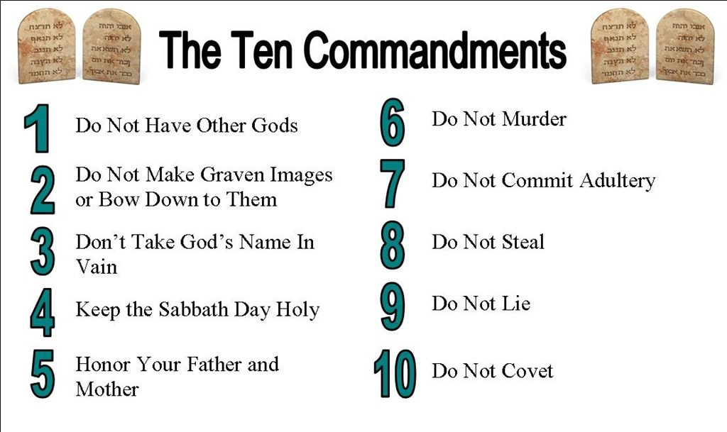
Pride and the 1st Commandment
Pride Is Found in All the Players in Isaiah
The Assyrians, the Babylonians, the Jews
In This Passage…The Philistines Too!
All of the Players Have a God/god
Assyrians – Asher
Babylonians – Marduk
The 1st Commandment…”You Shall Have NO Other gods Before Me!”

Slide 14
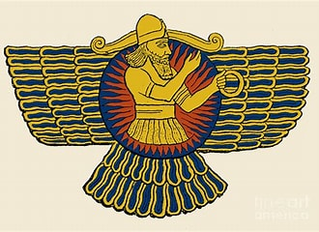
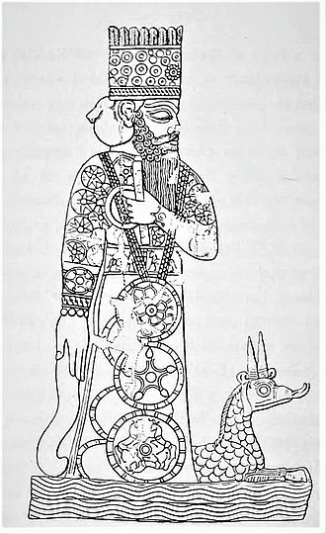
The Competing gods
Assyria
Assyrian imperial propaganda proclaimed the supremacy of Ashur and declared that the conquered peoples had been abandoned by their own gods.
Babylon
Marduk was depicted as a human, often with his symbol the snake-dragon
The head god of the pantheon of Babylonian gods
We have Our Competing gods too!

Slide 15
Science Is Just One!
“I think that a case can be made that faith is one of the world’s great evils, comparable to the smallpox virus but harder to eradicate. Faith, being belief that isn’t based on evidence, is the principal vice of any religion.”
- Richard Dawkins, “Is Science a Religion?” in The Humanist, Jan/Feb 1997, pp. 26-39.

Slide 16
Isaiah 14:1-2 The Restoration of Jacob
¹ For the Lord will have compassion on Jacob and will again choose Israel, and will set them in their own land, and sojourners will join them and will attach themselves to the house of Jacob.
² And the peoples will take them and bring them to their place, and the house of Israel will possess them in the Lord’s land as male and female slaves. They will take captive those who were their captors, and rule over those who oppressed them.

Slide 17
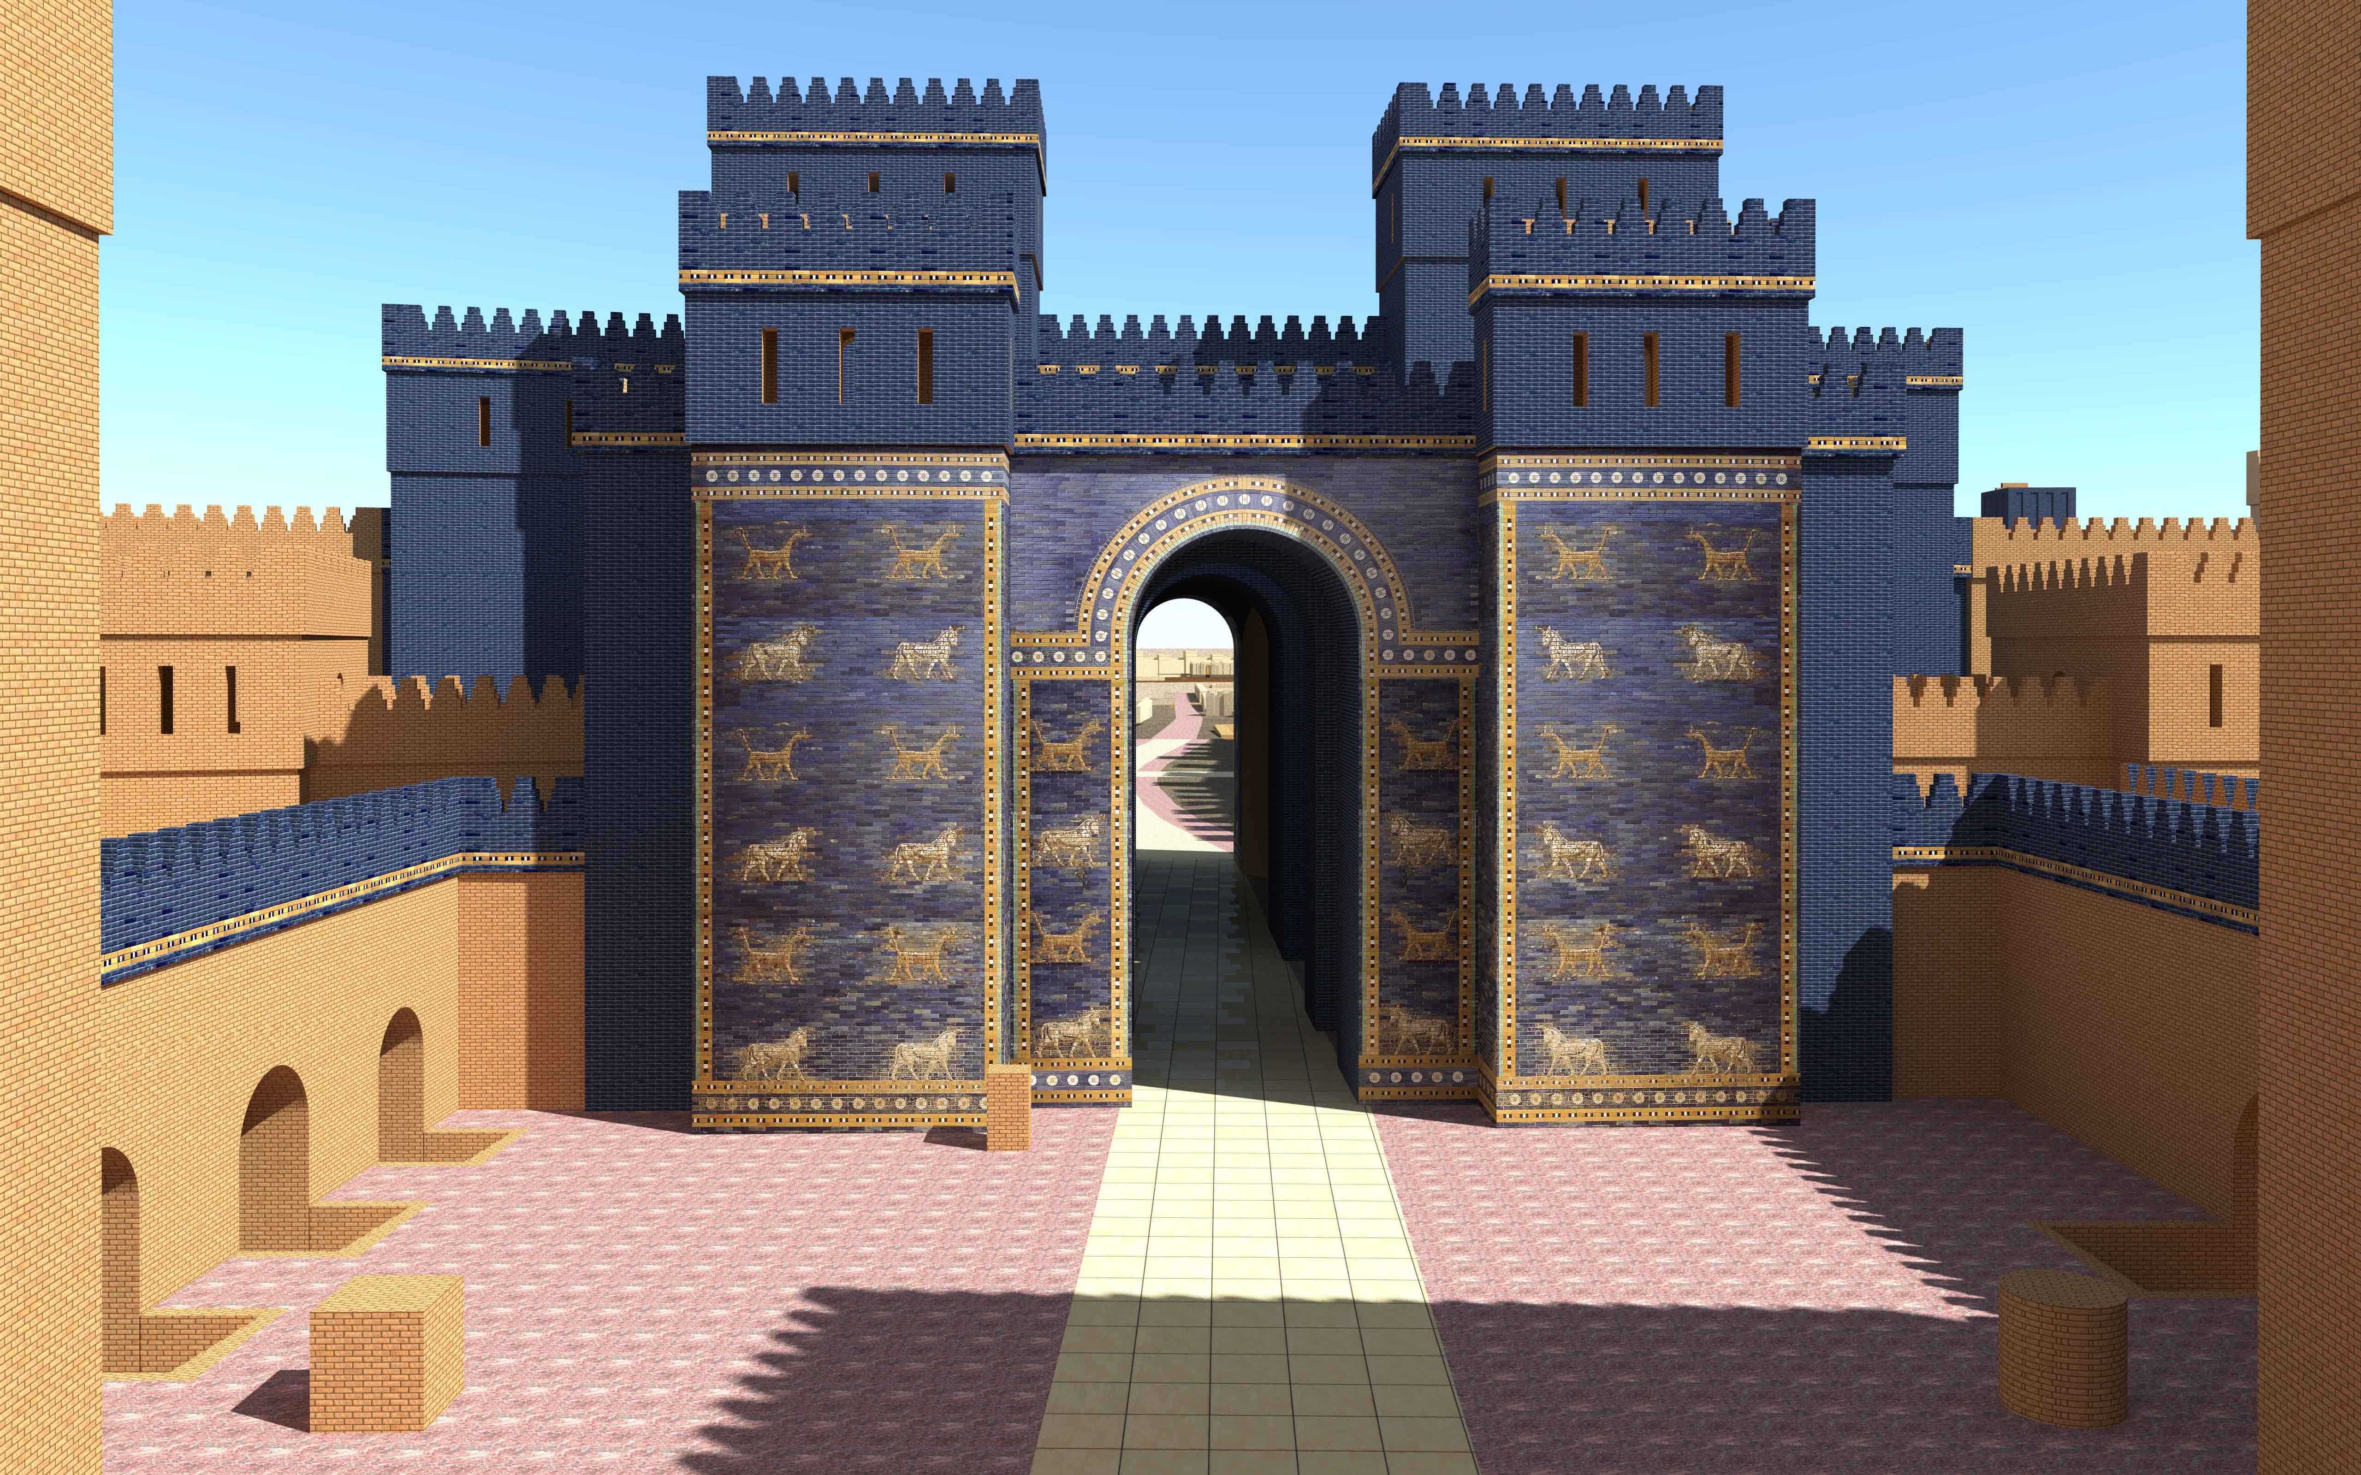
Isaiah 14:1-2 Restoration of Jacob/Taunting of Babylon
Epilogue to Isaiah 13 - desolation and gloom that would come upon Babylon
Judgement on Babylon = Mercy to Israel
God Chooses Israel – Compassion
“This promise had a measure of fulfillment when Israel was brought back from Babylon; and still is true that, when God’s people come to their worst, there is always something better before them.” (Spurgeon)
Gentiles Are Invited to God’s Goodness

Slide 18
World History
“The more we think of chapters 13–27 as a study of the principles of world history merging forward into eschatology, the easier it becomes to see that from the start Babylon carries overtones of the ‘city of emptiness’ (24:10) whose fall is the end of all that opposes the Lord’s rule.”
- J. A. Motyer, The Prophecy of Isaiah: An Introduction & Commentary (Downers Grove, IL: InterVarsity Press, 1996), 142.

Slide 19
Isaiah 14:3-4a Restoration of Jacob/Taunting of Babylon
³ When the Lord has given you rest from your pain and turmoil and the hard service with which you were made to serve,
^{4a} you will take up this taunt against the king of Babylon:

Slide 20
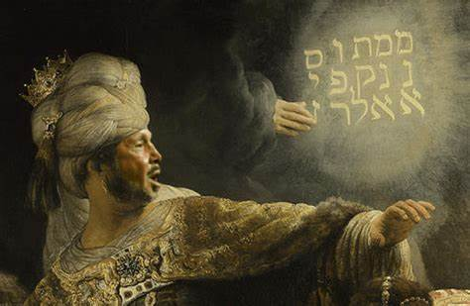
Isaiah 14:3-4a Restoration of Jacob/Taunting of Babylon
Rest Is the Birthright of Every Believer
“Come to Me, all you who labor and are heavy laden, and I will give you rest.” (Matthew 11:28)
Isaiah Has Potentially Two Aspects of Prophetic Fulfillment in Mind:
The immediate and partial fulfillment regarding Babylon and its king
The distant and ultimate fulfillment regarding the spiritual Babylon/Satan

Slide 21
Lucifer/Satan – Babylon - Both?
Significant Disagreement That These Passages in Isaiah Deal with Satan.
Calvin sees no reference to Satan. “The exposition of this passage, which some have given, as if it referred to Satan, has arisen from ignorance.”
Adam Clarke – “But the truth is, the text speaks nothing at all concerning Satan.”
IMHO…There Are Connections With Lucifer/Satan

Slide 22
Isaiah 14:4b-7 The Song of the Fallen King
^{4b} How the oppressor has ceased,
the insolent fury ceased!
⁵ The Lord has broken the staff of the wicked,
the scepter of rulers,
⁶ that struck the peoples in wrath
with unceasing blows,
That ruled the nations in anger
with unrelenting persecution.
⁷ The whole earth is at rest and quiet;
they break forth into singing.

Slide 23
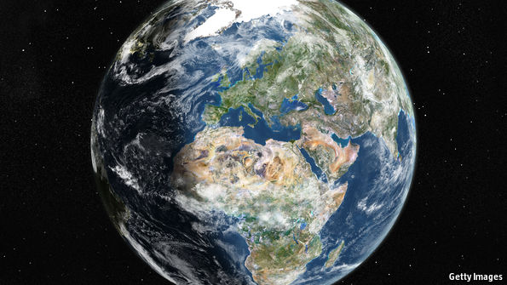
Isaiah 14:4b-7 The Song of the Fallen King
God wants us to know that he has numbered the days of the Kingdom of Babylon and the spiritual Babylon/Satan
The oppressive rulers over nations and peoples have been dealt with
As a result, the whole earth is at rest and quiet
Even the trees rejoice…
Attacking kings cut down the trees
Nebuchadnezzar used large supplies of trees to build his magnificent city
No translation can reproduce the sweep and surge of this truly magnificent poem. It is the work of a master. - Motyer

Slide 24
Isaiah 14:9 & 11 The Song of the Fallen King (Cont)
⁹Sheol beneath is stirred up
to meet you when you come;
it rouses the shades to greet you,
all who were leaders of the earth;
it raises from their thrones
all who were kings of the nations.
¹¹Your pomp is brought down to Sheol,
the sound of your harps;
maggots are laid as a bed beneath you,
and worms are your covers.

Slide 25
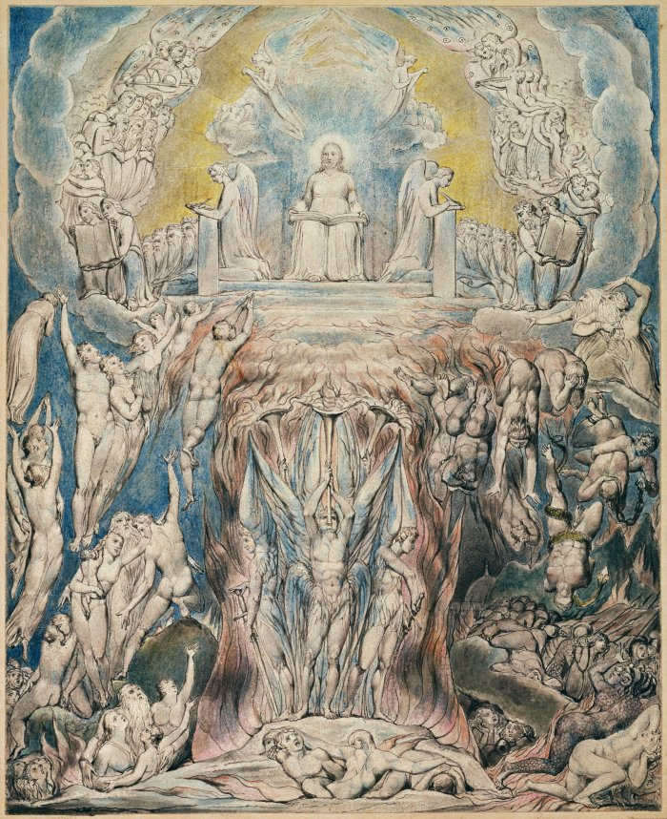
Isaiah 14:9 & 11 The Song of the Fallen King (Cont)
Sheol?
In the OT – The Place of the Dead
Those in Sheol Rise to See Who is Coming to Them
Kings on Earth Lay on Magnificent Beds…Sleep With Magnificent Covers/Blankets
Now…His Bed Is Maggots…Sheets Are Worms

Slide 26
Isaiah 14:12-13 The Song of the Fallen King (Cont)
¹² “How you are fallen from heaven,
O Day Star, son of Dawn!
How you are cut down to the ground,
you who laid the nations low!
13 You said in your heart,
‘I will ascend to heaven;
above the stars of God
I will set my throne on high;
I will sit on the mount of assembly
in the far reaches of the north;
Notes:
14 I will ascend above the heights of the clouds;
I will make myself like the Most High.’
15 But you are brought down to Sheol,
to the far reaches of the pit.
16 Those who see you will stare at you
and ponder over you:
‘Is this the man who made the earth tremble,
who shook kingdoms,
17 who made the world like a desert
and overthrew its cities,
who did not let his prisoners go home?’
18 All the kings of the nations lie in glory,
each in his own tomb;
19 but you are cast out, away from your grave,
like a loathed branch,
clothed with the slain, those pierced by the sword,
who go down to the stones of the pit,
like a dead body trampled underfoot.
20 You will not be joined with them in burial,
because you have destroyed your land,
you have slain your people.
“May the offspring of evildoers
nevermore be named!
21 Prepare slaughter for his sons
because of the guilt of their fathers,
lest they rise and possess the earth,
and fill the face of the world with cities.”
(Wheaton, IL: Crossway Bibles, 2016), Is 14:1421.
The Holy Bible: English Standard Version (Wheaton, IL: Crossway Bibles, 2016), Is 14:14–21.

Slide 27
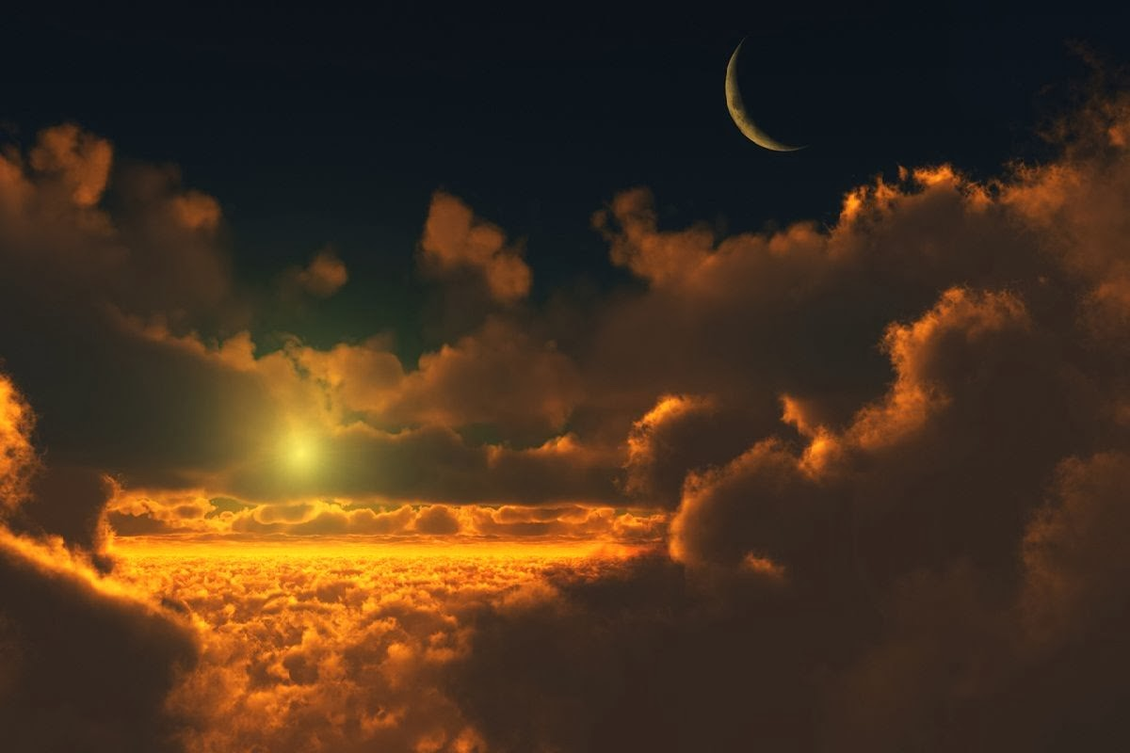
Isaiah 14:12-13 The Song of the Fallen King (Cont)
Near Prophecy or Far Prophecy?
A Shift from the Underworld to Heaven
Satan/Lucifer/Day Star
Fell From Glorified to Profane
Fell From Having Access to Heaven
Fell From Earth to the Bottomless Pit
Fell From Bottomless Pit to Lake of Fire
Canaanite Mythology the god Athtar May be the Day Star

Slide 28
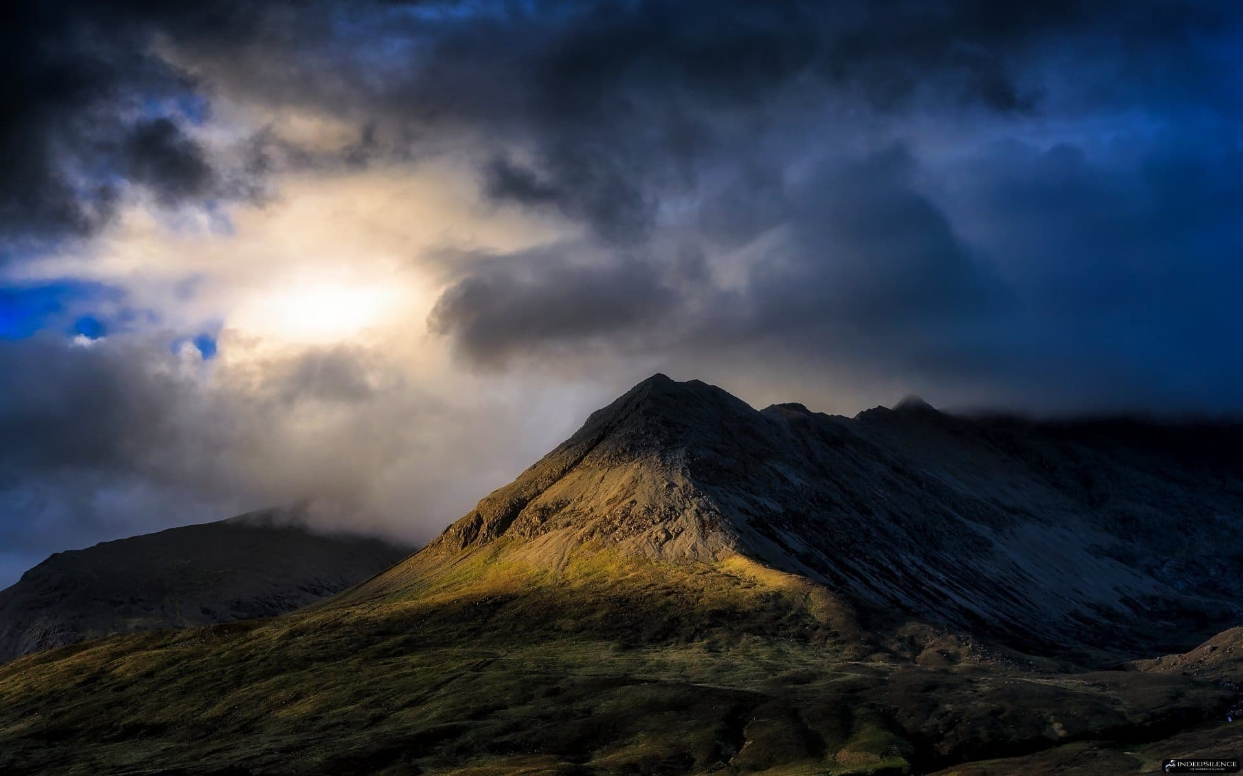
Isaiah 14:12-13 The Song of the Fallen King (Cont)
Pride
“I Will” Statements
Ascend to Heaven
Set My Throne on High
Sit on the Mount of Assembly
Ascend Above the Heights of the Clouds
Make Myself Like the Most High
Number of Verbal Similarities with Several Canaanite Poems.
High Places – Hilltops Where Sacrifices Were Made to the gods
Boast of Access to the Highest Places

Slide 29
Isaiah 14:22-23 The Song of the Fallen King (Cont)
²² I will rise up against them,” declares the Lord of hosts, “and will cut off from Babylon name and remnant, descendants and posterity,” declares the Lord.
²³ “And I will make it a possession of the hedgehog, and pools of water, and I will sweep it with the broom of destruction,” declares the Lord of hosts.

Slide 30
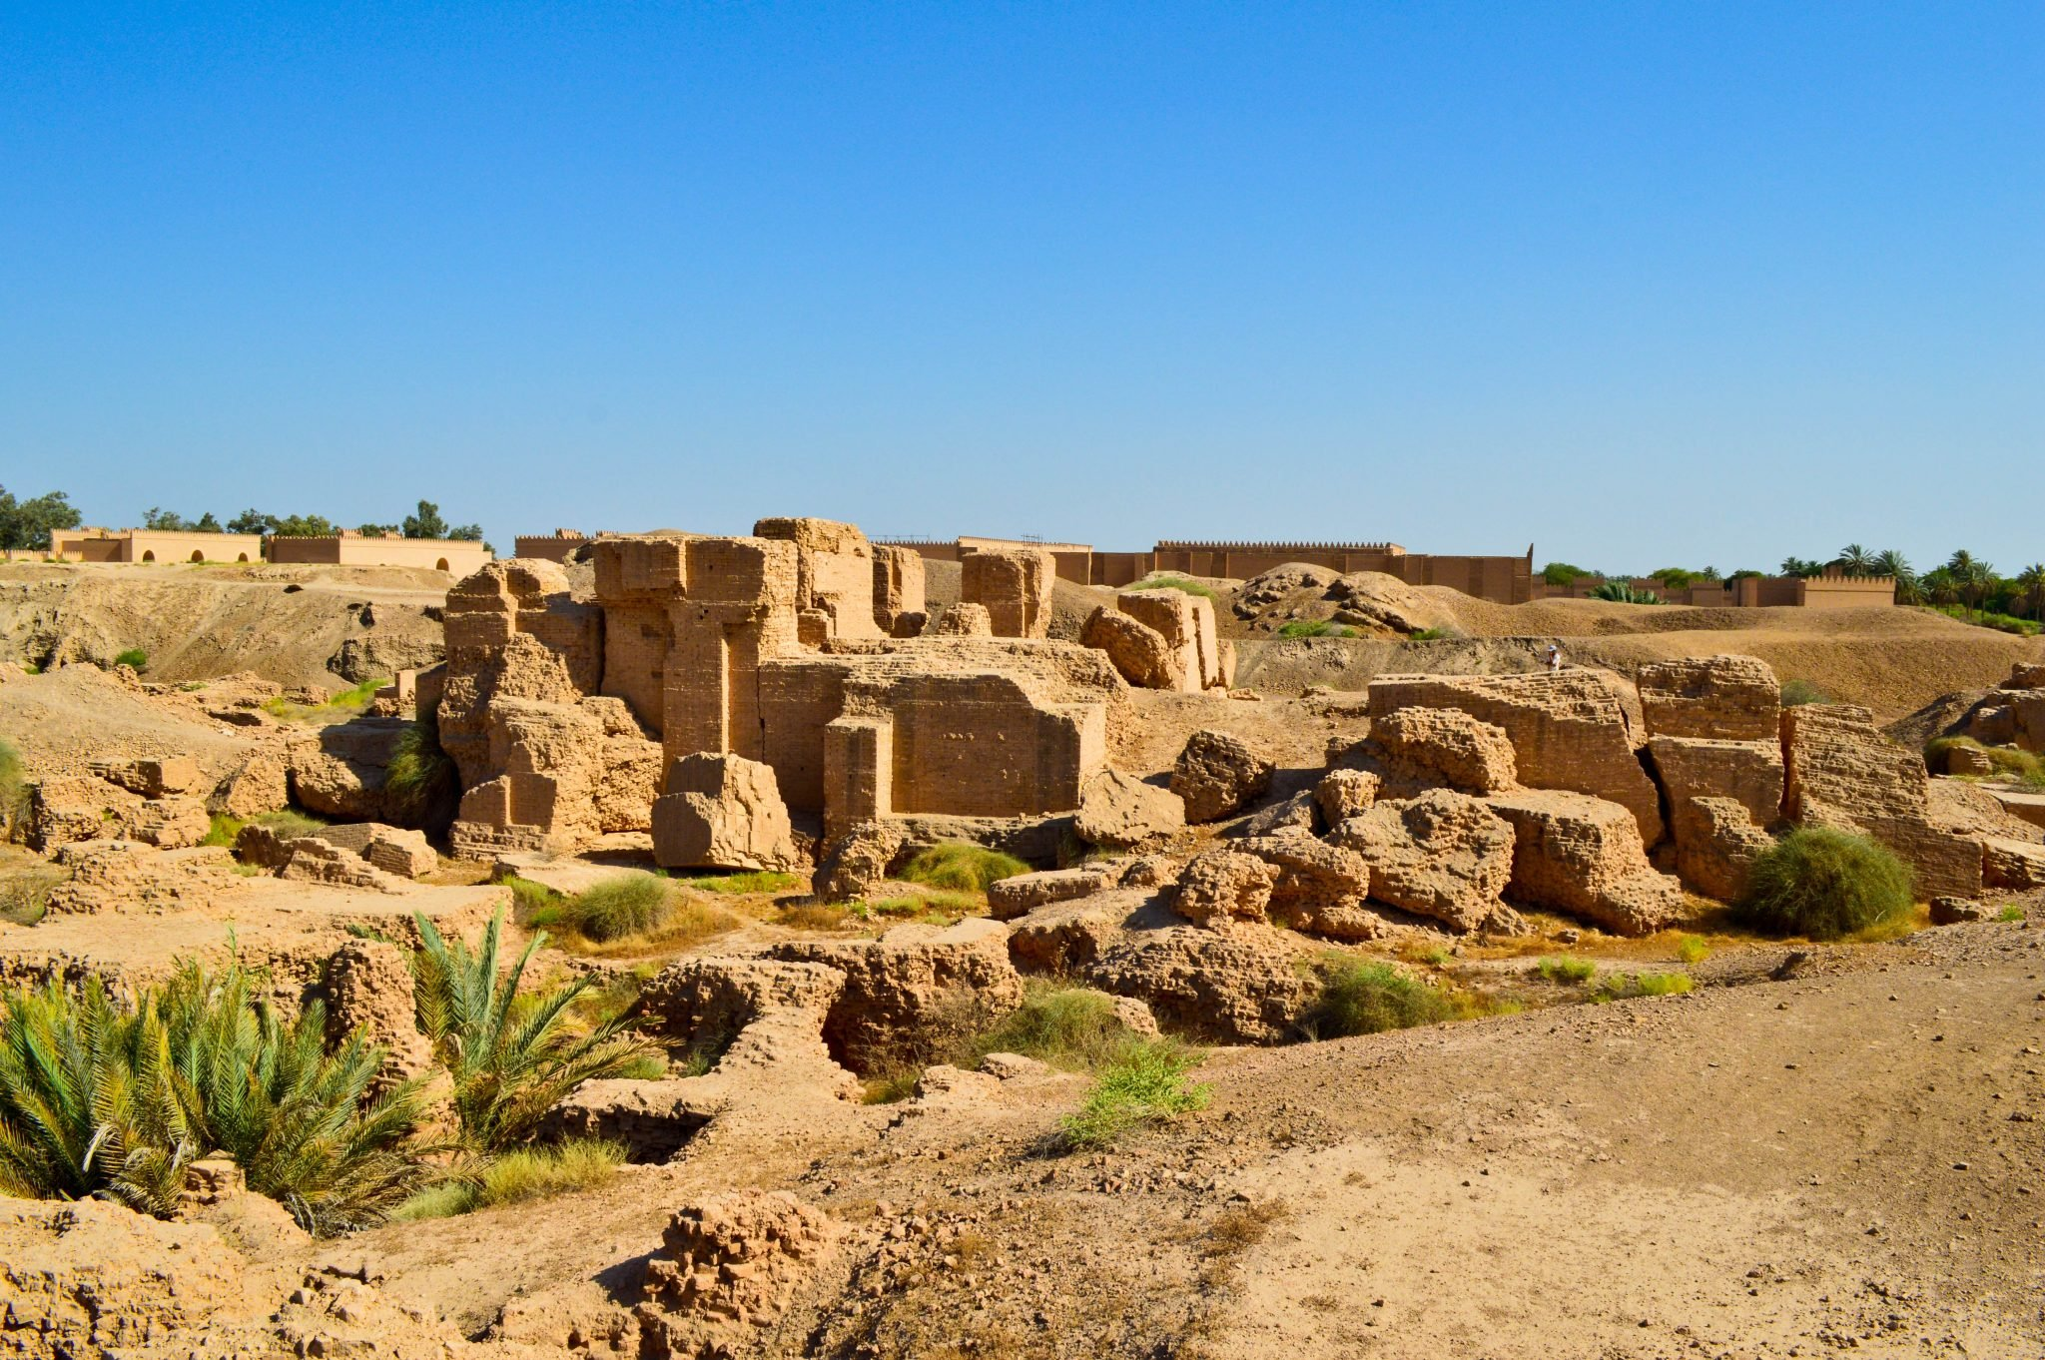
Isaiah 14:22-23 The Song of the Fallen King (Cont)
The Lord Almighty Will Rise—World Government Rests With Him.
God Always Has His Remnant
Babylon Will Not Have a Remnant
The Lord Declares – Three Times
The Lord’s broom is mighty enough to sweep the whole of great Babylon to destruction and oblivion. - Motyer

Slide 31
Isaiah 14:24-25 An Oracle Concerning Assyria
²⁴ The Lord of hosts has sworn:
“As I have planned,
so shall it be,
and as I have purposed,
so shall it stand,
25 that I will break the Assyrian in my land,
and on my mountains trample him underfoot;
and his yoke shall depart from them,
and his burden from their shoulder.”

Slide 32
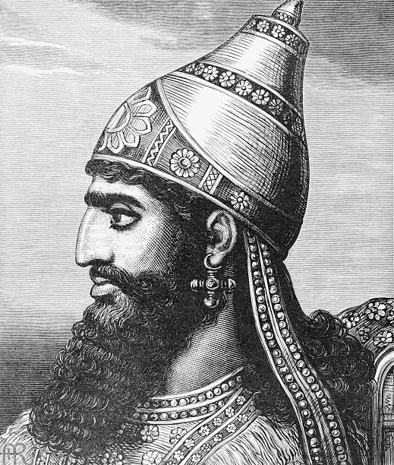
Isaiah 14:24-25 An Oracle Concerning Assyria
The Assyrian Threat will be Decisively Crushed
The Outstretched Hand – 13:2
This Assyrian Solution is the Model for the Final Solution
The Prediction and Solution Motif is Classic Isaiah
Universal Scale

Slide 33
Isaiah 14:28-30 An Oracle Concerning Philistia
28 In the year that King Ahaz died came this oracle:
29 Rejoice not, O Philistia, all of you,
that the rod that struck you is broken,
for from the serpent’s root will come forth an adder,
and its fruit will be a flying fiery serpent.
30 And the firstborn of the poor will graze,
and the needy lie down in safety;
but I will kill your root with famine,
and your remnant it will slay.

Slide 34
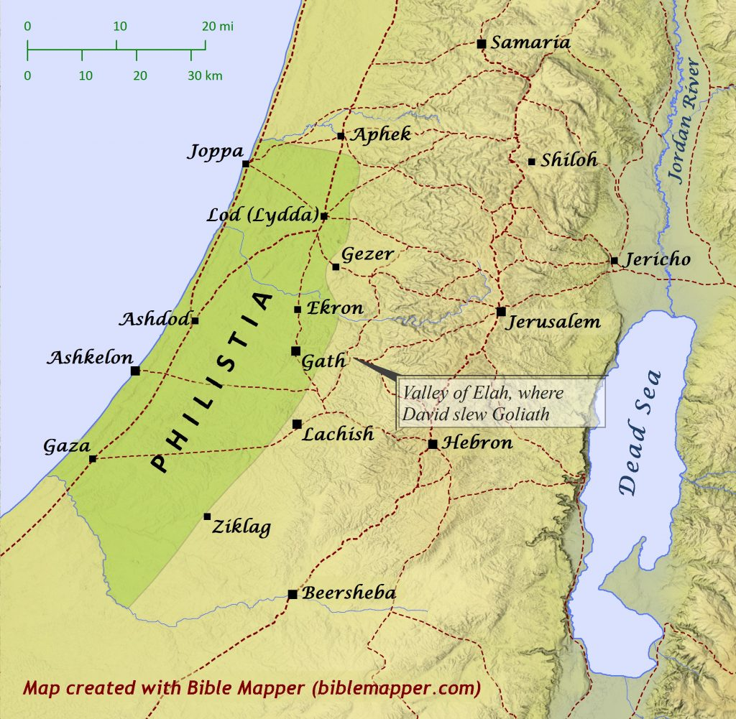
Isaiah 14:28-30 An Oracle Concerning Philistia
Back to Ahaz – In the Year of His Death
Philistia Was a Political Agitator
Possibly…They Made Overtures to Hezekiah
All “Youse Guys” – The City States of Philistia Often Worked Separately
Israel has no Need for Help – They have the Lord
No Need to Fear What Philistia Fears
Beginning of a Series of Oracles

Slide 35
God’s Blessings
“…these few verses contain the message of chs. 40–66 in a nutshell. They leap across the intervening ideas and events and remind the reader again (as in 2:1–4 and 4:2–6) of God’s ultimate purpose of blessing.”
- John N. Oswalt, , The New International Commentary on the Old Testament (Grand Rapids, MI: Wm. B. Eerdmans Publishing Co., 1986), 312.

Slide 36
Conclusion
God IS At Work In Our World AND In Your Life!
God Does NOT Like Competition
God Does NOT Like Pride (It Leads to Competition)

Slide 37
Next Meeting – 3 Jan
Review:
Isaiah 14, Jacob Restored, Babylon Taunted, Two Oracles
Memory Verse: Isaiah 14:12
Dr. Constable’s Notes, 2022 Ed., pp.116-123; Motyer, pp.141-149.
Study:
Isaiah 15, 16, 17, Oracles Concerning Moab and Damascus
Memory Verse: Psalm 121:1-2
Dr. Constable’s Notes, 2022 Ed., pp. 123-128; Motyer, pp. 149-161
Refreshment Host: Group C

Slide 38
Discussion & Application
1 of 2
What’s your understanding of the period of time, Isaiah prophesies, that the Lord will “resettle Israel in their own land”?
In what way will their return represent a “great role reversal” for the “house of Jacob”?
How do you interpret, and explain the nature and focus of, the call for a “taunt” against the king of Babylon?
What implications can you draw from this passage, and others in the Bible, about “sheol”—and death?
What’s your understanding of who the king is or represents?

Slide 39
Discussion & Application
2 of 2
How does the reference (in verse 12-15) to the “fallen star of the morning” relate to the fall of Lucifer and the rise of Satan?
How is the fall of Babylon, and its king, linked here, and elsewhere, with the activities of Satan?
What was Isaiah’s prophecy concerning Assyria, how was it fulfilled, and how does it “foreshadow” what will happen to Babylon and other nations who oppose God?
Why would Isaiah discourage an alliance with Philistia—and how’s it connected with the death of Ahaz?
What’s your key take-away from Isaiah 14?

Slide 40
Closing
Benediction – Psalm 46
Small Groups
Notes:
46 God is our refuge and strength, a very present^{[b]} help in trouble. ² Therefore we will not fear though the earth gives way, though the mountains be moved into the heart of the sea, ³ though its waters roar and foam, though the mountains tremble at its swelling. Selah
⁴ There is a river whose streams make glad the city of God, the holy habitation of the Most High. ⁵ God is in the midst of her; she shall not be moved; God will help her when morning dawns. ⁶ The nations rage, the kingdoms totter; he utters his voice, the earth melts. ⁷ The Lord of hosts is with us; the God of Jacob is our fortress. Selah
⁸ Come, behold the works of the Lord, how he has brought desolations on the earth. ⁹ He makes wars cease to the end of the earth; he breaks the bow and shatters the spear; he burns the chariots with fire. ¹⁰ “Be still, and know that I am God. I will be exalted among the nations, I will be exalted in the earth!” ¹¹ The Lord of hosts is with us; the God of Jacob is our fortress.

Slide 42
Book of Isaiah
Title: “The LORD is Salvation”
Author: Isaiah, Son of Amoz
Date: ~740 B.C. to 686 B.C.
Setting:
Prophesied in 4 kings’ reigns
Married, Two Sons
Key Details:
N.T. 65x; Name said 20x
Elevates God, Reveals Messiah
Overview of Vision (Chap. 1-39):
Ch. 1-6: Judah’s Sin, Isaiah’s Call
Ch. 7-12: Sign of Immanuel
Ch. 13-23: Oracles About Nations
Ch. 24-27: World Redemption
Ch. 28-35: Six Woes
Ch. 36-39: Historical Interlude
Ch. 40-66: Hope of Salvation

Slide 43
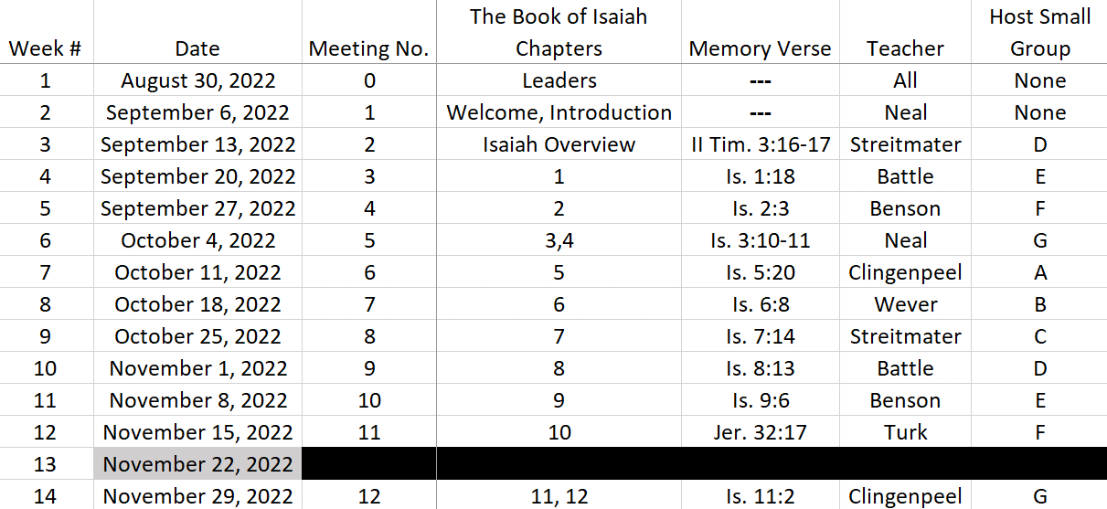
Isaiah Bible Study Schedule for Fall 2022 – Spring 2023

Slide 44
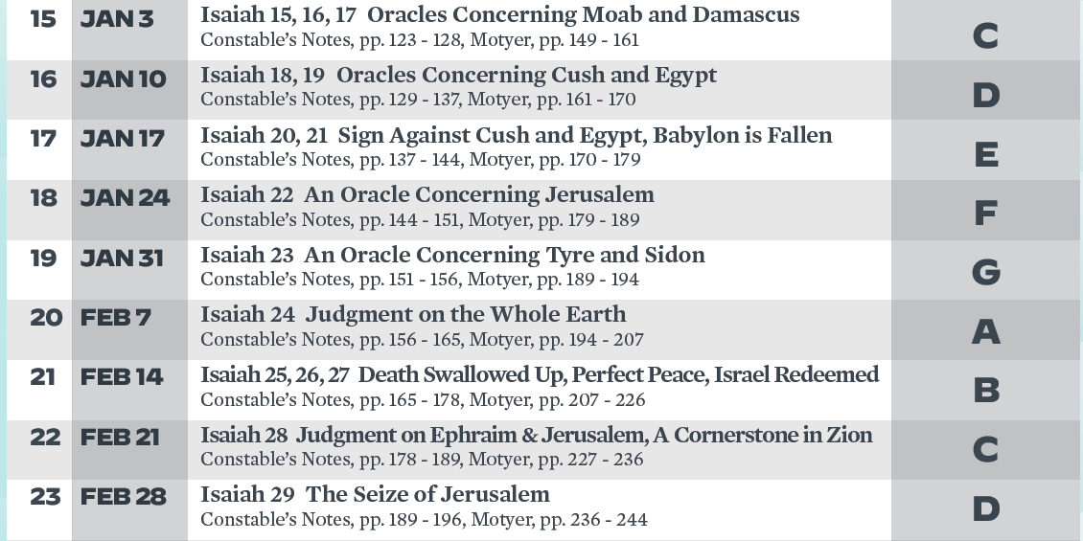
Isaiah Bible Study Schedule for Fall 2022 – Spring 2023 as of September 6, 2022

Slide 45
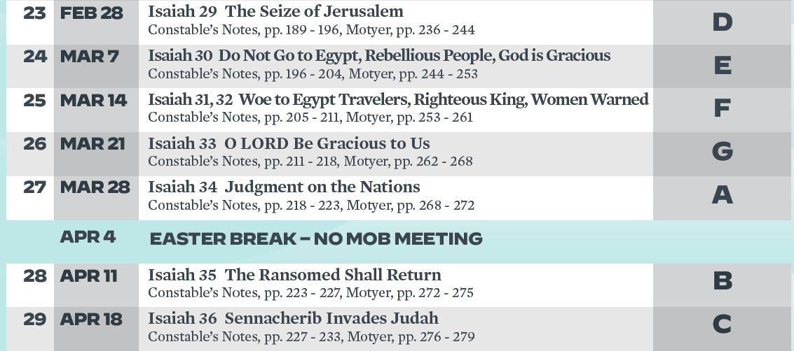
Isaiah Bible Study Schedule for Fall 2022 – Spring 2023 as of September 6, 2022

Slide 46
Isaiah Bible Study Schedule for Fall 2022 – Spring 2023 as of September 6, 2022

Slide 47
Today’s Lesson
In this section, God condemns the corrupt leaders. The King of Assyria is the tool of God but He will bring low their king. God Also declares that He will leave a remnant in Israel.
The poem that God begins in Chapter 9 continues into Chapter 10.
Jesus…Jesus…Jesus.
God uses situations for his purposes.
But…There will be a remnant remaining.

Slide 48
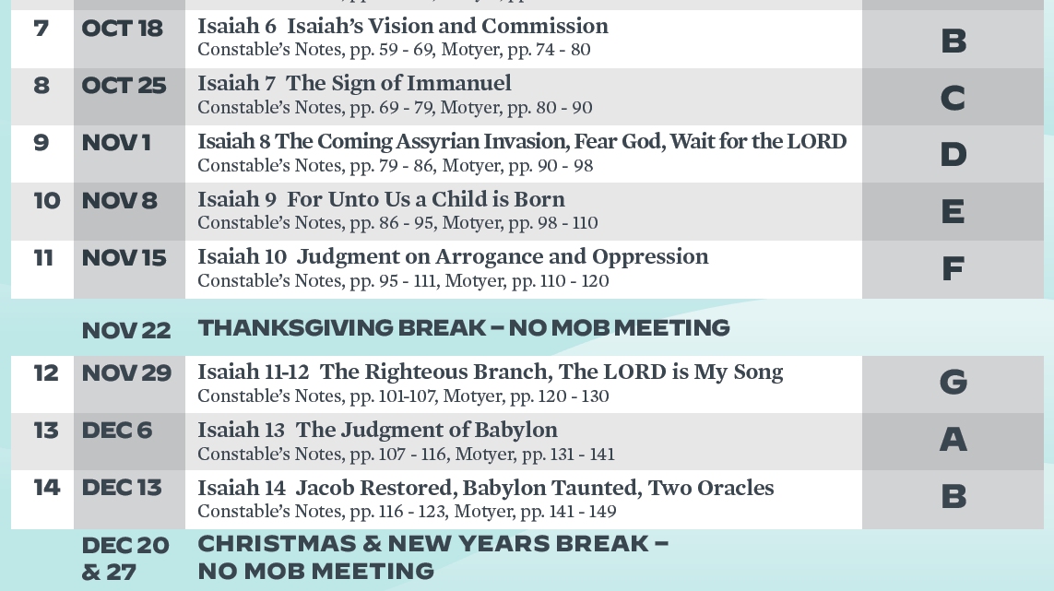
Isaiah Bible Study Schedule for Fall 2022 – Spring 2023 as of September 6, 2022

