Slide 1
WELCOME TO THE MOB!
All Scripture is breathed out by God and profitable for teaching, for reproof, for correction, and for training in righteousness, that the man of God may be complete, equipped for every good work.
2 Timothy 3:16-17 (ESV)

Slide 2
Announcements
Friday, 20 Oct, Christian Embassy Fellowship Dinner Fundraiser, 6:30-8:30 PM, Fairview Park Marriott
Saturday, 28 Oct, IBC Fall Outreach Festival, Saturday, 1-4 PM
https://immanuelbible.church/visit/fall-outreach-fest\
MOB Website & Resources: www.ibcmob.net

Slide 3
On Your Feet!
Invocation/Prayer
Song:
“Word of God Speak”

Slide 4
Word of God Speak 1 of 5
I am finding myself at a loss for words
And the funny thing is it’s okay
The last thing I need is to be heard
But to hear what you would say

Slide 5
Word of God Speak 2 of 5
Word of God, speak: would You pour down like rain?
Washing my eyes to see Your majesty
To be still and know that You’re in this place
Please let me stay and rest in Your holiness
Word of God, speak

Slide 6
Word of God Speak 3 of 5
I am finding myself in the midst of You
Beyond the music, beyond the noise
All that I need is to be with You
And in the quiet, hear your voice

Slide 7
Word of God Speak 4 of 5
Word of God, speak: would You pour down like rain?
Washing my eyes to see Your majesty
To be still and know that You’re in this place
Please let me stay and rest in Your holiness
Word of God, speak: would you pour down like rain?
Washing my eyes to see Your majesty
To be still and know that You’re in this place
Please let me stay and rest in Your holiness

Slide 8
Word of God Speak 5 of 5
I’m finding myself at a loss for words
And the funny thing is it’s okay

Slide 9
Memory Verse

Slide 10
Memory Verse
Isaiah 42:20 (ESV)
“He sees many things, but does not observe them; his ears are open, but he does not hear.”

Slide 11
Our Isaiah Study
Last Meeting:
Isaiah 42:1-17
Memory Verse: Isaiah 42:8
Dr. Constable’s Notes, 2023 Ed., pp. 281-289; Motyer, pp. 318-325
Refreshment Host: E
Tonight:
Isaiah 42:18-25, Israel is Deaf and Blind
Memory Verse: Isaiah 42:20
Dr. Constable’s Notes, 2023 Ed., pp. 289-290; Motyer, pp. 326-330 Refreshment Host: F

Slide 12
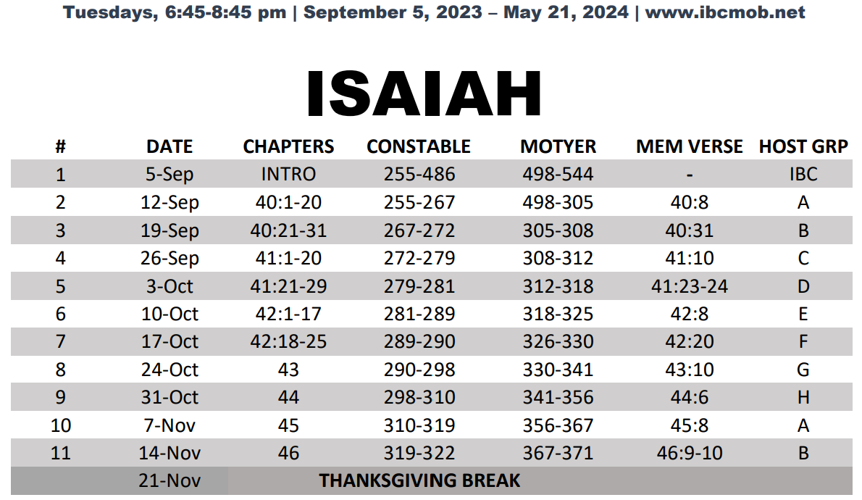
Isaiah Bible Study Schedule Fall 2023 – Spring 2024

Slide 13
Isaiah Outline
Focus | Prophecies of Condemnation |  |  |  |  |  |  |  | Historical Parenthesis |  | Prophecies of Comfort
 | 1:1 |  |  |  |  |  |  | 35:10 | 36:1 | 39:8 | 40:1 |  |  |  |  |  | 66:24
Divisions | Prophecies Against Judah |  | Prophecies Against the Nation |  | Prophesies Against the Day of the Lord |  | Prophesies of Judgement and Blessing |  | Sickness and Sin | Hezekiah’s Salvation | Israel’s Deliverance |  |  | Israel’s Deliverer |  | Israel’s Glorious Future
 | 1:1 | 12:6 | 13:1 | 23:18 | 24:1 | 27:13 | 28:1 | 35:10 | 36:1 | 39:8 | 40:1 | 48:22 |  | 49:1 | 57:21 | 58:1 | 66:24
Topics | Prophetic |  |  |  |  |  |  |  | Historic |  | Messianic
 | Judgement |  |  |  |  |  |  |  | Transition |  | Hope
Place | Israel & Judah
Time | 740 - 680 B.C.
We are here!
Bruce Wilkinson and Kenneth Boa, Talk Thru the Bible (Nashville: T. Nelson, 1983), 189.

Slide 14
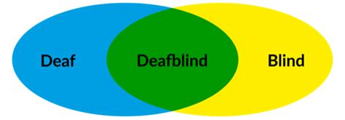
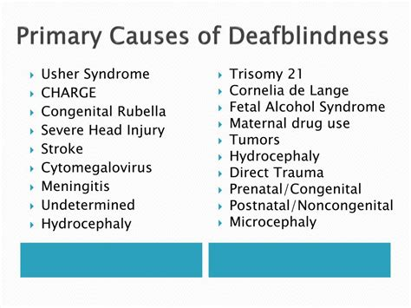
Deafblindness
Notes:
Physical Deafblindness
Four different categories of deafblindness

Slide 15
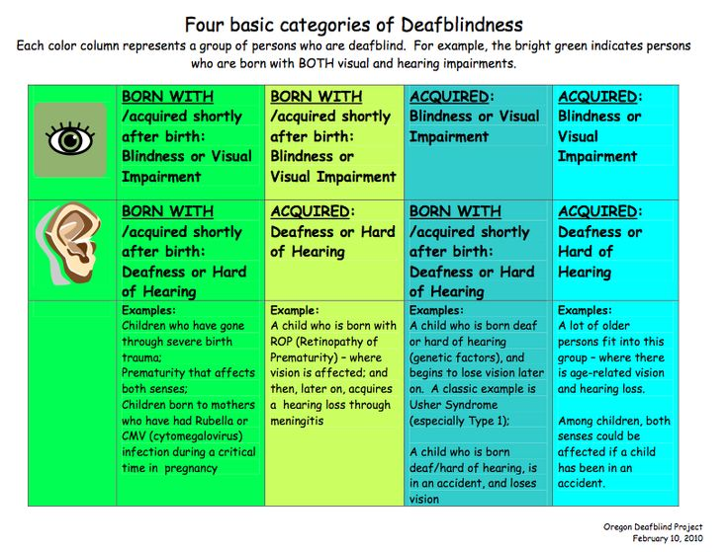
Deafblindness
Notes:
Four basic categories of deafblindness
There remains another category of Deafblindness that we will talk about tonight, choosing to be deafblind. Israel, God’s chosen servant, was deaf and blind to God.

Slide 16
Summary | Isaiah 42:20
He sees many things, but does not observe them; his ears are open, but he does not hear. Isaiah 42:20 (ESV)
Notes:
Tonight we are going to examine the spiritual deafblindness of Israel and God’s encouragement.

Slide 17
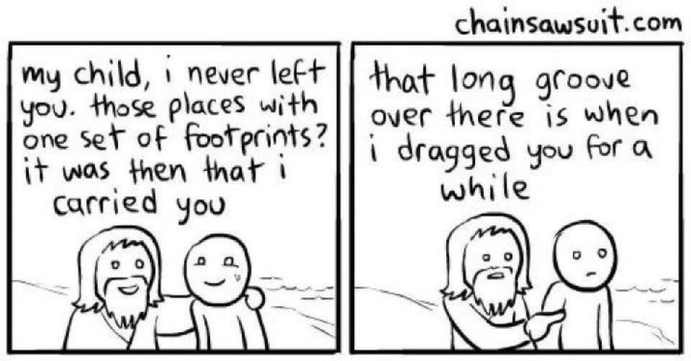
Isaiah 42:18-20
Israel’s Deafblindness
Notes:
Blind and deaf, there is only one way out of spiritual darkness.

Slide 18
Isaiah 42:18-20 (ESV)
Israel’s Deafblindness
18 Hear, you deaf, and look, you blind, that you may see!
19 Who is blind but my servant,
or deaf as my messenger whom I send?
Who is blind as my dedicated one,
or blind as the servant of the LORD?
20 He sees many things, but does not observe them;
his ears are open, but he does not hear.
Other people heard of the power of Israel’s God and were not deaf to His omnipotence
God warned Isaiah of Israel’s spiritual Deafblindness
“Go and tell this people, ‘Be ever hearing, but never understanding; be ever seeing, but never perceiving.’ Make the hearts of this people calloused; deafen their ears and close their eyes. Otherwise they might see with their eyes, hear with their ears, understand with their hearts, and turn and be healed.” – Isaiah 6:9-10

Slide 19
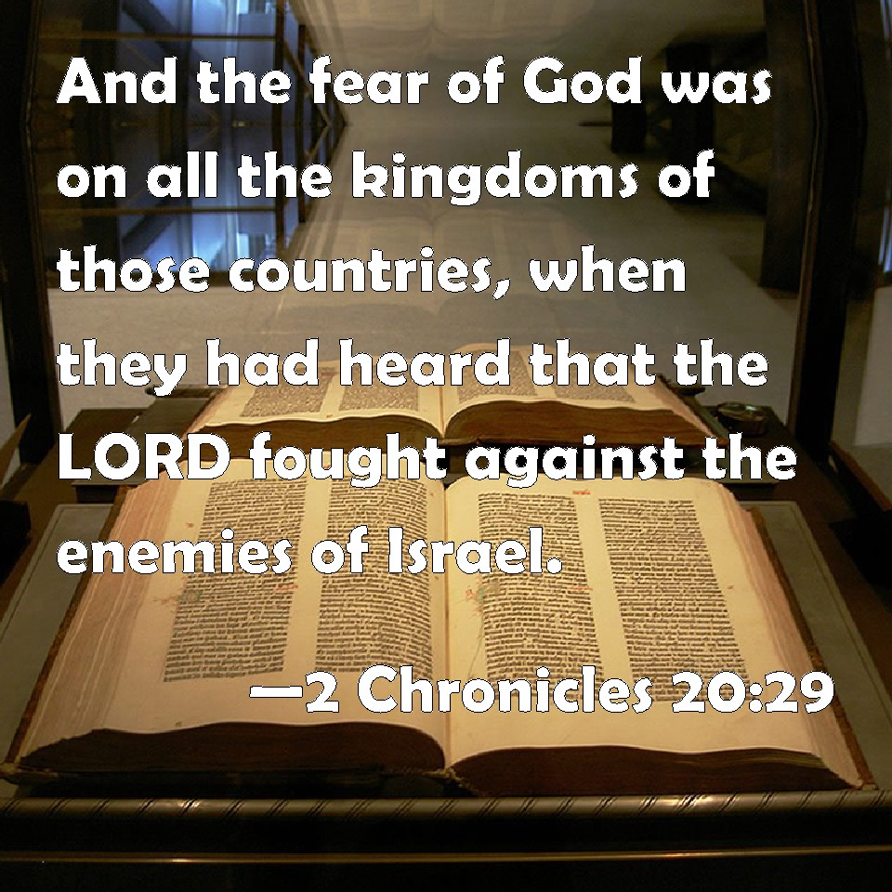
Isaiah 42:18-20
Others heard and knew about God’s help for Israel

Slide 20
Parable of the Sower
Jesus’ First Parable - Matthew
That same day Jesus went out of the house and sat beside the sea. And great crowds gathered about him, so that he got into a boat and sat down. And the whole crowd stood on the beach. And he told them many things in parables, saying: “A sower went out to sow. And as he sowed, some seeds fell along the path, and the birds came and devoured them. Other seeds fell on rocky ground, where they did not have much soil, and immediately they sprang up, since they had no depth of soil, but when the sun rose they were scorched. And since they had no root, they withered away. Other seeds fell among thorns, and the thorns grew up and choked them. Other seeds fell on good soil and produced grain, some a hundredfold, some sixty, some thirty. He who has ears, let him hear.” Matthew 13:1-9
– Mark 4:1-9 (Matthew 13:1-9; Luke 8:4-8)
Notes:
See same parable in Mark 4:1-12 and Luke 8:5-15

Slide 21
Parable of the Sower
Speaking in Parables
Then the disciples came and said to him, “Why do you speak to them in parables?” And he answered them, “To you it has been given to know the secrets of the kingdom of heaven, but to them it has not been given. For to the one who has, more will be given, and he will have an abundance, but from the one who has not, even what he has will be taken away. This is why I speak to them in parables, because seeing they do not see, and hearing they do not hear, nor do they understand. Indeed, in their case the prophecy of Isaiah is fulfilled that says:
“‘“You will indeed hear but never understand, and you will indeed see but never perceive.”
For this people’s heart has grown dull, and with their ears they can barely hear,
and their eyes they have closed, lest they should see with their eyes
and hear with their ears and understand with their heart and turn, and I would heal them.’
But blessed are your eyes, for they see, and your ears, for they hear. For truly, I say to you, many prophets and righteous people longed to see what you see, and did not see it, and to hear what you hear, and did not hear it. Matthew 13:10-17
– Mark 4:1-9 (Matthew 13:1-9; Luke 8:4-8)

Slide 22
Paul Preaches in Rome
Quotes Isaiah 6:9-10
Some of them were convinced by what he said, but others refused to believe. They disagreed among themselves and began to leave after Paul had made this final statement: “The Holy Spirit was right when He spoke to your fathers through Isaiah the prophet:
‘Go to this people and say,
“You will be ever hearing but never understanding;
you will be ever seeing but never perceiving.”
For this people’s heart has grown callous;
they hardly hear with their ears,
and they have closed their eyes.
Otherwise they might see with their eyes,
hear with their ears,
understand with their hearts,
and turn, and I would heal them.’ – Acts 28:24-27
– Mark 4:13-20
Notes:
Paul admonishes them for similar behavior to their fathers…

Slide 23
Cost of Spiritual Deafblindness
Deafblindness in the Garden of Eden
The LORD God took the man and put him in the garden of Eden to work it and keep it. And the LORD God commanded the man, saying, “You may surely eat of every tree of the garden, but of the tree of the knowledge of good and evil you shall not eat, for in the day that you eat of it you shall surely die.” Genesis 2:15-17
Now the serpent was more crafty than any other beast of the field that the LORD God had made. He said to the woman, “Did God actually say, ‘You shall not eat of any tree in the garden’?” And the woman said to the serpent, “We may eat of the fruit of the trees in the garden, but God said, ‘You shall not eat of the fruit of the tree that is in the midst of the garden, neither shall you touch it, lest you die.’” Genesis 3:1-3
But the serpent said to the woman, “You will not surely die. For God knows that when you eat of it your eyes will be opened, and you will be like God, knowing good and evil.” So when the woman saw that the tree was good for food, and that it was a delight to the eyes, and that the tree was to be desired to make one wise, she took of its fruit and ate, and she also gave some to her husband who was with her, and he ate. Then the eyes of both were opened, and they knew that they were naked. And they sewed fig leaves together and made themselves loincloths. Genesis 3:4-7

Slide 24
Isaiah 42:21 (ESV)
Consequences of Israel’s Spiritual Deafblindness
21 The LORD was pleased, for his righteousness’ sake, to magnify his law and make it glorious.
22 But this is a people plundered and looted; they are all of them trapped in holes and hidden in prisons; they have become plunder with none to rescue, spoil with none to say, “Restore!” 23 Who among you will give ear to this, will attend and listen for the time to come?
24 Who gave up Jacob to the looter, and Israel to the plunderers? Was it not the LORD, against whom we have sinned, in whose ways they would not walk, and whose law they would not obey?
25 So he poured on him the heat of his anger and the might of battle; it set him on fire all around, but he did not understand; it burned him up, but he did not take it to heart.
“The cardinal sin of the people of God is to possess the divine word and to ignore it.” Motyer
“The “Law” in view here probably includes all of what God had revealed to His people that enabled them to come into relationship with Him and to live lives of fulfillment as His creatures.” Constable

Slide 25
Isaiah 42:22-24 (ESV)
Consequences of Israel’s Spiritual Deafblindness
21 The LORD was pleased, for his righteousness’ sake, to magnify his law and make it glorious.
22 But this is a people plundered and looted; they are all of them trapped in holes and hidden in prisons; they have become plunder with none to rescue, spoil with none to say, “Restore!” 23 Who among you will give ear to this, will attend and listen for the time to come?
24 Who gave up Jacob to the looter, and Israel to the plunderers? Was it not the LORD, against whom we have sinned, in whose ways they would not walk, and whose law they would not obey?
25 So he poured on him the heat of his anger and the might of battle; it set him on fire all around, but he did not understand; it burned him up, but he did not take it to heart.
“… and the curse, if you do not obey the commandments of the LORD your God, but turn aside from the way that I am commanding you today, to go after other gods that you have not known.” Deuteronomy 11:28
“If, however, you do not obey the LORD your God by carefully following all His commandments and statutes I am giving you today, all these curses will come upon you and overtake you.” Deuteronomy 28:15

Slide 26
Isaiah 42:21-25
Curses for disobedience
16 Cursed shall you be in the city, and cursed shall you be in the field. 17 Cursed shall be your basket and your kneading bowl. 18 Cursed shall be the fruit of your womb and the fruit of your ground, the increase of your herds and the young of your flock. 19 Cursed shall you be when you come in, and cursed shall you be when you go out.
20 “The LORD will send on you curses, confusion, and frustration in all that you undertake to do, until you are destroyed and perish quickly on account of the evil of your deeds, because you have forsaken me. 21 The LORD will make the pestilence stick to you until he has consumed you off the land that you are entering to take possession of it. 22 The LORD will strike you with wasting disease and with fever, inflammation and fiery heat, and with drought and with blight and with mildew. They shall pursue you until you perish. 23 And the heavens over your head shall be bronze, and the earth under you shall be iron. 24 The LORD will make the rain of your land powder. From heaven dust shall come down on you until you are destroyed. Deuteronomy 28:16-24

Slide 27
Isaiah 42:21-25
Curses for disobedience
25 “The LORD will cause you to be defeated before your enemies. You shall go out one way against them and flee seven ways before them. And you shall be a horror to all the kingdoms of the earth. 26 And your dead body shall be food for all birds of the air and for the beasts of the earth, and there shall be no one to frighten them away. 27 The LORD will strike you with the boils of Egypt, and with tumors and scabs and itch, of which you cannot be healed. 28 The LORD will strike you with madness and blindness and confusion of mind, 29 and you shall grope at noonday, as the blind grope in darkness, and you shall not prosper in your ways. And you shall be only oppressed and robbed continually, and there shall be no one to help you. 30 You shall betroth a wife, but another man shall ravish her. You shall build a house, but you shall not dwell in it. You shall plant a vineyard, but you shall not enjoy its fruit. 31 Your ox shall be slaughtered before your eyes, but you shall not eat any of it. Your donkey shall be seized before your face, but shall not be restored to you. Your sheep shall be given to your enemies, but there shall be no one to help you. 32 Your sons and your daughters shall be given to another people, while your eyes look on and fail with longing for them all day long, but you shall be helpless. 33 A nation that you have not known shall eat up the fruit of your ground and of all your labors, and you shall be only oppressed and crushed continually, 34 so that you are driven mad by the sights that your eyes see. 35 The LORD will strike you on the knees and on the legs with grievous boils of which you cannot be healed, from the sole of your foot to the crown of your head. Deuteronomy 28:25-35

Slide 28
Isaiah 42:25 (ESV)
Consequences of Israel’s Spiritual Deafblindness
After being plundered and looted, Israel
did not learn their lesson
paid no attention
did not set it upon their heart
understood not
learned nothing at all from it
did not notice
was oblivious to their situation
25 So he poured on him the heat of his anger and the might of battle; it set him on fire all around, but he did not understand; it burned him up, but he did not take it to heart.

Slide 29
Conclusion and Application
God gave us eyes to see and ears to hear His commands, commandments, decrees, and statutes.
God gave us freewill to choose what we see, hear, and understand, but holds us accountable for spiritual deafblindness.

Slide 30
Discussion & Application
1 of 2
How does God describe His people in verses 18-20?
In verse 20, what were some of the “many things” God had done for Israel over the years? (Exodus 14:13-31, 15:22-27, 16:12-15, 17:8-13; Deuteronomy 29:2-6)
Where have you seen or experienced God’s work in your life? Where have you seen or heard of His powerful work in the lives of others?
Where do you struggle with spiritual deafblindness to the Lord’s commands, decrees, and statutes? What is the cause of spiritual deafblindness? What is the cure for spiritual deafblindness?
Where might God be calling you to be His messenger? Where in your life is God calling you to reflect His light and love into darkness?

Slide 31
Discussion & Application
2 of 2
Which skills make a good messenger? How would deafblindness affect the ability of a messenger to do their job?
What agricultural promise does God give us regarding our lives? (Galatians 6:7; Matthew 7:15-20; Luke 6:43-45)
Why does suffering give us the ability to have laser focus on a topic? Why does suffering teach us more than success or times of ease and plenty?
Where has God used suffering or hardship to get your attention or nudge you back toward the narrow path? (Matthew 7:13-14; Luke 13:24)
What does the Bible promise us regarding suffering? (John 16:33, John 10:10)

Slide 32
Next Meeting 24 Oct
Next Week:
Isaiah 43
Memory Verse: Isaiah 43:10
Dr. Constable’s Notes, 2023 Ed., pp. 290-298; Motyer, pp. 330-341
Refreshment Host: G

Slide 33
Closing
Benediction
Small Groups

