Slide 1
WELCOME TO THE MOB!
All Scripture is breathed out by God and profitable for teaching, for reproof, for correction, and for training in righteousness, that the man of God may be complete, equipped for every good work.
2 Timothy 3:16-17 (ESV)

Slide 2
Announcements
MOB Website & Resources: www.ibcmob.net
Assist Pregnancy Center Walk/Run/Ride
Saturday, May 13, https://runsignup.com/WRRforLife
Men's Summer Sundae Series
Tuesday, June 13th – Speaker is Jonathan Alexandre of Liberty Counsel
Sunday, July 23rd – Speaker is Janet Parshall who is a nationally syndicated radio talk show host - open to spouses
Tuesday, August 8th – Speaker is retired Navy Vice Admiral Scott Redd
July IBI Series

Slide 3
On Your Feet Men!
Invocation/Prayer
Song:
“Crown Him With Many Crowns”

Slide 4
Crown Him With Many Crowns 1 of 4
Crown Him with many crowns, The Lamb upon His throne; Hark! How the heav’nly anthem drowns All music but its own! Awake, my soul and sing Of Him Who died for thee, And hail Him as thy matchless King Through all eternity.

Slide 5
Crown Him With Many Crowns 2 of 4
Crown Him the Lord of love! Behold His hands and side— Rich wounds, yet visible above, In beauty glorified. No angel in the sky Can fully bear that sight, But downward bends His wond’ring eye At mysteries so bright.

Slide 6
Crown Him With Many Crowns 3 of 4
Crown Him the Lord of life! Who triumphed o’er the grave, Who rose victorious in the strife For those He came to save. His glories now we sing, Who died, and rose on high, Who died eternal life to bring, And lives that death may die.

Slide 7
Crown Him With Many Crowns 4 of 4
Crown Him the Lord of heav’n! One with the Father known, One with the Spirit through Him giv’n From yonder glorious throne, To Thee be endless praise, For Thou for us hast died; Be Thou, O Lord, through endless days Adored and magnified.

Slide 8
Memory Verse
Isaiah 39:6 (ESV)
“⁶ Behold, the days are coming, when all that is in your house, and that which your fathers have stored up till this day, shall be carried to Babylon. Nothing shall be left, says the Lord.”
Isaiah 39:6 (ESV)

Slide 9
Our Study of Isaiah
Last Meeting:
Isaiah 38, Hezekiah’s Sickness and Recovery
Memory Verse: Isaiah 38:17
Dr. Constable’s Notes, 2022 Ed., pp. 240-246; Motyer, pp. 289-295
Tonight:
Isaiah 39, Hezekiah Welcomes Babylonia Envoy
Memory Verse: Isaiah 39:6
Dr. Constable’s Notes, 2022 Ed., pp. 246-251; Motyer, pp. 295-297
Refreshment Host: Small Group E

Slide 10
Isaiah Bible Study Schedule for Fall 2022 – Spring 2023 as of December 30, 2022
Online

Slide 11
Isaiah Outline
Focus | Prophecies of Condemnation |  |  |  |  |  |  |  | Historical Parenthesis |  | Prophecies of Comfort
 | 1:1 |  |  |  |  |  |  | 35:10 | 36:1 | 39:8 | 40:1 |  |  |  |  |  | 66:24
Divisions | Prophecies Against Judah |  | Prophecies Against the Nation |  | Prophesies Against the Day of the Lord |  | Prophesies of Judgement and Blessing |  | Sickness and Sin | Hezekiah’s Salvation | Israel’s Deliverance |  |  | Israel’s Deliverer |  | Israel’s Glorious Future
 | 1:1 | 12:6 | 13:1 | 23:18 | 24:1 | 27:13 | 28:1 | 35:10 | 36:1 | 39:8 | 40:1 | 48:22 |  | 49:1 | 57:21 | 58:1 | 66:24
Topics | Prophetic |  |  |  |  |  |  |  | Historic |  | Messianic
 | Judgement |  |  |  |  |  |  |  | Transition |  | Hope
Place | Israel & Judah
Time | 740 - 680 B.C.
We are here!
Bruce Wilkinson and Kenneth Boa, Talk Thru the Bible (Nashville: T. Nelson, 1983), 189.

Slide 12
Overview | Isaiah 39 The Big Idea
How Big Is Your God?
Notes:
Hezekiah’s name means “Yahweh strengthens” or “Yahweh is my strength”

Slide 13
Our Creator God!
Notes:
R. C. Sproul – Isaiah 6
Comfort for God's People
40 Comfort, comfort my people, says your God. ² Speak tenderly to Jerusalem, and cry to her that her warfare^{[a]} is ended, that her iniquity is pardoned, that she has received from the Lord's hand double for all her sins.
³ A voice cries:^{[b]} “In the wilderness prepare the way of the Lord; make straight in the desert a highway for our God. ⁴ Every valley shall be lifted up, and every mountain and hill be made low; the uneven ground shall become level, and the rough places a plain. ⁵ And the glory of the Lord shall be revealed, and all flesh shall see it together, for the mouth of the Lord has spoken.”
The Word of God Stands Forever
⁶ A voice says, “Cry!” And I said,^{[c]} “What shall I cry?” All flesh is grass, and all its beauty^{[d]} is like the flower of the field. ⁷ The grass withers, the flower fades when the breath of the Lord blows on it; surely the people are grass. ⁸ The grass withers, the flower fades, but the word of our God will stand forever.
The Greatness of God
⁹ Go on up to a high mountain, O Zion, herald of good news;^{[e]} lift up your voice with strength, O Jerusalem, herald of good news;^{[f]} lift it up, fear not; say to the cities of Judah, “Behold your God!” ¹⁰ Behold, the Lord God comes with might, and his arm rules for him; behold, his reward is with him, and his recompense before him. ¹¹ He will tend his flock like a shepherd; he will gather the lambs in his arms; he will carry them in his bosom, and gently lead those that are with young.
¹² Who has measured the waters in the hollow of his hand and marked off the heavens with a span, enclosed the dust of the earth in a measure and weighed the mountains in scales and the hills in a balance? ¹³ Who has measured^{[g]} the Spirit of the Lord, or what man shows him his counsel? ¹⁴ Whom did he consult, and who made him understand? Who taught him the path of justice, and taught him knowledge, and showed him the way of understanding? ¹⁵ Behold, the nations are like a drop from a bucket, and are accounted as the dust on the scales; behold, he takes up the coastlands like fine dust. ¹⁶ Lebanon would not suffice for fuel, nor are its beasts enough for a burnt offering. ¹⁷ All the nations are as nothing before him, they are accounted by him as less than nothing and emptiness.
¹⁸ To whom then will you liken God, or what likeness compare with him? ¹⁹ An idol! A craftsman casts it, and a goldsmith overlays it with gold and casts for it silver chains. ²⁰ He who is too impoverished for an offering chooses wood^{[h]} that will not rot; he seeks out a skillful craftsman to set up an idol that will not move.
²¹ Do you not know? Do you not hear? Has it not been told you from the beginning? Have you not understood from the foundations of the earth? ²² It is he who sits above the circle of the earth, and its inhabitants are like grasshoppers; who stretches out the heavens like a curtain, and spreads them like a tent to dwell in; ²³ who brings princes to nothing, and makes the rulers of the earth as emptiness.
²⁴ Scarcely are they planted, scarcely sown, scarcely has their stem taken root in the earth, when he blows on them, and they wither, and the tempest carries them off like stubble.
²⁵ To whom then will you compare me, that I should be like him? says the Holy One. ²⁶ Lift up your eyes on high and see: who created these? He who brings out their host by number, calling them all by name; by the greatness of his might and because he is strong in power, not one is missing.
²⁷ Why do you say, O Jacob, and speak, O Israel, “My way is hidden from the Lord, and my right is disregarded by my God”? ²⁸ Have you not known? Have you not heard? The Lord is the everlasting God, the Creator of the ends of the earth. He does not faint or grow weary; his understanding is unsearchable. ²⁹ He gives power to the faint, and to him who has no might he increases strength. ³⁰ Even youths shall faint and be weary, and young men shall fall exhausted; ³¹ but they who wait for the Lord shall renew their strength; they shall mount up with wings like eagles; they shall run and not be weary; they shall walk and not faint.

Slide 14
Notes:
Timing …. Why are these two chapters Where they are?
God is a master of time as we saw last week.
38 In those days Hezekiah became sick and was at the point of death. And Isaiah the prophet the son of Amoz came to him, and said to him, “Thus says the Lord: Set your house in order, for you shall die, you shall not recover.”^{[a]} ² Then Hezekiah turned his face to the wall and prayed to the Lord, ³ and said, “Please, O Lord, remember how I have walked before you in faithfulness and with a whole heart, and have done what is good in your sight.” And Hezekiah wept bitterly.
⁴ Then the word of the Lord came to Isaiah: ⁵ “Go and say to Hezekiah, Thus says the Lord, the God of David your father: I have heard your prayer; I have seen your tears. Behold, I will add fifteen years to your life.^{[b]} ⁶ I will deliver you and this city out of the hand of the king of Assyria, and will defend this city.
⁷ “This shall be the sign to you from the Lord, that the Lord will do this thing that he has promised: ⁸ Behold, I will make the shadow cast by the declining sun on the dial of Ahaz turn back ten steps.” So the sun turned back on the dial the ten steps by which it had declined.^{[c]}
⁹ A writing of Hezekiah king of Judah, after he had been sick and had recovered from his sickness:
¹⁰ I said, In the middle^{[d]} of my days I must depart; I am consigned to the gates of Sheol for the rest of my years. ¹¹ I said, I shall not see the Lord, the Lord in the land of the living; I shall look on man no more among the inhabitants of the world. ¹² My dwelling is plucked up and removed from me like a shepherd's tent; like a weaver I have rolled up my life; he cuts me off from the loom; from day to night you bring me to an end; ¹³ I calmed myself^{[e]} until morning; like a lion he breaks all my bones; from day to night you bring me to an end.
¹⁴ Like a swallow or a crane I chirp; I moan like a dove. My eyes are weary with looking upward. O Lord, I am oppressed; be my pledge of safety! ¹⁵ What shall I say? For he has spoken to me, and he himself has done it. I walk slowly all my years because of the bitterness of my soul.
¹⁶ O Lord, by these things men live, and in all these is the life of my spirit. Oh restore me to health and make me live! ¹⁷ Behold, it was for my welfare that I had great bitterness; but in love you have delivered my life from the pit of destruction, for you have cast all my sins behind your back. ¹⁸ For Sheol does not thank you; death does not praise you; those who go down to the pit do not hope for your faithfulness. ¹⁹ The living, the living, he thanks you, as I do this day; the father makes known to the children your faithfulness.
²⁰ The Lord will save me, and we will play my music on stringed instruments all the days of our lives, at the house of the Lord.
²¹ Now Isaiah had said, “Let them take a cake of figs and apply it to the boil, that he may recover.” ²² Hezekiah also had said, “What is the sign that I shall go up to the house of the Lord?”

Slide 15
Overview…Isaiah 39 The Players
Babylon – Merodach-baladan
Judah - Hezekiah
Assyria - Sennacharib
God – Isaiah
Notes:
Hezekiah’s name means “Yahweh strengthens” or “Yahweh is my strength”
How big is our God?
This final chapter of the four chapters that parallel 2 Kgs 18–20 is almost identical to 2 Kgs 20:12–19. The only major place where it differs is the final verse.
Graham S. Ogden and Jan Sterk, , ed. Paul Clarke et al., vol. 1 & 2, United Bible Societies Handbooks (Reading, UK: United Bible Societies, 2011), 1027.
Graham S. Ogden and Jan Sterk, A Handbook on Isaiah, ed. Paul Clarke et al., vol. 1 & 2, United Bible Societies’ Handbooks (Reading, UK: United Bible Societies, 2011), 1027.
When Did all this Happen?
I will deliver you and this city out of the hand of the king of Assyria, and will defend this city.
7 “This shall be the sign to you from the Lord, that the Lord will do this thing that he has promised:
8 Behold, I will make the shadow cast by the declining sun on the dial of Ahaz turn back ten steps.” So the sun turned back on the dial the ten steps by which it had declined.
(Wheaton, IL: Crossway Bibles, 2016), Is 38:68.
The Holy Bible: English Standard Version (Wheaton, IL: Crossway Bibles, 2016), Is 38:6–8.
Why are these two Chapters after Sennacarib is defeated?

Slide 16
Isaiah 39:1-2
Hezehiah Shows Babylon His Wealth
¹At that time Merodach-baladan the son of Baladan, king of Babylon, sent envoys with letters and a present to Hezekiah, for he heard that he had been sick and had recovered. ² And Hezekiah welcomed them gladly. And he showed them his treasure house, the silver, the gold, the spices, the precious oil, his whole armory, all that was found in his storehouses. There was nothing in his house or in all his realm that Hezekiah did not show them.

Slide 17
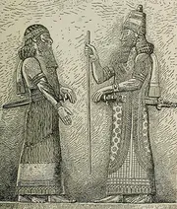
Isaiah 39 Babylon – Merodach-baladan
Merodach-baladan (Mb) was King of Babylon from 721 to 710 & From 705 to 703
Oswalt believes Chapters 38 & 39 Occurred in 711 or 712 BC
Opportune Time for Babylon to Seek Hezekiah’s Aid in a Revolt Against Assyria
Nebuchadnezzar in 597 & 586 BC Conquered Jerusalem

Slide 18
Isaiah 39:3-4
Hezekiah Shows Babylon His Wealth
³ Then Isaiah the prophet came to King Hezekiah, and said to him, “What did these men say? And from where did they come to you?” Hezekiah said, “They have come to me from a far country, from Babylon.” ⁴ He said, “What have they seen in your house?” Hezekiah answered, “They have seen all that is in my house. There is nothing in my storehouses that I did not show them.”

Slide 19
2 Kings 18:3-8 Judah - Hezekiah
³And he did what was right in the eyes of the LORD, according to all that David his father had done. ⁴He removed the high places and broke the pillars and cut down the Asherah. And he broke in pieces the bronze serpent that Moses had made, for until those days the people of Israel had made offerings to it (it was called Nehushtan). ⁵He trusted in the LORD, the God of Israel, so that there was none like him among all the kings of Judah after him, nor among those who were before him. ⁶For he held fast to the LORD. He did not depart from following him, but kept the commandments that the LORD commanded Moses. ⁷And the LORD was with him; wherever he went out, he prospered. He rebelled against the king of Assyria and would not serve him. ⁸He struck down the Philistines as far as Gaza and its territory, from watchtower to fortified city.

Slide 20
2 Kings 18:3-8 Judah - Hezekiah
³And he did what was right in the eyes of the LORD, according to all that David his father had done. ⁴He removed the high places and broke the pillars and cut down the Asherah. And he broke in pieces the bronze serpent that Moses had made, for until those days the people of Israel had made offerings to it (it was called Nehushtan). ⁵He trusted in the LORD, the God of Israel, so that there was none like him among all the kings of Judah after him, nor among those who were before him. ⁶For he held fast to the LORD. He did not depart from following him, but kept the commandments that the LORD commanded Moses. ⁷And the LORD was with him; wherever he went out, he prospered. He rebelled against the king of Assyria and would not serve him. ⁸He struck down the Philistines as far as Gaza and its territory, from watchtower to fortified city.

Slide 21
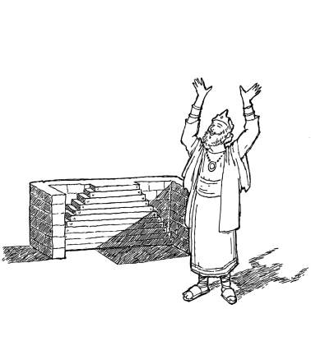
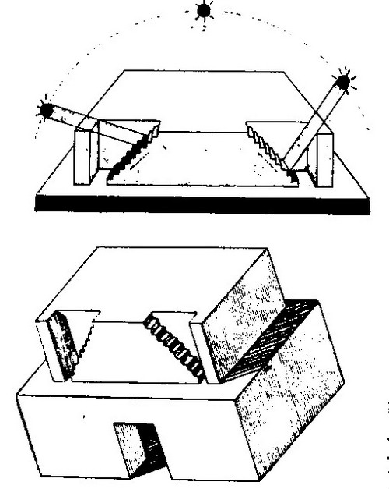
Isaiah 38:7-8
The LORD Answers Hezekiah’s Prayer
Hezekiah asked for a sign that the LORD would heal him (2 Kings 20:8)
Isaiah gave Hezekiah two options, make the shadow to go forward ten steps or back ten? (2 Kings 20:9)
Hezekiah surmised it was easier for the shadow to lengthen ten steps, but not to retreat ten (2 Kings 20:10)
Isaiah asked the LORD and He brought the shadow back the ten steps it had already descended on the stairway of Ahaz (2 Kings 20:11)
Notes:
Seeing is believing… used to say that when something unlikely is witnessed, the truth of its occurrence or existence can no longer be doubted.
Isaiah 7:3-12 The LORD spoke to king Ahaz and encouraged him to ask for a sign from the LORD your God to validate what He was saying, Ahaz refused and quoted Moses “I will not ask; I will not test the LORD.” Isaiah 7:12

Slide 22
In Those Days…
Isaiah’s Message to King Hezekiah
and Hezekiah’s Prayer
Hezekiah was:
25 years old when he began to reign as king (2 Kings 18:1)
+ 29 years he reigned (2 Kings 18:1)
54 years old when he died (2 Kings 18:1)
- 15 years added to his life (Isaiah 38:6)
39 years old when he was sick unto death (Isaiah 38:1)
39 years old when Sennarcherib king Assyria attacked all the
fortified cities of Judah and captured them (2 Kings 18:13; Isaiah 36:1)

Slide 23
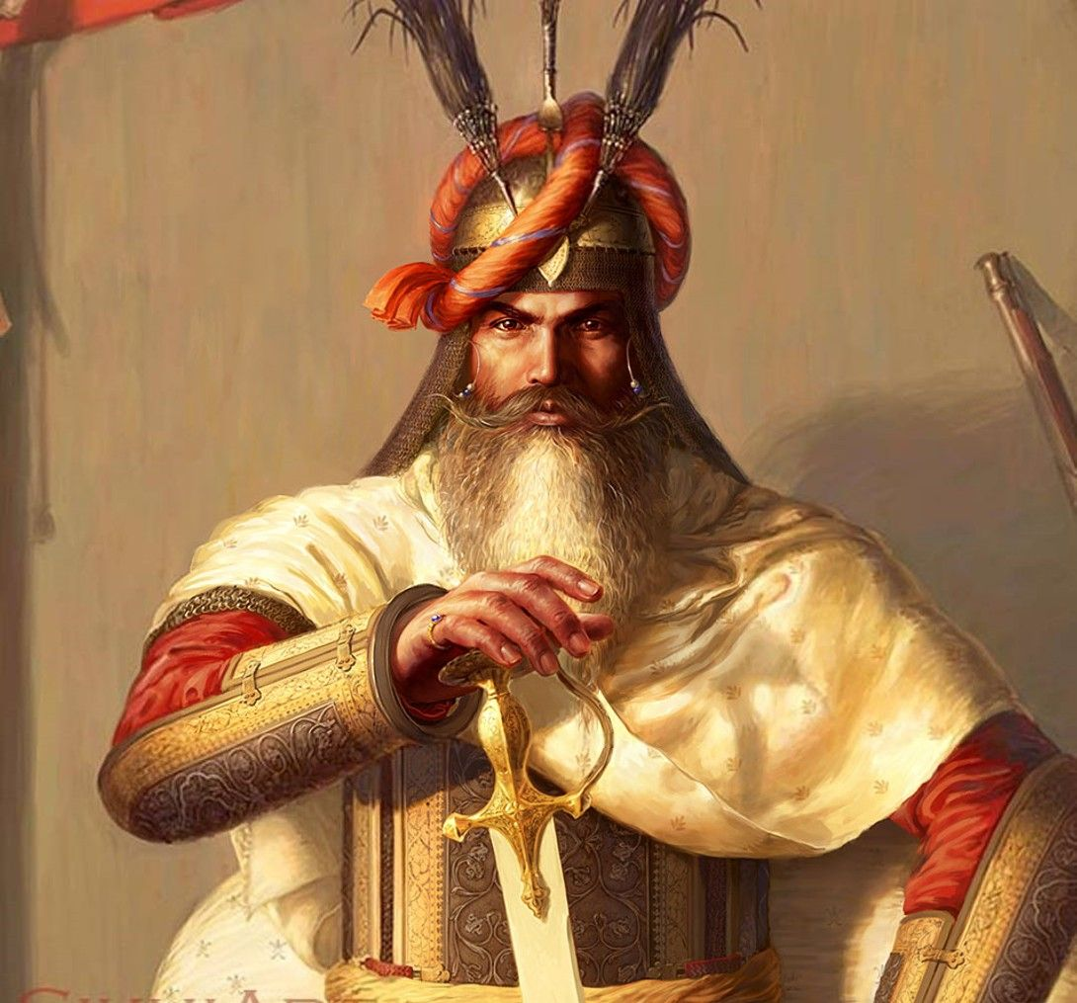
Isaiah 39 Judah - Hezekiah
Hezekiah Was Obedient to God
God Was With Hezekiah
In the Eyes of the People…Was Hezekiah the Promised Savior?
Hezekiah Shows His Desire to Please Earthly Powers in this Chapter
Shows the Babylonian Envoys His Wealth
A Desire to Show How Good an Ally Hezekiah Could Be…

Slide 24
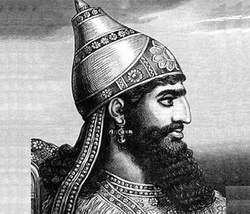
Isaiah 39 Assyria - Senacharib
While Not Mentioned in these Passages…Assyria was the Power in the Region
Sennacharib’s Siege of Lachish
And His Arrogance in Dealing with Hezekiah
But, God Dealt with Him…185,000 Men Later…

Slide 25
Isaiah 39:5-7
God’s Judgement Carried Out by Babylon
⁵ Then Isaiah said to Hezekiah, “Hear the word of the Lord of hosts: ⁶ Behold, the days are coming, when all that is in your house, and that which your fathers have stored up till this day, shall be carried to Babylon. Nothing shall be left, says the Lord. ⁷ And some of your own sons, who will come from you, whom you will father, shall be taken away, and they shall be eunuchs in the palace of the king of Babylon.”

Slide 26
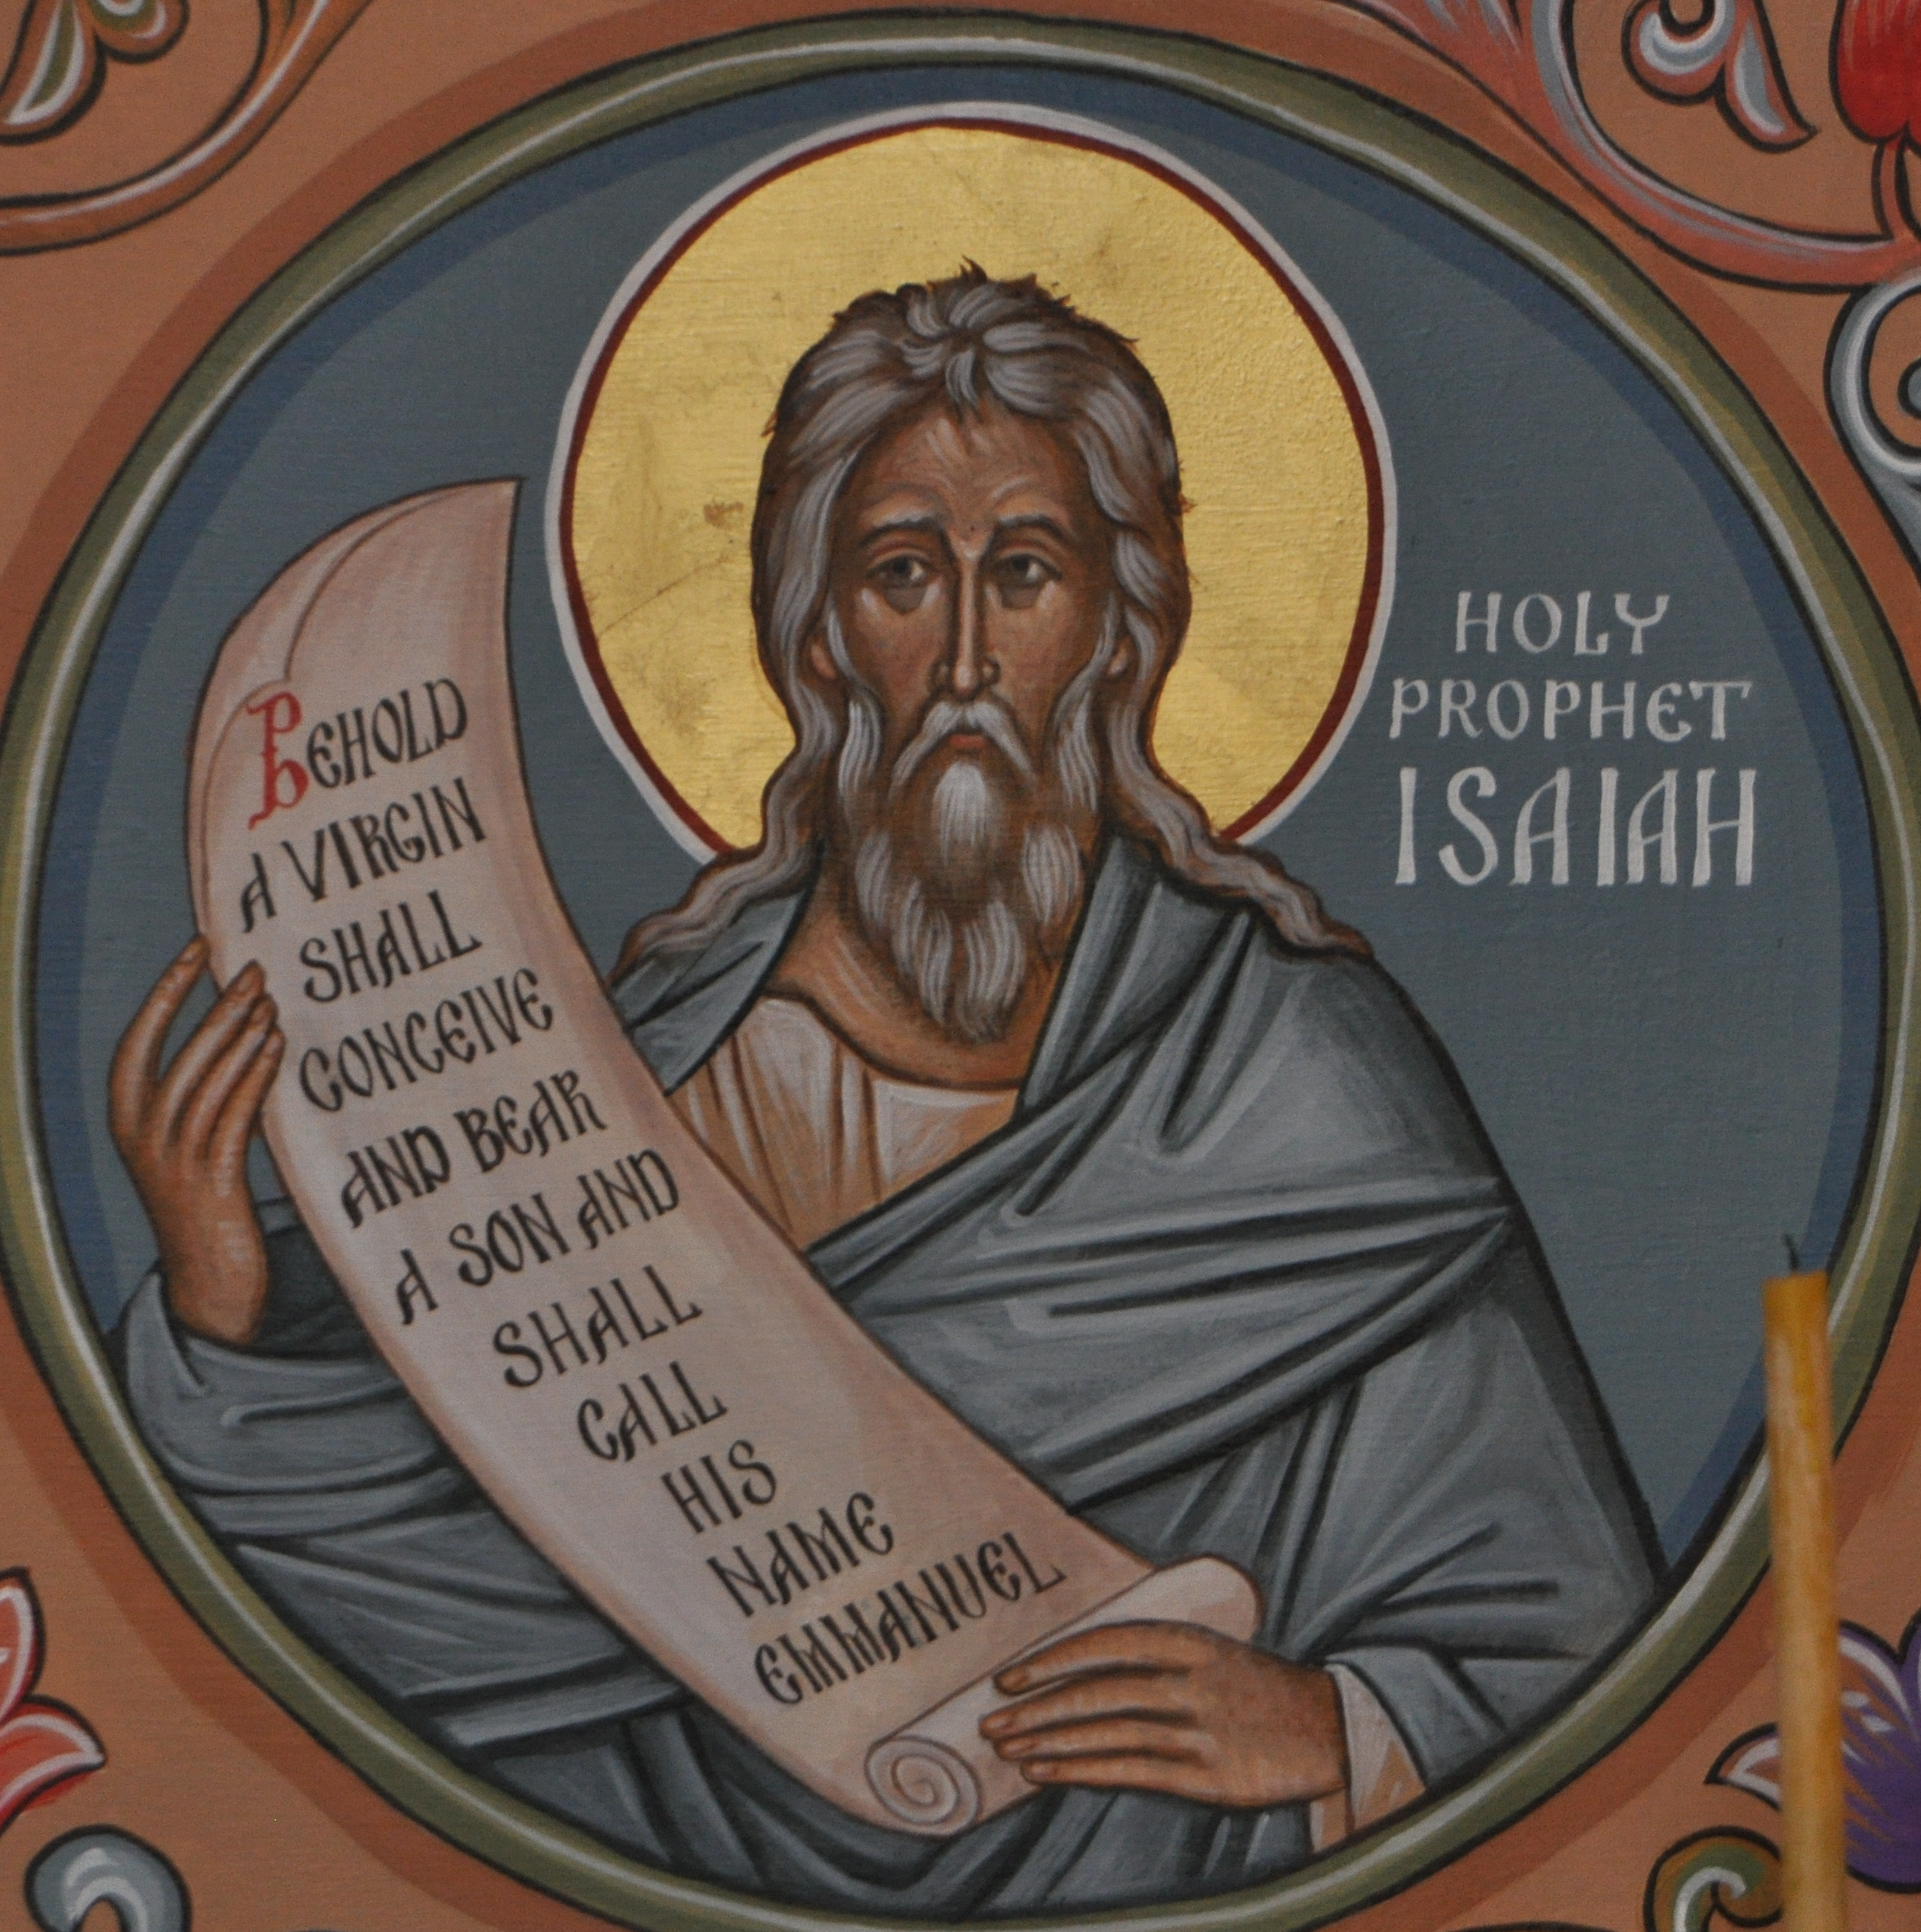
Isaiah 39 Isaiah - God
Chapter 38 & 39 Demonstrate the Bigness of Our God!
Hezekiah is not the Messiah!
God Deals with Hezekiah’s Reliance on Earthly Things
Chapters 38 & 39 are a Transition From the First Half of Isaiah to the Second
Isaiah is Called the 5th Gospel…We Will See Why…Next Year!

Slide 27
Isaiah 39:8
Hezekiah Says, “That’s Ok!”
⁸ Then Hezekiah said to Isaiah, “The word of the Lord that you have spoken is good.” For he thought, “There will be peace and security in my days.”

Slide 28
Conclusion and Application
God Is Big!
Omniscient, Omnipresent, Omnipotent, Infinite
God is Sovereign!
He is Large and In Charge
Bow Your Knee To the Wonder of Our Almighty God!
Notes:
Big Things versus Little things.

Slide 29
Discussion & Application
1 of 2
What’s your understanding of the timeframe, and status of things in Jerusalem for the events recorded in this text?
What might have been Hezekiah’s motive in catering to, and trying to impress the son of the king of Babylon—and what does it say about his earlier commitment to trust in the Lord?
What was the “state” of Babylon at this point in history?
How did Isaiah view the actions, and the response of Hezekiah to his “blunder,” and what did say would be the outcome of his actions?

Slide 30
Discussion & Application
2 of 2
How and when was Isaiah’s prophecy fulfilled?
How did Hezekiah rationalize and try to justify his actions, and what does this say about his heart, and commitment to seeking the Lord above all?
How do you explain Hezekiah’s actions and attitude here with what we just saw and learned about him in the last three lessons? And how might that apply to us?
What are your “takes” from this passage?

Slide 31
Next Meeting 16 May
Review:
Isaiah 39, Hezekiah Welcomes Babylonian Envoy
Memory Verse: Isaiah 39:6
Dr. Constable’s Notes, 2022 Ed., pp. 246-251; Motyer, pp. 295-297
Next Week:
Isaiah 1-39, Review, Lessons Learned, Testimonies
Memory Verse: Jeremiah 29:11-13
Dr. Constable’s Notes, 2022 Ed., pp. 1-251; Motyer, pp. 13-297
Next Week We Will Meet Online!

Slide 32
Closing
Benediction
Small Groups

