Slide 1
WELCOME TO THE MOB!
All Scripture is breathed out by God and profitable for teaching, for reproof, for correction, and for training in righteousness, that the man of God may be complete, equipped for every good work.
2 Timothy 3:16-17 (ESV)

Slide 2
Announcements
MOB Website & Resources: www.ibcmob.net
Immanuel Bible Institute classes | Started 28 January
Fundamentals of the Faith – Part 2, 8am, room B207
The Art of Marriage, 9:30am, room B207
Evangelism 101, 9:30am, room B209
Christian Worldview and Culture, 11:10am, room B207
Panorama of the Bible, 11:10am, room B209
Logos Bible Software for Beginners, 8am, room A207

Slide 3
Invocation/Prayer
Hymn:
Hallelujah! What a Savior!
Notes:
I prayed that my teaching would change the lives of my students, encourage them, give them more confidence, and help them make an impact on the world. – Jim Plueddemann

Slide 4
Hallelujah! What a Savior!
By Phillip Bliss, verses 1 & 2
Man of Sorrows! what a name for the Son of God, who came ruined sinners to reclaim. Hallelujah! What a Savior!
Bearing shame and scoffing rude, in my place condemned He stood; sealed my pardon with His blood. Hallelujah! What a Savior!

Slide 5
Hallelujah! What a Savior!
By Phillip Bliss, verses 3 & 4
Guilty, vile, and helpless we; spotless Lamb of God was He; full atonement can it be? Hallelujah! What a Savior! x Lifted up was He to die; "It is finished!" was His cry; now in heaven exalted high. Hallelujah! What a Savior!

Slide 6
Hallelujah! What a Savior!
By Phillip Bliss, verse 5 of 5
When He comes, our glorious King, all His ransomed home to bring, then anew this song we'll sing: Hallelujah! What a Savior!

Slide 7
Memory Verse
Isaiah 53:3-4 (ESV)
³ He was despised and rejected by men, a man of sorrows and acquainted with grief; and as one from whom men hide their faces he was despised, and we esteemed him not. ⁴ Surely he has borne our griefs and carried our sorrows; yet we esteemed him stricken, smitten by God, and afflicted.

Slide 8
Our Study of Isaiah
Last Meeting:
Isaiah 52:11-15
Memory Verse: Isaiah 52:15
Dr. Constable’s Notes, 2023 Ed., pp. 367-372; Motyer, pp. 420-426
This Meeting:
Isaiah 53:1-6
Memory Verse: Isaiah 53:3-4
Dr. Constable’s Notes, 2023 Ed., pp. 372-380; Motyer, pp. 426-431
Refreshment Host: Group B

Slide 9
Isaiah Outline
Focus | Prophecies of Condemnation |  |  |  |  |  |  |  | Historical Parenthesis |  | Prophecies of Comfort
 | 1:1 |  |  |  |  |  |  | 35:10 | 36:1 | 39:8 | 40:1 |  |  |  |  |  | 66:24
Divisions | Prophecies Against Judah |  | Prophecies Against the Nation |  | Prophesies Against the Day of the Lord |  | Prophesies of Judgement and Blessing |  | Sickness and Sin | Hezekiah’s Salvation | Israel’s Deliverance |  |  | Israel’s Deliverer |  | Israel’s Glorious Future
 | 1:1 | 12:6 | 13:1 | 23:18 | 24:1 | 27:13 | 28:1 | 35:10 | 36:1 | 39:8 | 40:1 | 48:22 |  | 49:1 | 57:21 | 58:1 | 66:24
Topics | Prophetic |  |  |  |  |  |  |  | Historic |  | Messianic
 | Judgement |  |  |  |  |  |  |  | Transition |  | Hope
Place | Israel & Judah
Time | 740 - 680 B.C.
We are here!
Bruce Wilkinson and Kenneth Boa, Talk Thru the Bible (Nashville: T. Nelson, 1983), 189.

Slide 10
Isaiah 53:1-3
¹ Who has believed our message? And to whom has the arm of the Lord been revealed?
² For He grew up before Him like a tender shoot, And like a root out of parched ground; He has no stately form or majesty That we should look upon Him, Nor appearance that we should be attracted to Him.
³ He was despised and forsaken of men, A man of sorrows and acquainted with grief; And like one from whom men hide their face He was despised, and we did not esteem Him.

Slide 11
Isaiah 53:4-6
⁴ Surely our griefs He Himself bore, And our sorrows He carried; Yet we ourselves esteemed Him stricken, Smitten of God, and afflicted.
⁵ But He was pierced through for our transgressions, He was crushed for our iniquities; The chastening for our well-being fell upon Him, And by His scourging we are healed.
⁶ All of us like sheep have gone astray, Each of us has turned to his own way; But the Lord has caused the iniquity of us all To fall on Him.
Unless otherwise noted, all Scripture quotations are from NASB95

Slide 12
Who Is “The Servant”?
Inquiring Minds Wanted to Know
My chosen one in whom My soul delights – Servant Song 1, 42.1
I will appoint You as a covenant to the people, As a light to the nations – SS1, 42.6
He says, “It is too small a thing that You should be My Servant To raise up the tribes of Jacob and to restore the preserved ones of Israel; I will also make You a light of the nations So that My salvation may reach to the end of the earth.” – SS2, 49.6
The Lord God has given Me the tongue of disciples, That I may know how to sustain the weary one with a word. – SS3, 50.4
Behold, My servant will prosper, He will be high and lifted up and greatly exalted. – SS4, 52:13
Notes:
Put yourself in the place of Isaiah’s original audience
- they knew they were sinners, though they didn’t want to admit it
- they knew Isaiah was prophesying of a strange and glorious future
- they knew Isaiah kept referring to “The Servant”
- but WHO was He?
- WHERE was He?
- WHEN was He going to act
- HOW was He going to fix things
52:13 words used exclusively for God
¹ In the year of King Uzziah’s death I saw the Lord sitting on a throne, lofty and exalted, with the train of His robe filling the temple. (Isaiah 6:1)

Slide 13
Who Is “The Servant”?
FINALLY, with Isaiah 52:13 Israel would understand clearly that the Servant is God, though in some way He is distinct from God the Father.
Behold, My servant will prosper, He will be high and lifted up and greatly exalted. – SS4, 52:13
A quick read of Isaiah 53:1-6 makes it clear in retrospect that Isaiah is talking about Jesus! (But not by name – that is still a mystery to Israel.)
Further, Isaiah gives us information about Jesus that is not found in the New Testament gospels! Watch for it.

Slide 14
Isaiah 53 Quoted
Isaiah 53 is “the most quoted and alluded to Old Testament chapter in the New Testament.” (Constable)
³⁷ But though He had performed so many signs before them, yet they were not believing in Him. ³⁸ This was to fulfill the word of Isaiah the prophet which he spoke: “Lord, who has believed our report? And to whom has the arm of the Lord been revealed?” (John 12:37–38)
Notes:
Another Example
¹⁶ When evening came, they brought to Him many who were demon-possessed; and He cast out the spirits with a word, and healed all who were ill. ¹⁷ This was to fulfill what was spoken through Isaiah the prophet: “He Himself took our infirmities and carried away our diseases.” (Matthew 8:16–17)

Slide 15
Isaiah 53 Quoted p2
Isaiah 53 is “the most quoted and alluded to Old Testament chapter in the New Testament.” (Constable)
²⁴ and He Himself bore our sins in His body on the cross, so that we might die to sin and live to righteousness; for by His wounds you were healed. ²⁵ For you were continually straying like sheep, but now you have returned to the Shepherd and Guardian of your souls. (1 Peter 2:24–25)
Notes:
Another Example
¹⁶ When evening came, they brought to Him many who were demon-possessed; and He cast out the spirits with a word, and healed all who were ill. ¹⁷ This was to fulfill what was spoken through Isaiah the prophet: “He Himself took our infirmities and carried away our diseases.” (Matthew 8:16–17)

Slide 16
Isaiah 53 Connections
¹³ Behold, My servant will prosper, He will be high and lifted up and greatly exalted. ¹⁴ Just as many were astonished at you, My people, So His appearance was marred more than any man And His form more than the sons of men. ¹⁵ Thus He will sprinkle many nations, Kings will shut their mouths on account of Him; For what had not been told them they will see, And what they had not heard they will understand.
¹ Who has believed our message? And to whom has the arm of the Lord been revealed? ² For He grew up before Him like a tender shoot, And like a root out of parched ground; He has no stately form or majesty That we should look upon Him, Nor appearance that we should be attracted to Him. ³ He was despised and forsaken of men, A man of sorrows and acquainted with grief; And like one from whom men hide their face He was despised, and we did not esteem Him.
⁴ Surely our griefs He Himself bore, And our sorrows He carried; Yet we ourselves esteemed Him stricken, Smitten of God, and afflicted. ⁵ But He was pierced through for our transgressions, He was crushed for our iniquities; The chastening for our well-being fell upon Him, And by His scourging we are healed. ⁶ All of us like sheep have gone astray, Each of us has turned to his own way; But the Lord has caused the iniquity of us all To fall on Him.
Notes:
Isaiah initiates a topic or phrase, then comes back quickly and develops it further. For example appearance/form in 52:14 shows up again in 53:2. The colored words highlight other repetitions.
The one that doesn’t seem to follow the pattern is here in red – “prosper” – after raising that topic , Isaiah apparently contradicts it for the next 10 verses! Finally at the end of verse 10 Isaiah brackets the chapter, saying “And the good pleasure of the Lord will prosper in His hand.”
Watch for “prosper” next week!

Slide 17
Isaiah 53:1a
Who has believed our message?
¹⁰ He was in the world, and the world was made through Him, and the world did not know Him. ¹¹ He came to His own, and those who were His own did not receive Him. (John 1:10–11)
Who is Isaiah expecting to believe the message?
- Isaiah is a prophet to Israel, so the messages is to Israel.
- But in chapters 1-52 Israel was notoriously unfaithful.
- However, God always preserves a faithful remnant.
Notes:
Jesus’ experience – John 1:10-11

Slide 18
Isaiah 53:1a p.2
Who has believed our message?
What message?
Notes:
Servant songs haven’t clearly told us a message - they have told some tantalizing things about Him
- He is the chosen One – chosen for what?
- He will be a covenant to the people – what does that mean?
- He will be a light to the nations
- Something about salvation and discipleship – but how? When?
It sounds enticing but vague
Isaiah will elaborate on the message in this chapter, so we will have to revisit this at the end.

Slide 19
Isaiah 53:1b
And to whom has the arm of the Lord been revealed?
Who/what is “the arm of the Lord”?
Isaiah is about to tell us more about the “Servant” who is “the arm”
- The Messiah, God in the flesh
- Exercising God’s power for our benefit
Note the word “revealed”
- Revelation was required here. We would not figure this out on our own.
Notes:
The Messiah is God – high and lifted up and greatly exalted
God’s power to deal with our problem of sin – our griefs and our sorrows He Himself bore
An answer from Jewish history would be to both Israel and Egypt saw God’s power in the 10 plagues and the Exodus.
In the immediate context, Isaiah prophesied the Millennial Kingdom coming in power to impress the whole world in 52.7-10.
The Servant’s arm will show a gentle exercise of power by His incarnation, climaxed by a unique exercise of power in His death and resurrection. Chapter 53 covers up to His death and then focuses on His power to justify the many.

Slide 20
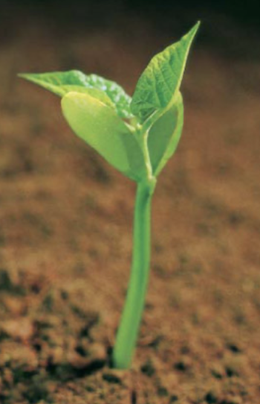
Isaiah 53:2 a,b
For He grew up before Him like a tender shoot, And like a root out of parched ground;
Isaiah comes quickly to the incarnation.
“A tender shoot” indicates God’s special affection for Him. It also indicates physical weakness of becoming human.
Israel was that parched ground - they were a failed and captive nation on spiritual life-support.
Yet “a root” gives hope for life and growth.

Slide 21
Isaiah 53:2 c,d
He has no stately form or majesty That we should look upon Him, Nor appearance that we should be attracted to Him.
What would Israel expect their Messiah to “be like”?
- Kingly? (They tried that with Saul – Mr. Tall, Dark & Handsome)
- Ordinary? Would not draw attention in a crowd
Notice “We” – Isaiah is identifying with the people of Israel
BTW, Isaiah just switched from past tense to present tense. Was Isaiah seeing a vision?

Slide 22
Isaiah 53:3
He was despised and forsaken of men, A man of sorrows and acquainted with grief And like one from whom men hide their face He was despised, and we did not esteem Him.
The English word "despised" carries strong emotional overtones, but its Hebrew source means
- To be considered worthless and unworthy of attention
- He would be hastily dismissed
- They would not give Him a second look.
Multitudes sought out Jesus for His healing and feeding miracles, but they were attracted to Him for selfish reasons, not because of His person. (Constable)
Notes:
This definition of “despised” surprised me. Every translation I could find uses “despised”.
The sense of ‘despise’ is “dismissive, mocking” (Motyer, 428)
Men hide their face from Him – dismissive, no second look
We did not esteem Him - worthless
Notice “a man of sorrows and acquainted with grief” – more on that in the next verse

Slide 23
Isaiah 53:4 a,b
Surely our griefs He Himself bore, And our sorrows He carried;
Connecting back to griefs and sorrows from v3
A man of sorrows and acquainted with grief
Important new information:
- OUR griefs, OUR sorrows
- HE bore them, HE carried them
Jesus is our substitute – bearing our burden
This is starting to sound like a message

Slide 24
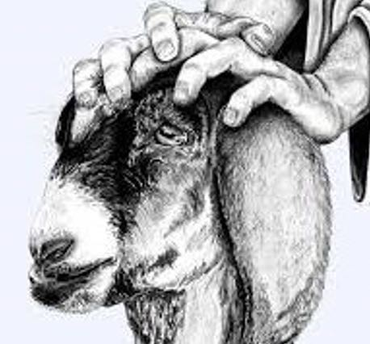
A Substitute
The law formally introduced the practice of substitutionary atonement – that is, sacrificing an animal in my place - for my sin.
- sinner brought animal ‘without blemish’ to sacrifice
- sinner placed his hand on animal’s head transferring his own sin to the animal - then slit it’s throat (See Leviticus 1:2-5)
Object Lesson: The penalty for sin is death (remember Genesis 3)
Notes:
A good deal – for me, not so much for the animal
Point out that in the substitution of an animal, the sinner placed his hand on the head of the animal while the priest slit its throat. (Leviticus 1:2-5, Leviticus 3:2)
² “Speak to the sons of Israel and say to them, ‘When any man of you brings an offering to the Lord, you shall bring your offering of animals from the herd or the flock. ³ ‘If his offering is a burnt offering from the herd, he shall offer it, a male without defect; he shall offer it at the doorway of the tent of meeting, that he may be accepted before the Lord. ⁴ ‘He shall lay his hand on the head of the burnt offering, that it may be accepted for him to make atonement on his behalf. ⁵ ‘He shall slay the young bull before the Lord; and Aaron’s sons the priests shall offer up the blood and sprinkle the blood around on the altar that is at the doorway of the tent of meeting. (Leviticus 1:2–5)
² ‘He shall lay his hand on the head of his offering and slay it at the doorway of the tent of meeting, and Aaron’s sons the priests shall sprinkle the blood around on the altar. (Leviticus 3:2)

Slide 25
Isaiah 53:4 c,d
Yet we ourselves esteemed Him stricken, Smitten of God, and afflicted.
Esteemed is an ‘accounting’ word, a reckoning up of value. When all that the human eye saw and the human mind apprehended was added up the result was zero. (Motyer)
Though He bore our griefs, we did not value Him
“We” thought He was stricken for His own sins –
but actually He was stricken for ours

Slide 26
Isaiah 53:5
But He was pierced through for our transgressions, He was crushed for our iniquities; The chastening for our well-being fell upon Him, And by His scourging we are healed.
Look at those verbs!
- Pierced
- Crushed
- Chastened
- Scourged
Notes:
Meditate on the pain in those verbs, the suffering, the sacrifice
He paid a debt He did not owe.
I owed a debt I could not pay.
The Servant went deeper in his work for us, dealing with our sinful state (5ab), our alienation from God (5c) and our broken personhood (5d) (Motyer, 430)
He is an emphatic pronoun, pointing to the Servant in splendid isolation as he tackles our need (Motyer, 430)
53.5 (Pierced) usually means ‘to pierce fatally’ (Motyer, 430)
53.5 Crushed is used of people being trampled to death, the infliction and enduring of crushing agonies ending in death (Motyer, 430)
53.5 Transgressions is the wilfulness and rebelliousness of sin, the deliberate flouting of the Lord and his law. (Motyer, 430)
53.5 Iniquities reflects the bentness or pervertedness of human nature, the result of the fall and the ever-flowing fount of sin (Motyer, 430)
53.5 (Chastisement) is the punishment necessary to secure or restore our peace with God (Motyer, 430)
53.5 Peace [shalom] … means the ‘peace with God’ whereby we are brought near to him and he is reconciled to us. (Motyer, 430)
"Pierced" and "crushed" describe extreme distress resulting in death (cf. 51:9; Job 26:13; Ps. 109:22; Lam. 3:34). The Hebrew words behind these terms are the strongest ones in that language that describe violent and excruciating death. (Delitzsch referenced in Constable)

Slide 27
The Price Jesus Paid - Isaiah 53:5
Pierced - usually means ‘to pierce fatally’
Crushed - is used of people being trampled to death, the infliction and enduring of crushing agonies ending in death
Chastened - is the punishment necessary to secure or restore our peace with God
Scourged - has the sense “of the actuality of blows inflicted and experienced, lacerations”
Motyer
Notes:
53.5 pierced – nailed to the cross, later pierced with sword proving He was dead
53.5 crushed – by weight of our sin
53.5 chastened – rebukes by Pharisees and Romans
53.5 scourged – by Romans at behest of Jews
53.5 Jesus paid it all – all to Him I owe
53.5 How bad is our sin? A traffic ticket? Look at the cost of our redemption – pierced, crushed, chastened, scourged
This verse is filled with the language of substitution. The Servant suffered not for His own sin, since He was sinless, but as the substitute for sinners. The emphasis here is on Christ being the substitute recipient of God’s wrath on sinners (MacArthur Study Bible)
He would bear away sins so that people could experience healing and well-being (Heb. shalom, the fullness of God's blessing). This is far more than just physical healing; the whole passage is dealing with redemption from sin. (Constable)

Slide 28
The Price Jesus Paid - Isaiah 53:5
But He was pierced through for our transgressions, He was crushed for our iniquities; The chastening for our well-being fell upon Him, And by His scourging we are healed.
Transgressions - willful and rebellious sins
Iniquities - sins that result from the perverted quality of human nature due to the continuing effects of the Fall.
Constable
Notes:
"Offenses" [transgressions] are willful and rebellious sins, and "wrongdoings" [iniquities] are sins that result from the perverted quality of human nature due to the continuing effects of the Fall. (Constable)
The other side of the equation → Our ‘contribution’ – transgressions and iniquities
Iniquities – I can sin almost without trying!
53.5 pierced – nailed to the cross, later pierced with sword proving He was dead
53.5 crushed – by weight of our sin
53.5 chastened – rebukes by Pharisees and Romans
53.5 scourged – by Romans at behest of Jews
53.5 Jesus paid it all – all to Him I owe
53.5 How bad is our sin? A traffic ticket? Look at the cost of our redemption – pierced, crushed, chastened, scourged
This verse is filled with the language of substitution. The Servant suffered not for His own sin, since He was sinless, but as the substitute for sinners. The emphasis here is on Christ being the substitute recipient of God’s wrath on sinners (MSB)
He would bear away sins so that people could experience healing and well-being (Heb. shalom, the fullness of God's blessing). This is far more than just physical healing; the whole passage is dealing with redemption from sin. (CON)

Slide 29
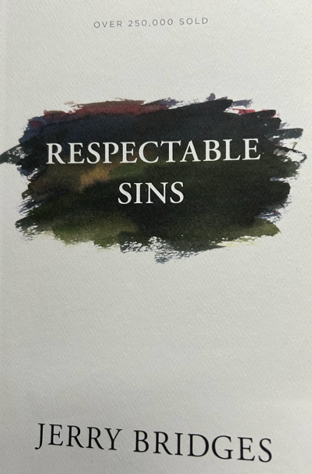
What is Included Here?
Certainly transgressions and iniquities include the “major” sins of our culture – murder, rape, etc.
Also there are many sins listed in the New Testament that we have allowed to become “acceptable” sins even in the church, for example:
Jealousy
Anger
Judgmentalism
Selfishness
Pride
Notes:
The military has “Conduct unbecoming an officer”
The church might want to think of “Conduct unbecoming a Christian”

Slide 30
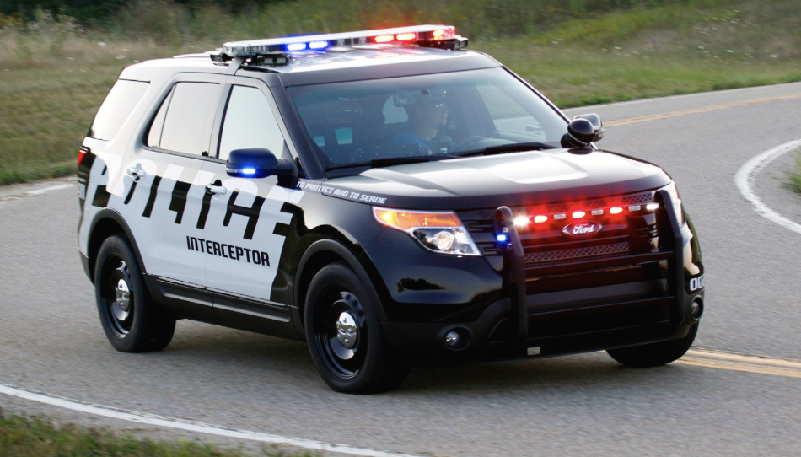
How Bad is Sin?
Like a speeding ticket?
- a violation of the law
- you pay a penalty – if you get caught
- nobody is hurt
- nobody is personally offended
Look at what our sin cost Jesus
- Pierced, Crushed, Chastened, Scourged
Notes:
Sin is not like a speeding ticket. A speeding ticket is a violation of the law, and if one is caught, one pays a penalty. But no one is hurt, assuming you don’t have an accident. Uncle Sam or the State Highway Department isn’t personally offended or hurt by your speeding violation.
Rather, God tells us that sin is more like adultery. It is a betrayal of a relationship. It brings pain. The ones you love the most dearly are the very ones who can hurt you the most deeply. The same is true for our relationship with God. Willful sin in our lives is a rejection of our relationship with him, and it brings pain to God.

Slide 31
What Was The Result of Jesus’ Sacrifice?
Our transgressions and iniquities are FORGIVEN!
¹³ When you were dead in your transgressions and the uncircumcision of your flesh, He made you alive together with Him, having forgiven us all our transgressions, ¹⁴ having canceled out the certificate of debt consisting of decrees against us, which was hostile to us; and He has taken it out of the way, having nailed it to the cross. (Colossians 2:13–14)

Slide 32
And More Good News!
Our well-being = Peace [shalom] … means the ‘peace with God’ whereby we are brought near to Him and He is reconciled to us.
Healed - Isaiah uses ‘healing’ in a total sense: the healing of the person, restoring fulness and completeness
Motyer

Slide 33
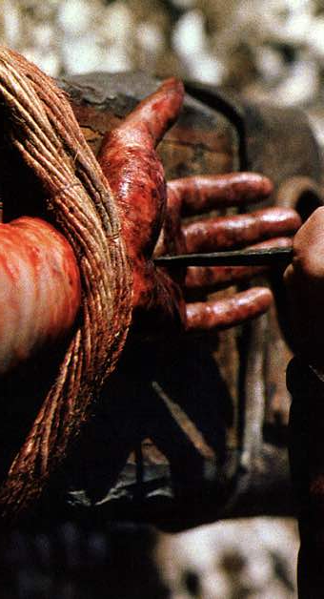
How Much Does Jesus Love You?
This Much!!
Jesus paid it all – all to Him I owe

Slide 34
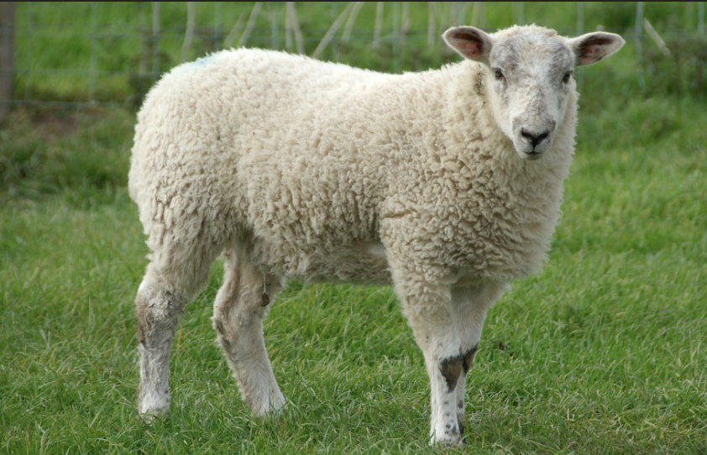
Isaiah 53:6
All of us like sheep have gone astray, Each of us has turned to his own way; But the Lord has caused the iniquity of us all To fall on Him.
Why did Jesus endure all that He did?
- Because we are like sheep – we cannot find our own way
- Because we were burdened with transgressions and iniquities for which we could not atone
- Because we need healing and peace with God
Notes:
A simile now reinforces the point just made. Sheep are notoriously shortsighted; they go after the next clump of grass without regard to where their feet may lead them. They are also self-centered; their only thought is how they can satisfy themselves with no concern for the welfare of other sheep. Consequently sheep often get lost. Humans are the same. (Constable)

Slide 35
Returning to Isaiah 53:1a
Who has believed our message?
What message?
²⁴ and He Himself bore our sins in His body on the cross, so that we might die to sin and live to righteousness; for by His wounds you were healed. ²⁵ For you were continually straying like sheep, but now you have returned to the Shepherd and Guardian of your souls. (1 Peter 2:24–25)
Notes:
This passage from 1 Peter 2 is built on multiple thoughts from Isaiah 53.
What a great summary! What a great message!
I trust that YOU have believed our message
– if not, understanding the message and knowing Him should be priority #1
– and if you do know Him, keep on growing

Slide 36
Our Study of Isaiah
This Meeting:
Isaiah 53:1-6
Memory Verse: Isaiah 53:3-4
Dr. Constable’s Notes, 2023 Ed., pp. 372-380; Motyer, pp. 426-431
Next Meeting:
Isaiah 53:7-12
Memory Verse: Isaiah 53:11
Dr. Constable’s Notes, 2023 Ed., pp. 380-386; Motyer, pp. 432-443
Refreshment Host: Group C

Slide 37
Discussion Questions
Put yourself in the place of Isaiah’s original audience up to Isaiah 52. What did they know about the Messiah? (The Servant Songs will help you here.) What questions about the Messiah would/should they want to have answered? What did they expect Messiah to accomplish?
Verse 53:2 makes it clear that the Messiah would be incarnated as a man, though not with stately form or majesty. Why is His incarnation important?
Verse 53:3 says “He was despised” which means that people tended to dismiss Him as unworthy of their attention. In what ways did this play out in Jesus’ life and ministry?

Slide 38
Discussion Questions p.2
In 53:4, the statement “Our griefs He Himself bore,” points directly to the concept of “substitutionary atonement.” What is the meaning of “substitutionary atonement” and how did Jesus accomplish that?
In the presentation, we spent some time defining terms in Isaiah 53:5 (“He was pierced through … etc.). What strikes you about Jesus’ suffering here?
Verse 53:6 introduces a metaphor saying “All of us like sheep have gone astray.” Why do you think the analogy of sheep is used here and elsewhere in Scripture to describe the redemption story?

Slide 39
Discussion Questions p.3
Almost as a lament, Isaiah 53:1 asked, “Who has believed our message?” What is the message? Why was it important?
Isaiah 53 and surrounding chapters have been called the “Fifth Gospel.” What do you learn from Isaiah 53 that you do not learn from the four New Testament gospels?
How did you find yourself responding to this portion of Scripture—and what will you take with you from it?

Slide 40
Additional Slides

Slide 41
He and We - Isaiah 53:5-6
He
We
Pierced
Crushed
Chastened
Scourged
Our Iniquity on Him
Transgressions
Iniquities
Well-being
Healed
Gone Astray

Slide 42
He and We - Isaiah 53:5-6
Cause
Effect
Our Transgressions
Our Iniquities
He - Chastened
He - Scourged
We – Gone Astray
He - Pierced
He - Crushed
Our Well-being
We - Healed
Our Iniquity on Him

