Slide 1
WELCOME TO THE MOB!
All Scripture is breathed out by God and profitable for teaching, for reproof, for correction, and for training in righteousness, that the man of God may be complete, equipped for every good work.
2 Timothy 3:16-17 (ESV)

Slide 2
Announcements
IBC Easter Concerts
Friday 22 March 7:30pm
Saturday 23 March 3 & 7pm
Sunday 24 March 5pm
MOB Easter break | 26 March - No MOB

Slide 3
Invocation/Prayer
Hymn:
It Is Well With My Soul
Notes:
I prayed that my teaching would change the lives of my students, encourage them, give them more confidence, and help them make an impact on the world. – Jim Plueddemann

Slide 4
It Is Well With My Soul
By Horatio Stafford, Music: Phillip Bliss v1 of 4
When peace like a river attendeth my way, When sorrows like sea billows roll; Whatever my lot, thou hast taught me to say, "It is well, it is well with my soul."
It is well (it is well) with my soul (with my soul); it is well, it is well with my soul.

Slide 5
It Is Well With My Soul
By Horatio Stafford, Music: Phillip Bliss v2 of 4
Though Satan should buffet, though trials should come, Let this blest assurance control: That Christ has regarded my helpless estate, And has shed his own blood for my soul.
It is well (it is well) with my soul (with my soul); it is well, it is well with my soul.

Slide 6
It Is Well With My Soul
By Horatio Stafford, Music: Phillip Bliss v3 of 4
My sin oh, the bliss of this glorious thought! My sin, not in part, but the whole, Is nailed to the cross, and I bear it no more; Praise the Lord, praise the Lord, O my soul!
It is well (it is well) with my soul (with my soul); it is well, it is well with my soul.

Slide 7
It Is Well With My Soul
By Horatio Stafford, Music: Phillip Bliss v4 of 4
O Lord, haste the day when my faith shall be sight, The clouds be rolled back as a scroll; The trump shall resound and the Lord shall descend; Even so, it is well with my soul.
It is well (it is well) with my soul (with my soul); it is well, it is well with my soul.

Slide 8
Memory Verse
Isaiah 57:20 (ESV)
But the wicked are like the tossing sea; for it cannot be quiet, and its waters toss up mire and dirt.

Slide 9
Our Study of Isaiah
Last Meeting:
Isaiah 56 | Blessings for All Nations; Israel’s Sinful Leaders
Memory Verse: Isaiah 56:7
Dr. Constable’s Notes, 2023 Ed., pp. 401-408; Motyer, pp. 459-469
Refreshment Host: F
Tonight:
Isaiah 57 | Israel’s Futile Idolatry; Comfort for the Contrite
Memory Verse: Isaiah 57:20
Dr. Constable’s Notes, 2023 Ed., pp. 408-415; Motyer, pp. 469-478
Refreshment Host: G

Slide 10
Isaiah Outline
Focus | Prophecies of Condemnation |  |  |  |  |  |  |  | Historical Parenthesis |  | Prophecies of Comfort
 | 1:1 |  |  |  |  |  |  | 35:10 | 36:1 | 39:8 | 40:1 |  |  |  |  |  | 66:24
Divisions | Prophecies Against Judah |  | Prophecies Against the Nation |  | Prophesies Against the Day of the Lord |  | Prophesies of Judgement and Blessing |  | Sickness and Sin | Hezekiah’s Salvation | Israel’s Deliverance |  |  | Israel’s Deliverer |  | Israel’s Glorious Future
 | 1:1 | 12:6 | 13:1 | 23:18 | 24:1 | 27:13 | 28:1 | 35:10 | 36:1 | 39:8 | 40:1 | 48:22 |  | 49:1 | 57:21 | 58:1 | 66:24
Topics | Prophetic |  |  |  |  |  |  |  | Historic |  | Messianic
 | Judgement |  |  |  |  |  |  |  | Transition |  | Hope
Place | Israel & Judah
Time | 740 - 680 B.C.
We are here!
Bruce Wilkinson and Kenneth Boa, Talk Thru the Bible (Nashville: T. Nelson, 1983), 189.

Slide 11
Peace No-Peace
Righteous Wicked
Deeds
Relationship with God
Ultimate end
It is your choice! But choose wisely.
Notes:
Peace/no peace is the theme that Isaiah develops here
This is a passage of contrasts, thus the arrows
Righteousness leads to peace with God
Rebellion, self-will – no deliverance
Watch for the contrasts – in thoughts, actions, results

Slide 12
Peace No-Peace
Remember
⁸ “For My thoughts are not your thoughts, Nor are your ways My ways,” declares the Lord. ⁹ “For as the heavens are higher than the earth, So are My ways higher than your ways And My thoughts than your thoughts. (Isaiah 55:8–9)
Unless otherwise noted, all Scripture quotations are from NASB95
Notes:
Let’s explore more of God’s ways and thoughts

Slide 13
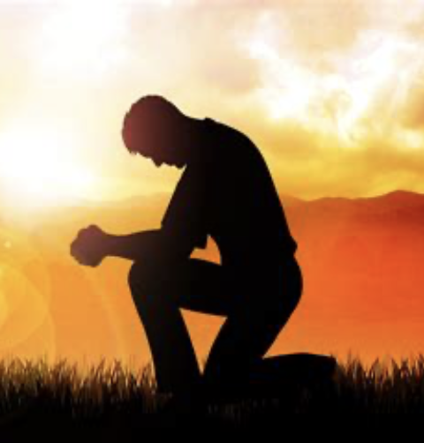
Isaiah 57:1-2 The Righteous Man
¹ The righteous man perishes, and no man takes it to heart; And devout men are taken away, while no one understands.
For the righteous man is taken away from evil, ² He enters into peace; They rest in their beds, Each one who walked in his upright way.
Notes:
This is a curious statement – something we might not expect as we look around our world
There are righteous/devout/upright men
God takes the righteous away from the evil of this world
God takes them into His peace
He can have true rest beds = grave
The righteous is not ‘perishing’ but entering peace; the ‘gathering’ is not purposeless but is a mercy extended to such as would find the burden of coming trouble more than they could bear. (Motyer)
In contrast to the evil leaders, who were engaged in debauchery and self-indulgence [56:9-12], were the righteous who were removed from impending divine judgments. The righteous do suffer by oppression and distress at what is going on around them, but they die in faith and enjoy their eternal reward. (MacArthur)

Slide 14
Peace - Shalom
Shalom =
wholeness, unity, and harmony
fulfillment that comes to human beings when they experience God’s presence
(Richards, Expository Dictionary of Bible Words)

Slide 15
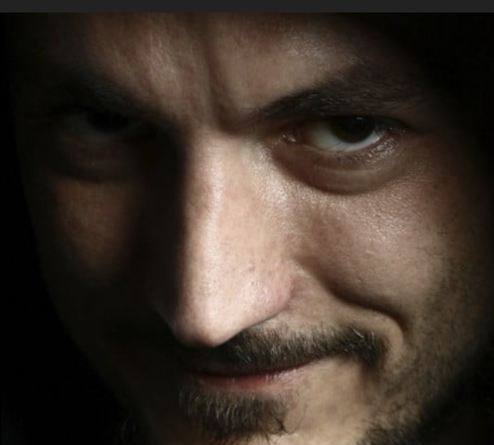
Isaiah 57:3 Listen Up!
³ “But come here,
you sons of a sorceress, Offspring of an adulterer and a prostitute.
A command to come before YHWH.
God calls them sons of a sorceress, offspring of an adulterer and a prostitute.
Not necessarily referring to their physical heritage but to their spiritual choices, to the lifestyles they choose to follow as if they were emulating parents.
Notes:
Speaker - God
Audience – People of Isaiah’s day
(but later generations including ours get to listen in)
God is about to elaborate on the evil actions of these ‘sons’ – we will skim through to get the idea,
This is like a review – we have heard all of this before in Isaiah
- there is no need to drill down into a swamp again
Alas, sinful nation, People weighed down with iniquity, Offspring of evildoers, Sons who act corruptly! They have abandoned the Lord, They have despised the Holy One of Israel, They have turned away from Him. (Isaiah 1:4)

Slide 16
Isaiah 57:4-6
⁴ “Against whom do you jest? Against whom do you open wide your mouth And stick out your tongue? Are you not children of rebellion, Offspring of deceit, ⁵ Who inflame yourselves among the oaks, Under every luxuriant tree, Who slaughter the children in the ravines, Under the clefts of the crags? ⁶ “Among the smooth stones of the ravine Is your portion, they are your lot; Even to them you have poured out a drink offering, You have made a grain offering.
Shall I relent concerning these things?
Notes:
God interjects His comment here

Slide 17
Isaiah 57:7-8
⁷ “Upon a high and lofty mountain You have made your bed. You also went up there to offer sacrifice. ⁸ “Behind the door and the doorpost You have set up your sign; Indeed, far removed from Me, you have uncovered yourself, And have gone up and made your bed wide. And you have made an agreement for yourself with them, You have loved their bed, You have looked on their manhood.
Notes:
The prostitute …

Slide 18
Isaiah 57:7-10
⁹ “You have journeyed to the king with oil And increased your perfumes; You have sent your envoys a great distance And made them go down to Sheol. ¹⁰ “You were tired out by the length of your road, Yet you did not say, ‘It is hopeless.’ You found renewed strength, Therefore you did not faint.
Notes:
The nation as a prostitute

Slide 19
The Background
We have here two aspects of Canaanite cults. First, the fertility cult, associated with the evergreen tree as a symbol of life and expressed in orgiastic rites.
Secondly, there is the cult of Molech with its demand for human sacrifice. There may be a deliberate contrast here between cults of life (fertility) and cults of death (human sacrifice) as summarizing the total range of hateful affronts to the Lord.
(Motyer)

Slide 20
Isaiah 57:3-10 Summary of Their Deeds
Sorcery
Adultery
Prostitution
Rebellion
Deceit
Child sacrifice
Idol worship
The nation prostituted with foreign kings
Notes:
People today aren’t thinking about Canaanite cults as excuses for their sins.
But some of our deeds are almost identical. Or we invent our own alternatives

Slide 21
Isaiah 57:11a
¹¹ “Of whom were you worried and fearful When you lied, and did not remember Me Nor give Me a thought?
The fear of man brings a snare, But he who trusts in the Lord will be exalted. (Proverbs 29:25)
Notes:
God comments again
“What were you thinking?”
“Who made you so fearful?”
“What worried you so much?”
The key issue - did not remember Me Nor give Me a thought
View of man ← → View of God
An issue of focus, of relative importance as reflected in their actions

Slide 22
Fear – cont’d
Remember
“I, even I, am He who comforts you. Who are you
that you are afraid of man who dies And of the son of man who is made like grass,
¹³ That you have forgotten the Lord your Maker, Who stretched out the heavens And laid the foundations of the earth.
(Isaiah 51:12–13a)
Notes:
View of man ← → View of God
Isaiah has said this before

Slide 23
Isaiah 57:11b-13
Was I not silent even for a long time So you do not fear Me? ¹² “I will declare your righteousness and your deeds, But they will not profit you.
¹³ “When you cry out, let your collection of idols deliver you. But the wind will carry all of them up, And a breath will take them away.
But he who takes refuge in Me will inherit the land And will possess My holy mountain.”
Notes:
Back to our passage
Israel has only a sham righteousness. Judgment is coming – and you won’t like it.
If you have a complaint about it, take it to your idols since you did not remember Me or give Me a thought
You will find that your idols have no substance - poof!
It’s your choice – poof! Or My inheritance

Slide 24
Application: Your Refuge?
Where will you turn in times of trouble ???
Idols God
* No substance * Inherit the Promised Land
* Smoke & mirrors * Possess His holy mountain
* Poof!

Slide 25
Idols – Do You Have Them?
One of the best ways to find out whether we have idols in our lives is to ask ourselves, 'Where do I instinctively turn when I face a decision or need to solve a problem?' Do we reach for the phone to call a friend? Do we assure ourselves that we can handle the situation ourselves? Or do we turn to God to see His will and receive His help?
(Wiersbe)

Slide 26
Refuge - Isaiah 57:14-15
“Refuge in Me” continues
¹⁴ And it will be said, “Build up, build up, prepare the way, Remove every obstacle out of the way of My people.”
¹⁵ For thus says the high and exalted One Who lives forever, whose name is Holy, “I dwell on a high and holy place, And also with the contrite and lowly of spirit In order to revive the spirit of the lowly And to revive the heart of the contrite.
Notes:
Clear the way! My people are coming to Me for refuge. My people will receive My inheritance.
Who can take refuge in Me? The contrite and lowly

Slide 27
Isaiah 57:16-17
¹⁶ “For I will not contend forever, Nor will I always be angry; For the spirit would grow faint before Me, And the breath of those whom I have made. ¹⁷ “Because of the iniquity of his unjust gain I was angry and struck him; I hid My face and was angry, And he went on turning away, in the way of his heart.
Notes:
Obviously the contrite and lowly were still sinners
So how do they get pst their sin?

Slide 28
Isaiah 57:18-19
¹⁸ “I have seen his ways, but I will heal him; I will lead him and restore comfort to him and to his mourners, ¹⁹ Creating the praise of the lips.
Peace, peace to him who is far and to him who is near,” Says the Lord, “and I will heal him.”
Notes:
Still talking about the contrite and lowly – who were sinners too
By grace, God will heal
Blessed are those who mourn, for they shall be comforted. (Matthew 5:4)
Does this sound like the story of the prodigal son? It should
Grace - But I will heal him - This is an amazing statement! What a reversal! What a hope! PTL! God is making this choice in spite of all the reasons not to do so, though He is very aware of those reasons

Slide 29
Isaiah 57:20-21
²⁰ But the wicked are like the tossing sea, For it cannot be quiet, And its waters toss up refuse and mud.
²¹ “There is no peace,” says my God, “for the wicked.”
Notes:
A final contrast

Slide 30
Shalom, Shalom
The Hebrew word for “peace” is shalom. It is derived from a root that conveys the image of wholeness, unity, and harmony – something that is complete and sound.
Although “peace” is essentially a relational concept in the OT, it also conveys the idea of prosperity, health, and fulfillment.… fulfillment that comes to human beings when they experience God’s presence.
Richards, Expository Dictionary of Bible Words
Notes:
“Shalom” is the key word for this chapter
let’s explore it a little more

Slide 31
The Cost of Shalom
Christ paid a high price so that you and I can have peace with God:
But he was pierced for our transgressions; he was crushed for our iniquities; upon him was the chastisement that brought us peace, and with his wounds we are healed.
(Isaiah 53:5, ESV)

Slide 32
Peace in the New Testament
“Peace I leave with you; My peace I give to you; not as the world gives do I give to you. Do not let your heart be troubled, nor let it be fearful. (John 14:27)
“These things I have spoken to you, so that in Me you may have peace. In the world you have tribulation, but take courage; I have overcome the world.” (John 16:33)

Slide 33
Peace in the New Testament p.2
Therefore, having been justified by faith, we have peace with God through our Lord Jesus Christ (Romans 5:1)
¹⁹ For it was the Father’s good pleasure for all the fullness to dwell in Him, ²⁰ and through Him to reconcile all things to Himself, having made peace through the blood of His cross; through Him, I say, whether things on earth or things in heaven. (Colossians 1:19–20)

Slide 34
Experiencing God’s Peace
The story of tonight’s hymn – “It Is Well With My Soul”
I pray that you know God’s peace. I pray it is well with your soul. If not, ask about it in your small group!

Slide 35
Next Week
415-421 | 478-484
415-421 | 478-484
415-421 | 478-484
Tonight:
Isaiah 57 | Israel’s Futile Idolatry; Comfort for the Contrite
Memory Verse: Isaiah 57:20
Dr. Constable’s Notes, 2023 Ed., pp. 408-415; Motyer, pp. 469-478
Next Week:
Isaiah 58 | Righteousness and Ritual
Memory Verse: Isaiah 58:5
Dr. Constable’s Notes, 2023 Ed., pp. 415-421; Motyer, pp. 478-484
Refreshment Host: H

Slide 36
Discussion Questions
Verse 2 mentions “peace” (“shalom” in Hebrew.) What is the meaning of “shalom”? Why is it desirable?
In contrast to the righteous man, verses 3-13 provides a laundry list of rebellious deeds and attitudes. What are some of them? What kind of rebellious deeds do people practice today?
In verse 11, God asks a key question “Of whom were you worried and fearful when you lied, and did not remember Me Nor give Me a thought?” Who has power over you to cause worry, fear, and ignoring God? What can you do about it?

Slide 37
Discussion Questions p.2
Verse 12 says the deeds and righteousness of the rebellious people will be judged and found wanting. How do we cultivate true righteousness and godly deeds that will be of true profit?
Verse 13 points to the inheritance available for those who take refuge in God. What is that inheritance? How would you know that you are taking refuge in God?
In verse 15, how can God, “the exalted One Who lives forever,” who dwells in a “high and holy place” also dwell with the contrite and lowly?

Slide 38
Discussion Questions p.3
Verse 18 promises God’s healing. What is included in God’s healing? Do you look to God for healing, even in the midst of all of life’s challenges?
What do verses 18-19 tell us about God’s peace?
What is the difference between people who receive “Peace, peace” and those who have “no peace”? How can you make sure that you are on the right side of that?
Have you experienced and/or witnessed this kind of peace/lack of peace

