Slide 1
WELCOME TO THE MOB!
All Scripture is breathed out by God and profitable for teaching, for reproof, for correction, and for training in righteousness, that the man of God may be complete, equipped for every good work.
2 Timothy 3:16-17 (ESV)

Slide 2
Announcements
MOB Website & Resources: www.ibcmob.net
IBCHS Baseball Coaching Position

Slide 3
Invocation/Prayer
Hymn:
Behold Our God
Notes:
I prayed that my teaching would change the lives of my students, encourage them, give them more confidence, and help them make an impact on the world. – Jim Plueddemann

Slide 4
Behold Our God
1 of 6
Who has held the oceans in His hands
Who has numbered every grain of sand
Kings and nations tremble at His voice
All creation rises to rejoice

Slide 5
Behold Our God
2 of 6
Behold our God seated on His throne
Come let us adore Him
Behold our King nothing can compare
Come let us adore Him

Slide 6
Behold Our God
3 of 6
Who has given counsel to the Lord
Who can question any of His words
Who can teach the One who knows all things
Who can fathom all His wondrous deeds

Slide 7
Behold Our God
4 of 6
Behold our God seated on His throne
Come let us adore Him
Behold our King nothing can compare
Come let us adore Him

Slide 8
Behold Our God
5 of 6
Who has felt the nails upon His hands
Bearing all the guilt of sinful man
God eternal humbled to the grave
Jesus Savior risen now to reign

Slide 9
Behold Our God
6 of 6
Behold our God seated on His throne
Come let us adore Him
Behold our King nothing can compare
Come let us adore Him

Slide 10
Memory Verse
Isaiah 60:12 (ESV)
For the nation and kingdom that will not serve you shall perish; those nations shall be utterly laid waste.

Slide 11
Our Study of Isaiah
Last Meeting:
Isaiah 59
Memory Verse: Isaiah 59:1-2
Dr. Constable’s Notes, 2023 Ed., pp. 421-428; Motyer, pp. 484-493
This Meeting:
Isaiah 60
Memory Verse: Isaiah 60:12
Dr. Constable’s Notes, 2023 Ed., pp. 428-435; Motyer, pp. 493-499
Refreshment Host: Group B

Slide 12
Isaiah Outline
Focus | Prophecies of Condemnation |  |  |  |  |  |  |  | Historical Parenthesis |  | Prophecies of Comfort
 | 1:1 |  |  |  |  |  |  | 35:10 | 36:1 | 39:8 | 40:1 |  |  |  |  |  | 66:24
Divisions | Prophecies Against Judah |  | Prophecies Against the Nation |  | Prophesies Against the Day of the Lord |  | Prophesies of Judgement and Blessing |  | Sickness and Sin | Hezekiah’s Salvation | Israel’s Deliverance |  |  | Israel’s Deliverer |  | Israel’s Glorious Future
 | 1:1 | 12:6 | 13:1 | 23:18 | 24:1 | 27:13 | 28:1 | 35:10 | 36:1 | 39:8 | 40:1 | 48:22 |  | 49:1 | 57:21 | 58:1 | 66:24
Topics | Prophetic |  |  |  |  |  |  |  | Historic |  | Messianic
 | Judgement |  |  |  |  |  |  |  | Transition |  | Hope
Place | Israel & Judah
Time | 740 - 680 B.C.
We are here!
Bruce Wilkinson and Kenneth Boa, Talk Thru the Bible (Nashville: T. Nelson, 1983), 189.

Slide 13
Themes in Chapters 60-62
God will save Israel.
God will give Israel light.
God will share His glory with Israel.
Israel will draw the nations to God.
The nations will bring the Israelites back to Zion.
The nations will bring their wealth to Zion.
God will exalt Israel over the nations.
Israel will experience and exemplify God’s righteousness.
- Constable (referencing Oswalt)

Slide 14
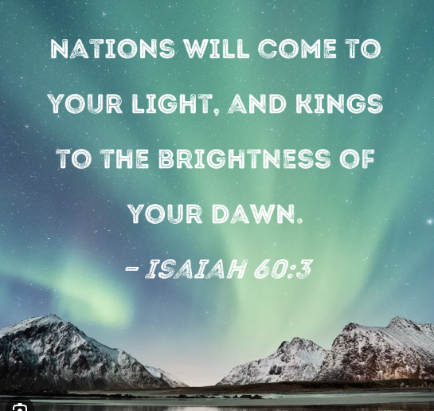
Introduction

Slide 15
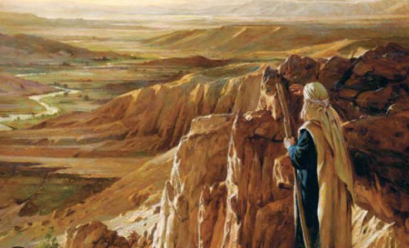
Abrahamic Covenant
…the poem centres on the Abrahamic covenant theme that those who bless him will be blessed and those that curse him will be cursed
- Motyer

Slide 16
Abrahamic Covenant
Genesis 12:3
I will bless those who bless you, and him who dishonors you I will curse, and in you all the families of the earth shall be blessed.”

Slide 17
Abrahamic Covenant
Genesis 12:3
I will bless those who bless you, and him who dishonors you I will curse, and in you all the families of the earth shall be blessed.”

Slide 18
Isaiah 60:1-5
¹Arise, shine, for your light has come, and the glory of the Lord has risen upon you. ²For behold, darkness shall cover the earth, and thick darkness the peoples; but the Lord will arise upon you, and his glory will be seen upon you. ³And nations shall come to your light, and kings to the brightness of your rising.
⁴Lift up your eyes all around, and see; they all gather together, they come to you; your sons shall come from afar, and your daughters shall be carried on the hip. ⁵Then you shall see and be radiant; your heart shall thrill and exult, because the abundance of the sea shall be turned to you, the wealth of the nations shall come to you.
Light to the nations – God had repeatedly called them to be a light to the nations. Now Israel will shine with a light that is not her own.
Verse 3 – Nations shall come….kings to the brightness…
Motyer notes “Nations and kings, the two aspects of organized life – the ruled and the rulers, signify total response.
Worldwide re-gathering
Gifts – Constable - ‘The gifts are really in praise of the LORD, not to gain Israel’s favor, or to repay her for her sufferings, or because she is a superior race.’

Slide 19
Isaiah 60:6-9
⁶A multitude of camels shall cover you, the young camels of Midian and Ephah; all those from Sheba shall come. They shall bring gold and frankincense, and shall bring good news, the praises of the Lord.
⁷All the flocks of Kedar shall be gathered to you; the rams of Nebaioth shall minister to you; they shall come up with acceptance on my altar, and I will beautify my beautiful house.
⁸Who are these that fly like a cloud, and like doves to their windows?
⁹For the coastlands shall hope for me, the ships of Tarshish first, to bring your children from afar, their silver and gold with them, for the name of the Lord your God, and for the Holy One of Israel, because he has made you beautiful.
Why list the countries of Midian, Ephah, Kedar, and Nebaioth?
Verse 6 – what is missing in the list of gifts?
…coastlands shall hope for me, the ships of Tarshish…
“acceptance on my altar”?

Slide 20
Isaiah 60:10-14
¹⁰Foreigners shall build up your walls, and their kings shall minister to you; for in my wrath I struck you, but in my favor I have had mercy on you. ¹¹Your gates shall be open continually; day and night they shall not be shut, that people may bring to you the wealth of the nations, with their kings led in procession. ¹²For the nation and kingdom that will not serve you shall perish; those nations shall be utterly laid waste. ¹³The glory of Lebanon shall come to you, the cypress, the plane, and the pine, to beautify the place of my sanctuary, and I will make the place of my feet glorious. ¹⁴The sons of those who afflicted you shall come bending low to you, and all who despised you shall bow down at your feet; they shall call you the City of the Lord, the Zion of the Holy One of Israel.
Verse 10: Wrath ➔ Mercy
Verse 14: Afflicted/despised you ➔ Bending low/bow down
Gates continually open – why?

Slide 21
Isaiah 60:15-18
¹⁵Whereas you have been forsaken and hated, with no one passing through, I will make you majestic forever, a joy from age to age. ¹⁶You shall suck the milk of nations; you shall nurse at the breast of kings; and you shall know that I, the Lord, am your Savior and your Redeemer, the Mighty One of Jacob. ¹⁷Instead of bronze I will bring gold, and instead of iron I will bring silver; instead of wood, bronze, instead of stones, iron. I will make your overseers peace and your taskmasters righteousness. ¹⁸Violence shall no more be heard in your land, devastation or destruction within your borders; you shall call your walls Salvation, and your gates Praise.
Verse 15: Forsaken and hated ➔ Majestic forever
Verse 18: Warfare ➔ Violence shall no more be heard
Peace and righteousness

Slide 22
Peace at Last!!
1948 – Israel officially declared an independent state
1948 – Arab-Israeli War - Egypt, Jordan, Iraq, Syria, and Lebanon attack
1956 – Suez Crisis – Egypt overtook the Suez Canal
1967 – Six-Day War – War with Egypt, Jordan, and Syria
1973 – Yom Kippur War – Egypt and Syria launched air strikes
1982 – Lebanon War – Israel invaded Lebanon and ejected the PLO
1987 – First Palestinian Intifada – Palestinian uprising
2000 – Second Palestinian Intifada - Palestinians launched suicide bombs and other attacks
2006 – Second Lebanon War – Israel went to war with Hezbollah – Shiite Islamic militant group
2008, 2012, 2014, 2021, 2023 – Hamas Wars

Slide 23
Poetic Structure
The new status of the nations: materially and spiritually accepted by the Lord (6-7)
World expectations met in the Lord (8-9)
The serving nations: the Lord’s compassion to Zion (10-11)
Zion, the key to the world destiny (12)
The submissive nations: their recognition of Zion (13-14)
Zion’s needs met by the Lord (15-16)
The transformation of Zion, materially and spiritually (17-18b)
- Motyer

Slide 24
Isaiah 60:19-22
¹⁹The sun shall be no more your light by day, nor for brightness shall the moon give you light; but the Lord will be your everlasting light, and your God will be your glory. ²⁰Your sun shall no more go down, nor your moon withdraw itself; for the Lord will be your everlasting light, and your days of mourning shall be ended. ²¹Your people shall all be righteous; they shall possess the land forever, the branch of my planting, the work of my hands, that I might be glorified. ²²The least one shall become a clan, and the smallest one a mighty nation; I am the Lord; in its time I will hasten it.
v 21: Your people shall all be righteous

Slide 25
Revelation 21:23-25
²³ And the city has no need of sun or moon to shine on it, for the glory of God gives it light, and its lamp is the Lamb.
²⁴ By its light will the nations walk, and the kings of the earth will bring their glory into it,
²⁵ and its gates will never be shut by day—and there will be no night there.

Slide 26
Recap of What God Has Done
“I will beautify my house”
Gifts being brought “for the name of the LORD…because he has made you beautiful”
“I have had mercy on you”
“I will make the place of my feet glorious”
“I will make you majestic forever”
“I will make your overseers peace and your taskmasters righteousness
Righteousness and security of land come – from “the branch of my planting, the work of my hands, that I might be glorified”
I am the LORD; in its time I will hasten it.

Slide 27
Contrasts
God’s glory dominates rather than His discipline
Constant warfare ends and never-ending peace is ushered in
Affliction from enemies turns to nations honoring Israel
Possession of the land…FOREVER
Idolatry, corruption, and rampant sin ends – gives way to righteousness (v 21 – “Your people shall all be righteous”)

Slide 28
Conclusion
New Life through the Servant’s Sacrifice

Slide 29
Our Study of Isaiah
This Meeting:
Isaiah 60
Memory Verse: Isaiah 60:12
Dr. Constable’s Notes, 2023 Ed., pp. 428-435; Motyer, pp. 493-499
Next Meeting:
Isaiah 61
Memory Verse: Isaiah 61:1-2
Dr. Constable’s Notes, 2023 Ed., pp. 435-440; Motyer, pp. 499-505
Refreshment Host: Group C

Slide 30
Discussion Questions
Why does Isaiah begin this chapter with a call for Israel to “rise and shine”?
What “big thing” has occurred that changes everything as we move from Isaiah 59 to Isaiah 60?
What’s your understanding of when the events prophesied in this passage will take place, in the overall scheme of “things to come”?
Who does Isaiah say will be “gathered together,” and allowed to enter into the earthly kingdom pictured in this text?
How will nations that previously oppressed Israel treat them during this time, and what will bring about their change of heart?
What role will the “ships of Tarshish” play in the process?
Who was, and will be, involved in building the walls

Slide 31
Discussion Questions
What does Isaiah will be the fate of the nations that don’t serve the Lord?
Why will the gates to the city “be open continually”?
What do you know about Kedar and Nebaioth, and how will they be involved--and why are they included in this passage?
Why would animal sacrifices be offered in the millennial kingdom?
How does Isaiah describe the future city of Jerusalem, and how does it compare with what’s pictured in Revelation 21-22?
How will the “glory” of the Lord be revealed during this time?
How will Isaiah’s prophecy in this chapter fulfill God’s covenant with Abraham?
What’s your main take-away from this lesson?

