Slide 1
WELCOME TO THE MOB!
All Scripture is breathed out by God and profitable for teaching, for reproof, for correction, and for training in righteousness, that the man of God may be complete, equipped for every good work.
2 Timothy 3:16-17 (ESV)

Slide 2
Announcements
Welcome to the MOB!
Assist Pregnancy Center Walk/Run/Ride – Saturday, May 13, sign up at:
-- https://runsignup.com/WRRforLife

Slide 3
Invocation/Prayer

Slide 4
Memory Verse
Isaiah 35:8 (NASB)
A highway will be there, a roadway,
And it will be called the Highway of Holiness. The unclean will not travel on it,
But it will be for him who walks that way,
And fools will not wander on it.
Unless otherwise noted, all Scripture quotations are from NASB95

Slide 5
Hymn:
“Redeemed, How I Love to Proclaim It!”

Slide 6
Why “Redeemed!”
“Redeemed” seems so New Testament – and it is. (More on that later.)
Yet “redeemed” is what God has been about in the whole Old Testament since Genesis 3
Isaiah 35:9-10, redeemed, is the climax of Chapters 1-35

Slide 7
Redeemed People!
Isaiah 35:9b-10
But the redeemed will walk there, ¹⁰ And the ransomed of the Lord will return And come with joyful shouting to Zion, With everlasting joy upon their heads. They will find gladness and joy, And sorrow and sighing will flee away.
Notes:
35.9b “there” = the Highway of Holiness introduced in v8
(Re 35.9-10) ²⁷ Zion will be redeemed with justice And her repentant ones with righteousness. (Isaiah 1:27)
(Re 35.10) ³ And I heard a loud voice from the throne, saying, “Behold, the tabernacle of God is among men, and He will dwell among them, and they shall be His people, and God Himself will be among them, ⁴ and He will wipe away every tear from their eyes; and there will no longer be any death; there will no longer be any mourning, or crying, or pain; the first things have passed away.” (Revelation 21:3–4)
The same new life which will renew nature, will also flow into God’s people (JAM)

Slide 8
Redeemed, How I Love to Proclaim It!”
By Fanny Crosby, Verse 1 of 3
Redeemed, how I love to proclaim it! Redeemed by the blood of the Lamb; Redeemed through His infinite mercy, His child and forever I am.
Refrain
Redeemed, redeemed, Redeemed by the blood of the Lamb; Redeemed, redeemed, His child and forever I am.
Notes:
Redeemed, How I Love to Proclaim It!
(Words: Fanny Crosby, Music: William Kirkpatrick)

Slide 9
Redeemed, How I Love to Proclaim It!”
By Fanny Crosby, Verse 2 of 3
Redeemed, and so happy in Jesus, No language my rapture can tell; I know that the light of His presence With me doth continually dwell.
Refrain
Redeemed, redeemed, Redeemed by the blood of the Lamb; Redeemed, redeemed, His child and forever I am.
Notes:
Redeemed, How I Love to Proclaim It!
(Words: Fanny Crosby, Music: William Kirkpatrick)

Slide 10
Redeemed, How I Love to Proclaim It!”
By Fanny Crosby, Verse 3 of 3
I think of my blessèd Redeemer, I think of Him all the day long: I sing, for I cannot be silent; His love is the theme of my song.
Refrain
Redeemed, redeemed, Redeemed by the blood of the Lamb; Redeemed, redeemed, His child and forever I am.
Notes:
Redeemed, How I Love to Proclaim It!
(Words: Fanny Crosby, Music: William Kirkpatrick)

Slide 11
Our Study of Isaiah
Last Meeting:
Isaiah 34, Judgment On The Nations
Memory Verse: Isaiah 34:16
Dr. Constable’s Notes, 2022 Ed., pp.218-223; Motyer, pp.268-272.
This Meeting:
Isaiah 35, The Ransomed Shall Return
Memory Verse: Isaiah 35:8
Dr. Constable’s Notes, 2022 Ed., pp.223-227; Motyer, pp.272-275.
Refreshment Host: A

Slide 12
Isaiah Outline
Focus | Prophecies of Condemnation |  |  |  |  |  |  |  | Historical Parenthesis |  | Prophecies of Comfort
 | 1:1 |  |  |  |  |  |  | 35:10 | 36:1 | 39:8 | 40:1 |  |  |  |  |  | 66:24
Divisions | Prophecies Against Judah |  | Prophecies Against the Nation |  | Prophesies Against the Day of the Lord |  | Prophesies of Judgement and Blessing |  | Sickness and Sin | Hezekiah’s Salvation | Israel’s Deliverance |  |  | Israel’s Deliverer |  | Israel’s Glorious Future
 | 1:1 | 12:6 | 13:1 | 23:18 | 24:1 | 27:13 | 28:1 | 35:10 | 36:1 | 39:8 | 40:1 | 48:22 |  | 49:1 | 57:21 | 58:1 | 66:24
Topics | Prophetic |  |  |  |  |  |  |  | Historic |  | Messianic
 | Judgment |  |  |  |  |  |  |  | Transition |  | Hope
Place | Israel & Judah
Time | 740 - 680 B.C.
Bruce Wilkinson and Kenneth Boa, Talk Thru the Bible (Nashville: T. Nelson, 1983), 189.
Notes:
Tonight we will complete the current section, Isaiah 28-35 – Prophecies of Judgment and Blessing
That means we will also complete the first major portion of Isaiah, chapters 1-35 – Prophecies of Condemnation
Next week we will move to a historical section, something very unusual in books of prophecy. There we will see how some of Isaiah’s prophecies played out in the history of Judah.

Slide 13
Context – Isaiah 34
YHWH’s indignation is against all the nations vv.1-4
The sword of the Lord will judge Edom and others vv.5-7
YHWH has a day of vengeance on behalf of Zion vv.8-15
YHWH Himself authenticates this coming judgment vv.16-17
Notes:
Since we have taken a week off, just a reminder of where we were when Joel spoke two weeks ago.
Notice all the words for YHWH’s judgment – indignation, judge, vengeance
Understand that Edom is mentioned here, not as the only nation to be judged, but as an example of what will happen to each of the nations when God judges.

Slide 14
Drilling Down – Isaiah 34
⁹ Its streams will be turned into pitch,
And its loose earth into brimstone,
And its land will become burning pitch.
¹⁰ It will not be quenched night or day;
Its smoke will go up forever.
From generation to generation it will be desolate;
None will pass through it forever and ever.
The Tribulation
Notes:
“Pitch” = a black tar substance
This passage describes the result of the Tribulation – not a place you want to live (fortunately Christians will not be there)

Slide 15
Isaiah 35 Outline
1. The Desert Will Bloom
2. Be strong, do not fear
People vv.3-6a
Nature
vv.1-2
3.
Redeemed!
The Millennium
vv.6b-10
Notes:
CONTRAST !!
God’s objective and climax for Israel are seen in chapter 35 – both in the land and the people.
This is the state that mankind constantly longs for—a utopia in which peace and fertility prevail. This condition will not come, however, till after God’s judgment on the world (chap. 34) (Bible Knowledge Commentary)

Slide 16
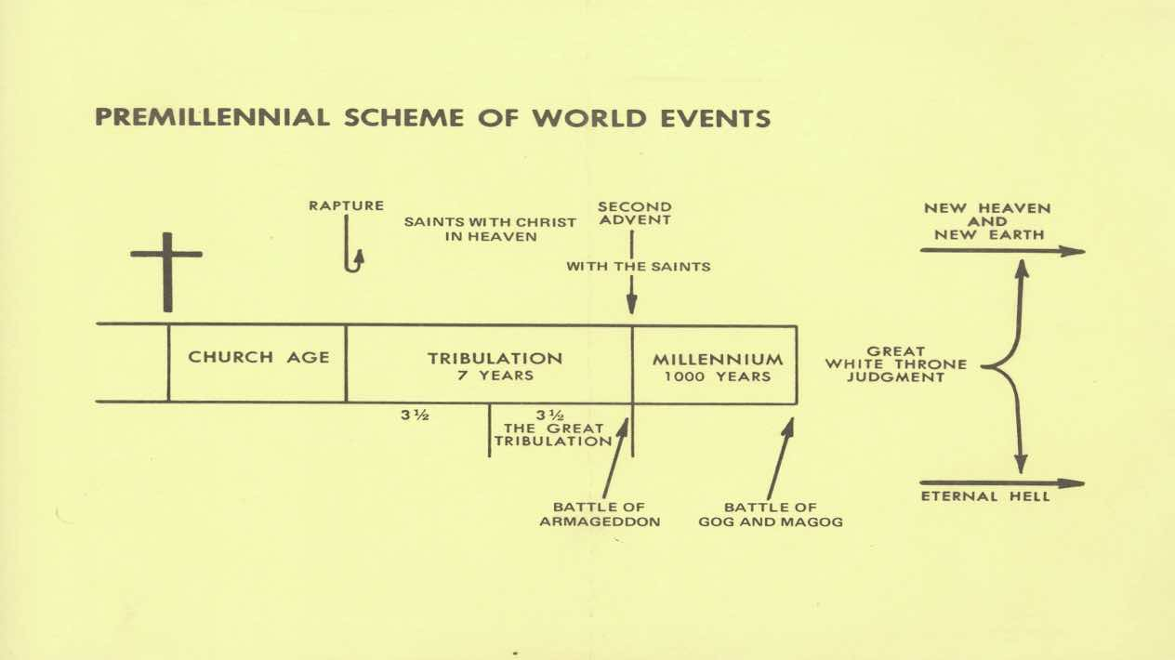
OT Covenants
Abraham Moses David
You Are Here
Revelation
2-3
6-19
20
21-22
Isaiah – Rough Fit
24, 34
25-27, 35
Notes:
This slide presents the pre-millennial, pre-tribulation understanding of future events. That means the rapture occurs before both the tribulation and the millennium.
They actually build on God’s major Old Testament covenants with Abraham, Moses, and David. While Christ fulfilled the Law of Moses, the other two are still awaiting God’s fulfillment.
The primary flow of this chart goes with the red box. Note that “you are here” inside that red box. The blue box highlights areas of great current interest, namely the rapture and second coming. Key chapters of revelation and Isaiah are highlighted to show where they fit in this chart.
Revelation covers a lot of these events and gives extensive treatment to the tribulation. But many other books have important contributions to our understanding of end-time events.
Isaiah’s Apocalypse, Isaiah 24-27 – generally corresponds to these periods for the Tribulation and the Millennium. Remember, Revelation is mostly sequential and we think mostly sequential. However, Isaiah often jumps around in his presentation.
Other important passages in Isaiah address the Millennium also:
2:1-5
11:1-16
32.1-20
35.1-10
60.1-22
Also, remember that God knows a lot more than we do about the subject. It is okay to have disagreements as we seek to understand end-time events, but we need to be gracious to others, treating them with dignity and respect.

Slide 17
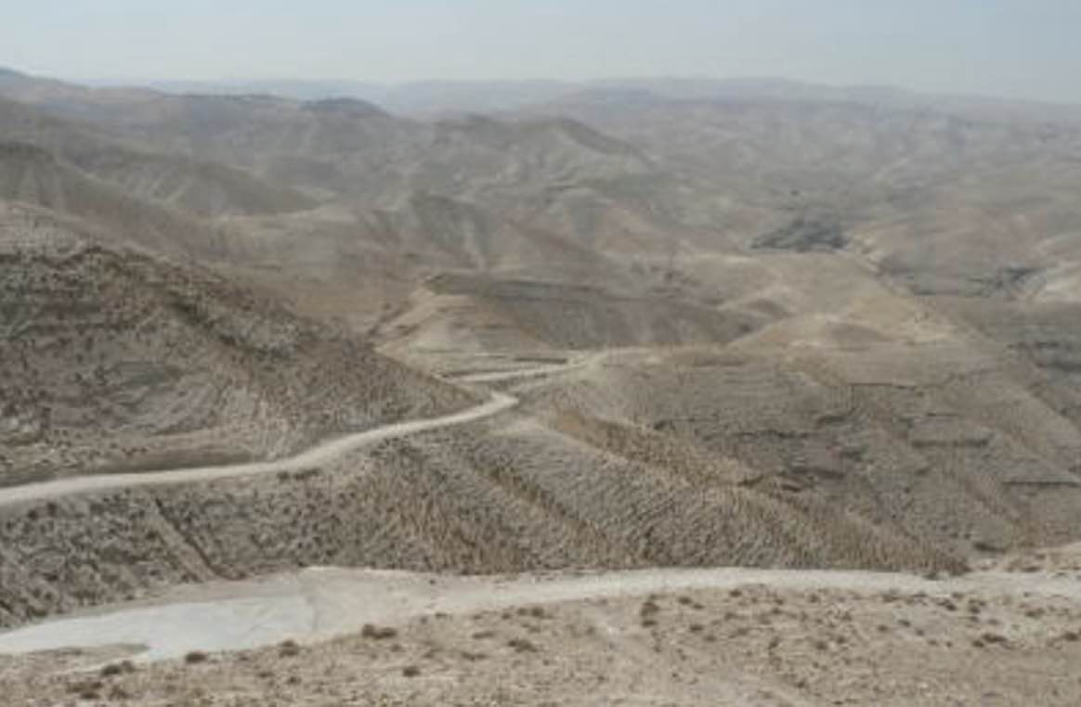
Wilderness/Arabah Now
Notes:
How many have ever been to Israel? If not, I would highly recommend it.
When they say “wilderness” they don’t mean like the Civil War battlefield 70 miles south of here that is totally overgrown with vegetation
Arabah - An arid desert valley that runs for 100 miles between the Dead Sea and the Gulf of Aqaba. (LBD)

Slide 18
1. Desert Will Bloom (Changes to Nature)
¹ The wilderness and the desert will be glad, And the Arabah will rejoice and blossom; Like the crocus ² It will blossom profusely And rejoice with rejoicing and shout of joy.
The glory of Lebanon will be given to it, The majesty of Carmel and Sharon.
They will see the glory of the Lord, The majesty of our God.
Notes:
Arabah - An arid desert valley that runs for 100 miles between the Dead Sea and the Gulf of Aqaba. (LBD)
Lebanon - The region north of Israel. Consisted of two mountain ranges with a fertile valley in between. (LBD)
Sharon - A segment of Israel’s coastal plain, remembered in the Bible for its fertility and pasture land. … about 50 miles long and a width of 9–10 miles (LBD)
Carmel - A Judaean city located approximately eight miles south of Hebron; not to be confused with Mount Carmel, a mountain range in northern Israel. (LBD)
The emphasis here is on fertility and a fruitful land, represented by Lebanon, Carmel, and Sharon

Slide 19
Why does the Arabah even exist?
Then to Adam He said, “Because you have listened to the voice of your wife, and have eaten from the tree about which I commanded you, saying, ‘You shall not eat from it’; Cursed is the ground because of you; In toil you will eat of it All the days of your life. (Genesis 3:17)
²⁰ For the creation was subjected to futility, … ²² For we know that the whole creation groans and suffers the pains of childbirth together until now. (Romans 8:20a, 22)
Notes:
Arabah - An arid desert valley that runs for 100 miles between the Dead Sea and the Gulf of Aqaba. (LBD)

Slide 20
A Lesson
The Arabah illustrates
the effect and seriousness of the curse on the land.
but also the effect and seriousness of sin on believers.
Contrast that to what the land and the people could be. We need to depend on God and live for Him – not for ourselves.
Notes:
Arabah - An arid desert valley that runs for 100 miles between the Dead Sea and the Gulf of Aqaba. (LBD)

Slide 21
2. Be Strong, Do Not Fear (Condition of the People)
³ Encourage the exhausted, and strengthen the feeble. ⁴ Say to those with anxious heart, “Take courage, fear not.”
“Behold, your God will come with vengeance; The recompense of God will come, But He will save you.”
(Because God …)
Notes:
The people were in an emotional desert. How could Isaiah help?
God is always a factor! Depend on Him!
After verse 4, don’t you feel encouraged already?
35.4 Note the parallel phrases ‘he will come with vengeance’ (what he will do against his adversaries) and ‘he will himself come and he will save you’ (what he will do for his people). (Motyer)
35.4 Recompense – to award compensation for (as for a damage incurred) (Wordnik, Merriam-Webster)

Slide 22
Take Our Own Vengeance?
‘Vengeance is Mine, and retribution, In due time their foot will slip; For the day of their calamity is near, And the impending things are hastening upon them.’ (Deuteronomy 32:35)
Never take your own revenge, beloved, but leave room for the wrath of God, for it is written, “Vengeance is Mine, I will repay,” says the Lord. (Romans 12:19)
Notes:
God is always a factor! Depend on Him!
35.4 Be encouraged because God will act on your behalf – and He does a much better job

Slide 23
A Lesson
Be sensitive that many around us are exhausted, feeble, anxious of heart. Then encourage them. Do not fear, knowing that God will ultimately deal with His enemies.
Our strength and courage can only come from the Lord

Slide 24
Condition of the People – cont’d
⁵ Then
[after God’s intervention]
the eyes of the blind will be opened And the ears of the deaf will be unstopped. ⁶ Then the lame will leap like a deer, And the tongue of the mute will shout for joy.
Notes:
Then – when God intervenes
This sounds a lot like the ministry of Jesus:
(Re 35.5) ⁴ Jesus answered and said to them, “Go and report to John what you hear and see: ⁵ the blind receive sight and the lame walk, the lepers are cleansed and the deaf hear, the dead are raised up, and the poor have the gospel preached to them. ⁶ “And blessed is he who does not take offense at Me.” (Matthew 11:4–6)
(Re 35.5) ⁶ When He had said this, He spat on the ground, and made clay of the spittle, and applied the clay to his eyes, ⁷ and said to him, “Go, wash in the pool of Siloam” (which is translated, Sent). So he went away and washed, and came back seeing. (John 9:6–7)
(Re 35.6) ³⁰ And large crowds came to Him, bringing with them those who were lame, crippled, blind, mute, and many others, and they laid them down at His feet; and He healed them. (Matthew 15:30)
(Re 35.6) ⁸ With a leap he stood upright and began to walk; and he entered the temple with them, walking and leaping and praising God. (Acts 3:8)

Slide 25
A Lesson
It’s not over until it’s over. (Yogi Berra)
Don’t expect God’s vengeance to be complete until the Final Judgment.
Even in the midst of the storm, we can rejoice because God is sovereign and He will save us. He will make all things right.
Notes:
As the great philosopher and theologian, Yogi Berra said, “It’s not over until its over.”
In case you don’t know of Yogi Berra, he was an all-star catcher for the New York Yankees in the 1950s and 1960s when they were the perennial champions of MLB.
Remember that sickness, disease and all affliction are the result of man’s sin. By God’s salvation, they will be lifted in His kingdom.

Slide 26
3. Redeemed
3a. Nature (vv.6b-7)
3b. The Way to God (vv.8-9a)
3c. The People (vv.9b-10)
Everything!

Slide 27
3a. Redeemed – Nature
For waters will break forth in the wilderness And streams in the Arabah. ⁷ The scorched land will become a pool And the thirsty ground springs of water; In the haunt of jackals, its resting place, Grass becomes reeds and rushes.
God will do this to redeem nature. This is also a picture of what He will do for us.
Notes:
35.6b God will make streams in the desert – the most unlikely of places
35.6b Remember the description of the Arabah – it is the desert region between the south end of the Dead Sea and the Gulf of Aqaba
35.6-7 The description of Arabah fits here – wilderness, scorched land, thirsty ground, haunt of jackals
(Re 35.6) ³⁸ “He who believes in Me, as the Scripture said, ‘From his innermost being will flow rivers of living water.’ ” (John 7:38)

Slide 28
3b. Redeemed – The Way to God
⁸ A highway will be there, a roadway, And it will be called the Highway of Holiness. The unclean will not travel on it, But it will be for him who walks that way, And fools will not wander on it. ⁹ No lion will be there, Nor will any vicious beast go up on it; These will not be found there.
Highway of Holiness. This refers to the way leading the redeemed back to Jerusalem, the throne of Messiah MacArthur Study Bible
Notes:
How to get there from here – use the highway!
(Re 35.8) ¹⁶ And there will be a highway from Assyria For the remnant of His people who will be left, Just as there was for Israel In the day that they came up out of the land of Egypt. (Isaiah 11:16)
35.8 A highway will be there leading through the then-lush landscape to Zion (v. 10). It will be used by the ransomed of the LORD (v. 10) to travel to Messiah's capital. It will be a highway marked by holiness, because only redeemed people will travel on it. (CON)

Slide 29
3b. Redeemed – The Way cont’d
A voice is calling, “Clear the way for the Lord in the wilderness; Make smooth in the desert a highway for our God. (Isaiah 40:3)
He [John the Baptist] said, “I am the voice of one crying out in the wilderness, ‘Make straight the way of the Lord,’ as the prophet Isaiah said.” (John 1:23)
Jesus said to him, “I am the way, and the truth, and the life; no one comes to the Father but through Me. (John 14:6)

Slide 30
3c. Redeemed People!
But the redeemed will walk there, ¹⁰ And the ransomed of the Lord will return And come with joyful shouting to Zion, With everlasting joy upon their heads. They will find gladness and joy,
And sorrow and sighing will flee away.
Notes:
And one more thing – sorrow will flee away
We are 35 chapters into Isaiah – but we heard about this back in 1:27 which used pāḏâ – ransomed/redeemed
(Re 35.9-10) ²⁷ Zion will be redeemed with justice And her repentant ones with righteousness. (Isaiah 1:27)

Slide 31
Meaning of ‘Redeemed’
Three different Hebrew words are translated “redeem” or “ransom.” Each presents and emphasizes a particular aspect of God’s great concern for humanity.
Each word is cast against the background of helplessness. Each finds human beings captured, held captive by the power of forces they cannot overcome. Only by the intervention of a third party can bondage be broken and the person freed.
Lawrence O. Richards
Notes:
Richards, Lawrence O. (1985), Expository Dictionary of Bible Words

Slide 32
Meaning of ‘Redeemed’
Hebrew gā’al, here translated "redeemed”
stresses [1] the person of the redeemer, [2] his relationship to the redeemed and [3] his intervention on their behalf.… It speaks here, therefore, of the Lord as the only one who can redeem his people, identifying with them as their next-of-kin, willingly shouldering, on their helpless behalf and in their place, all and every one of their needs, paying their price
Motyer
Hebrew pāḏâ, here translated “ransomed”
means specifically ‘to pay the ransom price’ [for their sins]
Motyer

Slide 33
Redeemed - NT
Redemption may be summarized around three basic ideas. (1) People are redeemed from something; namely, from the marketplace or slavery of sin (2) People are redeemed by something; namely by the payment of a price, the blood of Christ. (3) People are redeemed to something; namely, to a state of freedom; and then they are called to renounce that freedom for slavery to the Lord who redeemed them.
Charles Ryrie
What is added in the New Testament?
The blood of Christ.
The means of our redemption.
Notes:
Ryrie, Charles C. (1999). Basic Theology: A Popular Systematic Guide to Understanding Biblical Truth. Chicago: Moody.
Believers in Israel knew they would be redeemed. But at that time, they did not know God’s full plan to accomplish it.

Slide 34
3c. Redeemed People!
But the redeemed will walk there, ¹⁰ And the ransomed of the Lord will return And come with joyful shouting to Zion, With everlasting joy upon their heads. They will find gladness and joy, And sorrow and sighing will flee away.
“Redeemed” and “Ransomed” are near synonyms.
Notes:
Let’s look one more time at this great passage

Slide 35
A Lesson
If you have trusted Christ as Savior, you are already redeemed. Jesus died on the cross to pay our ransom price. Praise the Lord!
But in the Millennium, there will be more!
We can look forward to amazing gladness and joy in Zion with our King! As we struggle with life’s challenges now, remember this great future.

Slide 36
Summary – Isaiah 1-35
Chs. 7—12 posed a question: 'Is God Sovereign of the nations?' Can God deliver from an Assyria? Or is he just one more of the gods, waiting to be gobbled up by a bigger god? In short, can God be trusted?
Chs. 13—35 have sought to answer that question in four main sections: In the first (13-23), God's lordship over each of the nations is asserted.
In the second (24-27), it is shown that God is not merely the reactor to the nations, but is in fact the sovereign Actor on the world's stage.

Slide 37
Summary – Isaiah 1-35 cont’d
In the third (28-33), the superiority of God's counsel over that of the merely human leaders is shown.
Finally, the last two chapters (34-35) show the ultimate results of the two courses of action, with ch. 35 ending at exactly the same point as chs. 11—12, with the promise that God can, and will, redeem. He may be trusted.
(Oswalt quoted by Constable)

Slide 38
Redeemed, How I Love to Proclaim It!”
By Fanny Crosby, Verse 1 of 3
Redeemed, how I love to proclaim it! Redeemed by the blood of the Lamb; Redeemed through His infinite mercy, His child and forever I am.
Notes:
Meditate again on this great hymn. It is hard to express the thought better.

Slide 39
For Discussion and Application
How would you contrast this chapter (35) with the context of the previous chapter (34)? Where do the two fit in Bible prophecy?
2. How can the wilderness and the desert be glad (v.1)? What is going on here?
3. How does Isaiah elaborate on the gladness?
4. God’s people were in a bad way, based on what Isaiah says about them in verses 3-5. What problems did they have and what was the solution?

Slide 40
For Discussion and Application
5. What other changes will occur?
6. Consider the Highway of Holiness. Who/what does Isaiah say is there? Who/what does Isaiah say is not there?
7. The term “redeemed” was used in verse 9 while “ransomed” was used in verse 10. Compare and contrast the terms “redeemed” and “ransomed.”
8. Chapter 35 began with the gladness and joy seen in nature. It concludes with the gladness and joy of people. Compare and contrast the nature aspect of gladness and joy with the people aspect.
9. As one of the redeemed, what specifically encourages you in chapter 35?

Slide 41
Next Meeting
Review:
Isaiah 35, The Ransomed Shall Return
Memory Verse: Isaiah 35:8
Dr. Constable’s Notes, 2022 Ed., pp.223-227; Motyer, pp.272-275.
Study:
Isaiah 36, Sennacherib Invades Judah
Memory Verse: Proverbs 21:1
Dr. Constable’s Notes, 2022 Ed., pp.227-233; Motyer, pp.276-279.
Refreshment Host: B

