Slide 1
WELCOME TO THE MOB!
All Scripture is breathed out by God and profitable for teaching, for reproof, for correction, and for training in righteousness, that the man of God may be complete, equipped for every good work.
2 Timothy 3:16-17 (ESV)

Slide 2
Welcome To The MOB!
MOB Website & Resources: www.ibcmob.net
Summer Sundae Series, 7-9pm, June 13, July 11 (Rosario Butterfield), & August 13
Vacation Bible School, June 24-28.
Summer Breakout Teaching Series, July 14, 21, & 28.

Slide 3
Please Rise
Invocation/Prayer.
Song:
“Isaiah 43”

Slide 4
Isaiah 43 1 of 8
When you pass, Through the waters, I will be with you
And the waves, Will not, Overcome you
Do not fear, For I, Have redeemed you
I have called, You by name, You are Mine

Slide 5
Isaiah 43 2 of 8
For I am the Lord your God
For I am the Lord your God
The Holy One, Of Israel, Your Savior
For I am the Lord your God
For I am the Lord your God
The Holy One, Of Israel, Your Savior

Slide 6
Isaiah 43 3 of 8
I am the Lord (Groups A, B, C, D)
Do not fear (Groups E, F, G, H)
I am the Lord (Groups A, B, C, D)
Do not fear (Groups E, F, G, H)
I am the Lord (Groups A, B, C, D)
Do not fear (Groups E, F, G, H)
I am the Lord (Groups A, B, C, D)
Do not fear (Groups E, F, G, H)

Slide 7
Isaiah 43 4 of 8
All
I AM THE LORD!

Slide 8
Isaiah 43 5 of 8
When you pass, Through the fire, You’ll not be hurt
And the flames, Will not, Consume you
Do not fear, For I, Have redeemed you
I have called, You by name, You are Mine

Slide 9
Isaiah 43 6 of 8
For I am the Lord your God
For I am the Lord your God
The Holy One, of Israel, Your Savior
For I am the Lord your God
For I am the Lord your God
The Holy One, Of Israel, Your Savior

Slide 10
Isaiah 43 7.1 of 8
I am the Lord (Groups A, B, C, D)
Do not fear (Groups E, F, G, H)
I am the Lord (Groups A, B, C, D)
Do not fear (Groups E, F, G, H)
I am the Lord (Groups A, B, C, D)
Do not fear (Groups E, F, G, H)
I am the Lord (Groups A, B, C, D)
Do not fear (Groups E, F, G, H)

Slide 11
Isaiah 43 7.2 of 8
You are the Lord (Groups A, B, C, D)
I’ll not fear (Groups E, F, G, H)
You are the Lord (Groups A, B, C, D)
I’ll not fear (Groups E, F, G, H)
You are the Lord (Groups A, B, C, D)
I’ll not fear (Groups E, F, G, H)
You are the Lord (Groups A, B, C, D)
I’ll not fear (Groups E, F, G, H)

Slide 12
Isaiah 43 8 of 8
All
YOU ARE THE LORD!

Slide 13
Memory Verse
Isaiah 63:7 (ESV)
“I will recount the steadfast love of the LORD, the praises of the LORD, according to all that the LORD has granted us, and the great goodness to the house of Israel that he has granted them according to his compassion, according to the abundance of his steadfast love.”
Isaiah 63:7 (ESV)

Slide 14
Book of Isaiah
Book of Judgment (Chap. 1-39):
Ch. 1-6: Judah’s Sin, Isaiah’s Call
Ch. 7-12: Sign of Immanuel
Ch. 13-23: Oracles About Nations
Ch. 24-27: World Redemption
Ch. 28-35: Six Woes
Ch. 36-39: Historical Interlude
Book of Salvation (Chap. 40-66):
Ch. 40-48: God’s Grace To Israel
King Cyrus delivers Israel from Babylonian captivity in Babylon.
Ch. 49-55: God’s Atonement
The rejection and restoration of the Suffering Servant, the deliverer.
Ch. 56-66: A Glorious Future
God’s restoration and transformation of Israel and the world.

Slide 15
Isaiah Bible Study Schedule for Fall 2023 – Spring 2024 as of April 23, 2024

Slide 16
Our Study of Isaiah
Last Meeting:
Isaiah 62, Zion’s Coming Salvation
Memory Verse: Isaiah 62:4
Dr. Constable’s Notes, 2023 Ed., pp. 440-443; Motyer, pp. 505-509.
This Meeting:
Isaiah 63, The LORD's Vengeance Revealed and Mercy Recalled
Memory Verse: Isaiah 63:7
Dr. Constable’s Notes, 2023 Ed., pp. 443-453; Motyer, pp. 509-518.
Refreshment Host: E

Slide 17
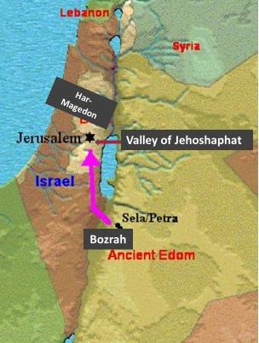
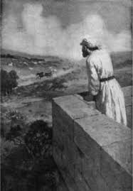
Introduction
In Luke 4, Jesus did not finish reading Is. 61:2. Today, we see why, and what He intends to do.
Is. 62:7 said a man in a watchtower was guarding Jerusalem. Our lesson begins with what he sees.

Slide 18
Overview
Aspects of Isaiah 63: There are three key emphases that thread this chapter.
Satan introduces sin to hamper our relationship with Christ and seeks to disrupt our understanding of these areas!

Slide 19
Lesson Overview Isaiah Chapters 63
What Is It About Sin That Satan Really Likes? Because It __________:
Causes Blindness (63:1-2)
Ensures Judgment (63:3-6)
Hinders Gratitude (63:7-9)
Fosters Rebellion (63:10)
Clouds Remembrance (63:11-14)
Distorts Promises (63:15-19)

Slide 20
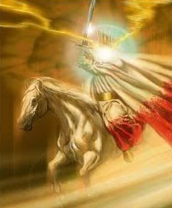
Isaiah 63:1-2 Sin Causes Blindness In Seeing The Messiah
“In this same tradition of using Edom as symbolic of the final hostile power stands the present passage in Isaiah (i.e, 11:14, 34:5-6, 63:1-6; Nu. 24:18).” J.A. Motyer
“Who is this?” Ps. 24, Matt. 21:10, Lk. 5:21.
Edom, Bozrah = Esau’s lineage; enemy.
“In crimsoned garments.”
“It is I, righteousness, mighty to save.”
Why red apparel, like in a winepress?
Revelation 19:15-17

Slide 21
Isaiah 63:1-2 Sin Causes Blindness In Seeing The Messiah
Isa 34:6 The sword of the LORD is filled with blood, It is made overflowing with fatness, With the blood of lambs and goats, With the fat of the kidneys of rams. For the LORD has a sacrifice in Bozrah, And a great slaughter in the land of Edom.
Jer 49:13 "For I have sworn by Myself," says the LORD, "that Bozrah shall become a desolation, a reproach, a waste, and a curse. And all its cities shall be perpetual wastes."

Slide 22
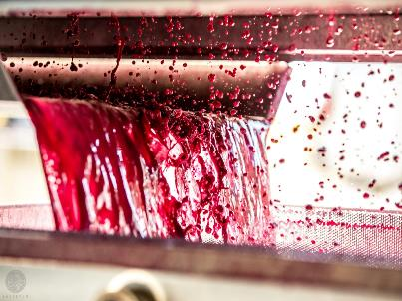
Isaiah 63:3-6 Sin Ensures Judgment From God’s Servant
“The prophet looks ahead in 63:1–6 and sees Jesus Christ returning from the Battle of Armageddon that climaxes the day of the Lord (Rev. 19:11–21).” Warren Weirsbe
Seven ‘I’s result in Servant’s 11 acts.
I have trodden the winepress alone.
Trod in anger, trampled in wrath.
Day of vengeance in my heart (61:2).
I made them drunk in my wrath.
Revelation 14:19-20

Slide 23
Isaiah 63:3-6 Sin Ensures Judgment From God’s Servant
Rev 19:15 Now out of His mouth goes a sharp sword, that with it He should strike the nations. And He Himself will rule them with a rod of iron. He Himself treads the winepress of the fierceness and wrath of Almighty God.
Rev 16:6 For they have shed the blood of saints and prophets, You have given them blood to drink. For it is their just due.

Slide 24
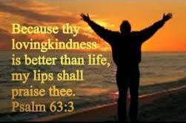
Isaiah 63:7-9 Sin Hinders Gratitude For God’s Blessings
“This part of Isaiah's lament consists of a review of Israel’s relationship with the LORD (vv. 7-10) and a call for Israel to remember who He is (vv. 11-14).” Thomas Constable
Tell of God’s ‘hesed,’ praises, according to: 1.) granted us, 2.) great goodness, 3.) compassion, 4.) abundant ‘hesed’.
The Savior of His chosen people.
In their affliction, He’s afflicted. 2 Cor. 1:4
His love, pity redeemed/carried them.

Slide 25
Isaiah 63:7-9 Sin Hinders Gratitude For God’s Blessings
Ps 51:1 Have mercy upon me, O God, According to Your lovingkindness; According to the multitude of Your tender mercies, Blot out my transgressions.
1 Jo 4:13-14 By this we know that we abide in Him, and He in us, because He has given us of His Spirit. And we have seen and testify the Father has sent the Son as Savior of the world.

Slide 26
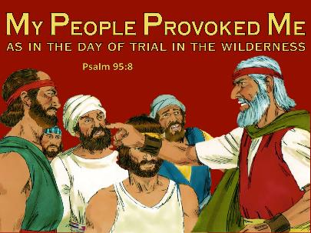
Isaiah 63:10 Sin Fosters Rebellion Against God
“Notice two verbs (rebelled, grieve) describe Israel's sin and two verbs (turn, fought) describe YHWH's reaction (synonymous parallelism).” Bob Utley
“rebelled” Israel vs. Servant (Is. 50:5).
Only OT use, “grieved his Holy Spirit.”
Most of the rebellions we read in Exodus and Numbers.
God tells Moses they had tempted Him 10 times (Num. 14:22-23).
Exodus 17:7

Slide 27
Isaiah 63:10 Sin Fosters Rebellion Against God
Nu 14:11 Then the LORD said to Moses: "How long will these people reject Me? And how long will they not believe Me, with all the signs which I have performed among them?
Ac 7:51 "You stiffnecked and uncircumcised in heart and ears! You always resist the Holy Spirit; as your fathers did, so do you.

Slide 28
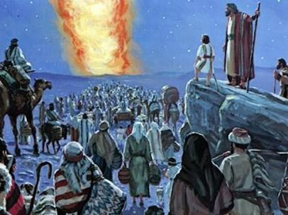
Isaiah 63:11-14 Sin Clouds Remembrance Of God’s Blessings
“That is, the people of Israel being afflicted, called to mind God's benefits, which he had bestowed on their fathers in times past.” Geneva Study Bible
Isaiah recalls the time of Moses.
“Where is He”: past marvelous works.
The Exodus is a key miraculous event.
God led them through many barriers.
The Spirit gave them rest in Canaan.
Exodus 13:22

Slide 29
Isaiah 63:11-14 Sin Clouds Remembrance Of God’s Blessings
2 Sa 7:23 And who is like Your people, like Israel, the one nation on the earth whom God went to redeem for Himself as a people, to make for Himself a name-and to do for Yourself great and awesome deeds for Your land-before Your people whom You redeemed for Yourself from Egypt, the nations, and their gods?
Hag 2:5 'According to the word that I covenanted with you when you came out of Egypt, so My Spirit remains among you; do not fear!’

Slide 30
Isaiah 63:15-19 Sin Distorts Promises To The Elect
“The praying one isn’t accurate in all his theology, but he is an expert in expressing the pain of the human heart.” David Guzik
There are pleas for God to leave his perch to show His zeal and strength.
God is Israel's Father, not Patriarchs.
Israel's rebellion = their hard hearts.
God’s people began to act just like other nations, ignoring Holy things.
Romans 4:16

Slide 31
Isaiah 63:15-19 Sin Distorts Promises To The Elect
De 26:15 Look down from Your holy habitation, from heaven, and bless Your people Israel and the land which You have given us, just as You swore to our fathers, “a land flowing with milk and honey.”
Joh 12:40 “He has blinded their eyes and hardened their hearts, Lest they should see with their eyes, Lest they should understand with their hearts and turn, So that I should heal them.” [cf. 6:9-10]

Slide 32
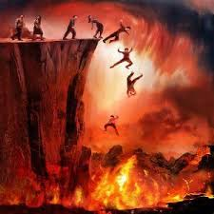
Conclusion
What is it about sin, that we really hate?
Isaiah 63 contrasted God’s judgment and mercy. The removal of God’s enemies is followed by intercessory prayer. Because sin leads to death, it must be dealt with. Thus, we must warn others, agonizing over its impact.
Luke 21:36

Slide 33
Next Meeting
Review:
Isaiah 63, The LORD's Vengeance Revealed and Mercy Recalled
Memory Verse: Isaiah 63:7
Dr. Constable’s Notes, 2023 Ed., pp. 443-453; Motyer, pp. 509-518.
Study:
Isaiah 64, A Prayer For God’s Mercy
Memory Verse: Isaiah 64:4
Dr. Constable’s Notes, 2023 Ed., pp. 453-455; Motyer, pp. 518-522.
Refreshment Host: F

Slide 34
Discussion & Application
1 of 2
1.) Who is the one who Isaiah describes as coming from Edom, “with garments of glowing colors from Bozrah,”?
2.) What are the circumstances and implications of his coming?
3.) How is this scene similar to that pictured and prophesied in Revelation 19:11-16?
4.) What does reference here, and in Isaiah 61:2, as a “day of vengeance” as well as God’s “day of redemption” tell us about the prophetic timeline for the events and issues in this passage?
5.) What does Isaiah’s “intercessory lament,” in verses 7-10, say about God and His relationship, expectations, and dealings with Israel over time?

Slide 35
Discussion & Application
2 of 2
6.) Why might verse 9 be considered (according to Grogan) “one of the most moving expressions of the compassionate love of God in the Old Testament”?
7.) What does Isaiah say the Israelites, having been chastened by the Lord—and looking back—remembered about “the days of old”?
8.) What stands out to you, and other lessons on prayer, from Isaiah’s “prayer of repentance” in verses 15-19?
9.) What’s your understanding of why Isaiah would say (even dare to say!) that God, in some sense, actually “caused Israel to stray from God’s ways”?
10.) What key thoughts will you take away from this awesome chapter?

Slide 36
Closing
Benediction
Small Groups

Slide 38
Isaiah 63
1 Who is this who comes from Edom, in crimsoned garments from Bozrah, he who is splendid in his apparel, marching in the greatness of his strength? "It is I, speaking in righteousness, mighty to save.“ 2 Why is your apparel red, and your garments like his who treads in the winepress? 3 "I have trodden the winepress alone, and from the peoples no one was with me; I trod them in my anger and trampled them in my wrath; their lifeblood spattered on my garments, and stained all my apparel. 4 For the day of vengeance was in my heart, and my year of redemption had come. 5 I looked, but there was no one to help; I was appalled, but there was no one to uphold; so my own arm brought me salvation, and my wrath upheld me. 6 I trampled down the peoples in my anger; I made them drunk in my wrath, and I poured out their lifeblood on the earth."

Slide 39
Isaiah 63
7 I will recount the steadfast love of the LORD, the praises of the LORD, according to all that the LORD has granted us, and the great goodness to the house of Israel that he has granted them according to his compassion, according to the abundance of his steadfast love. 8 For he said, "Surely they are my people, children who will not deal falsely." And he became their Savior. 9 In all their affliction he was afflicted, and the angel of his presence saved them; in his love and in his pity he redeemed them; he lifted them up and carried them all the days of old. 10 But they rebelled and grieved his Holy Spirit; therefore he turned to be their enemy, and himself fought against them. 11 Then he remembered the days of old, of Moses and his people. Where is he who brought them up out of the sea with the shepherds of his flock? Where is he who put in the midst of them his Holy Spirit, 12 who caused his glorious arm to go at the right hand of Moses, who divided the waters before them to make for himself an everlasting name,

Slide 40
Isaiah 63
13 who led them through the depths? Like a horse in the desert, they did not stumble. 14 Like livestock that go down into the valley, the Spirit of the LORD gave them rest. So you led your people, to make for yourself a glorious name. 15 Look down from heaven and see, from your holy and beautiful habitation. Where are your zeal and your might? The stirring of your inner parts and your compassion are held back from me. 16 For you are our Father, though Abraham does not know us, and Israel does not acknowledge us; you, O LORD, are our Father, our Redeemer from of old is your name. 17 O LORD, why do you make us wander from your ways and harden our heart, so that we fear you not? Return for the sake of your servants, the tribes of your heritage. 18 Your holy people held possession for a little while; our adversaries have trampled down your sanctuary. 19 We have become like those over whom you have never ruled, like those who are not called by your name.

Slide 41
Isaiah Outline
Focus | Prophecies of Condemnation |  |  |  |  |  |  |  | Historical Parenthesis |  | Prophecies of Comfort
 | 1:1 |  |  |  |  |  |  | 35:10 | 36:1 | 39:8 | 40:1 |  |  |  |  | 66:24
Divisions | Prophecies Against Judah |  | Prophecies Against the Nation |  | Prophesies Against the Day of the Lord |  | Prophesies of Judgement and Blessing |  | Sickness and Sin | Hezekiah’s Salvation | Israel’s Deliverance |  | Israel’s Deliverer |  | Israel’s Glorious Future
 | 1:1 | 12:6 | 13:1 | 23:18 | 24:1 | 27:13 | 28:1 | 35:10 | 36:1 | 39:8 | 40:1 | 48:22 | 49:1 | 57:21 | 58:1 | 66:24
Topics | Prophetic |  |  |  |  |  |  |  | Historic |  | Messianic
 | Judgement |  |  |  |  |  |  |  | Transition |  | Hope
Place | Israel & Judah
Time | 740 - 680 B.C.

