Slide 1
WELCOME TO THE MOB!
All Scripture is breathed out by God and profitable for teaching, for reproof, for correction, and for training in righteousness, that the man of God may be complete, equipped for every good work.
2 Timothy 3:16-17 (ESV)

Slide 2
Announcements
Men's Summer Sundae Series
Tuesday, June 13th –Jonathan Alexandre of Liberty Counsel
Sunday, July 23rd –Janet Parshall who is a nationally syndicated radio talk show host - open to spouses
Tuesday, August 8th –Navy Vice Admiral (Ret.) Scott Redd
MOB Group D’s Summer Study – Hebrews
MOB Group F’s Summer Study – “The Titus Ten,” J. Josh Smith
Free Logos Training – Kirk Streitmater – Sat. June 24
9-11 AM Introduction; 12-2 PM Basic Functionality
If interested, please email streitmaterk@verizon.net
Notes:
Group D study - Contact: Web Tileston: hwtileston@gmail.com, 703-626-4596
Group F study - Contact: Mark Wever: kbdgv2@hotmail.com, 703-336-3578
LOGOS TRAINING - People are welcome to attend either or both sessions and are encouraged to bring their own installed desktop version of Logos to follow along and practice. The online web-based version of Logos 10 will also be demonstrated. If interested, please email streitmaterk@verizon.net so that we can confirm seating arrangements.

Slide 3
Invocation/Prayer
Hymn:
When I Survey the Wondrous Cross
Notes:
I prayed that my teaching would change the lives of my students, encourage them, give them more confidence, and help them make an impact on the world. – Jim Plueddemann

Slide 4
When I Survey the Wondrous Cross
By Isaac Watts, Verse 1 of 4
When I survey the wondrous cross on which the Prince of glory died, My richest gain I count but loss, and pour contempt on all my pride.

Slide 5
When I Survey the Wondrous Cross
By Isaac Watts, Verse 2 of 4
Forbid it, Lord, that I should boast save in the death of Christ, my God! All the vain things that charm me most, I sacrifice them to His blood.

Slide 6
When I Survey the Wondrous Cross
By Isaac Watts, Verse 3 of 4
See, from His head, His hands, His feet, sorrow and love flow mingled down. Did e'er such love and sorrow meet, or thorns compose so rich a crown?

Slide 7
When I Survey the Wondrous Cross
By Isaac Watts, Verse 4 of 4
Were the whole realm of nature mine, that were a present far too small. Love so amazing, so divine, demands my soul, my life, my all.

Slide 8
Memory Verse
Isaiah 40:1 (NASB)
“Comfort, O comfort My people,” says your God.
Unless otherwise noted, all Scripture quotations are from NASB95

Slide 9
Our Study of Isaiah
Last Meeting:
Isaiah 1-39, Review, Lessons Learned, Testimonies
Memory Verse: Isaiah 1:25-26
Dr. Constable’s Notes, 2022 Ed., pp. 1-251; Motyer, pp. 13-297.
This Meeting:
Isaiah 40-66, Introduction and Overview
Memory Verse: Isaiah 40:1
Dr. Constable’s Notes, 2022 Ed., pp. 251-493; Motyer, pp. 298-544.
Refreshment Host: F

Slide 10
Isaiah Bible Study Schedule for Fall 2022 – Spring 2023
Online

Slide 11
Isaiah Outline
Focus | Prophecies of Condemnation |  |  |  |  |  |  |  | Historical Parenthesis |  | Prophecies of Comfort
 | 1:1 |  |  |  |  |  |  | 35:10 | 36:1 | 39:8 | 40:1 |  |  |  |  |  | 66:24
Divisions | Prophecies Against Judah |  | Prophecies Against the Nation |  | Prophesies Against the Day of the Lord |  | Prophesies of Judgement and Blessing |  | Sickness and Sin | Hezekiah’s Salvation | Israel’s Deliverance |  |  | Israel’s Deliverer |  | Israel’s Glorious Future
 | 1:1 | 12:6 | 13:1 | 23:18 | 24:1 | 27:13 | 28:1 | 35:10 | 36:1 | 39:8 | 40:1 | 48:22 |  | 49:1 | 57:21 | 58:1 | 66:24
Topics | Prophetic |  |  |  |  |  |  |  | Historic |  | Messianic
 | Judgment |  |  |  |  |  |  |  | Transition |  | Hope
Place | Israel & Judah
Time | 740 - 680 B.C.
Bruce Wilkinson and Kenneth Boa, Talk Thru the Bible (Nashville: T. Nelson, 1983), 189.
Notes:
Tonight we will introduce the second major division of Isaiah, chapters 40-66.
Then plan on joining us in September when we will work our way through this second portion in a style similar to what we just completed with the first section, chapters 1-39

Slide 12
Isaiah – What Just Happened?
"When one turns from the thirty-ninth to the fortieth chapter
it is as though he steps out of the darkness of judgment into
the light of salvation."
Edward J. Young
Notes:
Young, Edward J. The Book of Isaiah. 3 vols. The New International Commentary on the Old Testament series. Grand Rapids: Wm. B. Eerdmans Publishing Co., 1965, 1969, 1972.

Slide 13
Two Sections of Isaiah
Isaiah 1—39 | Isaiah 40—66
The focus is on Assyria. | The focus is on Babylon.
The primary theme is judgment. | The primary theme is deliverance.
Historical details are present. | Historical details are absent.
Messiah is the "shoot from Jesse." | Messiah is the "Servant of the LORD."
The life of Isaiah is prominent. | The life of Isaiah is absent.
Adapted from Dyer & Merrill
Notes:
Dyer, Charles H., and Eugene H. Merrill. The Old Testament Explorer. Nashville: Word Publishing, 2001.

Slide 14
Isaiah - A Transition
We have completed Isaiah 1-39. You probably agree that there are a lot of discouraging thoughts in this section.
Isaiah 1-39 left us with a strong sense of failure and need –
It is easy to understand why Ahaz, the ‘evil’ king, failed himself and the nation.
But Hezekiah, the ‘good’ king, also failed himself and the nation.
They needed a righteous King to lead them.

Slide 15
The Transition Prophesied
When the Lord has finished all his work on Mount Zion and on Jerusalem, he will punish the arrogant boasting of the king of Assyria and his haughty pride.
Isaiah 10:12
Some of your own sons who are born to you shall be taken away; they shall be eunuchs in the palace of the king of Babylon.”
Isaiah 39:7
Taking away of Hezekiah’s sons did not happen for almost 100 years – until Babylon started taking Judah into exile

Slide 16
Isaiah - A Dividing Line
The exile to Babylon came in three phases –
605 BC, 597 BC, 586 BC
EXILE
Isaiah 39 ended in 701 BC
In Isaiah 40, the people are already in exile.
Notes:
A dividing line
Exile rocked their world – a different world – after the DISASTER
Felt
Remorse for disobeying the Lord
Disbelief that they ignored so many warnings
Powerless
Doubt that they would ever again see the Promised Land
Would captivity ever end?
Doubt that God would have any more to do with them
But Judah survived for 90+ years – not addressed by Isaiah

Slide 17
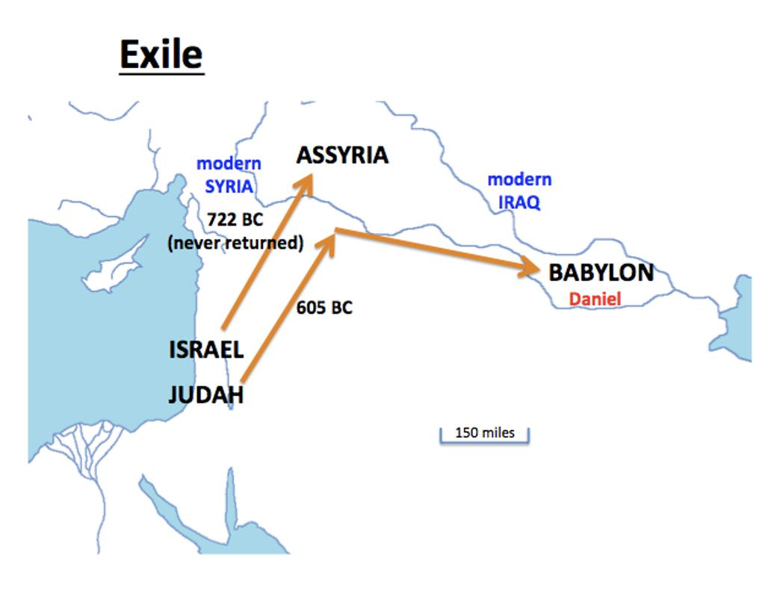
Exiled! (The History)
597 BC
586 BC
34

Slide 18
Why the Exile?
Consequences of covenant unfaithfulness: Judgment is real and ugly.
2 Kings 17:7,18
“Now this came about because the sons of Israel had sinned against the Lord their God … So the Lord was very angry with Israel and removed them from His sight; none was left except the tribe of Judah.”

Slide 19
The People in Exile
By the rivers of Babylon,
There we sat down and wept,
When we remembered Zion.
Psalm 137:1
42

Slide 20
Return from Exile
42

Slide 21
Major Bible Events
Pre-Tribulation Rapture
The Rapture
1 Thess. 4:13-17
Second Coming
Matt. 24:29-30; Matt. 25:31-34
Eternal Life
Matt. 25:46
Church Age
Matt. 16:18-19
Matt. 28:19-20
Acts 1:9-11
Tribulation
Matt. 24:15-16,21
Millennium
Rev. 20:2-7; Matt 19:28
EXILE
8
3.5 Years
3.5 Years
1,000 Years
You Are Here
Great White Throne Judgment
Rev. 20:11-15
21-22
Revelation
2-3
6-19
20
Isaiah – Rough Fit
24
25-27
Notes:
Isaiah 24-27, but many other places in Isaiah
Isaiah did not foresee the church age or the rapture. He did foresee the Tribulation and the Millennium, but not the lengths of the time periods.

Slide 22
Major Bible Events
Pre-Tribulation Rapture
The Rapture
1 Thess. 4:13-17
Second Coming
Matt. 24:29-30; Matt. 25:31-34
Eternal Life
Matt. 25:46
Church Age
Matt. 16:18-19
Matt. 28:19-20
Acts 1:9-11
Tribulation
Matt. 24:15-16,21
Millennium
Rev. 20:2-7; Matt 19:28
EXILE
8
3.5 Years
3.5 Years
1,000 Years
You Are Here
Great White Throne Judgment
Rev. 20:11-15
21-22
Revelation
2-3
6-19
20
Isaiah – Rough Fit
24
25-27
Notes:
Isaiah 24-27, but many other places in Isaiah
Isaiah did not foresee the church age or the rapture. He did foresee the Tribulation and the Millennium, but not the lengths of the time periods.

Slide 23
Isaiah 40-66 Three Major Events
Israel’s Deliverance (chapters 40-48)
Event - Deliverance from captivity in Babylon
The human deliverer is Cyrus, mentioned near the middle of the section (44:28–45:1)
Israel’s Deliverer (chapters 49-57)
Event - Rejection and restoration of the Suffering Servant (Jesus)
Especially 52:13–53:12
Israel’s Glorious Future (chapters 58-66)
Event - The consummation of God’s restoration of Israel and world.
coming of the Messiah (chaps. 61–63)
A

Slide 24
Isaiah 40-66 – Big Picture
Chapters 40–66 emphasize more than redemption from sin.
Those chapters go beyond that to speak of a change in the cosmos, of the Lord’s restoration of His created order….
atonement for that sin and the resulting change in people and the world system are discussed.
Bible Knowledge Commentary

Slide 25
Isaiah 40-66 – Big Picture
Hard to make a nice clean outline
Mostly future prophecy even now – not history or interaction with kings and people of Israel
With every paragraph, you still have to ask “What is the timeframe?”
There are many recognizable quotes referenced in NT
Isaiah 40-66 is much more positive and hopeful than 1-39 which alternated between failure/depression and hope

Slide 26
Time Span Addressed by Isaiah
~700 BC
During Isaiah’s Prophetic Ministry
~590 BC
During Judah’s Exile to Babylon
After the Exile
~32 AD
During Christ’s Earthly Ministry
2023
Applica-tion for Today’s Ministry
Future
Revela-tion of End Time Events
Isaiah 1-39
Isaiah 40-55
Isaiah 56-66
Notes:
Isaiah’s target audience was Judah and Jerusalem of his own day.
However many of his prophecies pointed far into the future.
Isaiah had many prophecies that were fulfilled in his own lifetime (blue-green)
Isaiah had many prophecies to be fulfilled in the future from his standpoint (darker blue). From our standpoint, many of those have now been fulfilled.
Isaiah also had many prophecies that are still future, even today. (gray)

Slide 27
Themes in Isaiah 40-66
Comfort
My Word
God will restore Israel
New things are coming
Servant songs
Your God reigns!
The Millennium
Jerusalem Glorified
Notes:
To give you a feel for Isaiah’s message in the second half

Slide 28
A Theme - Comfort
¹ “Comfort, O comfort My people,” says your God. ² “Speak kindly to Jerusalem; And call out to her, that her warfare has ended, That her iniquity has been removed, That she has received of the Lord’s hand Double for all her sins.” Isaiah 40:1-2
“Comfort / Comforts / Comforted”
Once in Isaiah 1-39 13x in Isaiah 40-66
Notes:
In chapters 1–39: 12:1
In chapters 40-66: 40:1 [2x]; 49:13; 51:3, 51:12; 19; 52:9; 54:11; 57:18; 61:2; 66:13; 66:13 [3x];

Slide 29
A Theme – My Word
The grass withers, the flower fades, But the word of our God stands forever. Isaiah 40:8
So will My word be which goes forth from My mouth; It will not return to Me empty, Without accomplishing what I desire, And without succeeding in the matter for which I sent it. Isaiah 55:11

Slide 30
A Theme – God Will Restore Israel
⁸ “But you, Israel, My servant, Jacob whom I have chosen, Descendant of Abraham My friend, … ¹⁰ ‘Do not fear, for I am with you; Do not anxiously look about you, for I am your God. I will strengthen you, surely I will help you, Surely I will uphold you with My righteous right hand.’ Isaiah 41:8,10
So the ransomed of the Lord will return And come with joyful shouting to Zion, And everlasting joy will be on their heads. They will obtain gladness and joy, And sorrow and sighing will flee away. Isaiah 51:11

Slide 31
A Theme – God Will Restore Israel p2
⁶ Seek the Lord while He may be found; Call upon Him while He is near. ⁷ Let the wicked forsake his way And the unrighteous man his thoughts; And let him return to the Lord, And He will have compassion on him, And to our God, For He will abundantly pardon. Isaiah 55:6-7
“A Redeemer will come to Zion, And to those who turn from transgression in Jacob,” declares the Lord.
Isaiah 59:20

Slide 32
A Theme – New Things Coming
I declared the former things long ago And they went forth from My mouth, and I proclaimed them. Suddenly I acted, and they came to pass. … I proclaim to you new things from this time, Even hidden things which you have not known.
Isaiah 48:3, 6b
¹ The Spirit of the Lord God is upon me, Because the Lord has anointed me To bring good news to the afflicted; He has sent me to bind up the brokenhearted, To proclaim liberty to captives And freedom to prisoners; ² To proclaim the favorable year of the Lord And the day of vengeance of our God; To comfort all who mourn, Isaiah 61:1-2
Notes:
Jesus quoted 61:1-2a – and then stopped!
Gives an idea of how challenging it can be to put timeline to verses, even phrases

Slide 33
A Theme – Servant Songs
⁸ “I am the Lord, that is My name; I will not give My glory to another, Nor My praise to graven images. ⁹ “Behold, the former things have come to pass, Now I declare new things; Before they spring forth I proclaim them to you.” Isaiah 42:8-9
⁶ He says, “It is too small a thing that You should be My Servant To raise up the tribes of Jacob and to restore the preserved ones of Israel; I will also make You a light of the nations So that My salvation may reach to the end of the earth.” Isaiah 49:6
Notes:
“Servant Songs” in Isaiah 40-66 (42:1–9; 49:1–13; 50:4–11; 52:13–53:12).

Slide 34
A Theme – Servant Songs p2
He was despised and forsaken of men, A man of sorrows and acquainted with grief; And like one from whom men hide their face He was despised, and we did not esteem Him. Isaiah 53:3
⁴ Surely our griefs He Himself bore, And our sorrows He carried; Yet we ourselves esteemed Him stricken, Smitten of God, and afflicted. Isaiah 53:4-5
All of us like sheep have gone astray, Each of us has turned to his own way; But the Lord has caused the iniquity of us all To fall on Him. Isaiah 53:6
Notes:
“Servant Songs” in Isaiah 40-66 (42:1–9; 49:1–13; 50:4–11; 52:13–53:12).

Slide 35
Servant Songs p3
Isaiah 53 – Used in 1 Peter
²² who committed no sin, nor was any deceit found in His mouth [Is 53:9];
²³ and while being reviled, He did not revile in return; while suffering, He uttered no threats [Is 53:7c-d], but kept entrusting Himself [Is 53:12c] to Him who judges righteously [Is 53:8a];
²⁴ and He Himself bore our sins [Is 53:4a, 12] in His body on the cross, so that we might die to sin and live to righteousness; for by His wounds you were healed [Is 53:5d].
²⁵ For you were continually straying like sheep [Is 53:6a], but now you have returned to the Shepherd and Guardian of your souls.
Adapted from Jobes
Notes:
The bold are direct quotes from Isaiah 53
The underlines are allusions to Isaiah 53
The references show the specific verses in Isaiah 53 that Peter referenced
Peter had absorbed Isaiah’s prophecy about Jesus into his soul
This is not just a quote – Peter delves into the significance of Isaiah 53
Isaiah 53 became integral to Peter’s understanding of Jesus’ suffering and therefore of how we should handle suffering

Slide 36
Servant Songs p3a
Isaiah 53 – Used in 1 Peter
²² who committed no sin, nor was any deceit found in His mouth [Is 53:9];
²³ and while being reviled, He did not revile in return; while suffering, He uttered no threats [Is 53:7c-d], but kept entrusting Himself [Is 53:12c] to Him who judges righteously [Is 53:8a];
²⁴ and He Himself bore our sins [Is 53:4a, 12] in His body on the cross, so that we might die to sin and live to righteousness; for by His wounds you were healed [Is 53:5d].
²⁵ For you were continually straying like sheep [Is 53:6a], but now you have returned to the Shepherd and Guardian of your souls.
Adapted from Jobes
Notes:
The bold are direct quotes from Isaiah 53
The underlines are allusions to Isaiah 53
The references show the specific verses in Isaiah 53 that Peter referenced
Peter had absorbed Isaiah’s prophecy about Jesus into his soul
This is not just a quote – Peter delves into the significance of Isaiah 53
Isaiah 53 became integral to Peter’s understanding of Jesus’ suffering and therefore of how we should handle suffering

Slide 37
A Lesson
but kept entrusting Himself to Him who judges righteously
That was Isaiah’s main message to Ahaz, Hezekiah, and all of Israel !!
But they would not accept it –
DO YOU ??

Slide 38
A Theme – Your God Reigns
Thus says the Lord, the King of Israel and his Redeemer, the Lord of hosts: ‘I am the first and I am the last, And there is no God besides Me.’ Isaiah 44:6
How lovely on the mountains Are the feet of him who brings good news, Who announces peace And brings good news of happiness, Who announces salvation, And says to Zion, “Your God reigns!” Isaiah 52:7

Slide 39
A Theme – Millennium
³ A voice is calling, “Clear the way for the Lord in the wilderness; Make smooth in the desert a highway for our God. ⁴ “Let every valley be lifted up, And every mountain and hill be made low; And let the rough ground become a plain, And the rugged terrain a broad valley; ⁵ Then the glory of the Lord will be revealed, And all flesh will see it together; For the mouth of the Lord has spoken.”
Isaiah 40:3-5

Slide 40
A Theme – Millennium p2
²⁵ “The wolf and the lamb will graze together, and the lion will eat straw like the ox; and dust will be the serpent’s food. They will do no evil or harm in all My holy mountain,” says the Lord. Isaiah 65:25
“For just as the new heavens and the new earth Which I make will endure before Me,” declares the Lord, “So your offspring and your name will endure. Isaiah 66:22

Slide 41
A Theme – Jerusalem Glorified
Your gates will be open continually; They will not be closed day or night, So that men may bring to you the wealth of the nations, With their kings led in procession.
Isaiah 60:11
No longer will you have the sun for light by day, Nor for brightness will the moon give you light; But you will have the Lord for an everlasting light, And your God for your glory. Isaiah 60:19
Notes:
A forerunner of Revelation

Slide 42
A Theme – Jerusalem Glorified p2
It will no longer be said to you, “Forsaken,” Nor to your land will it any longer be said, “Desolate”; But you will be called, “My delight is in her,” And your land, “Married”; For the Lord delights in you, And to Him your land will be married.
Isaiah 62:4

Slide 43
Discussion Questions (1 of 2)
1. Read Isaiah 39:5-8 and Isaiah 40:1-2. What observations can you make about the transition to the second part of Isaiah’s book?
2. Think about the generation that was carried off to Babylon. What remorse would they have felt? What questions and doubts would they have had?
3. Do you have a favorite verse or chapter from Isaiah 40-66 to share with your group?

Slide 44
Discussion Questions (2 of 2)
Probably the greatest single chapter in Isaiah’s book is chapter 53, The Suffering Servant. Read Isaiah 53 and use it for the remaining questions.
4. What aspects of the servant’s life are foretold?
5. What words in verses 4-6 explain what of ours the servant took on Himself?
6. What was the purpose of the servant’s suffering?
7. Isaiah 53 was quoted and referenced heavily in 1 Peter 2:22-25. What do you learn from considering Peter’s use of Isaiah 53?
Notes:
Questions 4-6 taken from
Nielson, Kathleen Buswell (2011), Isaiah: The Lord Saves. Phillipsburg, NJ: P & R Publishing.

Slide 45
Next Meeting
Will I see you in September …
or lose you to …?

