Slide 1
Announcements
Welcome to the MOB!
Small Group Leader Training on Sundays, June 14 – 19 July & June 21 – July 26
The Master’s Seminary at IBC, Fall 2015
Pray for MOB Fall 2015 – Spring 2016
Watch your e-mail for MOB survey
MOB Website: www.ibcmob.net

Slide 2
Memory Verse
John 15:16 (ESV)
¹⁶ You did not choose me, but I chose you and appointed you that you should go and bear fruit and that your fruit should abide, so that whatever you ask the Father in my name, he may give it to you.

Slide 3
John’s Purpose
John 20:30-31
³⁰ Now Jesus did many other signs in the presence of the disciples, which are not written in this book; ³¹ but these are written so that you may believe that Jesus is the Christ, the Son of God, and that by believing you may have life in his name.

Slide 4
The Gospel
According to John
Outline
Focus | Incarnation of the Son of God | Presentation of the Son of God | Opposition to the Son of God | Preparation of the Disciples | Crucifixion and Resurrection of the Son of God
Reference | 1:1-18 | 1:19 - 4:54 | 5:1 - 12:50 | 13:1 - 17:26 | 18:1 - 21:25
Division | Introduction to Christ | Revelation of Christ | Rejection of Christ | Revelation of Christ | Rejection of Christ
Topic | Seven Miracles |  |  | Upper Room Discourse | Supreme Miracle
 | That you might believe |  |  | That you might have life
Time | A Few Years |  |  | A Few Hours | A Few Weeks

Slide 5
This Week
John 1:1-18
The Incarnation of the Son of God
John 1:1-2 The Deity of Christ
John 1:3-5 The Pre-incarnate Work of Christ
John 1:6-8 The Forerunner of Christ
John 1:9-11 The Rejection of Christ
John 1:12-13 The Acceptance of Christ
John 1:14-18 The Incarnation of Christ
References:
John: The Gospel of Belief, Merrill C. Tenney, Ph.D., Eerdmans Publishing Co, 1976
Encountering John: The Gospel in Historical, Literary, and Theological Perspective, Andreas J. Köstenberger, Baker Publishing Group, 2013.
Vines Complete Expository Dictionary, ed. W.E. Vine, M.A., Thomas Publisher, 1996

Slide 6
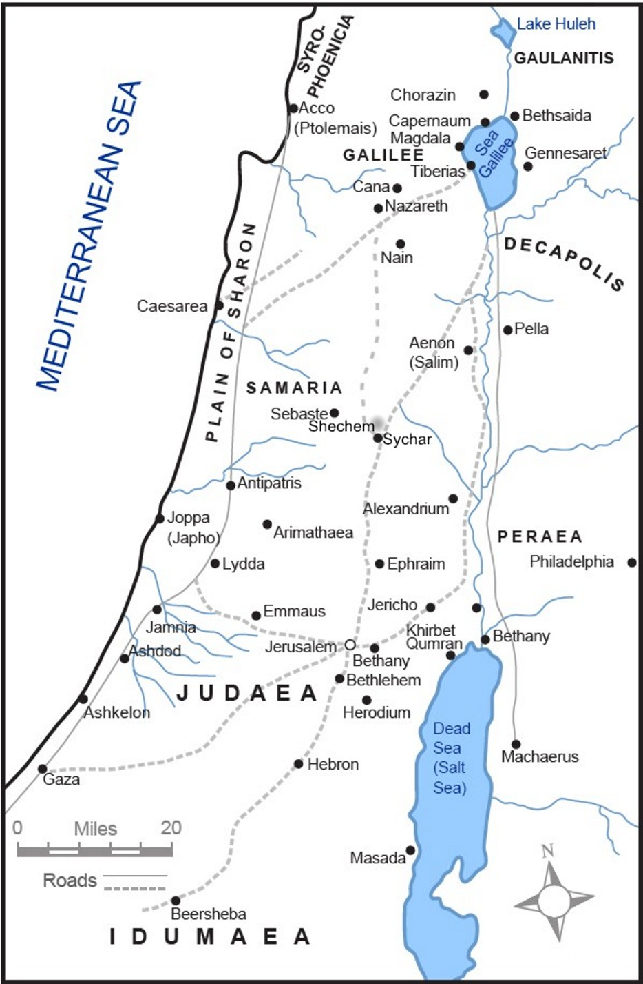
Where did Jesus and
His Disciples primarily “operate” according to John?

Slide 7
Galilee
Samaria
Judea

Slide 8
Immanuel’s View of Scripture
God’s authoritative written revelation to mankind (2 Timothy 3:16-17; 1 Thessalonians 2:13; Galatians 1:12)
God interacted with the human writers of those books so that every word of the original texts was exactly as He wanted (2 Peter 1:20-21); without error (John 17:17)
The Scriptures are the supreme and final authority (Psalm 19:7-11; Psalm 119; Romans 10:17: Hebrews 4:12)
Interpretation of Scripture
Normal – understanding in their common usage
Literal – understanding meaning in its ordinary sense, unless context requires figurative interpretation
Grammatical – use of recognized rules of grammar
Historical – in the context of the times
Systematic – with the whole view of scripture

Slide 9
John’s Viewpoint
¹ The book of the genealogy of Jesus Christ, the son of David, the son of Abraham.
¹ The beginning of the gospel of Jesus Christ, the Son of God.
Messiah/King
Matthew
Mark
Suffering Servant
Genealogy: Matthew 1:1-17
Luke
Miracles?
Parables?
Genealogy: Luke 3:23-38
Son of Man
¹ Inasmuch as many have undertaken to compile a narrative of the things that have been accomplished among us,
¹ In the beginning was the Word, and the Word was with God, and the Word was God.

Slide 10
1 John 1:1
A Unique Perspective
¹ That which was from the beginning, which we have heard, which we have seen with our eyes, which we looked upon and have touched with our hands, concerning the word of life

Slide 11
Gospel of John
pisteúō
alétheia
Ceremonies
1
2
3
4
5
6
7
8
9
10
11
12
13
14
15
16
17
18
19
20
21
phṓs
Matthew
Mark
Messiah/King
Suffering Servant
amḗn
Wedding
Luke
martureó
Passover
s
Turning Water to Wine
Son of Man
zōḗ
s
Healing Nobleman’s Son
paraklétos
Festival
s
Healing Paralytic Man
5:35 Jesus said to them, “I am the bread of life; he who comes to Me will not hunger, and he who believes in Me will never thirst.
s
Feeding 5000
Feast of Tabernacles
s
Walking on Water
8:12 Then Jesus again spoke to them, saying, “I am the Light of the world; he who follows Me will not walk in the darkness, but will have the Light of life.”
s
Healing Man born blind
Dedication
10:9 ”I am the door; if anyone enters through Me, he will be saved, and will go in and out and find pasture.”
Raising Lazarus
10:14 “I am the good shepherd, and I know My own and My own know Me,”
s
Mary Anoints Jesus
11:25 Jesus said to her, “I am the resurrection and the life; he who believes in Me will live even if he dies,
Passover
Jesus washes feet
Upper Room Discourse
14:6 Jesus said to him, “I am the way, and the truth, and the life; no one comes to the Father but through Me.
16:1 “I am the true vine, and My Father is the vinedresser.”
Betrayal/Arrest
Trial
Crucifixion
Empty Tomb

Slide 12
Observation
John was…
Intentional
Relational
Transformational

Slide 13
Intentional
An eyewitness with a unique perspective and starting point
“The striking opening of John’s gospel establishes a connection between God’s act of creation through his spoken Word and his act of providing salvation through the incarnate Word, Jesus”. Köstenberger; p 26
First person, personal
An excellent historian who knew his audience
Terms and context
An author who communicated specific concepts and ideas
A good historian is one who does not give equal weight to every event in history, but who focuses on the “turning points” of history - Bob Deffinbaugh

Slide 14
pisteuó
Strong's Concordance pisteuó: to believe, entrust Original Word: πιστεύω Part of Speech: Verb Transliteration: pisteuó Phonetic Spelling: (pist-yoo'-o) Short Definition: I believe, have faith in Definition: I believe, have faith in, trust in; pass: I am entrusted with. HELPS Word-studies 4100 pisteúō (from 4102 /pístis, "faith," derived from 3982 /peíthō, "persuade, be persuaded") – believe (affirm, have confidence); used of persuading oneself (= human believing) and with the sacred significance of being persuaded by the Lord (= faith-believing). Only the context indicates whether 4100 /pisteúō ("believe") is self-serving (without sacred meaning), or the believing that leads to/proceeds from God's inbirthing of faith.

Slide 15
zóé
Strong's Concordance zóé: life Original Word: ζωή, ῆς, ἡ Part of Speech: Noun, Feminine Transliteration: zóé Phonetic Spelling: (dzo-ay') Short Definition: life Definition: life, both of physical (present) and of spiritual (particularly future) existence. HELPS Word-studies 2222 zōḗ – life (physical and spiritual). All life (2222 /zōḗ), throughout the universe, is derived – i.e. it always (only) comes from and is sustained by God's self-existent life. The Lord intimately shares His gift of life with people, creating each in His image which gives all the capacity to know His eternal life.

Slide 16
alḗtheia
Strong's Concordance alétheia: truth Original Word: ἀλήθεια, ας, ἡ Part of Speech: Noun, Feminine Transliteration: alétheia Phonetic Spelling: (al-ay'-thi-a) Short Definition: truth Definition: truth, but not merely truth as spoken; truth of idea, reality, sincerity, truth in the moral sphere, divine truth revealed to man, straightforwardness. HELPS Word-studies 225 alḗtheia (from 227 /alēthḗs, "true to fact") – properly, truth (true to fact), reality. [In ancient Greek culture, 225 (alḗtheia) was synonymous for "reality" as the opposite of illusion, i.e. fact.]

Slide 17
Relational
To the Father
To the Spirit
To the disciples
To the Jewish people
To the world
Hebrews 1:3
³And He is the radiance of His glory and the exact representation of His nature, and upholds all things by the word of His power. When He had made purification of sins, He sat down at the right hand of the Majesty on high,

Slide 18
John 1:14-18
The Incarnation of Christ
Unequivocal affirmation!!!!
separate
Theos
¹⁸ No one has ever seen God; the only God, who is at the Father's side, he has made him known.
Greek: “is in the bosom of the father”
- perfect understanding and love
exēgeomai
“to show the way; to lead out; to rehearse declare”
NASB – He has explained Him

Slide 19
paraklétos
John 14:16 you another Helper, that He may be with you forever; John 14:26 But the Helper, the Holy Spirit, John 15:26 When the Helper comes, whom John 16:7 I do not go away, the Helper will not come 1 John 2:1
we have an Advocate with the Father,
Strong's Concordance paraklétos: called to one's aid Original Word: παράκλητος, ου, ὁ Part of Speech: Noun, Masculine Transliteration: paraklétos Phonetic Spelling: (par-ak'-lay-tos) Short Definition: an advocate, comforter, helper, Paraclete Definition: (a) an advocate, intercessor, (b) a consoler, comforter, helper, (c) Paraclete. HELPS Word-studies 3875 paráklētos (from 3844 /pará, "from close-beside" and 2564 /kaléō, "make a call") – properly, a legal advocate who makes the right judgment-call because close enough to the situation. 3875 /paráklētos ("advocate, advisor-helper") is the regular term in NT times of an attorney (lawyer) – i.e. someone giving evidence that stands up in court.

Slide 20
Transformational
The 8 “I Am” Statements leave no doubt about role or relationship
The most complete representation of the words of Christ
Extensive treatment of the narrative associated with the Upper Room Discourse
Amen, literally
John 1:12
¹² But to all who did receive him, who believed in his name, he gave the right to become children of God, ¹³ who were born, not of blood nor of the will of the flesh nor of the will of man, but of God.

Slide 21
amén
Strong's Concordance amén: truly Original Word: ἀμήν Part of Speech: Hebrew Form (Indclinable) Transliteration: amén Phonetic Spelling: (am-ane') Short Definition: verily, truly, amen, so let it be Definition: verily, truly, amen; at the end of sentences may be paraphrased by: So let it be. HELPS Word-studies 281 amḗn (the counterpart of the Hebrew OT term, 543 /apeítheia, "steadfast") – properly, sure (certain). 281 (amḗn) is usually translated "amen," and sometimes "verily," "of a truth," "most assuredly," "so let it be." 281 /amḗn ("amen"), as an "emphasis marker," introduces a statement of pivotal importance – i.e. that is essential in interpreting the over-all passage

Slide 22
Application
Jordan Management Consultants
HOFGFINHBJLB
Éclairs in your refrigerator?
Romans 7
You are the Gospel

Slide 23
Discussion Questions
John’s Gospel makes the boldest claims of Jesus as the Son of God. How does that claim impact the way you live your life? How does it impact your role as a son, father, husband and/or Christian?
If you were called on to defend the deity of Jesus, how would you use the Gospel of John to provide that defense?
In 1 John 1:4, he is “writing these things so that our joy may be complete.” How can you serve the Holy God with what you have learned from John’s Gospel in a way to make “your joy complete?”

Slide 24
Closing
Questions?
Comments?
Closing Prayer

