Slide 1
WELCOME TO THE MOB!
All Scripture is breathed out by God and profitable for teaching, for reproof, for correction, and for training in righteousness, that the man of God may be complete, equipped for every good work.
2 Timothy 3:16-17 (ESV)

Slide 2
Announcements
MOB Website & Resources: www.ibcmob.net
Keith & Kristyn Getty Concert – Sep 30th
Mid-Atlantic Regional WACCM Conference – Nov 5th

Slide 3
Please Rise
Invocation/Prayer.
Song:
“Are You Washed in the Blood?”

Slide 4
Are You Washed in the Blood?
Words & Music: Elisha A. Hoffman
Verse 1 of 4
Have you been to Jesus for the cleansing power? Are you washed in the blood of the Lamb? Are you fully trusting in His grace this hour? Are you washed in the blood of the Lamb?
Are you washed in the blood, In the soul-cleansing blood of the Lamb?
Are your garments spotless? Are they white as snow? Are you washed in the blood of the Lamb?

Slide 5
Are You Washed in the Blood?
Words & Music: Elisha A. Hoffman
Verse 2 of 4
Are you walking daily by the Savior’s side? Are you washed in the blood of the Lamb? Do you rest each moment in the Crucified? Are you washed in the blood of the Lamb?
Are you washed in the blood, In the soul-cleansing blood of the Lamb?
Are your garments spotless? Are they white as snow? Are you washed in the blood of the Lamb?

Slide 6
Are You Washed in the Blood?
Words & Music: Elisha A. Hoffman
Verse 3 of 4
When the Bridegroom cometh will your robes be white? Are you washed in the blood of the Lamb? Will your soul be ready for the mansions bright? And be washed in the blood of the Lamb?
Are you washed in the blood, In the soul-cleansing blood of the Lamb?
Are your garments spotless? Are they white as snow? Are you washed in the blood of the Lamb?

Slide 7
Are You Washed in the Blood?
Words & Music: Elisha A. Hoffman
Verse 4 of 4
Lay aside the garments that are stained with sin, And be washed in the blood of the Lamb. There’s a fountain flowing for the soul unclean, O be washed in the blood of the Lamb.
Are you washed in the blood, In the soul-cleansing blood of the Lamb?
Are your garments spotless? Are they white as snow? Are you washed in the blood of the Lamb?

Slide 8
Our Study of Isaiah
Last Meeting:
Isaiah Overview
Memory Verse: 2 Timothy 3:16-17
Dr. Constable’s Notes, 2022 Ed., pp. 1 – 25
This Meeting:
Isaiah 1
Memory Verse: Isaiah 1:18
Dr. Constable’s Notes on Isaiah, 2022 Edition, pp. 26-33
Refreshment Host: Small Group E

Slide 9
Memory Verse
Isaiah 1:18 (NASB)
“Come now, and let us reason together,” Says the Lord, “Though your sins are as scarlet, They will be as white as snow; Though they are red like crimson, They will be like wool.”

Slide 10
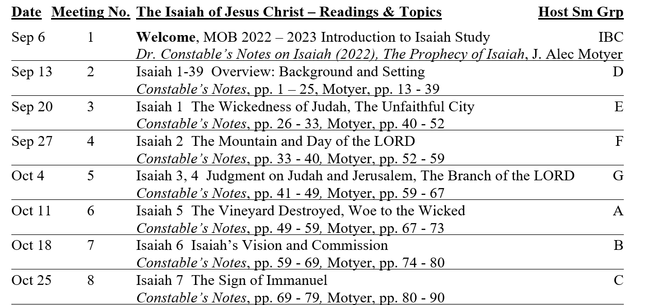
Isaiah Bible Study Schedule for Fall 2022 – Spring 2023 as of September 6, 2022

Slide 11
Isaiah Outline
Focus | Prophecies of Condemnation |  |  |  |  |  |  |  | Historical Parenthesis |  | Prophecies of Comfort
 | 1:1 |  |  |  |  |  |  | 35:10 | 36:1 | 39:8 | 40:1 |  |  |  |  |  | 66:24
Divisions | Prophecies Against Judah |  | Prophecies Against the Nation |  | Prophesies Against the Day of the Lord |  | Prophesies of Judgement and Blessing |  | Sickness and Sin | Hezekiah’s Salvation | Israel’s Deliverance |  |  | Israel’s Deliverer |  | Israel’s Glorious Future
 | 1:1 | 12:6 | 13:1 | 23:18 | 24:1 | 27:13 | 28:1 | 35:10 | 36:1 | 39:8 | 40:1 | 48:22 |  | 49:1 | 57:21 | 58:1 | 66:24
Topics | Prophetic |  |  |  |  |  |  |  | Historic |  | Messianic
 | Judgement |  |  |  |  |  |  |  | Transition |  | Hope
Place | Israel & Judah
Time | 740 - 680 B.C.
Bruce Wilkinson and Kenneth Boa, Talk Thru the Bible (Nashville: T. Nelson, 1983), 189.

Slide 12
ISAIAH 1
“The Lord is Salvation”
A
Notes:
Isaiah's name, "The LORD (Yahweh) is salvation," meaning the Lord is the source of salvation, summarizes his message. "... in that one name is compressed the whole contents of the book!" (quoting F. C. Jennings) (Constable)

Slide 13
Isaiah’s Context: Three Covenants
When Isaiah taught and prophesied, he and all Israel were living in the context of three great covenants initiated by YHWH with His special chosen people. We will see the influence of these covenants throughout the book.
Abraham – land, people, blessing
Genesis 12:1-3, 15:18-21, 17:1-8
Moses – blessings for obedience, else curses
Exodus 20, Deuteronomy 28
David – peace, descendant on throne forever
2 Samuel 7:8-16
A
Notes:
Note these covenants are not specifically called out – they are just present – it is in the culture, the way of life
Look for the influence of these covenants – you can pick them out in Isaiah

Slide 14
Contrast: Christians Live Under the New Covenant
We live under the New Covenant – a covenant of grace, not Law.
It was inaugurated by death and resurrection of Jesus the Messiah
For the Law was given through Moses;
grace and truth were realized through Jesus Christ.
(John 1:17)
⁸ For by grace you have been saved through faith;
and that not of yourselves, it is the gift of God;
⁹ not as a result of works, so that no one may boast.
(Ephesians 2:8–9)
A
Notes:
Make the distinction in your mind -
Isaiah’s writing does not apply to us in the same way it did to his immediate audience in Judah during the Kingdom period. (For example, we don’t bring temple sacrifices or have new moon festivals.)
Remember we are NOT under the Law of Moses. But we make disciples “teaching the to observe” all that Christ commanded us. When there is a difference between the two, we go with Christ and grace.
¹⁸ And Jesus came up and spoke to them, saying, “All authority has been given to Me in heaven and on earth. ¹⁹ “Go therefore and make disciples of all the nations, baptizing them in the name of the Father and the Son and the Holy Spirit, ²⁰ teaching them to observe all that I commanded you; and lo, I am with you always, even to the end of the age.” (Matthew 28:18–20)
³¹ “Behold, days are coming,” declares the Lord, “when I will make a new covenant with the house of Israel and with the house of Judah, ³² not like the covenant which I made with their fathers in the day I took them by the hand to bring them out of the land of Egypt, My covenant which they broke, although I was a husband to them,” declares the Lord. ³³ “But this is the covenant which I will make with the house of Israel after those days,” declares the Lord, “I will put My law within them and on their heart I will write it; and I will be their God, and they shall be My people. ³⁴ “They will not teach again, each man his neighbor and each man his brother, saying, ‘Know the Lord,’ for they will all know Me, from the least of them to the greatest of them,” declares the Lord, “for I will forgive their iniquity, and their sin I will remember no more.” (Jeremiah 31:31–34)

Slide 15
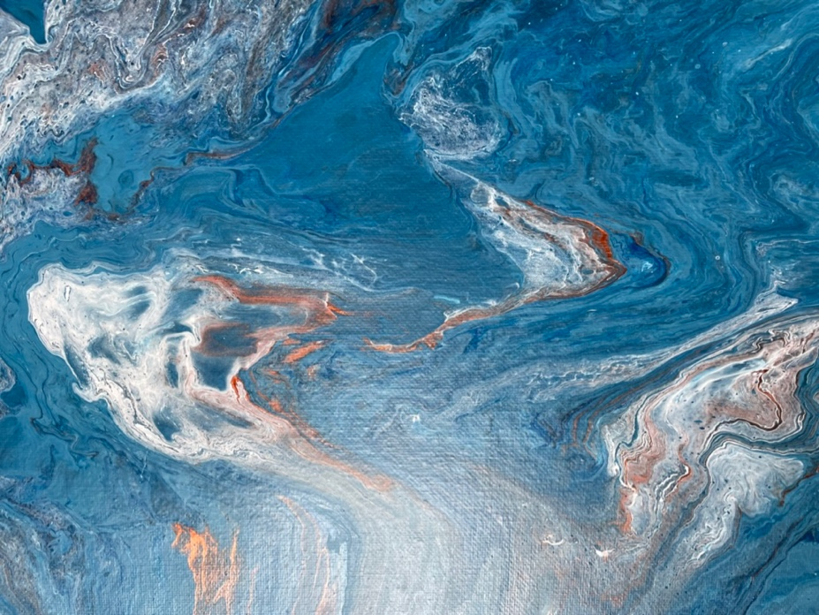
An Artist’s View – Time in Isaiah
Isaiah’s Time - Exile - Return
Jesus’ Birth - Death - Resurrection
Great Tribulation - Millennium - Final Judgment
Notes:
Art by Faith Battle
Isaiah is a difficult, challenging, and puzzling book. Among other things, it is not really sequential. We just jumped from Isaiah’s time to some indefinite future time to the Millennium.
The graphic art may offer some insights.
Are you confused by this art, as with Isaiah? The prophecies of Isaiah address many nations and time periods from his own day (~ 740-680 BC) to the Millennium which is still to come.
Picture the blue as rebukes and prophecies directed to Judah and Jerusalem, Isaiah’s primary audience. Maybe darker shades of blue would represent other nations of Isaiah’s time including Assyria, Babylon, and Egypt. Let the orange represent prophecies of the Great Tribulation which is yet to come. And let the white represent prophecies of the Millennium, of which there are many wonderful details in Isaiah.
All the colors are interwoven and blurred, even as Isaiah’s many prophecies may appear to be. But understand that God has a purpose in revealing His message in the way He does. In the end, God will extract each strand in the right way in His own time and for His glory. In the end, God wins!

Slide 16
Introducing Isaiah’s Vision
Speaker:
The vision of Isaiah the son of Amoz concerning Judah and Jerusalem, which he saw during the reigns of Uzziah, Jotham, Ahaz and Hezekiah, kings of Judah. (Isaiah 1:1)
Historical Context:
2 Kings 15-20
2 Chronicles 26-32
Isaiah 36-39
Isaiah
Audience:
Judah & Jerusalem
Time Period:
Kings
740–680BC
Covenant:
A
Abraham
All Scripture quotations are from NASB
Notes:
Note the concurrency here – prophets existed in the context of the kings and kingdoms, but also the exile and return
Generally, for all prophets, seek out their historical context in Kings and Chronicles
One unusual historical note – Isaiah 36-39 contains a historical section – other prophets do not do that
Thoughts on the Nature of Bible Prophecy – by Jim Battle
Understanding the unusual nature of Bible is helpful for the reading and interpretation of Bible prophecy - messages that can be obscure and difficult to understand.
Prophecies are often not as clear or complete as we would like them – but they are what God has chosen to give us.
Sometimes God explains prophecies in the Bible, either through the original prophet or through biblical cross-references. Be sure to take advantage of these solid insights.
Prophecies are not necessarily given in sequential order.
A single prophecy can have more than one fulfillment – partial or complete.
Prophecies can “blur together” so that part refers to one time period and part refers to another.
Consider the time of fulfillment – by definition, prophecies are future when given by the prophet. But a lot of time has now passed. Some prophecies have already been fulfilled and some still remain to be fulfilled.
Sometimes a prophet may speak in the “prophetic past” tense, meaning that he is talking about a future event, but its fulfillment is so certain that he presents it as already accomplished.
Accurately interpreting prophecy is not easy and nobody gets it all right.
All of God’s prophecies will be fulfilled.
Check the “Fulfillment Status” of prophecies – not yet, partial but more to come, completely

Slide 17
Sons Don’t Know Their Place
Speaker:
² Listen, O heavens, and hear, O earth; For the Lord speaks, “Sons I have reared and brought up, But they have revolted against Me.
³ “An ox knows its owner, And a donkey its master’s manger, But Israel does not know, My people do not understand.”
(Isaiah 1:2–3)
YHWH
Audience:
Heavens & Earth
Time Period:
Kings
740–680BC
Covenant:
Abraham Moses
Notes:
V2 YHWH calls on heaven and earth to judge
LORD = YHWH
Trying to get their attention – What’s wrong with you? Are you really dumber than an ox? – Watch how many times in chapter 1 God is calling for Israel’s attention – WAKE UP!
V2 Sons He reared - have revolted – who?
God’s history with them goes way back – He loves them and cares for them – even now
Created to be God’s image bearers
Gen 1:27 ²⁷ God created man in His own image, in the image of God He created him; male and female He created them. (Genesis 1:27)
Called out a nation for His special blessing
Genesis 12:1–3 ¹ Now the Lord said to Abram, “Go forth from your country, … ² And I will make you a great nation, And I will bless you, And make your name great; And so you shall be a blessing; ³ … And in you all the families of the earth will be blessed.” (Genesis 12:1–3)
MyPeople - even before covenant with Moses (The Law)
Ex 6:6-7 ⁶ “Say, therefore, to the sons of Israel, ‘I am the Lord, and I will bring you out from under the burdens of the Egyptians, and I will deliver you from their bondage. I will also redeem you with an outstretched arm and with great judgments. ⁷ ‘Then I will take you for My people, and I will be your God; and you shall know that I am the Lord your God, who brought you out from under the burdens of the Egyptians. (Exodus 6:6–7)
Even dumb ox and donkey know their place
Sons/Israel/Mypeople – do not

Slide 18
Charges Against Sons / Israel / My People
Speaker:
Alas, sinful nation,
People weighed down with iniquity,
Offspring of evildoers,
Sons who act corruptly!
They have abandoned the Lord,
They have despised the Holy One of Israel,
They have turned away from Him.
(Isaiah 1:4)
YHWH
Audience:
Heavens & Earth
Time Period:
Kings
740–680BC
Covenant:
Moses
Notes:
The charges against Sons / Israel / Mypeople
Sinful in heritage and in deed
Worse! Forsaken the all-powerful creator YHWH
Isaiah was especially impressed by the holiness of God. We will see it often.
³ And one called out to another and said, “Holy, Holy, Holy, is the Lord of hosts, The whole earth is full of His glory.” (Isaiah 6:3)
Despised the Holy One of Israel – contrast to their total lack of holiness
Constable calls this “Isaiah’s hallmark title for God” – used it 25x
The Holy One of Israel – v4 In many contexts the name contrasts the holiness of God with the sinfulness of Israel. (MacArthur Study Bible)
Holy = moral perfection, also uniqueness, separateness, otherness
You don’t want to be in their position

Slide 19
Why Continue This Way?
Speaker:
Where will you be stricken again,
As you continue in your rebellion?
The whole head is sick
And the whole heart is faint.
(Isaiah 1:5)
Bruises, welts, raw wounds
Land is desolate
Cities are burned
YHWH
Audience:
Israel
Time Period:
Kings
740–680BC
Covenant:
Moses
Notes:
Son/Israel/Mypeople – supposed to bear the image of God
You are already sick and faint from your rebellion against the Holy One of Israel – why would you continue?
God has been trying to get their attention through striking them but not so as to destroy them. Clearly, grace and patience is not working.
Would have been like Sodom and Gomorrah - background
¹⁶ Then the men rose up from there, and looked down toward Sodom; and Abraham was walking with them to send them off. ¹⁷ The Lord said, “Shall I hide from Abraham what I am about to do, ¹⁸ since Abraham will surely become a great and mighty nation, and in him all the nations of the earth will be blessed? ¹⁹ “For I have chosen him, so that he may command his children and his household after him to keep the way of the Lord by doing righteousness and justice, so that the Lord may bring upon Abraham what He has spoken about him.” ²⁰ And the Lord said, “The outcry of Sodom and Gomorrah is indeed great, and their sin is exceedingly grave. ²¹ “I will go down now, and see if they have done entirely according to its outcry, which has come to Me; and if not, I will know.” (Genesis 18:16–21)
²³ The sun had risen over the earth when Lot came to Zoar. ²⁴ Then the Lord rained on Sodom and Gomorrah brimstone and fire from the Lord out of heaven, ²⁵ and He overthrew those cities, and all the valley, and all the inhabitants of the cities, and what grew on the ground. ²⁶ But his wife, from behind him, looked back, and she became a pillar of salt. ²⁷ Now Abraham arose early in the morning and went to the place where he had stood before the Lord; ²⁸ and he looked down toward Sodom and Gomorrah, and toward all the land of the valley, and he saw, and behold, the smoke of the land ascended like the smoke of a furnace. ²⁹ Thus it came about, when God destroyed the cities of the valley, that God remembered Abraham, and sent Lot out of the midst of the overthrow, when He overthrew the cities in which Lot lived. (Genesis 19:23–29)

Slide 20
The Word of the Lord
Speaker:
Hear the word of the Lord, You rulers of Sodom;
Give ear to the instruction of our God, You people of Gomorrah.
“What are your multiplied sacrifices to Me?” says the Lord.
“I have had enough of burnt offerings of rams And the fat of fed cattle;
(Isaiah 1:10–11a)
Incense, Assemblies, Prayers
YHWH
Audience:
Israel
Time Period:
Kings
740–680BC
Covenant:
Moses
Notes:
Son/Israel/Mypeople → rulers of Sodom, people of Gomorrah – That is a SLAP! WAKE UP!
Enough already!!
Says the Lord – i.e. the LORD Keeps on saying!

Slide 21
Why Are Sacrifices Rejected?
Speaker:
I cannot endure iniquity and the solemn assembly. (Isaiah 1:13b)
Yes, even though you multiply prayers, I will not listen. Your hands are covered with blood. (Isaiah 1:15b)
Israel was very aware of the Law of Moses. They were “going through the motions” BUT not with integrity.
YHWH
Audience:
Israel
Time Period:
Kings
740–680BC
Covenant:
Moses
Notes:
But Moses commanded these sacrifices, assemblies, prayers! And we are doing it.
If a little sacrifice covers our sins, more must be better, right?

Slide 22
What Israel Should Be Doing
Speaker:
Wash yourselves, make yourselves clean;
Remove the evil of your deeds from My sight.
Cease to do evil, Learn to do good;
Seek justice, Reprove the ruthless,
Defend the orphan, Plead for the widow.
(Isaiah 1:16–17)
The widow and orphan are test cases of the quality of biblical society. - Motyer
YHWH
Audience:
Israel
Time Period:
Kings
740–680BC
Covenant:
Moses
Notes:
Recognize the problem of their sin – REPENT! – TURN AROUND!
Live and worship with biblical integrity – here’s a start

Slide 23
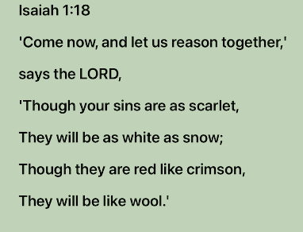
Let Us Reason Together
Speaker:
YHWH
Audience:
Israel
Time Period:
Kings
740–680BC
Covenant:
Abraham Moses
Notes:
This is our memory verse for the week. Remember the app! Record & Playback feature
Click – let’s say it together
Says the Lord – i.e. the LORD Keeps on saying!
Scarlet / red / crimson → snow / wool – now that is contrast!
How? This is a teaser to get our attention. Reminder of more.
All the world will be blessed through Abraham

Slide 24
Your Options, Israel
Speaker:
“If you consent and obey, You will eat the best of the land;
But if you refuse and rebel, You will be devoured by the sword.”
Truly, the mouth of the Lord has spoken. (Isaiah 1:19–20)
Parallel to (Deuteronomy 28:2-3, 15-16)
YHWH
Audience:
Israel
Time Period:
Kings
740–680BC
Covenant:
Moses
Notes:
The choice is clear – which would you choose and why?
Harkens back to Abraham and Promised Land
- the best of the land
Eat or be eaten!
Harkens back to Moses in Deuteronomy 28 – before entering Promised Land
² “All these blessings will come upon you and overtake you if you obey the Lord your God: ³ “Blessed shall you be in the city, and blessed shall you be in the country. . .
¹⁵ “But it shall come about, if you do not obey the Lord your God, to observe to do all His commandments and His statutes with which I charge you today, that all these curses will come upon you and overtake you: ¹⁶ “Cursed shall you be in the city, and cursed shall you be in the country. (Deuteronomy 28:2-3, 15-16)
Obey what?
Start with “Come” v18
Then vv. 16-17
“Wash yourselves, make yourselves clean; Remove the evil of your deeds from My sight. Cease to do evil, Learn to do good; Seek justice, Reprove the ruthless, Defend the orphan, Plead for the widow. (Isaiah 1:16–17)

Slide 25
Israel Needs to Repent
Speaker:
How the faithful city has become a harlot,
She who was full of justice!
Righteousness once lodged in her,
But now murderers.
(Isaiah 1:21)
Silver → dross
Drink → diluted
Rulers → rebels
YHWH
Audience:
Israel
Time Period:
Kings
740–680BC
Covenant:
Moses
Notes:
Harlot – that’s harsh! Another wakeup call.
Where you have fallen from
Contrasts
faithful → harlot
justice/righteousness → murderers
² When the Lord first spoke through Hosea, the Lord said to Hosea, “Go, take to yourself a wife of harlotry and have children of harlotry; for the land commits flagrant harlotry, forsaking the Lord.” (Hosea 1:2)
²⁰ “For long ago I broke your yoke And tore off your bonds; But you said, ‘I will not serve!’ For on every high hill And under every green tree You have lain down as a harlot. (Jeremiah 2:20)

Slide 26
God’s Coming Action
Speaker:
Therefore the Lord God of hosts, The Mighty One of Israel, declares,
“Ah, I will be relieved of My adversaries
And avenge Myself on My foes.
“I will also turn My hand against you,
And will smelt away your dross as with lye
And will remove all your alloy.
(Isaiah 1:24–25)
YHWH
Audience:
Israel
Time Period:
Future
Covenant:
Moses
Abraham
Notes:
Therefore – because of all the preceding
Multiple names emphasizing God’s authority and power to act – He brings the only possible solution to the problem
Adversaries/foes would be Assyrians, Babylonians, Philistines, Moabites and others mentioned in Isaiah
Against you = Israel
Yet God is announcing amazing grace that He will purify them and it will hurt, - Covenant with Moses BUT not destroy them with the enemies – Covenant with Abraham
Time period is future an an indeterminate time, maybe multiple times – when? How?
What can we learn about God from these verses?

Slide 27
Restoration!
Speaker:
Then I will restore your judges as at the first, And your counselors as at the beginning; After that you will be called
the city of righteousness, A faithful city.”
(Isaiah 1:26)
YHWH
Audience:
Israel
Time Period:
Millennium
Covenant:
Abraham
David
Notes:
After purification, God will RESTORE !!
Amazing! Clearly not deserved.
Shows God’s love.
His commitment to the Covenant with Abraham – all the earth would be blessed through him
His commitment to the Covenant with David – founder of Jerusalem as a righteous & faithful city
The climax of this section is a Davidic restoration. It was under David that Jerusalem first became the capital city. . . 1:26 is a veritable seed-thought. (Motyer)
This is part of our connection back the the book of Revelation. Fortunately we know about the Millennium – 1000 years of Christ’s rule on earth from Jerusalem/Zion

Slide 28
Restoration Continued
Speaker:
Zion will be redeemed with justice
And her repentant ones with righteousness.
But transgressors and sinners will be
crushed together,
And those who forsake the Lord will
come to an end.
(Isaiah 1:27–28)
Idolatrous oaks, gardens, strong men –
all burned with none to quench them
YHWH
Audience:
Israel
Time Period:
Millennium
Tribulation
Final Judgmt
Covenant:
Abraham
Moses
David
Notes:
Redeemed means specifically ‘to pay the ransom price.’ Penitent ones/‘returning ones’ stresses the practical side of repentance: a change of mind resulting in a new (Godward) direction of life. (Motyer)
In 1:24–31 … the divine reaction of wrath and punishment fills the foreground, but the background is full of the light of hope…. Certainly, rebellion brings disaster as its reward but yet it does not exhaust the Lord’s capacity to redeem and restore. (Motyer)
³ Blessed be the God and Father of our Lord Jesus Christ, who has blessed us with every spiritual blessing in the heavenly places in Christ, ⁴ just as He chose us in Him before the foundation of the world, that we would be holy and blameless before Him. In love ⁵ He predestined us to adoption as sons through Jesus Christ to Himself, according to the kind intention of His will, ⁶ to the praise of the glory of His grace, which He freely bestowed on us in the Beloved. ⁷ In Him we have redemption through His blood, the forgiveness of our trespasses, according to the riches of His grace ⁸ which He lavished on us. In all wisdom and insight ⁹ He made known to us the mystery of His will, according to His kind intention which He purposed in Him ¹⁰ with a view to an administration suitable to the fullness of the times, that is, the summing up of all things in Christ, things in the heavens and things on the earth. In Him (Ephesians 1:3–10)
³ For we also once were foolish ourselves, disobedient, deceived, enslaved to various lusts and pleasures, spending our life in malice and envy, hateful, hating one another. ⁴ But when the kindness of God our Savior and His love for mankind appeared, ⁵ He saved us, not on the basis of deeds which we have done in righteousness, but according to His mercy, by the washing of regeneration and renewing by the Holy Spirit, ⁶ whom He poured out upon us richly through Jesus Christ our Savior, ⁷ so that being justified by His grace we would be made heirs according to the hope of eternal life. (Titus 3:3–7)

Slide 29
Summary of Ch. 1 and of Isaiah
Isaiah’s primary purpose was to remind his readers of the special
relationship they had with God as members of the nation of Israel,
His special covenant community. . . .
Isaiah was calling the people of Judah back to a proper covenantal
relationship with God. He was reminding his generation of the sinful
condition in which they were living and of its consequences.
God would judge the nation, but He would also eventually restore
them to the land (cf. Deut. 30:1–5) with full kingdom blessings
because of His promises to Abraham.
(Bible Knowledge Commentary)

Slide 30
For Discussion and Application
In Isaiah 1, how many times/ways did Isaiah call for God’s people to WAKE UP? Are there ways that we (at IBC, in America, in the 21st century) need to wakeup to God’s message?
When things fall apart in front of people’s eyes (vv. 5-9), why would they continue in the same destructive way?
In what ways do people today “go through the motions” (vv. 11-15) but not really give their heart to God?

Slide 31
For Discussion and Application
In vv. 18-20, Isaiah was calling for obedience to the Law of Moses. Is that the standard for the church? If not, what is the standard for the church?
If you were in God’s place and your chosen people had rejected you in so many ways, what would you do? What did God say about it?
In v. 24 we see names of God: “the Lord God of hosts, The Mighty One of Israel.” What do we learn about God from 1) these names and 2) His actions of judging and cleansing

Slide 32
For Discussion and Application
In vv. 24-26, God will judge His enemies, but will cleanse Israel. Do we fit in that picture of judgment/cleansing? If so, where? And why?
Verses 26 and 27 use key words “restore” and “redeem.” Who will be restored and redeemed? What do you learn about how that will be accomplished?
Read Titus 2:11-14. How does God ultimately develop the themes of “restore” and “redeem”? What themes are similar to Isaiah 1?
Notes:
¹¹ For the grace of God has appeared, bringing salvation to all men, ¹² instructing us to deny ungodliness and worldly desires and to live sensibly, righteously and godly in the present age, ¹³ looking for the blessed hope and the appearing of the glory of our great God and Savior, Christ Jesus, ¹⁴ who gave Himself for us to redeem us from every lawless deed, and to purify for Himself a people for His own possession, zealous for good deeds. (Titus 2:11–14)

Slide 33
Isaiah Outline
Focus | Prophecies of Condemnation |  |  |  |  |  |  |  | Historical Parenthesis |  | Prophecies of Comfort
 | 1:1 |  |  |  |  |  |  | 35:10 | 36:1 | 39:8 | 40:1 |  |  |  |  |  | 66:24
Divisions | Prophecies Against Judah |  | Prophecies Against the Nation |  | Prophesies Against the Day of the Lord |  | Prophesies of Judgement and Blessing |  | Sickness and Sin | Hezekiah’s Salvation | Israel’s Deliverance |  |  | Israel’s Deliverer |  | Israel’s Glorious Future
 | 1:1 | 12:6 | 13:1 | 23:18 | 24:1 | 27:13 | 28:1 | 35:10 | 36:1 | 39:8 | 40:1 | 48:22 |  | 49:1 | 57:21 | 58:1 | 66:24
Topics | Prophetic |  |  |  |  |  |  |  | Historic |  | Messianic
 | Judgement |  |  |  |  |  |  |  | Transition |  | Hope
Place | Israel & Judah
Time | 740 - 680 B.C.
Bruce Wilkinson and Kenneth Boa, Talk Thru the Bible (Nashville: T. Nelson, 1983), 189.

Slide 34
Next Meeting
Review:
Isaiah 1
Memory Verse: Isaiah 1:18
Dr. Constable’s Notes on Isaiah, 2022 Edition, pp. 26-33
Study:
Isaiah 2
Memory Verse: Isaiah 2:3
Dr. Constable’s Notes on Isaiah, 2022 Edition, pp. 33-40
Refreshment Host: Small Group F

Slide 35
Isaiah Bible Study Schedule for Fall 2022 – Spring 2023 as of September 6, 2022

