Slide 1
Announcements
Welcome to the MOB!
Website: www.ibcmob.net

Slide 2
Memory Verse
John 3:3 (ESV)
Jesus answered him,
“Truly, truly, I say to you,
unless one is born again
he cannot see the kingdom of God.”

Slide 3
John’s Purpose
John 20:30-31 (ESV)
³⁰ Now Jesus did many other signs in the presence of the disciples, which are not written in this book; ³¹ but these are written so that you may believe that Jesus is the Christ, the Son of God, and that by believing you may have life in his name.

Slide 4
The Gospel
According to John
Outline
Focus | Incarnation of the Son of God | Presentation of the Son of God | Opposition to the Son of God | Preparation of the Disciples | Crucifixion and Resurrection of the Son of God
Reference | 1:1-18 | 1:19 - 4:54 | 5:1 - 12:50 | 13:1 - 17:26 | 18:1 - 21:25
Division | Introduction to Christ | Revelation of Christ | Rejection of Christ | Revelation of Christ | Rejection of Christ
Topic | Seven Miracles |  |  | Upper Room Discourse | Supreme Miracle
 | That you might believe |  |  | That you might have life
Time | A Few Years |  |  | A Few Hours | A Few Weeks

Slide 5
Last Week
John 2:13-25
Jesus Cleansed the Temple

Slide 6
John 2:23-25
(ESV)
²³ Now when he was in Jerusalem at the Passover Feast, many believed in his name when they saw the signs that he was doing. ²⁴ But Jesus on his part did not entrust himself to them, because he knew all people ²⁵ and needed no one to bear witness about man, for he himself knew what was in man.

Slide 7
This Week
John 3:1-36
John 3:1-21 Jesus
witnesses to Nicodemus
John 3:22-36 John the Baptist
witnesses about Jesus

Slide 8
John 3:1-36 (ESV)
Jesus witnesses to Nicodemus
¹ Now there was a man of the Pharisees named Nicodemus, a ruler of the Jews. ² This man came to Jesus by night and said to him, “Rabbi, we know that you are a teacher come from God, for no one can do these signs that you do unless God is with him.” ³ Jesus answered him, “Truly, truly, I say to you, unless one is born again he cannot see the kingdom of God.” ⁴ Nicodemus said to him, “How can a man be born when he is old? Can he enter a second time into his mother's womb and be born?”

Slide 9
John 3:1-36 (ESV)
Jesus witnesses to Nicodemus
⁵ Jesus answered, “Truly, truly, I say to you, unless one is born of water and the Spirit, he cannot enter the kingdom of God. ⁶ That which is born of the flesh is flesh, and that which is born of the Spirit is spirit. ⁷ Do not marvel that I said to you, ‘You must be born again.’ ⁸ The wind blows where it wishes, and you hear its sound, but you do not know where it comes from or where it goes. So it is with everyone who is born of the Spirit.”

Slide 10
John 3:1-36 (ESV)
Jesus witnesses to Nicodemus
⁹ Nicodemus said to him, “How can these things be?” ¹⁰ Jesus answered him, “Are you the teacher of Israel and yet you do not understand these things? ¹¹ Truly, truly, I say to you, we speak of what we know, and bear witness to what we have seen, but you do not receive our testimony. ¹² If I have told you earthly things and you do not believe, how can you believe if I tell you heavenly things? ¹³ No one has ascended into heaven except he who descended from heaven, the Son of Man. ¹⁴ And as Moses lifted up the serpent in the wilderness, so must the Son of Man be lifted up, ¹⁵ that whoever believes in him may have eternal life.

Slide 11
John 3:1-36 (ESV)
Jesus witnesses to Nicodemus
¹⁶ “For God so loved the world, that he gave his only Son, that whoever believes in him should not perish but have eternal life. ¹⁷ For God did not send his Son into the world to condemn the world, but in order that the world might be saved through him. ¹⁸ Whoever believes in him is not condemned, but whoever does not believe is condemned already, because he has not believed in the name of the only Son of God.

Slide 12
John 3:1-36 (ESV)
Jesus witnesses to Nicodemus
¹⁹ And this is the judgment: the light has come into the world, and people loved the darkness rather than the light because their works were evil. ²⁰ For everyone who does wicked things hates the light and does not come to the light, lest his works should be exposed. ²¹ But whoever does what is true comes to the light, so that it may be clearly seen that his works have been carried out in God.”

Slide 13
John 3:1-36 (ESV)
Jesus witnesses to Nicodemus
²² After this Jesus and his disciples went into the Judean countryside, and he remained there with them and was baptizing. ²³ John also was baptizing at Aenon near Salim, because water was plentiful there, and people were coming and being baptized ²⁴ (for John had not yet been put in prison).

Slide 14
John 3:1-36 (ESV)
Jesus witnesses to Nicodemus
²⁵ Now a discussion arose between some of John's disciples and a Jew over purification. ²⁶ And they came to John and said to him, “Rabbi, he who was with you across the Jordan, to whom you bore witness—look, he is baptizing, and all are going to him.” ²⁷ John answered, “A person cannot receive even one thing unless it is given him from heaven. ²⁸ You yourselves bear me witness, that I said, ‘I am not the Christ, but I have been sent before him.’ ²⁹ The one who has the bride is the bridegroom. The friend of the bridegroom, who stands and hears him, rejoices greatly at the bridegroom's voice. Therefore this joy of mine is now complete. ³⁰ He must increase, but I must decrease.”

Slide 15
John 3:1-36 (ESV)
Jesus witnesses to Nicodemus
³¹ He who comes from above is above all. He who is of the earth belongs to the earth and speaks in an earthly way. He who comes from heaven is above all. ³² He bears witness to what he has seen and heard, yet no one receives his testimony. ³³ Whoever receives his testimony sets his seal to this, that God is true. ³⁴ For he whom God has sent utters the words of God, for he gives the Spirit without measure. ³⁵ The Father loves the Son and has given all things into his hand. ³⁶ Whoever believes in the Son has eternal life; whoever does not obey the Son shall not see life, but the wrath of God remains on him.

Slide 16
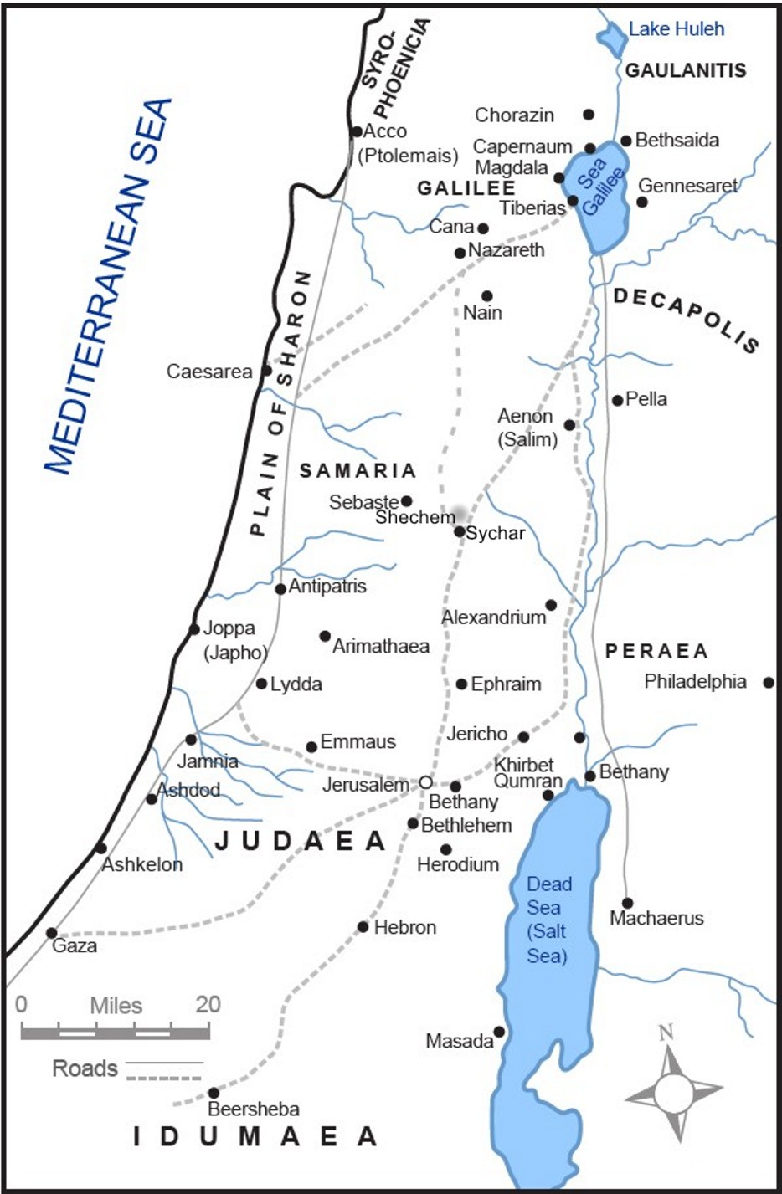
Where is
Jerusalem?

Slide 17
Where is
Aenon?
(near Salim)

Slide 18
Being “Born Again”
What does it mean?
Why do you need it?
How do you get it?
What is the result?

Slide 19
Different Ways
of Saying It!
Being saved!
Having eternal life!
Trusting in Christ!
Accepting Christ as personal Savior!
Becoming a believer in Christ!
Giving your heart to Christ!
Receiving Christ as Savior and Lord!
Experiencing salvation through Christ!
Coming to Jesus—just as I am!
Being “born again”!

Slide 20
Chuck Colson’s
Testimony
“While I sat alone staring at the sea I love, words I had not been certain I could understand or say fell from my lips; ‘Lord Jesus, I believe in You! I accept you! Please come into my life. I commit it to You.’ With these words… came a sureness of mind that matched the depth of feeling in my heart. There came something more: strength and serenity, a wonderful new assurance about life, a fresh perspective of myself in the world around me…”

Slide 21
Meaning of
“born again”
Greek word “anothen”
ανοθεν
“born from above”
Definition:
- from above, from a higher place
- of things which come from heaven or God
- from the first, from the beginning, from the very first
- anew, over again
http://www.biblestudytools.com/lexicons/greek/nas/anothen.html

Slide 22
Ezekiel 36:25-27
(ESV)
²⁵ I will sprinkle clean water on you, and you shall be clean from all your uncleannesses, and from all your idols I will cleanse you. ²⁶ And I will give you a new heart, and a new spirit I will put within you. And I will remove the heart of stone from your flesh and give you a heart of flesh. ²⁷ And I will put my Spirit within you, and cause you to walk in my statutes and be careful to obey my rules.

Slide 23
1 Peter 1:23
(ESV)
²³ since you have been born again, not of perishable seed but of imperishable, through the living and abiding word of God;

Slide 24
Titus 3:5-7
(ESV)
⁵ he saved us, not because of works done by us in righteousness, but according to his own mercy, by the washing of regeneration and renewal of the Holy Spirit, ⁶ whom he poured out on us richly through Jesus Christ our Savior, ⁷ so that being justified by his grace we might become heirs according to the hope of eternal life.

Slide 25
2 Corinthians 5:17
(ESV)
¹⁷ Therefore, if anyone is in Christ, he is a new creation. The old has passed away; behold, the new has come.

Slide 26
John 3:36
(ESV)
³⁶ Whoever believes in the Son has eternal life; whoever does not obey the Son shall not see life, but the wrath of God remains on him.

Slide 27
Closing Thoughts
John Piper once said, “Eternity hangs in the balance when we are talking about the new birth!”
Is that someone here who has never placed his trust in Christ or been “born again” as the basis for salvation and eternal life?
Jesus said in John 6:37,
“…whoever comes to me I will never cast out.”
You can come “just as you are”!

Slide 28
John 3:1-36
Application & Discussion
Are you “born again”? How do you know? Share your story.
What can you learn from Jesus’ approach to evangelism that you might be able to apply?
What impact does John the Baptist’s statement in John 3:27 have on the way you work and live?
What can you learn from John the Baptist about your role in ministry and sharing the Gospel of Jesus Christ?

Slide 29
Closing
Questions?
Comments?
Closing Prayer

