Slide 1
WELCOME TO THE MOB!
All Scripture is breathed out by God and profitable for teaching, for reproof, for correction, and for training in righteousness, that the man of God may be complete, equipped for every good work.
2 Timothy 3:16-17 (ESV)

Slide 2
Announcements
Welcome to the MOB!
MOB Website & Resources: www.ibcmob.net
2022 G3 Regional Conference (Just Thinking About the Bible) – Sep 15th – 17th
Keith & Kristyn Getty Concert – Sep 30th
Mid-Atlantic Regional WACCM Conference – Nov 5th

Slide 3
Please Rise
Invocation/Prayer.
Song:
“Rise Up of Men of God”

Slide 4
Rise Up, O Men of God!
Verse 1 of 4
Rise up, O men of God!
Have done with lesser things.
Give heart and mind and soul and strength
To serve the King of kings.

Slide 5
Rise Up, O Men of God!
Verse 2 of 4
Rise up, O men of God!
The kingdom tarries long.
Bring in the day of brotherhood
And end the night of wrong.

Slide 6
Rise Up, O Men of God!
Verse 3 of 4
Rise up, O men of God! The church for you doth wait, Her strength unequal to her task; Rise up and make her great!

Slide 7
Rise Up, O Men of God!
Verse 4 of 4
Lift high the cross of Christ! Tread where His feet have trod. As brothers of the Son of Man, Rise up, O men of God!

Slide 8
Our Study of Isaiah
Last Meeting:
MOB Welcome / Introduction
Memory Verse: N/A
Dr. Constable’s Notes, 2022 Ed.
This Meeting:
Isaiah Overview
Memory Verse: 2 Timothy 3:16-17
Dr. Constable’s Notes, 2022 Ed., pp. 1 – 25
Refreshment Host: Small Group D

Slide 9
Memory Verse
2 Timothy 3:16-17 (ESV)
““All Scripture is breathed out by God and profitable for teaching, for reproof, for correction, and for training in righteousness, that the man of God may be complete, equipped for every good work!”
2 Timothy 3:16-17 (ESV)

Slide 10
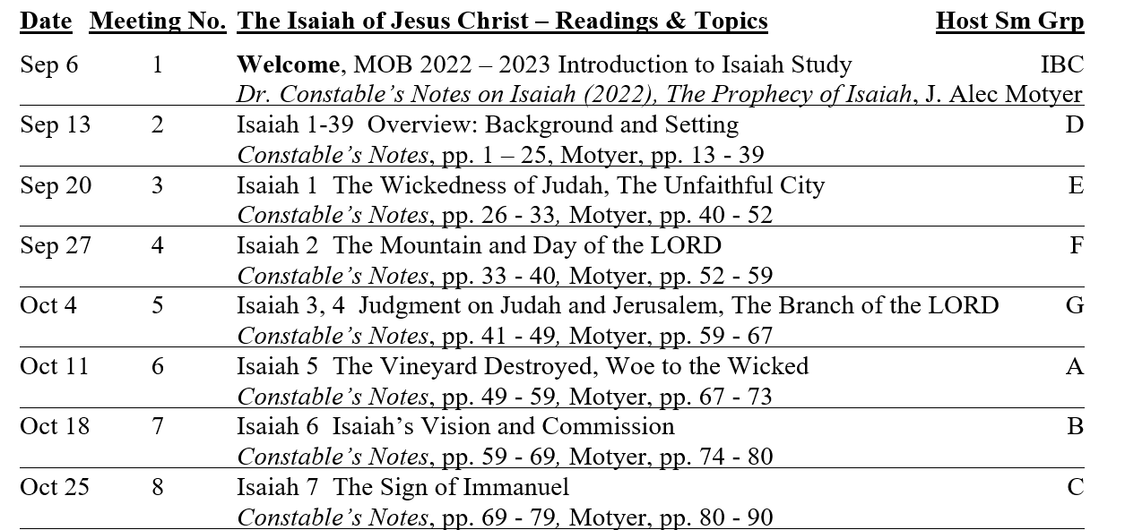
Isaiah Bible Study Schedule for Fall 2022 – Spring 2023 as of September 6, 2022

Slide 11
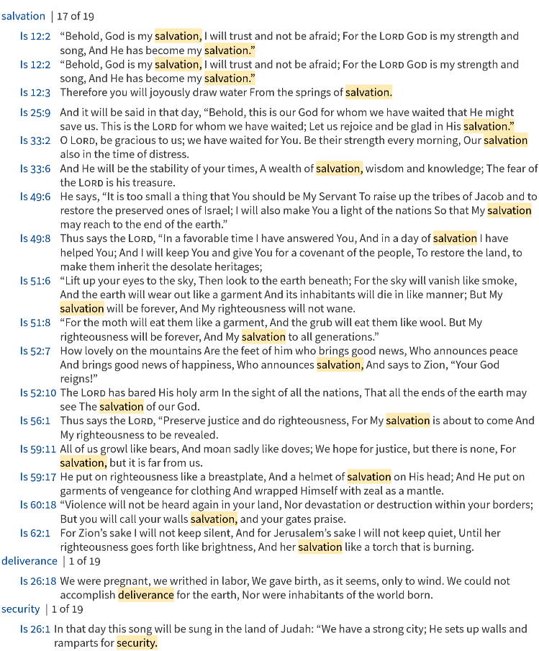
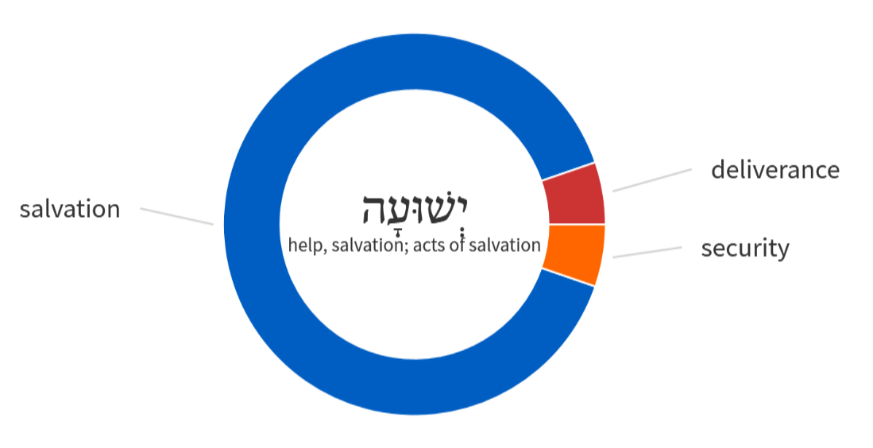
Isaiah = Key word is Salvation
Isaiah means ‘Yahweh (is) salvation’

Slide 12
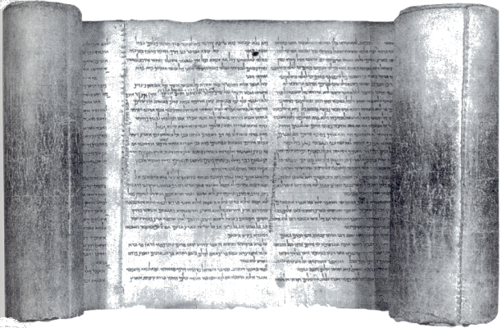
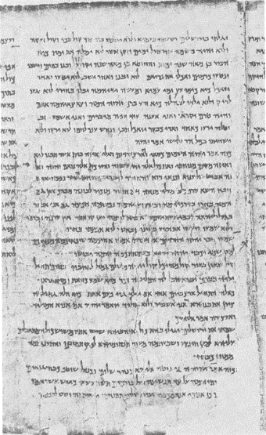
Isaiah and the Dead Sea Scrolls
Masoretic Text dated to ~1000 A.D.
Dead Sea Scrolls added over 1200 years
Qumran sect were detailed in their study and copying of the scripture
Complete text of Isaiah found in Cave 1
600 manuscripts, 200 biblical
Numerous commentaries and hymns
“…there is no evidence from Qumran to justify a major reassessment of traditional views of the origin of Biblical writings.”
Charles F. Pfeiffer, The Dead Sea Scrolls and the Bible (1969).
Isaiah 1 – Showing Is 38:4 – 40:28
“There is indeed, no probability that we shall ever find manuscripts of the Hebrew text going back to a period before the formation of the text which we know as Masoretic.” Sir Frederick Kenyon, 1948
1QIsa (dated circa 100 BC)

Slide 13
Isaiah Outline
Focus | Prophecies of Condemnation |  |  |  |  |  |  |  | Historical Parenthesis |  | Prophecies of Comfort
 | 1:1 |  |  |  |  |  |  | 35:10 | 36:1 | 39:8 | 40:1 |  |  |  |  |  | 66:24
Divisions | Prophecies Against Judah |  | Prophecies Against the Nation |  | Prophesies Against the Day of the Lord |  | Prophesies of Judgement and Blessing |  | Sickness and Sin | Hezekiah’s Salvation | Israel’s Deliverance |  |  | Israel’s Deliverer |  | Israel’s Glorious Future
 | 1:1 | 12:6 | 13:1 | 23:18 | 24:1 | 27:13 | 28:1 | 35:10 | 36:1 | 39:8 | 40:1 | 48:22 |  | 49:1 | 57:21 | 58:1 | 66:24
Topics | Prophetic |  |  |  |  |  |  |  | Historic |  | Messianic
 | Judgement |  |  |  |  |  |  |  | Transition |  | Hope
Place | Israel & Judah
Time | 740 - 680 B.C.
Bruce Wilkinson and Kenneth Boa, Talk Thru the Bible (Nashville: T. Nelson, 1983), 189.

Slide 14
Isaiah – One Writer or more?
Bible | Isaiah 1 – 39 (39 chapters) | Isaiah 40 – 66 (27 Chapters)
Unity supported by Ecclesiastes, Septuagint (LXX) and Talmud | First Isaiah | Deutero-Isaiah (40 – 55) or Deutero-Isaiah (40 – 66)
 | References to Isaiah himself | Lack of prose, stylistic differences
 | Focus on Judah/Jerusalem | Focus on Babylon
All NT authors refer to Isaiah as a single author (e.g. Jn 12:37–41; Rom 9:27; 10:16–21, Mt 3:3; 12:17–21; Lk 3:4–6; Acts 8:28) |  | Sometimes argued as post-exhilic due to familiarity with those events (includes ref to Cyrus and Persia)¹
66 Total books in the Bible | 39 books in the OT | 27 books in the NT
“Salvation” יְשׁוּעָה - 26 times in Isaiah (7 times w/other prophets) | Focus on great need for salvation (e.g. judgement) | Focus on great provision of salvation (e.g. restoration)
 | Historical Parenthesis (36 – 39) Back at Assyria/forward to Babylon | 56 – 66 – focus on how one lives?
The Holy One of Israel (31 total times) | The Holy One of Israel (25 total times)
¹ Isa 44:28; 45:1

Slide 15
The Book of Isaiah
I, I am the Lord, and besides me there is no savior.
43:11

Slide 16
Three Areas for the Overview
~700 BC
During the time of Isaiah’s Prophetic Ministry
~ 32 AD
During the time of Christ’s Earthly Ministry
Today
(and tomorrow)
Application for the Study of the Isaiah Today

Slide 17
During the Time of Isaiah’s Prophetic Ministry (~700 B.C.)
And I heard the voice of the Lord saying, “Whom shall I send, and who will go for us?” Then I said, “Here I am! Send me.”
Isaiah 6:8

Slide 18
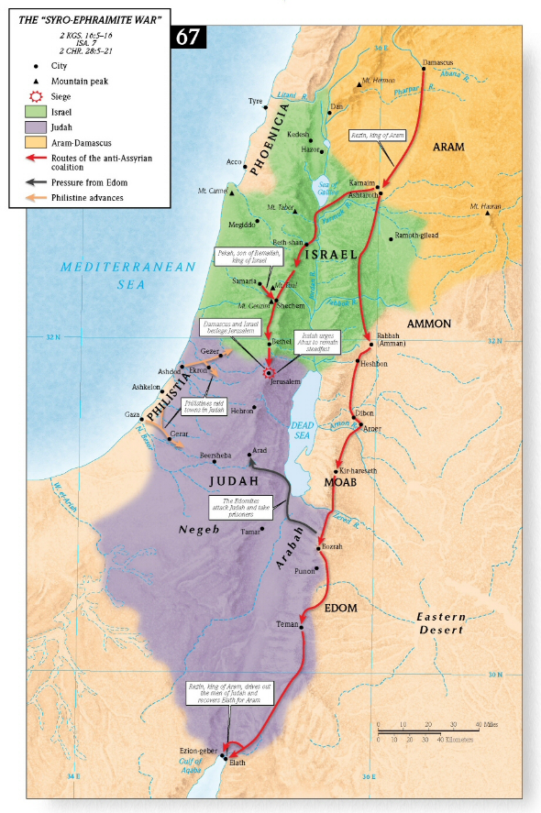
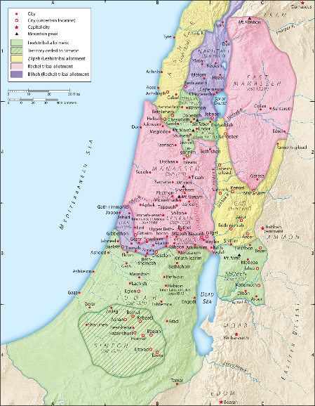
Isaiah’s Ministry (~740 B.C. – 680 B.C.)
The vision of Isaiah the son of Amoz, which he saw concerning Judah and Jerusalem in the days of Uzziah, Jotham, Ahaz, and Hezekiah, kings of Judah.
Isaiah 1:1
Uzziah (790–739 B.C.)
Jotham (739–731 B.C.)
Ahaz (731–715 B.C.)
Hezekiah (715–686 B.C.)
The “Syro-Ephraimite War” ~ 735 B.C.
Notes:
Isaiah lived through a pivotal period of his nation’s history, the second half of the eighth century bc, which saw the rise of written prophecy in the work of Amos, Hosea, Micah and himself, but also the downfall and disappearance of the greater part of Israel, the ten tribes of the northern kingdom
F. Derek Kidner, Isaiah, in New Bible Commentary: 21st Century Edition, ed. D. A. Carson et al., 4th ed. (Leicester, England; Downers Grove, IL: Inter-Varsity Press, 1994), 629.

Slide 19
The Kings of the Divided Monarchy
June 15, 763 BC
931 BC
722 BC
Elijah
Jonah?
Elisha
Amos
Hosea
841 BC
ISRAEL
Jereboam II
Menahem
Jeroboam
Jehoahaz
Zechariah
Pekahiah
971 BC
Baasha
Ahaziah
Jehoash
Shallum
Hoshea
Nadab
Ahab
Joram
Pekah
Elah
Zimri
Omri
Jehu
950
850
750
650
Asa
Joash
Ahaz
Amon
Abijah
Ahaziah
Uzziah
Jotham
Josiah
Jehoram
Athaliah
Amaziah
Hezekiah
Jehoahaz
Zedekiah
Jehoiakim
JUDAH
Rehaboam
Jehosahphat
Manasseh
Jehoiachin
853 BC
Battle of Qarqar (Ahab).
Twelve years later, Shalmaneser III received tribute (Jehu).
Isaiah
Nahum
Zephaniah
Habakkuk
Davidic Reign
(1011-971)
Micah
Jeremiah
Solomonic Reign
(971-931)
Table 6 The Kings of the Divided Monarchy: Merrill, Kingdom of Priests: A History of Old Testament Israel (2008).
Constable, Thomas L. 1985. “1 Kings.” In The Bible Knowledge Commentary: An Exposition of the Scriptures, edited by J. F. Walvoord and R. B. Zuck. Wheaton, IL: Victor Books.
Notes:
Outside the OT an abundance of material provides evidence for a chronology of the period. By far the most important single source is a collection of Assyrian limmu lists. In Assyria a record of each king’s reign was kept on a particular kind of an annal. Each year of reign was named after an individual of high rank in the court; the first year was named after the king himself, the second after the next highest-ranking official (though that name appears to have been selected by lot originally), and so on, down until the death of the king. The word limmu was used to introduce the name of the official after whom the current year was to be named, hence the designation “limmu lists.”
Assyrian limmu lists are tied precisely to the solar year, making the documents highly reliable. Further, in addition to many events in Assyrian history, notable natural phenomena were dated on the basis of the limmu in which they occurred. For example, a solar eclipse dated by the Assyrian scribes in the limmu year of Bur-Sagale has been computed astronomically as June 15, 763 bc Beginning with the year 763, then, and working both backward and forward, a complete list of Assyrian limmu officials has been obtained for the period between 891 and 648 bc.
Walter A. Elwell and Barry J. Beitzel, Chronology, Old Testament, Baker Encyclopedia of the Bible (Grand Rapids, MI: Baker Book House, 1988), 454.
It becomes extremely significant then, that in the eponym of Daian-Assur, 853 b.c., the sixth year of Shalmaneser III, that the battle of Qarqar was fought in which the Israelite king Ahab opposed him. Twelve years later, in the eponym of Adad-rimani, or 841 b.c., Shalmaneser III received tribute from a king “ia-a-u,” a ruler of Israel. This could be none other than the Israelite King Jehu.
Walter C. Kaiser Jr., A History of Israel: From the Bronze Age through the Jewish Wars (Nashville, TN: Broadman & Holman Publishers, 1998), 293.

Slide 20
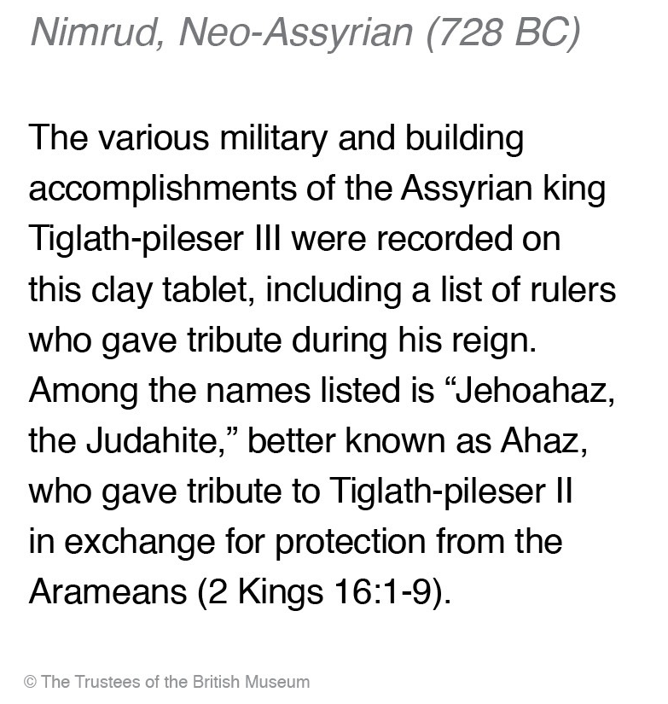
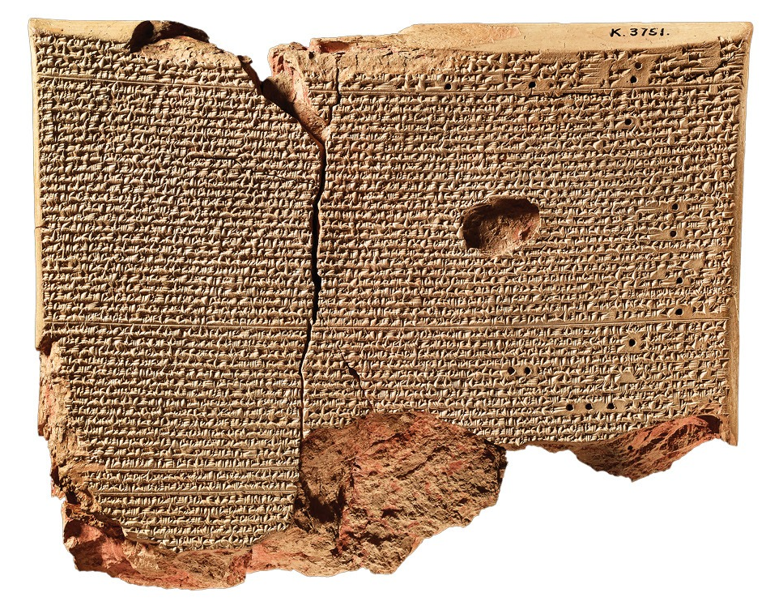
Nimrud Tablet

Slide 21
Four Significant Events
750
740
730
720
710
700
690 B.C.
Co-regency / Co-rule
Uzziah
(790–739 B.C.)
Jotham
(739–731 B.C )
Ahaz
(731–715 B.C.)
Hezekiah
(715–686 B.C.)
King Uzziah died
Isaiah 6
Tiglath-pileser III defeats Syria/Israel
(2 Kgs 16).
Judah pays tribute and becomes vassal state of Assyria
(Isaiah 7)
Shalmanezer V
Assyrian Captivity of Israel
2 Kgs 17
Isaiah 36-37
Sennacherib besieges Jerusalem
(2 Kings 19-19)
Assyrians Destroyed
Isaiah 37:36-38
Kings of Judah Timeline (750 B.C – 686 B.C)
2 Chronicles 26 – 32
2 Kings 14 – 20
Isaiah 1, 6, 14, 20, 21, 36 - 39
Good
Bad
Notes:
And Ahaz slept with his fathers, and they buried him in the city, in Jerusalem, for they did not bring him into the tombs of the kings of Israel.
2 Ch 28:27.

Slide 22
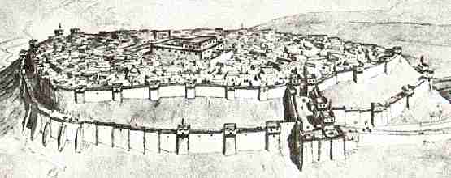
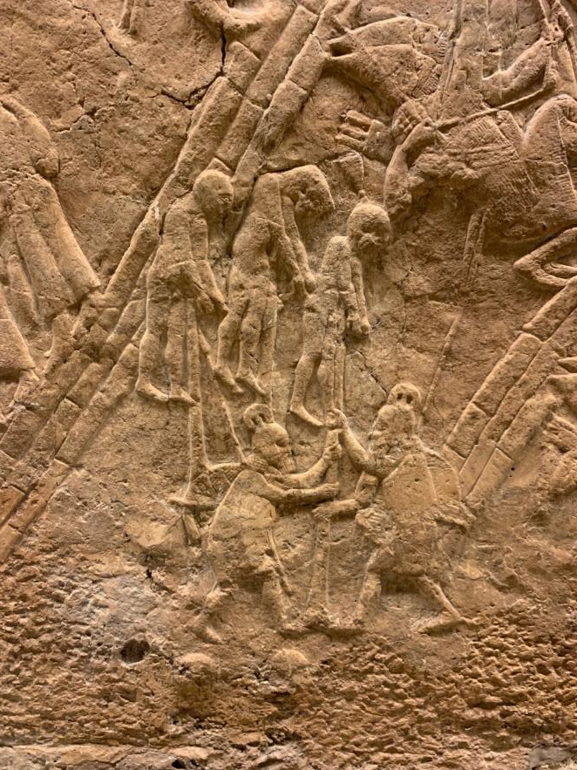
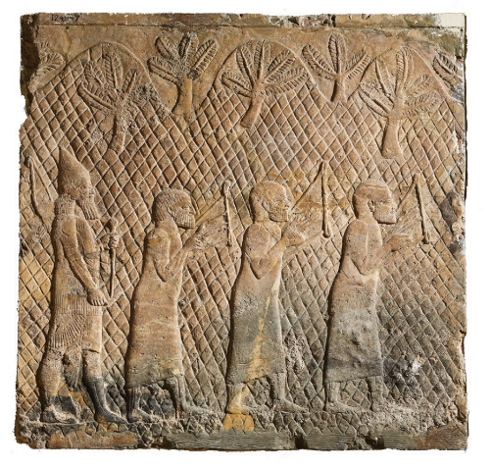
The Siege of Lachish
The capture of Lachish was used as a decorative theme for paneling in one of the most prominent rooms is Sennacherib’s palace at Nineveh. 2 Kings 18 records that Sennacherib was based at Lachish while negotiating Hezekiah’s submission.
Relief of Assyrian Soldier with captives
2 Kings 18-19, 2 Chron 32, Isa 36-37
British Museum, Streitmater 2018
Notes:
The Assyrian kings were proud of their cruel and terrible reputation and went to great trouble and expense to record their exploits for posterity. Archaeologists have uncovered many reliefs (large stone wall panels with carved depictions) of grisly post-battle scenes, which were erected in palaces so that they could be seen daily. In addition, written descriptions of post-battle tortures of prisoners were preserved on obelisks and cylindrical pillars. Discovered in these pictorial and written displays are gruesome details and horrific boasting. “It is as gory and bloodcurdling a history as we know.”
Assyrians boasted of their cruelty to captured peoples following the siege of their town or city, and their victims were not limited to combatants. (Warning: What follows is rated “R” for gore and violence.) Records brag of live dismemberment, often leaving one hand attached so they could shake it before the person died. They made parades of heads, requiring friends of the deceased to carry them elevated on poles. They boasted of their practice of stretching live prisoners with ropes so they could be skinned alive. The human skins were then displayed on city walls and on poles. They commissioned pictures of their post-battle tortures where piles of heads, hands, and feet, and heads impaled on poles—eight heads to a stake—were displayed. They pulled out the tongues and testicles of live victims and burned the young alive.
James Bruckner, Jonah, Nahum, Habakkuk, Zephaniah, The NIV Application Commentary (Grand Rapids, MI: Zondervan Publishing House, 2004), 2829.

Slide 23
During the Time of Christ’s Earthly Ministry
And Paul went in, as was his custom…explaining and proving that it was necessary for the Christ to suffer and to rise from the dead, and saying, “This Jesus, whom I proclaim to you, is the Christ.”
Acts 17:2-3

Slide 24
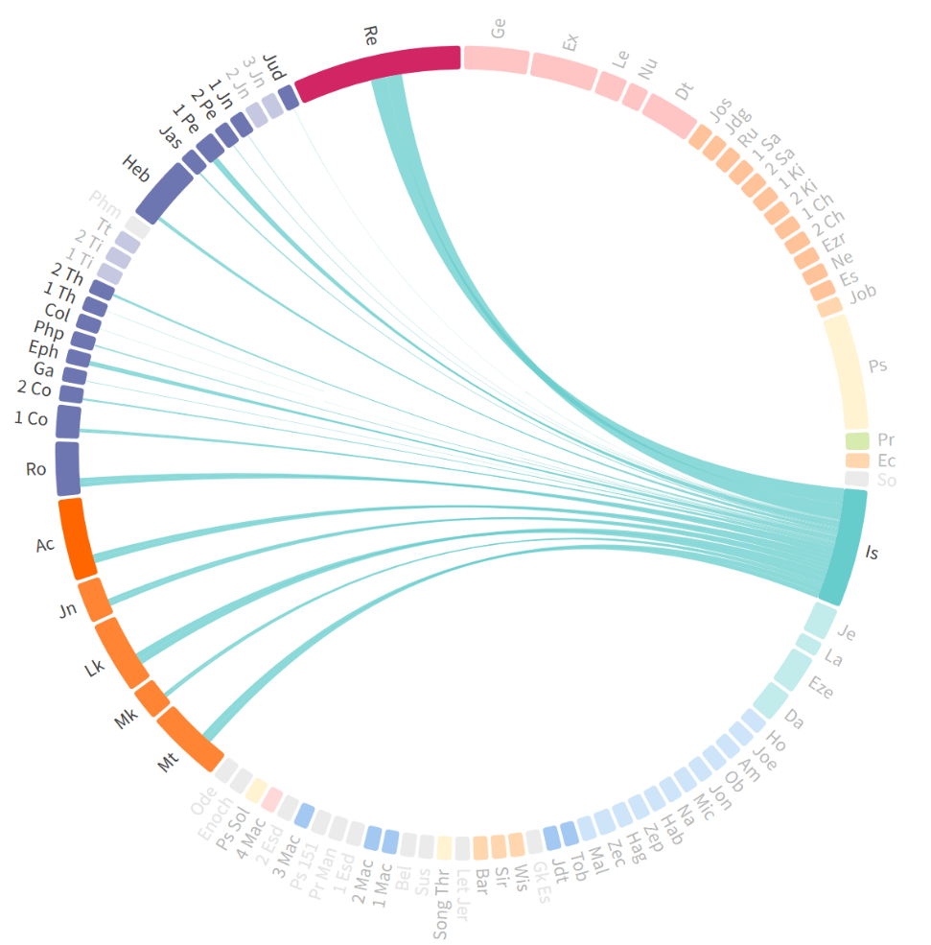
Isaiah’s Use in the New Testament
Most quoted prophet in NT
63 Citations
Gospels, Acts, 1 & 2 Cor, Romans, Galatians, Hebrews, 1 Peter
22 direct references to Isaiah
47 of 66 Chapters with allusions
366 lemmas “root words” used only in Isaiah
(a very complex writing)
Bible Books Explorer. (2020). Bellingham, WA: Faithlife.

Slide 25
Depth of Isaiah in the New Testament
58 direct quotes, in which 41 different verses or passages are represented
Is 6:9-10 most quoted
In discussing the fate of the Jews, Paul quotes Isaiah 11 times
(Rom. 9:29 = Is. 1:9; 9:27–28 = 10:22–23; 11:26–27 = 27:9; 11:8 = 29:10; 11:34 = 40:13; 10:15 = 52:7; 11:26–27 = 59:20–21; 10:20 = 65:1; 10:21 = 65:2).
Isaiah influenced the church’s understanding of its mission to the Gentiles.
The mysterious plan of God (29:14 = 1 Cor. 1:19; 40:13 = 1 Cor. 2:16; 66:4 = 1 Cor. 2:9),
God’s people would declare salvation to the entire world (11:10 = Rom. 15:12; 49:6 = Acts 13:47; 52:5 = Rom. 2:24; 52:15 = Rom. 15:21),
J. N. Oswalt, Isaiah, in New Dictionary of Biblical Theology, ed. T. Desmond Alexander and Brian S. Rosner, electronic ed. (Downers Grove, IL: InterVarsity Press, 2000), 223.

Slide 26
Matthew 4:12 - 16
Now when he heard that John had been arrested, he withdrew into Galilee. And leaving Nazareth he went and lived in Capernaum by the sea, in the territory of Zebulun and Naphtali, so that what was spoken by the prophet Isaiah might be fulfilled:
“The land of Zebulun and the land of Naphtali, the way of the sea, beyond the Jordan, Galilee of the Gentiles— the people dwelling in darkness have seen a great light, and for those dwelling in the region and shadow of death, on them a light has dawned.” (Isaiah 9:1b-2)

Slide 27
Luke 4:16-21
And He came to Nazareth, where He had been brought up; and as was His custom, He entered the synagogue on the Sabbath, and stood up to read. And the book of the prophet Isaiah was handed to Him. And He opened the book and found the place where it was written,
“The Spirit of the Lord is upon Me, Because He anointed Me to preach the gospel to the poor. He has sent Me to proclaim release to the captives, And recovery of sight to the blind, To set free those who are oppressed, To proclaim the favorable year of the Lord.” (Isaiah 61:1-2a)
And He closed the book, gave it back to the attendant and sat down; and the eyes of all in the synagogue were fixed on Him. And He began to say to them, “Today this Scripture has been fulfilled in your hearing.”

Slide 28
Isaiah Messianic Prophesy
Along with Psalm 22, Isaiah 53¹ lists the most remarkable and specific prophecies of the atonement of the Messiah. Fulfilling each clear prophecy, the Jewish nation later proved the messiahship of Jesus.
Isaiah’s messianic prophecies that await fulfillment in the Lord’s second advent include: 4:2; 11:2–6, 10; 32:1–8; 49:7; 52:13, 15; 59:20–21; 60:1–3; 61:2–3.
¹ Bruce Wilkinson and Kenneth Boa, Talk Thru the Bible (Nashville: T. Nelson, 1983), 192.
¹ Alluded to or quoted at least 85 times in the NT

Slide 29
Some familiar verses…
A voice is calling, “Clear the way for the Lord in the wilderness; Make smooth in the desert a highway for our God. (Is 40:3) – all 4 gospels
Therefore the Lord himself will give you a sign. Behold, the virgin shall conceive and bear a son, and shall call his name Immanuel. (Is 7:14)
The people who walked in darkness have seen a great light; those who dwelt in a land of deep darkness, on them has light shone. (Is 9:2)
He was despised and rejected by men, a man of sorrows and acquainted with grief; (Is 53:3)
But he was pierced for our transgressions; he was crushed for our iniquities
All we like sheep have gone astray; we have turned—every one—to his own way; and the Lord has laid on him the iniquity of us all.
Thus says the LORD, “Heaven is My throne and the earth is My footstool. Where then is a house you could build for Me? And where is a place that I may rest? (Is 66:1)

Slide 30
Application for the Study of the Isaiah Today
“Behold, God is my salvation; I will trust, and will not be afraid; for the Lord God is my strength and my song, and he has become my salvation.”
Isaiah 12:2

Slide 31
Key Things to Consider
Isaiah was a prophet without peer
Presented God as great, transcendently separate, authoritative, omnipotent, majestic, holy, and morally and ethically perfect ¹
Front row seat to the human condition of rebellion
v 1:2; 66:24 – the ultimate result is judgement
A literal interpretation lens guides Messianic view
Amazing detail provided on the Messiah / Suffering Servant
The books prophetic focus drives a certainty on Jesus as the Messiah and an end times view
¹ Dr. Constables notes, Page 12
Notes:
Some of his prophecies have been fulfilled but many await fulfillment. Fulfillment of some of Isaiah’s prophecies in his own lifetime provided his credentials for the prophetic office. Sennacherib’s effort to take Jerusalem failed, just as Isaiah had said it would (37:6, 7, 36-38). The Lord healed Hezekiah’s illness as Isaiah predicted (38:5; 2 Kings 20:7). Long before Cyrus, king of Persia appeared on the scene, Isaiah named him as Judah’s deliverer from Babylonian captivity (44:28; 45:1). Fulfillment of his prophecies concerning Christ’s first coming have given Isaiah further vindication (e.g., 7:14). The literal fulfillment pattern of his already-fulfilled prophecies gives assurance that prophecies of Christ’s Second Coming will also see literal fulfillment.
Isaiah provides data on the future Day of the Lord and the time following. He details numerous aspects of Israel’s future kingdom on earth not found elsewhere in the Old Testament or New Testament, including changes in nature, the animal world, Jerusalem’s status among the nations, and the Suffering Servant’s leadership.

Slide 32
Discussion and Application
What element discussed tonight about the context of Isaiah brought a new perspective to Scripture?
Isaiah plumbs the depth of God and his vision pointed the Jesus Christ 700 years later. Read Isaiah 40 and each person individually pick a verse with specific meaning they can share.

Slide 33
Isaiah Outline
Focus | Prophecies of Condemnation |  |  |  |  |  |  |  | Historical Parenthesis |  | Prophecies of Comfort
 | 1:1 |  |  |  |  |  |  | 35:10 | 36:1 | 39:8 | 40:1 |  |  |  |  |  | 66:24
Divisions | Prophecies Against Judah |  | Prophecies Against the Nation |  | Prophesies Against the Day of the Lord |  | Prophesies of Judgement and Blessing |  | Sickness and Sin | Hezekiah’s Salvation | Israel’s Deliverance |  |  | Israel’s Deliverer |  | Israel’s Glorious Future
 | 1:1 | 12:6 | 13:1 | 23:18 | 24:1 | 27:13 | 28:1 | 35:10 | 36:1 | 39:8 | 40:1 | 48:22 |  | 49:1 | 57:21 | 58:1 | 66:24
Topics | Prophetic |  |  |  |  |  |  |  | Historic |  | Messianic
 | Judgement |  |  |  |  |  |  |  | Transition |  | Hope
Place | Israel & Judah
Time | 740 - 680 B.C.
Bruce Wilkinson and Kenneth Boa, Talk Thru the Bible (Nashville: T. Nelson, 1983), 189.

Slide 34
Next Meeting
Review:
Isaiah – Overview
Memory Verse: 2 Timothy 3:16-17
Dr. Constable’s Notes on Isaiah, 2022 Edition, pp. 1-25
Study:
Isaiah 1
Memory Verse: Isaiah 1:18
Dr. Constable’s Notes on Isaiah, 2022 Edition, pp. 26-33
Refreshment Host: Small Group E

Slide 35
Isaiah Bible Study Schedule for Fall 2022 – Spring 2023 as of September 6, 2022

Slide 36
Backup

Slide 37
Isaiah had two sons (Isa 8:3)
Maher-shalal-hash-baz means “hasten booty, speed the spoil,” a reference to the impending destruction of Judah’s enemies, Damascus and Israel, by the Assyrians. (Isa 8:3)
Shear-jashub—“a remnant shall return”—foreshadows either a promise or warning that a remnant of Judah would survive God’s judgment meted out by the Assyrians. (Isa 7:3)
Thomas V. Brisco, Holman Bible Atlas, Holman Reference (Nashville, TN: Broadman & Holman Publishers, 1998), 141.

Slide 38
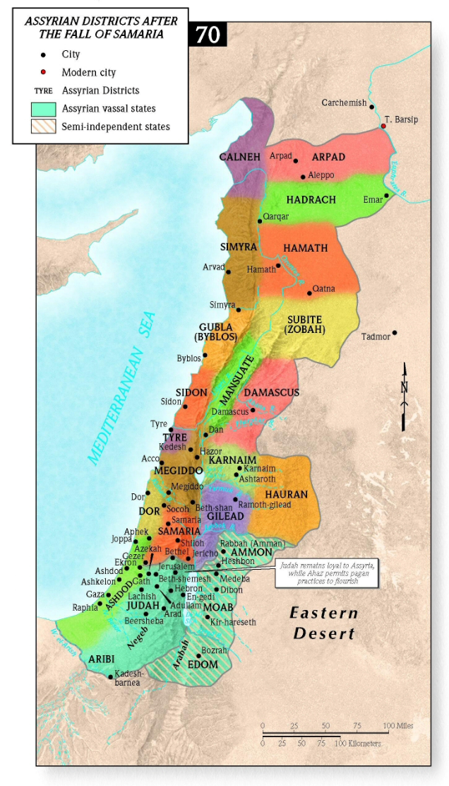

Slide 39
The Dating of The Kings
In Assyria a record of each king’s reign was kept on a particular kind of an annal… The word limmu was used to introduce the name of the official—resulting in the designation “limmu lists.
The limmu list of the Assyrian king Shalmaneser III pulls together Assyria, Israel, and Judah. In Shalmaneser’s sixth year on the throne, Ahab of Israel was listed as one of the kings who fought against the Assyrians in the battle of Qarqar. Thus the date for that battle may be placed confidently in 853 bc.
Walter A. Elwell and Barry J. Beitzel, Chronology, Old Testament, Baker Encyclopedia of the Bible (Grand Rapids, MI: Baker Book House, 1988), 455.

Slide 40
More Familiar Verses
The Spirit of the Lord God is upon me, Because the Lord has anointed me To bring good news to the afflicted (Is 61:1)
“For behold, I create new heavens and a new earth; And the former things will not be remembered or come to mind. (Is 65:17)
“Come now, let us reason together, says the Lord: though your sins are like scarlet, they shall be as white as snow; though they are red like crimson, they shall become like wool. (Is 1:18)
Learn to do good; Seek justice, Reprove the ruthless, Defend the orphan, Plead for the widow. (Is 1:17)
And the foundations of the thresholds shook at the voice of him who called, and the house was filled with smoke. And I said: “Woe is me! For I am lost; for I am a man of unclean lips, and I dwell in the midst of a people of unclean lips; for my eyes have seen the King, the Lord of hosts!” (Is 6:5)

Slide 41
More Familiar Verses
There shall come forth a shoot from the stump of Jesse, and a branch from his roots shall bear fruit. And the Spirit of the LORD shall rest upon him, the Spirit of wisdom and understanding, the Spirit of counsel and might, the Spirit of knowledge and the fear of the LORD. (Is 11:1-2)
And the Lord said: “Because this people draw near with their mouth and honor me with their lips, while their hearts are far from me, and their fear of me is a commandment taught by men, (Is 29:13)
The grass withers, the flower fades, but the word of our God will stand forever. (Is 40:8)
How lovely on the mountains Are the feet of him who brings good news, Who announces peace And brings good news of happiness, Who announces salvation, And says to Zion, “Your God reigns!” (Is 52:7)

