Slide 1
Exodus 2 9
The Consecration of the Priests

Slide 2
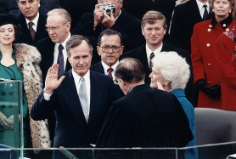
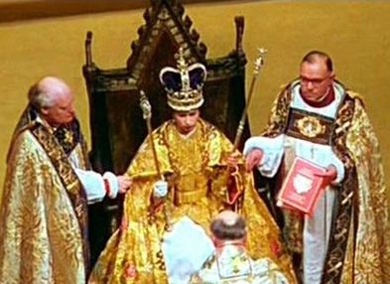
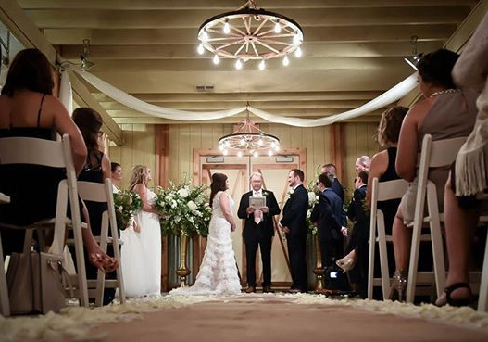
Public Consecrations
Presidential Inaugurations
Royal
Coronations
Weddings
Weddings

Slide 3
The Consecration of the Priests
The Consecration was Seen in Public
The Consecration was Symbolic
The Consecration was Sacrificial
The Consecration was Seven Days in Length

Slide 4
The Consecration of the Priests
The Priests were Publicly Washed (Exodus 29:4)
^{4 ”}You shall bring Aaron and his sons to the entrance of the tent of meeting and wash them with water.”

Slide 5
The Consecration of the Priests
The Priests were Publicly Clothed (Exodus 29:5-6; 8-9)
⁵ Then you shall take the garments, and put on Aaron the coat and the robe of the ephod, and the ephod, and the breastpiece, and gird him with the skillfully woven band of the ephod. ⁶ And you shall set the turban on his head and put the holy crown on the turban.
⁸ Then you shall bring his sons and put coats on them, ⁹ and you shall gird Aaron and his sons with sashes and bind caps on them. And the priesthood shall be theirs by a statute forever. Thus you shall ordain Aaron and his sons.

Slide 6
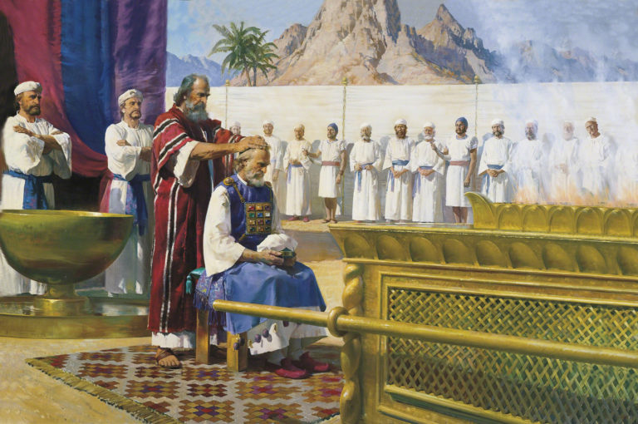
Exodus 29
The Ordination of Aaron

Slide 7
The Consecration of the Priests
The Priests were Publicly Anointed (Exodus 29: 7, 21)
⁷ You shall take the anointing oil and pour it on his head and anoint him.
²¹ Then you shall take part of the blood that is on the altar, and of the anointing oil, and sprinkle it on Aaron and his garments, and on his sons and his sons' garments with him. He and his garments shall be holy, and his sons and his sons' garments with him.

Slide 8
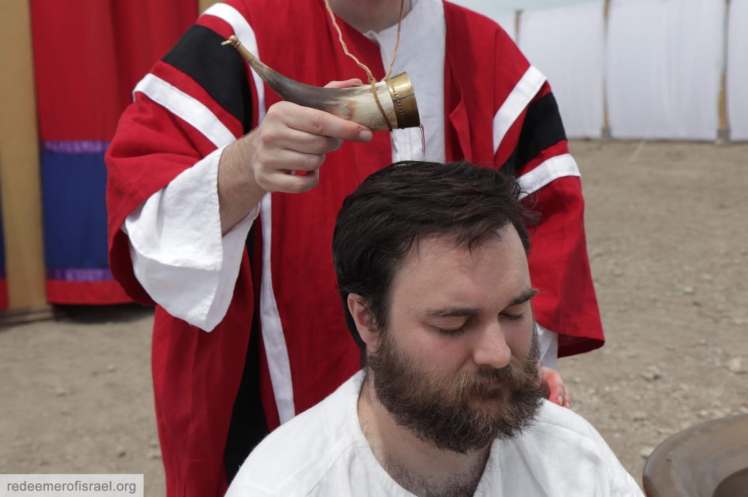

Slide 9
The Consecration of the Priests
The Priests Offered Public Sacrifices (Exodus 29: 10 - 14)
¹⁰ “Then you shall bring the bull before the tent of meeting. Aaron and his sons shall lay their hands on the head of the bull. ¹¹ Then you shall kill the bull before the Lord at the entrance of the tent of meeting, ¹² and shall take part of the blood of the bull and put it on the horns of the altar with your finger, and the rest of the blood you shall pour out at the base of the altar.
¹³ And you shall take all the fat that covers the entrails, and the long lobe of the liver, and the two kidneys with the fat that is on them, and burn them on the altar. ¹⁴ But the flesh of the bull and its skin and its dung you shall burn with fire outside the camp; it is a sin offering.

Slide 10
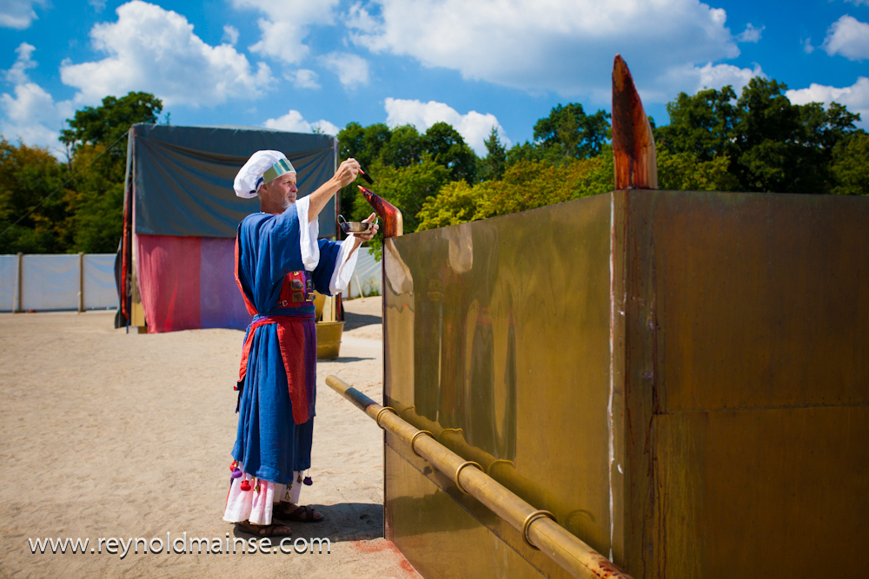

Slide 11
The Consecration of the Priests
The Priests were Publicly Dedicated to God (Exodus 29: 15-18)
¹⁵ “Then you shall take one of the rams, and Aaron and his sons shall lay their hands on the head of the ram, ¹⁶ and you shall kill the ram and shall take its blood and throw it against the sides of the altar.
¹⁷ Then you shall cut the ram into pieces, and wash its entrails and its legs, and put them with its pieces and its head, ¹⁸ and burn the whole ram on the altar. It is a burnt offering to the Lord. It is a pleasing aroma, a food offering to the Lord.

Slide 12
The Consecration of the Priests
The Priests were Publicly Marked by Blood (Exodus 29: 19-22)
¹⁹ “You shall take the other ram, and Aaron and his sons shall lay their hands on the head of the ram, ²⁰ and you shall kill the ram and take part of its blood and put it on the tip of the right ear of Aaron and on the tips of the right ears of his sons, and on the thumbs of their right hands and on the great toes of their right feet, and throw the rest of the blood against the sides of the altar.

Slide 13
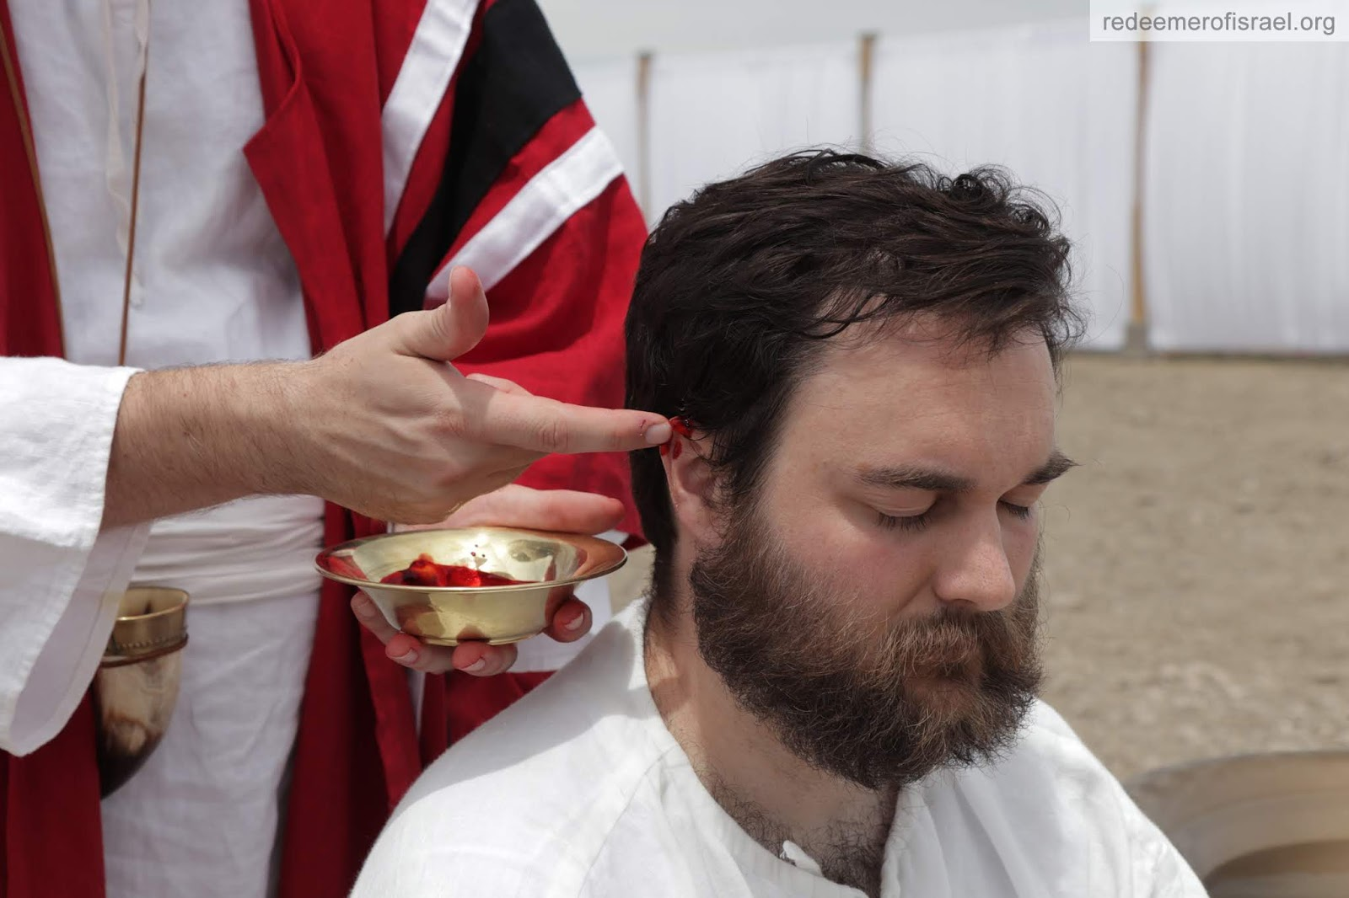
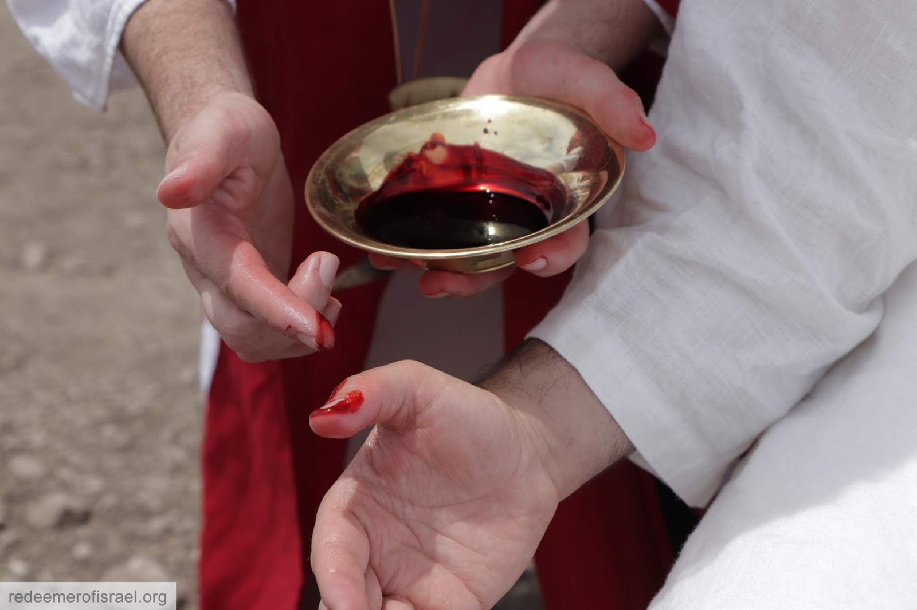
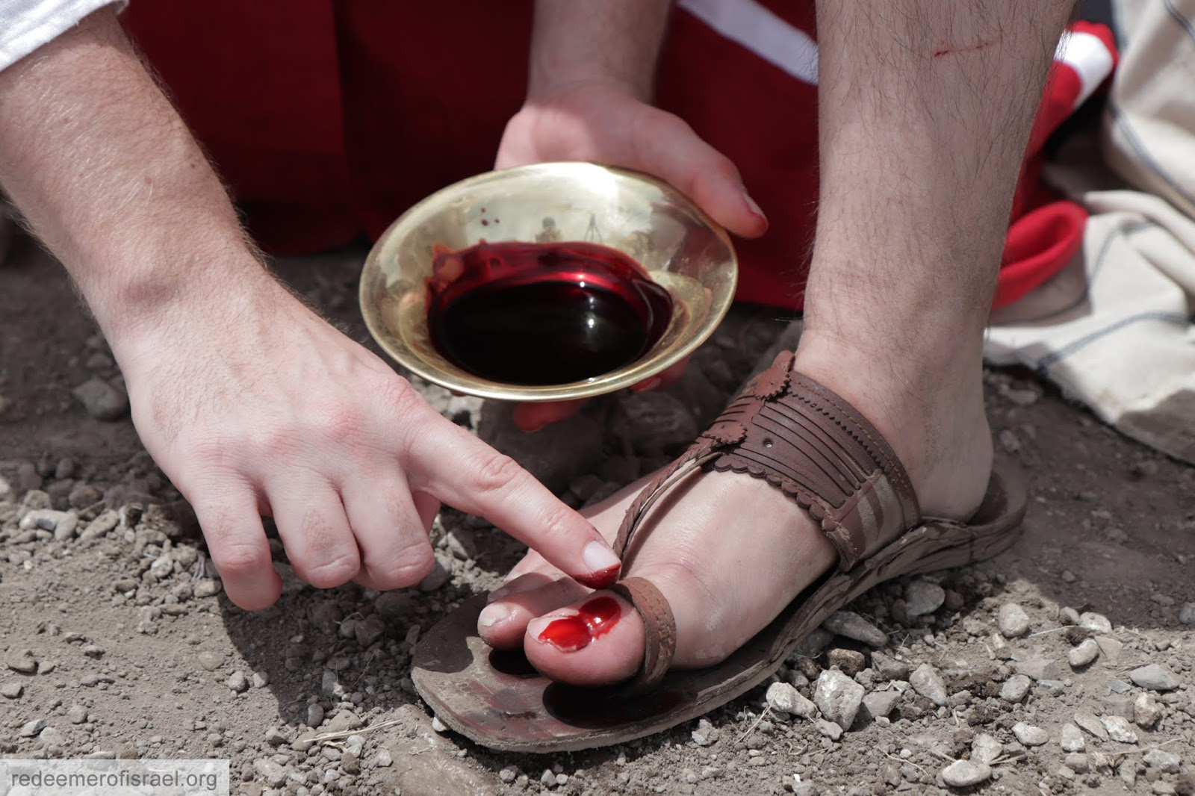

Slide 14
The Consecration of the Priests
The Priests were Publicly Marked by Blood (Exodus 29: 19-22)
²¹ Then you shall take part of the blood that is on the altar, and of the anointing oil, and sprinkle it on Aaron and his garments, and on his sons and his sons' garments with him. He and his garments shall be holy, and his sons and his sons' garments with him. ²² “You shall also take the fat from the ram and the fat tail and the fat that covers the entrails, and the long lobe of the liver and the two kidneys with the fat that is on them, and the right thigh (for it is a ram of ordination),…”

Slide 15
The Consecration of the Priests
The Priests were Publicly Fed (Exodus 29:22-28; 31-34)
²² “You shall also take the fat from the ram and the fat tail and the fat that covers the entrails, and the long lobe of the liver and the two kidneys with the fat that is on them, and the right thigh (for it is a ram of ordination), ²³ and one loaf of bread and one cake of bread made with oil, and one wafer out of the basket of unleavened bread that is before the Lord.
²⁴ You shall put all these on the palms of Aaron and on the palms of his sons, and wave them for a wave offering before the Lord. ²⁵ Then you shall take them from their hands and burn them on the altar on top of the burnt offering, as a pleasing aroma before the Lord. It is a food offering to the Lord.

Slide 16
The Consecration of the Priests
The Priests were Publicly Fed (Exodus 29:22-28; 31-34)
²⁶ “You shall take the breast of the ram of Aaron's ordination and wave it for a wave offering before the Lord, and it shall be your portion. ²⁷ And you shall consecrate the breast of the wave offering that is waved and the thigh of the priests' portion that is contributed from the ram of ordination, from what was Aaron's and his sons'. ²⁸ It shall be for Aaron and his sons as a perpetual due from the people of Israel, for it is a contribution. It shall be a contribution from the people of Israel from their peace offerings, their contribution to the Lord.

Slide 17
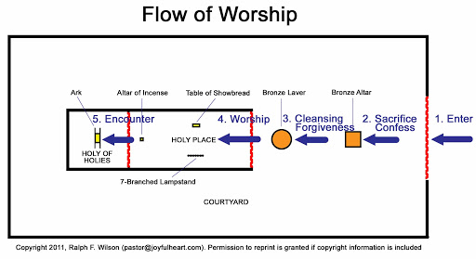

Slide 18
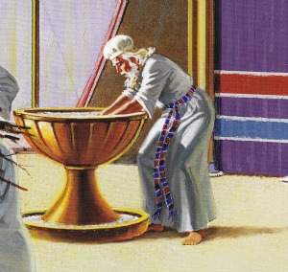
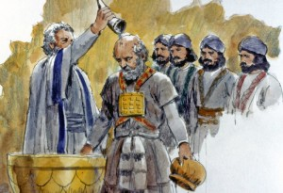

Slide 20
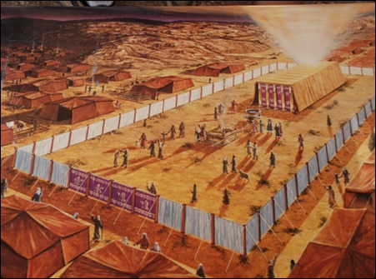

Slide 21
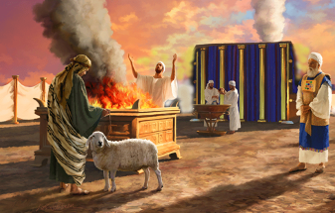

Slide 22
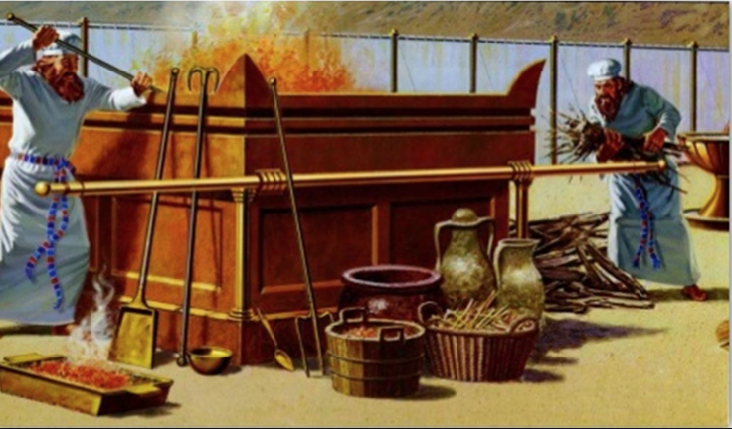

Slide 23
