Slide 1
WELCOME TO THE MOB!
All Scripture is breathed out by God and profitable for teaching, for reproof, for correction, and for training in righteousness, that the man of God may be complete, equipped for every good work.
2 Timothy 3:16-17 (ESV)

Slide 2
Announcements
MOB Website & Resources: www.ibcmob.net
Welcome to Immanuel Christian School!
https://immanuelbible.church/
https://immanuelbible.church/summer-breakout-series-2023
(943) What's Happening at IBC - Fall 2023 – YouTube
(943) Croc's Corner - YouTube
Jesse Johnson – The Christian Worldview

Slide 3
Please Rise
Invocation/Prayer.
Song:
“Behold Our God”

Slide 4
Behold Our God
Verse 1
Who has held the oceans in His hands?
Who has numbered every grain of sand?
Kings and nations tremble at His voice
All creation rises to rejoice

Slide 5
Behold Our God
Chorus
Behold our God seated on His throne
Come let us adore Him
Behold our King nothing can compare
Come let us adore Him!

Slide 6
Behold Our God
Verse 2
Who has given counsel to the Lord?
Who can question any of His Words?
Who can teach the One who knows all things?
Who can fathom all His wondrous deeds?

Slide 7
Behold Our God
Chorus
Behold our God seated on His throne
Come let us adore Him
Behold our King nothing can compare
Come let us adore Him!

Slide 8
Behold Our God
Verse 3
Who has felt the nails upon His hands
Bearing all the guilt of sinful man?
God eternal humbled to the grave
Jesus, Savior risen now to reign.

Slide 9
Behold Our God
Chorus
Behold our God seated on His throne
Come let us adore Him
Behold our King nothing can compare
Come let us adore Him!

Slide 10
Our Study of Isaiah
Last Meeting:
Isaiah Intro
Memory Verse: N/A
Dr. Constable’s Notes, 2022 Ed., pp. 255-486; Motyer, pp. 498-305
Refreshment Host: Courtesy of IBC
This Meeting:
Isaiah 40:1-20, The Consolation of Zion
Memory Verse: Isaiah 40:8
Dr. Constable’s Notes, 2022 Ed., pp. 255-267; Motyer, pp. 498-305
Refreshment Host: Group A
Notes:
Welcome to MOB
Rod Turk covered Isaiah 14 last year. Does anyone remember the key word or topic he highlighted as part of his lesson? PRIDE. We’ll expand on that idea—but more from God’s attributes than our own.

Slide 11
Memory Verse
Isaiah 40:8 (ESV)
“The grass withers, the flower fades, but the word of our God will stand forever.”
Isaiah 40:8 (ESV)
Notes:
It really is a great verse. A lot packed into the application of Isaiah that we’ll touch on.

Slide 12
Isaiah Outline
Focus | Prophecies of Condemnation |  |  |  |  |  |  |  | Historical Parenthesis |  | Prophecies of Comfort
 | 1:1 |  |  |  |  |  |  | 35:10 | 36:1 | 39:8 | 40:1 |  |  |  |  |  | 66:24
Divisions | Prophecies Against Judah |  | Prophecies Against the Nation |  | Prophesies Against the Day of the Lord |  | Prophesies of Judgement and Blessing |  | Sickness and Sin | Hezekiah’s Salvation | Israel’s Deliverance |  |  | Israel’s Deliverer |  | Israel’s Glorious Future
 | 1:1 | 12:6 | 13:1 | 23:18 | 24:1 | 27:13 | 28:1 | 35:10 | 36:1 | 39:8 | 40:1 | 48:22 |  | 49:1 | 57:21 | 58:1 | 66:24
Topics | Prophetic |  |  |  |  |  |  |  | Historic |  | Messianic
 | Judgement |  |  |  |  |  |  |  | Transition |  | Hope
Place | Israel & Judah
Time | 740 - 680 B.C.
We are here!
Bruce Wilkinson and Kenneth Boa, Talk Thru the Bible (Nashville: T. Nelson, 1983), 189.

Slide 13
Scriptural Interpretation at IBC
https://immanuelbible.church/visit/what-we-teach
Notes:
The teaching of Immanuel Bible Church is based on the Scriptures. This
article (Article V) serves as our statement of faith, and it reflects those
doctrines that the elders and congregation consider essential to understanding, teaching, and practicing God’s Word. It is based on an interpretation of the Scripture that is:

Slide 14
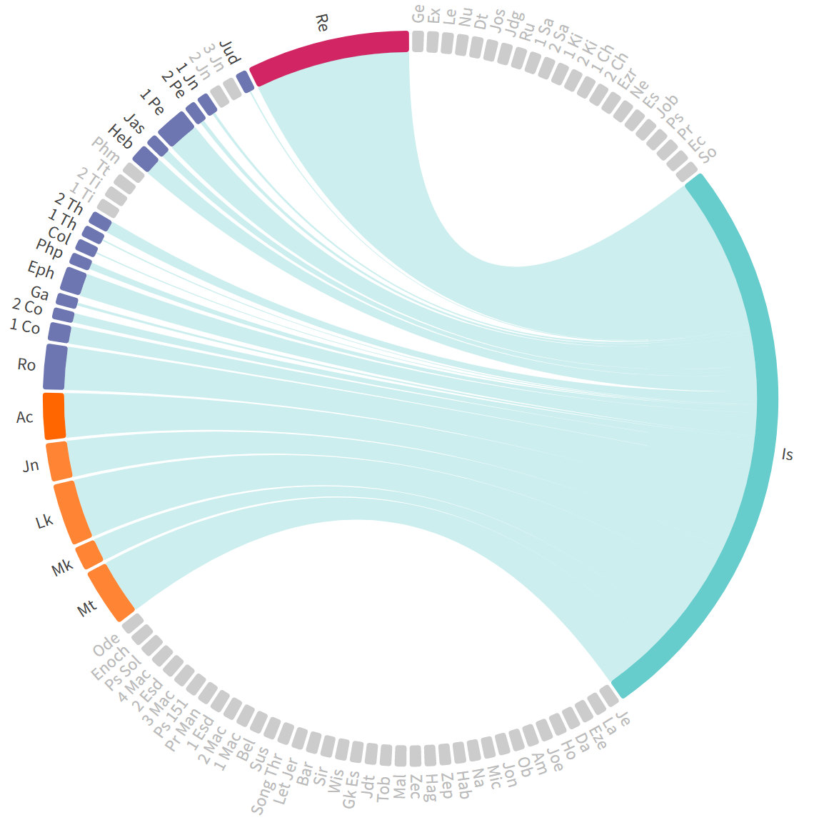
New Testament Use of Isaiah
412 times there are references to the book and prophet Isaiah
162 times within the gospels and Acts
66x Isaiah a source for Jesus
100 times by Paul
32x in Romans (22 quotes/citations)
115 times in Revelation
Chord Graph

Slide 15
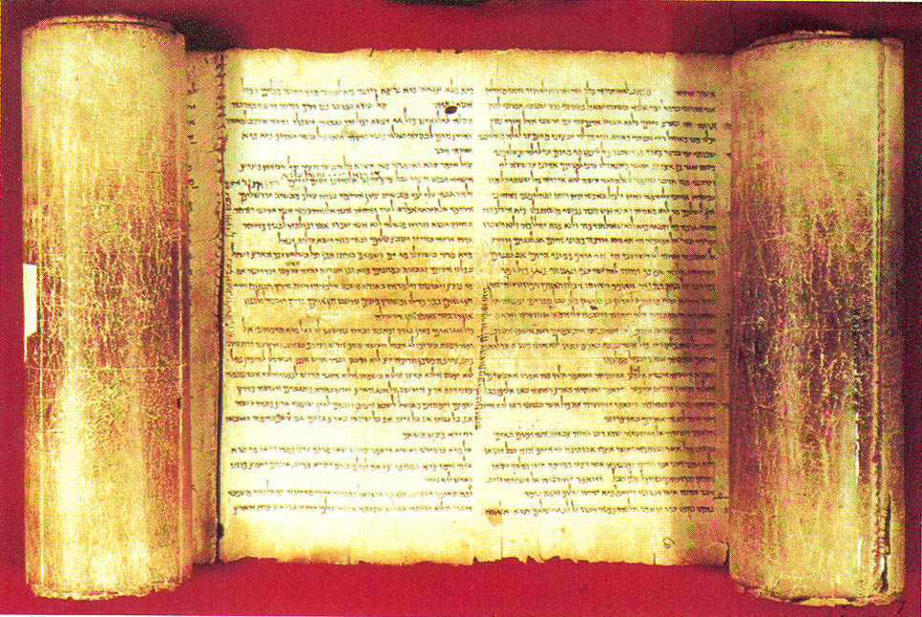
Theme – from Constable’s notes
God’s faithfulness to His promises to give His people a glorious future after He disciplined them for their unfaithfulness

Slide 16
Isaiah 40:1-2
¹ “Comfort, O comfort My people,” says your God.
² “Speak kindly to Jerusalem;
And call out to her, that her warfare has ended,
That her iniquity has been removed, That she has received of the Lord’s hand
Double for all her sins.”
Through: Poetry
Literary compositions characterized by figurative language, wordplay, rhythm, balance, and emotional expression that are crafted in order to produce an emotional response in the reader.
The Lexham Glossary of Literary Types (Bellingham, WA: Lexham Press, 2014).
Notes:
Twenty-Three Days - August 22
He was a has-been, a fossil, a relic, an old fogey … but as a child, George Frideric Handel had accompanied his father to the court of Duke Johann Adolf. Idly wandering into the chapel, the boy found the organ and started improvising, causing Duke Adolf to exclaim, “Who is this remarkable child?”
This “remarkable child” soon began composing operas, first in Italy, then in London. By his 20s he was the talk of England and the best paid composer on earth. He opened the Royal Academy of Music. Londoners fought for seats at his every performance, and his fame soared around the world.
But the glory passed. Audiences dwindled. His music became outdated. The academy went bankrupt, and newer artists eclipsed the aging composer. One project after another failed, and Handel grew depressed. The stress brought on a case of palsy that crippled some of his fingers. “Handel’s great days are over,” wrote Frederick the Great, “his inspiration is exhausted.”
Yet his troubles also matured him, softening his sharp tongue. His temper mellowed, and his music became more heartfelt. One morning Handel received by post a script from Charles Jennens. It was a word-for-word collection of various biblical texts about Christ. The opening words from Isaiah 40 moved Handel: Comfort ye my people. …
On August 22, 1741 he shut the door of his London home and started composing music for the words. Twenty-three days later, the world had Messiah. “Whether I was in the body or out of the body when I wrote it, I know not,” Handel later said, trying to describe the experience. Messiah opened in London to enormous crowds on March 23, 1743. Handel led from his harpsichord, and King George II, who was present that night, surprised everyone by leaping to his feet during the Hallelujah Chorus. No one knows why. Some believe the king, being hard of hearing, thought it the national anthem. No matter—from that day audiences everywhere have stood in reverence during the stirring words: Hallelujah! For He shall reign forever and ever.
Robert J. Morgan, On This Day: 365 Amazing and Inspiring Stories about Saints, Martyrs & Heroes, electronic ed. (Nashville: Thomas Nelson Publishers, 1997).
Robert J. Morgan, On This Day: 365 Amazing and Inspiring Stories about Saints, Martyrs & Heroes, electronic ed. (Nashville: Thomas Nelson Publishers, 1997).

Slide 17
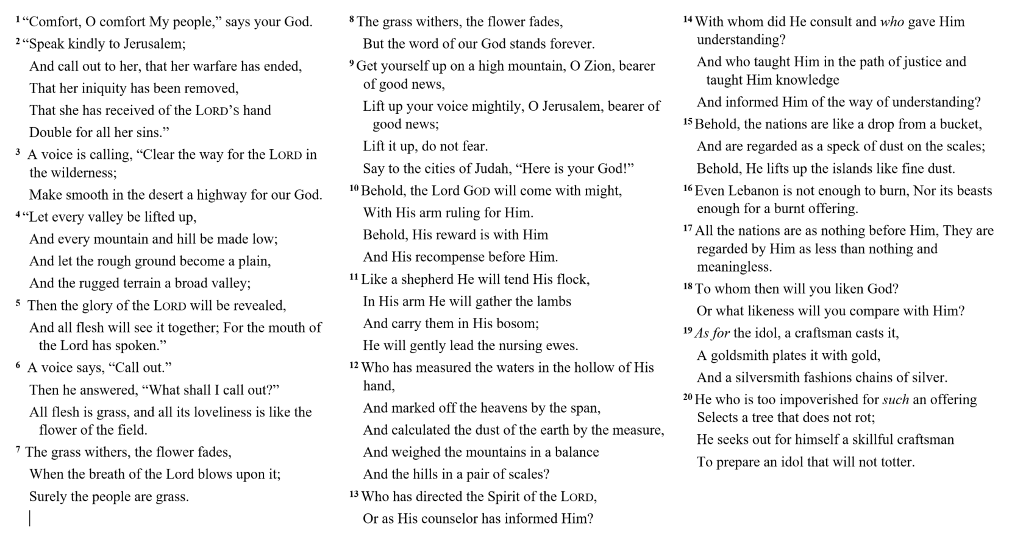

Slide 18
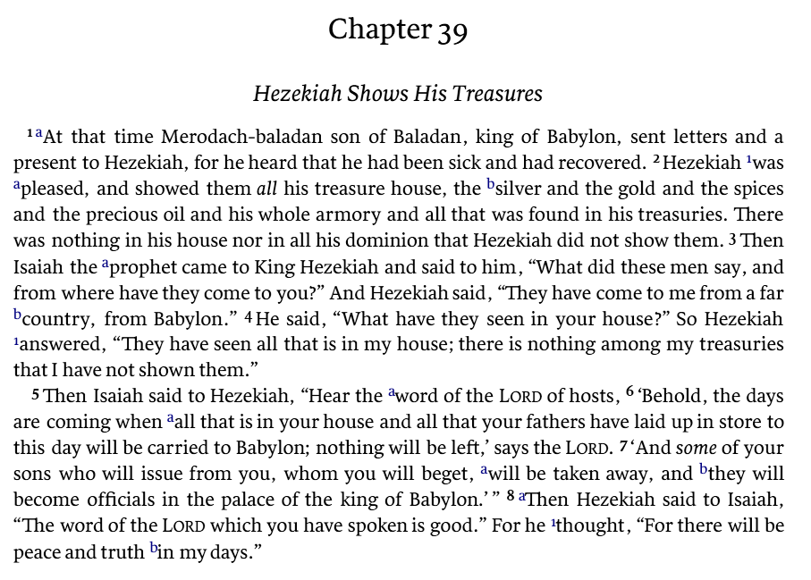

Slide 19
Isaiah 40:1-2
¹ “Comfort, O comfort My people,” says your God.
² “Speak kindly to Jerusalem;
And call out to her, that her warfare has ended,
That her iniquity has been removed, That she has received of the Lord’s hand
Double for all her sins.”
Transition back to poetic form
A key pivot point for Isaiah
An amazing statement by God
Sets Isaiah’s tone going forward
The new historical situation did not signal a change in God or His plans. Rather it would show even more clearly than ever that God is sovereign and that people can trust in Him to deliver. - Constable
Notes:
"We emerge in 40:1 in a different world from Hezekiah's, immersed in the situation foretold in 39:5-8, which he was so thankful to escape. Nothing is said of the intervening century and a half; we wake, so to speak, on the far side of the disaster, impatient for the end of captivity. In chs. 40—48 liberation is in the air; there is the persistent promise of a new exodus, with God at its head; there is the approach of a conqueror, eventually disclosed as Cyrus, to break Babylon open; there is also a new theme unfolding, to reveal the glory of the call to be a servant and a light to the nations."
Thomas L. Constable, Constables Notes - Isaiah, n.d.
Thomas L. Constable, Constables Notes - Isaiah, n.d.

Slide 20
Isaiah 40:3 – 5
³ A voice is calling,
“Clear the way for the Lord in the wilderness;
Make smooth in the desert a highway for our God.
⁴ “Let every valley be lifted up,
And every mountain and hill be made low;
And let the rough ground become a plain,
And the rugged terrain a broad valley;
⁵ Then the glory of the Lord will be revealed,
And all flesh will see it together;
For the mouth of the Lord has spoken.”
A clear prophetic message
Lk 3:4 - All four gospels;
John the Baptist proclamation!
The submission of nature
Lk 3:5
The revealing to all flesh (e.g. mankind)
Is 52:10; and all of Zion
Notes:
"We emerge in 40:1 in a different world from Hezekiah's, immersed in the situation foretold in 39:5-8, which he was so thankful to escape. Nothing is said of the intervening century and a half; we wake, so to speak, on the far side of the disaster, impatient for the end of captivity. In chs. 40—48 liberation is in the air; there is the persistent promise of a new exodus, with God at its head; there is the approach of a conqueror, eventually disclosed as Cyrus, to break Babylon open; there is also a new theme unfolding, to reveal the glory of the call to be a servant and a light to the nations."
Thomas L. Constable, Constables Notes - Isaiah, n.d.

Slide 21
Synoptic References of Is 40:3
See also: Jesus referring to John in Matthew 11:10; Luke 7:27
Notes:
24 When the messengers of John had left, He began to speak to the crowds about John, “What did you go out into the wilderness to see? A reed shaken by the wind? 25 But what did you go out to see? A man dressed in soft clothing? Those who are splendidly clothed and live in luxury are found in royal palaces! 26 But what did you go out to see? A prophet? Yes, I say to you, and one who is more than a prophet. 27 This is the one about whom it is written,
‘BEHOLD, I SEND MY MESSENGER AHEAD OF YOU,
WHO WILL PREPARE YOUR WAY BEFORE YOU.’
Lk 7:24–27.
19 This is the testimony of John, when the Jews sent to him priests and Levites from Jerusalem to ask him, “Who are you?” 20 And he confessed and did not deny, but confessed, “I am not the Christ.” 21 They asked him, “What then? Are you Elijah?” And he said, “I am not.” “Are you the Prophet?” And he answered, “No.” 22 Then they said to him, “Who are you, so that we may give an answer to those who sent us? What do you say about yourself?” 23 He said, “I am A VOICE OF ONE CRYING IN THE WILDERNESS, ‘MAKE STRAIGHT THE WAY OF THE LORD,’ as Isaiah the prophet said.”
New American Standard Bible, 1995 Edition: Paragraph Version (La Habra, CA: The Lockman Foundation, 1995), Jn 1:19–23.

Slide 22
Isaiah 40:9 – 11
⁹ Get yourself up on a high mountain,
O Zion, bearer of good news,
Lift up your voice mightily,
O Jerusalem, bearer of good news;
Lift it up, do not fear.
Say to the cities of Judah,
“Here is your God!”
¹⁰ Behold, the Lord God will come with might,
With His arm ruling for Him.
Behold, His reward is with Him
And His recompense before Him.
He will gently lead the nursing ewes.
¹¹ Like a shepherd He will tend His flock,
In His arm He will gather the lambs
And carry them in His bosom;
He will gently lead the nursing ewes.
To the people
Good news (Is 61:1)
Declare God!
Of the Lord
His arm ruling (v 10)
His arm gathering (v 11)

Slide 23
Isaiah 40:12 – 13
¹² Who has measured the waters in the
hollow of His hand,
And marked off the heavens by the span,
And calculated the dust of the earth by the measure,
And weighed the mountains in a balance
And the hills in a pair of scales?
¹³ Who has directed the Spirit of the Lord,
Or as His counselor has informed Him?
Israel’s incomparable God
A theme though Chapters 40-55
Powerful and rhetorical
Who can direct/comprehend the Lord
Rom 11:34
1 Cor 2:16
…But we have the mind of Christ.
Notes:
"We emerge in 40:1 in a different world from Hezekiah's, immersed in the situation foretold in 39:5-8, which he was so thankful to escape. Nothing is said of the intervening century and a half; we wake, so to speak, on the far side of the disaster, impatient for the end of captivity. In chs. 40—48 liberation is in the air; there is the persistent promise of a new exodus, with God at its head; there is the approach of a conqueror, eventually disclosed as Cyrus, to break Babylon open; there is also a new theme unfolding, to reveal the glory of the call to be a servant and a light to the nations."
Thomas L. Constable, Constables Notes - Isaiah, n.d.
Thomas L. Constable, Constables Notes - Isaiah, n.d.

Slide 24
Romans 11:33-36
Oh, the depth of the riches both of the wisdom and knowledge of God! How unsearchable are His judgments and unfathomable His ways! For WHO HAS KNOWN THE MIND OF THE LORD, OR WHO BECAME HIS COUNSELOR? Or WHO HAS FIRST GIVEN TO HIM THAT IT MIGHT BE PAID BACK TO HIM AGAIN? For from Him and through Him and to Him are all things. To Him be the glory forever. Amen.

Slide 25
1 Corinthians 2:14 – 16
But a natural man does not accept the things of the Spirit of God, for they are foolishness to him; and he cannot understand them, because they are spiritually appraised. But he who is spiritual appraises all things, yet he himself is appraised by no one. For WHO HAS KNOWN THE MIND OF THE LORD, THAT HE WILL INSTRUCT HIM? But we have the mind of Christ.

Slide 26
A personal relationship…
O T T F F S S E N __
What’s the Missing Letter?

Slide 27
Key Things to Consider
Isaiah as a guidepost to the greatness and character of God
“Comfort, O comfort My people…” v1
“Then the glory of the Lord will be revealed…” v5
“The grass withers, the flower fades, but the word of our God stands forever.” v8
Isaiah as a prophet pointing to the Promise of God
“A voice is calling, Clear the way for the Lord…” v3
“Who had directed the Spirit of the Lord?”
A personal relationship with the letter “T”
¹ Dr. Constables notes, Page 12

Slide 28
Discussion and Application
Do you agree with the statement: This is one of the greatest pieces of poetic literature ever written? What verses strike you as the most impressive?
As a poetic message, discuss the use of hyperbole, metaphors, similes, rhetoric, figures of speech, imagery, contrasting terms, irony…
Review the references of Isaiah 40 in the NT. Read Luke 2:25-35. Discuss the significance of Isaiah with Simeon’s prayer? (v 32 includes references to Is 9:2; 42:6; 49:6, 9; 51:4; 60:1–3; Matt 4:16; Acts 13:47; 26:23)
Discuss the 40:3 - 11 and the role/assignment of the three voices
v3 – A voice is calling… (3rd person)
v6 – A voice says, “Cry out” (1st person)
v10 – A voice saying to the cities of Judah (3rd person)

Slide 29
Discussion and Application
Discuss 40:9 – 11 (Jerusalem is called to be the messenger)
Discuss the introduction of a shepherd in v 11. Does it flow or seem out of place? What about the symbol of the arm?
Discuss 40:12 – 17
What about God does it reflect? What about that which was made? What about the two considered together?
Discuss the use of Isaiah 40:13 in two NT passages and possible reasons that God guided Paul to use this direct quote in the context of his letter.
Romans 11:34
2 Cor 2:6

Slide 30
Our Study of Isaiah
This Meeting:
Isaiah 40:1-20, The Consolation of Zion
Memory Verse: Isaiah 40:8
Dr. Constable’s Notes, 2022 Ed., pp. 255-267; Motyer, pp. 298-305
Refreshment Host: Group A
Next Meeting:
Isaiah 40:21-31
Memory Verse: Isaiah 40:31
Dr. Constable’s Notes, 2022 Ed., pp. 267-272; Motyer, pp. 305-308
Refreshment Host: Group B
Notes:
Welcome to MOB
Rod Turk covered Isaiah 14 last year. Does anyone remember the key word or topic he highlighted as part of his lesson? PRIDE. We’ll expand on that idea—but more from God’s attributes than our own.

Slide 31
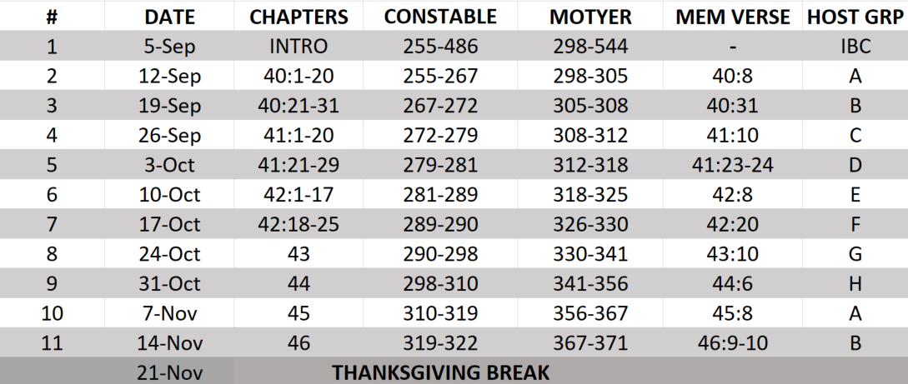
Isaiah Bible Study Schedule for Fall 2023 – Spring 2024 as of September 2023

Slide 32
Backup

Slide 33
Isaiah Bible Study Schedule for Fall 2023 – Spring 2024 as of September 2023

Slide 34
Isaiah Bible Study Schedule for Fall 2023 – Spring 2024 as of September 2023

Slide 35
Isaiah Bible Study Schedule for Fall 2023 – Spring 2024 as of September 2023

