Slide 1
WELCOME TO THE MOB!
All Scripture is breathed out by God and profitable for teaching, for reproof, for correction, and for training in righteousness, that the man of God may be complete, equipped for every good work.
2 Timothy 3:16-17 (ESV)

Slide 2
Welcome To The MOB!
MOB Website & Resources: www.ibcmob.net
Assist Pregnancy Center’s Fundraising Vision Dinner, Friday, Oct. 13, 2023, 6:30-9:00 PM, Fairview Park Marriott
Christian Embassy Fellowship Dinner Fundraiser, Friday, Oct. 20, 2023, 6:30-8:30 PM, Fairview Park Marriott
IBC Fall Outreach Festival Oct. 28, 1-4 PM
https://immanuelbible.church/visit/fall-outreach-fest

Slide 3
Please Rise
Invocation/Prayer
Song: A Mighty Fortress Is Our God

Slide 4
A Mighty Fortress Is Our God
1 of 4
A mighty fortress is our God, a bulwark never failing;
Our helper He, amid the flood of mortal ills prevailing:
For still our ancient foe doth seek to work us woe;
His craft and pow’r are great and armed with cruel hate,
On earth is not his equal.

Slide 5
A Mighty Fortress Is Our God
2 of 4
Did we in our own strength confide, our striving would be losing, Were not the right Man on our side, the Man of God’s own choosing: Dost ask who that may be? Christ Jesus, it is He; Lord Sabaoth, His Name, from age to age the same, And He must win the battle.

Slide 6
A Mighty Fortress Is Our God
3 of 4
And though this world, with devils filled, should threaten to undo us, We will not fear, for God hath willed His truth to triumph through us; The Prince of Darkness grim, we tremble not for him; His rage we can endure, for lo, his doom is sure, One little word shall fell him.

Slide 7
A Mighty Fortress Is Our God
4 of 4
That word above all earthly pow’rs, no thanks to them, abideth; The Spirit and the gifts are ours through Him Who with us sideth; Let goods and kindred go, this mortal life also; The body they may kill: God’s truth abideth still, His kingdom is forever.

Slide 8
Our Study of Isaiah
Last Meeting:
Isaiah 41:1-20
Memory Verse: Isaiah 41:10
Dr. Constable’s Notes, 2023 Ed., pp.272-279; Motyer, pp.308-312.
Refreshment Host: C
This Meeting:
Isaiah 41:21-29
Memory Verse: 41:23-24
Dr. Constable’s Notes, 2023 Ed., pp.279-281; Motyer, pp.312-318.
Refreshment Host: D

Slide 9
Memory Verse
Isaiah 41:23-24 (ESV)
²³ Tell us what is to come hereafter, that we may know that you are gods; do good, or do harm, that we may be dismayed and terrified. ²⁴ Behold, you are nothing, and your work is less than nothing; an abomination is he who chooses you.
Isaiah 41:23-24 (ESV)

Slide 10
Isaiah Outline
Focus | Prophecies of Condemnation |  |  |  |  |  |  |  | Historical Parenthesis |  | Prophecies of Comfort
 | 1:1 |  |  |  |  |  |  | 35:10 | 36:1 | 39:8 | 40:1 |  |  |  |  |  | 66:24
Divisions | Prophecies Against Judah |  | Prophecies Against the Nation |  | Prophesies Against the Day of the Lord |  | Prophesies of Judgement and Blessing |  | Sickness and Sin | Hezekiah’s Salvation | Israel’s Deliverance |  |  | Israel’s Deliverer |  | Israel’s Glorious Future
 | 1:1 | 12:6 | 13:1 | 23:18 | 24:1 | 27:13 | 28:1 | 35:10 | 36:1 | 39:8 | 40:1 | 48:22 |  | 49:1 | 57:21 | 58:1 | 66:24
Topics | Prophetic |  |  |  |  |  |  |  | Historic |  | Messianic
 | Judgement |  |  |  |  |  |  |  | Transition |  | Hope
Place | Israel & Judah
Time | 740 - 680 B.C.
You Are Here!
Bruce Wilkinson and Kenneth Boa, Talk Thru the Bible (Nashville: T. Nelson, 1983), 189.

Slide 11
Review
Book of Salvation (Chap. 40-66):
Ch. 40-48: God’s Grace To Israel
King Cyrus delivers Israel from Babylonian captivity.
Ch. 49-55: God’s Atonement
The rejection and restoration of the Suffering Servant, the deliverer.
Ch. 56-66: A Glorious Future
God’s restoration and transformation of Israel and the world.

Slide 12
How To Interpret Scripture The Immanuel Way
Normal - understanding the words of Scripture in their common usage unless otherwise indicated by the context.
Literal - understanding the meaning of Scripture in its ordinary sense unless the context requires a figurative interpretation.
Grammatical - using the recognized rules of grammar to interpret the text.
Historical - understanding the words of Scripture in the context of the times in which they were written.
Systematic - categorizing and comparing the teaching of the Scriptures with the whole of Scripture in view.

Slide 13
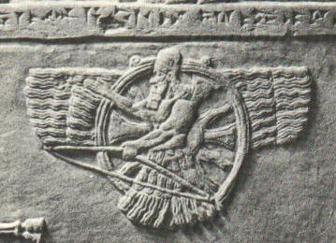
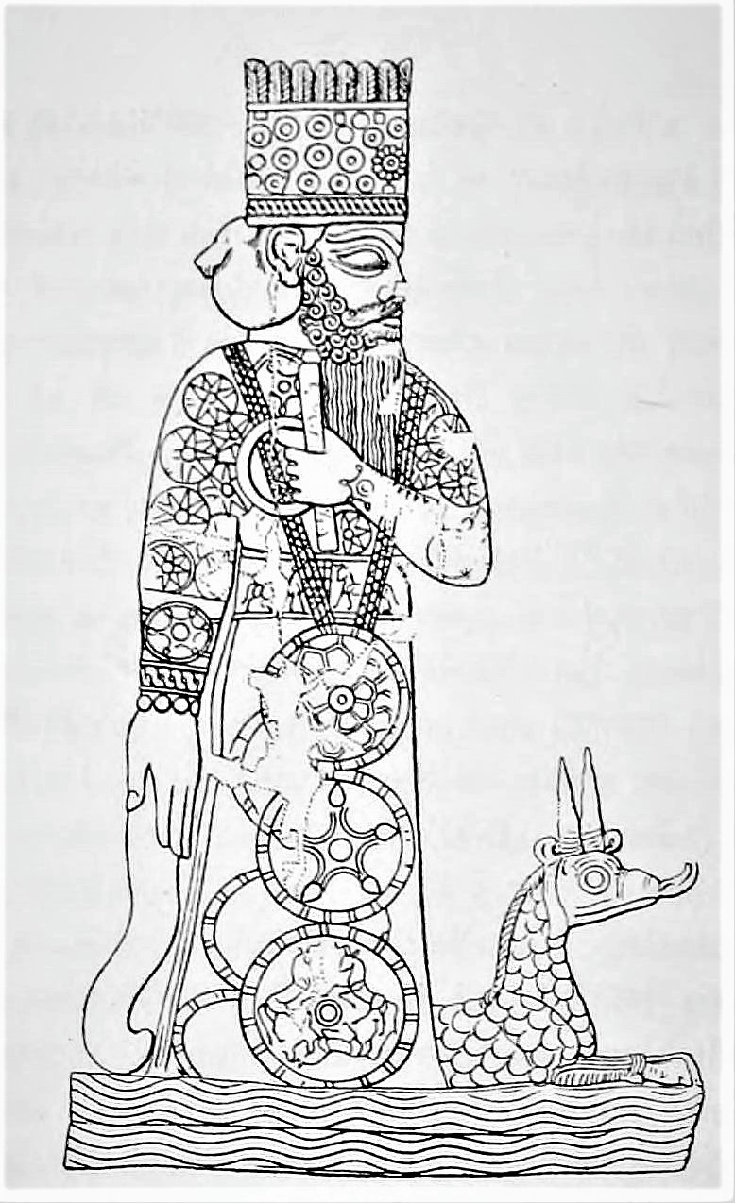
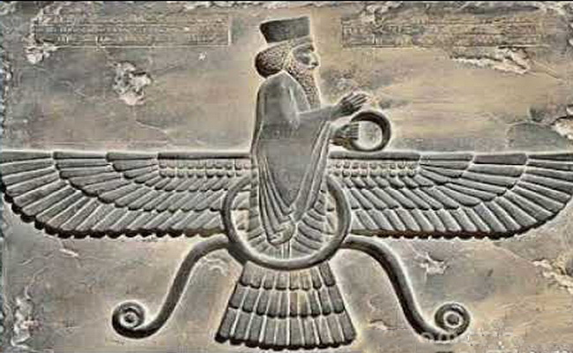
Main gods of Assyria, Babylon & Medo-Persia
Assyria - Ashur
Medo-Persian
Ahura Mazda
Babylon - Marduk

Slide 14
On The Nature of Pagan gods
The gods of antiquity were pagan…living in a closed universe.
For the pagan gods:
Everything that exists is part of everything else.
Thus humanity, nature, and deity are all inseparable from one another.
The cosmos is eternal…There is no beginning or ending of the universe
What is, always has been and what has been, always will be.
In the cycle of existence there is no beginning and no end and nothing ever changes.
To predict the future just look to the past.
The gods are absolutely helpless to tell us how the world began or how it will end.
Notes:
The pagan understanding of existence rests on the concept of continuity. According to this concept, everything that exists is part of everything else. Thus humanity, nature, and deity are all inseparable from one another. In an ultimate sense, the cosmos is eternal. What is always has been, and what has been always will be. In the cycles of existence there is no beginning and no end, and nothing ever changes. Thus the way to tell the future in such a system is to find the ways in which the present is congruent with the past, for what happened in the past under similar circumstances must happen again. But the gods are absolutely helpless to tell us how the world began or how it will end; the gods are the system personified. By the same token, they are helpless to tell us about something that has never happened before. First, by definition there cannot be such a thing; second, the system cannot know what it has not yet experienced.
Thus Isaiah’s attack betrays a penetrating understanding of the nature of the system he is attacking. He has attacked it precisely at its weak point. His attack also illustrates the breathtaking difference between his (and the Bible’s) conception of God and that of Israel’s neighbors. What kind of God is he who knows what has not happened? What kind of God is he who can explain the first principles of existence? He is one who is Other than the system, one who has made the system according to certain specifications, one who makes the system operate according to his sovereign will. He is the one who is himself “the first and the last” (cf. 41:4; 44:6; 48:12; and the discussion of “first” and “last” above on 41:22). Isaiah says, in effect, that anything worthy of the term “god” must be more than the system itself. Since these beings are incapable of independent activity, they are not gods. This is philosophical sophistication of a sort found elsewhere only in the logical reductionism of Aristotle’s Unmoved Mover. But there it is little more than an abstract formulation that was little more than a philosophical concept. Here it is the fervently held conviction of a whole people, a conviction that was to change the entire Western world. Whence came such a belief, except, as the Hebrews insist, through divine self-revelation?
John N. Oswalt, , The New International Commentary on the Old Testament (Grand Rapids, MI: Wm. B. Eerdmans Publishing Co., 1998), 106.
John N. Oswalt, The Book of Isaiah, Chapters 40–66, The New International Commentary on the Old Testament (Grand Rapids, MI: Wm. B. Eerdmans Publishing Co., 1998), 106.

Slide 15
On The Nature of The GOD
YAHWEH is:
Self existent.
Unchanging in His being.
Completely outside of His creation.
Therefore…He can supernaturally reach into his creation to exercise His will.
“A high view of God will lead us to lofty worship of Him. A growing understanding of His character will lead to holy and righteous living in the pursuit of His will. Conversely, a low view of God will lead to diminished praise of Him. Inevitably, base views of Him will lead to low and empty living.” - Dr. Steve Lawson, “Show Me Your Glory”
Notes:
The pagan understanding of existence rests on the concept of continuity. According to this concept, everything that exists is part of everything else. Thus humanity, nature, and deity are all inseparable from one another. In an ultimate sense, the cosmos is eternal. What is always has been, and what has been always will be. In the cycles of existence there is no beginning and no end, and nothing ever changes. Thus the way to tell the future in such a system is to find the ways in which the present is congruent with the past, for what happened in the past under similar circumstances must happen again. But the gods are absolutely helpless to tell us how the world began or how it will end; the gods are the system personified. By the same token, they are helpless to tell us about something that has never happened before. First, by definition there cannot be such a thing; second, the system cannot know what it has not yet experienced.
Thus Isaiah’s attack betrays a penetrating understanding of the nature of the system he is attacking. He has attacked it precisely at its weak point. His attack also illustrates the breathtaking difference between his (and the Bible’s) conception of God and that of Israel’s neighbors. What kind of God is he who knows what has not happened? What kind of God is he who can explain the first principles of existence? He is one who is Other than the system, one who has made the system according to certain specifications, one who makes the system operate according to his sovereign will. He is the one who is himself “the first and the last” (cf. 41:4; 44:6; 48:12; and the discussion of “first” and “last” above on 41:22). Isaiah says, in effect, that anything worthy of the term “god” must be more than the system itself. Since these beings are incapable of independent activity, they are not gods. This is philosophical sophistication of a sort found elsewhere only in the logical reductionism of Aristotle’s Unmoved Mover. But there it is little more than an abstract formulation that was little more than a philosophical concept. Here it is the fervently held conviction of a whole people, a conviction that was to change the entire Western world. Whence came such a belief, except, as the Hebrews insist, through divine self-revelation?
John N. Oswalt, , The New International Commentary on the Old Testament (Grand Rapids, MI: Wm. B. Eerdmans Publishing Co., 1998), 106.
John N. Oswalt, The Book of Isaiah, Chapters 40–66, The New International Commentary on the Old Testament (Grand Rapids, MI: Wm. B. Eerdmans Publishing Co., 1998), 106.

Slide 16
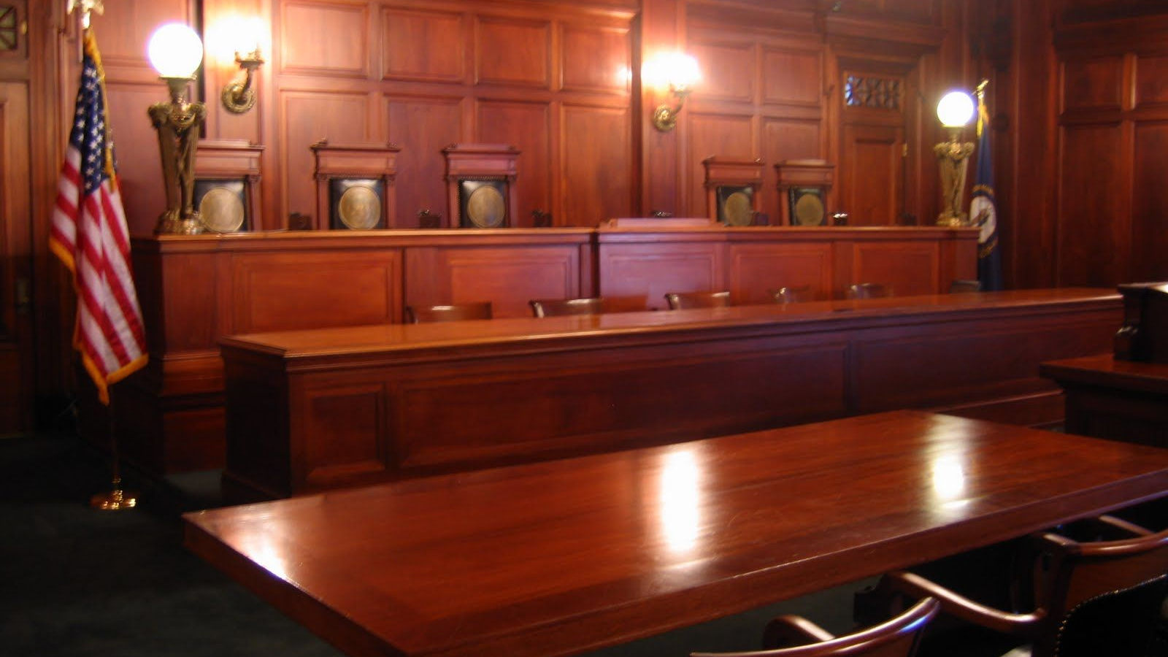

Slide 17
²¹ “Present your case,” the Lord says.
“Bring forward your evidence,” The King of Jacob says.
²² Let them bring them forward and declare
to us what is going to take place;
As for the former events, declare what they were,
So that we may consider them and know their outcome.
Or announce to us what is coming;
²³ Declare the things that are going to come afterward,
So that we may know that you are gods;
Indeed, do good or evil, that we may be
afraid and fear together.
²⁴ Behold, you are less than nothing,
And your work is less than nothing!
He who chooses you is an abomination.
²⁵ “I have put one from the north into motion, and he has come;
From the rising of the sun he will call on My name;
And he will come upon rulers as upon mortar,
As the potter treads on clay.”
²⁶ Who has declared this from the beginning, that we might know? Or from former times, that we may say, “He is right!”? There was no one at all who declared, There was no one at all who proclaimed, There was no one at all who heard your words. ²⁷ “Previously I said to Zion, ‘Behold, here they are.’ And to Jerusalem, ‘I will give a messenger of good news.’ ²⁸ But when I look, there is no one, And there is no counselor among them Who, if I ask, can give an answer. ²⁹ Behold, all of them are false; Their works are nothing, Their cast metal images are wind and emptiness.

Slide 18
Isaiah 41:21
Isaiah 41:6-7…God announces that Cyrus is on his way. The people respond by building idols.
The Trial against those idols begins.
“The Lord here humbly descends into a sort of ‘identity parade’ of competing gods in order that the true may be isolated from the spurious.” - J. A. Motyer
²¹ “Present your case,” the Lord says.
“Bring forward your evidence,” The King of Jacob says.
Notes:
Isaiah 41: 6-7
6 Everyone helps his neighbor
and says to his brother, “Be strong!”
7 The craftsman strengthens the goldsmith,
and he who smooths with the hammer him who strikes the anvil,
saying of the soldering, “It is good”;
and they strengthen it with nails so that it cannot be moved
(Wheaton, IL: Crossway Bibles, 2016), Is 41:67.
The Holy Bible: English Standard Version (Wheaton, IL: Crossway Bibles, 2016), Is 41:6–7.

Slide 19
Isaiah 41:22-23
Idolators! Bring your gods forward!
God is asking for proof that they are independent of the whims of the cosmos.
These gods are not transcendent. They are part of the cosmos and therefore unable to do anything supernaturally.
Do something…Yahweh says. They cannot!
²² Let them bring them forward and declare
to us what is going to take place;
As for the former events, declare what they were,
So that we may consider them and know their outcome.
Or announce to us what is coming;
²³ Declare the things that are going to come afterward,
So that we may know that you are gods;
Indeed, do good or evil, that we may be
afraid and fear together.

Slide 20
Isaiah 41:24
²⁴ Behold, you are less than nothing,
And your work is less than nothing!
He who chooses you is an abomination.
The idols are silent!
Yahweh has already passed judgement!
Yahweh is stating the obvious. These idols/gods are nothing!
And…if you made such an idol and choose to put your faith in that idol, then you are an abomination!
Choose wisely…Joshua 24:15
Notes:
For a classic expression of this point in the context of becoming a servant of God, see Josh. 24:15.
John N. Oswalt, , The New International Commentary on the Old Testament (Grand Rapids, MI: Wm. B. Eerdmans Publishing Co., 1998), 102.
John N. Oswalt, The Book of Isaiah, Chapters 40–66, The New International Commentary on the Old Testament (Grand Rapids, MI: Wm. B. Eerdmans Publishing Co., 1998), 102.
Joshua 24:15
14 “Now therefore fear the Lord and serve him in sincerity and in faithfulness. Put away the gods that your fathers served beyond the River and in Egypt, and serve the Lord.
15 And if it is evil in your eyes to serve the Lord, choose this day whom you will serve, whether the gods your fathers served in the region beyond the River, or the gods of the Amorites in whose land you dwell. But as for me and my house, we will serve the Lord.”
(Wheaton, IL: Crossway Bibles, 2016), Jos 24:1415.
The Holy Bible: English Standard Version (Wheaton, IL: Crossway Bibles, 2016), Jos 24:14–15.

Slide 21
Isaiah 41:25
²⁵ “I have put one from the north into motion, and he has come; From the rising of the sun he will call on My name;
And he will come upon rulers as upon mortar,
As the potter treads on clay.”
Yahweh demonstrates that He is in control of the future.
He has called Cyrus into motion.
Yahweh is doing what the pagan idols/gods cannot and could not do.
Yahweh is demonstrating that He is outside His creation and acts supernaturally in his creation.
Yahweh can “suspend the rules of the cosmos” in order to exercise His will.

Slide 22
Isaiah 41:26
²⁶ Who has declared this from the beginning, that we might know? Or from former times, that we may say, “He is right!”? There was no one at all who declared, There was no one at all who proclaimed, There was no one at all who heard your words.
“The Lord is awarded the verdict, his case being clinched by evidence of predictive power.” - J. A. Motyer
“For Isaiah, any interpretation of history has to have the possibility of verification…Not one whisper of Cyrus’s coming has been made by the gods or heard by one of their adherents.” - John N. Oswalt

Slide 23
Isaiah 41:27-28
²⁷ “Previously I said to Zion, ‘Behold, here they are.’ And to Jerusalem, ‘I will give a messenger of good news.’ ²⁸ But when I look, there is no one, And there is no counselor among them Who, if I ask, can give an answer.
“Which of the gods is able to explain the world to God? Which one can explain the direction of history? The answer is plain: none—He is unique.”
- John N. Oswalt
“The force of the verse is, then, that the Gentile world is without a sure voice coming from outside, without a veritable revelation of God.” - J. A. Motyer

Slide 24
Isaiah 41:29
Remember Isaiah 41:6-7?
Those idols fashioned by the people in response to the news that Cyrus was on his way…”Are wind and emptiness”.
“It is only a God who is totally other than this world…who can explain to us why he created the world and who can be free enough from it to direct and redirect its progress so as to deliver it from itself.
- John Oswalt
²⁹ Behold, all of them are false; Their works are nothing, Their cast metal images are wind and emptiness.
Notes:
It is only a God who is totally Other than this world that he can never be imaged in any of this world’s forms who can explain to us why he created the world and who can be free enough from it to direct and redirect its progress so as to deliver it from itself.
John N. Oswalt, , The New International Commentary on the Old Testament (Grand Rapids, MI: Wm. B. Eerdmans Publishing Co., 1998), 105.
John N. Oswalt, The Book of Isaiah, Chapters 40–66, The New International Commentary on the Old Testament (Grand Rapids, MI: Wm. B. Eerdmans Publishing Co., 1998), 105.

Slide 25
Job
Notes:
The Lord Answers Job
38 Then the Lord answered Job out of the whirlwind and said:
² “Who is this that darkens counsel by words without knowledge? ³ Dress for action^{[a]} like a man; I will question you, and you make it known to me.
⁴ “Where were you when I laid the foundation of the earth? Tell me, if you have understanding. ⁵ Who determined its measurements—surely you know! Or who stretched the line upon it? ⁶ On what were its bases sunk, or who laid its cornerstone, ⁷ when the morning stars sang together and all the sons of God shouted for joy?
⁸ “Or who shut in the sea with doors when it burst out from the womb, ⁹ when I made clouds its garment and thick darkness its swaddling band, ¹⁰ and prescribed limits for it and set bars and doors, ¹¹ and said, ‘Thus far shall you come, and no farther, and here shall your proud waves be stayed’?
¹² “Have you commanded the morning since your days began, and caused the dawn to know its place, ¹³ that it might take hold of the skirts of the earth, and the wicked be shaken out of it? ¹⁴ It is changed like clay under the seal, and its features stand out like a garment. ¹⁵ From the wicked their light is withheld, and their uplifted arm is broken.
¹⁶ “Have you entered into the springs of the sea, or walked in the recesses of the deep? ¹⁷ Have the gates of death been revealed to you, or have you seen the gates of deep darkness? ¹⁸ Have you comprehended the expanse of the earth? Declare, if you know all this.
¹⁹ “Where is the way to the dwelling of light, and where is the place of darkness, ²⁰ that you may take it to its territory and that you may discern the paths to its home? ²¹ You know, for you were born then, and the number of your days is great!
²² “Have you entered the storehouses of the snow, or have you seen the storehouses of the hail, ²³ which I have reserved for the time of trouble, for the day of battle and war? ²⁴ What is the way to the place where the light is distributed, or where the east wind is scattered upon the earth?
²⁵ “Who has cleft a channel for the torrents of rain and a way for the thunderbolt, ²⁶ to bring rain on a land where no man is, on the desert in which there is no man, ²⁷ to satisfy the waste and desolate land, and to make the ground sprout with grass?
²⁸ “Has the rain a father, or who has begotten the drops of dew? ²⁹ From whose womb did the ice come forth, and who has given birth to the frost of heaven? ³⁰ The waters become hard like stone, and the face of the deep is frozen.
³¹ “Can you bind the chains of the Pleiades or loose the cords of Orion? ³² Can you lead forth the Mazzaroth^{[b]} in their season, or can you guide the Bear with its children? ³³ Do you know the ordinances of the heavens? Can you establish their rule on the earth?
³⁴ “Can you lift up your voice to the clouds, that a flood of waters may cover you? ³⁵ Can you send forth lightnings, that they may go and say to you, ‘Here we are’? ³⁶ Who has put wisdom in the inward parts^{[c]} or given understanding to the mind?^{[d]} ³⁷ Who can number the clouds by wisdom? Or who can tilt the waterskins of the heavens, ³⁸ when the dust runs into a mass and the clods stick fast together?
³⁹ “Can you hunt the prey for the lion, or satisfy the appetite of the young lions, ⁴⁰ when they crouch in their dens or lie in wait in their thicket? ⁴¹ Who provides for the raven its prey, when its young ones cry to God for help, and wander about for lack of food?

Slide 26
Summary
God Is Sovereign!
God Is Our Mighty Fortress!
There is NO One Like Him!
How Big Is Your God?

Slide 27
Next Meeting
Review:
Isaiah 41:21-29
Memory Verse: Isaiah 41:23-24
Dr. Constable’s Notes, 2023 Ed., pp. 279-281; Motyer, pp.312-318
Study:
Isaiah 42:1-17
Memory Verse: Isaiah 42:8
Dr. Constable’s Notes, 2023 Ed., pp. 281-289; Motyer, pp.318-325
Refreshment Host: E

Slide 28
Questions & Application Lowell’s Questions
In what way does this passage continue to present a picture of a courtroom scene?
What’s the essence of the case Isaiah makes here for worshiping Yahweh, as opposed to other objects of worship?
Who is the “one from the north” that God said He would “arouse”? And how does this one relate to the one He aroused (or would arouse) “from the east,” cited in verse 2?
In what sense it the one who chooses an idol “an abomination”—and what is his “plight”?
What specific prophecy was eventually fulfilled by God that no one else, other than Yahweh, could have predicted, and made happen? What’s so significant about it, and can you cite the reference?

Slide 29
Questions & Application Lowell’s Questions
How does this passage support the statement attributed to the noted Bible expositor A.T. Pierson that “history is all about His story”?
What are other examples from Scripture, other than that of Cyrus, of how God used unbelieving world leaders to accomplish His purpose?
What does this passage teach us about “the world,” and about God?
What key idea will you take away from this lesson?

Slide 30
Closing
Benediction
Small Groups

Slide 32
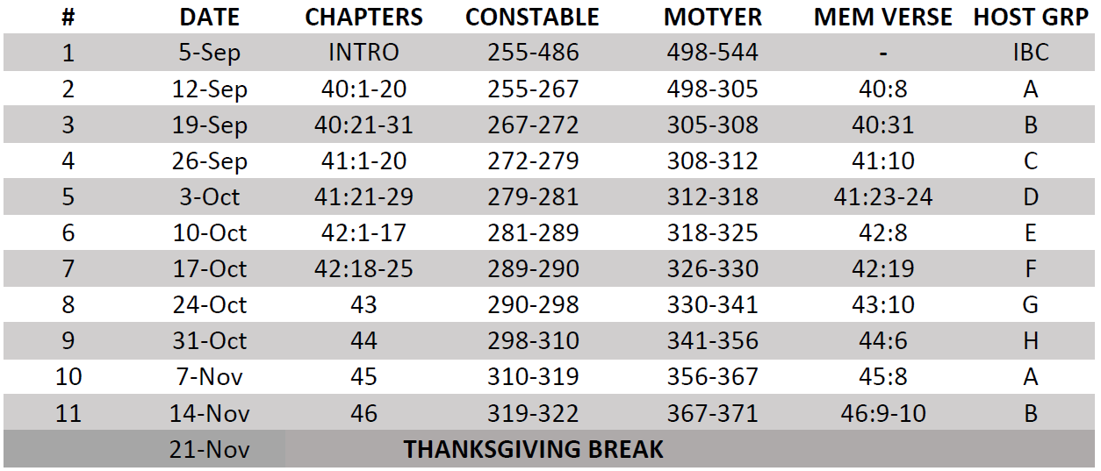
Isaiah Bible Study Schedule for Fall 2023 – Spring 2024 as of September 5, 2023

Slide 33
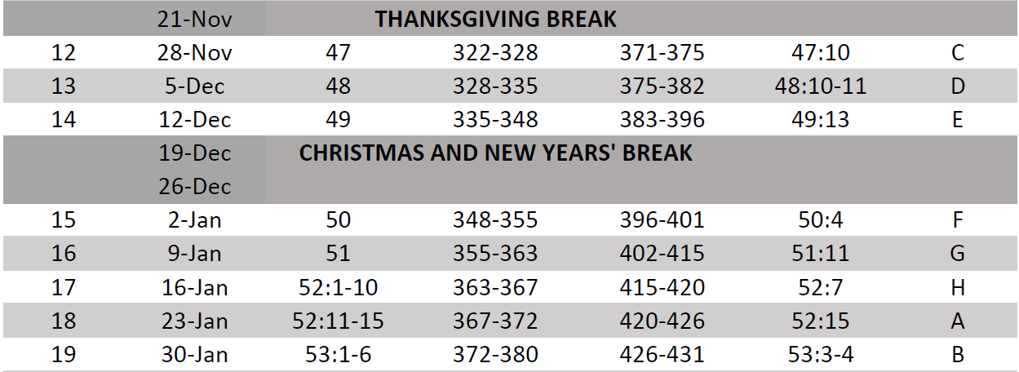
Isaiah Bible Study Schedule for Fall 2023 – Spring 2024 as of September 5, 2023

Slide 34
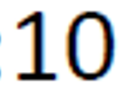
Isaiah Bible Study Schedule for Fall 2023 – Spring 2024 as of September 5, 2023

Slide 35
Isaiah Bible Study Schedule for Fall 2023 – Spring 2024 as of September 5, 2023

