Slide 1
WELCOME TO THE MOB!
All Scripture is breathed out by God and profitable for teaching, for reproof, for correction, and for training in righteousness, that the man of God may be complete, equipped for every good work.
2 Timothy 3:16-17 (ESV)

Slide 2
Announcements
MOB Website & Resources: www.ibcmob.net
Logos Zoom Intro + Setting up a Daily Devotional/Prayer List
January 13 at 0900 AM (zoom details via email)
Discover Immanuel, Membership Class,
January 14 at 0930 AM.
Parent & Child Dedication Ceremony,
January 21 each service.

Slide 3
Please Rise
Invocation/Prayer.
Song:
“Immortal, Invisible, God only Wise”

Slide 4
Immortal, Invisible,
God Only Wise
Verse 1 of 5
Immortal, invisible,
God only wise,
In light inaccessible
hid from our eyes,
Most blessed, most glorious,
the Ancient of Days,
Almighty, victorious,
Thy great name we praise.

Slide 5
Immortal, Invisible,
God Only Wise
Verse 2 of 5
Unresting, unhasting,
and silent as light,
Nor wanting, nor wasting,
Thou rulest in might:
Thy justice, like mountains
high soaring above;
Thy clouds, which are fountains
of goodness and love.

Slide 6
Immortal, Invisible,
God Only Wise
Verse 3 of 5
To all, life Thou givest,
to both great and small.
In all life Thou livest,
the True Life of all.
We blossom and flourish
like leaves on the tree,
Then wither and perish;
but naught changeth Thee.

Slide 7
Immortal, Invisible,
God Only Wise
Verse 4 of 5
Great Father of Glory,
pure Father of Light.
Thine angels adore Thee,
all veiling their sight.
All laud we would render,
O help us to see:
‘Tis only the splendor
of light hideth Thee!

Slide 8
Immortal, Invisible,
God Only Wise
Verse 5 of 5
Immortal, invisible,
God only wise,
In light inaccessible
hid from our eyes,
Most blessed, most glorious,
the Ancient of Days,
Almighty, victorious,
Thy great name we praise.

Slide 9
Our Study of Isaiah
Last Meeting:
  Isaiah 50, Israel's Sin and the Servant's Obedience
  Memory Verse: Isaiah 50:4
  Dr. Constable’s Notes, 2023 Ed., pp. 348-355; Motyer, pp. 396-401.
This Meeting:
  Isaiah 51, The Lord’s Comfort/The Remnant to be Exalted
    NOTE: Many Outlines carry the Pericope/Theme through Isaiah 52:12
  Memory Verse: Isaiah 51:11
  Dr. Constable’s Notes, 2023 Ed., pp. 355-363; Motyer, pp. 402-415
  Refreshment Host: Group G
Notes:
Welcome to MOB

Slide 10
Memory Verse
Isaiah 51:11 (ESV)
“And the ransomed of the LORD shall return and come to Zion with singing; everlasting joy shall be upon their heads; they shall obtain gladness and joy, and sorrow and sighing shall flee away.”
Isaiah 51:11 (ESV)
Notes:
It really is a great verse. A lot packed into the application of Isaiah that we’ll touch on.

Slide 11
Isaiah Outline
Focus | Prophecies of Condemnation |  |  |  |  |  |  |  | Historical Parenthesis |  | Prophecies of Comfort
 | 1:1 |  |  |  |  |  |  | 35:10 | 36:1 | 39:8 | 40:1 |  |  |  |  |  | 66:24
Divisions | Prophecies Against Judah |  | Prophecies Against the Nation |  | Prophesies Against the Day of the Lord |  | Prophesies of Judgement and Blessing |  | Sickness and Sin | Hezekiah’s Salvation | Israel’s Deliverance |  |  | Israel’s Deliverer |  | Israel’s Glorious Future
 | 1:1 | 12:6 | 13:1 | 23:18 | 24:1 | 27:13 | 28:1 | 35:10 | 36:1 | 39:8 | 40:1 | 48:22 |  | 49:1 | 57:21 | 58:1 | 66:24
Topics | Prophetic |  |  |  |  |  |  |  | Historic |  | Messianic
 | Judgement |  |  |  |  |  |  |  | Transition |  | Hope
Place | Israel & Judah
Time | 740 - 680 B.C.
We are here!
  Bruce Wilkinson and Kenneth Boa, Talk Thru the Bible (Nashville: T. Nelson, 1983), 189.

Slide 12
Conclusion – Isaiah 50 Lesson
Constable says Isaiah 50 “is a call to listen to the Servant, to follow His example, and so experience God's salvation. Failure to do so would result in sharing the fate of His opponents.”
“Truly, truly, I say to you, whoever hears my word and believes him who sent me has eternal life. He does not come into judgment, but has passed from death to life. Truly, truly, I say to you, an hour is coming, and is now here, when the dead will hear the voice of the Son of God, and those who hear will live.” John 5:24-25

Slide 13
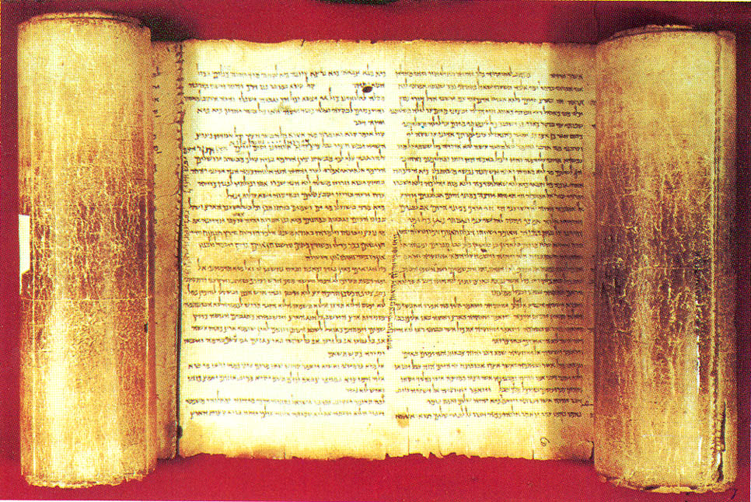
Genre Form and Messaging
Poetry
Literary compositions characterized by figurative language, wordplay, rhythm, balance, and emotional expression that are crafted in order to produce an emotional response in the reader.
  The Lexham Glossary of Literary Types (Bellingham, WA: Lexham Press, 2014).

Slide 14
Isaiah 51 Translation Pericopes
ESV The Lord's Comfort for Zion
LEB Yahweh Comforts Zion
NASB Israel Exhorted
NIV Everlasting Salvation for Zion
LSB Yahweh's Righteousness is Forever
CSB Salvation for Zion
Notes:
In other words, a prerequisite for hearing good news may be first of all that we receive the true bad news. So John Wesley said to his young preachers, “Preach the Law until they are convicted, then preach Grace until they are converted.”
John N. Oswalt, Isaiah, The NIV Application Commentary (Grand Rapids, MI: Zondervan Publishing House, 2003), 580.

Slide 15
Imperatives!
A significant feature of 51:1–16 is the use of imperatives.
  Plural imperatives addressed to the Israelites vv 1, 2, 4, 6, and 7.
  Singular imperatives addressed to “the arm of the Lord” v 9.
This heavy use of imperatives gives verses 1–16 a special character as the Lord calls on his people to respond in various ways.
  A Handbook on Isaiah, ed. Paul Clarke et al., vol. 1 & 2, United Bible Societies Handbooks ,1433.

Slide 16
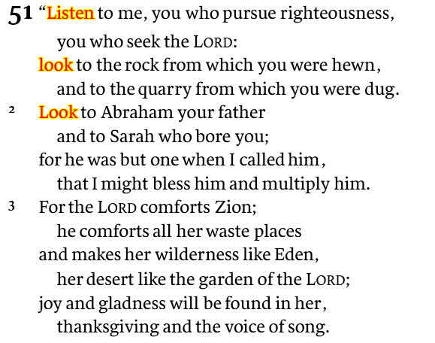
Isaiah 51:1-3
Zion Renewed, Eden Restored
Doublets
pursue/seek
rock/quarry
Abraham/Sarah
blessed/made many
…
Abrahamic Covenant
  Recalling the Lord’s faithfulness in the past
  Encourage waiting in faith

Slide 17
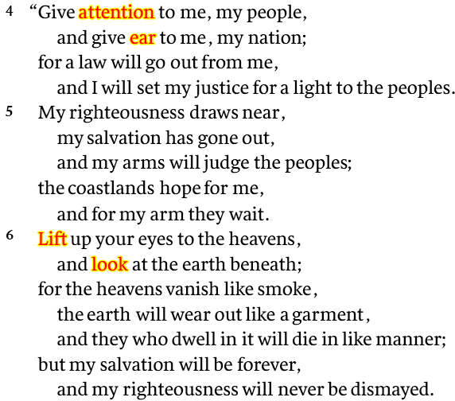
Isaiah 51:4-6
Revelation to the world: Eternal Salvation
Doublets
pay attention/give ear
people/nation
law/justice
righteousness/salvation
peoples/coastlands
…
  a motif of personal divine action!
  Universality of the Lord’s righteous salvation
  The eternal nature of the promise

Slide 18
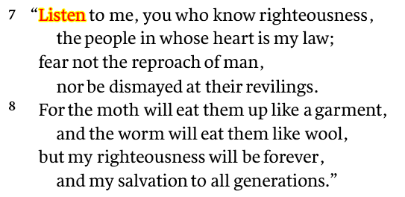
Isaiah 51:7-8
Lit. “know (in an intimate way) what is right”
New Covenant
Eternal Salvation: A call to fearlessness

Slide 19
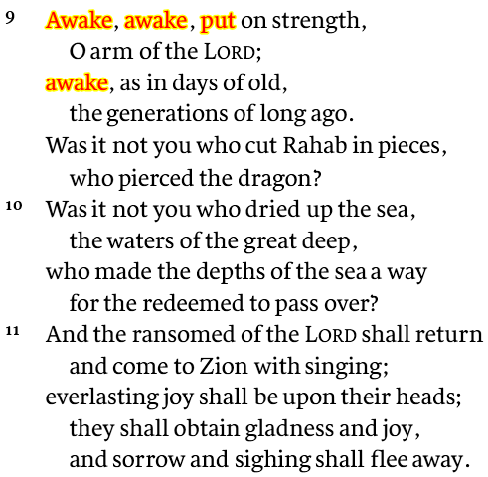
Isaiah 51:9-11
“The Arm of the Lord”: Exodus past and future
  Depths of the sea: pathway
  Redeemed: past event
  Rahab: Code for Egypt?
  Exodus prefigures ultimate redemption

Slide 20
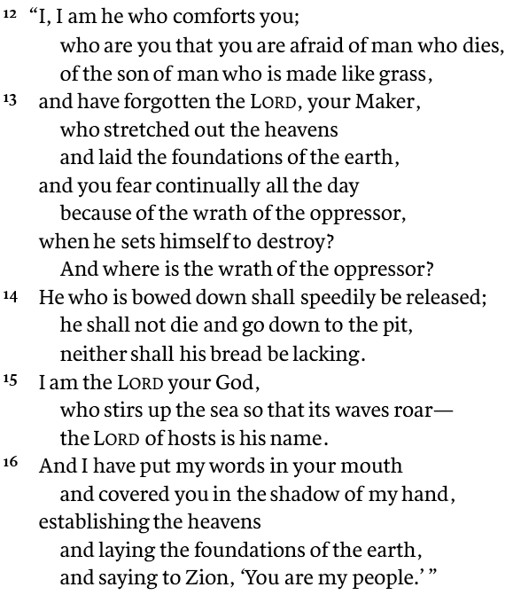
Isaiah 51:12-16
Interlude between promises and commands
Continued emotional Intensity
  The creator God (v. 15)
  The Servant described (v. 16)
The plight of those unless saved

Slide 21
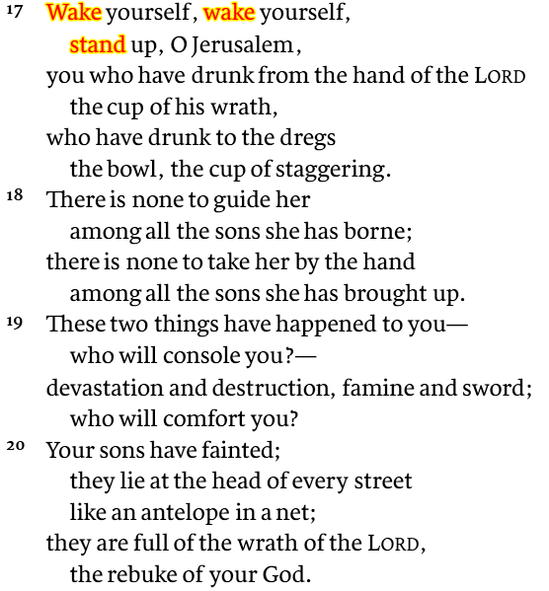
Isaiah 51:17-20
Commands to Respond: The experience of salvation (51:17-52:12)
The cup of fury
Doublets
Sons/sons
Borne/guide
Brought up/take
Duplication is the idiom of totality

Slide 22
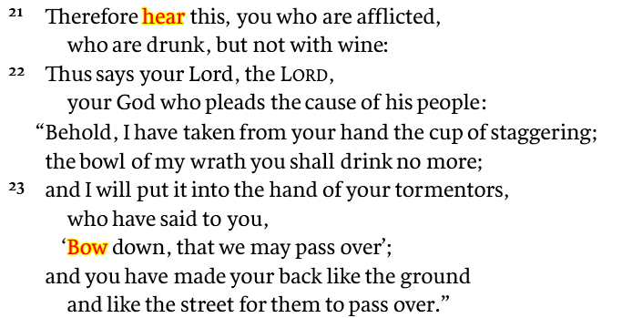
Isaiah 51:21-23
  “‘[Behold], I have taken’ belongs within the vividness of the illustration.”
  “The poor trembling drunk is awake now to see that the cup of wrath has gone from the hand that held it. Somehow, while the drunken stupor lasted, the Lord acted for the helpless one.”
  - Montyer

Slide 23
Key Things to Consider
From Isaiah 50/51: Are you Listening (getting prepared)?
  Listen to me, you who pursue righteousness, who seek the Lord (v. 1)
  My righteousness is near, My salvation has gone forth (v. 5;NASB)
  Do not fear the reproach of man, nor be dismayed at their revilings (v. 7)
  I, even I, am He who comforts you (v. 12a; NASB)
  He who is bowed down shall speedily be released; he shall not die and go down to the pit, neither shall his bread be lacking. (v. 14)
Thus says your Lord, the LORD, your God who pleads the cause of his people: “Behold, I have taken from your hand the cup of staggering; the bowl of my wrath you shall drink no more” Isaiah 51:22
¹ Dr. Constables notes, Page 12

Slide 24
Application
Wake up! Wake up!
God is Holy, Loving, Merciful and Just
To know and not to do, is not to know…
Beware of éclairs in your refrigerator
“The one spiritual disease is thinking that one [is] quite well.”
~ G. K. Chesterton
Notes:
In other words, a prerequisite for hearing good news may be first of all that we receive the true bad news. So John Wesley said to his young preachers, “Preach the Law until they are convicted, then preach Grace until they are converted.”
John N. Oswalt, Isaiah, The NIV Application Commentary (Grand Rapids, MI: Zondervan Publishing House, 2003), 580.
listen now to these surprising words from Professor Hobart Mowrer, one-time president of the American Psychological Association, who taught at both Harvard and Yale. In an article in the American Psychologist in 1960 he said:
For several decades we psychologists looked upon the whole matter of sin and moral accountability as a great incubus and acclaimed our liberation from it as epoch making. But at length we have discovered that to be free in this sense, that is, to have the excuse of being sick rather than sinful, is to court the danger of also becoming lost. This danger is, I believe, betokened by the widespread interest in existentialism, which we are presently witnessing. In becoming amoral, ethically neutral and free, we have cut the very roots of our being, lost our deepest sense of selfhood and identity, and with neurotics, themselves, we find ourselves asking, “Who am I, what is my deepest destiny, what does living mean?”
Ravi Zacharias, Can Man Live Without God?, n.d.
Mowrer then quotes Anna Russell in a psychiatric folk song:
At three I had a feeling of
Ambivalence toward my brothers,
And so it follows naturally
I poisoned all my lovers.
But now I’m happy I have learned
The lesson this has taught,
That everything I do that’s wrong
Is someone else’s fault.⁵
Can there be a clearer statement on the condition of the human heart? To be sure, Mowrer would not want to be perceived as espousing a biblical doctrine of sin. (Unfortunately, as many of you know, Mowrer’s own life ended in suicide.) But he does confess outrightly that the humanistic trivializing of wrongdoing is utterly bankrupt and incapable of expressing our real human predicament. An admission such as this from one not sympathetic to Christianity signifies that the attempt to portray mankind without any transcendent accountability has inexorably contributed to our individual sense of loss and alienation.
Ravi Zacharias, Can Man Live Without God?, n.d.

Slide 25
Discussion and Application
What about Chapter 51 indicates you are being prepared for a message?
What vivid historical events were described as part of this chapter and what did they represent? Why were those events used?
We didn’t cover v. 23 in the large group. How important is that verse in the chapter and what does it say about the character of God?
Read John 9:35-41. How does those verses correspond with Isaiah 51?
Is there a personal example where your actions don’t align with the concept of “knowing God’s righteousness”? In what way?
What concrete actions can you take in 2024 to better know God’s righteousness?

Slide 26
Chapter 51 Questions
To whom was this chapter addressed and what were the circumstances of those receiving the message?
Why do you think they were told to “look back” to their origin and to their heritage, and what were they told to look back to?
Why would God next tell them to “look ahead,” and “pay attention to,” and “give ear to” what He was forecasting about the future of the world? And what did He forecasts about the future?
What’s your understanding of when these events forecasted would (or will) take place, in the overall scheme of things?
Who’s telling whom to “awake,” in verse 9, and what’s the reference to “Rahab” all about?

Slide 27
Chapter 51 Questions
Why did the people “fear continually all day long”—and why did God say they didn’t need to fear?
Why is God calling on His people to “rouse themselves” (in verse 17)?
What does it mean that Jerusalem “is drunk, but not with wine,” and what does God say will happen to the “cup of reeling”?
How would you describe the main point of this text, and how might it apply to us?
What key thought will you take away from this lesson?

Slide 28
Our Study of Isaiah
This Meeting:
  Isaiah 51, The Lord’s Comfort/The Remnant to be Exalted
  Memory Verse: Isaiah 51:11
  Dr. Constable’s Notes, 2023 Ed., pp. 355-363; Motyer, pp. 402-415
  Refreshment Host: Group G
Next Meeting:
  Isaiah 52:1-10, The Lord’s Coming Salvation
  Memory Verse: Isaiah 52:7
  Dr. Constable’s Notes, 2023 Ed., pp. 363-367; Motyer, pp. 415-420
  Refreshment Host: Group H
Notes:
Welcome to MOB
Rod Turk covered Isaiah 14 last year. Does anyone remember the key word or topic he highlighted as part of his lesson? PRIDE. We’ll expand on that idea—but more from God’s attributes than our own.

Slide 29
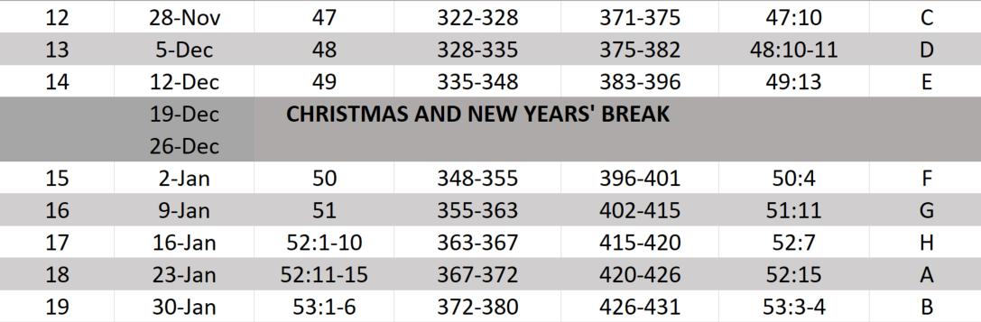
Isaiah Bible Study Schedule for Fall 2023 – Spring 2024 as of September 2023

Slide 30
Backup

Slide 31
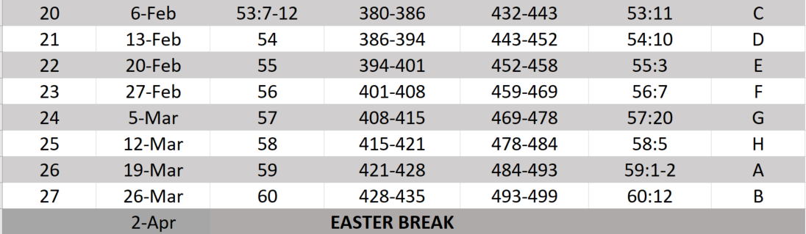
Isaiah Bible Study Schedule for Fall 2023 – Spring 2024 as of September 2023

Slide 32
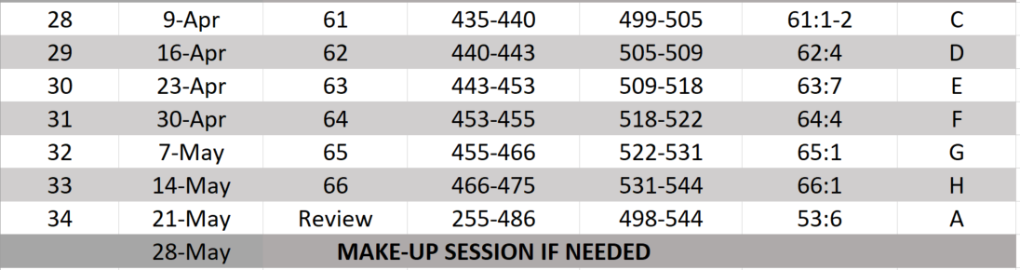
Isaiah Bible Study Schedule for Fall 2023 – Spring 2024 as of September 2023

Slide 33
Isaiah 51 – Constable Outline
Listening to the Servant (vv. 1 – 8)
The Lord’s Arm (vv. 9 – 16)
  Awakening to Deliverance (51:9 – 52:12)
Drunken Jerusalem (vv. 21 – 28)
Notes:
Oracles of salvation and oracles concerning the Suffering Servant 47:1–55:13
Earl D. Radmacher, Ronald Barclay Allen, and H. Wayne House, Nelsons New Illustrated Bible Commentary (Nashville: T. Nelson Publishers, 1999), 805.
Earl D. Radmacher, Ronald Barclay Allen, and H. Wayne House, Nelson’s New Illustrated Bible Commentary (Nashville: T. Nelson Publishers, 1999), 805.
2. Deliverance from Sin (49:1–57:21)
a. The Encouragement of Israel (49:1–52:11)
(1) The Servant’s Roles (49:1–13)
(2) The Lord’s Reassurance of Faithfulness (49:14–26)
(3) The Servant’s Example (50:1–11)
(4) God’s Promised Deliverance (51:1–52:12)
Michael A. Rydelnik and James Spencer, Isaiah, in The Moody Bible Commentary, ed. Michael A. Rydelnik and Michael Vanlaningham (Chicago, IL: Moody Publishers, 2014), 1010.
Michael A. Rydelnik and James Spencer, “Isaiah,” in The Moody Bible Commentary, ed. Michael A. Rydelnik and Michael Vanlaningham 1010.

Slide 34
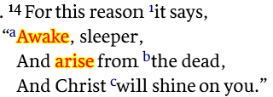
NT References of Isaiah 51
Ephesians 5:14 (NASB)

