Slide 1
WELCOME TO THE MOB!
All Scripture is breathed out by God and profitable for teaching, for reproof, for correction, and for training in righteousness, that the man of God may be complete, equipped for every good work.
2 Timothy 3:16-17 (ESV)

Slide 2
Announcements
MOB Website & Resources: www.ibcmob.net
Welcome to Immanuel Christian School!
https://immanuelbible.church/
https://immanuelbible.church/summer-breakout-series-2023
(943) What's Happening at IBC - Fall 2023 – YouTube
(943) Croc's Corner - YouTube
Jesse Johnson – The Christian Worldview

Slide 3
Please Rise
Invocation/Prayer.
Song:
“Rise up, O Men of God!”

Slide 4
Rise Up, O Men of God!
Verse 1 of 4
Rise up, O men of God!
Have done with lesser things.
Give heart and mind and soul and strength
To serve the King of kings.

Slide 5
Rise Up, O Men of God!
Verse 2 of 4
Rise up, O men of God!
The kingdom tarries long.
Bring in the day of brotherhood
And end the night of wrong.

Slide 6
Rise Up, O Men of God!
Verse 3 of 4
Rise up, O men of God! The church for you doth wait, Her strength unequal to her task; Rise up and make her great!

Slide 7
Rise Up, O Men of God!
Verse 4 of 4
Lift high the cross of Christ! Tread where His feet have trod. As brothers of the Son of Man, Rise up, O men of God!

Slide 8
Our Study of Isaiah
Last Meeting:
Isaiah 60, The Future Glory of Israel
Memory Verse: Isaiah 60:12
Dr. Constable’s Notes, 2022 Ed., pp. 428-435; Motyer, pp. 493-499
Refreshment Host: B
This Meeting:
Isaiah 61, The Year of the Lord’s Favor
Memory Verse: Isaiah 61:1-2
Dr. Constable’s Notes, 2022 Ed., pp. 435-440; Motyer, pp. 499-505
Refreshment Host: Group C

Slide 9
Memory Verse
Isaiah 61:1-2 (ESV)
“The Spirit of the Lord GOD is upon me, because the LORD has anointed me to bring good news to the poor; he has sent me to bind up the brokenhearted, to proclaim liberty to the captives, and the opening of the prison to those who are bound; to proclaim the year of the LORD’s favor, and the day of vengeance of our God; to comfort all who mourn”
Isaiah 61:1-2 (ESV)
Notes:
It really is a great verse. A lot packed into the application of Isaiah that we’ll touch on.

Slide 10
Isaiah Outline
Focus | Prophecies of Condemnation |  |  |  |  |  |  |  | Historical Parenthesis |  | Prophecies of Comfort
 | 1:1 |  |  |  |  |  |  | 35:10 | 36:1 | 39:8 | 40:1 |  |  |  |  |  | 66:24
Divisions | Prophecies Against Judah |  | Prophecies Against the Nation |  | Prophesies Against the Day of the Lord |  | Prophesies of Judgement and Blessing |  | Sickness and Sin | Hezekiah’s Salvation | Israel’s Deliverance |  |  | Israel’s Deliverer |  | Israel’s Glorious Future
 | 1:1 | 12:6 | 13:1 | 23:18 | 24:1 | 27:13 | 28:1 | 35:10 | 36:1 | 39:8 | 40:1 | 48:22 |  | 49:1 | 57:21 | 58:1 | 66:24
Topics | Prophetic |  |  |  |  |  |  |  | Historic |  | Messianic
 | Judgement |  |  |  |  |  |  |  | Transition |  | Hope
Place | Israel & Judah
Time | 740 - 680 B.C.
We are here!
Bruce Wilkinson and Kenneth Boa, Talk Thru the Bible (Nashville: T. Nelson, 1983), 189.

Slide 11
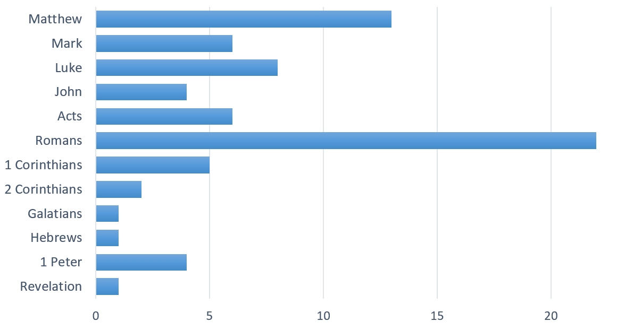
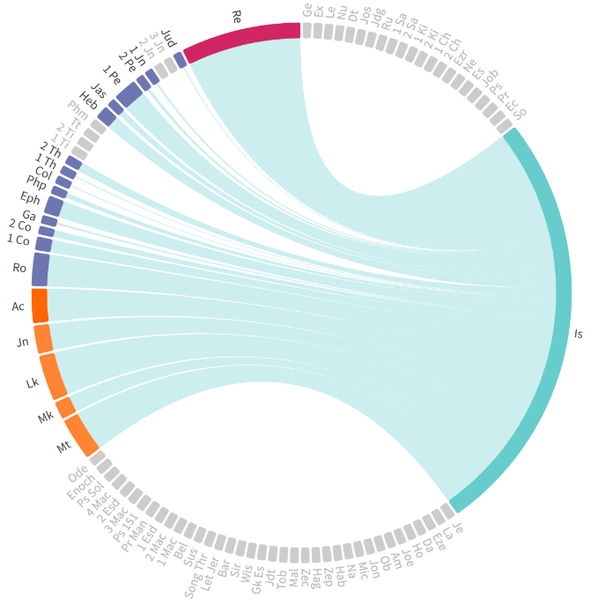
New Testament Use of Isaiah
Total
412
Chord Graph
73 Total Citations and Quotations of Isaiah
Notes:
31 in the Gospels …authoritative narrative!
Revelation has over 100 allusions and one quotation on Isaiah. 29 associated with Revelation 21 and 22

Slide 12
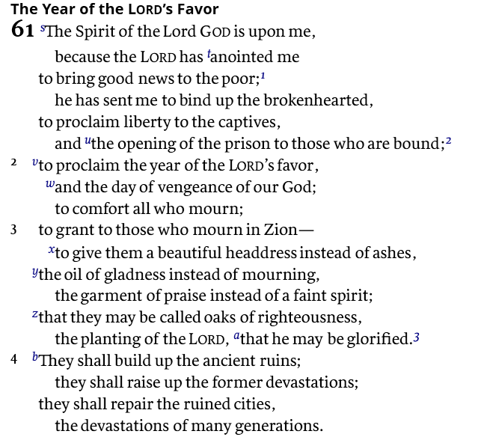
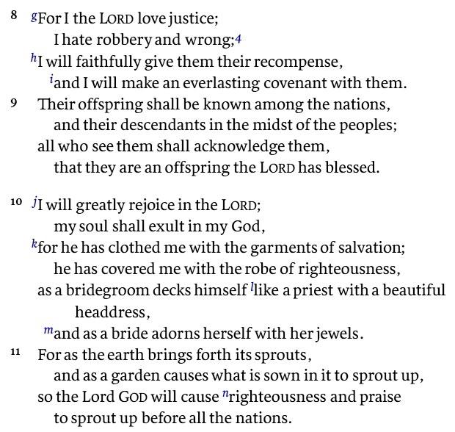
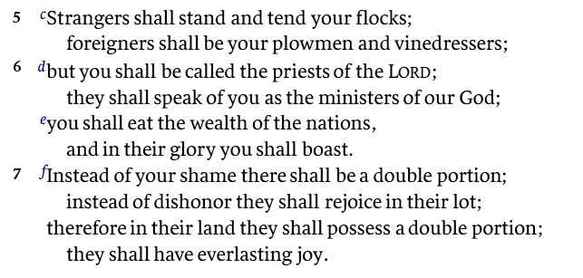
Note the Personal Pronoun Transition
Verses 1 – 4
Third Person
Verses 5 - 7
Second Person
Verses 8/9 – 10/11
First Person

Slide 13
Luke 4:16-21
¹⁶And He came to Nazareth, where He had been brought up; and as was His custom, He entered the synagogue on the Sabbath, and stood up to read. ¹⁷And the book of the prophet Isaiah was handed to Him. And He opened the book and found the place where it was written,
¹⁸“The Spirit of the Lord is upon Me, Because He anointed Me to preach the gospel to the poor. He has sent Me to proclaim release to the captives, And recovery of sight to the blind, To set free those who are oppressed, ¹⁹To proclaim the favorable year of the Lord.” (Isaiah 61:1-2a)
²⁰And He closed the book, gave it back to the attendant and sat down; and the eyes of all in the synagogue were fixed on Him. ²¹And He began to say to them, “Today this Scripture has been fulfilled in your hearing.”
Notes:
Of the many events that Luke could have chosen to begin his account of Christ’s ministry, he picked His visit to Nazareth. He did so because what Jesus said on this occasion identifies Him as the Messiah and perfectly defines His ministry (MacArthur Jr., Luke 15, 269).
Verse 18 succinctly summarizes the Messiah’s ministry. Four metaphors depict the desperate condition of needy sinners whom God seeks to rescue from hell. Ptōchos (ptoe-hoos) (poor) derives from a verb that means, “to cringe,” “to shrink back,” or “to cower.” It conveys the idea of a beggar cringing in the shadows, cowering in shame – think wretched…completely devoid of any value or commodity.
What He said was shocking, unexpected, and unprecedented: He began to say to them, “Today this Scripture has been fulfilled in your hearing.” Other teachers had spoken of a future fulfillment of Isaiah’s prophecy, but Jesus told them that they were witnessing its fulfillment before their eyes. Salvation had come; the messianic era had begun; the Messiah was present that day in the synagogue in the person of Jesus, a man from that very village.

Slide 14
Prophesies Fulfilled
The Announcement
The Declaration
A voice is calling, “Clear the way for the Lord in the wilderness; Make smooth in the desert a highway for our God.
…the Lord has anointed me To bring good news…to proclaim the favorable year of the Lord
Isaiah 40:3
Isaiah 61
(Isaiah 35; Lk 7:22)
The King Covenant
The Triumphal Entry
Your house and your kingdom shall endure before me forever; your throne shall be established forever
M
Behold, your king is coming to you; He is just and endowed with salvation, Humble, and mounted on a donkey
2 Sam 7:16
Zechariah 9
(Isaiah 42:6; 55:3; 59:21
Zechariah 12:10)
The term "Messiah" is derived from Hebrew and means "Anointed One," while in Greek, it is translated as "Christ."
Notes:
22 And He answered and said to them, “Go and report to John what you have seen and heard: the BLIND RECEIVE SIGHT (Is 35:5) the lame walk, the lepers are cleansed, and the deaf hear, the dead are raised up, the POOR HAVE THE GOSPEL PREACHED TO THEM (61:1). Lk 7:22.
Afflicted in NASB = Poor in ESV
The record of the genealogy of Jesus the Messiah, the son of David, the son of Abraham: Mt 1:1.
But when he had considered this, behold, an angel of the Lord appeared to him in a dream, saying, “Joseph, son of David, do not be afraid to take Mary as your wife; for the Child who has been conceived in her is of the Holy Spirit. She will bear a Son; and you shall call His name Jesus, for He will save His people from their sins.” Mt 1:20-21

Slide 15
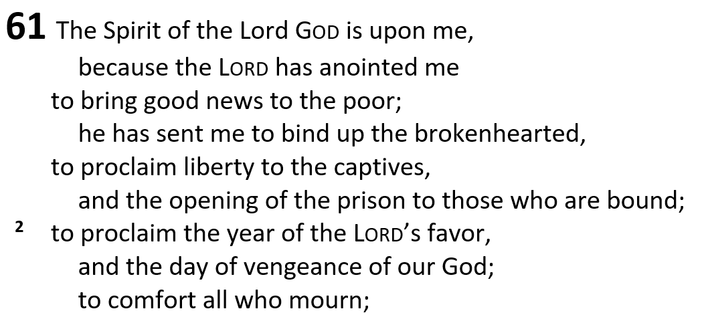
Isaiah 61
Idiomatic way YHWH power is bestowed
e.g. lost hope
Notes:
And he answered them, “Go and tell John what you have seen and heard: the blind receive their sight, the lame walk, lepers are cleansed, and the deaf hear, the dead are raised up, the poor have good news preached to them.”
– Luke 7:22 (Mt 11:5)
Captives = those enslaved
A series of seven purpose clauses follows v1a, outlining the mission of the prophet, together with the goal of that mission, namely to build up God’s people so that they can restore Jerusalem and the rest of the devastated nation of Judah (verses 1b–4).

Slide 16
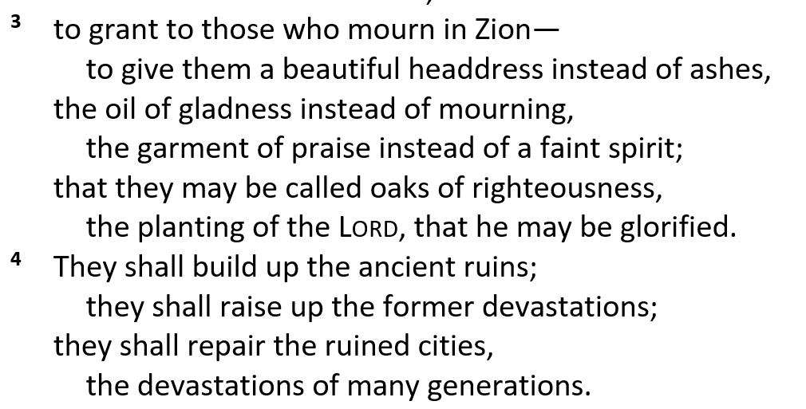
Isaiah 61
3 Reversal Phrases
(contrasting terms)
Restoration

Slide 17
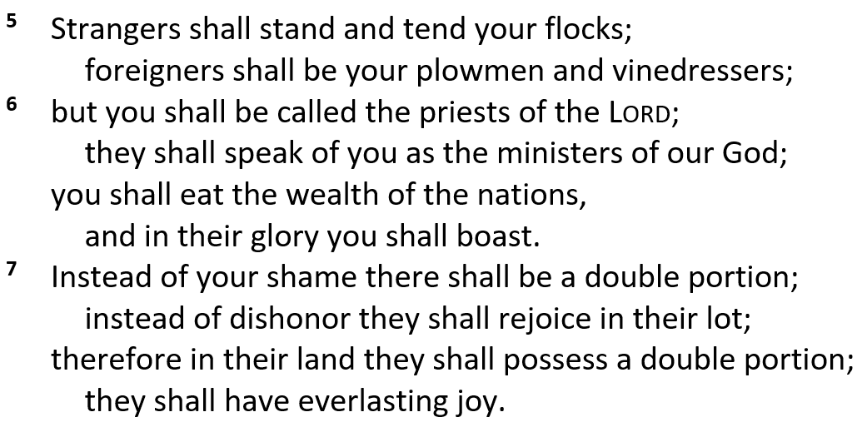
Isaiah 61
1 Peter 2:9
But you are a CHOSEN RACE, a royal PRIESTHOOD, a HOLY NATION, A PEOPLE FOR God’s OWN POSSESSION, so that you may proclaim the excellencies of Him who has called you out of darkness into His marvelous light
Is 43:20; Deut 10:15
Is 66:21: 1 Pt 2:5; Rev 1:6
Ex 19:6; Deut 7:6
Ex 19:5; Deut 4:20; 14:12; Titus 2:14
Notes:
Is 43:20; Deut 10:15
Is 66:21: 1 Pt 2:5; Rev 1:6
Ex 19:6; Deut 7:6
Ex 19:5; Deut 4:20; 14:12; Titus 2:14

Slide 18
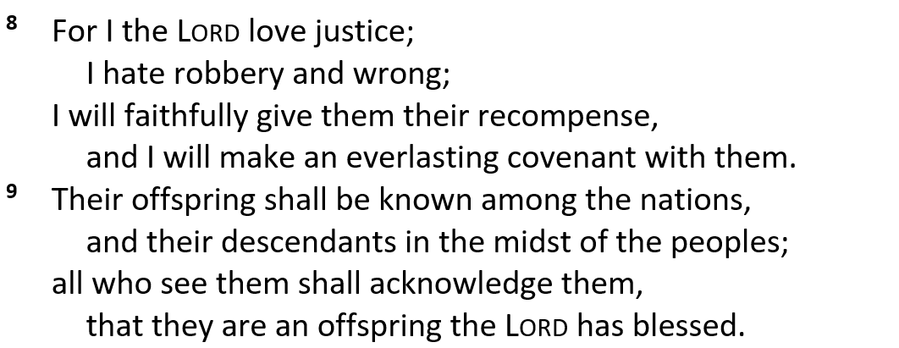
Isaiah 61
Speaker turns to YHWH – Personal pronouns present His character (note comparisons and contrasts)

Slide 19
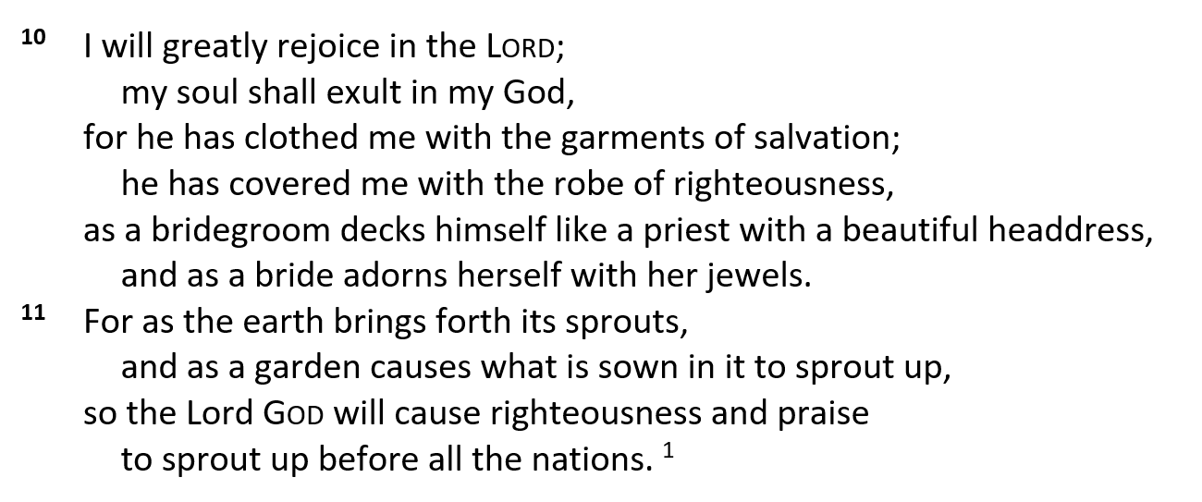
Isaiah 61
Lit, rejoicing, I will greatly rejoice…
Royalty and Wedding metaphors!
Declared righteous!!
Resembles a Psalm of Thanksgiving -- dripping with imagery

Slide 20
Key Things to Consider
Isaiah 61 lays out the multi-purpose role of the Messiah
Declared the starting point of Jesus’ public ministry
The news embraces personal renewal, restoration, release and rectification - Motyer
Two Advents are woven into the message
Luke ends with the year of the Lord’s favor, not the day of vengeance
The term everlasting provides a rich message (Is 35:10; 55:3)
Why does this scripture matter to us over 2700 years later?
¹ Dr. Constables notes, Page 12
Notes:
We aren’t studying Isaiah because of Isaiah…we are studying Isaiah because he provides a roadmap to the Messiah.
A head knowledge of God is like kissing your sister…have you ever kissed your sister?
I can’t tell you how many times in the many decades that I read Luke 4—but I didn’t really read it. Do you know what I mean?
One of the great honors we have as elders is to vote on membership—it includes a written testimony and explanation of the gospel. I love reading those personal testimony’s and walk away encouraged. I see how they fully realized God and accepted Him as their personal savior.
Some it was early
Many it was a compliant upbringing, followed by rebellion
A more than just a few it was a crisis that they couldn’t untangle

Slide 21
A personal relationship…
O T T F F S S E N __
What’s the Missing Letter?

Slide 22
Discussion and Application
Isaiah 61:1 makes reference to a Trinitarian God view? Why did this quotation in Luke not complete through verse 2?
Seven purpose clauses are contained in vv 1 – 3. Can you point them out?
To whom are the first person pronouns referencing in vv 8 – 11?
Discuss where you find the use of reversal clauses and repetition. How do they help frame the message in this chapter?
The Hebrew word for everlasting is used twice in Ch 61. Discuss the use in each verse and how they apply to the message.
Do you view the quotation of Is 61:1-3a in Luke 4:18-19 differently after being part of this lesson? How does the year of the Lord’s favor fit in?

Slide 23
Discussion and Application
Review the “everlasting covenant” of Isaiah 61:8 as described in Jeremiah 31:31-37 and consider the blessings of the New Covenant that Jesus Christ instituted by His death (Heb 10:1-18; Mt 26:28)
Review Isaiah 35 or Isaiah 40 and discuss similarities between these chapters and Is 61.
How does Isaiah 61:10-11 resemble a psalm of thanksgiving? See Psalm 85
Review Luke 6:17-21 and discuss the four metaphors—(1) preach to the poor; (2) proclaim release to the captives; (3) recover sight to the blind; and (4) set free those who are oppressed. Apply them to us.

Slide 24
Our Study of Isaiah
This Meeting:
Isaiah 61, The Year of the Lord’s Favor
Memory Verse: Isaiah 61:1-2
Dr. Constable’s Notes, 2022 Ed., pp. 435-440; Motyer, pp. 499-505
Refreshment Host: Group C
Next Meeting:
Isaiah 62, Zion’s Coming Salvation
Memory Verse: Isaiah 62:4
Dr. Constable’s Notes, 2022 Ed., pp. 440-443; Motyer, pp. 505-509
Refreshment Host: Group D
Notes:
Welcome to MOB

Slide 25
Isaiah Bible Study Schedule for Fall 2023 – Spring 2024 as of March 2024

Slide 26
Backup

Slide 27
Scriptural Interpretation at IBC
https://immanuelbible.church/visit/what-we-teach
Notes:
The teaching of Immanuel Bible Church is based on the Scriptures. This
article (Article V) serves as our statement of faith, and it reflects those
doctrines that the elders and congregation consider essential to understanding, teaching, and practicing God’s Word. It is based on an interpretation of the Scripture that is:

Slide 28
Section Overview
Chs. 58-66 will end the section by explaining that Israel has received of Jehovah's hand double for all her sins.
-This last segment will be dealt with in seven parts:
1) Israel's national wickedness (58:1-59:21)
2) Her future in the Messianic kingdom (60:1-22)
3) The Servant of YHWH (61:1-11)
4) The redemption of Israel and Jerusalem (62:1-63:6)
5) The penitential prayer of the remnant (63:7-64:12)
6) Israel in the plan of God (65:1-25)
7) The rebirth of Israel (66:1-24)
Constable’s notes, quote from Fruchtenbaum

Slide 29
The Fifth Servant Song
Emphasis on the Servant’s Mission
(1) The Servant refers to God as His Master, the Lord
(2) He has received the Lord’s Spirit
(3) He brings a word of healing and liberation
(4) He proclaims the “year of the Lord”
(5) He is associated with an everlasting covenant
(6) Jesus Christ inaugurated His ministry by identifying Himself as this Servant (Luke 4:17–21).
#1 – 42:1
#2 – 49:1
#3 – 50:4
#4 – 52:13
#5 – 61:1
Earl D. Radmacher, Ronald Barclay Allen, and H. Wayne House, Nelsons New Illustrated Bible Commentary (Nashville: T.)
Notes:
Isaiah 61 is sometimes referred to as the 5th Servant Song—with the emphasis on the Servant’s mission. What are elements of the mission discussed in this chapter? The others are noted in backup slides.

Slide 30
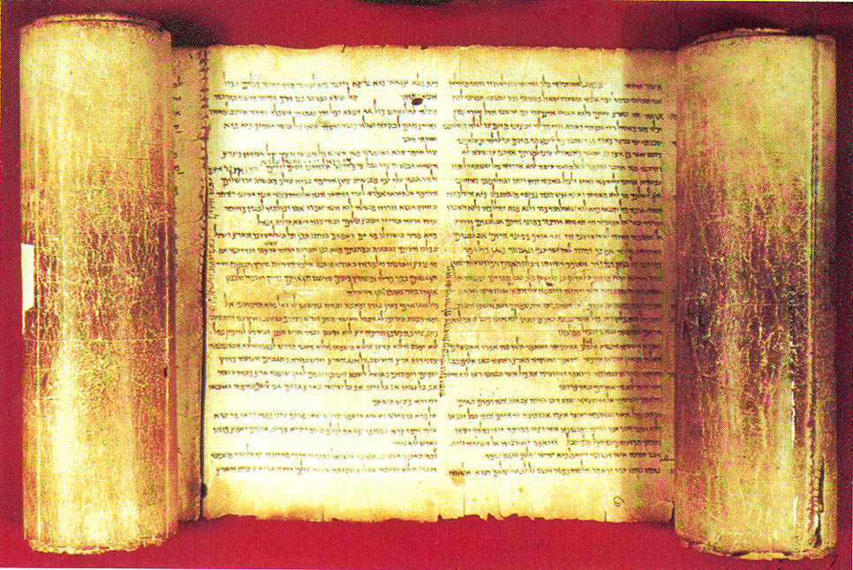
Theme – from Constable’s notes
Israel under the Lord (Ch 61 & 62)
These chapters explain the character of the Israelites in the era following the LORD's future provision of salvation for them.
Notes:
Chapter 60 presented the blessings that Israel would enjoy in the future, like a city lit by the rising sun. Chapter 61 begins by introducing the One who would bring those blessings, the “Sun” that lights that city.
Tom Constable, Tom Constables Expository Notes on the Bible (Galaxie Software, 2003), Is 61:1.

Slide 31
Isaiah 61 - Pericopes
A series of seven purpose clauses follows v1a, outlining the mission of the prophet, together with the goal of that mission, namely to build up God’s people so that they can restore Jerusalem and the rest of the devastated nation of Judah (verses 1b–4).
Graham S. Ogden and Jan Sterk, A Handbook on Isaiah, ed. Paul Clarke et al., vol. 1 & 2, United Bible Societies Handbooks, 1718.

