Slide 1
WELCOME TO THE MOB!
All Scripture is breathed out by God and profitable for teaching, for reproof, for correction, and for training in righteousness, that the man of God may be complete, equipped for every good work.
2 Timothy 3:16-17 (ESV)

Slide 2
Announcements
MOB Website & Resources | www.ibcmob.net
Immanuel Bible Institute classes | Starting 28 January
Fundamentals of the Faith – Part 2, 8am, room B207
The Art of Marriage, 9:30am, room B207
Evangelism 101, 9:30am, room B209
Christian Worldview and Culture, 11:10am, room B207
Panorama of the Bible, 11:10am, room B209
Logos Bible Software for Beginners, 8am, room A207

Slide 3
On Your Feet!
Invocation/Prayer
Song:
“A Mighty Fortress Is Our God”

Slide 4
A Mighty Fortress Is Our God 1 of 4
A mighty fortress is our God, a bulwark never failing;
Our helper He, amid the flood of mortal ills prevailing:
For still our ancient foe doth seek to work us woe;
His craft and pow’r are great, and, armed with cruel hate,
On Earth is not his equal

Slide 5
A Mighty Fortress Is Our God 2 of 4
Did we in our own strength confide, our striving would be losing, We’re not the right Man on our side, the Man of God’s own choosing: Dost ask who that may be? Christ Jesus, it is He; Lord Sabaoth, His Name, from age to age the same, And He must win the battle.

Slide 6
A Mighty Fortress Is Our God 3 of 4
And though this world, with devils filled,
Should threaten to undo us,
We will not fear, for God hath willed His truth to triumph through us; The Prince of Darkness grim, we tremble not for him;
His rage we can endure, for lo, his doom is sure,
One little word shall fell him.

Slide 7
A Mighty Fortress Is Our God 4 of 4
That word above all earthly pow’rs, no thanks to them, abideth;
The Spirit and the gifts are ours through Him who with us sideth;
Let goods and kindred go, this mortal life also;
The body they may kill: God’s truth abideth still, His kingdom is forever.

Slide 8
Memory Verse

Slide 9
Memory Verse
Isaiah 52:15 (ESV)
so shall he sprinkle many nations. Kings shall shut their mouths because of him, for that which has not been told them they see, and that which they have not heard they understand.

Slide 10
Isaiah Study
Last Week
Isaiah 52:1-10
Memory Verse | Isaiah 52:7
Dr. Constable’s Notes, 2023 Ed., pp. 363-367; Motyer, pp. 415-420
Refreshment Host | N/A
Tonight
Isaiah 52:11-15 | Departing Captivity, Suffering & Glory of the Servant
Memory Verse | Isaiah 52:15
Dr. Constable’s Notes, 2023 Ed., pp. 367-372; Motyer, pp. 420-426
Refreshment Host | Group A

Slide 11
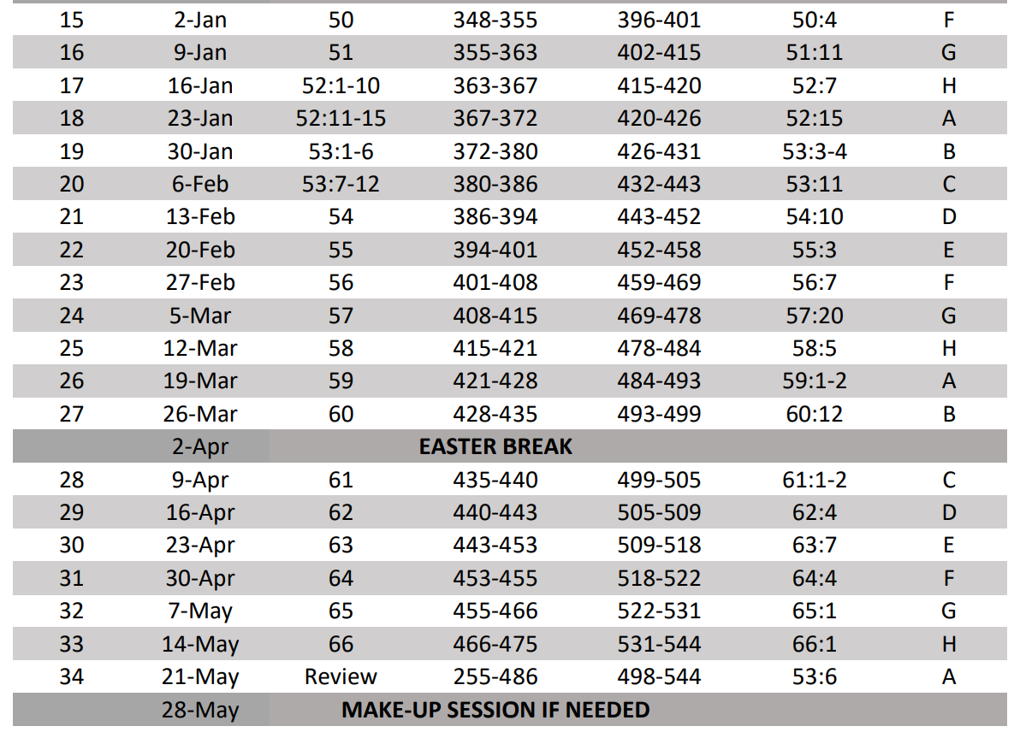
Isaiah Bible Study Schedule Fall 2023 – Spring 2024

Slide 12
Isaiah Outline
Focus | Prophecies of Condemnation |  |  |  |  |  |  |  | Historical Parenthesis |  | Prophecies of Comfort
 | 1:1 |  |  |  |  |  |  | 35:10 | 36:1 | 39:8 | 40:1 |  |  |  |  |  | 66:24
Divisions | Prophecies Against Judah |  | Prophecies Against the Nation |  | Prophesies Against the Day of the Lord |  | Prophesies of Judgement and Blessing |  | Sickness and Sin | Hezekiah’s Salvation | Israel’s Deliverance |  |  | Israel’s Deliverer |  | Israel’s Glorious Future
 | 1:1 | 12:6 | 13:1 | 23:18 | 24:1 | 27:13 | 28:1 | 35:10 | 36:1 | 39:8 | 40:1 | 48:22 |  | 49:1 | 57:21 | 58:1 | 66:24
Topics | Prophetic |  |  |  |  |  |  |  | Historic |  | Messianic
 | Judgement |  |  |  |  |  |  |  | Transition |  | Hope
Place | Israel & Judah
Time | 740 - 680 B.C.
We are here!
Bruce Wilkinson and Kenneth Boa, Talk Thru the Bible (Nashville: T. Nelson, 1983), 189.

Slide 13
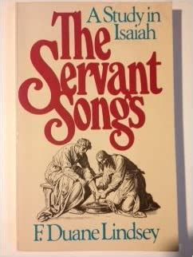
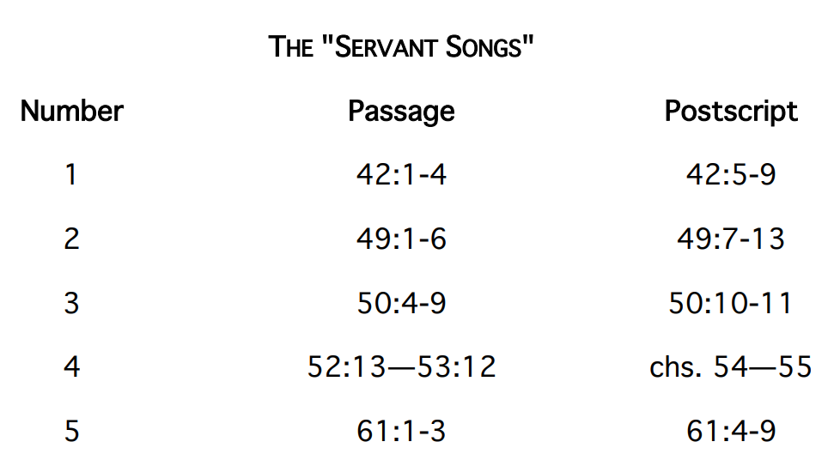
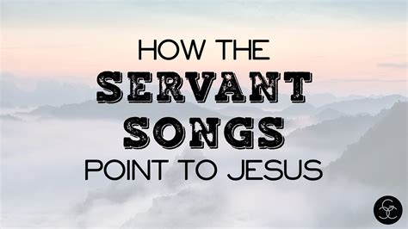
Servant Songs

Slide 14
Isaiah
“The artistry of Isaiah is as much seen in his suspenseful withholding of information as in his use of words and images.” - Motyer

Slide 15
Servant Songs | Overview
The book of Isaiah contains four “Servant Songs” or “Servant Poems” that describe the service, suffering, and exaltation of the Servant of the LORD.* The term “Servant Songs” was coined by Bernard Duhm in his 1892 German commentary of Isaiah.
“”Servant of the LORD” describes Moses 21 times and Joshua twice in the Old Testament. The LORD referred to the following entities as “My Servant”: Israel (14 times, including seven times in Isaiah 40-55), Moses (six times), David (21 times), the prophets (nine times), Job (seven times), and Nebuchadnezzar (twice).” – Motyer
There is disagreement about the number and content of the Servant Songs with some saying there are four or five and others disagreeing upon their length.
Servant Song #1 | Isaiah 42:1-9 (Kirk S. 10/10/2023) “Predicted Justice on Earth is Coming” - Paul Apple
Servant Song #2 | Isaiah 49:1-13 (Joel B. 12/12/2023) “The Unveiling of the Servant” - Apple
Servant Song #3 | Isaiah 50:4-11 (John N. 1/2/2024) “The Marks of an Obedient Servant” - Apple
Servant Song #4 | Isaiah 52:13-53:12 (Tonight and Jim B. 1/30/2024 and Jim C. 2/6/2024) “The Mission of the Suffering Servant in Accomplishing Redemption” - Apple
*What are the four Servant Songs in Isaiah? | GotQuestions.org

Slide 16
First Servant Song | Review
1Behold my servant, whom I uphold, my chosen, in whom my soul delights; I have put my Spirit upon him; he will bring forth justice to the nations. 2He will not cry aloud or lift up his voice, or make it heard in the street; 3a bruised reed he will not break, and a faintly burning wick he will not quench; he will faithfully bring forth justice. 4He will not grow faint or be discouraged till he has established justice in the earth; and the coastlands wait for his law. 5Thus says God, the LORD, who created the heavens and stretched them out, who spread out the earth and what comes from it, who gives breath to the people on it and spirit to those who walk in it: 6“I am the LORD; I have called you in righteousness; I will take you by the hand and keep you; I will give you as a covenant for the people, a light for the nations, 7to open the eyes that are blind, to bring out the prisoners from the dungeon, from the prison those who sit in darkness. 8I am the LORD; that is my name; my glory I give to no other, nor my praise to carved idols. 9Behold, the former things have come to pass, and new things I now declare; before they spring forth I tell you of them.” (Isaiah 42:1-9)
The LORD’s Chosen Servant (ESV, KJV, and NLT)
The Servant of the LORD (NIV)
Here is My Servant (BSB)
God’s Promise Concerning His Servant (NASB)
The LORD’s Servant (CEV)
Verses 1-4 | The LORD wrote “Of” or “about” His Servant
Verses 5-9 | The LORD wrote “To” His Servant
Behold (Isaiah 42:1, 9; 49:12; 50:9, 11; 52:13)
Spirit upon him (Isaiah 11:2; Matt. 3:16)
Justice to the nations in view, not just Israel (“… societal order as well as meaning legal equity” – Constable)
“The Servant’s ministry will fulfill the Creator’s original intention for the earth.” – Motyer
Notes:
“Yahweh had challenged the nations to behold the folly of idols (41:24) and idol worshippers (41:29), but now He urged them to behold His Servant (42:1)
Fulfilled in Matthew 12:18-21
Blessing Him with His presence and empowering Him for service by placing His Spirit on this Servant
First of six times in Isaiah where God claims the ability to predict the future - Constable

Slide 17
Second Servant Song | Review
1Listen to me, O coastlands, and give attention, you peoples from afar. The LORD called me from the womb, from the body of my mother he named my name. 2He made my mouth like a sharp sword; in the shadow of his hand he hid me; he made me a polished arrow; in his quiver he hid me away. 3And he said to me, “You are my servant, Israel, in whom I will be glorified.” 4But I said, “I have labored in vain; I have spent my strength for nothing and vanity; yet surely my right is with the LORD, and my recompense with my God.” 5And now the LORD says, he who formed me from the womb to be his servant, to bring Jacob back to him; and that Israel might be gathered to him — for I am honored in the eyes of the LORD, and my God has become my strength — 6he says: “It is too light a thing that you should be my servant to raise up the tribes of Jacob and to bring back the preserved of Israel; I will make you as a light for the nations, that my salvation may reach to the end of the earth.” 7Thus says the LORD, the Redeemer of Israel and his Holy One, to one deeply despised, abhorred by the nation, the servant of rulers: “Kings shall see and arise; princes, and they shall prostrate themselves; because of the LORD, who is faithful, the Holy One of Israel, who has chosen you.” 8Thus says the LORD: “In a time of favor I have answered you; in a day of salvation I have helped you; I will keep you and give you as a covenant to the people, to establish the land, to apportion the desolate heritages, 9saying to the prisoners, ‘Come out,’ to those who are in darkness, ‘Appear.’ They shall feed along the ways; on all bare heights shall be their pasture; 10they shall not hunger or thirst, neither scorching wind nor sun shall strike them, for he who has pity on them will lead them, and by springs of water will guide them. 11And I will make all my mountains a road, and my highways shall be raised up. 12Behold, these shall come from afar, behold, these from the north and from the west, and these from the land of Syene.” 13Sing for joy, O heavens, and exult, O earth; break forth, O mountains, into singing! For the LORD has comforted his people and will have compassion on his afflicted. (Isaiah 49:1-13)

Slide 18
Second Servant Song | Review
(Isaiah 49:1-13)
The Servant of the LORD (ESV)
You are My Servant (KJV)
The LORD’s Servant Commissioned (NLT)
Salvation Reaches to the Ends of the Earth (NASB)
The Work of the LORD’s Servant (CEV)
The Servant’s Calling (Isaiah 49:1-7) and Servant’s Ministry (Isaiah 49:8-13)
“Depiction of the Servant here concurs with the first Song” - Motyer
Summoning the “coastlands” means addressing the known world at the time of Isaiah
“Servant is a prophetic, covenant figure, but… much, much more than any prophet ever was or claimed to be.” - Motyer
Includes restoration of the covenant people to their land
Discussion of the land in verse 11 has to be in the future, the Millennium
People mentioned coming from “afar” was the known civilized world at the time of Isaiah
Notes:
Revelation 1:16 In his right hand he held seven stars, from his mouth came a sharp two-edged sword, and his face was like the sun shining in full strength.
Hebrews 4:12 For the word of God is living and active, sharper than any two-edged sword, piercing to the division of soul and of spirit, of joings and of marrow, and discerning the thoughts and intentions of the heart.
“The Second Song, however, goes beyond the first in another way. The same Servant who was there given a world ministry now has a double task. He is sent to Israel as well – indeed, to Israel first… The first Song was a word from the Lord to the world about his Servant… but the second Song is the Servant’s testimony how that worldwide task devolved upon one who was already commissioned to minister to Israel.” – Motyer
In Revelation 1:16, John uses this same term “sword,” as in verse 2
In John 1:10-11, John describes Jesus as not being well received by most Jews, as in verse 4

Slide 19
Third Servant Song | Review
4The Lord GOD has given me the tongue of those who are taught, that I may know how to sustain with a word him who is weary. Morning by morning he awakens; he awakens my ear to hear as those who are taught. 5The Lord GOD has opened my ear, and I was not rebellious; I turned not backward. 6I gave my back to those who strike, and my cheeks to those who pull out the beard; I hid not my face from disgrace and spitting. 7But the Lord GOD helps me; therefore I have not been disgraced;
therefore I have set my face like a flint, and I know that I shall not be put to shame. 8He who vindicates me is near. Who will contend with me? Let us stand up together. Who is my adversary? Let him come near to me. 9Behold, the Lord GOD helps me;
who will declare me guilty? Behold, all of them will wear out like a garment; the moth will eat them up. 10Who among you fears the LORD and obeys the voice of his servant? Let him who walks in darkness and has no light trust in the name of the LORD and rely on his God. 11Behold, all you who kindle a fire, who equip yourselves with burning torches! Walk by the light of your fire, and by the torches that you have kindled! This you have from my hand: you shall lie down in torment. (Isaiah 50:4-11)
The LORD’s Obedient Servant (NLT)
The Servant’s Obedience (BSB, ESV, KJV)
God Helps His Servant (NASB)
God’s Servant Must Suffer (CEV)
Isaiah presents One who heard from God and responded with trust and confidence:
Responsiveness or Unwillingness (Isaiah 50:4-6) “Everything Jesus said and did was taught Him by His Father (John 5:19, 30; 6:39; 8:28) – Warren Wiersbe
Reliance or Independence (Isaiah 50:7-9)
Repentance or Rejection (Isaiah 50:10-11) “How true it is to this life that those who trust walk in darkness and those who are self-sufficient walk in light! … The picture here is of people seeking to equip themselves… to deal with earth’s dark experiences. They feel the need of nothing they cannot generate for themselves.” – Motyer
Constable says Isaiah 50 “… is a call to listen to the Servant, to follow His example, and so experience God’s salvation. Failure to do so will result in sharing the fate of His opponents.

Slide 20
Fourth Servant Song
13Behold, my servant shall act wisely; he shall be high and lifted up, and shall be exalted. 14As many were astonished at you — his appearance was so marred, beyond human semblance, and his form beyond that of the children of mankind — 15so shall he sprinkle many nations. Kings shall shut their mouths because of him, for that which has not been told them they see, and that which they have not heard they understand.
1Who has believed what he has heard from us? And to whom has the arm of the LORD been revealed? 2For he grew up before him like a young plant, and like a root out of dry ground; he had no form or majesty that we should look at him, and no beauty that we should desire him. 3He was despised and rejected by men, a man of sorrows and acquainted with grief; and as one from whom men hide their faces he was despised, and we esteemed him not. 4Surely he has borne our griefs and carried our sorrows; yet we esteemed him stricken, smitten by God, and afflicted. 5But he was pierced for our transgressions; he was crushed for our iniquities; upon him was the chastisement that brought us peace, and with his wounds we are healed. 6All we like sheep have gone astray; we have turned—every one—to his own way; and the LORD has laid on him the iniquity of us all.
7He was oppressed, and he was afflicted, yet he opened not his mouth; like a lamb that is led to the slaughter, and like a sheep that before its shearers is silent, so he opened not his mouth. 8By oppression and judgment he was taken away; and as for his generation, who considered that he was cut off out of the land of the living, stricken for the transgression of my people? 9And they made his grave with the wicked and with a rich man in his death, although he had done no violence, and there was no deceit in his mouth. 10Yet it was the will of the LORD to crush him; he has put him to grief; when his soul makes an offering for guilt, he shall see his offspring; he shall prolong his days; the will of the LORD shall prosper in his hand. 11Out of the anguish of his soul he shall see and be satisfied; by his knowledge shall the righteous one, my servant, make many to be accounted righteous, and he shall bear their iniquities. 12Therefore I will divide him a portion with the many, and he shall divide the spoil with the strong, because he poured out his soul to death and was numbered with the transgressors; yet he bore the sin of many, and makes intercession for the transgressors.
He Was Pierced for Our Transgressions (ESV)
The Suffering Servant (CEV)
The Suffering and Glory of the Servant (NIV)
The LORD’s Suffering Servant (NLT)
The Servant Exalted (BSB, KJV)
The Exalted Servant (NASB)

Slide 21
Isaiah 52:11
11 Depart, depart, go out from there; touch no unclean thing; go out from the midst of her; purify yourselves, you who bear the vessels of the LORD. 12 For you shall not go out in haste, and you shall not go in flight, for the LORD will go before you, and the God of Israel will be your rear guard.
Depart, get out, leave, run (Isaiah 48:20; Jeremiah 50:8, 51:6, 51:45)
Constable reminds us “all recipients of spiritual salvation, which these Babylonian exiles represent, should also respond to redemption by living lives separated from sin and unto God (2 Corinthians 6:17)
Motyer considers Luke 1:74-75 a commentary on these two verses: “that we, being delivered from the hand of our enemies, might serve him without fear, in holiness and righteousness before him all our days.”
Potential for near-term fulfillment, Babylon, and ultimate fulfillment, Millennium

Slide 22
Babylon?
“In view of this salvation, the redeemed should depart from the unclean place where they had been, and purify themselves. The Babylonian exiles, who would be set free, should return to Jerusalem to reestablish their holy lives, in a holy city, in a holy land. The decision of many Israelites to remain in Babylon rather than returning with Zerubbabel, Ezra, or Nehemiah, was sinful rebellion against God’s revealed will for them.” - Constable
“The redeemed would not need to run away from their former captor as fast as they could, or to depart like fugitives, as they had to do when they left Egypt in the Exodus. They were completely free. Yahweh would go before to lead them and He would go behind to protect them as they journeyed to their Promised (Exodus 13:21-22; 14:19-20). - Constable

Slide 23
The Greater Exodus?
“Most commentators find in Go out from there a reference to leaving Babylon with the temple vessels (Ezra 1:7-11), but this cannot be correct. First, Isaiah concluded his treatment of Cyrus and Babylon at 48:20-21. The new need (48:22) and the predicted remedy (49:5-6) have been the sole theme... It is unthinkable to return at 52:11 to the historical events of captivity and liberation… Secondly, there is a clear contrast between Isaiah’s vision of leaving Babylon (48:20-21) and the vision here… But if we treat the verse as packed with exodus motifs, it fits perfectly in its context. A great salvation has been effected in which the Lord’s wrath is gone (51:17-23) and his people are established in holiness as a royal priesthood (52:1). - Motyer
“… the call is to leave the whole setting and ambience of the old sinful life behind. In contrast to the exodus, when they were commanded to load themselves with the treasures of Egypt, they are now commanded to touch no unclean thing.” - Motyer

Slide 24
Isaiah 52:12
11 Depart, depart, go out from there; touch no unclean thing; go out from the midst of her; purify yourselves, you who bear the vessels of the LORD. 12 For you shall not go out in haste, and you shall not go in flight, for the LORD will go before you, and the God of Israel will be your rear guard.
“Leave” or “go out” appears for the third time
“… the call to holy pilgrimage… the old situation can and must now be decisively left… every divine care will be available, for the LORD will surround them with his guardian presence. They live, as it were, in a holy enclave.” – Motyer
“… the LORD guards his priestly people. The exodus imagery of the fiery-cloudy pillar (Exodus 13:21) is a contributory motif, for in their need (Exodus 14:19) they found the pillar, which had led them, moved to protect their rear. Even so the LORD… the God of Israel surrounds them.” - Motyer

Slide 25
Introduction to Isaiah 53
(Isaiah 52:13-15)
Isaiah 53 is considered by some to be the
“heart of Isaiah” or the
“pinnacle of Messianic vision” or the
“greatest chapter in the book.”

Slide 26
Fourth Servant Song
(Isaiah 52:13-53:12)
“The profoundest thoughts in the Old Testament revelation are to be found in this section. It is a vindication of the Servant, so clear and so true, and wrought out with such a pathos and potency, that it holds first place in Messianic prophecy.” - George L. Robinson
“The reader of the promises that God would redeem His people with His mighty arm (Isaiah 50:2; 51:5, 9; 52:10) could reasonably expect that redemption to come with a great display of overwhelming power… In this passage, Isaiah filled out the previously sketchy picture of the Servant with more detail concerning His work, His character, and His nature. The LORD’s greatest power is evident in His ability to return love and forgiveness for hatred and injustice, not in His ability to crush all opposition.” - Constable

Slide 27
Isaiah 52:13
13 Behold, my servant shall act wisely; he shall be high and lifted up, and shall be exalted. 14 As many were astonished at you — his appearance was so marred, beyond human semblance, and his form beyond that of the children of mankind —
“… brings to a rounded climax the revelation of the Servant which began with (“Behold my Servant”) in 42:1.” - Motyer
Servant will “succeed in the sense of fulfilling the purpose to which God had called Him.” - Constable
“The threefold exaltation (raised… lifted up … highly exalted) expresses a dignity beyond what any other merits or receives and is surely intended as a clue leading to the identity of the Servant. It is impossible not to be reminded of the resurrection, ascension, and heavenly exaltedness of the Lord Jesus.” - Motyer
“The terms high, lifted up, and greatly exalted describe God… (Isaiah 6:1; 33:10; 57:15)… thus the Servant would take a place of equality with God (Acts 2:33; 3:13, 26).” - Constable

Slide 28
Isaiah 52:14
13 Behold, my servant shall act wisely; he shall be high and lifted up, and shall be exalted. 14 As many were astonished at you — his appearance was so marred, beyond human semblance, and his form beyond that of the children of mankind —
Contrast many, “referring to the whole company for whose benefit the Servant acts” - Motyer
“The Servant would experience the same humiliation and degradation that had marked the Israelites. Rather than appearing to be the strongest and most attractive representative of Yahweh the Servant would appear extremely weak and unattractive to the people.” - Constable
“In His trials and crucifixion, Jesus underwent beatings that “marred” His physical appearance, but far more than that is in view in this description of Him. By saying that “His appearance was marred beyond that of a man.” and “His form beyond the sons of mankind,” Isaiah was saying, in a very strong way, that His sufferings would be extremely great.” - Constable

Slide 29
Isaiah 52:15
15 so shall he sprinkle many nations. Kings shall shut their mouths because of him, for that which has not been told them they see, and that which they have not heard they understand.
The interpretation of the Hebrew word yazzeh, translated either “sprinkle” or “startle,” has led students of this verse to two different understandings of the prophet’s line of thought. If “sprinkle” is correct, Isaiah meant that even though the Servant was such an unlikely candidate as Yahweh’s representative, He would still perform the priestly function of cleansing the world of its sins… If “startle’ is correct, the prophet meant that since the Servant was such an unlikely candidate as Yahweh’s representative, He would shock the world (when He made His claims and when God would exalt Him). – Constable
Speechless kings?
“Kings shall shut their mouths – both from amazement and from their inability to say anything by way of self-justification.” – Gleason L. Archer

Slide 30
Conclusion
With the LORD’s coming salvation, humble yourselves and leave those old sinful habits behind.
The LORD’s suffering Servant will be exalted.

Slide 31
Discussion & Application
1 of 2
How does the command to “depart” in verses 11-12 mirror the call for Christians to live lives set apart from the world? (Romans 12:1-2; 2 Corinthians 10:3; Ephesians 5:8; James 4:4; 1 John 2:15)
Where in your life are you choosing to remain in Babylon? What sinful environment is GOD calling you to depart? What sinful habit? (Genesis 4:4-7; Mark 7:20-23; 1 Corinthians 10:13; Colossians 3:5-6)
Why would staying in Babylon, verses 11-12, be rebellion against GOD?
Why does GOD make a distinction between clean and unclean? (Leviticus 10:10, 13:59, 14:57, 20:25; Ecclesiastes 9:2; Ezekiel 22:26, 44:23)
In verse 12, God promised to protect His people. When have you experienced God’s hand of protection upon you or your family?

Slide 32
Discussion & Application
2 of 2
In verses 13-15, what parallels can you draw from the suffering servant and Jesus?
How could the suffering servants initial humiliation and ultimate exaltation give you hope in times of trial or suffering? (Isaiah 55:8-9; Romans 8:28; James 1:2-4, 12)
Verses 13-15 provide a dramatic and profound description of the suffering servant. How does this alter your understanding of sacrifice and service?
What does the quote from Constable, “Suffering in God’s service leads to exaltation and glorification” mean? (Luke 14:11; Romans 8:17; 2 Corinthians 1:7; Hebrews 12:7-11; 1 Peter 1:6-7)
Which attributes of GOD are revealed in verses 11-15?

Slide 33
Next Meeting 30 Jan
Review
Isaiah 52:11-15
Memory Verse | Isaiah 52:15
Dr. Constable’s Notes, 2023 Ed., pp. 367-372; Motyer, pp. 420-426
Refreshment Host | Group A
Next Week
Isaiah 53:1-6 | Rejection of Servant; Substitution of the Punished Servant
Memory Verse | Isaiah 53:3-4
Dr. Constable’s Notes, 2023 Ed., pp. 372-380; Motyer, pp. 426-431
Refreshment Host | Group B

Slide 34
Closing
Benediction
Small Groups

