Slide 1
WELCOME TO THE MOB!
All Scripture is breathed out by God and profitable for teaching, for reproof, for correction, and for training in righteousness, that the man of God may be complete, equipped for every good work.
2 Timothy 3:16-17 (ESV)

Slide 2
Announcements
MOB Website & Resources: www.ibcmob.net
IBC Easter Concerts | 22 March 7:30pm; 23 March 3 & 7pm; 24 March 5pm
MOB Easter break | 26 March - No MOB
Interested in getting baptized?
Interested in IBC membership?

Slide 3
On Your Feet!
Invocation/Prayer
Song:
“My Hope is Built on Nothing Less”

Slide 4
My Hope is Built on Nothing Less 1 of 4
My hope is built on nothing less
Than Jesus Christ, my righteousness;
I dare not trust the sweetest frame,
But wholly lean on Jesus’ name.
On Christ, the solid Rock, I stand;
All other ground is sinking sand,
All other ground is sinking sand.

Slide 5
My Hope is Built on Nothing Less 2 of 4
When darkness veils His lovely face,
I rest on His unchanging grace;
In every high and stormy gale,
My anchor holds within the veil.
On Christ, the solid Rock, I stand;
All other ground is sinking sand,
All other ground is sinking sand.

Slide 6
My Hope is Built on Nothing Less 3 of 4
His oath, His covenant, His blood,
Support me in the whelming flood;
When all around my soul gives way,
He then is all my hope and stay.
On Christ, the solid Rock, I stand;
All other ground is sinking sand,
All other ground is sinking sand.

Slide 7
My Hope is Built on Nothing Less 4 of 4
When He shall come with trumpet sound,
Oh, may I then in Him be found;
In Him, my righteousness, alone,
Faultless to stand before the throne
On Christ, the solid Rock, I stand;
All other ground is sinking sand,
All other ground is sinking sand.

Slide 8
Memory Verse

Slide 9
Memory Verse
Isaiah 56:7 (ESV)
“these I will bring to my holy mountain, and make them joyful in my house of prayer; their burnt offerings and their sacrifices will be accepted on my altar; for my house shall be called a house of prayer for all peoples.”

Slide 10
Schedule
Last Week:
Isaiah 55
Memory Verse: Isaiah 55:3
Dr. Constable’s Notes, 2023 Ed., pp. 394-401; Motyer, pp. 452-458
Refreshment Host: E
Tonight:
Isaiah 56 | Blessings for All Nations; Israel’s Sinful Leaders
Memory Verse: Isaiah 56:7
Dr. Constable’s Notes, 2023 Ed., pp. 401-408; Motyer, pp. 459-469
Refreshment Host: F

Slide 11
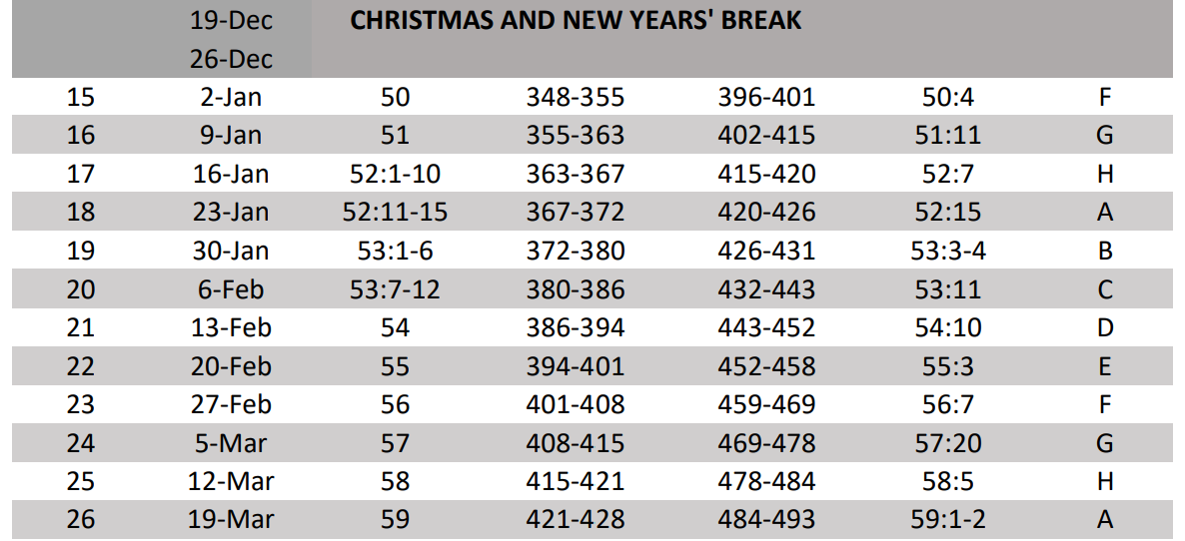
Isaiah Bible Study Schedule Fall 2023 – Spring 2024

Slide 12
Isaiah Outline
Focus | Prophecies of Condemnation |  |  |  |  |  |  |  | Historical Parenthesis |  | Prophecies of Comfort
 | 1:1 |  |  |  |  |  |  | 35:10 | 36:1 | 39:8 | 40:1 |  |  |  |  |  | 66:24
Divisions | Prophecies Against Judah |  | Prophecies Against the Nation |  | Prophesies Against the Day of the Lord |  | Prophesies of Judgement and Blessing |  | Sickness and Sin | Hezekiah’s Salvation | Israel’s Deliverance |  |  | Israel’s Deliverer |  | Israel’s Glorious Future
 | 1:1 | 12:6 | 13:1 | 23:18 | 24:1 | 27:13 | 28:1 | 35:10 | 36:1 | 39:8 | 40:1 | 48:22 |  | 49:1 | 57:21 | 58:1 | 66:24
Topics | Prophetic |  |  |  |  |  |  |  | Historic |  | Messianic
 | Judgement |  |  |  |  |  |  |  | Transition |  | Hope
Place | Israel & Judah
Time | 740 - 680 B.C.
We are here!
Bruce Wilkinson and Kenneth Boa, Talk Thru the Bible (Nashville: T. Nelson, 1983), 189.

Slide 13
Israel’s Future Transformation Isaiah 56-66
“This last major section of Isaiah deals with the necessity of living out the righteousness of God (cf. Rom. 12-16). These chapters emphasize what the characteristics of the servants of the LORD should be. Again, the focus is on Israel primarily but not exclusively. All God’s people are in view, though God’s will for Israel and His promises to Israel were Isaiah’s chief concern.” Constable
“The remainder of chapters 56-66 reveal that the salvation in which his righteousness will be revealed is, on the one hand, the deliverance of his people from the whole environment and plague of sin, and on the other hand, his devastating and merited judgment on those who rebel against him.” Motyer

Slide 14
Jesus References Isaiah
Isaiah 6:9-10 And he said, “Go, and say to this people: “Keep on hearing, but do not understand; keep on seeing, but do not perceive. Make the heart of this people dull…”
Isaiah 29:13 And the Lord said: “Because this people draw near with their mouth and honor me with their lips…
Isaiah 35:5-6 Then the eyes of the blind will be opened and the ears of the deaf unstopped. Then the lame will leap like a dear
Isaiah 54:13 All your children shall be taught by the LORD…
Matthew 13:14-15 “Indeed, in their case the prophecy of Isaiah is fulfilled that says: “”You will indeed hear but never understand, and you will indeed see but never perceive.” For this people’s heart has grown dull…”
Matthew 15:7-9 “You hypocrites! Well did Isaiah prophesy of you, when he said: “’ This people honors me with their lips…
Luke 7:22 And he answered them, “Go and tell John what you have seen and heard; the blind receive their sight, the lame walk, lepers are cleansed, and the deaf hear…
John 6:45 It is written in the Prophets, ‘And they will all be taught by God.’
Notes:
Jesus quotes Isaiah ~21 times in the four gospels.
Paul references Isaiah five times in Romans 10.

Slide 15
Jesus and Paul Reference Isaiah
Isaiah 56:7 “…these I will bring to my holy mountain, and make them joyful in my house of prayer; their burnt offerings and their sacrifices will be accepted on my altar; for my house shall be called a house of prayer for all peoples.”
Isaiah 65:1-2 I was ready to be sought by those who did not ask for me; I was ready to be found by those who did not seek me. I said, “Here I am, here I am,” to a nation that was not called by my name. I spread out my hands all the day to a rebellious people…
Matthew 21:12-13 He said to them, “It is written, ‘My house shall be called a house of prayer,’ but you make it a den or robbers.” Mark 11:17 And he was teaching them and saying to them, “Is it not written, ‘My house shall be called a house of prayer for all the nations’? But you have made it a den of robbers.” Luke 19:46 And he entered the temple and began to drive out those who sold, saying to them, “It is written, ‘My house shall be called a house of prayer,’ but you have made it a den of robbers.”
Romans 10:20-21 And Isaiah boldly says, “I was found by those who did not seek me; I revealed myself to those who did not ask for me…”

Slide 16
Overview | Isaiah 56
The “need for humility and holiness*” as the LORD:
Pronounces a blessing, yet to come, upon covenant keepers – those who seek justice, do what is right, and maintain the sabbath (vv 1-2, 6-7)
Encourages foreigners and eunuch followers (vv 3-4)
Promises an everlasting gift (v 5)
Promises to gather others beyond Israel (v 8)
Warns Israel’s leaders about their wickedness (vv 9-12)
*Constable
Notes:
“The last major section of Isaiah deals with the necessity of living out the righteousness of God (Romans 12-16). These chapters emphasize what the characteristics of the servants of the LORD should be… the focus is on Israel primarily but not exclusively. All God’s people are in view, though God’s will for Israel and His promises to Israel where Isaiah’s chief concerns.” Constable
Constable calls Isaiah chapters 56-66 “Israel’s future transformation.”

Slide 17
Isaiah 56:1
1Thus says the LORD: “Keep justice, and do righteousness, for soon my salvation will come, and my righteousness be revealed. 2Blessed is the man who does this, and the son of man who holds it fast, who keeps the Sabbath, not profaning it, and keeps his hand from doing any evil.”
The LORD reminds His people about their covenant obligations
Keep, maintain, and promote justice (Isaiah 1:17; 5:7c; 16; 10:1-2)
Do righteousness (Isaiah 1:27, 5:7d, 16)
Honor, keep, and not break the Sabbath (Exodus 16:23-29, 20:8-11, 31:14-16, 35:2-3; Deuteronomy 5:12-15)
Keeps, retrains his hand from doing evil
Justice involves conduct that conforms to moral rightness in action or attitude - doing what is right.
Righteousness is the quality of state of being righteous; holiness; purity; uprightness, etc. – NOT attainable on our own!
“Isaiah is not inviting people to seek salvation by their own works of righteousness but urging (along with the rest of the Bible) those who belong to the Lord to devote themselves to the life that reflects what he has revealed to be right. Taken together, justice and what is right/ ’righteousness’ point respectively to the Lord’s law (what he has ‘judged’ to be right) and the Lord’s character (his righteous person). Motyer
Notes:
Live a life of consistency!
Just like we have to remind our kids to do what is right and just, the LORD reminds Israel again of the important of guarding justice and doing righteousness
“They had a responsibility beyond just believing His promises (Isaiah 54-55)” Notice that practicing justice and righteousness does not accomplish salvation. They should be its consequence; they cannot be its cause (Romans 12:1-2). Constable

Slide 18
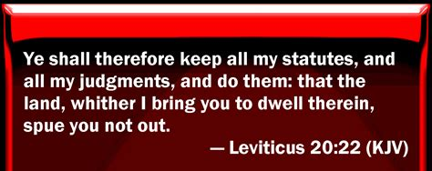
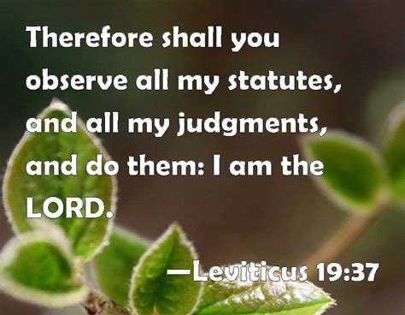
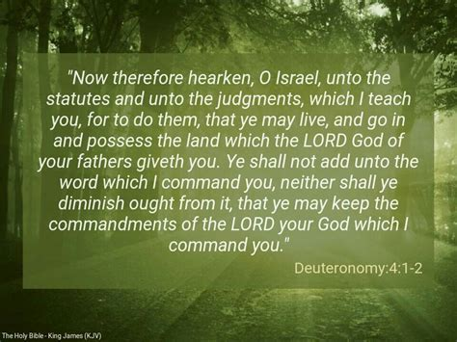
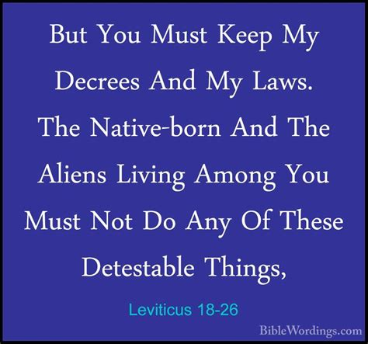
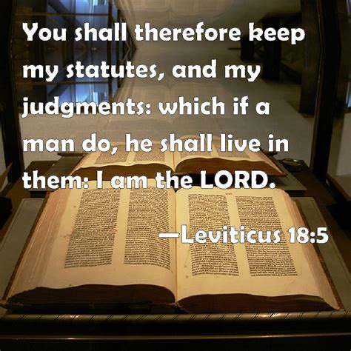
Isaiah 56:1

Slide 19
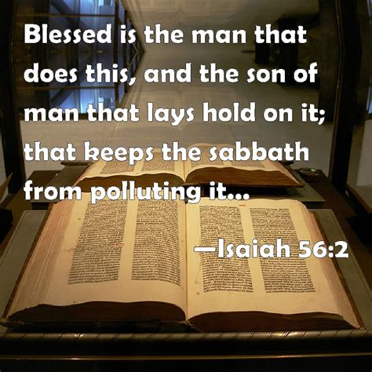
Isaiah 56:1-2
1Thus says the LORD: “Keep justice, and do righteousness, for soon my salvation will come, and my righteousness be revealed. 2Blessed is the man who does this, and the son of man who holds it fast, who keeps the Sabbath, not profaning it, and keeps his hand from doing any evil.”
The LORD had reminded His people that salvation was on the way (Psalm 85:9)
First Servant Song | Isaiah 42:1-9
Second Servant Song | Isaiah 49:1-13
Third Servant Song | Isaiah 50:4-11
Fourth Servant Song | Isaiah 52:13-53:12
Blessed is the man… an open invitation to mankind
“This looks back to the commands in verse 1. The duty of waiting for the Lord’s coming act and of filling the waiting days with a life which obeys his law and imitates his character is open to all without exception.” Motyer

Slide 20
Isaiah 56:2
1Thus says the LORD: “Keep justice, and do righteousness, for soon my salvation will come, and my righteousness be revealed. 2Blessed is the man who does this, and the son of man who holds it fast, who keeps the Sabbath, not profaning it, and keeps his hand from doing any evil.”
Blessings from the LORD:
Blessed is the man who fears the LORD, who greatly delights in his commandments (Psalm 112:1)
Blessed are those whose way is blameless, who walk in the law of the LORD (Psalm 119:1)
Blessed are those who keep his testimonies, who seek him with their whole heart (Psalm 119:2)
“Profaning the Sabbath and doing evil were the opposite of preserving justice and doing righteousness. They represent specific acts of obedience (observing the Sabbath) and an attitude toward life (doing right). By refraining from work on the Sabbath, the Israelites expressed trust that God would provide for their needs as He promised.” Constable
“And if your right hand causes you to sin, cut it off and throw it away. For it is better that you lose one of your members than that your whole body go into hell.” (Matthew 5:30)

Slide 21
Isaiah 56:3-4
3Let not the foreigner who has joined himself to the LORD say, “The LORD will surely separate me from his people”; and let not the eunuch say, “Behold, I am a dry tree.” 4For thus says the LORD: “To the eunuchs who keep my Sabbaths, who choose the things that please me and hold fast my covenant,
“The foreigner and the eunuch are offered as striking cases in point of the all-embracing inclusiveness of verse 2. The Old Testament was never exclusivist on a nationalistic basis. Deuteronomy 23:3ff. dealt with specific matters requiring special treatment, but Exodus 12:48-49 expresses the general position that the ‘stranger’ was always a welcome convert.” Motyer
“The foreigner comes fearing either rejection of his request for membership or that, having been accepted, he will still remain in a ‘separated’ category as a second-class citizen. All such fears are groundless… No one is excluded from membership of God’s people, either by nation or ancestry (the foreigner), accident of birth, parental or personal former affiliation to another god, falling below the creational standards of God or deep and fundamental personal defect (the eunuch). Motyer
“Dry tree” is a withered or dead tree - compared to a green/growing tree
““For this is what the LORD says,” … was not just Isaiah’s opinion but divine revelation.” Constable
Notes:
Eunuchs were not part of Jewish practice or custom, but the Assyrians and Egyptians employed Eunuchs to watch of a kings harem
The Law of Moses excluded them from the congregation (Deuteronomy 23:1), yet in the Millennium these will also enter into blessing.
Don’t let your hearts be troubled… (John 14:1)
What is the LORD’s love language – obedience, we are called to obey His commands

Slide 22
Isaiah 56:3-4
“If a stranger shall sojourn with you and would keep the Passover to the LORD, let all his males be circumcised. Then he many come near and keep it; he shall be as a native of the land. But no uncircumcised person shall eat of it. There shall be one law for the native and for the stranger who sojourns among you.” (Exodus 12:48-49)
“And you shall say to them, Any one of the house of Israel, or of the strangers who sojourn among them, who offers a burnt offering or sacrifice and does not bring it to the entrance of the tent of meeting to offer it to the LORD, that man shall be cut off from his people.” (Leviticus 17:8-9)
But you shall keep my statues and my rules and do none of these abominations, either the native or the stranger who sojourns among you (Leviticus 19:26)

Slide 23
Isaiah 56:3-4
“Seek the LORD while he may be found; call upon him while he is near” (Isaiah 55:6)
“All who genuinely seek the LORD (55:6) would find acceptance by Him, even though they might not qualify for participation in the worship rituals of Israel because they were foreigners or eunuchs.” Constable
“Truly I understand that God shows no partiality, but in every nation anyone who fears him and does what is right is acceptable to him. (Acts 10:34-35)

Slide 24
Isaiah 56:5-6
5I will give in my house and within my walls a monument and a name better than sons and daughters; I will give them an everlasting name that shall not be cut off. 6“And the foreigners who join themselves to the LORD, to minister to him, to love the name of the LORD, and to be his servants, everyone who keeps the Sabbath and does not profane it, and holds fast my covenant
“If they follow God faithfully, He will bless them more greatly than He would bless them if they only had physical children. This promise of an eternal reward anticipates Jesus’ teaching that His disciples should pursue eternal rewards rather than treasures on earth (cf. Matthew 6:1-24).” Constable
The LORD promises those with no family of their own to discover another family
For a foreigner or non-Israelite, true godliness meant:
Joined to the LORD
Minister to the LORD
Love the name of the LORD
Serve the LORD
Keep the Sabbath
Honor the LORD’s covenant

Slide 25
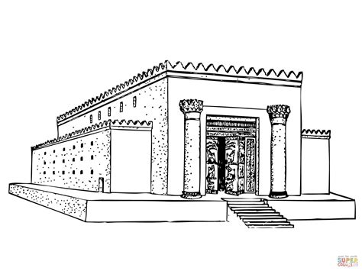
Isaiah 56:7
7these I will bring to my holy mountain, and make them joyful in my house of prayer; their burnt offerings and their sacrifices will be accepted on my altar; for my house shall be called a house of prayer for all peoples.
“All of Israel’s separation from the world was in order to keep Israel from being absorbed into the world and thus losing the ability to call the world out of itself into the blessings of God. But should Israel ever come to believe that its separation was so that Israel could keep her God and his blessings to herself, then all was lost.” John N. Oswalt
Temple | “House of God” was where He would meet His people (Ezra 5:2)
Prayer | An important component of worship and associated with the temple (1 Kings 8:29, 38; Luke 1:10, 2:37; 18:10; Acts 3:1) – “God’s design was for His house in Jerusalem to be a gathering place for worshippers from all nations, a place where prayers would rise like incense from the hearts of the faithful to the presence of the living God.” (Got Questions)
Unclean #1 | “Has this house, which is called by my name, become a den of robbers in your eyes? Behold, I myself have seen it, declares the LORD.” (Jeremiah 7:11)
Notes:
“God wants those excluded from His house to know that, in that blessed day, they would be welcome to enter His temple, which would be a house of prayer for all people, of all nations and backgrounds.”* (Isaiah 56:7) * Got Questions “Why does God call His house a house of prayer (Isaiah 56:7)?
In Isaiah 55, the prophet focuses on God’s invitation to experience salvation
In Isaiah 56, the prophet makes it clear that God’s invitation extends far beyond just His chosen people, Israel.

Slide 26
Isaiah 56:7, cont’d
7these I will bring to my holy mountain, and make them joyful in my house of prayer; their burnt offerings and their sacrifices will be accepted on my altar; for my house shall be called a house of prayer for all peoples.
Unclean #2 | “In the temple he found those who were selling oxen and sheep and pigeons, and the money-changers sitting there. And making a whip of cords, he drove them all out of the temple… and overturned their tables. And he told those who sold the pigeons, “Take these things away; do not make my Father’s house a house of trade.” (John 2:14-16)
Unclean #3 | After Jesus’ triumphal entry into Jerusalem he cleansed the temple a second time. “And he entered the temple and began to drive out those who sold and those who bought… overturned the tables of the money-changers… “Is it not written, ‘My house shall be called a house of prayer for all the nations’? But you have made it a den of robbers.” The “House of God,” – the place where He dwelt, a holy place reserved for prayer and worship, had become a “den of thieves” or a “den of robbers,” repurposed for selfish gain, which brought the wrath of Jesus. (Mark 11:17; Matt 21:13)
Notes:
Instead of being made holy in the Temple; the people were make the Temple unholy (Brian Bell)

Slide 27
Isaiah 56:8
7these I will bring to my holy mountain, and make them joyful in my house of prayer; their burnt offerings and their sacrifices will be accepted on my altar; for my house shall be called a house of prayer for all peoples.” 8The Lord GOD, who gathers the outcasts of Israel, declares, “I will gather yet others to him besides those already gathered.”
With special emphasis, “The Sovereign LORD declares,” salvation for Israel first and others, second
“Formerly Gentiles came into relationship with God indirectly – through Israel, like Ruth and the Ethiopian eunuch did.” Constable
The LORD declared “…that He would gather many other Gentiles to Himself along with the Israelites (cf. 19:25; 49:6-7; 51:5; 55:5: John 10:16). He would not save only Israelites, but Gentiles as well. The new revelation, or mystery, concerning the relationship of Jews and Gentiles church (Eph. 2-3), was not that God would save Gentiles as well as Jews. It was that in the church He would deal with Jews and Gentiles on the same basis: equally. Jews would have no advantage over Gentiles – in their relationship to God – as they did previously.” Constable

Slide 28
Isaiah 56:9-11
9All you beasts of the field, come to devour—all you beasts in the forest. 10His watchmen are blind; they are all without knowledge; they are all silent dogs; they cannot bark, dreaming, lying down, loving to slumber. 11The dogs have a mighty appetite; they never have enough. But they are shepherds who have no understanding; they have all turned to their own way, each to his own gain, one and all. 12“Come,” they say, “let me get wine; let us fill ourselves with strong drink; and tomorrow will be like this day, great beyond measure.”
Make haste wild animals to a feast
Summoning/inviting all the enemies of God’s flock (Jeremiah 12:9, Ezekiel 34:5)
Israel’s guides and teachers suffered from spiritual blindness, the worst kind, as they were greedy and unsatisfied
Jesus warned about “the blind leading the blind” (Matthew 15:14; Luke 6:39)
“… watchmen (10a) and shepherds (11c), contrast two aspects of the true leader – to guard from external danger and to care for internal need.” Motyer
“When the minister does not warn the flock of false doctrine, he ceases to be a faithful under-shepherd of the sheep, and instead becomes a dumb dog that cannot bark.” Edward J. Young
Notes:
Condemnation of self-seeking leadership.
Jesse’s sermon this past Sunday talked about sheep and their not flattering characteristics, which against wild animals, would not be good
Defenseless flock

Slide 29
Isaiah 56:11-12
9All you beasts of the field, come to devour—all you beasts in the forest. 10His watchmen are blind; they are all without knowledge; they are all silent dogs; they cannot bark, dreaming, lying down, loving to slumber. 11The dogs have a mighty appetite; they never have enough. But they are shepherds who have no understanding; they have all turned to their own way, each to his own gain, one and all. 12“Come,” they say, “let me get wine; let us fill ourselves with strong drink; and tomorrow will be like this day, great beyond measure.”
Selfish shepherds whose focus was self-interest and self-indulgence
“The eyes of the leaders, which should be turned outwards, whether in guardianship (10a-d) or in care (11c-f), are turned inwards to their own welfare.” Motyer
Oblivious of their situation; they partied
“Rather than caring for the sheep unselfishly, these shepherds went off and got drunk – repeatedly. They indulged themselves at the expense of their charges, and in the process, became enslaved and incapable of fulfilling their responsibilities.” Constable
Warning to spiritual leaders today!

Slide 30
Isaiah 56:12
“By the time the poem reaches verse 12 the leadership believes itself never to have had it so good, and we hear delighted voices calling to feasting, promising unending supply. They do not know that the wild beasts have already been invited (9). Such a piece is timeless in its applicability to the Davidic kings, and to the opportunistic adventurers who seized the northern throne. For each, sooner or later, the beasts arrived at the feast.” Motyer

Slide 31
Conclusion
God reminds Israel of their covenant.
God informs Israel that He will gather others to Himself.
God warns Israel’s corrupt religious leaders.

Slide 32
Discussion & Application
Where might God be giving you opportunities to maintain justice and/or do what is right? What does the Bible say about anyone who “knows the right thing to do and fails to do it?” (James 4:17)
Why did the LORD remind the Israelites of His covenant with them? (Leviticus 18:5, 26, 19:37, 20:22; Deuteronomy 4:1-2, 40, 12:32) Why were they prone to wander? (Isaiah 53:6; Jeremiah 14:10) Why are we prone to wander?
Which command(s) do you struggle to obey and how can your group pray for you?

Slide 33
Discussion & Application
What did keeping the Sabbath do for the Israelites? (Exodus 31:13)
Which non-Israelites did the LORD accept on the basis of their faith in Him? (Ruth 1:16-17; Acts 8:26-40)
How might Isaiah 56 serve as a call to action for leaders today?
How might you respond to being called a blind watchman or a silent dog? What can we do to ensure we don’t become complacent in ur walk with Jesus?
How should we promote justice and righteousness from a Biblical perspective?

Slide 34
Next Week
Tonight:
Isaiah 56 | Blessings for All Nations; Israel’s Sinful Leaders
Memory Verse: Isaiah 56:7
Dr. Constable’s Notes, 2023 Ed., pp. 401-408; Motyer, pp. 459-469
Refreshment Host: F
Next Week:
Isaiah 57 | Israel’s Futile Idolatry; Comfort for the Contrite
Memory Verse: Isaiah 57:20
Dr. Constable’s Notes, 2023 Ed., pp. 408-415; Motyer, pp. 469-478
Refreshment Host: G

Slide 35
Closing
Benediction
Small Groups

