Slide 1
Isaiah Outline
Focus | Prophecies of Condemnation |  |  |  |  |  |  |  | Historical Parenthesis |  | Prophecies of Comfort
 | 1:1 |  |  |  |  |  |  | 35:10 | 36:1 | 39:8 | 40:1 |  |  |  |  | 66:24
Divisions | Prophecies Against Judah |  | Prophecies Against the Nations |  | Prophesies Against the Day of the Lord |  | Prophesies of Judgement and Blessing |  | Sickness and Sin | Hezekiah’s Salvation | Israel’s Deliverance |  | Israel’s Deliverer |  | Israel’s Glorious Future
 | 1:1 | 12:6 | 13:1 | 23:18 | 24:1 | 27:13 | 28:1 | 35:10 | 36:1 | 39:8 | 40:1 | 48:22 | 49:1 | 57:21 | 58:1 | 66:24
Topics | Prophetic |  |  |  |  |  |  |  | Historic |  | Messianic
 | Judgement |  |  |  |  |  |  |  | Transition |  | Hope
Place | Israel & Judah
Time | 740 - 680 B.C.
We are here!
Notes:
For context, this is Isaiah dealing with the time of refreshing or blessing from the perspective of Israel preparing going through this time of suffering and time of trouble. God’s condemnation of Israel and Jerusalem, the blindness of Israel and their lack of trust and faith, but those who do see and believe will return. Last week we studied those who are taking counseling with Egypt and not consulting the book or God.

Slide 2
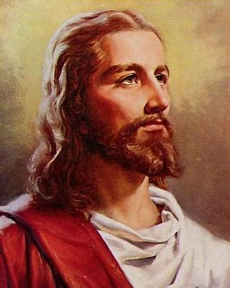
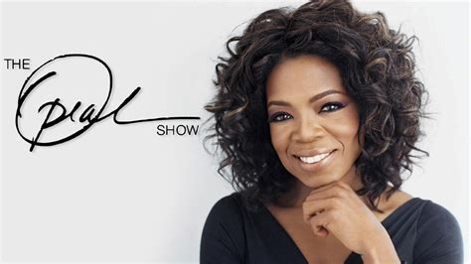
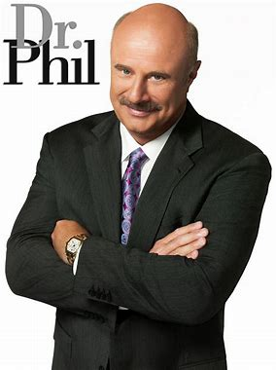
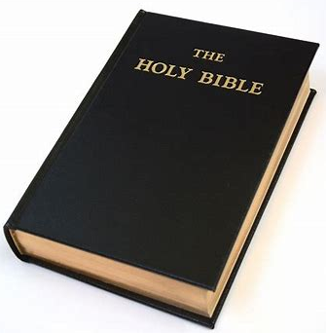
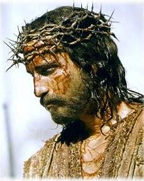
Where does our help come from?
Notes:
Am I now trying to win the approval of human beings, or of God? Or am I trying to please people? If I were still trying to please people, I would not be a servant of Christ. – Galatians 1:10

Slide 3
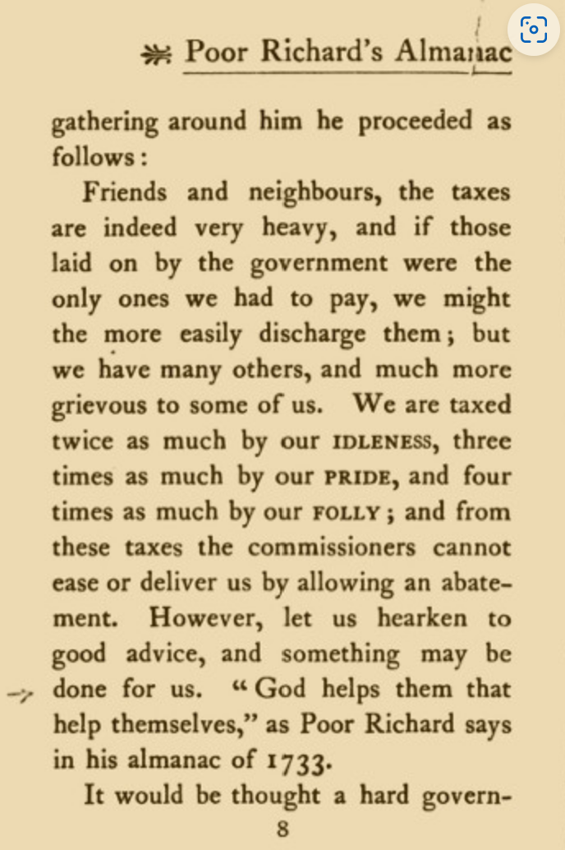
Where does our help come from?
“The gods help them that help themselves.” - Aesop’s Fables
“God helps those who help themselves.” - Popularized by Benjamin Franklin
Does Franklin’s phrase reflect Biblical teaching?
What does the Bible say? (Proverbs 28:26; Isaiah 25:4; Psalm 121:1-2)
Notes:
Does the first postmaster general’s phrase reflect what the Bible teaches?
From “Got Questions”
"God helps those who help themselves" is probably the most often quoted phrase that is not found in the Bible. This saying is usually attributed to Ben Franklin, quoted in Poor Richard’s Almanac in 1757. In actuality, it originated from Algernon Sydney in 1698 in an article titled Discourses Concerning Government Whatever the original source of this saying, the Bible teaches the opposite. God helps the helpless! Isaiah 25:4 declares, "For You have been a defense for the helpless, a defense for the needy in his distress, a refuge from the storm, a shade from the heat..." Romans 5:6 tells us, "For while we were still helpless, at the right time Christ died for the ungodly." In terms of salvation, we are all utterly helpless. We are all infected by sin (Romans 3:23), and condemned as a result of that sin (Romans 6:23). Nothing we can do on our own can remedy this situation (Isaiah 64:6). Thankfully, God is the helper of the helpless. While we were still sinners, Jesus died for us (Romans 5:8). Jesus paid the penalty that we were incapable of paying (2 Corinthians 5:21). God provided the "help" that we need precisely because we could not help ourselves. Apart from salvation, there is perhaps a way that the concept "God helps those who help themselves" is correct. As an example, if you asked me to help you move a piece of furniture, but then just watched me as I moved the furniture for you, I was not actually helping you. I would be doing the work for you. Many Christians fall into the trap of inactivity. Many Christians ask God for help, but then expect God to do everything Himself. They excuse this by pointing to the fact that God will provide according to His will and in His timing. However, this is not a reason for inactivity. As a specific example, if you are in need of a job, ask the Lord to help you find a job - but then be active in actually looking for a job. While it is in His power to do so, it is highly unlikely that God will cause employers to come looking for you!

Slide 4
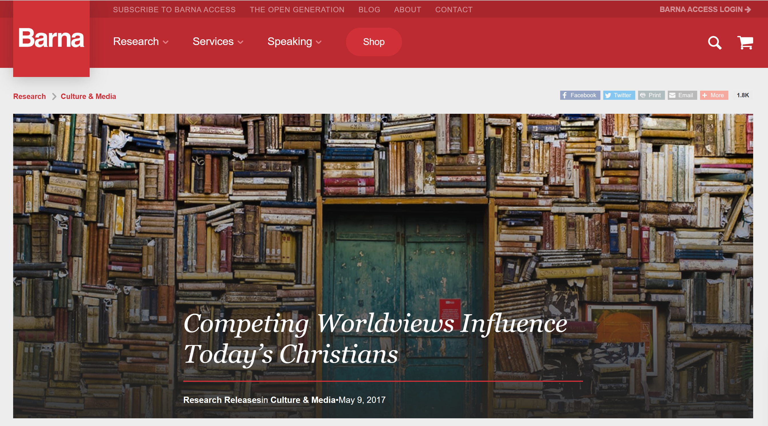
“The New Spirituality worldview has also inched its way into Christian ethics; one-third of practicing Christians (32%) strongly agree that “if you do good, you will receive good, and if you do bad, you will receive bad.” This karmic statement, though not explicitly from scripture, appeals to many Christians’ sense of ultimate justice. For example, another Barna study found that 52 percent of practicing Christians strongly agree that the Bible teaches “God helps those who help themselves.”
Notes:
Source: Competing Worldviews Influence Today’s Christians - Barna Group

Slide 5
Overview | Isaiah 31-32
“The woe against rejecters of God’s help”
- Constable
“The Lord never merely reacts to events as if sprung on him. He has prepared all beforehand and is totally master of the situation. The merest movement of his hand (31:3) is sufficient to dispose Judah and its supposed helper, Egypt.” – Motyer

Slide 6
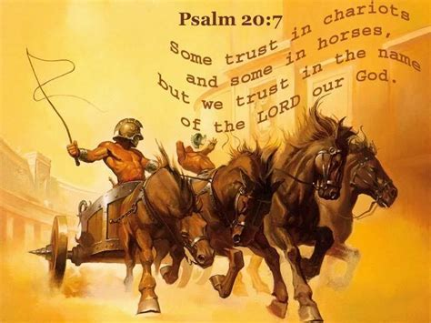
Isaiah 31:1-3 Misplaced Trust in a Weak King
1 Woe to those who go down to Egypt for help and rely on horses, who trust in chariots because they are many and in horsemen because they are very strong, but do not look to the Holy One of Israel or consult the LORD!
2 And yet he is wise and brings disaster; he does not call back his words, but will arise against the house of the evildoers and against the helpers of those who work iniquity.
3 The Egyptians are man, and not God, and their horses are flesh, and not spirit. When the LORD stretches out his hand, the helper will stumble, and he who is helped will fall, and they will all perish together.
Stray spiritually - stray physically
Judah/Jerusalem placed their trust in might, mount, and men (worldly security)
The LORD is sovereign, supreme, holy, immutable, reliable, trustworthy, incomparable, unequaled, perfect, all-powerful, just, and righteous
We too place more trust in man than God and more trust in flesh than spirit
Notes:
“But the king must not acquire many horses for himself or send the people back to Egypt to acquire more horses, for the LORD has said, ‘You are never to go back that way again.’” – Deuteronomy 17:16
“Trust in the Lord with all your heart and lean not on your own understanding. In all your ways acknowledge Him and He will make your paths straight.” – Proverbs 3:5-6
Isaiah condemns Judah and and Jerusalem for relying on the brute strength, military might, and men of Egypt to provide their security (Deuteronomy 17:14-20)

Slide 7
Isaiah 31:1-3 Trust Flesh or Spirit?
“To us ‘flesh’ seems so substantial, because its visible and tangible, while ‘spirit’ may seem ethereal. …Nothing could be further from biblical thinking, as a glance at passages like Zechariah 4:6 and John 3:5-8 will disclose.” – Geoffrey W. Grogan
Thus says the LORD: “Cursed is the man who trusts in man and makes flesh his strength, whose heart turns away from the LORD.” – Jeremiah 17:5
“It is better to take refuge in the LORD than to trust in man.” – Proverbs 118:8
“The fear of man brings a snare, but he who trusts in the LORD will be exalted.” – Proverbs 29:25
“Stop regarding man in whose nostrils is breath, for of what account is he?” – Isaiah 2:22
Notes:
Geoffrey W. Grogan, “Isaiah,” in Isaiah-Ezekiel, vol. 6 of the Expositor’s Bible Commentary, page 202
We often go by the idiom, “Seeing is believing”

Slide 8
Isaiah 31:1-3 Trust Flesh or Spirit?

Slide 9
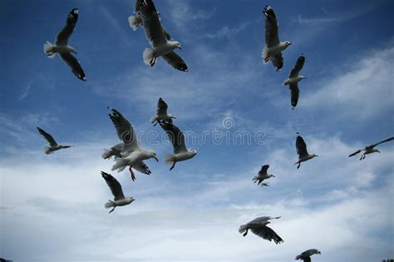
Isaiah 31:4-5 Misplaced Trust In a Weak King
4 This is what the Lord says to me:
“As a lion growls, a great lion over its prey—
and though a whole band of shepherds
is called together against it,
it is not frightened by their shouts
or disturbed by their clamor—
so the Lord Almighty will come down
to do battle on Mount Zion and on its heights.
5 Like birds hovering overhead,
the Lord Almighty will shield Jerusalem;
he will shield it and deliver it,
he will ‘pass over’ it and will rescue it.”
Lion = LORD, prey = Zion, and the shepherds = Egypt
The LORD comes to down to fight
The LORD would pass over Jerusalem to protect it from its predator = Assyria (Exodus 12:23, 27, 19:4)
Notes:
God protects like a lion, very protective of his prey, like a bird, hovering over them.
Back in the wilderness, God had saved Israel.

Slide 10
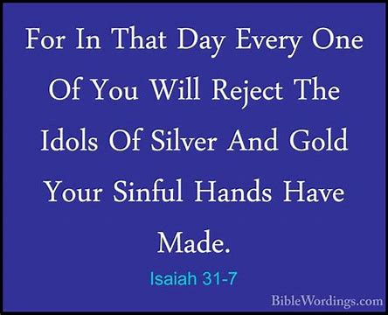
Isaiah 31:6-9 Misplaced Trust in a Weak King
Isaiah calls for repentance – “turn or burn”
“In that day” points to the eschatological revival of Israel
Idols tossed because they don’t work
Assyria’s promised defeat (2 Kings 19:32-35)
6 Return, you Israelites, to the One you have so greatly revolted against. 7 For in that day every one of you will reject the idols of silver and gold your sinful hands have made.
8 “Assyria will fall by no human sword;
a sword, not of mortals, will devour them.
They will flee before the sword
and their young men will be put to forced labor.
9 Their stronghold will fall because of terror;
at the sight of the battle standard their commanders will panic,” declares the Lord, whose fire is in Zion,
whose furnace is in Jerusalem.
Notes:
“Turn or burn” preaching or a warning from the prophets.
Turn around, from going to Egypt, and turn to God.
In that day, can refer to future events, or current.
Judah did not have to fear the Assyrian’s.

Slide 11
Isaiah 31:6-9 Trust the Righteous King
“The destruction of the Assyrian army points prophetically to the final world conflict, which will usher in the rule of Christ, the perfect King of Israel. Christ’s kingdom will fulfill God’s ideal of a holy commonwealth, administering a perfect righteousness throughout the earth. God’s King will provide complete shelter to all who seek refuge in him, and he will satisfy their thirsty souls with living water.” - Archer

Slide 12
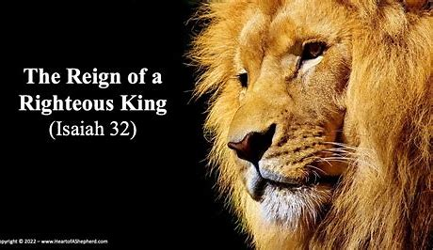
Isaiah 32:1-4 Trust the Righteousness King
Rule of a righteous kings (Isaiah 7, 9, 11; Jeremiah 23:5-6; 1 Peter 1:11)
Protection from the dangers of wind and water and provision and refreshment via water and shade (Genesis 7:4; Exodus 13:21; Job 1:18-19; John 7:37)
Restored eyes that see, ears that hear, hearts that know, and tongues that speak clearly. (Isaiah 6:9-10)
1 See, a king will reign in righteousness
and rulers will rule with justice.
2 Each one will be like a shelter from the wind and a refuge from the storm, like streams of water in the desert and the shadow of a great rock in a thirsty land.
3 Then the eyes of those who see will no longer be closed,
and the ears of those who hear will listen.
4 The fearful heart will know and understand, and the stammering tongue will be fluent and clear.
References
2 Kings 8:12; Psalm 137:9; Daniel 5:30, 6:8,12,15; Jeremiah 50:40
Notes:
Contrast between the Assyrian king and the Righteous king, Messiah
True Rule – Four Comparisons
Protection from the dangers…
“Completeness is expressed by the contrasting dangers of wind and water; there is protection from every threat. Water and shade are the two components of provision and refreshment, therefore symbolizing every beneficial care.” – Motyer
New People – Four Transformations

Slide 13
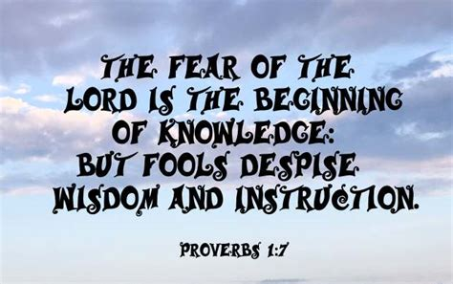
Isaiah 32:5-8 New Society = New Values
Isaiah looks to a new society grounded in truth
Fools, live without acknowledging moral or spiritual obligations, are no longer called noble (1 Samuel 25:25)
Scoundrels, plotting evil against the poor and needy, are no longer considered honorable (Jeremiah 5:26-28)
Those who are noble display personal, spiritual, and social characteristics that merit commendation (Proverbs 11:25)
5 No longer will the fool be called noble nor the scoundrel be highly respected. 6 For fools speak folly,
their hearts are bent on evil: They practice ungodliness and spread error concerning the Lord; the hungry they leave empty and from the thirsty they withhold water. 7 Scoundrels use wicked methods, they make up evil scheme to destroy the poor with lies,
even when the plea of the needy is just. 8 But the noble make noble plans, and by noble deeds they stand.
References
2 Kings 8:12; Psalm 137:9; Daniel 5:30, 6:8,12,15; Jeremiah 50:40
Notes:
No longer will good be called evil and evil called good (Isaiah 5:20)
Fools are amoral
No more will fools become celebrities, nor crooks be rewarded with fame – Isaiah 32:5 Message Bible
Lawlessness is expelled – fools, scoundrels, and rebels are called by their true names

Slide 14
Isaiah 32:9-14 Trouble on the Horizon
9 You women who are so complacent, rise up and listen to me; you daughters who feel secure, hear what I have to say! 10 In little more than a year you who feel secure will tremble; the grape harvest will fail, and the harvest of fruit will not come. 11 Tremble, you complacent women; Shudder, you daughters who feel secure! Strip off your fine clothes and wrap yourselves in rags. 12 Beat your breasts for the pleasant fields, for the fruitful vines 13 and for the land of my people, a land overgrown with thorns and briers—yes, mourn for all houses of merriment and for this city of revelry. 14 The fortress will be abandoned, the noisy city deserted; citadel and watchtower will become a wasteland forever, the delight of donkeys, a pasture for flocks,
Women reflect the heart, soul, and glory of the city – at ease, careless, not troubled (Isaiah 3:16)
Trouble on the horizon – no grape nor fruit harvest
Trouble in the city – lamentation, desolation, and forsaken
Vines, land, and city gone
“Strip and go bare” not a sign or mourning but of enslavement or captivity
Images of a land once cultivated but now laid waste - over grown with thorn and briers, abandoned, a vibrant bustling city will have become a wasteland

Slide 15
Isaiah 32:15-20 Spirit of God Poured Out
15 till the Spirit is poured on us from on high, and the desert becomes a fertile field, and the fertile field seems like a forest. 16 The Lord’s justice will dwell in the desert, his righteousness live in the fertile field. 17 The fruit of that righteousness will be peace; its effect will be quietness and confidence forever. 18 My people will live in peaceful dwelling places, in secure homes, in undisturbed places of rest. 19 Though hail flattens the forest and the city is leveled completely, 20 how blessed you will be, sowing your seed by every stream, and letting your cattle and donkeys range free.
As life-giver, God’s Spirit is poured out from above
New Earth – from desert to fertile field
“When that which is perfect comes, what now seems like ordered cultivation will look like scrub!” - Motyer
Messiah’s rule will be just and righteous (Isaiah 32:1)
God’s people are restored and dwell in peaceful, secure, undisturbed places of rest (Ezekiel 34:22-27, 36:24-31)

Slide 16
Conclusion
God helps those who place their trust in Him
God provides a king to reigns righteously
God leverages suffering to inspire repentance

Slide 17
Discussion & Application
1 of 2
What is the significance of Egypt in the Bible? What had God previously instructed Israel regarding Egypt?
Like Judah, where are you tempted to return for comfort or safety? Where does your help come from?
What decision(s) do we make without seeking God’s input? Where do you draw the line between when you resolve something or when you involve God?
From Isaiah 31 verses 1-3, where did Judah and Jerusalem place their trust besides God? Why was Judah’s return to Egypt such an affront to God?
Besides lions and birds, what other animals or insects does God use to describe Himself? What do we learn about God from these descriptions?
Verses 4-5 describe God’s protection of Judah and Jerusalem, when or where have you experienced His protection?

Slide 18
Discussion & Application
2 of 2
Through Isaiah, God called Israel to repent and turn back to Him. Where are you revolting against Him and need to repent?
What historical event did Isaiah prophesy in verses 8 and what does it allude to in the future? (2 Chronicles 32:16-22)
Verse 2 of chapter 32 mentions shelter, refuge, water, and shade, who can you pray for this week who struggles from the storms of life?
What does it mean to be a noble man, make noble plans, or engage in noble deeds? How can you live a nobler life this week?
Verse 15 cites the pouring out of the Spirit, where has the indwelling Holy Spirit drastically changed your life?

