Slide 1
WELCOME TO THE MOB!
All Scripture is breathed out by God and profitable for teaching, for reproof, for correction, and for training in righteousness, that the man of God may be complete, equipped for every good work.
2 Timothy 3:16-17 (ESV)

Slide 2
Announcements
MOB Website & Resources: www.ibcmob.net
https://immanuelbible.church/
(943) Croc's Corner – YouTube
https://immanuelbible.church/vbs

Slide 3
Please Rise
Invocation/Prayer.
Song:
“Great is Thy Faithfulness”

Slide 4
Great is Thy Faithfulness 1 of 6
Great is Thy faithfulness O God my Father There is no shadow Of turning with Thee Thou changest not Thy compassions they fail not As Thou hast been Thou forever wilt be

Slide 5
Great is Thy Faithfulness 2 of 6
Great is Thy faithfulness Great is Thy faithfulness Morning by morning New mercies I see All I have needed Thy hand hath provided Great is Thy faithfulness Lord unto me

Slide 6
Great is Thy Faithfulness 3 of 6
Summer and winter And springtime and harvest Sun moon and stars In their courses above Join with all nature In manifold witness To Thy great faithfulness Mercy and love

Slide 7
Great is Thy Faithfulness 4 of 6
Great is Thy faithfulness Great is Thy faithfulness Morning by morning New mercies I see All I have needed Thy hand hath provided Great is Thy faithfulness Lord unto me

Slide 8
Great is Thy Faithfulness 5 of 6
Pardon for sin
And a peace that endureth Thy own dear presence To cheer and to guide Strength for today And bright hope for tomorrow Blessings all mine With ten thousand beside

Slide 9
Great is Thy Faithfulness 6 of 6
Great is Thy faithfulness Great is Thy faithfulness Morning by morning New mercies I see All I have needed Thy hand hath provided Great is Thy faithfulness Lord unto me

Slide 10
Our Study of Isaiah
Last Meeting:
Isaiah 61, The Year of the Lord’s Favor
Memory Verse: Isaiah 61:1-2
Dr. Constable’s Notes, 2022 Ed., pp. 435-440; Motyer, pp. 499-505
Refreshment Host: Group C
This Meeting:
Isaiah 62, Zion’s Coming Salvation
Memory Verse: Isaiah 62:4
Dr. Constable’s Notes, 2022 Ed., pp. 440-443; Motyer, pp. 505-509
Refreshment Host: Group D
Notes:
Welcome to MOB
Rod Turk covered Isaiah 14 last year. Does anyone remember the key word or topic he highlighted as part of his lesson? PRIDE. We’ll expand on that idea—but more from God’s attributes than our own.

Slide 11
Memory Verse
Isaiah 62:4 (ESV)
“You shall no more be termed Forsaken, and your land shall no more be termed Desolate, but you shall be called My Delight Is in Her, and your land Married; for the LORD delights in you, and your land shall be married.”
Isaiah 62:4 (ESV)
Notes:
It really is a great verse. A lot packed into the application of Isaiah that we’ll touch on.

Slide 12
Isaiah Outline
Focus | Prophecies of Condemnation |  |  |  |  |  |  |  | Historical Parenthesis |  | Prophecies of Comfort
 | 1:1 |  |  |  |  |  |  | 35:10 | 36:1 | 39:8 | 40:1 |  |  |  |  |  | 66:24
Divisions | Prophecies Against Judah |  | Prophecies Against the Nation |  | Prophesies Against the Day of the Lord |  | Prophesies of Judgement and Blessing |  | Sickness and Sin | Hezekiah’s Salvation | Israel’s Deliverance |  |  | Israel’s Deliverer |  | Israel’s Glorious Future
 | 1:1 | 12:6 | 13:1 | 23:18 | 24:1 | 27:13 | 28:1 | 35:10 | 36:1 | 39:8 | 40:1 | 48:22 |  | 49:1 | 57:21 | 58:1 | 66:24
Topics | Prophetic |  |  |  |  |  |  |  | Historic |  | Messianic
 | Judgement |  |  |  |  |  |  |  | Transition |  | Hope
Place | Israel & Judah
Time | 740 - 680 B.C.
We are here!
Bruce Wilkinson and Kenneth Boa, Talk Thru the Bible (Nashville: T. Nelson, 1983), 189.

Slide 13
Three Unconditional Covenants
Abrahamic Covenant | Davidic Covenant | New Covenant
Genesis 15 | 2 Samuel 7 | Jeremiah 31
Future descendants, possession of Promised Land and blessings to all nations | A Davidic throne would be permanent and reign forever | God’s plan to write His law “in their minds and write it on their hearts” (v. Jer 31:31)
Dispensational View: more literal vs allegorical emphasis; conditional blessings (Deut 28-30) Covenantal View: The church replaces Israel in promises
“Unless one grasps correctly how the biblical covenants unfold God’s eternal plan and find their fulfillment in Christ, we will inevitably misinterpret Scripture and make various theological mistakes.”
Gentry & Wellum
Notes:
An unconditional covenant is not to be confused with conditional blessings that may be attached to that relationship or agreement. The traditional dispensational view is that a covenant cannot be broken, but may have blessings attached that are predicated on the response of the covenant recipient. A conditional set of promised blessings and curses related to behavior didn’t remove their title to the land, but set expectations for their enjoyment of it.
Deuteronomy 30 notes that curses eventually give way to promises of restoration where the people come to their senses, return to the Lord, listen to His voice, have their lives restored and are brought into the land.
Affirmation: Gen 17:8; Gen 49:10; Eze 16:60; 1 Chron 16:16-18; 2 Chron 2:14

Slide 14
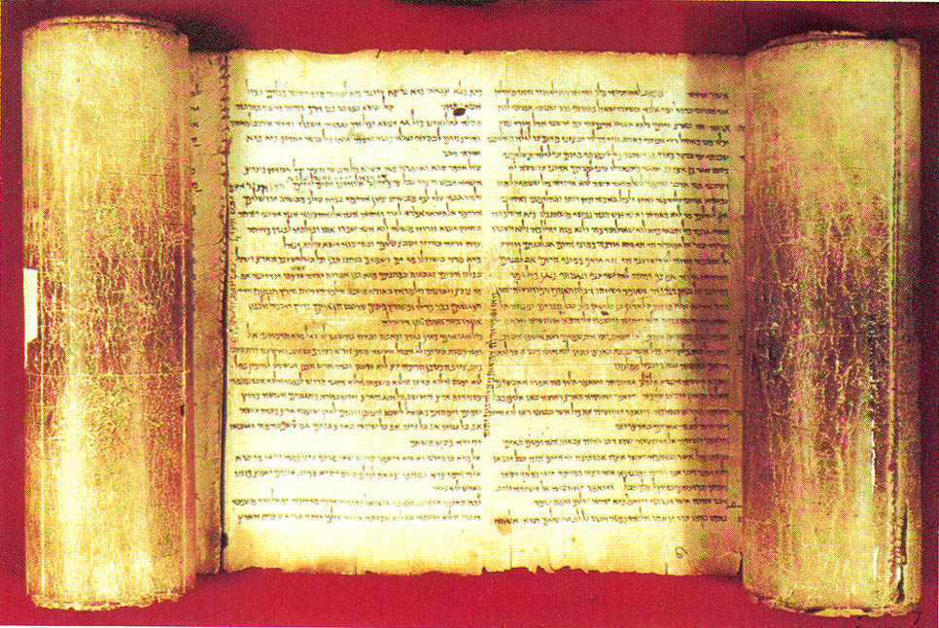
Theme – from Constable’s notes
“Much of this chapter speaks of preparation being made for the coming of the Lord and for the restoration of His people, thus expanding the thoughts in 40:3–5, 9.”
Notes:
This pericope concludes the section of Isaiah dealing with the revelation of future glory (chs. 60–62; cf. 40:1–11; 52:1–12)

Slide 15
Isaiah 62 - Pericopes
Notes:
God will have no rest till He accomplishes His purposes for His people, and the world will have no peace till He succeeds. He asks us to “give Him no rest” (v. 7) but to intercede for Israel and Jerusalem, for the prayers of His people are an important part of the program of God.
Warren W. Wiersbe, Be Comforted

Slide 16
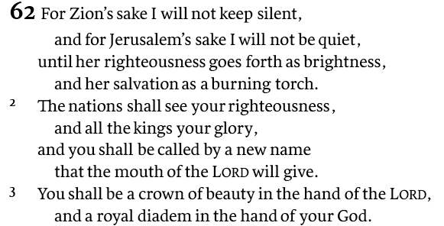
Isaiah 62
Zion’s Coming Salvation
Righteousness
Royalty
Renewal
Rev 2:17
Rev 21:2
And I saw the holy city, new Jerusalem, coming down out of heaven from God, made ready as a bride adorned for her husband.
Hesed is “the unfailing love that is ever loyal to its pledge, love as a settled disposition …” – Motyer
Notes:
First two lines of v 2: All-inclusive parallelism is a construction in which two parallel lines describe different features of two different subjects, but in which the underlying purpose is to give a summary statement. That is to say, all features belong to both subjects. These subjects, in addition, often form one global unit, such as “heaven and earth” representing the whole universe. One example is the first two lines of 1:3: “ox” and “ass” represent all domestic animals—they all know both their master and their feeding trough. Other examples are 5:13 (last two lines): both the honored men and the masses will die of both hunger and thirst; 17:3 (first two lines): both Ephraim and Damascus will lose their fortresses and their kingdoms will be destroyed; 18:6 (last two lines): all creatures (birds and beasts) will prey the whole year (summer and winter).

Slide 17
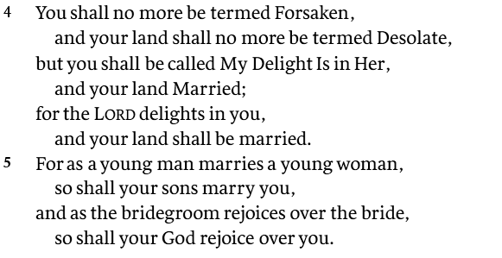
Isaiah 62
adversative kî
“but, nevertheless”
The benefits of the mission of the Anointed One
Isaiah 54 (17x)
Isaiah 1:7 (16x)
The restoration of the Promised Land
Marriage metaphors provide a powerful message and permanent commitment
Notes:
Now the new names that are to describe Zion are announced. V. 4 is reminiscent of Hos. 1 in the naming and renaming. It is a continuation of the “insteads” that have been frequent in this subdivision (Isa. 60:17; 61:3, 7), expressing God’s constant desire that ashes should give way to beauty, and deprivation to abundance.
John N. Oswalt, The Book of Isaiah, Chapters 4066, The New International Commentary on the Old Testament
The language throughout these two verses continues the marriage imagery of 61:10. The connotations of joy, exclusive choice, surrender, and commitment that surround marriage make it a good vehicle for conveying what God clearly wants to say. Whatever the faithful in Israel might feel in the long dark years following the destruction of Jerusalem in 586 b.c., they should remember that Forsaken is not the name by which God remembers them, nor is Desolate the way he views their land. He does not see himself as Zion’s destroyer, but as her husband, who will care for her, nourish her, and protect her.
it is clear that the relational element is important to the writer. It is not merely that the land will be reinhabited, but that it will be in a relationship of belonging. This stress on relationship seems to be the reason for using a word that has the potential problems bʿl has.

Slide 18
Isaiah 2:1-4
There will be no righteousness and peace on this earth till Jerusalem gets her new name and becomes a crown of glory to the Lord. - Wiersbe (Is 61)

Slide 19
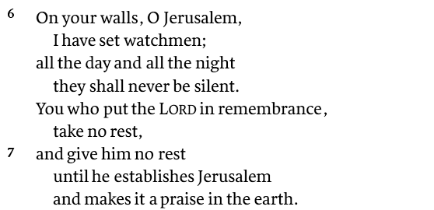
Isaiah 62
Emphasis turns to Jerusalem!
God will have no rest till He accomplishes His purposes for His people, and the world will have no peace till He succeeds. Wiersbe
Forceful Hyperbole?
A striking contrast to the blind, dumb, indolent, sleepy hirelings of the prophet’s own time?

Slide 20
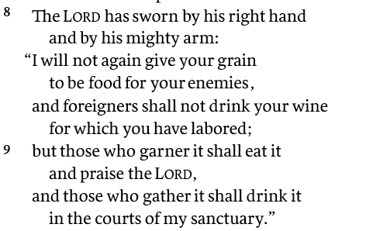
Isaiah 62
A promise of permanent protection and peace
Confirmed...with an oath…sworn to himself

Slide 21
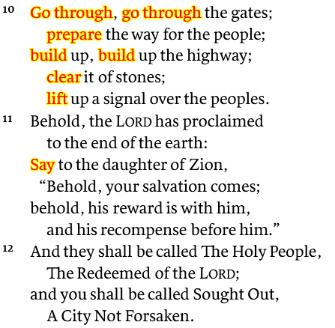
Isaiah 62
Note the constant flow of imperative verbs…
ACTIVELY CLAIM THE PROMISE WITH ACTION
John 12:15
Matt 21:5
Rev 22:12
+ Is 40
“Behold, I am coming soon, bringing my recompense with me, to repay each one for what he has done.
– Rev 22:12
Notes:
vv 11-12 conclude the section of Isaiah dealing with the revelation of future glory (chs. 60—62; cf. 40:1-11; 52:1-12).
The raising of “the flag” would be the signal that Jerusalem and its temple are prepared to receive the pilgrims (see 49:22). The imperatives of this verse exhort workers to continue in the tasks already begun.
John D. W. Watts, Isaiah 3466, Revised Edition., vol. 25, Word Biblical Commentary (Nashville, TN: Thomas Nelson, Inc, 2005), 888.

Slide 22
Key Things to Consider
Isaiah 60-62 captures a message of comfort—despite a looming Babylonian captivity
Isaiah 60 – Blessings Israel would enjoy in the future
Isaiah 61 – Introducing the true Messiah’s arrival and role
Isaiah 62 – Zion’s coming salvation and Jerusalem: “My delight is in her”
God’s unconditional covenants reflect His hesed toward his promises and weave God’s ultimate plan
Love as a settled disposition; an unbreakable loyalty to His pledge
Watchmen with no rest; Go through…, prepare…, lift up…
¹ Dr. Constables notes, Page 12

Slide 23
Discussion and Application
What’s your understanding of who the speaker is in this passage, and of His motivation to speak?
What do verses 2-3 picture about what God’s people are to become as a result of their redemption?
What “new name” will be given to God’s people, and what does it reflect about who they are, or will become?
What does Isaiah say about how the land will be changed and renamed—and what does it mean, and what are the implications, that God will be “married” to it?
Again, review Is 40 and discuss similarities between these two chapters.

Slide 24
Discussion and Application
What is the duty that will be assigned to the watchmen of Jerusalem, and for how long, according to Isaiah? Who are these watchmen?
Where else is this message of persistence? (Ezek. 33; Dan. 4:13; Luke 11:5–10; 18:1–8)
What imperatives (commands) are given to Israel in verse 10, for what purpose--and how does that apply to us?
What does it mean to “lift up a standard over the peoples” (62:10b; NASB)?
What did you learn about God from this lesson?
How would you sum up the key theme, or themes, of this lesson, and what will your take with you from it?

Slide 25
Our Study of Isaiah
This Meeting:
Isaiah 62, Zion’s Coming Salvation
Memory Verse: Isaiah 62:4
Dr. Constable’s Notes, 2022 Ed., pp. 440-443; Motyer, pp. 505-509
Refreshment Host: Group D
Next Meeting:
Isaiah 63, The Lord’s Day of Vengeance
Memory Verse: Isaiah 63:7
Dr. Constable’s Notes, 2022 Ed., pp. 443-453; Motyer, pp. 509-518
Refreshment Host: Group E
Notes:
Welcome to MOB
Rod Turk covered Isaiah 14 last year. Does anyone remember the key word or topic he highlighted as part of his lesson? PRIDE. We’ll expand on that idea—but more from God’s attributes than our own.

Slide 26
Isaiah Bible Study Schedule for Fall 2023 – Spring 2024 as of March 2024

Slide 27
Backup

Slide 28
Scriptural Interpretation at IBC
https://immanuelbible.church/visit/what-we-teach
Notes:
The teaching of Immanuel Bible Church is based on the Scriptures. This
article (Article V) serves as our statement of faith, and it reflects those
doctrines that the elders and congregation consider essential to understanding, teaching, and practicing God’s Word. It is based on an interpretation of the Scripture that is:

Slide 29
Covenant Prophesies
Dispensationalism teaches that all God’s remaining covenant promises to Israel will be literally fulfilled—including the promises of earthly blessings and an earthly messianic kingdom. God promised Israel, for example, that they would possess the promised land forever ( Gen. 13:14–17 ; Exod. 32:13 ).
Covenant theology, on the other hand, usually views such prophecies as already fulfilled allegorically or symbolically. Covenant theologians believe that the church, not literal Israel, is the recipient of the covenant promises. They believe the church has superseded Israel in God’s eternal program. God’s promises to Israel are therefore fulfilled in spiritual blessings realized by Christians.
Source: John MacArthur. “Appenidix 2” in The Gospel According to the Apostles. Nashville: Thomas Nelson, 2005.
https://verticallivingministries.com/tag/john-macarthur-on-dispensationalism/

