Slide 1
WELCOME TO THE MOB!
All Scripture is breathed out by God and profitable for teaching, for reproof, for correction, and for training in righteousness, that the man of God may be complete, equipped for every good work.
2 Timothy 3:16-17 (ESV)

Slide 2
Announcements
MOB Website & Resources: www.ibcmob.net
Welcome to Immanuel Christian School!
https://immanuelbible.church/
(943) Croc's Corner - YouTube

Slide 3
Please Rise
Invocation/Prayer.
Song:
“Immortal, Invisible, God only Wise”

Slide 4
Immortal, Invisible,
God Only Wise
Verse 1 of 5
Immortal, invisible,
God only wise, In light inaccessible
hid from our eyes, Most blessed, most glorious,
the Ancient of Days, Almighty, victorious,
Thy great name we praise.

Slide 5
Immortal, Invisible,
God Only Wise
Verse 2 of 5
Unresting, unhasting,
and silent as light, Nor wanting, nor wasting,
Thou rulest in might: Thy justice, like mountains
high soaring above; Thy clouds, which are fountains
of goodness and love.

Slide 6
Immortal, Invisible,
God Only Wise
Verse 3 of 5
To all, life Thou givest,
to both great and small. In all life Thou livest,
the True Life of all. We blossom and flourish
like leaves on the tree, Then wither and perish;
but naught changeth Thee.

Slide 7
Immortal, Invisible,
God Only Wise
Verse 4 of 5
Great Father of Glory,
pure Father of Light. Thine angels adore Thee,
all veiling their sight. All laud we would render,
O help us to see: ‘Tis only the splendor
of light hideth Thee!

Slide 8
Immortal, Invisible,
God Only Wise
Verse 5 of 5
Immortal, invisible,
God only wise, In light inaccessible
hid from our eyes, Most blessed, most glorious,
the Ancient of Days, Almighty, victorious,
Thy great name we praise.

Slide 9
Our Study of Isaiah
Last Meeting:
Isaiah 43, Called By His Name
Memory Verse: Isaiah 43:10
Dr. Constable’s Notes, 2023 Ed., pp. 290-298; Motyer, pp. 330-341.
This Meeting:
Isaiah 44, The Blessings of Israel and the Folly of Idolatry
Memory Verse: Isaiah 44:6
Dr. Constable’s Notes, 2023 Ed., pp. 298-310; Motyer, pp. 341-356
Refreshment Host: Group H
Notes:
Welcome to MOB

Slide 10
Memory Verse
Isaiah 44:6 (ESV)
“Thus says the Lord, the King of Israel and his Redeemer, the Lord of hosts: "I am the first and I am the last; besides me there is no god.”
Isaiah 44:6 (ESV)
Notes:
It really is a great verse. A lot packed into the application of Isaiah that we’ll touch on.

Slide 11
NT References of Isaiah 44
Isaiah 44:6 (ESV)
⁶ “Thus says the Lord, the King of Israel and his Redeemer, the Lord of hosts:
"I am the first and I am the last; besides me there is no god.”

Slide 12
Isaiah Outline
Focus | Prophecies of Condemnation |  |  |  |  |  |  |  | Historical Parenthesis |  | Prophecies of Comfort
 | 1:1 |  |  |  |  |  |  | 35:10 | 36:1 | 39:8 | 40:1 |  |  |  |  |  | 66:24
Divisions | Prophecies Against Judah |  | Prophecies Against the Nation |  | Prophesies Against the Day of the Lord |  | Prophesies of Judgement and Blessing |  | Sickness and Sin | Hezekiah’s Salvation | Israel’s Deliverance |  |  | Israel’s Deliverer |  | Israel’s Glorious Future
 | 1:1 | 12:6 | 13:1 | 23:18 | 24:1 | 27:13 | 28:1 | 35:10 | 36:1 | 39:8 | 40:1 | 48:22 |  | 49:1 | 57:21 | 58:1 | 66:24
Topics | Prophetic |  |  |  |  |  |  |  | Historic |  | Messianic
 | Judgement |  |  |  |  |  |  |  | Transition |  | Hope
Place | Israel & Judah
Time | 740 - 680 B.C.
We are here!
Bruce Wilkinson and Kenneth Boa, Talk Thru the Bible (Nashville: T. Nelson, 1983), 189.

Slide 13
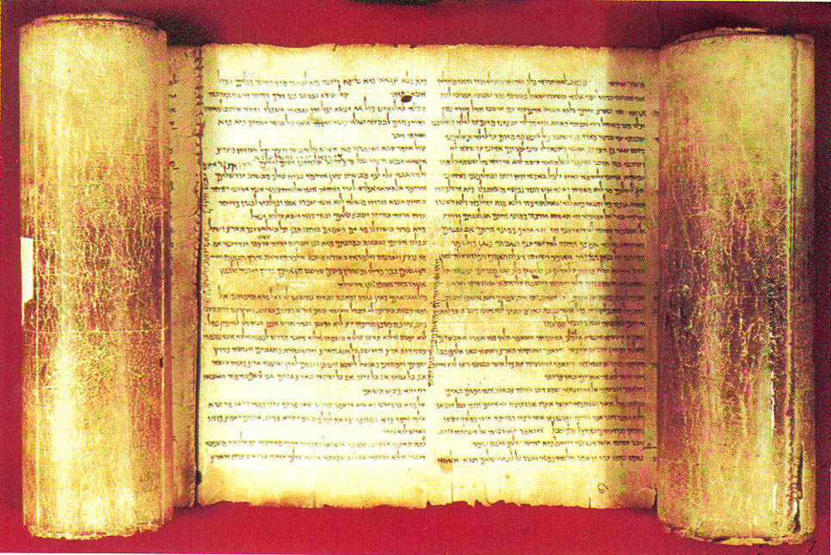
Theme – from Constable’s notes (another pivot)
Judgment was not Yahweh's final word to His people. This new word would be good news in contrast to what had immediately preceded (cf. 43:28)

Slide 14
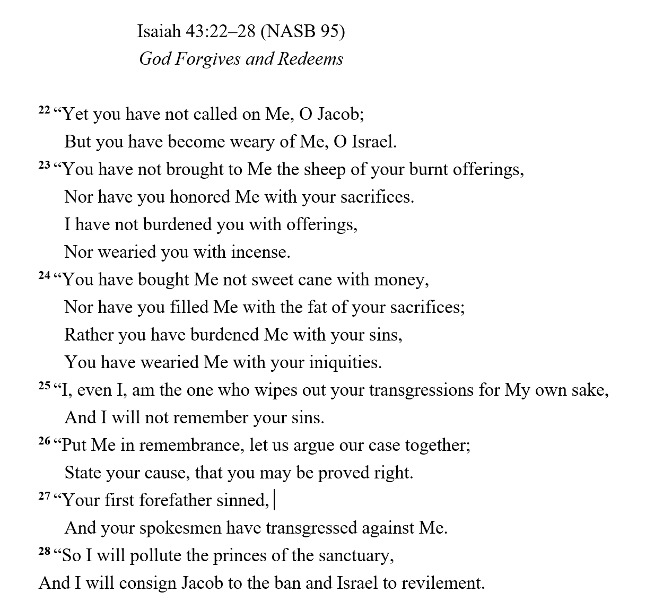
The Shortcomings of Israel
Quite an indictment on both Israel and Jacob from the previous chapter!

Slide 15
Isaiah 44
The Blessings of Israel (vv. 1 – 8)
The Folly of Idolatry (vv. 9 – 20)
God Forgives and Redeems (vv. 21 – 28)

Slide 16
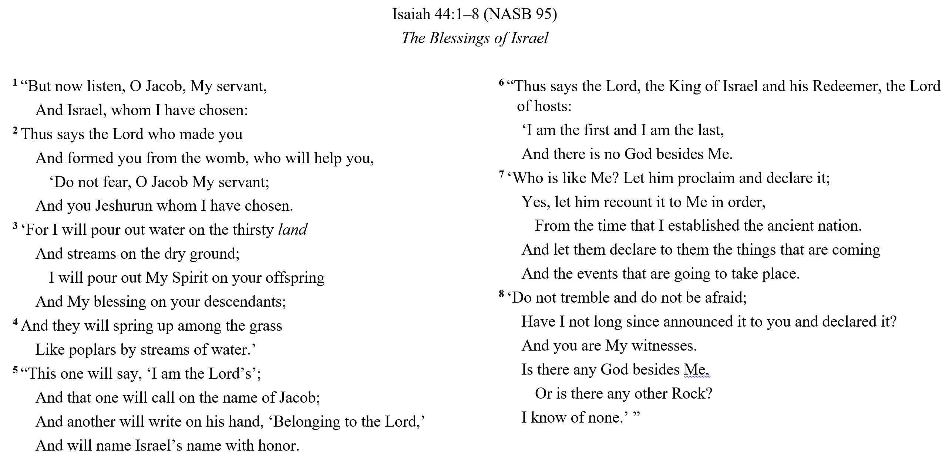

Slide 17
The past forgotten, the future blessed
Isaiah leaps straight from the God burdened by his people’s sins (43:24) to the God who blots them out. No connecting word in human vocabulary can bring these two realities together. Only God knows how holiness and pardon co-exist in the divine nature. The poem offers no explanation, only a statement that wrath (43:28) is replaced by blessing (44:3).
J. A. Motyer, The Prophecy of Isaiah: An Introduction & Commentary, 340.

Slide 18
Isaiah 44:1 – 3
¹ “But now listen, O Jacob, My servant,
And Israel, whom I have chosen:
² Thus says the Lord who made you
And formed you from the womb, who will help you,
‘Do not fear, O Jacob My servant;
And you Jeshurun whom I have chosen.
³ ‘For I will pour out water on the thirsty land
And streams on the dry ground;
I will pour out My Spirit on your offspring
And My blessing on your descendants;
A parallel to Ch 43:1-7
The parallel section opened with the word w^{e}‛attâ (‘now then’), and the same word opens verse 1.
Jeshurun
Poetic name for Israel, both as a people and a place
Deut 32:15; 33:5, 26; Isa 44:2
Chosen – perfect tense (completed)
“Jeshurun,” The Lexham Bible Dictionary, 2016.
Notes:
¹ But now, thus says the Lord, your Creator, O Jacob,
And He who formed you, O Israel,
“Do not fear, for I have redeemed you;
I have called you by name; you are Mine!
New American Standard Bible, Is 43:1.

Slide 19
Divine Grace
Jeremiah 31:34
³⁴ They will not teach again, each man his neighbor and each man his brother, saying, ‘Know the Lord,’ for they will all know Me, from the least of them to the greatest of them,” declares the Lord, “for I will forgive their iniquity, and their sin I will remember no more.”
Micah 7:18-19
¹⁸ Who is a God like You, who pardons iniquity
And passes over the rebellious act of the remnant of His possession?
He does not retain His anger forever,
Because He delights in unchanging love.
¹⁹ He will again have compassion on us;
He will tread our iniquities under foot.
Yes, You will cast all their sins
Into the depths of the sea.
Hesed is “the unfailing love that is ever loyal to its pledge, love as a settled disposition …” – Motyer
Notes:
²⁰ You will give truth to Jacob
And unchanging love to Abraham,
Which You swore to our forefathers
From the days of old.
Mic 7:20
Motyer - (Isaiah 54:8) – God’s inability not to follow-through on His promises (double negative)

Slide 20
Dripping Irony: Isaiah 44:9 – 20
⁹ Those who fashion a graven image are all of them futile, and their precious things are of no profit; even their own witnesses fail to see or know, so that they will be put to shame. (v 44:9)
One shapes iron…
Working with a strong arm, he also gets hungry, his strength fails, he drinks no water and becomes weary (v. 12)
…another shapes wood
…like the beauty of a man so it may sit in a house. (v. 13)
He burns to eat and keep warm—and fall down and worship (vv. 16-17)

Slide 21
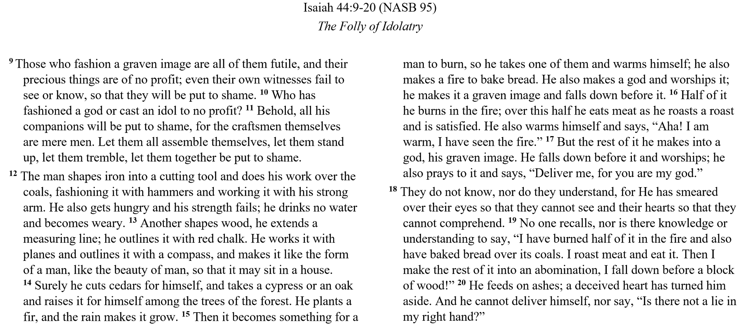
Notes:
Some verses within this quasipoetic section exhibit many poetic parallelisms; thus the NIV arranges the whole section as if it were all poetry (NASB arranges these verses in a narrative format). Since there is no sharp distinction between rhythmic narrative and pure poetry, either way of presenting this text can be justified. It is important to notice parallelism when it occurs (44:9–11, 18–20), but not to force it on a text when there is little parallelism present in other verses (44:12–17).
Gary Smith, Isaiah 40-66, vol. 15B, The New American Commentary (Nashville, TN: Broadman & Holman Publishers, 2009), 229.

Slide 22
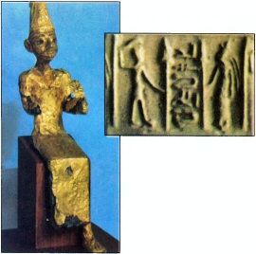
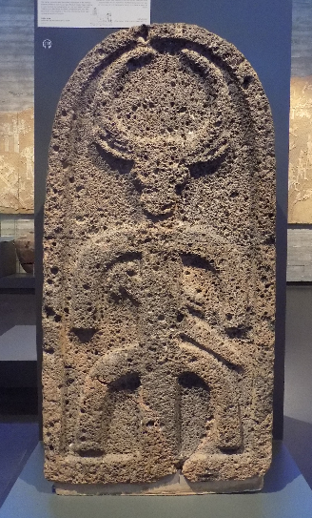
What’s with the Image?
¹⁷ But the rest of it he makes into a god, his graven image. He falls down before it and worships; he also prays to it and says, “Deliver me, for you are my god.”
A bronze statue of a god (probably Baal) overlaid with gold leaf and found at Megiddo
Cultic Stele from Aramean Kingdom of Geshur
“You shall not make for yourself an idol, or any likeness of what is in heaven above or on the earth beneath or in the water under the earth.” Exodus 20:4
Notes:
While the Old Testament mentions several pagan gods, such as Dagon and Molech, our attention will focus upon Baal and Asherah. While sometimes treated separately, these two deities represent fertility religions, with Baal being the male and Asherah the female deity.
That ancient Near Eastern religion focused primarily upon fertility was no coincidence. Infertility of crops meant hunger, if not starvation, while the infertility of animals and people meant economic loss. The lack of socioeconomic security in ancient life meant that the people were never further than one failed crop away from potential starvation.
David S. Dockery, ed., Holman Bible Handbook (Nashville, TN: Holman Bible Publishers, 1992), 40.
This carved stone slab was discovered in the capital of the Aramean kingdom of Geshur, near the city gate. The Bull-headed figure wearing a sword probably symbolized either the chief god Hadad, who was the storm god responsible for rainfall, or the moon god, who was responsible for the swelling fo rivers. Alternatively, it could have represented a fusion of the two.

Slide 23
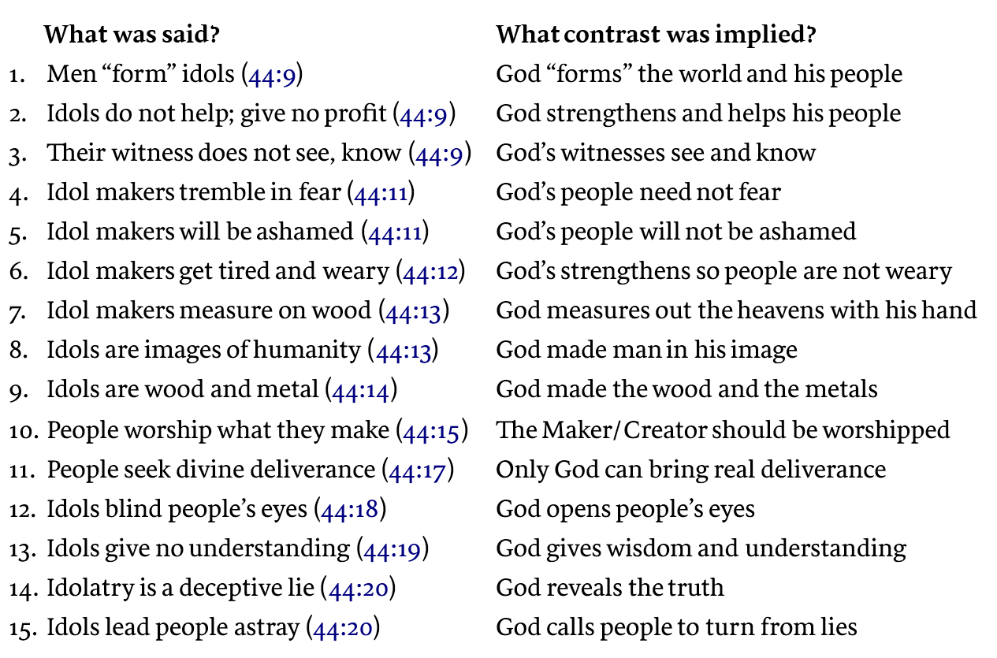
Man made vs God made?
If people were aware of what the prophet had said earlier about God, the sensitive, spiritually minded person would immediately see how these factors contrast with what was said about the idols and the idol makers.
The New American Commentary, 238.

Slide 24
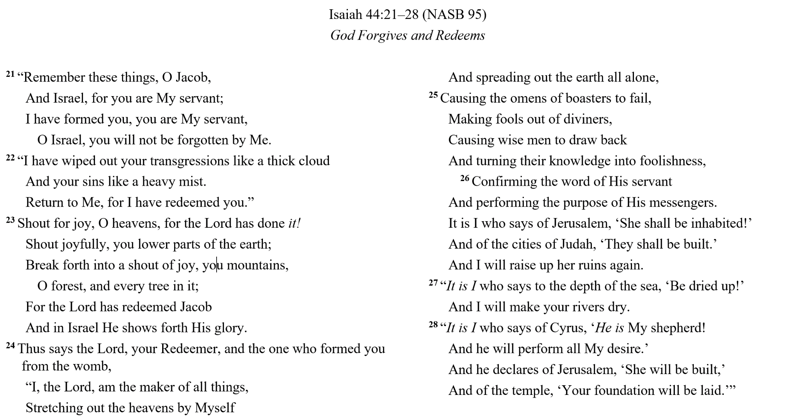
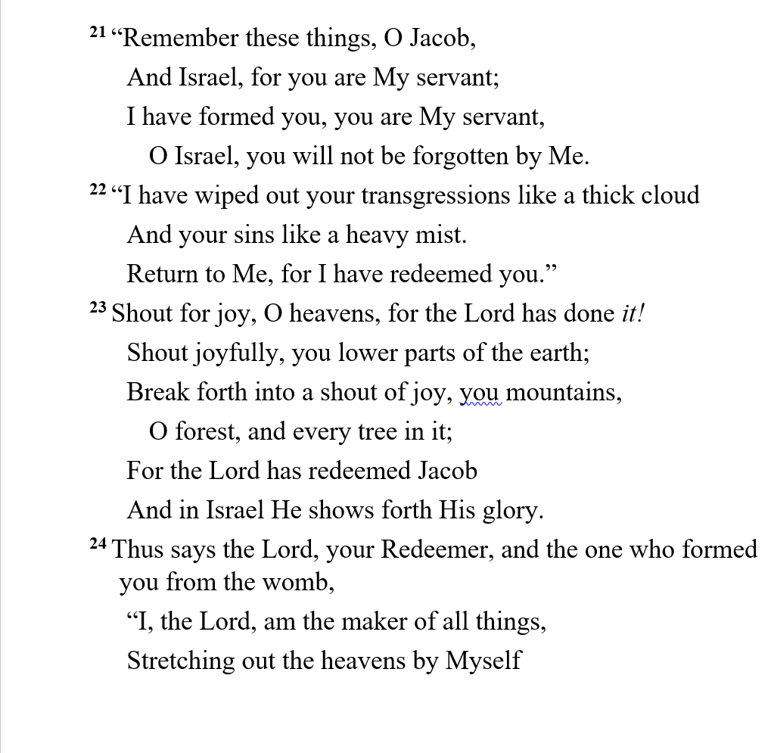

Slide 25
vv 21– 27 – Remember these things…
²² “I have wiped out your transgressions like a thick cloud
And your sins like a heavy mist.
Return to Me, for I have redeemed you.”
²³ Shout for joy, O heavens, for the LORD has done it!
Shout joyfully, you lower parts of the earth;
Break forth into a shout of joy, you mountains,
O forest, and every tree in it;
For the LORD has redeemed Jacob
And in Israel He shows forth His glory.
Note the imperatives
“But now listen, O Jacob…
Jacob is redeemed
gōʾēl גאל – 41:14; 43:14
The powerful message of restoration for Jacob and Jerusalem
Notes:
¹ But now, thus says the Lord, your Creator, O Jacob,
And He who formed you, O Israel,
“Do not fear, for I have redeemed you;
I have called you by name; you are Mine!
New American Standard Bible, Is 43:1.

Slide 26
A Personalized Redemption
²¹ “Remember these things, O Jacob,
And Israel, for you are My servant;
I have formed you, you are My servant,
O Israel, you will not be forgotten by Me.
²² “I have wiped out your transgressions like a thick cloud
And your sins like a heavy mist.
Return to Me, for I have redeemed you.”

Slide 27
A Personalized Redemption
²¹ “Remember these things, O fellowship at Immanuel,
And men of the MOB, for you are My servant;
I have formed you, you are My servant,
O men of the MOB, you will not be forgotten by Me.
²² “I have wiped out your transgressions like a thick cloud
And your sins like a heavy mist.
Return to Me, for I have redeemed you.”

Slide 28
Key Things to Consider
The blessings of Israel and the message to Jacob underscore the character of God
“…and in Israel he shows forth His glory.” v 23
The folly of idolatry is a gripping visual picture of man’s pathetic inability to bridge God’s divine role
Forgiveness + Joy + Redemption is a powerful message from the Maker to the servant
“I have wiped out your transgressions like a thick cloud and your sins like a heavy mist. Return to Me, for I have redeemed you.” - Isaiah 44:22
¹ Dr. Constables notes, Page 12
Notes:
Metaphorically, the term gʾl often reflects the special relationship between God and Israel both in redeeming individuals and groups from adversity and the entire nation from Egyptian Slavery. A good example of this relationship is found in the book of Isaiah where God exclaims “I am the one who helps you, declares the LORD; your Redeemer is the Holy One of Israel.” (Isaiah 41:14) Using the Logos Bible Browser Tool for NASB, the use of redeem in the sense of “to deliver” includes 35 results in the Old Testament all associated with God and His role as Deliverer. Interestingly, both NASB and ESV include God as a redeemer and those filling the role as a human as avenger, relative or kinsman.
Kirk Streitmater, BE109DC - Bible Word Study Redeemer, n.d.

Slide 29
Discussion and Application
In what ways were the early verses of Chapters 43 & 44 similar, complementary, duplicative or cumulative? Are they more powerful together?
How is the uniqueness of God explained or described in vv. 1 – 8? Do these statements exude confidence in the message? Cite your favorite example.
Read vv. 9 – 20. What is the most impactful description/statement? Why?
How are some of the descriptions of idols contrasted against specific elements of God found in Chapters 40 – 44?
Considering God’s statements, why is the term abomination describing an idol appropriate? (Deut 27:15; 1 Kg 11:5; 2 Kg 23:13)
How is the introduction of Cyrus in v 28 an appropriate follow-up to the earlier elements of Chapter 44?

Slide 30
Our Study of Isaiah
This Meeting:
Isaiah 44, The Blessings of Israel and the Folly of Idolatry
Memory Verse: Isaiah 44:6
Dr. Constable’s Notes, 2022 Ed., pp. 298-310; Motyer, pp. 341-356
Refreshment Host: Group H
Next Meeting:
Isaiah 45, Cyrus God’s Instrument & The Lord, the Only Savior
Memory Verse: Isaiah 45:8
Dr. Constable’s Notes, 2023 Ed., pp. 310-319; Motyer, pp. 356-367
Refreshment Host: Group A
Notes:
Welcome to MOB
Rod Turk covered Isaiah 14 last year. Does anyone remember the key word or topic he highlighted as part of his lesson? PRIDE. We’ll expand on that idea—but more from God’s attributes than our own.

Slide 31
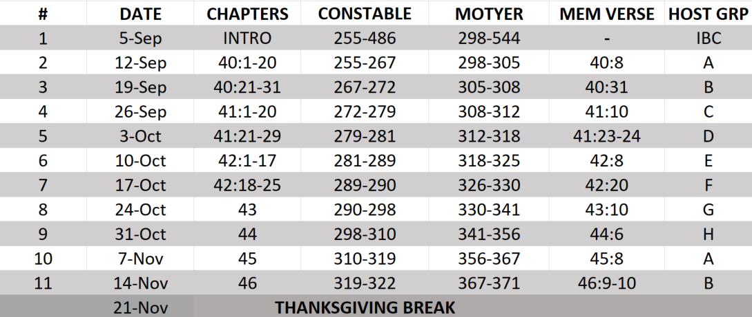
Isaiah Bible Study Schedule for Fall 2023 – Spring 2024 as of September 2023

Slide 32
Backup

Slide 33
Isaiah Bible Study Schedule for Fall 2023 – Spring 2024 as of September 2023

Slide 34
Isaiah Bible Study Schedule for Fall 2023 – Spring 2024 as of September 2023

Slide 35
Isaiah Bible Study Schedule for Fall 2023 – Spring 2024 as of September 2023

