Slide 1
WELCOME TO THE MOB!
All Scripture is breathed out by God and profitable for teaching, for reproof, for correction, and for training in righteousness, that the man of God may be complete, equipped for every good work.
2 Timothy 3:16-17 (ESV)

Slide 2
Welcome To The MOB!
MOB Website & Resources: www.ibcmob.net
Christmas Concerts this week – Dec 7, 8, 9, 10
SOLD OUT – but…
MOB next week (12/12) but Christmas break after that

Slide 3
Please Rise
Invocation/Prayer
Song:
Before the Throne of God Above

Slide 4
Before the Throne of God Above 1 of 3
Before the throne of God above
I have a strong and perfect Plea
A great high priest whose name is Love
Who ever lives and pleads for me
My name is graven on His hands
My name is written on His heart
I know that while in Heaven He stands
No tongue can bid me thence depart
No tongue can bid me thence depart

Slide 5
Before the Throne of God Above 2 of 3
When Satan tempts me to despair
And tells me of the guilt within
Upward I look and see Him there
Who made an end to all my sin
Because the sinless Savior died
My sinful soul is counted free
For God the Just is satisfied
To look on Him and pardon me
To look on Him and pardon me

Slide 6
Before the Throne of God Above 3 of 3
Behold Him there, the risen Lamb
My perfect spotless Righteousness
The great unchangable I am
The King of glory and of grace
One with Himself, I cannot die
My soul is purchased by His blood
My life is hid with Christ on high
With Christ, my Savior and my God
With Christ, my Savior and my God

Slide 7
Our Study of Isaiah
Last Meeting:
Isaiah 47
Memory Verse: Isaiah 47:10
Dr. Constable’s Notes, pp. 322-328; Motyer, pp. 371-375
Refreshment Host: Group C
This Meeting:
Isaiah 48
Memory Verse: 48:10-11
Dr. Constable’s Notes, 2023 Ed., pp. 328-335; Motyer, pp. 375-382
Refreshment Host: D

Slide 8
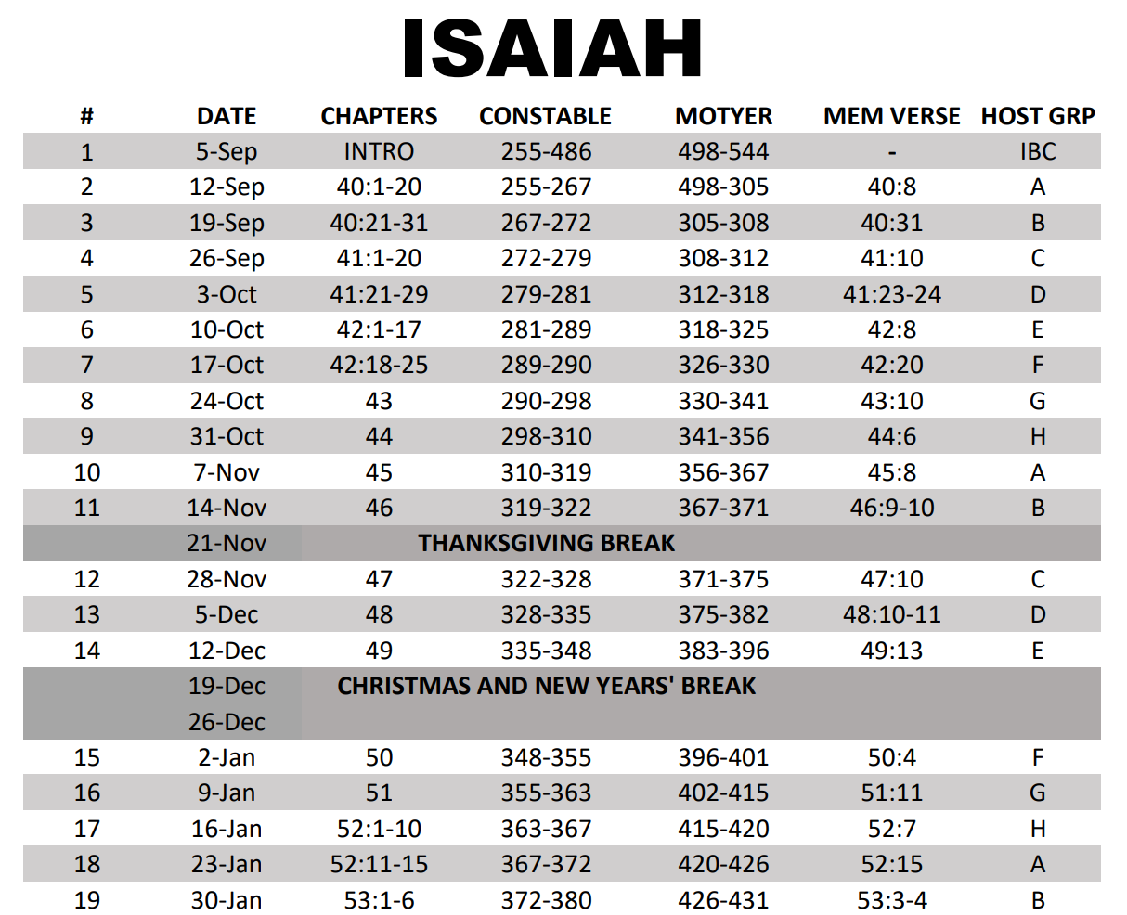
Isaiah Bible Study Schedule Fall 2023 – Spring 2024

Slide 9
Memory Verse
Isaiah 48:10-11 (ESV)
¹⁰Behold, I have refined you, but not as silver; I have tried you in the furnace of affliction.
¹¹For my own sake, for my own sake, I do it, for how should my name be profaned? My glory I will not give to another.

Slide 10
Isaiah Outline
Focus | Prophecies of Condemnation |  |  |  |  |  |  |  | Historical Parenthesis |  | Prophecies of Comfort
 | 1:1 |  |  |  |  |  |  | 35:10 | 36:1 | 39:8 | 40:1 |  |  |  |  |  | 66:24
Divisions | Prophecies Against Judah |  | Prophecies Against the Nation |  | Prophesies Against the Day of the Lord |  | Prophesies of Judgement and Blessing |  | Sickness and Sin | Hezekiah’s Salvation | Israel’s Deliverance |  |  | Israel’s Deliverer |  | Israel’s Glorious Future
 | 1:1 | 12:6 | 13:1 | 23:18 | 24:1 | 27:13 | 28:1 | 35:10 | 36:1 | 39:8 | 40:1 | 48:22 |  | 49:1 | 57:21 | 58:1 | 66:24
Topics | Prophetic |  |  |  |  |  |  |  | Historic |  | Messianic
 | Judgement |  |  |  |  |  |  |  | Transition |  | Hope
Place | Israel & Judah
Time | 740 - 680 B.C.
You Are Here!
Bruce Wilkinson and Kenneth Boa, Talk Thru the Bible (Nashville: T. Nelson, 1983), 189.

Slide 11
Highlights of Chapter 48
God calls Judah out re: their hypocrisy – professing Him with their lips yet living very differently
The focus turns from Babylon falling (chapter 47) to the captives of Babylon returning home
Creator God’s Sovereignty – REVISITED
God would redeem a stubborn people – for HIS glory
God was a faithful Redeemer in the past and He will be a faithful Redeemer in the future

Slide 12
Highlights of Chapter 48
Isaiah has demonstrated God’s trustworthiness (chapters 7-39) and had promised that He would graciously redeem His people (chapters 40-47). Now it was up to the Israelites to trust Him. Chapter 48 consists of exhortations to the impenitent and unbelieving Israel, during the captivity, to truly listen to their God.
-- Constable
God calls Judah out on their hypocrisy – professing Him with their lips yet living very differently
The focus turns from Babylon falling (chapter 47) to the captives of Babylon returning home
Creator God’s Sovereignty – REVISITED
God would redeem a stubborn people – for HIS glory
God was a faithful Redeemer in the past and He will be a faithful Redeemer in the future

Slide 13
Highlights of Chapter 48
Chapter 48 is the inevitable climax of a rising tide of awareness of Israel’s sin and need -
-- Motyer

Slide 14
Isaiah 48:1-2
¹Hear this, O house of Jacob, who are called by the name of Israel, and who came from the waters of Judah, who swear by the name of the Lord and confess the God of Israel, but not in truth or right.
²For they call themselves after the holy city, and stay themselves on the God of Israel; the Lord of hosts is his name.
House of Jacob – “Jacob I have loved”; chosen
Israel – aligned with their patriarch
Judah – the royal tribe
“…respectively the nation, the covenant people, and the particular audience addressed” -- Motyer

Slide 15
Isaiah 48:3-5
³“The former things I declared of old; they went out from my mouth, and I announced them; then suddenly I did them, and they came to pass.
⁴Because I know that you are obstinate, and your neck is an iron sinew and your forehead brass,
⁵I declared them to you from of old, before they came to pass I announced them to you, lest you should say, ‘My idol did them, my carved image and my metal image commanded them.’
Obstinate “to the max”
Genesis 15:12-14 – one example of God prophesying trouble...and deliverance

Slide 16
Isaiah 48:6-8
⁶“You have heard; now see all this; and will you not declare it? From this time forth I announce to you new things, hidden things that you have not known.
⁷They are created now, not long ago; before today you have never heard of them, lest you should say, ‘Behold, I knew them.’
⁸You have never heard, you have never known, from of old your ear has not been opened. For I knew that you would surely deal treacherously, and that from before birth you were called a rebel.
The structure of the poem proposes its own interpretation: the former things are the Cyrus-plan (the fall of Babylon and the release of the captives), the new things are the servant events (the coming of the Spirit-endowed one).
J. A. Motyer
”Congenitally rebellious” – verse 8

Slide 17
Isaiah 48:9-11
⁹“For my name’s sake I defer my anger; for the sake of my praise I restrain it for you, that I may not cut you off.
¹⁰Behold, I have refined you, but not as silver; I have tried you in the furnace of affliction.
¹¹For my own sake, for my own sake, I do it, for how should my name be profaned? My glory I will not give to another.
“Not as silver”
God has ALWAYS been a God who saves, redeems, and withholds judgment based on His character, and for His glory - not on the behavior of people

Slide 18
Ephesians 2 – by grace…
Ephesians 2:1–9 (ESV)
¹And you were dead in the trespasses and sins ²in which you once walked, following the course of this world, following the prince of the power of the air, the spirit that is now at work in the sons of disobedience— ³among whom we all once lived in the passions of our flesh, carrying out the desires of the body and the mind, and were by nature children of wrath, like the rest of mankind. ⁴But God, being rich in mercy, because of the great love with which he loved us, ⁵even when we were dead in our trespasses, made us alive together with Christ—by grace you have been saved—
⁶and raised us up with him and seated us with him in the heavenly places in Christ Jesus, ⁷so that in the coming ages he might show the immeasurable riches of his grace in kindness toward us in Christ Jesus.
⁸For by grace you have been saved through faith. And this is not your own doing; it is the gift of God, ⁹not a result of works, so that no one may boast.

Slide 19
Isaiah 48:12-16
¹²“Listen to me, O Jacob, and Israel, whom I called! I am he; I am the first, and I am the last.
¹³My hand laid the foundation of the earth, and my right hand spread out the heavens; when I call to them, they stand forth together.
¹⁴“Assemble, all of you, and listen! Who among them has declared these things? The Lord loves him;
he shall perform his purpose on Babylon, and his arm shall be against the Chaldeans.
¹⁵I, even I, have spoken and called him; I have brought him, and he will prosper in his way.
¹⁶Draw near to me, hear this: from the beginning I have not spoken in secret, from the time it came to be I have been there.” And now the Lord God has sent me, and his Spirit.

Slide 20
Isaiah 48:17-21
¹⁷Thus says the Lord, your Redeemer, the Holy One of Israel: “I am the Lord your God, who teaches you to profit, who leads you in the way you should go. ¹⁸Oh that you had paid attention to my commandments! Then your peace would have been like a river, and your righteousness like the waves of the sea; ¹⁹your offspring would have been like the sand, and your descendants like its grains; their name would never
be cut off or destroyed from before me.” ²⁰Go out from Babylon, flee from Chaldea, declare this with a shout of joy, proclaim it, send it out to the end of the earth; say, “The Lord has redeemed his servant Jacob!” ²¹They did not thirst when he led them through the deserts; he made water flow for them from the rock; he split the rock and the water gushed out.

Slide 21
Isaiah 48:22
²²“There is no peace,” says the Lord, “for the wicked.”

Slide 22
Conclusion
Profession vs Obedience
1 John 2:3-6
God is a God of Justice – and Grace

Slide 23
Next Meeting
Review:
Isaiah 48
Memory Verse: 48:10-11
Dr. Constable’s Notes, 2023 Ed., pp. 328-335; Motyer, pp. 375-382
Study:
Isaiah 49
Memory Verse: Isaiah 49:13
Dr. Constable’s Notes, 2023 Ed., pp. 335-338; Motyer, pp. 383-396
Refreshment Host: E

Slide 24
Questions & Application
How would you describe the tenor and tone of this text?
Why would God exhort the impenitent and unbelieving ones of Israel while they were in captivity in Babylon?
Why might the Jews have become comfortable and complacent during their captivity?
What characteristic of God was on display when He did not abandon His people even when He would have been totally justified in doing so?
What were the “new things” that God said that He was going to be doing for them?
In what ways were they stubborn, or hypocritical, according to Isaiah?
How did Isaiah’s use to the terms “neck of iron,” and “bronze foreheads” define the state of the Jewish mind?

Slide 25
Questions & Application
What does Isaiah say would have happened (or not happened) to them if they would have paid attention to, and obeyed, the Lord’s commandments in the first place, or at least sooner?
What are the implications of God’s role as Creator in maintaining control over the flow of history?
What was God’s purpose in “sending them off” into captivity?
What do you think the Lord had in mind in commanding the hostages to “go forth from Babylon and flee the Chaldeans”?
How did the exile in Babylon, and the release from exile, prove God’s sovereignty?
Why do you think Isaiah 48 ends with a “warning”—and how might that apply to believers today?
How might this lesson apply to the church and, more specifically, to us as “men of the Bible”?

Slide 26
Closing
Benediction
Small Groups

Slide 28
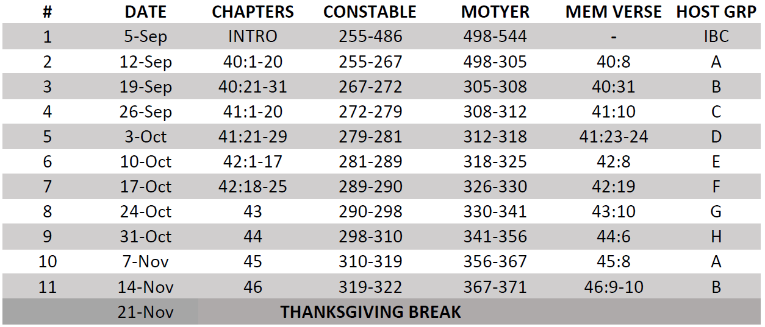
Isaiah Bible Study Schedule for Fall 2023 – Spring 2024 as of September 5, 2023

Slide 29
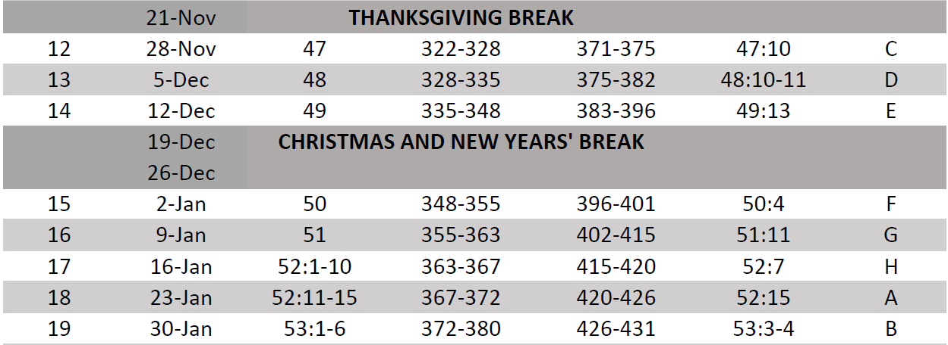
Isaiah Bible Study Schedule for Fall 2023 – Spring 2024 as of September 5, 2023

Slide 30
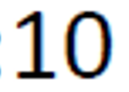
Isaiah Bible Study Schedule for Fall 2023 – Spring 2024 as of September 5, 2023

Slide 31
Isaiah Bible Study Schedule for Fall 2023 – Spring 2024 as of September 5, 2023

