Slide 1
WELCOME TO THE MOB!
All Scripture is breathed out by God and profitable for teaching, for reproof, for correction, and for training in righteousness, that the man of God may be complete, equipped for every good work.
2 Timothy 3:16-17 (ESV)

Slide 2
Announcements
MOB Website & Resources: www.ibcmob.net
Thanksgiving Day service – Thurs, Nov 23, 10 AM
Christmas Concerts – Dec 7-10

Slide 3
Invocation/Prayer
Hymn:
Immortal, Invisible
Notes:
I prayed that my teaching would change the lives of my students, encourage them, give them more confidence, and help them make an impact on the world. – Jim Plueddemann

Slide 4
Immortal, Invisible
By Walter Chalmers Smith, Verse 1 of 4
Immortal, invisible, God only wise,
In light inaccessible hid from our eyes,
Most blessed, most glorious, the Ancient of Days,
Almighty, victorious, Thy great name we praise.

Slide 5
Immortal, Invisible
By Walter Chalmers Smith, Verse 2 of 4
Unresting, unhasting, and silent as light,
Nor wanting, nor wasting, Thou rulest in might:
Thy justice, like mountains high soaring above;
Thy clouds, which are fountains of goodness and love.

Slide 6
Immortal, Invisible
By Walter Chalmers Smith, Verse 3 of 4
To all, life Thou givest, to both great and small.
In all life Thou livest, the True Life of all.
We blossom and flourish like leaves on the tree,
Then wither and perish; but naught changeth Thee.

Slide 7
Immortal, Invisible
By Walter Chalmers Smith, Verse 4 of 4
Thou reignest in glory; Thou dwellest in light.
Thine angels adore Thee, all veiling their sight.
All praise we would render; O help us to see
‘Tis only the splendor of light hideth Thee!

Slide 8
Memory Verse
Isaiah 45:8 (ESV)
Shower, O heavens, from above, and let the clouds rain down righteousness; let the earth open, that salvation and righteousness may bear fruit; let the earth cause them both to sprout; I the Lord have created it.
Unless otherwise noted, all Scripture quotations are from NASB95

Slide 9
Our Study of Isaiah
Last Meeting:
Isaiah 44, The Blessings of Israel and the Folly of Idolatry
Memory Verse: Isaiah 44:6
Dr. Constable’s Notes, 2023 Ed., pp. 298-310; Motyer, pp. 341-356
This Meeting:
Isaiah 45, Cyrus God’s Instrument & The Lord, the Only Savior
Memory Verse: Isaiah 45:8
Dr. Constable’s Notes, 2023 Ed., pp. 310-319; Motyer, pp. 356-367
Refreshment Host: Group A

Slide 10
Isaiah Outline
Focus | Prophecies of Condemnation |  |  |  |  |  |  |  | Historical Parenthesis |  | Prophecies of Comfort
 | 1:1 |  |  |  |  |  |  | 35:10 | 36:1 | 39:8 | 40:1 |  |  |  |  |  | 66:24
Divisions | Prophecies Against Judah |  | Prophecies Against the Nation |  | Prophesies Against the Day of the Lord |  | Prophesies of Judgement and Blessing |  | Sickness and Sin | Hezekiah’s Salvation | Israel’s Deliverance |  |  | Israel’s Deliverer |  | Israel’s Glorious Future
 | 1:1 | 12:6 | 13:1 | 23:18 | 24:1 | 27:13 | 28:1 | 35:10 | 36:1 | 39:8 | 40:1 | 48:22 |  | 49:1 | 57:21 | 58:1 | 66:24
Topics | Prophetic |  |  |  |  |  |  |  | Historic |  | Messianic
 | Judgement |  |  |  |  |  |  |  | Transition |  | Hope
Place | Israel & Judah
Time | 740 - 680 B.C.
We are here!
Bruce Wilkinson and Kenneth Boa, Talk Thru the Bible (Nashville: T. Nelson, 1983), 189.

Slide 11
Unlikely Headlines Department
The Jerusalem Times
Dateline: 700 BC - 586 BC
- Jews released from captivity!
- Temple to be rebuilt!
- Gentile king to pay for it!
Notes:
Create a visual timeline for people – especially to distinguish Isaiah’s time from the future time of fulfillment.
Left side of room is 900s BC – prophecy to Jeroboam, naming Josiah
Center of room is 700s BC – Isaiah’s time
Right of room (podium) is 500s BC – Exile and Cyrus’ time

Slide 12
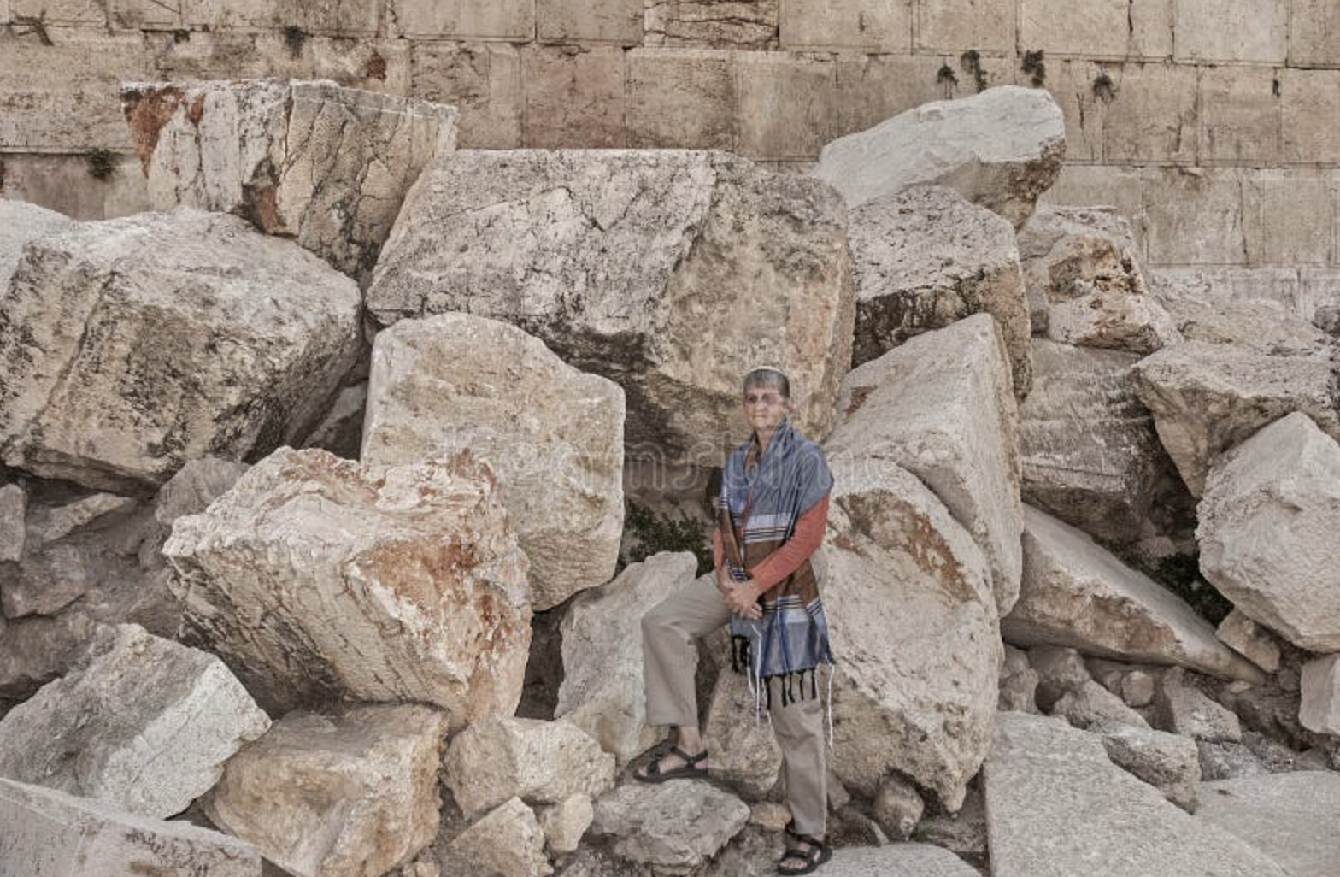
Background: Isaiah 44:26b
YHWH will rescue
It is I who says of Jerusalem, ‘She shall be inhabited!’ And of the cities of Judah, ‘They shall be built.’
And I will raise up her ruins again.
Notes:
Stated in Isaiah’s time – 700s BC – they weren’t even picturing the coming destruction of Jerusalem
Let’s be very clear: YHWH is the true power behind everything stated here about Jerusalem. And Jerusalem is God’s objective behind what will follow in Isaiah’s prophecy.
An inconvenient chapter division – keep prophecy of return from exile all together
The heavens are telling of the glory of God; And their expanse is declaring the work of His hands. (Psalm 19:1)
“It is He who changes the times and the epochs; He removes kings and establishes kings; He gives wisdom to wise men And knowledge to men of understanding. (Daniel 2:21)
Create a visual timeline for people – especially to distinguish Isaiah’s time from the future time of fulfillment.
Left side of room is 900s BC – prophecy to Jeroboam, naming Josiah
Center of room is 700s BC – Isaiah’s time
Right of room (podium) is 500s BC – Exile and Cyrus’ time

Slide 13
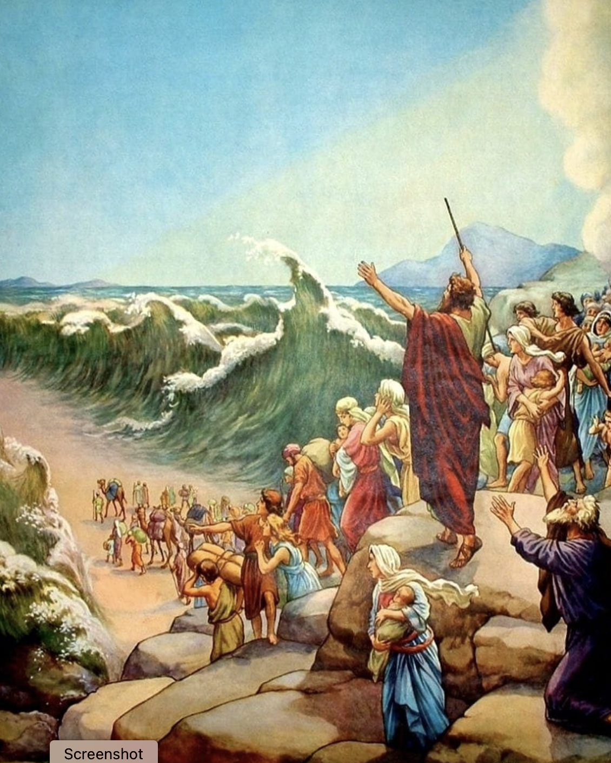
Background: Isaiah 44:27
YHWH provides historical evidence
It is I who says to the depth of the sea, ‘Be dried up!’
Reminiscent of Israel crossing the Red Sea
And I will make your rivers dry.
Reminiscent of Israel crossing Jordan into Canaan
Notes:
When did this happen? Moses’ time – 1500s BC
BTW – No idol ever did anything like this
The heavens are telling of the glory of God; And their expanse is declaring the work of His hands. (Psalm 19:1)
“It is He who changes the times and the epochs; He removes kings and establishes kings; He gives wisdom to wise men And knowledge to men of understanding. (Daniel 2:21)

Slide 14
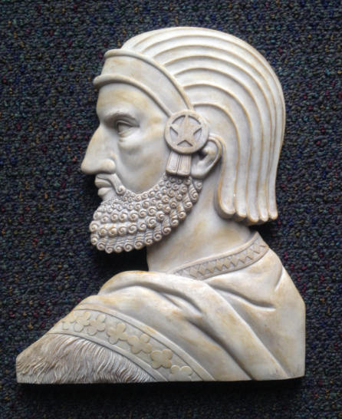
A Twist: Isaiah 44:28
YHWH will do something NEW (cf. 43.19)
It is I who says of Cyrus, ‘He is My shepherd! And he will perform all My desire.’
And he declares of Jerusalem, ‘She will be built,’ And of the temple, ‘Your foundation will be laid.’
Notes:
Prophesied of Cyrus’ time – 500s BC
God’s assignment for Cyrus
¹⁹ “Behold, I will do something new, Now it will spring forth; Will you not be aware of it? I will even make a roadway in the wilderness, Rivers in the desert. (Isaiah 43:19)
(Re 45.1 – another king named in advance) ² He cried against the altar by the word of the Lord, and said, “O altar, altar, thus says the Lord, ‘Behold, a son shall be born to the house of David, Josiah by name; and on you he shall sacrifice the priests of the high places who burn incense on you, and human bones shall be burned on you.’ ” (1 Kings 13:2) [a similar prediction by name before the person was even born - Josiah lived 648-609 BC – the prophecy was made to Jeroboam who died in 901BC ]

Slide 15
A Twist: Bible Critics Reaction
The Bible critics say:
Isaiah could not possibly have known Cyrus’ name in advance.
This proves there must be a second writer, Deutero-Isaiah, about 550 BC or later, when Cyrus was living.
We would respond:
No. Since God is omniscient, He knows in advance. Since God speaks through prophets, He could tell Isaiah in advance.

Slide 16
A Twist: Jews Reaction
At this point, apparently Israel took exception too.
Remember Isaiah wrote this ~700 BC. Israel had a lot of issues. And the Exile was not clearly in their view. But …
Perhaps they were expecting somebody from the line of David. (Remember God’s covenant with David.)
At any rate, like Jonah, they wanted nothing to do with Gentiles
Notes:
Jews took exception to Isaiah’s prophecy – 700s BC
Clearly it was a cultural thing – but God intended that the Gentiles were to be the target of their ministry, not rejected as enemies
Create a visual timeline for people – especially to distinguish Isaiah’s time from the future time of fulfillment.
Left side of room is 900s BC – prophecy to Jeroboam, naming Josiah
Center of room is 700s BC – Isaiah’s time
Right of room (podium) is 500s BC – Exile and Cyrus’ time

Slide 17
Why Cyrus? “Doing Something New”
By calling Cyrus His anointed, the LORD was teaching [Israel] that He was the sovereign of all the earth, not just Israel. He could and would use whomever He chose to deliver His people. Constable
The issue behind God's choice of Cyrus is who the LORD is, not who Cyrus is. Yahweh is the only true God, so He could choose whom He would, even though Cyrus did not know Him. Constable
Notes:
New is okay, but a Gentile? Really?
Israel and the Davidic kings had plenty of opportunities over many centuries to seek God, to obey His commands, and thus deliver His people, but they failed terribly.
So God would use Cyrus, a Gentile, who obeyed God’s command

Slide 18
Isaiah 45:1-3a Cyrus’ Secret Weapon
¹ Thus says the Lord to Cyrus His anointed, Whom I have taken by the right hand, To subdue nations before him And to loose the loins of kings; To open doors before him so that gates will not be shut: ² “I will go before you and make the rough places smooth; I will shatter the doors of bronze and cut through their iron bars. ³ “I will give you the treasures of darkness And hidden wealth of secret places,
Notes:
Again, prophecy given in Isaiah’s time - 700s BC
Describing Cyrus’ time – 500s BC

Slide 19
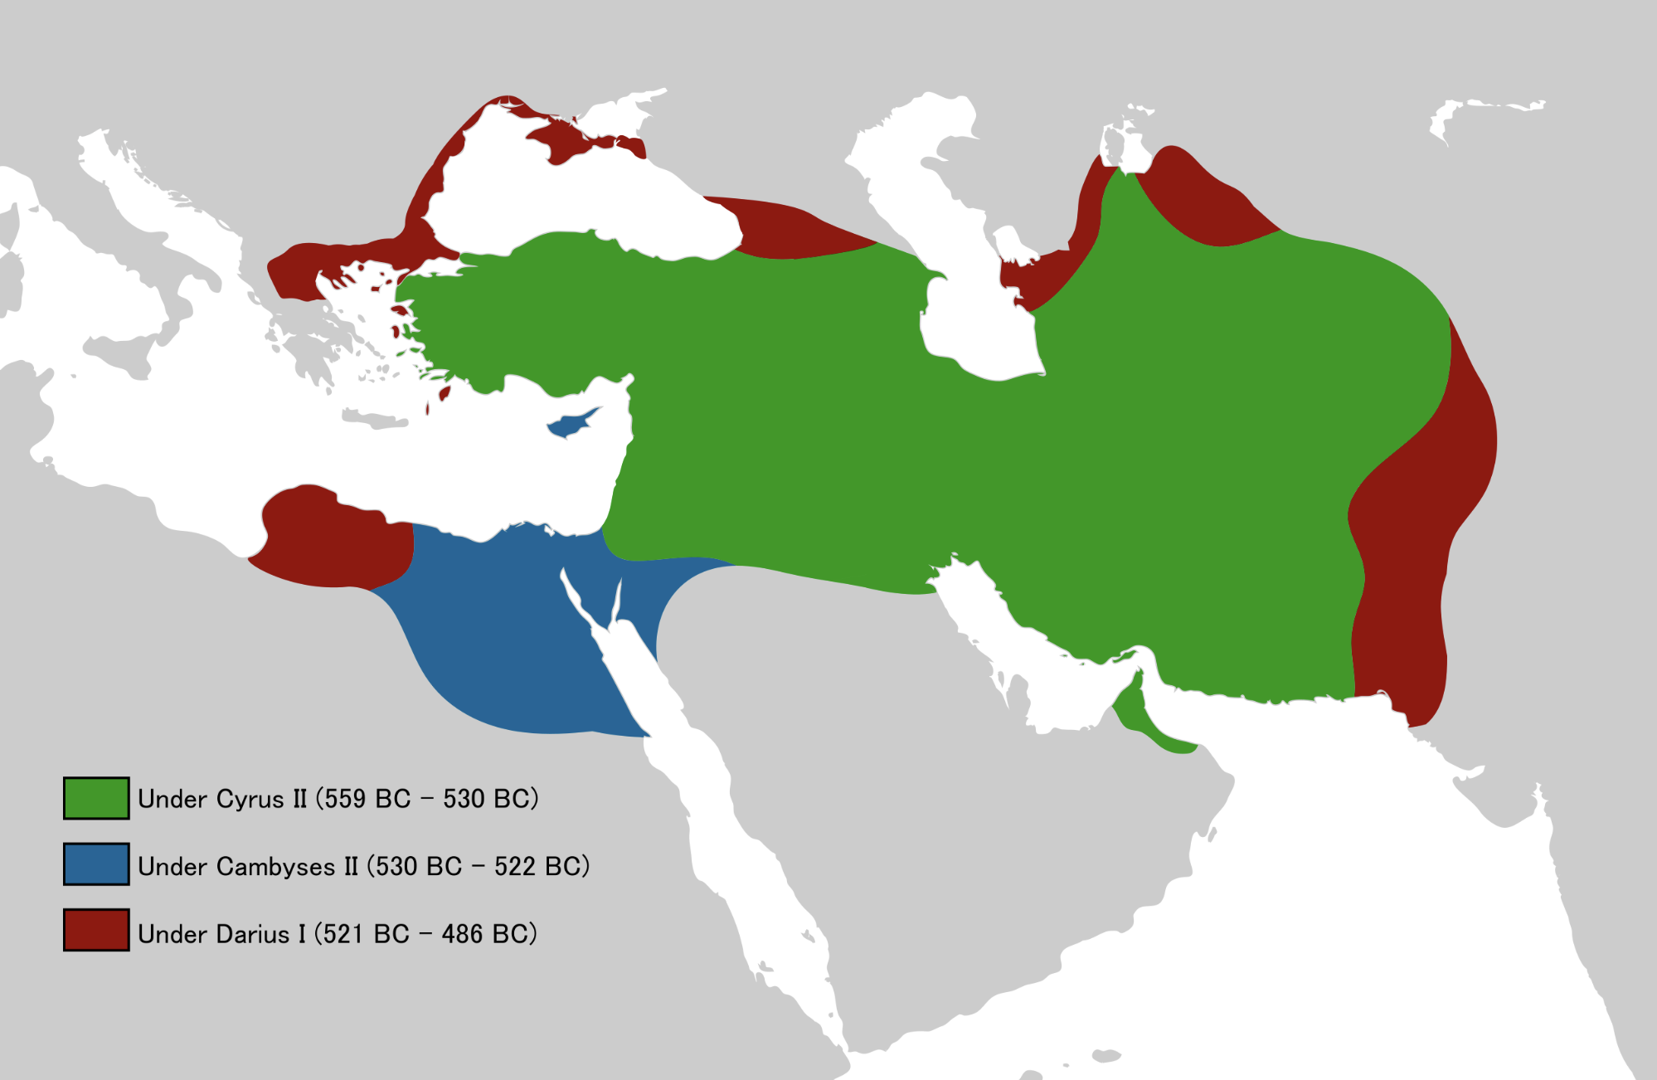
Cyrus’ Empire
Notes:
He was known for how fast he swept in and conquered
Cyrus the Great’s empire extended
As far east as Pakistan, Afghanistan, into India
As far west as all of Turkey
Biblically, Cyrus’ most significant conquest was Babylon – where Judah was captive

Slide 20
God’s Three-Tiered Purpose for Cyrus
YHWH gave Cyrus astonishing success 45.1-3a
- With a purpose in mind:
So that Cyrus would know that YHWH, the God of Israel, did it – 45.3b
So that Cyrus would promote the rebuilding of Jerusalem and the temple - 45.4a
So that all men everywhere might know YHWH is the only God – 45.6a
Notes:
God lists three nested purpose statements for raising up Cyrus in verses 3-6:
purpose for Cyrus – v3
purpose regarding Israel – v4
purpose for the world – v6
Spreading God’s message beyond borders of Israel – if they would accept it

Slide 21
How Did Cyrus Do?
¹ Now in the first year of Cyrus king of Persia, in order to fulfill the word of the Lord by the mouth of Jeremiah, the Lord stirred up the spirit of Cyrus king of Persia, so that he sent a proclamation throughout all his kingdom, and also put it in writing, saying: ² “Thus says Cyrus king of Persia, ‘The Lord, the God of heaven, has given me all the kingdoms of the earth and He has appointed me to build Him a house in Jerusalem, which is in Judah. …
Notes:
Remember God’s assignment for Cyrus beginning in Isaiah 44:28
It is I who says of Cyrus, ‘He is My shepherd! And he will perform all My desire.’
And he declares of Jerusalem, ‘She will be built,’ And of the temple, ‘Your foundation will be laid.’

Slide 22
How Did Cyrus Do? p2
³ ‘Whoever there is among you of all His people, may his God be with him! Let him go up to Jerusalem which is in Judah and rebuild the house of the Lord, the God of Israel; He is the God who is in Jerusalem. Ezra 1:1-3

Slide 23
How Did Cyrus Do? p3
In the first year of King Cyrus, Cyrus the king issued a decree: ‘Concerning the house of God at Jerusalem, let the temple, the place where sacrifices are offered, be rebuilt and let its foundations be retained, its height being 60 cubits and its width 60 cubits; ⁴ with three layers of huge stones and one layer of timbers. And let the cost be paid from the royal treasury. Ezra 5:3-4
Notes:
60 cubits = 90 feet tall

Slide 24
Unlikely Headlines Department
The Babylon Post
Dateline: 700 BC - 586 BC 539 BC
- Jews released from captivity!
- Temple to be rebuilt!
- Gentile king to pay for it!

Slide 25
What Cyrus/Israel Knew About YHWH
YHWH said He would subdue nations before me – 45.1
YHWH told me to rebuild Jerusalem and the temple – 44.28
YHWH said He calls me by name for the sake of Israel – 45.4
YHWH said, “I am the Lord, and there is no other; Besides Me there is no God.” – 45.5
YHWH purposes that all men on earth would know that there is no God besides Him – 45.6
Notes:
God called me His “shepherd” – 44.28 and His “anointed” – 45.1
God said I will perform His desire – 44.28
God told me to rebuild Jerusalem and the temple – 44.28
God said He would take me by the right hand – 45.1
God said He would subdue nations before me – 45.1
God said He will go before me to clear the way – 45.2
God said He will give me hidden treasures – 45.3
God calls me by name – 45.3
God identifies Himself as YHWH, the God of Israel – 45.3
God said He calls me by name for the sake of Israel – 45.4
God gave me a title of honor, though I have not known Him – 45.4
God said, “I am the Lord, and there is no other; Besides Me there is no God.” – 45.5
God said He will gird/equip me, though I have not known Him – 45.5
God purposes that all men on earth would know that there is no God besides Him – 45.6
God said again, “I am the Lord, and there is no other” – 45.6
God said that He forms light, creates darkness, causes well-being, creates calamity – 45.6

Slide 26
A Repeating Theme
I am the Lord, and there is no other (45:5)
I am the Lord, and there is no other (45:6)
I am the Lord, and there is none else (45:18)
Is it not I, the Lord? And there is no other God besides Me (45:21)
For I am God, and there is no other (45:22)
Who is the audience for this message?
Notes:
There is a message here – who is the message for?
Judah in Isaiah’s day – 700s BC
Judah in exile – 500s BC
Cyrus – 500s BC
The world – 500s BC and beyond
Judah after the return
Us today

Slide 27
God Addresses Israel
Don’t argue with Me (can the clay argue with its potter?) (45:9-10)
As creator of heaven and earth, I will use Cyrus for your benefit (45:12-13)
Israel has been saved by the Lord … to all eternity (45:17)
Notes:
There is a message here – who is the message for?
Judah in Isaiah’s day – 700s BC
Judah in exile – 500s BC
Cyrus – 500s BC
The world – 500s BC and beyond
Judah after the return
Us today

Slide 28
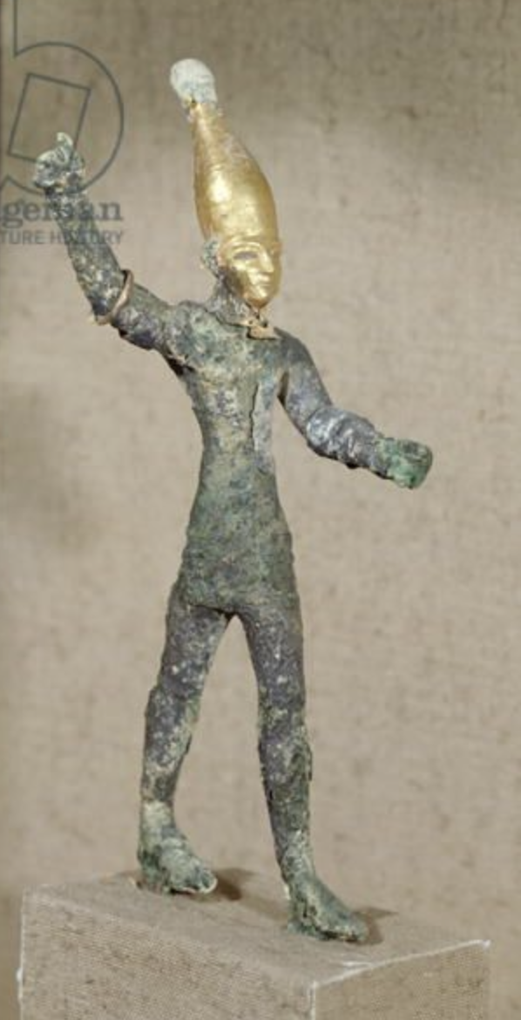
God Addresses the Nations
Regarding Idols (45:20-21)
Bring your idols – come present your case for them
There is no God besides Me
The proper response (45:22-23)
Turn to Me and be saved, all the ends of the earth; For I am God, and there is no other.
to Me every knee will bow, every tongue will swear allegiance
Baal god
Notes:
There is a message here – who is the message for?
Judah in Isaiah’s day – 700s BC
Judah in exile – 500s BC
Cyrus – 500s BC
The world – 500s BC and beyond
Judah after the return
Us today

Slide 29
Discussion Questions
Why would God appoint a Gentile king, Cyrus, who admittedly did not know Him, to be the liberator of the exiles? Why would God announce Cyrus by name 150 years in advance?
After 45:1-7, Cyrus knows a lot about YHWH, directly from YHWH’s mouth. What specifically has Cyrus been told about YHWH? What else do we learn about YHWH in this chapter?
Apparently, many Israelites were quite angry with God for calling a Gentile, Cyrus, His “shepherd” and His “anointed”? Why would they be upset? Considering Israel’s position at the time, did they have any right to be upset?

Slide 30
Discussion Questions p.2
What was the timeframe of this prophecy? Of its fulfillment? How would the Israelites of Isaiah’s day react to this prophecy? How about the Israelites of Cyrus’ time?
Israel had to learn the lesson of not questioning the potter (45:9-10). What lessons does the potter episode have for us today?
In this chapter God repeatedly says, “I am the Lord, and there is no other.” What else did He say in support of that statement? What applies to Christians today from these statements?

Slide 31
Discussion Questions p.3
Since the idol-worshipers in verses 20-21 have no spiritual understanding, what should they do to get spiritual understanding?
“Every knee will bow and every tongue confess.” Where have you heard that before? How does that apply to Christians today?

Slide 32
Our Study of Isaiah
This Meeting:
Isaiah 45, Cyrus God’s Instrument & The Lord, the Only Savior
Memory Verse: Isaiah 45:8
Dr. Constable’s Notes, 2023 Ed., pp. 310-319; Motyer, pp. 356-367
Refreshment Host: Group A
Next Meeting:
Isaiah 46, YHWH, the Only God, Gives Salvation
Memory Verse: Isaiah 46:9-10
Dr. Constable’s Notes, 2023 Ed., pp. 319-322; Motyer, pp. 367-371
Refreshment Host: Group B

