Slide 1
Announcements
Welcome to the MOB!
Next MOB meeting: December 2, 2014
Pastor Tim and Elyssa Pinkard farewell November 23, 5:15 pm Sunday evening
Thanksgiving Holiday Food Box Drive put box in atrium by November 23, 1200 noon
Christmas by Candlelight, December 11-14 Order tickets online; Volunteers needed
Website: www.ibcmob.net

Slide 2
Memory Verse
John 4:14 (ESV)
“but whoever drinks of the water that I will give him will never be thirsty again. The water that I will give him
will become in him a spring of water welling up to eternal life.”

Slide 3
John’s Purpose
John 20:30-31
³⁰ Now Jesus did many other signs in the presence of the disciples, which are not written in this book; ³¹ but these are written so that you may believe that Jesus is the Christ, the Son of God, and that by believing you may have life in his name.

Slide 4
The Gospel
According to John
Outline
Focus | Incarnation of the Son of God | Presentation of the Son of God | Opposition to the Son of God | Preparation of the Disciples | Crucifixion and Resurrection of the Son of God
Reference | 1:1-18 | 1:19-4:54 | 5:1-12:50 | 13:1-17:26 | 18:1-21:25
Division | Introduction to Christ | Revelation of Christ | Rejection of Christ | Revelation of Christ | Rejection of Christ
Topic | Seven Signs |  |  | Upper Room Discourse | Supreme Sign
 | That you might believe |  |  | That you might have life
Time | A Few Years |  |  | A Few Hours | A Few Weeks

Slide 5
Last Week
John 3:1-36
John 3:1-21 Jesus
witnesses to Nicodemus
John 3:22-36 John the Baptist
witnesses about Jesus

Slide 6
This Week
John 4:1-42 Jesus Witnesses…
John 4:1-26 to the Woman at the Well
John 4:27-38 to the Disciples
John 4:39-42 to the Samaritans

Slide 7
John 4:1-42
Jesus Witnesses in Samaria
¹ Now when Jesus learned that the Pharisees had heard that Jesus was making and baptizing more disciples than John ² (although Jesus himself did not baptize, but only his disciples), ³ he left Judea and departed again for Galilee. ⁴ And he had to pass through Samaria. ⁵ So he came to a town of Samaria called Sychar, near the field that Jacob had given to his son Joseph. ⁶ Jacob's well was there; so Jesus, wearied as he was from his journey, was sitting beside the well. It was about the sixth hour.

Slide 8
John 4:1-42
Jesus Witnesses in Samaria
⁷ A woman from Samaria came to draw water. Jesus said to her, “Give me a drink.” ⁸ (For his disciples had gone away into the city to buy food.) ⁹ The Samaritan woman said to him, “How is it that you, a Jew, ask for a drink from me, a woman of Samaria?” (For Jews have no dealings with Samaritans.) ¹⁰ Jesus answered her, “If you knew the gift of God, and who it is that is saying to you, ‘Give me a drink,’ you would have asked him, and he would have given you living water.”

Slide 9
John 4:1-42
Jesus Witnesses in Samaria
¹¹ The woman said to him, “Sir, you have nothing to draw water with, and the well is deep. Where do you get that living water? ¹² Are you greater than our father Jacob? He gave us the well and drank from it himself, as did his sons and his livestock.” ¹³ Jesus said to her, “Everyone who drinks of this water will be thirsty again, ¹⁴ but whoever drinks of the water that I will give him will never be thirsty again. The water that I will give him will become in him a spring of water welling up to eternal life.” ¹⁵ The woman said to him, “Sir, give me this water, so that I will not be thirsty or have to come here to draw water.”

Slide 10
John 4:1-42
Jesus Witnesses in Samaria
¹⁶ Jesus said to her, “Go, call your husband, and come here.” ¹⁷ The woman answered him, “I have no husband.” Jesus said to her, “You are right in saying, ‘I have no husband’; ¹⁸ for you have had five husbands, and the one you now have is not your husband. What you have said is true.” ¹⁹ The woman said to him, “Sir, I perceive that you are a prophet. ²⁰ Our fathers worshiped on this mountain, but you say that in Jerusalem is the place where people ought to worship.” ²¹ Jesus said to her, “Woman, believe me, the hour is coming when neither on this mountain nor in Jerusalem will you worship the Father.

Slide 11
John 4:1-42
Jesus Witnesses in Samaria
²² You worship what you do not know; we worship what we know, for salvation is from the Jews. ²³ But the hour is coming, and is now here, when the true worshipers will worship the Father in spirit and truth, for the Father is seeking such people to worship him. ²⁴ God is spirit, and those who worship him must worship in spirit and truth.” ²⁵ The woman said to him, “I know that Messiah is coming (he who is called Christ). When he comes, he will tell us all things.” ²⁶ Jesus said to her, “I who speak to you am he.”

Slide 12
John 4:1-42
Jesus Witnesses in Samaria
²⁷ Just then his disciples came back. They marveled that he was talking with a woman, but no one said, “What do you seek?” or, “Why are you talking with her?” ²⁸ So the woman left her water jar and went away into town and said to the people, ²⁹ “Come, see a man who told me all that I ever did. Can this be the Christ?” ³⁰ They went out of the town and were coming to him.

Slide 13
John 4:1-42
Jesus Witnesses in Samaria
³¹ Meanwhile the disciples were urging him, saying, “Rabbi, eat.” ³² But he said to them, “I have food to eat that you do not know about.” ³³ So the disciples said to one another, “Has anyone brought him something to eat?” ³⁴ Jesus said to them, “My food is to do the will of him who sent me and to accomplish his work. ³⁵ Do you not say, ‘There are yet four months, then comes the harvest’? Look, I tell you, lift up your eyes, and see that the fields are white for harvest.

Slide 14
John 4:1-42
Jesus Witnesses in Samaria
³⁶ Already the one who reaps is receiving wages and gathering fruit for eternal life, so that sower and reaper may rejoice together. ³⁷ For here the saying holds true, ‘One sows and another reaps.’ ³⁸ I sent you to reap that for which you did not labor. Others have labored, and you have entered into their labor.”

Slide 15
John 4:1-42
Jesus Witnesses in Samaria
³⁹ Many Samaritans from that town believed in him because of the woman's testimony, “He told me all that I ever did.” ⁴⁰ So when the Samaritans came to him, they asked him to stay with them, and he stayed there two days. ⁴¹ And many more believed because of his word. ⁴² They said to the woman, “It is no longer because of what you said that we believe, for we have heard for ourselves, and we know that this is indeed the Savior of the world.”

Slide 16
John 4:1-42
Jesus Witnesses in Samaria
Where was Jesus at the beginning of John Chapter 4?
Where was He going?
What route did He take to get to His destination?

Slide 17
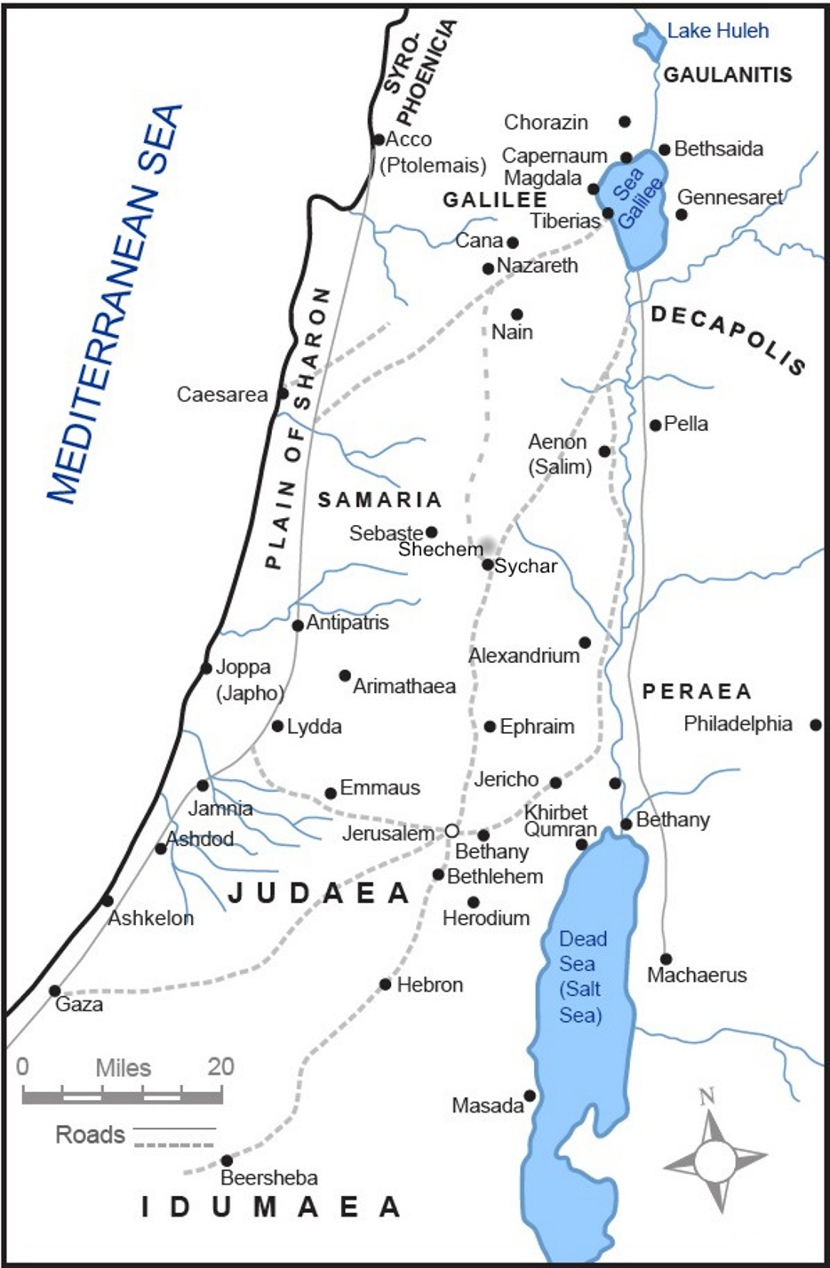
Where is
Judea?

Slide 18
Where is
Galilee?

Slide 19
John 4:1-42
Jesus Witnesses in Samaria
The route through Samaria:
Several roads led from Judea to Galilee. The one through the heart of Samaria was generally the shortest route.
The custom of Jews at the time of great festivals in Jerusalem was to travel through Samaria, even if they did not feel comfortable from a social standpoint about traveling through Samaria.

Slide 20
John 4:1-42
Jesus Witnesses in Samaria
Route through Samaria (continued):
John 4:4, “And he had to pass through Samaria…,” may indicate Jesus traveled this route to save time or was it a providential route?

Slide 21
John 4:1-42
Jesus Witnesses in Samaria
Where is Sychar?
What is the historical background of the territory of Samaria?

Slide 22
Where is
Sychar?
(modern day Nablus)

Slide 23
John 4:1-42
Jesus Witnesses in Samaria
Samaria Historical Summary:
Nation of Israel split after Solomon’s rule
Capital of northern kingdom was Samaria
1 Kings 16:21-24
Assyria conquered Israel circa 722 BC 2 Kings 17
Assyria transported many Israelites away, but left some Israelites and brought other nationalities into Samaria

Slide 24
John 4:1-42
Jesus Witnesses in Samaria
Samaria Historical Summary (Con’t):
Israelites and other groups remaining in Samaria after the invasion by Assyria intermingled forming a mixed race
Samaritans established their own temple for worship at Mount Gerizim in Samaria John 4:21
Jews considered Samaritans to be heretical

Slide 25
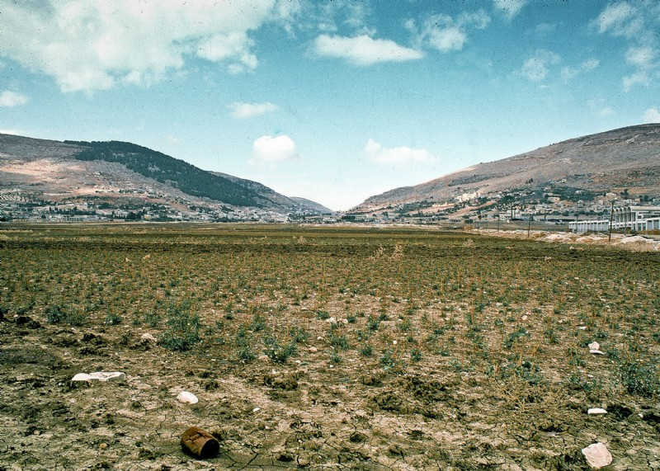

Slide 26
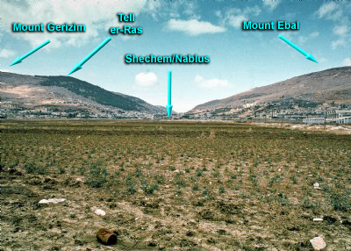

Slide 27
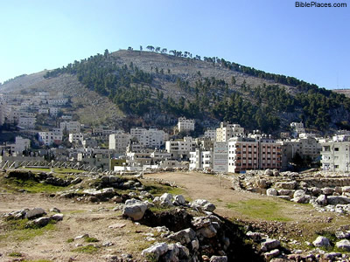

Slide 28
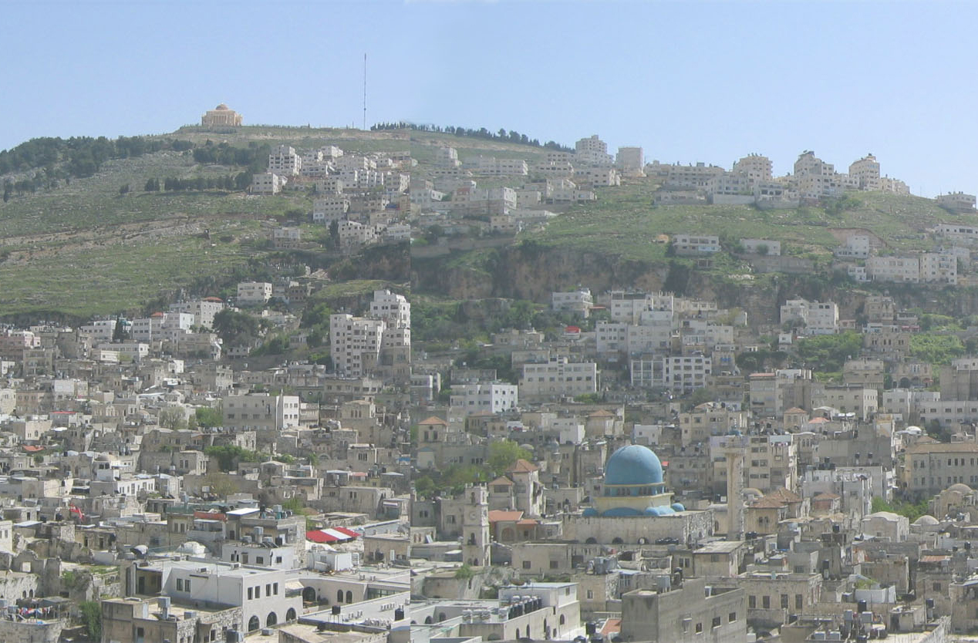

Slide 29
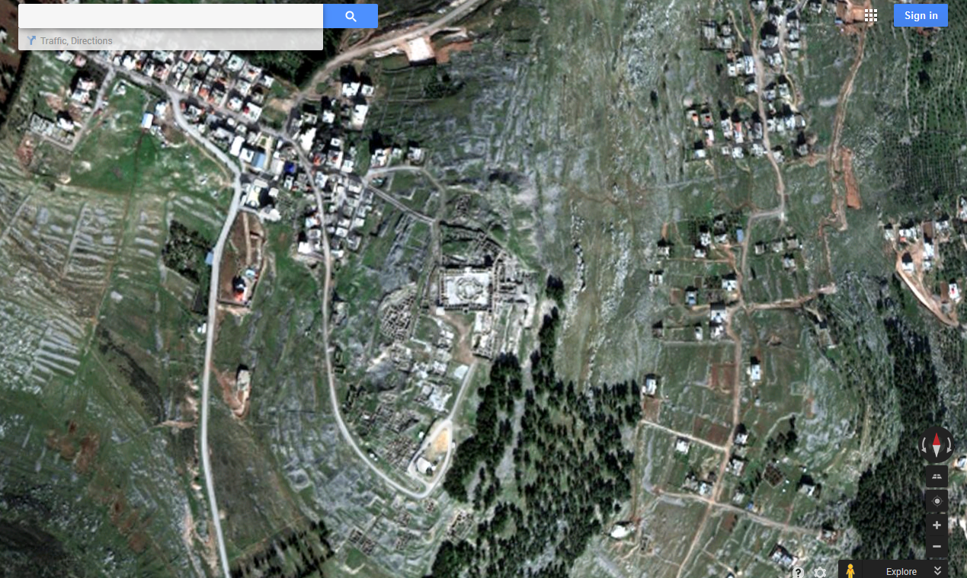

Slide 30
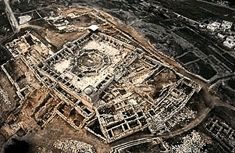

Slide 31
John 4:1-42
Jesus Witnesses in Samaria
In light of the historical background of Samaria, did the woman expect Jesus to speak with her?
What is the possible importance of Jacob’s well?
What is the importance of Jesus’ revealing the woman’s marital history in John 4:17-18?
Could there be some importance in how John orders the timing of Jesus’ witness to the Samaritans in contrast to His testimony to others in the Gospel According to John?

Slide 32
John 4:1-42
Jesus Witnesses in Samaria
What are two issues that that the disciples focus on in John 4?
Are we likely to focus on similar issues today?

Slide 33
John 4:1-42
Jesus Witnesses in Samaria
Application & Discussion
How can you reach out and minister to people outside of your “comfort zone”?
How can you keep your focus on the things Jesus focused on in his discussion with the disciples in John 4?
How can you become sowers and/or reapers as Jesus tells his disciples in John 4:38?

Slide 34
Closing
Questions?
Comments?
Closing Prayer

