Slide 1
WELCOME TO THE MOB!
All Scripture is breathed out by God and profitable for teaching, for reproof, for correction, and for training in righteousness, that the man of God may be complete, equipped for every good work.
2 Timothy 3:16-17 (ESV)

Slide 2
Announcements
MOB Website & Resources: www.ibcmob.net
Welcome to Immanuel Christian School!
Logos Demo and Daily Devotional lesson
Jan 21st (9:00 – 12:00) – Zoom session open (will post on MOB)

Slide 3
Please Rise
Invocation/Prayer.
Song:
“To God Be The Glory”

Slide 4
To God be the Glory
Verse 1 of 3 & Chorus
To God be the glory, great things He hath done;
So loved He the world that He gave us His Son,
Who yielded His life an atonement for sin,
And opened the life gate that all may go in.
Praise the Lord, praise the Lord; let the earth hear His voice!
Praise the Lord, praise the Lord; let the people rejoice!
O come to the Father through Jesus the Son,
And give Him the glory; great things He hath done.

Slide 5
To God be the Glory
Verse 2 of 3 & Chorus
O perfect redemption, the purchase of blood, To every believer the promise of God; The vilest offender who truly believes, That moment from Jesus a pardon receives.
Praise the Lord, praise the Lord; let the earth hear His voice!
Praise the Lord, praise the Lord; let the people rejoice!
O come to the Father through Jesus the Son,
And give Him the glory; great things He hath done.

Slide 6
To God be the Glory
Verse 3 of 3 & Chorus
Great things he hath taught us, great things he hath done, And great our rejoicing through Jesus the Son; But purer and higher and greater will be, Our wonder, our transport, when Jesus we see!
Praise the Lord, praise the Lord; let the earth hear His voice!
Praise the Lord, praise the Lord; let the people rejoice!
O come to the Father through Jesus the Son,
And give Him the glory; great things He hath done.

Slide 7
Our Study of Isaiah
Last Meeting:
Isaiah 14, Jacob Restored, Babylon Taunted, Two Oracles
Memory Verse: Isaiah 14:12
Dr. Constable’s Notes, 2022 Ed., pp.116-123; Motyer, pp.141-149.
Refreshment Host: B
This Meeting:
Isaiah 15, 16, 17, Oracles Concerning Moab and Damascus
Memory Verse: Psalm 121:1-2
Dr. Constable’s Notes, 2022 Ed., pp. 123-128; Motyer, pp. 149-161
Refreshment Host: N/A
Notes:
Welcome to MOB
Rod Turk covered Isaiah 14 last year. Does anyone remember the key word or topic he highlighted as part of his lesson? PRIDE. We’ll expand on that idea—but more from God’s attributes than our own.

Slide 8
Memory Verse
Psalm 121:1-2 (ESV)
“I lift up my eyes to the hills. From where does my help come? My help comes from the Lord, who made heaven and earth”
Psalm 121:1-2 (ESV)
Notes:
It really is a great verse. A lot packed into the application of Isaiah that we’ll touch on.

Slide 9
Isaiah Outline
Focus | Prophecies of Condemnation |  |  |  |  |  |  |  | Historical Parenthesis |  | Prophecies of Comfort
 | 1:1 |  |  |  |  |  |  | 35:10 | 36:1 | 39:8 | 40:1 |  |  |  |  |  | 66:24
Divisions | Prophecies Against Judah |  | Prophecies Against the Nation |  | Prophesies Against the Day of the Lord |  | Prophesies of Judgement and Blessing |  | Sickness and Sin | Hezekiah’s Salvation | Israel’s Deliverance |  |  | Israel’s Deliverer |  | Israel’s Glorious Future
 | 1:1 | 12:6 | 13:1 | 23:18 | 24:1 | 27:13 | 28:1 | 35:10 | 36:1 | 39:8 | 40:1 | 48:22 |  | 49:1 | 57:21 | 58:1 | 66:24
Topics | Prophetic |  |  |  |  |  |  |  | Historic |  | Messianic
 | Judgement |  |  |  |  |  |  |  | Transition |  | Hope
Place | Israel & Judah
Time | 740 - 680 B.C.
We are here!
Bruce Wilkinson and Kenneth Boa, Talk Thru the Bible (Nashville: T. Nelson, 1983), 189.

Slide 10
Scriptural Interpretation at IBC
https://immanuelbible.church/visit/what-we-teach
Notes:
The teaching of Immanuel Bible Church is based on the Scriptures. This
article (Article V) serves as our statement of faith, and it reflects those
doctrines that the elders and congregation consider essential to understanding, teaching, and practicing God’s Word. It is based on an interpretation of the Scripture that is:

Slide 11
NoLiGHtS - acrostic
Normal - understanding the words of Scripture in their common usage unless otherwise indicated by the context.
Literal - understanding the meaning of Scripture in its ordinary sense unless the context requires a figurative interpretation.
Grammatical - using the recognized rules of grammar to interpret the text.
Historical - understanding the words of Scripture in the context of the times in which they were written.
Systematic - categorizing and comparing the teaching of the Scriptures with the whole of Scripture in view.
Scriptural Interpretation (Immanuel Bible Church)
Notes:
This aligns very closely with a dispensational view of scripture—which will reflect these key areas. Part of the challenge we will see is applying this approach to poetic scripture has its own set of challenges, but the bottom line is that you have a structured approach to hermeneutics. The last three play a critical role in the literature of Isaiah.

Slide 12
Oracle Against Moab
The thematic development of the oracles continues.
The Babylon oracle revealed that world history, even in its most threatening and climactic forms, is so organized that the people of God are cared for.
The Philistia oracle confirmed this by insisting that the Davidic promises would be kept,
[Assyria Oracle]
and the Moab oracle corrects any impression that the hope expressed in the Davidic promises is exclusivist.
A lament over the ruin of Moab (15:1–9)
A Moabite request for shelter in Judah (16:1–5)
A lament: pride will cause the devastation of Moab (16:6–12)
An announcement: Moab’s end within three years (16:13-14)
Isaiah 1–39, The New American Commentary, 328.
J. A. Motyer, The Prophecy of Isaiah, 149.
Notes:
The Restoration of Jacob
Israel’s Remnant Taunts Babylon
22 “I will rise up against them,” declares the LORD of hosts, “and will cut off from Babylon name and remnant, descendants and posterity,” declares the LORD. 23 “And I will make it a possession of the hedgehog, and pools of water, and I will sweep it with the broom of destruction,” declares the LORD of hosts.
Is 14:22–23.
Pride is not the preserve of great powers nor reserved for the eschatological day. It brings destruction and sorrow here and now, standing between the needy and the security they can obtain only by submitting to the people and promises of the Lord. Isaiah’s intention is not to mark out a situation but to underline a reaction: pride and the doom it brings.
J. A. Motyer, 150.

Slide 13
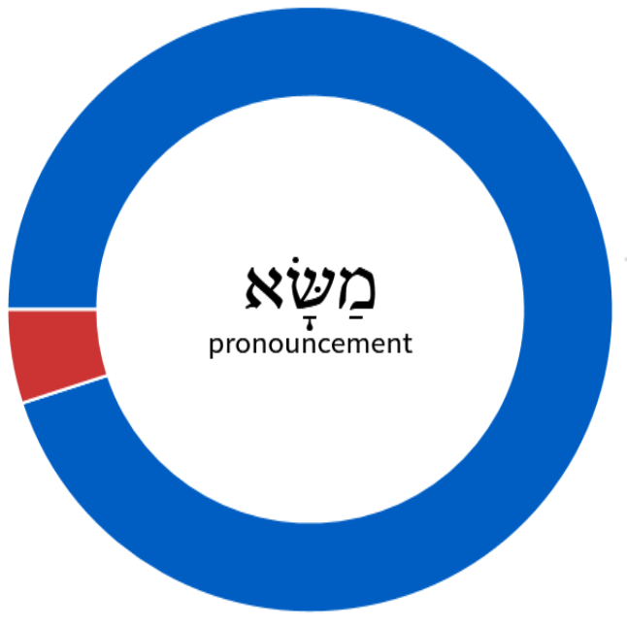
Oracle
Pronouncement
(1 of 20)
Divine revelation communicated through God’s spokesperson (prophet, priest, or king), usually pronouncing blessing, instruction or judgment.
Massa’
“Oracle,” Baker Encyclopedia of the Bible, 1592.
11 out of 19 OT times this term is used in Isaiah
Serve the indirect purpose of comforting Judah
Dutch: God’s menacing words
oracle, oracles
(19 of 20)
Notes:
For the section headings within this major section, translators may begin each one with “Oracle about/against …” Since these oracles are similar in content and literary features, translators are advised to use the same format for the headings they give to each one.
Most of these oracles are presented in poetic form in Hebrew. While actual events may lie behind the descriptions, these chapters are best understood as dramatic and poetic addresses that are intended to bring a message of comfort to Judah, rather than as historical narratives.

Slide 14
Brief Summary
These prophecies about the punishment of various nations are actually oracles about God’s sovereign power over all the nations of the earth.
Isaiah 139, The New American Commentary, 291.
Through: Poetry
Literary compositions characterized by figurative language, wordplay, rhythm, balance, and emotional expression that are crafted in order to produce an emotional response in the reader.
The Lexham Glossary of Literary Types (Bellingham, WA: Lexham Press, 2014).

Slide 15
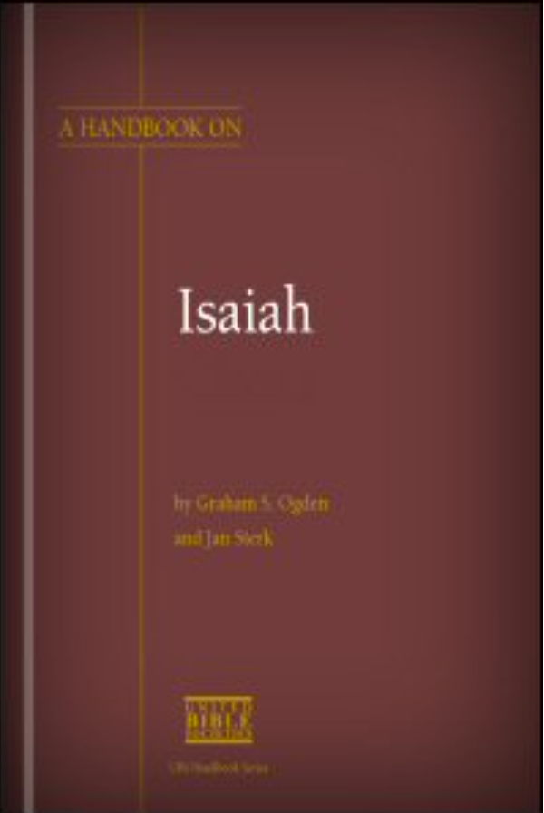
UBS Series – Literary Features/Poetry
Poetry in any language, including Hebrew, is sometimes difficult to define…[often] words are deliberately crafted, usually in a pleasing and concise way, so as to communicate meaning by suggesting it rather than stating it plainly. Because of its very nature, the apparent vagueness of a poem’s wording may have a greater emotional impact than a prose text that would try to give the same content in precise, clear wording.
Therefore poetry is appropriate as a means of conveying the prophets’ message, since the use of poetic language allowed them to paint vivid word pictures rather than describe or analyze situations with more objective, narrative precision.
Parallelism
Assonance or sound rhythm
Other literary features
Wide vocabulary range
Rare words
Repetition and synonymous phrases
Figurative language and idioms
Metaphors and similes
Chiasmus
Rhetorical questions
Plays-on-words
Irony
Ogden, G. S., & Sterk, J. (2011). A Handbook on Isaiah (P. Clarke, S. Brown, L. Dorn, & D. Slager, Eds.). Reading, UK: United Bible Societies.
Notes:
- UBS Series are a set of handbooks that are built for those that are translating scripture into other languages. Isaiah has a nice summary in the front that talks about the element of poetry and when I use this commentary it does a nice job of weaving the element of figurative interpretation where needed.
- Assonance is the repetition of a vowel sound within a single line. ... “Hear the mellow wedding bells” by Edgar Allen Poe. …or my favorite How now, brown cow.
- An example of personification in Macbeth is: "Stones have been known to move, and trees to speak.“
The first time, ever I saw your face I thought the sun rose in your eyes And the moon and the stars Were the gifts you gave To the dark, and the endless sky
Melanie: Well—I’ve got a brand new pair of rollerskates, you’ve got a brand new KEY. (Billboard Top 40 ranked it as #9 for 1972)

Slide 16
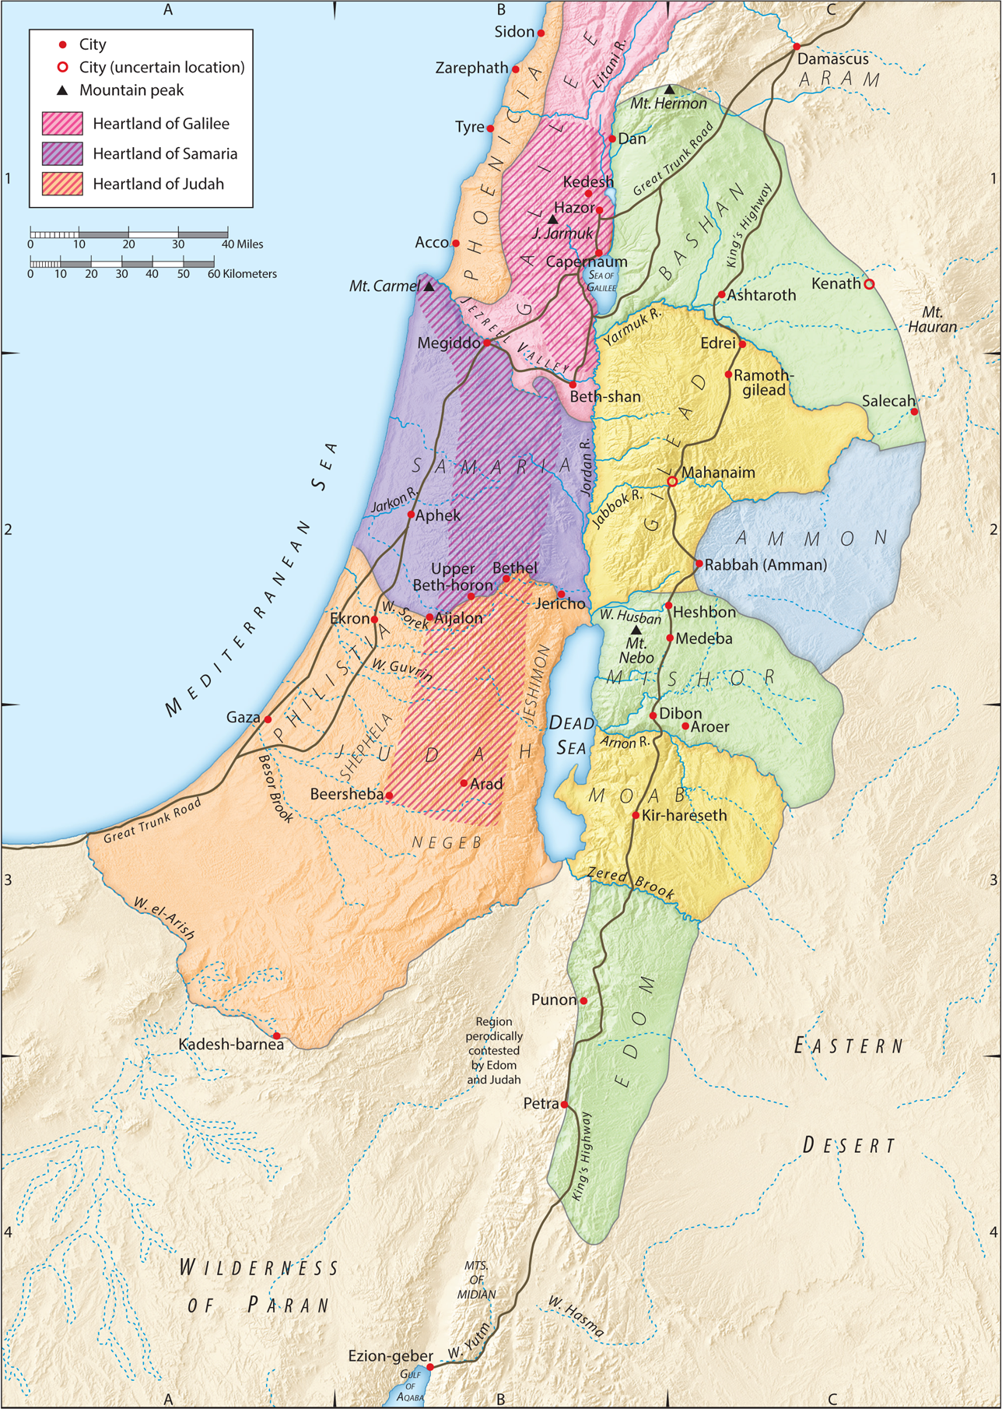
Isaiah 15:1-2a
¹ An oracle concerning Moab.
Because Ar of Moab is laid waste in a night, Moab is undone;
because Kir of Moab is laid waste in a night, Moab is undone.
² He has gone up to the temple, and to Dibon, to the high places to weep;
over Nebo and over Medeba Moab wails.

Slide 17
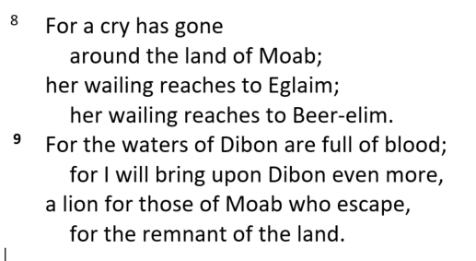
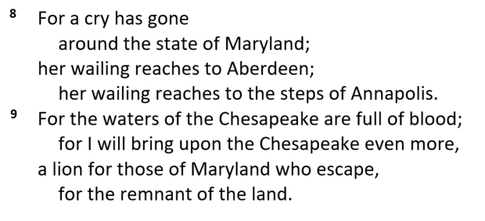
Isaiah 15:8-9
(Slightly Revised)
Notes:
Note the difference…
Does the changing of references to something a little more familiar change the view? Does it paint a visual picture—does it elicit an emotional reponse? I would say—more so…
As you read these verses, don’t just say—hard name, local place, familiar setting—catch the cadence, tone and speed of the events. Catch the underlying message that
But, certainly in these oracle chapters, we can become too date-conscious and not sufficiently theme-conscious. Had Isaiah considered that the oracle needed a clear historical setting, he would have given it. But the wording throughout is non-specific and even the foe is the unnamed ‘rulers of the nations’ (16:8). Attention is focused on content not on occasion.
J. A. Motyer, 149-150.

Slide 18
Prophesy of Moab’s Devastation – Ch 16
Judgement on Moab
Chapter 15
Then…
Imperative Verbs
Imperative Verbs
Imperative Verbs
Notes:
There are differing opinions on the first part of Chapter 16 regarding the outcasts of Moab. Do you agree with Motyer that: Moab oracle corrects any impression that the hope expressed in the Davidic promises is exclusivist.

Slide 19
God is the King…
he is holy, loving, merciful and just
God is the King…
he is holy, loving, kind and fair
God Loves You and Me
God would like us to obey
God’s wants all of us
to be in His family
Notes:
Here is a catechism -- Originally the term was applied to the oral instruction on the principal Christian truths given to children and adults before Baptism.
Your view of God, specifically the holiness of God, will determine how you can address many of the key cultural issues people seem to struggle with today.
“Does it not make a great difference whether I am, so to speak, the landlord of my own mind and body, or only a tenant, responsible to the real landlord? If somebody else made me, for his own purposes, then I shall have a lot of duties which I should not have if I simply belonged to myself.” – C.S. Lewis, 63
Regarding my occasional statements about abortion - I PERSONALLY believe that it is wrong. No question. That being said, there are over 600 Mosaic laws (google tells me 613 to be exact) and there is nothing about abortion, despite the fact that the first recorded abortions pre-date the Mosaic law by 100 years. In Numbers 35 there is quite a list of things that fall under the sin of murder, but abortion is not among them by any interpretation. Again, that doesn't mean I believe it is right - but I also believe that we don't have the right to call murder what God doesn't call murder in His word.

Slide 20
Oracle Against Damascus
The capital of Aram
Allied w/Northern Kingdom of Israel against Assyria
Assyria defeated Aram in 732 and Israel in 722

Slide 21
Oracle Against Damascus (Is 17)
¹² Ah, the thunder of many peoples;
they thunder like the thundering of the sea!
Ah, the roar of nations;
they roar like the roaring of mighty waters!
¹³ The nations roar like the roaring of many waters,
but he will rebuke them, and they will flee far away,
chased like chaff on the mountains before the wind
and whirling dust before the storm.
¹⁴ At evening time, behold, terror!
Before morning, they are no more!
This is the portion of those who loot us,
and the lot of those who plunder us.
Verses 12–13a compare the activities of foreign nations to the noise made by crashing sea waves and roaring floodwaters.
This type of repetition is common in Hebrew poetry as a way to heighten the dramatic effect of the words.
This imagery is often used to picture divine punishment (for example, 29:5; Psa 83:13).
The speed at which Yahweh achieves his purpose is highlighted here by the phrases At evening and Before morning. God blows away the enemy nations overnight.
Notes:
Enemy nations are defeated (17:12–14)
This short section takes up a new theme: the punishment of the nations that oppressed Judah. It uses the imagery of the roaring sea to picture their wild and harsh activities on the world scene. There is also the image of chaff blown by the wind, which depicts the end of those nations. Some scholars believe this section refers to the destruction of Assyria, but it only mentions “peoples” and “nations,” which are plural nouns referring to more than one nation. Verse 13 only uses the pronoun “he” for the person who will destroy them, but it is clear from the context that this is Yahweh.
The words “thunder,” “roar,” “nations” and “waters” are repeated for emphasis in this section. Four similes are used in verses 12–13. There is sound play in Hebrew with the words ‘ammim (“peoples”), yammim (“the sea”), rabbim (“many”), and birim (“mighty”). So this passage has several striking rhetorical features. They lead to the climax at the close of verse 14. Translators should preserve as many of them as possible or at least try to achieve their same function.
Graham S. Ogden and Jan Sterk, A Handbook on Isaiah, ed. Paul Clarke et al., vol. 1 & 2, United Bible Societies Handbooks (Reading, UK: United Bible Societies, 2011), 502503.

Slide 22
Key Things to Consider
The Poetic and rhetorical nature of Isaiah
The woven tapestry of the message of YHWH
Isaiah 17:12-14
The arrogance of man and nations
The desolation that awaits –complete and eternal
The Utter Power and Holiness of God
In the morning—no more…(17:14)
Covenantal Love – Lovingkindness/Steadfast Love (hĕ'·sĕd)
¹ Dr. Constables notes, Page 12
Notes:
At evening time, behold, terror! Before morning, they are no more!: The speed at which Yahweh achieves his purpose is highlighted here by the phrases At evening and Before morning. God blows away the enemy nations overnight. Behold calls for the prophet’s audience to take special note (see the comments on 3:1). Terror may refer to the fear of these nations as Yahweh turns against them, or it may refer to the fear they cause when they attack others. This second view is made explicit in gnb and cev, which renders the first line as “In the evening their attack is fierce.” Like rsv, njb and reb allow for both interpretations by saying “At evening all is terror.” They are no more is literally “it is no more.” This clause could refer to the enemy nations or the terror. reb says “it [the terror] is gone,” and njb has “all [the nations] have disappeared.”
The form of the first two lines in Hebrew helps to convey the meaning. There are no verbs in these lines, only brief noun phrases. This form highlights the speed of God’s action. Translators could try to copy this structure, if the same impact can be achieved (see the first example below).
Graham S. Ogden and Jan Sterk, A Handbook on Isaiah, 506.

Slide 23
Moabites and Ammonites – 2 Ch 20
⁵ And Jehoshaphat stood in the assembly of Judah and Jerusalem, in the house of the Lord, before the new court, ⁶ and said,
“O Lord, God of our fathers, are you not God in heaven? You rule over all the kingdoms of the nations. In your hand are power and might, so that none is able to withstand you.
⁷ Did you not, our God, drive out the inhabitants of this land before your people….
¹² O our God, will you not execute judgment on them? For we are powerless against this great horde that is coming against us. We do not know what to do, but our eyes are on you.”

Slide 24
Discussion and Application
There are differing opinions on the first part of Chapter 16 regarding the outcasts of Moab. Do you agree with Motyer that: Moab oracle corrects any impression that the hope expressed in the Davidic promises is exclusivist?
Does the poetic nature of Isaiah, especially in this section lead you to view the text and your study methods differently?
Review 2 Chron 20 and discuss the application of Jehoshaphat’s Prayer to the events described in Isaiah 15 & 16.
Starting in 2023, discuss any type of commitment you are considering in personal study and devotion. What might be helpful methods, tools and resources that have helped you personally?

Slide 25
Isaiah Outline
Focus | Prophecies of Condemnation |  |  |  |  |  |  |  | Historical Parenthesis |  | Prophecies of Comfort
 | 1:1 |  |  |  |  |  |  | 35:10 | 36:1 | 39:8 | 40:1 |  |  |  |  |  | 66:24
Divisions | Prophecies Against Judah |  | Prophecies Against the Nation |  | Prophesies Against the Day of the Lord |  | Prophesies of Judgement and Blessing |  | Sickness and Sin | Hezekiah’s Salvation | Israel’s Deliverance |  |  | Israel’s Deliverer |  | Israel’s Glorious Future
 | 1:1 | 12:6 | 13:1 | 23:18 | 24:1 | 27:13 | 28:1 | 35:10 | 36:1 | 39:8 | 40:1 | 48:22 |  | 49:1 | 57:21 | 58:1 | 66:24
Topics | Prophetic |  |  |  |  |  |  |  | Historic |  | Messianic
 | Judgement |  |  |  |  |  |  |  | Transition |  | Hope
Place | Israel & Judah
Time | 740 - 680 B.C.
We are here!
Bruce Wilkinson and Kenneth Boa, Talk Thru the Bible (Nashville: T. Nelson, 1983), 189.

Slide 26
A Quick Demo
Logos 10 was released this fall
Immanuel has a group license with access to a basic, but very powerful set of features, tools and videos.
You can chose to subsidize this set with your own investment
PC, tablet, phone and web versions all sync to your account making it very available
It is a free and powerful resource to help your study
It is easy to develop a devotional layout and prayer list

Slide 27
Our Study of Isaiah
This Meeting:
Isaiah 15, 16, 17, Oracles Concerning Moab and Damascus
Memory Verse: Psalm 121:1-2
Dr. Constable’s Notes, 2022 Ed., pp. 123-128; Motyer, pp. 149-161
Next Meeting:
Isaiah 18, 19 – Oracles Concerning Cush and Egypt
Memory Verse: Isaiah 19:22
Dr. Constable’s Notes, 2022 Ed., pp.129-137; Motyer, pp.161-170.
Refreshment Host: Group C

Slide 28
Isaiah Bible Study Schedule for Fall 2022 – Spring 2023 as of December 30, 2022

Slide 29
Backup

Slide 30
Isaiah Bible Study Schedule for Fall 2022 – Spring 2023 as of December 30, 2022

Slide 31
Isaiah Bible Study Schedule for Fall 2022 – Spring 2023 as of December 30, 2022

Slide 32
Description of God
Description of humanity
Description of ourselves
Description of our community

Slide 33
Holiness
Justice
Hesed
Grace
Love
Ps 37:28
Ps 90:11
1 Chron 16:34
Eph 2:8
1 John 4:10
Love your neighbor as yourself
I am a sinner responsible for my actions
Gal 5:14
Rom 6:23
Prov 28:26
I received amazing and underserved grace
“Made in the Image of God”
Eph 1:13-14
Gen 9:6
I am called to be holy
1 Pt 1:16
The Society
The Family
The Church
John 15:18
2 Tim 4:3-4
Gal 4:4-7
Eph 2:19
“Don’t let the world teach you theology”
The image of God in relationship
“Sanctification is a team sport!”

Slide 34
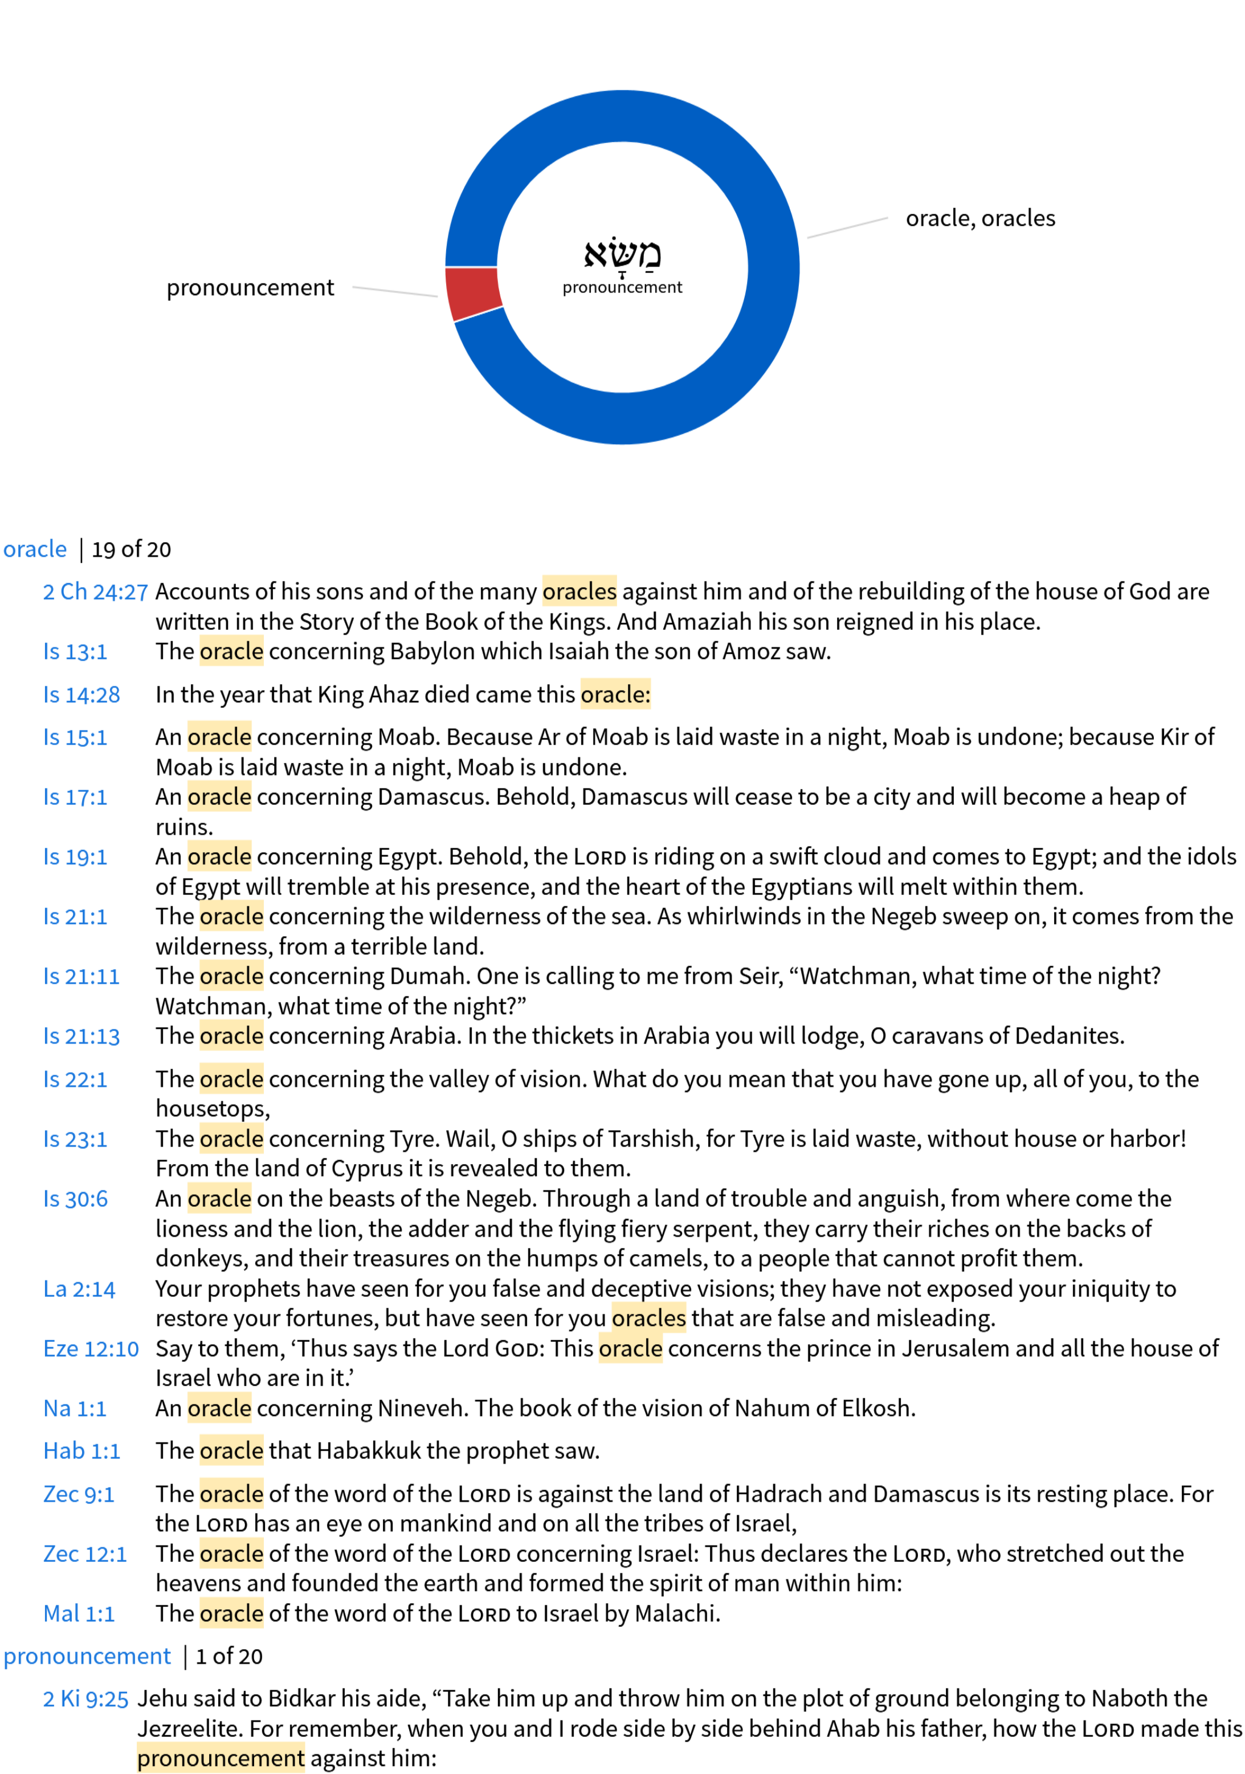

Slide 35
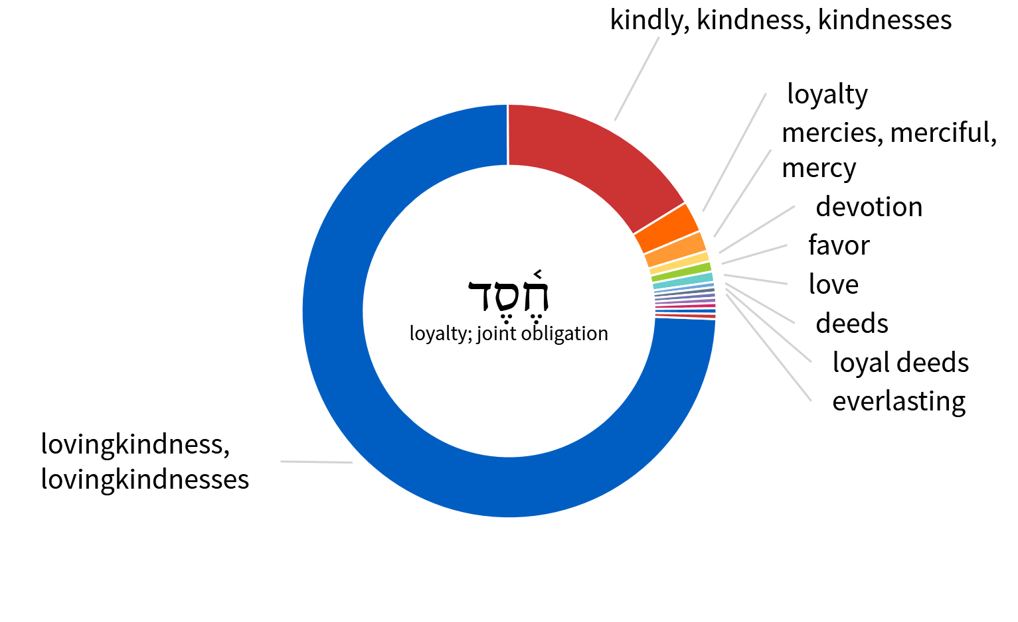
Lovingkindness – hĕ'·sĕd

Slide 36
ISAIAH 15-17
But, as Isaiah understood it, the real issue was not one of military ‘muscle’ nor of political cleverness in creating defensive alliances but whether the Lord could be trusted to do what his word promised
J. A. Motyer, The Prophecy of Isaiah: An Introduction & Commentary, 80.
Notes:
Here is a great summary I previously pulled from one of our sources, Motyer. It applies to our topic today, because of the topic of alliances and not only the pride of people, but the pride of nations. Underscoring the topic of the Lord can be trusted to do what he promised.
To start, I’m going to hit on a couple of key elements of overall bible interpretation.

Slide 37
The Background of Moab
Historical basis with the daughter of Lot (Gen 19)
Ongoing tension with Israel
Traveling from Kadish-Barnea, Balaam prophesies against Balak, King of Moab (Nu 22)
Servants of David (2 Sam 8)
Conflicts along with the Ammonites (Jehoshaphat; 2 Ch 20)
Eventual downfall (Is 15-16)

