Slide 1
WELCOME TO THE MOB!
All Scripture is breathed out by God and profitable for teaching, for reproof, for correction, and for training in righteousness, that the man of God may be complete, equipped for every good work.
2 Timothy 3:16-17 (ESV)

Slide 2
Welcome To The MOB!
MOB Website & Resources: www.ibcmob.net
Logos Zoom Intro + Setting up a Daily Devotional/Prayer List
January 13 at 0900 AM (zoom details via email)
Discover Immanuel, Membership Class, January 14 at 0930 AM.
Parent & Child Dedication Ceremony, January 21 each service.

Slide 3
Please Rise
Invocation/Prayer.
Song:
“Trust And Obey”

Slide 4
Trust And Obey 1 of 4
When we walk with the Lord, In the light of His Word,
What a glory He sheds on our way!
While we do His good will, He abides with us still,
And with all who will trust and obey!
Trust and obey, for there’s no other way
To be happy in Jesus, but to trust and obey!

Slide 5
Trust And Obey 2 of 4
Not a shadow can rise, Not a cloud in the skies,
But His smile quickly drives it away;
Not a doubt nor a fear, Not a sigh nor a tear,
Can abide while we trust and obey.
Trust and obey, for there’s no other way
To be happy in Jesus, but to trust and obey!

Slide 6
Trust And Obey 3 of 4
Not a burden we bear, not a sorrow we share,
But our toil He doth richly repay;
Not a grief nor a loss, not a frown nor a cross,
But is blessed if we trust and obey.
Trust and obey, for there’s no other way
To be happy in Jesus, but to trust and obey!

Slide 7
Trust And Obey 4 of 4
Then in fellowship sweet, we will sit at His feet,
Or we’ll walk by His side in the way;
What He says we will do, where He sends we will go -
Never fear, only trust and obey!
Trust and obey, for there’s no other way
To be happy in Jesus, but to trust and obey!

Slide 8
Memory Verse
Isaiah 50:4 (ESV)
“The Lord GOD has given me the tongue of those who are taught, that I may know how to sustain with a word him who is weary. Morning by morning he awakens; he awakens my ear to hear as those who are taught.”
Isaiah 50:4 (ESV)

Slide 9
Our Study of Isaiah
Last Meeting:
Isaiah 49, The Servant of the Lord & The Restoration of Israel
Memory Verse: Isaiah 49:13
Dr. Constable’s Notes, 2023 Ed., pp. 335-348; Motyer, pp. 383-396.
This Meeting:
Isaiah 50, Israel's Sin and the Servant's Obedience
Memory Verse: Isaiah 50:4
Dr. Constable’s Notes, 2023 Ed., pp. 348-355; Motyer, pp. 396-401.
Refreshment Host: F

Slide 10
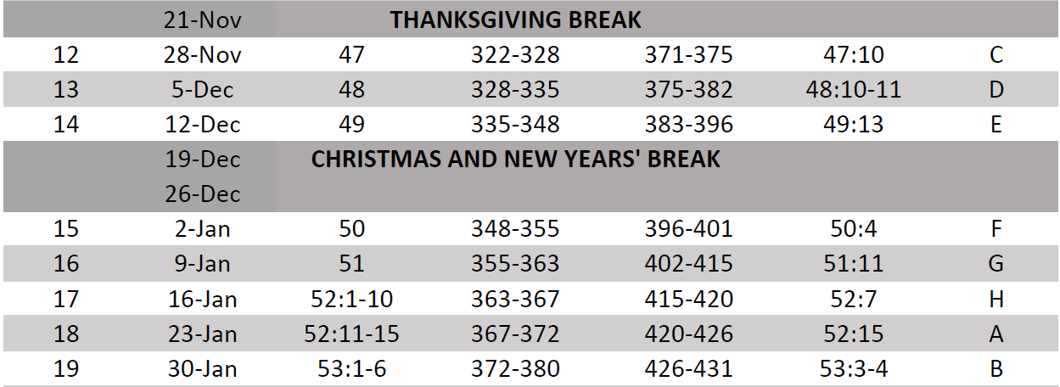
Isaiah Bible Study Schedule for Fall 2023 – Spring 2024 as of September 5, 2023

Slide 11
Isaiah Outline
Focus | Prophecies of Condemnation |  |  |  |  |  |  |  | Historical Parenthesis |  | Prophecies of Comfort
 | 1:1 |  |  |  |  |  |  | 35:10 | 36:1 | 39:8 | 40:1 |  |  |  |  | 66:24
Divisions | Prophecies Against Judah |  | Prophecies Against the Nation |  | Prophesies Against the Day of the Lord |  | Prophesies of Judgement and Blessing |  | Sickness and Sin | Hezekiah’s Salvation | Israel’s Deliverance |  | Israel’s Deliverer |  | Israel’s Glorious Future
 | 1:1 | 12:6 | 13:1 | 23:18 | 24:1 | 27:13 | 28:1 | 35:10 | 36:1 | 39:8 | 40:1 | 48:22 | 49:1 | 57:21 | 58:1 | 66:24
Topics | Prophetic |  |  |  |  |  |  |  | Historic |  | Messianic
 | Judgement |  |  |  |  |  |  |  | Transition |  | Hope
Place | Israel & Judah
Time | 740 - 680 B.C.

Slide 12
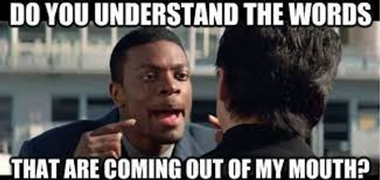

Slide 13
Today’s Lesson
At the end of the Sermon on the Mount, Jesus challenged all those who heard him to respond in obedience (Mt. 7:24-26).
Good listeners always focus on what the speaker says.
Throughout Isaiah, we’ve witnessed Israel’s lack of trust.
In the third Servant Song, Isaiah presents One who heard from God and responded with trust and confidence.
When God is speaking to you, are you a good listener, and how can you tell?

Slide 14
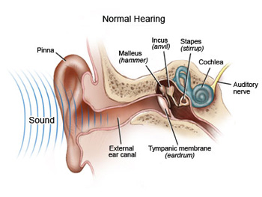
Listening Involves Hearing
1. Sound waves travel through the ear canal to your eardrum.
2. Your eardrum sends the vibrations to three tiny bones in the middle ear.
3. The middle ear amplify and send the sound to your cochlea, activating tiny hair cells in the inner ear that release neurochemical messages.
4. The auditory nerve carries an electrical signal to the brain, which translates it into a detectable sound.
4
2
1
3

Slide 15
Lesson Overview Isaiah Chapters 50
When God Speaks, The Type of Listener
Is Identified By Their:
Rebellion or Obedience (50:1)
Recollection or Amnesia (50:2-3)
Responsiveness or Unwillingness (50:4-6)
Reliance or Independence (50:7-9)
Repentance or Rejection (50:10-11)

Slide 16
Isaiah 50:1 Rebellion or Obedience
¹ Thus says the LORD: "Where is your mother's certificate of divorce, with which I sent her away? Or which of my creditors is it to whom I have sold you? Behold, for your iniquities you were sold, and for your transgressions your mother was sent away.
Deut. 24:1-4

Slide 17
Isaiah 50:1 Rebellion or Obedience
Divorce & debt have legal procedures in Israel.
Israel’s accusation is really against the LORD.
“The thrust … is to ask if something irretrievable has happened, terminating a relationship.” Motyer
The Covenant is with Judah:
Jer. 3:8 vs. 2 Sam. 7:12-16
“… Addressing the assertion that God had forgotten Zion (Is. 49:14), the Lord reminds the nation that He never broke His covenant … or gave Israel away. The Lord declares Israel’s disobedience and unbelief is the cause of the people’s imminent exile to Babylon.” Moody Bible Commentary

Slide 18
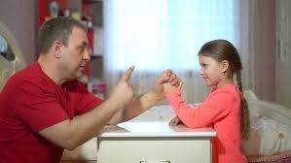
Isaiah 50:2-3 Recollection or Amnesia
² Why, when I came, was there no man; why, when I called, was there no one to answer? Is my hand shortened, that it cannot redeem? Or have I no power to deliver? Behold, by my rebuke I dry up the sea, I make the rivers a desert; their fish stink for lack of water and die of thirst. ³ I clothe the heavens with blackness and make sackcloth their covering."
Psalm 78:42

Slide 19
Isaiah 50:2-3 Recollection or Amnesia
No one responded to God’s prophets.
Some relate ‘came’ and ‘call’ to Jesus’ earthly ministry.
First use of the Lord’s ‘hand’ in Isaiah (51:5, 9; 52:10; 53:1).
God illustrates the authority He possesses with just His voice, giving a ‘rebuke.’
Four examples of his ‘power.’
“YHWH asked four rhetorical questions to disobedient Israel. Each provokes the people to remember Who God is and what He had done in their history. God follows the four questions with a set of declarations that spoke primarily of His great power.” Precept Austin Commentary

Slide 20
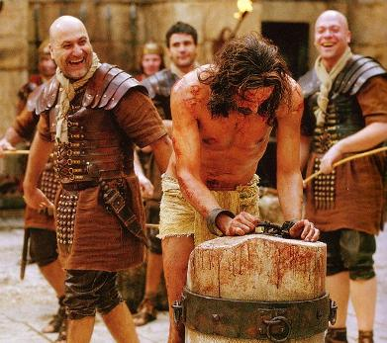
Isaiah 50:4-6 Responsiveness or Unwillingness
⁴ The Lord GOD has given me the tongue of those who are taught, that I may know how to sustain with a word him who is weary. Morning by morning he awakens; he awakens my ear to hear as those who are taught. ⁵ The Lord GOD has opened my ear, and I was not rebellious; I turned not backward. ⁶ I gave my back to those who strike, and my cheeks to those who pull out the beard; I hid not my face from disgrace and spitting.
Luke 22:63

Slide 21
Isaiah 50:4-6 Responsiveness or Unwillingness
When Jesus came, He learned as a disciple (Lk 2:46,47,52).
His gospel message sustained the weary (Matt. 11:28).
Every morning Jesus awoke to hear words from His Father.
He faced suffering head-on (John 8:28-29; Matt. 26:67, 27:26, 27:30).
Warren Wiersbe says, “Everything Jesus said and did was taught to Him by His Father (John 5:19, 30; 6:38; 8:28).” John MacArthur comments that this section “is Messiah's soliloquy about being perfected through obedience and sufferings.”

Slide 22
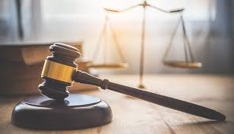
Isaiah 50:7-9 Reliance or Independence
⁷ But the Lord GOD helps me; therefore I have not been disgraced; therefore I have set my face like a flint, and I know that I shall not be put to shame. ⁸ He who vindicates me is near. Who will contend with me? Let us stand up together. Who is my adversary? Let him come near to me. ⁹ Behold, the Lord GOD helps me; who will declare me guilty? Behold, all of them will wear out like a garment; the moth will eat them up.
Isaiah 3:13-14

Slide 23
Isaiah 50:7-9 Reliance or Independence
Even in suffering, the ‘Lord God’ helps (x2) the Servant.
He is headed for Jerusalem to be crucified (Lk 9:51).
Vss. 8-9 contain legal terms.
Vindicate = proven true in everything He said and did.
Jesus’ enemies (John 8:46) were determined to oppose him (Mark 14:55–56).
“Despite the agony and the separation from His Father that being made sin for us would bring about, our Savior maintains a steadfast resolve to obey the Lord God. Just as ‘flint’ is firm, the Messiah's face was firm in accomplishing His work of the Father (cf. John 4:34, 17:4).” Brian Bell

Slide 24
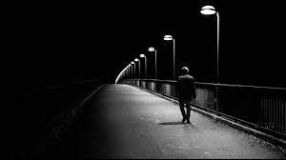
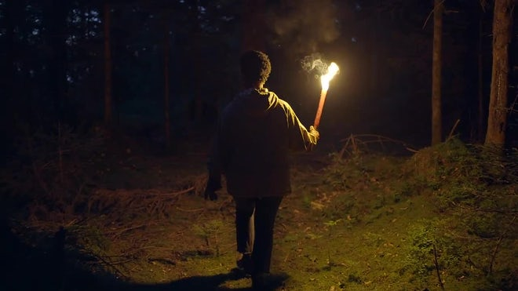
Isaiah 50:10-11 Repentance or Rejection
¹⁰ Who among you fears the LORD and obeys the voice of his servant? Let him who walks in darkness and has no light trust in the name of the LORD and rely on his God. ¹¹ Behold, all you who kindle a fire, who equip yourselves with burning torches! Walk by the light of your fire, and by the torches that you have kindled! This you have from my hand: you shall lie down in torment.
Proverbs 4:19

Slide 25
Isaiah 50:10-11 Repentance or Rejection
Obedience to the Servant is parallel to obedience to God.
Fear the Lord (Prov. 14:2).
Obey the Servant (Jer. 7:23).
Dichotomy (John 9:39):
Believers walk in darkness.
Sinners walk in their light.
“God is the real furnace of judgment.” Cornerstone BC
“How true it is to this life that those who trust walk in darkness and those who are self-sufficient walk in light! … The picture here is of people seeking to equip themselves, … to deal with earth’s dark experiences. They feel the need of nothing they cannot generate for themselves.”
Alex Motyer

Slide 26
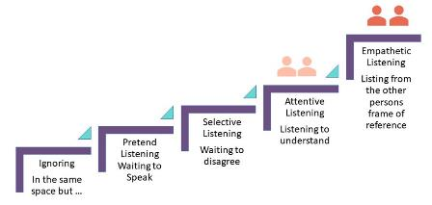
Summary
Strive to be an Active Listener. “The ear that listens to life-giving reproof will dwell among the wise.” Proverbs 15:31
“The Listening Staircase,” is a secular continuum of hearing from a human perspective or a spiritual dimension.
Active Listening
Empathetic Listening from the other persons frame of reference
Attentive Listening
Listening to Understand
Selective Listening
Waiting to Disagree
Pretend Listening Waiting to Speak
Ignoring
In the same space but not engaged

Slide 27
Conclusion
Constable says Isaiah 50 “is a call to listen to the Servant, to follow His example, and so experience God's salvation. Failure to do so would result in sharing the fate of His opponents.”
“Truly, truly, I say to you, whoever hears my word and believes him who sent me has eternal life. He does not come into judgment, but has passed from death to life. Truly, truly, I say to you, an hour is coming, and is now here, when the dead will hear the voice of the Son of God, and those who hear will live.” John 5:24-25

Slide 28
Next Meeting
Review:
Isaiah 50, Israel's Sin and the Servant's Obedience
Memory Verse: Isaiah 50:4
Dr. Constable’s Notes, 2023 Ed., pp. 348-355; Motyer, pp. 396-401.
Study:
Isaiah 51, The LORD’s Comfort for Zion
Memory Verse: Isaiah 51:11
Dr. Constable’s Notes, 2023 Ed., pp.355-363; Motyer, pp.402-415.
Refreshment Host: G

Slide 29
Discussion & Application*
1 of 2
Why does Yahweh ask for a certificate of divorce and proof of creditors (50:1)? What does this reveal about Zion’s fears?
What events does Yahweh recount to remind his people of his power to redeem?
If you’ve ever felt your sin made you unlovable or unredeemable, what did you learn from Chapter 50 to combat these thoughts?
How do the four occurrences of “Lord GOD” in verses 4–9 help you understand its structure?
Who speaks in vs. 4–9, and to whom does he speak?
*Note: These questions are taken from Pastor Rob Davis Isaiah Messages delivered at the Bible Church of Cabot, Arkansas.

Slide 30
Discussion & Application*
2 of 2
How are the truths found in vs. 4–9 fulfilled in the life of Jesus?
“Morning by morning” (v. 4) shows the Servant involved in the regular and early intake of Yahweh’s word. How will you increase the regular intake of the Scriptures (Yahweh’s breathed-out word)?
Is there a difference between the help mentioned in v. 7 and the help mentioned in v. 9?
Who speaks in vs. 10–11, and to whom does he speak?
In what ways does God’s work in Christ on your behalf equip you to “trust in the name of Yahweh and rely on his God”?
*Note: These questions are taken from Pastor Rob Davis Isaiah Messages in June 2023 at the Bible Church of Cabot, Arkansas.

Slide 31
Closing
Benediction
Small Groups

Slide 33
Isaiah 50
1 Thus says the LORD: "Where is your mother's certificate of divorce, with which I sent her away? Or which of my creditors is it to whom I have sold you? Behold, for your iniquities you were sold, and for your transgressions your mother was sent away.
2 Why, when I came, was there no man; why, when I called, was there no one to answer? Is my hand shortened, that it cannot redeem? Or have I no power to deliver? Behold, by my rebuke I dry up the sea, I make the rivers a desert; their fish stink for lack of water and die of thirst.
3 I clothe the heavens with blackness and make sackcloth their covering."
4 The Lord GOD has given me the tongue of those who are taught, that I may know how to sustain with a word him who is weary. Morning by morning he awakens; he awakens my ear to hear as those who are taught.
5 The Lord GOD has opened my ear, and I was not rebellious; I turned not backward.
6 I gave my back to those who strike, and my cheeks to those who pull out the beard; I hid not my face from disgrace and spitting.
7 But the Lord GOD helps me; therefore I have not been disgraced; therefore I have set my face like a flint, and I know that I shall not be put to shame.
8 He who vindicates me is near. Who will contend with me? Let us stand up together. Who is my adversary? Let him come near to me.
9 Behold, the Lord GOD helps me; who will declare me guilty? Behold, all of them will wear out like a garment; the moth will eat them up.
10 Who among you fears the LORD and obeys the voice of his servant? Let him who walks in darkness and has no light trust in the name of the LORD and rely on his God.
11 Behold, all you who kindle a fire, who equip yourselves with burning torches! Walk by the light of your fire, and by the torches that you have kindled! This you have from my hand: you shall lie down in torment.

Slide 34
Book of Isaiah
Title: “The LORD is Salvation”
Author: Isaiah, Son of Amoz
Date: ~740 B.C. to 686 B.C.
Setting:
Prophesied in 4 kings’ reigns
Married, Two Sons
Key Details:
Gospel of the Old Testament
Elevates God, Reveals Messiah
Connections with the New Testament:
Most quoted prophet in NT
63 Citations
Gospels, Acts, 1 & 2 Cor, Romans, Galatians, Hebrews, 1 Peter
22 direct references to Isaiah’s name
47 of 66 Chapters w/472 allusions
In 23 of 27 NT books
Uniqueness with Revelation (70 of 500)
366 lemmas “root words” used only in Isaiah (a very complex writing)

Slide 35
Book of Isaiah
Book of Judgment (Chap. 1-39):
Ch. 1-6: Judah’s Sin, Isaiah’s Call
Ch. 7-12: Sign of Immanuel
Ch. 13-23: Oracles About Nations
Ch. 24-27: World Redemption
Ch. 28-35: Six Woes
Ch. 36-39: Historical Interlude
Book of Salvation (Chap. 40-66):
Ch. 40-48: God’s Grace To Israel
King Cyrus delivers Israel from Babylonian captivity in Babylon.
Ch. 49-55: God’s Atonement
The rejection and restoration of the Suffering Servant, the deliverer.
Ch. 56-66: A Glorious Future
God’s restoration and transformation of Israel and the world.

Slide 36
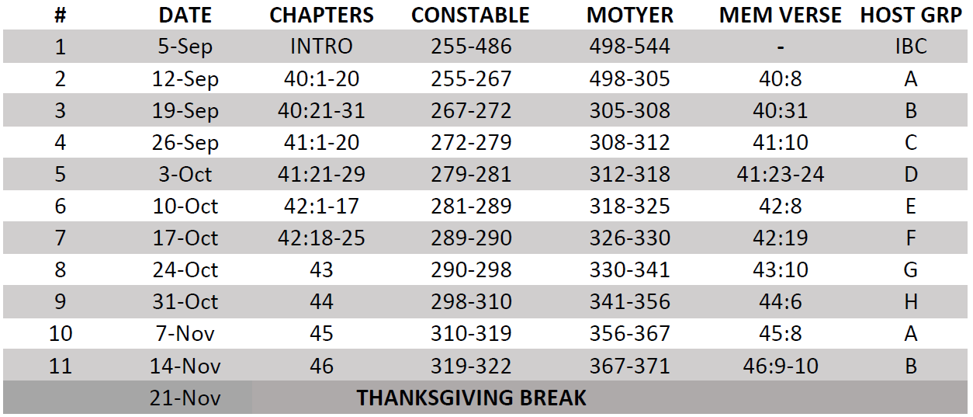
Isaiah Bible Study Schedule for Fall 2023 – Spring 2024 as of September 5, 2023

Slide 37
Isaiah Bible Study Schedule for Fall 2023 – Spring 2024 as of September 5, 2023

Slide 38
Isaiah Bible Study Schedule for Fall 2023 – Spring 2024 as of September 5, 2023

Slide 39
Isaiah Bible Study Schedule for Fall 2023 – Spring 2024 as of September 5, 2023

