Slide 1
Announcements
Welcome to the MOB!
The Gospel of John presented by Marquis Laughlin, March 28, 6 PM
CPREP Couples Commo Workshop begins April 9, 2015, More Info Online
Website: www.ibcmob.net

Slide 2
Memory Verse
John 10:27-28 (ESV)
²⁷ My sheep hear my voice, and
I know them, and they follow me.
²⁸ I give them eternal life, and they will never perish, and no one will snatch them out of my hand.

Slide 3
John’s Purpose
John 20:30-31 (ESV)
³⁰ Now Jesus did many other signs in the presence of the disciples, which are not written in this book; ³¹ but these are written so that you may believe that Jesus is the Christ, the Son of God, and that by believing you may have life in his name.

Slide 4
The Gospel
According to John
Outline
Focus | Incarnation of the Son of God | Presentation of the Son of God | Opposition to the Son of God | Preparation of the Disciples | Crucifixion and Resurrection of the Son of God
Reference | 1:1-18 | 1:19-4:54 | 5:1-12:50 | 13:1-17:26 | 18:1-21:25
Division | Introduction to Christ | Revelation of Christ | Rejection of Christ | Revelation of Christ | Rejection of Christ
Topic | Seven Signs |  |  | Upper Room Discourse | Supreme Sign
 | That you might believe |  |  | That you might have life
Time | A Few Years |  |  | A Few Hours | A Few Weeks

Slide 5
Last Week
John 9:1-41
Jesus heals a man born blind

Slide 6
This Week
John 10:1-42 I AM The Door
I AM The Good Shepherd
I and the Father are One

Slide 7
John 10:1-18 (ESV)
I AM The Door
I AM The Good Shepherd
https://www.youtube.com/watch?v=IMg5OPwAx28
Please follow along in your Bible

Slide 8
John 10:1-42 (ESV)
I AM The Good Shepherd
¹⁹ There was again a division among the Jews because of these words. ²⁰ Many of them said, “He has a demon, and is insane; why listen to him?” ²¹ Others said, “These are not the words of one who is oppressed by a demon. Can a demon open the eyes of the blind?”

Slide 9
John 10:1-42 (ESV)
I and the Father are One
²² At that time the Feast of Dedication took place at Jerusalem. It was winter, ²³ and Jesus was walking in the temple, in the colonnade of Solomon. ²⁴ So the Jews gathered around him and said to him, “How long will you keep us in suspense? If you are the Christ, tell us plainly.” ²⁵ Jesus answered them, “I told you, and you do not believe. The works that I do in my Father's name bear witness about me, ²⁶ but you do not believe because you are not among my sheep. ²⁷ My sheep hear my voice, and I know them, and they follow me. ²⁸ I give them eternal life, and they will never perish, and no one will snatch them out of my hand. ²⁹ My Father, who has given them to me,] is greater than all, and no one is able to snatch them out of the Father's hand. ³⁰ I and the Father are one.”

Slide 10
John 10:1-42 (ESV)
I and the Father are One
³¹ The Jews picked up stones again to stone him. ³² Jesus answered them, “I have shown you many good works from the Father; for which of them are you going to stone me?” ³³ The Jews answered him, “It is not for a good work that we are going to stone you but for blasphemy, because you, being a man, make yourself God.” ³⁴ Jesus answered them, “Is it not written in your Law, ‘I said, you are gods’? ³⁵ If he called them gods to whom the word of God came—and Scripture cannot be broken— ³⁶ do you say of him whom the Father consecrated and sent into the world, ‘You are blaspheming,’ because I said, ‘I am the Son of God’?

Slide 11
John 10:1-42 (ESV)
I and the Father are One
³⁷ If I am not doing the works of my Father, then do not believe me; ³⁸ but if I do them, even though you do not believe me, believe the works, that you may know and understand that the Father is in me and I am in the Father.” ³⁹ Again they sought to arrest him, but he escaped from their hands.
⁴⁰ He went away again across the Jordan to the place where John had been baptizing at first, and there he remained. ⁴¹ And many came to him. And they said, “John did no sign, but everything that John said about this man was true.” ⁴² And many believed in him there.

Slide 12
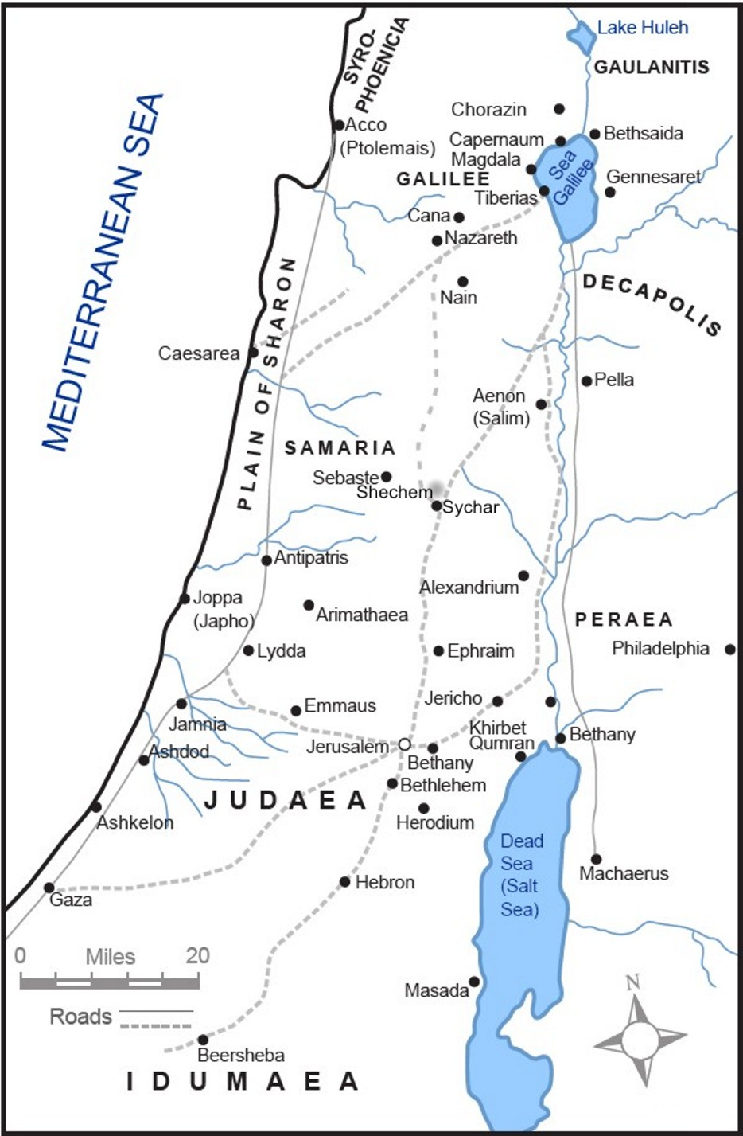
Where are Jesus and His disciples at the start of this Scripture passage?

Slide 13
Jerusalem

Slide 14
Where are Jesus and His disciples at the end of this Scripture passage?

Slide 15
Bethany
across the Jordan

Slide 16
Main Things
I Want to Talk About
The “link” and natural flow from chapter 9 to chapter 10
The contrast between the “Good Shepherd” and the “false shepherds” of Israel, who lead the people astray
A general characterization of “sheep” and their desperate need for a “good shepherd”
The four “I AM” statements of Christ (covered so far) - as claims for His “Deity”
The “exclusivity” of the way of salvation, as indicated by the “Door” reference in John 10:9-10, and related Scripture
“Security of the believer” - as established in John 10:27, and other references

Slide 17
The Excommunication
of the Blind Man from the Synagogue, Kostenberger
“Jesus saw in this provocative act an arrogant assertion of usurped authority that called for further comment. For the Pharisees were not only blind themselves (John 9:40-41); they were “blind guides” (cf. Matthew 23:16,24), leading astray those entrusted to their care. They were the ones who spared no effort to win even a single proselyte, only to make him (in Jesus’ terms) ‘twice as much a child of hell’ as they were.” (Matthew 23:15)

Slide 18
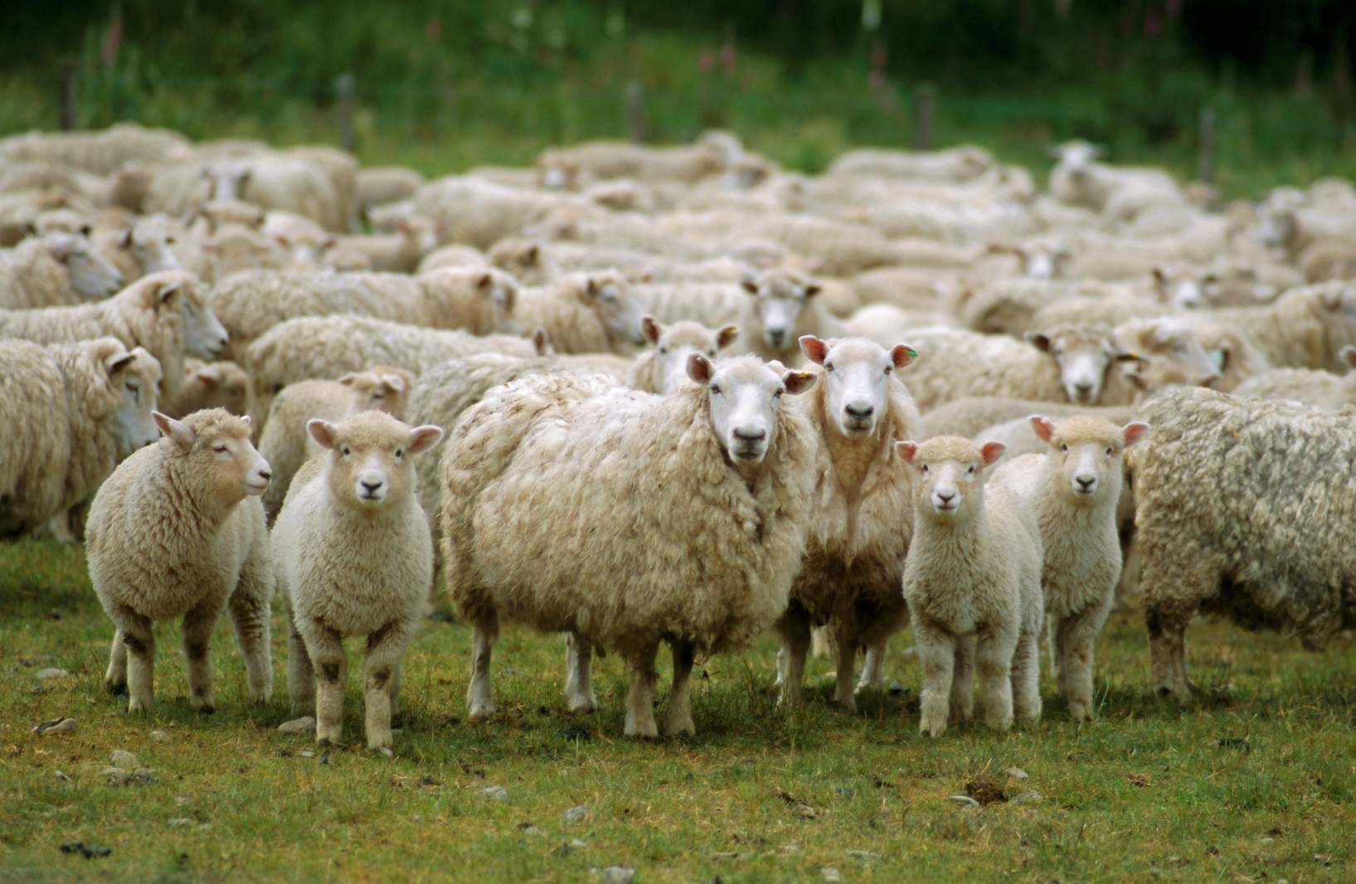
So, What Do You Know About “Sheep”?

Slide 19
About Sheep
Of all domesticated animals, the most helpless!
Spend their entire day grazing, wandering from place to place, never looking up—often getting lost!
Unlike most animals, have no “homing instinct” to find their way back to the sheepfold—even if in plain sight!
By nature, followers! If the “lead sheep” were to step off a cliff, the others would follow!
Easily susceptible to injuries—and easily slaughtered!
Will drown if falling into moving water—and won’t drink from any stream or lake unless water is perfectly calm!
Totally dependent on the shepherd—who is provider, guide, protector, and constant companion.
Middle Eastern shepherds were said to develop such a close bond with their sheep that the sheep would recognize their voices and follow them to pasture—and back to sheepfold at night!

Slide 20
Mark 6:34 (NASB)
When Jesus went ashore, He saw a large crowd, and He felt compassion for them because they were like sheep without a shepherd; and He began to teach them many things.

Slide 21
Psalm 100:3-4a (NASB)
³ Know that the Lord Himself is God; It is He who has made us,
and not we ourselves; We are His people
and the sheep of His pasture.
⁴ Enter His gates with thanksgiving And His courts with praise.

Slide 22
Jeremiah 23:1-4 (NASB)
¹ “Woe to the shepherds who are destroying and scattering the sheep of My pasture!” declares the Lord. ² Therefore thus says the Lord God of Israel concerning the shepherds who are tending My people: “You have scattered My flock and driven them away, and have not attended to them; behold, I am about to attend to you for the evil of your deeds,” declares the Lord. ³ “Then I Myself will gather the remnant of My flock out of all the countries where I have driven them and bring them back to their pasture, and they will be fruitful and multiply. ⁴ I will also raise up shepherds over them and they will tend them; and they will not be afraid any longer, nor be terrified, nor will any be missing,” declares the Lord.

Slide 23
Psalm 23 (KJV)
“The Lord is my shepherd, I shall not want! He makes me to lie down in green pastures; He leadeth me beside the still waters. He restoreth my soul; He leadeth me in the paths of righteousness, for His name’s sake! Yea though I walk through the valley of the shadow of death, I will fear no evil, for Thou art with me; Thy rod and Thy staff they comfort me! Thou prepareth a table before me in the presence of mine enemies; Thou anointeth my head with oil; My cup runneth over! Surely goodness and mercy will follow me all the days of my life, and I will dwell in the house of the Lord forever!”

Slide 24
“I AM” Statements in
John’s Gospel - So Far!
“I AM the Bread of Life” (John 6:35,41,48,51)
“I AM the Light of the World” (John 8:12)
“I AM the Door of the sheep” (John 10:7,9)
“ I AM the Good Shepherd” (John 10:11,14)

Slide 25
John 10:27-28 (NASB)
“My sheep hear My voice, and I know them, and they follow Me; and I give eternal life to them, and they will never perish; and no man will snatch them out of My hand!”

Slide 26
1 John 5:11-13 (NASB)
“And the testimony is this, that God has given us eternal life, and this life is in His Son. He who has the Son has the life; he who does not have the Son of God does not have the life. These things I have written to you who believe in the name of the Son of God, so that you may know that you have eternal life!”

Slide 27
Questions for
Reflection & Application
Have you personally entered through the “Door” and are you in the “fold” of the Good Shepherd?
What verses in the Bible would you turn to or recite if you or another person were seeking “assurance for salvation”?
How do you deal with the “exclusivity factor” associated with Jesus’ message concerning how a person can be saved and have eternal life?
And how does this “exclusivity” affect the way you think about and approach others on the subject of salvation, particularly with others who have doubts or skepticism about the Christian faith or their relationship with God?

Slide 28
Closing
Questions?
Comments?
Closing Prayer

