Slide 1
WELCOME TO THE MOB!
All Scripture is breathed out by God and profitable for teaching, for reproof, for correction, and for training in righteousness, that the man of God may be complete, equipped for every good work.
2 Timothy 3:16-17 (ESV)

Slide 2
Announcements
MOB Website & Resources: www.ibcmob.net
Welcome to Immanuel Christian School!
Substitute Teachers and Teaching Assistants always needed
Easter Pageant Tickets are available
https://immanuelbible.church/easter-pageant

Slide 3
Please Rise
Invocation/Prayer.
Song:
“Blessed Assurance”

Slide 4
Blessed Assurance
Blessed assurance, Jesus is mine! O what a foretaste of glory divine! Heir of salvation, purchase of God, born of his Spirit, washed in his blood. This is my story, this is my song, praising my Savior all the day long; this is my story, this is my song, praising my Savior all the day long.

Slide 5
Blessed Assurance
Perfect submission, perfect delight, visions of rapture now burst on my sight; angels descending, bring from above echoes of mercy, whispers of love.
This is my story, this is my song, praising my Savior all the day long; this is my story, this is my song, praising my Savior all the day long.

Slide 6
Blessed Assurance
Perfect submission, all is at rest, I in my Savior am happy and blest, watching and waiting, looking above, filled with his goodness, lost in his love.
This is my story, this is my song, praising my Savior all the day long; this is my story, this is my song, praising my Savior all the day long.

Slide 7
Our Study of Isaiah
Last Meeting:
Isaiah 29, The Siege of Jerusalem
Memory Verse: Isaiah 29:16
Dr. Constable’s Notes, 2022 Ed., pp. 189-196; Motyer, pp. 236-244
Refreshment Host: Small Group C
This Meeting
Isaiah 30 – Do Not Go to Egypt, Rebellious People, God is Gracious
Memory Verse: Isaiah 30:1
Dr. Constable’s Notes, 2022 Ed., pp.196-204; Motyer, pp. 244-253
Refreshment Host: Group D

Slide 8
Memory Verse
Isaiah 30:1 (ESV)
“Ah, stubborn children, ‘declares the Lord, ‘who carry out a plan, but not mine, and who make an alliance, but not of My Spirit, that they may add sin to sin!”
Isaiah 30:1 (ESV)
Notes:
It really is a great verse. A lot packed into the application of Isaiah that we’ll touch on.

Slide 9
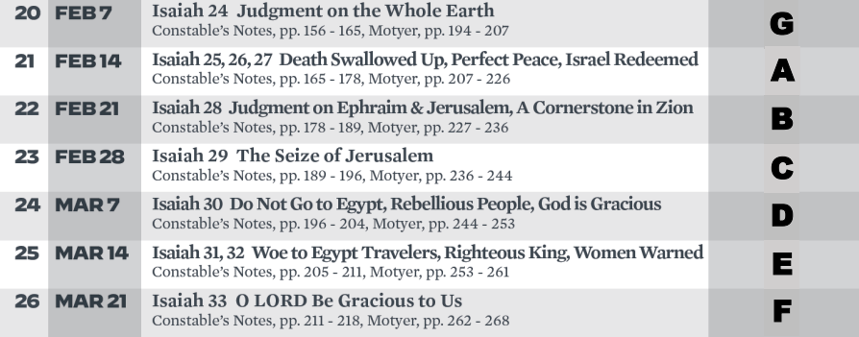
Isaiah Bible Study Schedule for Spring 2023

Slide 10
Isaiah Outline
Focus | Prophecies of Condemnation |  |  |  |  |  |  |  | Historical Parenthesis |  | Prophecies of Comfort
 | 1:1 |  |  |  |  |  |  | 35:10 | 36:1 | 39:8 | 40:1 |  |  |  |  |  | 66:24
Divisions | Prophecies Against Judah |  | Prophecies Against the Nation |  | Prophesies Against the Day of the Lord |  | Prophesies of Judgement and Blessing |  | Sickness and Sin | Hezekiah’s Salvation | Israel’s Deliverance |  |  | Israel’s Deliverer |  | Israel’s Glorious Future
 | 1:1 | 12:6 | 13:1 | 23:18 | 24:1 | 27:13 | 28:1 | 35:10 | 36:1 | 39:8 | 40:1 | 48:22 |  | 49:1 | 57:21 | 58:1 | 66:24
Topics | Prophetic |  |  |  |  |  |  |  | Historic |  | Messianic
 | Judgement |  |  |  |  |  |  |  | Transition |  | Hope
Place | Israel & Judah
Time | 740 - 680 B.C.
We are here!
Bruce Wilkinson and Kenneth Boa, Talk Thru the Bible (Nashville: T. Nelson, 1983), 189.

Slide 11
Isaiah 30
Woe against Trusting Worthless Egypt (30:1–17)
God’s Future Grace Transforming Judah (30:18–26)
God’s Plan to Destroy Assyria (30:27–33)
A brief primer on English Bible Translations

Slide 12
Earlier Themes
The flood as an image of punishment in 30:30 was used earlier in 8:7; 17:12–13; 28:2, 17;
The rejection of the prophet’s words in 30:9–12 is also found in 1:10; 5:24; 28:9–10; and
The need to rest in God in 30:15 is picking up a theme that was important in 11:10; 14:3; 28:12; 32:17.
Gary V. Smith, Isaiah 139, ed. E. Ray Clendenen, The New American Commentary, 508.
Notes:
These messages are very different and their unity is not obvious because some paragraphs lament the nation’s disobedience (30:1–17) and others paradoxically promise hope because of God’s grace (30:18–26). These two rather contradictory themes come together in the historical circumstances of the Assyrian attack on Jerusalem around 701 BC. God condemns the people of Judah for not trusting him and instead leaning on Egypt, but he also promises in his grace to defeat the Assyrians (30:31). Such contradictory acts of God are possible because God is gracious and will lead his people to repent and rest in him for salvation (30:15). Then he will eventually transform their sinful world (30:23–26).
Gary V. Smith, Isaiah 139, ed. E. Ray Clendenen, The New American Commentary (Nashville: B & H Publishing Group, 2007), 508.
Gary V. Smith, Isaiah 1–39, ed. E. Ray Clendenen, The New American Commentary (Nashville: B & H Publishing Group, 2007), 508.

Slide 13
Motyer’s Links to Chapter 28
The ‘inundation’ motif also occurs at 4:6; 25:4; 32:2 but ‘hail’ only in 28:2, 17; 30:30.
Other common themes:
The scornful rejection of the prophetic word (28:9–10; 30:9–12);
Rest (28:12; 30:15);
Seeking false security (28:15; 30:2–3);
The discerning God (28:26, 29; 30:18).
The ‘fringe of hope’ in 28:5–6 offers a pattern for the surprising message of hope in 30:18.
J. A. Motyer, The Prophecy of Isaiah: An Introduction & Commentary (Downers Grove, IL: InterVarsity Press, 1996), 244.

Slide 14
The 4th Woe…
1st: Woe to the proud crown of the drunkards of Ephraim (28:1)
2nd: Woe, O Ariel, Ariel the city where David once camped! Add year to year, observe your feasts on schedule. (29:1)
3rd: Woe to those who deeply hide their plans from the Lord, And whose deeds are done in a dark place, And they say, “Who sees us?” or “Who knows us?” (29:15)
4th: “Woe to the rebellious children,” declares the Lord, “Who execute a plan, but not Mine, And make an alliance, but not of My Spirit, In order to add sin to sin (30:1)

Slide 15
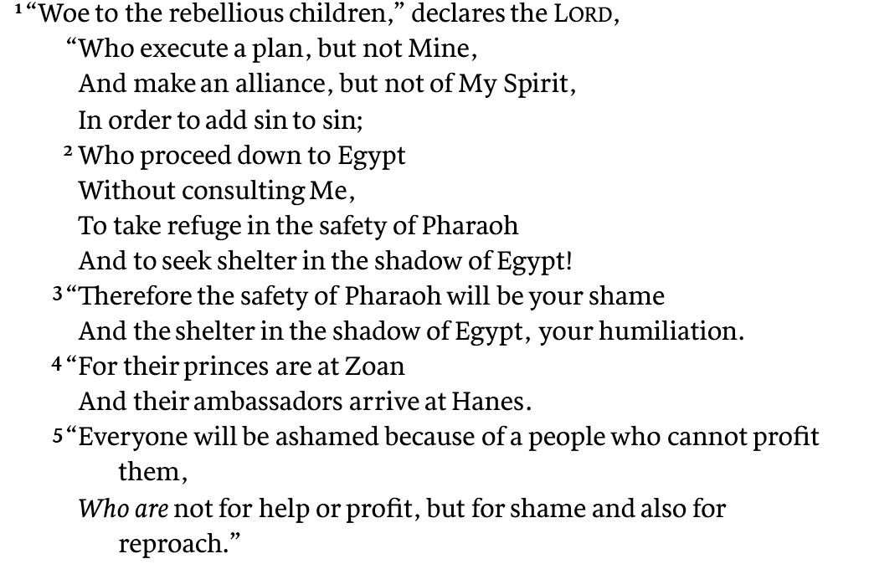
Woe against Trusting Worthless Egypt

Slide 16
O Holy One of Israel (Isa 1:4)
4 Alas, sinful nation,
People weighed down with iniquity,
Offspring of evildoers,
Sons who act corruptly!
They have abandoned the Lord,
They have despised the Holy One of Israel,
They have turned away from Him.

Slide 17
Woe against Trusting Worthless Egypt
Castigate the people for misplaced faith…
The irony and danger of the journey…
This circumstance is forever witnessed (notice the mocking tone and imperative verbs)
Therefore…
Iniquity will be on you like sudden, irreversible events
…it is futile to outrun; but you will flee from a pittance of soldiers
…and yet the Lord longs to be gracious to you

Slide 18
God’s Future Grace Transforming
God will have compassion on helpless Zion (18–19)
God will give understanding of his ways (20-22)
God will give agricultural prosperity and healing (23–26)
Gary V. Smith, Isaiah 139, ed. E. Ray Clendenen, The New American Commentary, 519.
A logic of God is at work. Judge and punish he must, but forsake his purposes he will not! - Motyer
Notes:
This section concludes the major section of verses 1–26. It builds on the theme of verse 18, which offers a message of hope to the people of Judah. It develops the theme of Yahweh’s salvation, using images of a renewed creation. The connection with verse 18 is evident in the repetition of “be gracious” in verse 19.
UBS
The poetic form in verses 1–18 changes to narrative form for this section. Although it is prose, it is highly figurative, especially verses 23–26, which refer to a future time when God will heal his people by providing abundant crops and extraordinary light.

Slide 19
Key Things to Consider
Woe to the rebellious children – e.g. Judah
“Let us hear no more of the Holy one of Israel” (11b)
Therefore, the Lord longs to be gracious to you
“How blessed are all those who long for Him” (v18)
God’s promise to come in His power to destroy Assyria
With fire, his voice, his scepter, his rod (v27, 31, 32)
The poetic and rhetorical nature of Isaiah, again!
Poetry – Prose – Poetry
¹ Dr. Constables notes, Page 12

Slide 20
Discussion and Application
What’s the basis for the fourth “woe” revealed in this lesson?
What’s so repugnant to God, and ironic, about Hezekiah’s advisers journeying to Egypt by way of Zoan and Hanes to arrange an alliance?
Why did the Lord instruct Isaiah to “make a two separate records” of Judah’s effort to make an alliance with Egypt, and how does it compare to instructions in Isaiah 8:1?
What were the consequences for Judah’s rejection of God’s will regarding Egypt—and how was it portrayed and illustrated by Isaiah?
What’s your understanding of the basis for, and timing of God’s ultimate blessing for the people of Zion (beginning in verse 18)?
Why do you think Isaiah would close out this chapter, in verses 27-33 (as Motyer notes), by “turning from eschatology to imminent history”?
What do you know about Topheth (or “the Valley of Hinnom”) and how does it fit in with this closing passage?

Slide 21
Exercise
Review the details of Motyer review of the Assyrian poem three seven line stanzas:
A¹ - Divine action: the shaking of the nations (27–28)
B - The song and the shout: Judah’s festivity and the Lord’s rage (29–30)
A² - Divine action: the overthrow of Asshur and its king (31–33)
J. A. Motyer, The Prophecy of Isaiah: An Introduction & Commentary (Downers Grove, IL: InterVarsity Press, 1996), 251.

Slide 22
Starter question…
The best bible translation for personal growth and ministry is one that you _______.
Notes:
Note that I didn’t say…paraphrase

Slide 23
Plenary Verbal View of Inspiration
The plenary verbal perspective describes Scripture as being the very Word of God.
“Plenary” means that it fully extends to all parts
“Verbal” emphasizes that inspiration extends to the very words themselves
…So that every word of the Bible is inspired.

Slide 24
Dynamic Equivalence
Dynamic equivalence (or functional equivalence) is popularly referred to as “thought for thought” because the approach prioritizes conveying the thoughts or ideas of the source text over reproducing the linguistic form or structure of the source.

Slide 25
Formal Equivalence
Formal equivalence is characterized by an attempt to match the structure and word choice of the translation with the structure and word choice of the source text as much as possible. For this reason, it is often popularly called “word for word” translation.
Is it really possible to have a “word-for-word” translation of the bible?

Slide 26
Translations

Slide 27
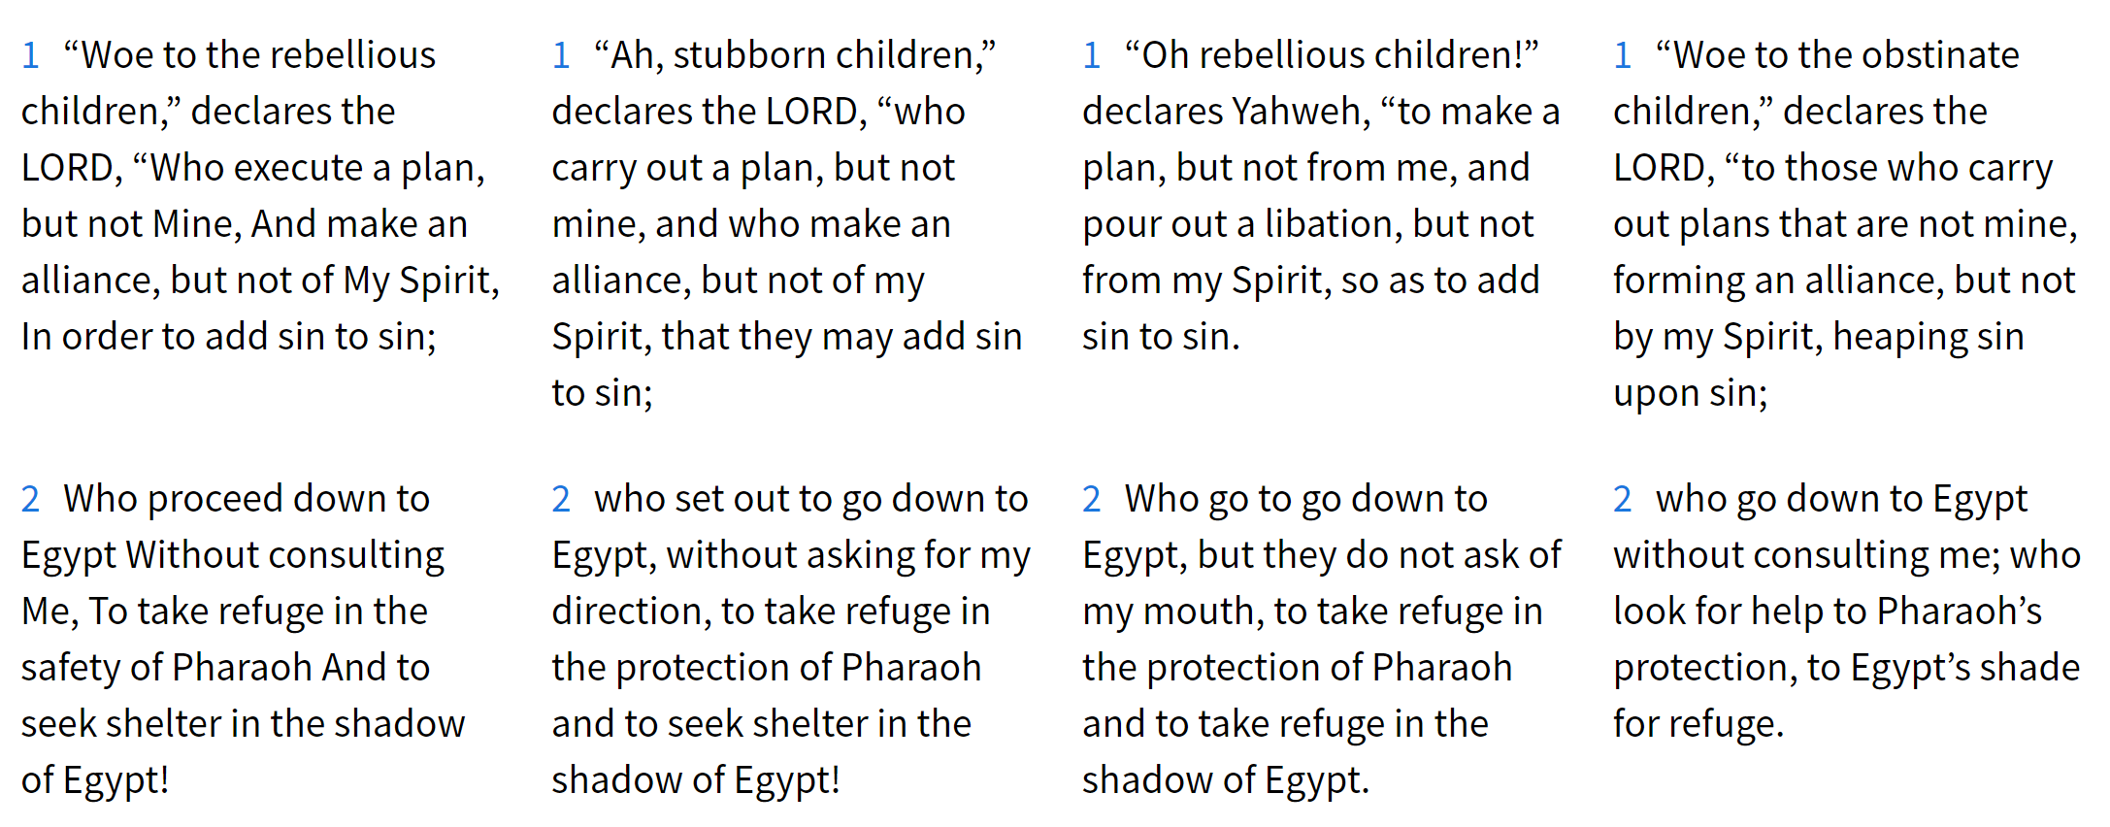
Isaiah 30

Slide 28
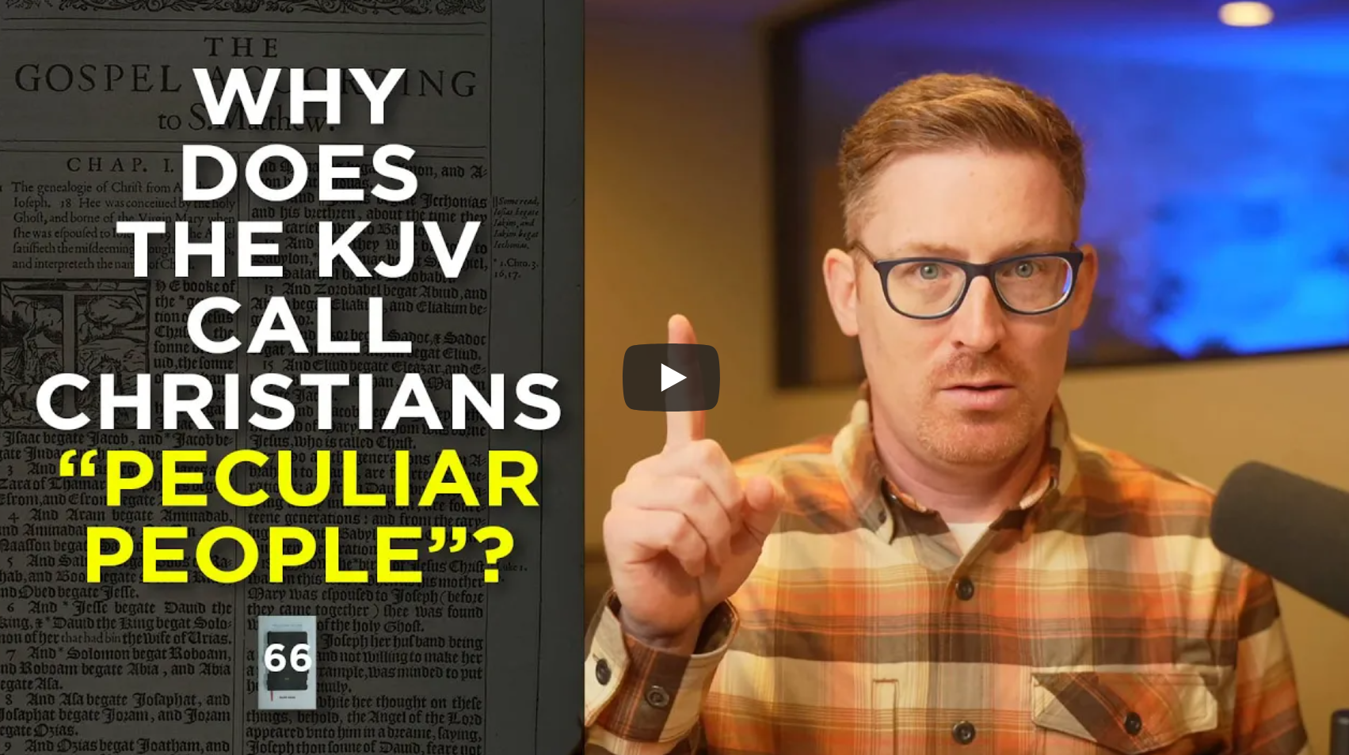
Bible Translation Insights
Dr. Michael Easley
https://michaelincontext.com/
Dr. Mark Ward
https://www.youtube.com/@markwardonwords
The Legacy Standard Bible
What Bible should I buy? - Part 1
What Bible should I buy? - Part 2
Ask Dr E - Bible inerrancy and translations
Fragments of Truth Dr. Evans
Authorized: The Use and Misuse of the King James Bible

Slide 29
Next Meeting – Mar 14
Review:
Isaiah 30 – Do Not Go to Egypt, Rebellious People, God is Gracious
Memory Verse: Isaiah 30:1
Dr. Constable’s Notes, 2022 Ed., pp.196-204; Motyer, pp. 244-253
Study
Isaiah 31, Woe to Egypt Travelers, Righteous Kin, Women Warned
Memory Verse: Isaiah 31:1
Dr. Constable’s Notes, 2022 Ed., pp.205-211; Motyer, pp.253-261

Slide 30
Isaiah Bible Study Schedule for Fall 2022 – Spring 2023 as of December 30, 2022

Slide 31
Backup

Slide 32
Isaiah Bible Study Schedule for Fall 2022 – Spring 2023 as of December 30, 2022

