Slide 1
Announcements
Welcome to the MOB!
CPREP Couples Commo Workshop begins April 9, More Info Online
Spring into Service, April 24-26
WACMM Men’s Conferences, April 27
MOB Website: www.ibcmob.net

Slide 2
Memory Verse
John 12:46 (ESV)
⁴⁶ I have come into the world as light, so that whoever believes in me may not remain in darkness.

Slide 3
John’s Purpose
John 20:30-31 (ESV)
³⁰ Now Jesus did many other signs in the presence of the disciples, which are not written in this book; ³¹ but these are written so that you may believe that Jesus is the Christ, the Son of God, and that by believing you may have life in his name.

Slide 4
The Gospel
According to John
Outline
Focus | Incarnation of the Son of God | Presentation of the Son of God | Opposition to the Son of God | Preparation of the Disciples | Crucifixion and Resurrection of the Son of God
Reference | 1:1-18 | 1:19-4:54 | 5:1-12:50 | 13:1-17:26 | 18:1-21:25
Division | Introduction to Christ | Revelation of Christ | Rejection of Christ | Revelation of Christ | Rejection of Christ
Topic | Seven Signs |  |  | Upper Room Discourse | Supreme Sign
 | That you might believe |  |  | That you might have life
Time | A Few Years |  |  | A Few Hours | A Few Weeks

Slide 5
Last Week
John 12:1-8 Mary Anoints Jesus
John 12:9-11 The Plot
to Kill Lazarus

Slide 6
This Week
John 12:12-19 The Triumphal Entry
John 12:20-26 Some Greeks Seek Jesus
John 12:27-36 The Son of Man Must Be Lifted Up
John 12:37-43 The Unbelief of the People
John 12:44-50 Jesus Came to Save the World

Slide 7
John 12:12-19 (ESV)
The Triumphal Entry
¹² The next day the large crowd that had come to the feast heard that Jesus was coming to Jerusalem. ¹³ So they took branches of palm trees and went out to meet him, crying out, “Hosanna! Blessed is he who comes in the name of the Lord, even the King of Israel!” ¹⁴ And Jesus found a young donkey and sat on it, just as it is written,
¹⁵ “Fear not, daughter of Zion; behold, your king is coming, sitting on a donkey's colt!”

Slide 8
John 12:12-19 (ESV)
The Triumphal Entry
¹⁶ His disciples did not understand these things at first, but when Jesus was glorified, then they remembered that these things had been written about him and had been done to him. ¹⁷ The crowd that had been with him when he called Lazarus out of the tomb and raised him from the dead continued to bear witness. ¹⁸ The reason why the crowd went to meet him was that they heard he had done this sign. ¹⁹ So the Pharisees said to one another, “You see that you are gaining nothing. Look, the world has gone after him.”

Slide 9
John 12:20-26 (ESV)
Some Greeks Seek Jesus
²⁰ Now among those who went up to worship at the feast were some Greeks. ²¹ So these came to Philip, who was from Bethsaida in Galilee, and asked him, “Sir, we wish to see Jesus.” ²² Philip went and told Andrew; Andrew and Philip went and told Jesus. ²³ And Jesus answered them, “The hour has come for the Son of Man to be glorified. ²⁴ Truly, truly, I say to you, unless a grain of wheat falls into the earth and dies, it remains alone; but if it dies, it bears much fruit. ²⁵ Whoever loves his life loses it, and whoever hates his life in this world will keep it for eternal life. ²⁶ If anyone serves me, he must follow me; and where I am, there will my servant be also. If anyone serves me, the Father will honor him.

Slide 10
John 12:27-36 (ESV)
The Son of Man Must Be Lifted Up
²⁷ “Now is my soul troubled. And what shall I say? ‘Father, save me from this hour’? But for this purpose I have come to this hour. ²⁸ Father, glorify your name.” Then a voice came from heaven: “I have glorified it, and I will glorify it again.” ²⁹ The crowd that stood there and heard it said that it had thundered. Others said, “An angel has spoken to him.” ³⁰ Jesus answered, “This voice has come for your sake, not mine. ³¹ Now is the judgment of this world; now will the ruler of this world be cast out. ³² And I, when I am lifted up from the earth, will draw all people to myself.” ³³ He said this to show by what kind of death he was going to die.

Slide 11
John 12:27-36 (ESV)
The Son of Man Must Be Lifted Up
³⁴ So the crowd answered him, “We have heard from the Law that the Christ remains forever. How can you say that the Son of Man must be lifted up? Who is this Son of Man?” ³⁵ So Jesus said to them, “The light is among you for a little while longer. Walk while you have the light, lest darkness overtake you. The one who walks in the darkness does not know where he is going. ³⁶ While you have the light, believe in the light, that you may become sons of light.”

Slide 12
John 12:12-50 (ESV)
The Unbelief of the People
³⁶ When Jesus had said these things, he departed and hid himself from them. ³⁷ Though he had done so many signs before them, they still did not believe in him, ³⁸ so that the word spoken by the prophet Isaiah might be fulfilled:
“Lord, who has believed what he heard from us, and to whom has the arm of the Lord been revealed?”
³⁹ Therefore they could not believe. For again Isaiah said,
⁴⁰ “He has blinded their eyes and hardened their heart, lest they see with their eyes, and understand with their heart, and turn, and I would heal them.”

Slide 13
John 12:12-50 (ESV)
The Unbelief of the People
⁴¹ Isaiah said these things because he saw his glory and spoke of him. ⁴² Nevertheless, many even of the authorities believed in him, but for fear of the Pharisees they did not confess it, so that they would not be put out of the synagogue; ⁴³ for they loved the glory that comes from man more than the glory that comes from God.

Slide 14
John 12:12-50 (ESV)
Jesus Came to Save the World
⁴⁴ And Jesus cried out and said, “Whoever believes in me, believes not in me but in him who sent me. ⁴⁵ And whoever sees me sees him who sent me. ⁴⁶ I have come into the world as light, so that whoever believes in me may not remain in darkness. ⁴⁷ If anyone hears my words and does not keep them, I do not judge him; for I did not come to judge the world but to save the world. ⁴⁸ The one who rejects me and does not receive my words has a judge; the word that I have spoken will judge him on the last day. ⁴⁹ For I have not spoken on my own authority, but the Father who sent me has himself given me a commandment—what to say and what to speak. ⁵⁰ And I know that his commandment is eternal life. What I say, therefore, I say as the Father has told me.”

Slide 15
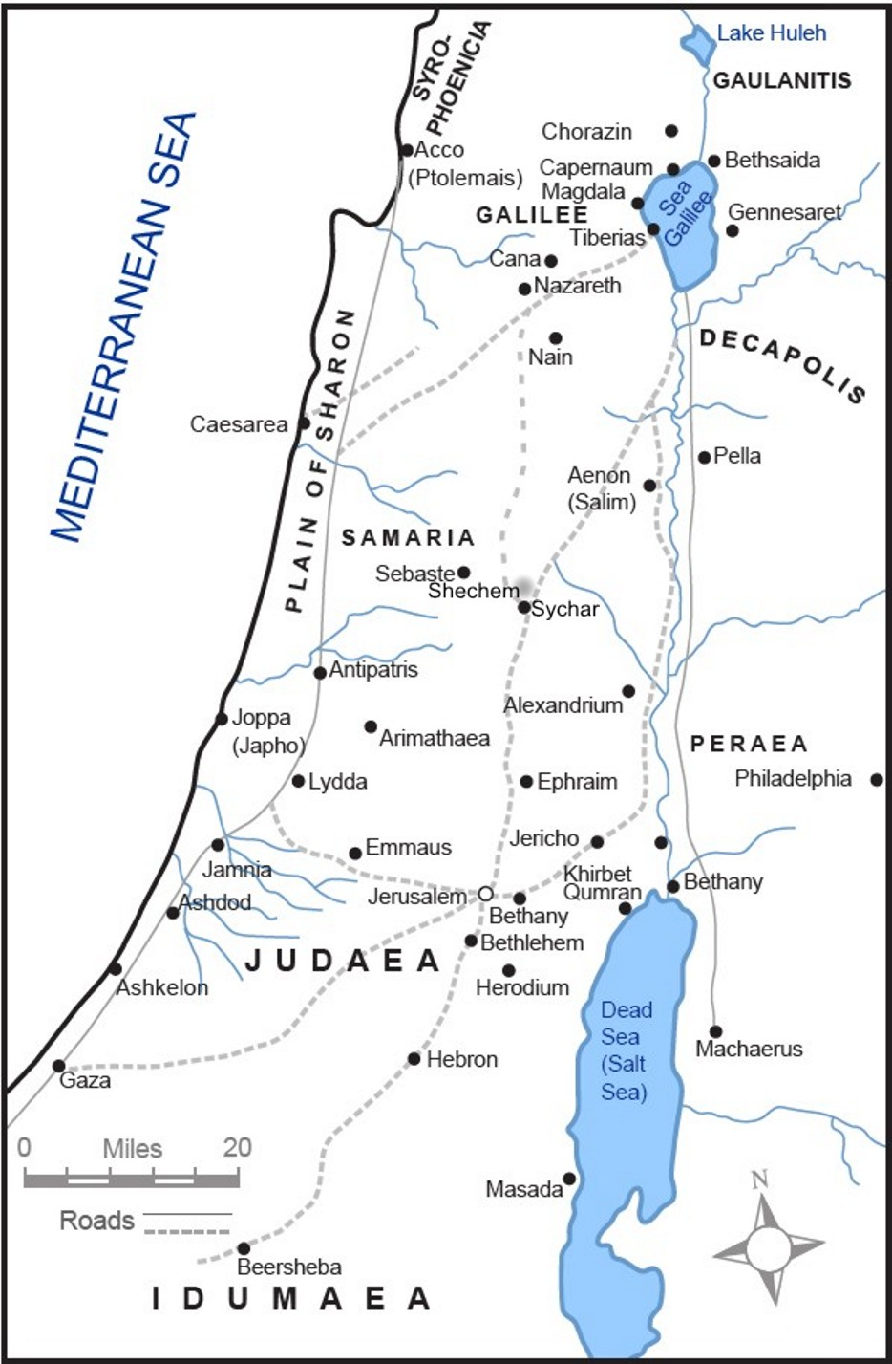
Where are Jesus and His Disciples and why?

Slide 16
Bethany &
Jerusalem
before
Passover

Slide 17
John 12:12-19 (ESV)
The Triumphal Entry
Observation
Riding vs. walking / “Hosanna”
Pharisees “smear campaign”
Greeks in Jerusalem / Seeking Jesus
Jesus’ “Hour”
God’s voice vs. “thunder”
Requirements for serving Jesus
Jesus’ soul troubled

Slide 18
John 12:12-19 (ESV)
The Triumphal Entry
Interpretation
What did Jesus mean by John 12:25?
Who “follows and supports” who?
What did Jesus mean by John 12:32?
What are the implications of Jesus’ statements in John 12:35-36?
What are the implications of Jesus’ statements in John 12:44-46, 49-50?
What are the implications of Jesus’ statements in John 12:47-48?

Slide 19
John 12:12-19 (ESV)
The Triumphal Entry
Application & Discussion
How have you tried to apply John 12:25 in your life in the past?
How will you apply John 12:25 in your life in the future?
How will you apply John 12:26 in your life in the future?
Will John 12:39-40 change your approach to sharing the Gospel with others? If so, how?

Slide 20
Closing
Questions?
Comments?
Closing Prayer

