Slide 1
Announcements
Welcome to the MOB!
Living Victoriously in Difficult Times, April 18, 9:00 AM – 2:00 PM, Rm A207
Spring into Service, April 24-26
WACMM Men’s Conferences, April 27
MOB Website: www.ibcmob.net

Slide 2
Memory Verse
John 13:15 (ESV)
“For I have given you an example, that you also should do just as I have done to you.“

Slide 3
John’s Purpose
John 20:30-31 (ESV)
³⁰ Now Jesus did many other signs in the presence of the disciples, which are not written in this book; ³¹ but these are written so that you may believe that Jesus is the Christ, the Son of God, and that by believing you may have life in his name.

Slide 4
The Gospel
According to John
Outline
Focus | Incarnation of the Son of God | Presentation of the Son of God | Opposition to the Son of God | Preparation of the Disciples | Crucifixion and Resurrection of the Son of God
Reference | 1:1-18 | 1:19-4:54 | 5:1-12:50 | 13:1-17:26 | 18:1-21:25
Division | Introduction to Christ | Revelation of Christ | Rejection of Christ | Revelation of Christ | Rejection of Christ
Topic | Seven Signs |  |  | Upper Room Discourse | Supreme Sign
 | That you might believe |  |  | That you might have life
Time | A Few Years |  |  | A Few Hours | A Few Weeks

Slide 5
Last Week
John 12:12-19 The Triumphal Entry
John 12:20-26 Some Greeks Seek Jesus
John 12:27-36 The Son of Man Must Be Lifted Up
John 12:37-43 The Unbelief of the People
John 12:44-50 Jesus Came to Save the World

Slide 6
This Week
John 13:1-20 Jesus Washes the Disciples' Feet

Slide 7
John 13:1-20 (ESV)
Jesus Washes the Disciples' Feet
¹ Now before the Feast of the Passover, when Jesus knew that his hour had come to depart out of this world to the Father, having loved his own who were in the world, he loved them to the end. ² During supper, when the devil had already put it into the heart of Judas Iscariot, Simon's son, to betray him, ³Jesus, knowing that the Father had given all things into his hands, and that he had come from God and was going back to God, ⁴ rose from supper. He laid aside his outer garments, and taking a towel, tied it around his waist.

Slide 8
John 13:1-20 (ESV)
Jesus Washes the Disciples' Feet
⁵ Then he poured water into a basin and began to wash the disciples' feet and to wipe them with the towel that was wrapped around him. ⁶ He came to Simon Peter, who said to him, “Lord, do you wash my feet?” ⁷ Jesus answered him, “What I am doing you do not understand now, but afterward you will understand.” ⁸ Peter said to him, “You shall never wash my feet.” Jesus answered him, “If I do not wash you, you have no share with me.” ⁹ Simon Peter said to him, “Lord, not my feet only but also my hands and my head!”

Slide 9
John 13:1-20 (ESV)
Jesus Washes the Disciples' Feet
¹⁰ Jesus said to him, “The one who has bathed does not need to wash, except for his feet, but is completely clean. And you are clean, but not every one of you.” ¹¹ For he knew who was to betray him; that was why he said, “Not all of you are clean.”
¹² When he had washed their feet and put on his outer garments and resumed his place, he said to them, “Do you understand what I have done to you? ¹³ You call me Teacher and Lord, and you are right, for so I am.

Slide 10
John 13:1-20 (ESV)
Jesus Washes the Disciples' Feet
¹⁴ If I then, your Lord and Teacher, have washed your feet, you also ought to wash one another's feet. ¹⁵ For I have given you an example, that you also should do just as I have done to you. ¹⁶ Truly, truly, I say to you, a servant is not greater than his master, nor is a messenger greater than the one who sent him. ¹⁷ If you know these things, blessed are you if you do them. ¹⁸ I am not speaking of all of you; I know whom I have chosen. But the Scripture will be fulfilled, ‘He who ate my bread has lifted his heel against me.’

Slide 11
John 13:1-20 (ESV)
Jesus Washes the Disciples' Feet
¹⁹ I am telling you this now, before it takes place, that when it does take place you may believe that I am he. ²⁰ Truly, truly, I say to you, whoever receives the one I send receives me, and whoever receives me receives the one who sent me.”

Slide 12
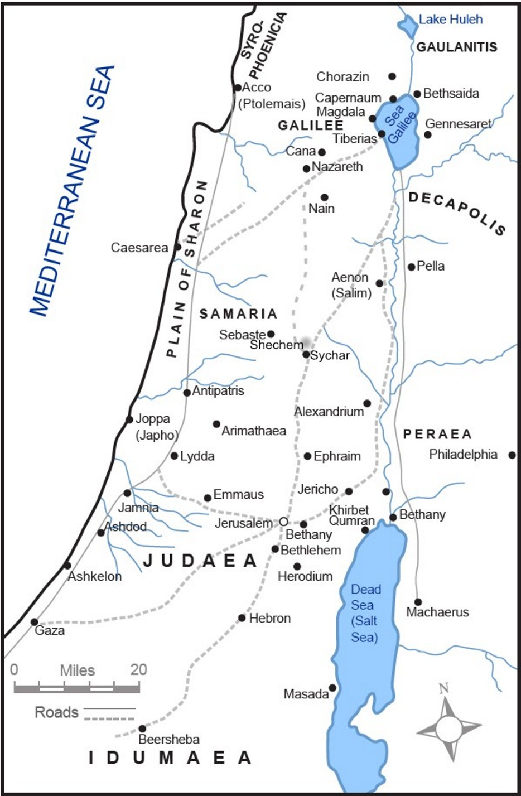
Where are Jesus and His Disciples and why?

Slide 13
Jerusalem
(Upper Room) for
Passover

Slide 14
Observation
Verse 1 sets the scene
¹ Now before the Feast of the Passover, when Jesus knew that his hour had come to depart out of this world to the Father, having loved his own who were in the world, he loved them to the end.
The time marker, “just before the Passover Festival,” continues the buildup to Jesus’s last Passover.
“Jesus knew that the hour had come,” echoes Jesus’ words in John 12:23, “The hour has come for the Son of Man to be glorified.”
“To leave this world and go to the Father” is a euphemism for the cruel cross-death about to be suffered by the Messiah.
“Having loved his own . . . , he loved them to the end” signals love as the major theme of the Farewell Discourse and the whole gospel.
Köstenberger, Andreas J. (2013-11-05). Encountering John (Encountering Biblical Studies)

Slide 15
Observation
Verses 2-4
² During supper, when the devil had already put it into the heart of Judas Iscariot, Simon's son, to betray him, ³Jesus, knowing that the Father had given all things into his hands, and that he had come from God and was going back to God, ⁴ rose from supper. He laid aside his outer garments, and taking a towel, tied it around his waist,
“John draws attention to Jesus’s patience, kindness, and love even of his enemies. Knowing that Judas was about to betray him, Jesus washed his disciples’ feet— including Judas’!”
Köstenberger, Andreas J. (2013-11-05). Encountering John (Encountering Biblical Studies)

Slide 16
Observation
On Footwashing
Dinner had been served and the people’s feet should long have been cleaned.
The practice of footwashing has a long Old Testament tradition (Gen. 18: 4; 19: 2; 24: 32; 43: 24)
In the dry climate of Palestine, where most travel was by foot, usually in sandals.
To wash the feet of one’s guests was common hospitality.
Feet were washed by slaves.
Köstenberger, Andreas J. (2013-11-05). Encountering John (Encountering Biblical Studies)

Slide 17
Observation
Verses 5-6
⁵ Then he poured water into a basin and began to wash the disciples' feet and to wipe them with the towel that was wrapped around him. ⁶ He came to Simon Peter, who said to him, “Lord, do you wash my feet?”
“Every act of Jesus would have been like a dagger in the disciples’ hearts, convicting them of their pride and refusal to lower themselves to the role of servant.”
“The scandal of Jesus’s condescension is highlighted by Peter’s initial refusal: “Lord, are you going to wash my feet?” (v. 6).”
Köstenberger, Andreas J. (2013-11-05). Encountering John (Encountering Biblical Studies)

Slide 18
Observation
Verses 12-17
¹² When he had washed their feet and put on his outer garments and resumed his place, he said to them, “Do you understand what I have done to you? ¹³ You call me Teacher and Lord, and you are right, for so I am. ¹⁴ If I then, your Lord and Teacher, have washed your feet, you also ought to wash one another's feet. ¹⁵ For I have given you an example, that you also should do just as I have done to you. ¹⁶ Truly, truly, I say to you, a servant is not greater than his master, nor is a messenger greater than the one who sent him. ¹⁷ If you know these things, blessed are you if you do them.”
What are the key points Jesus wanted to teach his disciples?

Slide 19
Interpretation
Philippians 2:5-8 (ESV)
⁵ Have this mind among yourselves, which is yours in Christ Jesus,⁶ who, though he was in the form of God, did not count equality with God a thing to be grasped, ⁷ but emptied himself, by taking the form of a servant, being born in the likeness of men. ⁸ And being found in human form, he humbled himself by becoming obedient to the point of death, even death on a cross.
“It is hard to think of an event that better encapsulates the attitude of Christ Jesus commended in the following verses by Paul than the footwashing”
Köstenberger, Andreas J. (2013-11-05). Encountering John (Encountering Biblical Studies)

Slide 20
Interpretation
“Jesus did what he was about to do fully aware that the Father had given all things into his hands and that he had come from God and was returning to God. John here emphasizes that, at the outset of the footwashing, Jesus was fully assured of his status. He knew he was the Son of God, yet he lowered himself to the status of slave— what amazing condescension! No one said it better than Paul: Jesus, “being in very nature God, did not consider equality with God something to be used to his own advantage” (Phil. 2: 6). Thus the footwashing becomes an acted parable of the theological significance of the incarnation itself.”
Köstenberger, Andreas J. (2013-11-05). Encountering John (Encountering Biblical Studies)

Slide 21
Application & Discussion
“In the upper room, the need of the hour was clean feet. In your and my life, the need may be any of a virtually limitless number. We must be perceptive and caring in order to identify such needs and then meet them as we are able.”
“Carry each other’s burdens, and in this way you will fulfill the law of Christ” (Gal. 6: 2).
“Do nothing out of selfish ambition or vain conceit. Rather, in humility value others above yourselves, not looking to your own interests but each of you to the interests of the others” (Phil. 2: 3– 4).”
Köstenberger, Andreas J. (2013-11-05). Encountering John (Encountering Biblical Studies)

Slide 22
Application & Discussion
This week focus on increasing your perception and compassion for your brothers in Christ by asking God to give you a loving attitude of servanthood and how you can meet the needs of your brothers.
Spring into Service, April 24-26

Slide 23
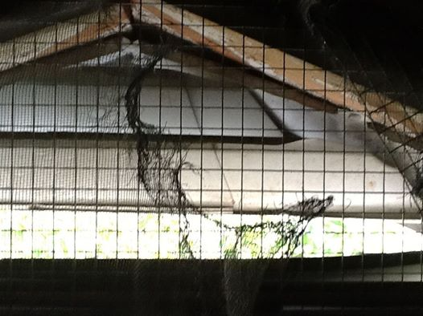
My time of need.
The story of a raccoon
in my attic…

Slide 24
Closing
Questions?
Comments?
Closing Prayer

