Slide 1
Announcements
Welcome to the MOB!
Great Date Night, May 9
MissionNext Forum, May 8-9
Fellowship of Christian Athletes
(FCA-DC) Victory Luncheon, May 12,
POC: Don Woodall (703) 402-4790 or dwoodall@fca.org
Pray for MOB Fall 2015 – Spring 2016
MOB Website: www.ibcmob.net

Slide 2
Memory Verse
John 14:27 (ESV)
²⁷ Peace I leave with you; my peace I give to you. Not as the world gives do I give to you. Let not your hearts be troubled, neither let them be afraid.

Slide 3
John’s Purpose
John 20:30-31 (ESV)
³⁰ Now Jesus did many other signs in the presence of the disciples, which are not written in this book; ³¹ but these are written so that you may believe that Jesus is the Christ, the Son of God, and that by believing you may have life in his name.

Slide 4
The Gospel
According to John
Outline
Focus | Incarnation of the Son of God | Presentation of the Son of God | Opposition to the Son of God | Preparation of the Disciples | Crucifixion and Resurrection of the Son of God
Reference | 1:1-18 | 1:19-4:54 | 5:1-12:50 | 13:1-17:26 | 18:1-21:25
Division | Introduction to Christ | Revelation of Christ | Rejection of Christ | Revelation of Christ | Rejection of Christ
Topic | Seven Signs |  |  | Upper Room Discourse | Supreme Sign
 | That you might believe |  |  | That you might have life
Time | A Few Years |  |  | A Few Hours | A Few Weeks

Slide 5
Last Week
John 13:21-30 Jesus Announces His Betrayer
John 13:31-38 New Commandment &
Peter’s Denial Foretold

Slide 6
This Week
John 14:1-31 The Upper Room Discourse
John 14:1-4 Preparing a Place
John 14:5-7 Knowing the Way
John 14:8-11 Greater Intimacy of Relationship
John 14:12-14 Greater Works
John 14: 15-31 Another Divine Helper

Slide 7
John 14:1-31 (ESV)
The Upper Room Discourse
¹ “Let not your hearts be troubled. Believe in God; believe also in me. ² In my Father's house are many rooms. If it were not so, would I have told you that I go to prepare a place for you? ³ And if I go and prepare a place for you, I will come again and will take you to myself, that where I am you may be also. ⁴ And you know the way to where I am going.” ⁵ Thomas said to him, “Lord, we do not know where you are going. How can we know the way?” ⁶ Jesus said to him, “I am the way, and the truth, and the life. No one comes to the Father except through me. ⁷ If you had known me, you would have known my Father also. From now on you do know him and have seen him.”

Slide 8
John 14:1-31 (ESV)
The Upper Room Discourse
⁸ Philip said to him, “Lord, show us the Father, and it is enough for us.” ⁹ Jesus said to him, “Have I been with you so long, and you still do not know me, Philip? Whoever has seen me has seen the Father. How can you say, ‘Show us the Father’? ¹⁰ Do you not believe that I am in the Father and the Father is in me? The words that I say to you I do not speak on my own authority, but the Father who dwells in me does his works. ¹¹ Believe me that I am in the Father and the Father is in me, or else believe on account of the works themselves.
¹² “Truly, truly, I say to you, whoever believes in me will also do the works that I do; and greater works than these will he do, because I am going to the Father. ¹³ Whatever you ask in my name, this I will do, that the Father may be glorified in the Son. ¹⁴ If you ask me anything in my name, I will do it.

Slide 9
John 14:1-31 (ESV)
The Upper Room Discourse
¹⁵ “If you love me, you will keep my commandments. ¹⁶ And I will ask the Father, and he will give you another Helper, to be with you forever, ¹⁷ even the Spirit of truth, whom the world cannot receive, because it neither sees him nor knows him. You know him, for he dwells with you and will be in you.
¹⁸ “I will not leave you as orphans; I will come to you. ¹⁹ Yet a little while and the world will see me no more, but you will see me. Because I live, you also will live. ²⁰ In that day you will know that I am in my Father, and you in me, and I in you. ²¹ Whoever has my commandments and keeps them, he it is who loves me. And he who loves me will be loved by my Father, and I will love him and manifest myself to him.” ²² Judas (not Iscariot) said to him, “Lord, how is it that you will manifest yourself to us, and not to the world?” ²³ Jesus answered him, “If anyone loves me, he will keep my word, and my Father will love him, and we will come to him and make our home with him. ²⁴ Whoever does not love me does not keep my words. And the word that you hear is not mine but the Father's who sent me.

Slide 10
John 14:1-31 (ESV)
The Upper Room Discourse
²⁵ “These things I have spoken to you while I am still with you. ²⁶ But the Helper, the Holy Spirit, whom the Father will send in my name, he will teach you all things and bring to your remembrance all that I have said to you. ²⁷ Peace I leave with you; my peace I give to you. Not as the world gives do I give to you. Let not your hearts be troubled, neither let them be afraid. ²⁸ You heard me say to you, ‘I am going away, and I will come to you.’ If you loved me, you would have rejoiced, because I am going to the Father, for the Father is greater than I. ²⁹ And now I have told you before it takes place, so that when it does take place you may believe. ³⁰ I will no longer talk much with you, for the ruler of this world is coming. He has no claim on me, ³¹ but I do as the Father has commanded me, so that the world may know that I love the Father. Rise, let us go from here.

Slide 11
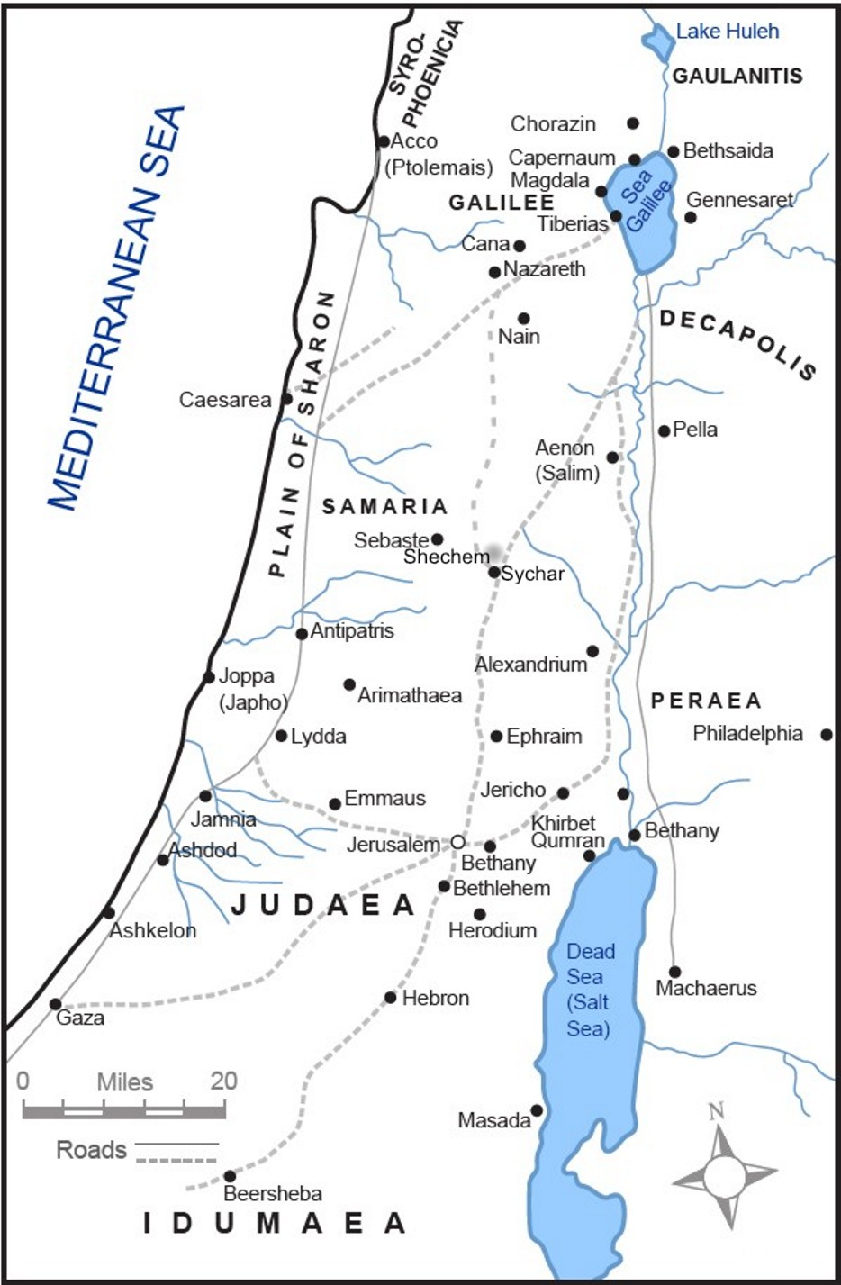
Where are Jesus and His Disciples and why?

Slide 12
Jerusalem
(Upper Room) for
Passover

Slide 13
John 14:1-31 (ESV)
The Upper Room Discourse
Observation
Why were Jesus’ disciples so “troubled” at the start of our text?

Slide 14
John 14:1-31 (ESV)
The Upper Room Discourse
Jesus Comforts His Disciples!
¹ “Let not your hearts be troubled. Believe in God; believe also in me. ² In my Father's house are many rooms. If it were not so, would I have told you that I go to prepare a place for you? ³ And if I go and prepare a place for you, I will come again and will take you to myself, that where I am you may be also. ⁴ And you know the way to where I am going.” (John 14:1-4 ESV)

Slide 15
John 14:1-31 (ESV)
The Upper Room Discourse
The Way!
⁶ Jesus said to him, “I am the way, and the truth, and the life. No one comes to the Father except through me. ⁷ If you had known me, you would have known my Father also. From now on you do know him and have seen him.”
(John 14:6-7 ESV)

Slide 16
John 14:1-31 (ESV)
The Upper Room Discourse
Köstenberger’s Comment
“Jesus’s claim to be the way (implying that that no one can come to the Father except through Him) is as timely today as it was when our Lord first uttered it! For we live in an age of religious pluralism, when Christianity’s exclusive claims are considered inappropriately narrow, even intolerant, and when pluralism itself has, ironically, become the dogma by which all truth claims are judged! It has been said that pluralism accepts no absolute truth claims other than its contention that there are no absolute truth claims!”

Slide 17
John 14:1-31 (ESV)
The Upper Room Discourse
1 Timothy 2:5-6 (ESV)
⁵ For there is one God, and there is one mediator between God and men, the man Christ Jesus, ⁶ who gave himself as a ransom for all, which is the testimony given at the proper time.
Are there other verses with the same message that come to mind?

Slide 18
John 14:1-31 (ESV)
The Upper Room Discourse
Observation
Did you get the “in” or “in one another” terminology expressed in the Gospel of John -- according to Köstenberger --
and the implications it has for an intimate relationship between Jesus and the Father, as well as between believers and Jesus and the Father?

Slide 19
John 14:1-31 (ESV)
The Upper Room Discourse
Observation
^{16 ”}And I will ask the Father, and he will give you another Helper, to be with you forever, ¹⁷ even the Spirit of truth, whom the world cannot receive, because it neither sees him nor knows him. You know him, for he dwells with you and will be in you.
¹⁸ I will not leave you as orphans; I will come to you. ¹⁹ Yet a little while and the world will see me no more, but you will see me. Because I live, you also will live. ²⁰ In that day you will know that I am in my Father, and you in me, and I in you.” (John 14:16-20 ESV)

Slide 20
John 14:1-31 (ESV)
The Upper Room Discourse
Implications of John 14:26
²⁶ But the Helper, the Holy Spirit, whom the Father will send in my name, he will teach you all things
and bring to your remembrance
all that I have said to you.

Slide 21
John 14:1-31 (ESV)
The Upper Room Discourse
John MacArthur’s Comments
According to MacArthur, the Holy Spirit energized the hearts and minds of the apostles in their ministry, helping them to produce the New Testament Scriptures. The disciples had failed to understand many things about Jesus and what He taught, but because of this supernatural work, they came to an inerrant and accurate understanding of the Lord and His work and recorded it in the Gospels and the rest of the New Testament Scriptures!

Slide 22
John 14:1-31 (ESV)
The Upper Room Discourse
Interpretation
Why were both the disciples and Jesus, in the final analysis, “better off,”
and able to accomplish more,
because Jesus returned to His Father?

Slide 23
John 14:1-31 (ESV)
The Upper Room Discourse
John 14:27 (ESV)
²⁷ Peace I leave with you; my peace I give to you. Not as the world gives do I give to you. Let not your hearts be troubled, neither let them be afraid.
SHALOM!

Slide 24
John 14:1-31 (ESV)
The Upper Room Discourse
Application & Discussion
How would you speak to someone who told you, “There are many ways to God”?
Of all the promises in this Scripture passage, which one means the most to you and why?
What does it mean to you personally that Jesus sent the Holy Spirit to indwell you as a believer?
On a scale of 1 to 10, how would you rate your “peace quotient”?

Slide 25
Closing
Questions?
Comments?
Closing Prayer

