Slide 1
Announcements
Welcome to the MOB!
Great Date Night, May 9
MissionNext Forum, May 8-9
Fellowship of Christian Athletes
(FCA-DC) Victory Luncheon, May 12,
POC: Don Woodall (703) 402-4790 or dwoodall@fca.org
IBC Childcare Tues evenings ends May 19
Pray for MOB Fall 2015 – Spring 2016
MOB Website: www.ibcmob.net

Slide 2
Memory Verse
John 15:5 (ESV)
⁵ I am the vine; you are the branches.
Whoever abides in me and I in him,
he it is that bears much fruit,
for apart from me you can do nothing.

Slide 3
John’s Purpose
John 20:30-31 (ESV)
³⁰ Now Jesus did many other signs in the presence of the disciples, which are not written in this book; ³¹ but these are written so that you may believe that Jesus is the Christ, the Son of God, and that by believing you may have life in his name.

Slide 4
The Gospel
According to John
Outline
Focus | Incarnation of the Son of God | Presentation of the Son of God | Opposition to the Son of God | Preparation of the Disciples | Crucifixion and Resurrection of the Son of God
Reference | 1:1-18 | 1:19-4:54 | 5:1-12:50 | 13:1-17:26 | 18:1-21:25
Division | Introduction to Christ | Revelation of Christ | Rejection of Christ | Revelation of Christ | Rejection of Christ
Topic | Seven Signs |  |  | Upper Room Discourse | Supreme Sign
 | That you might believe |  |  | That you might have life
Time | A Few Years |  |  | A Few Hours | A Few Weeks

Slide 5
Last Week
John 14:1-31 The Upper Room Discourse
John 14:1-4 Preparing a Place
John 14:5-7 Knowing the Way
John 14:8-11 Greater Intimacy of Relationship
John 14:12-14 Greater Works
John 14:15-31 Another Divine Helper

Slide 6
This Week
John 15:1-25 Jesus’ continuing discourse with His disciples
The Relationship of Believers to:
John 15:1-11 Jesus
John 15:12-17 Each Other
John 15:18-25 The World

Slide 7
John 15:1-25 (ESV)
Jesus’ Continuing Discourse
with His Disciples
¹ “I am the true vine, and my Father is the vinedresser. ² Every branch in me that does not bear fruit he takes away, and every branch that does bear fruit he prunes, that it may bear more fruit. ³ Already you are clean because of the word that I have spoken to you. ⁴ Abide in me, and I in you. As the branch cannot bear fruit by itself, unless it abides in the vine, neither can you, unless you abide in me. ⁵ I am the vine; you are the branches. Whoever abides in me and I in him, he it is that bears much fruit, for apart from me you can do nothing. ⁶ If anyone does not abide in me he is thrown away like a branch and withers; and the branches are gathered, thrown into the fire, and burned.

Slide 8
John 15:1-25 (ESV)
Jesus’ Continuing Discourse
with His Disciples
⁷ If you abide in me, and my words abide in you, ask whatever you wish, and it will be done for you. ⁸ By this my Father is glorified, that you bear much fruit and so prove to be my disciples. ⁹ As the Father has loved me, so have I loved you. Abide in my love. ¹⁰ If you keep my commandments, you will abide in my love, just as I have kept my Father's commandments and abide in his love. ¹¹ These things I have spoken to you, that my joy may be in you, and that your joy may be full.

Slide 9
John 15:1-25 (ESV)
Jesus’ Continuing Discourse
with His Disciples
¹² “This is my commandment, that you love one another as I have loved you. ¹³ Greater love has no one than this, that someone lay down his life for his friends. ¹⁴ You are my friends if you do what I command you. ¹⁵ No longer do I call you servants, for the servant does not know what his master is doing; but I have called you friends, for all that I have heard from my Father I have made known to you. ¹⁶ You did not choose me, but I chose you and appointed you that you should go and bear fruit and that your fruit should abide, so that whatever you ask the Father in my name, he may give it to you. ¹⁷ These things I command you, so that you will love one another.

Slide 10
John 15:1-25 (ESV)
Jesus’ Continuing Discourse
with His Disciples
¹⁸ “If the world hates you, know that it has hated me before it hated you. ¹⁹ If you were of the world, the world would love you as its own; but because you are not of the world, but I chose you out of the world, therefore the world hates you. ²⁰ Remember the word that I said to you: ‘A servant is not greater than his master.’ If they persecuted me, they will also persecute you. If they kept my word, they will also keep yours. ²¹ But all these things they will do to you on account of my name, because they do not know him who sent me. ²² If I had not come and spoken to them, they would not have been guilty of sin,^{[c]} but now they have no excuse for their sin. ²³ Whoever hates me hates my Father also. ²⁴ If I had not done among them the works that no one else did, they would not be guilty of sin, but now they have seen and hated both me and my Father. ²⁵ But the word that is written in their Law must be fulfilled: ‘They hated me without a cause.’

Slide 11
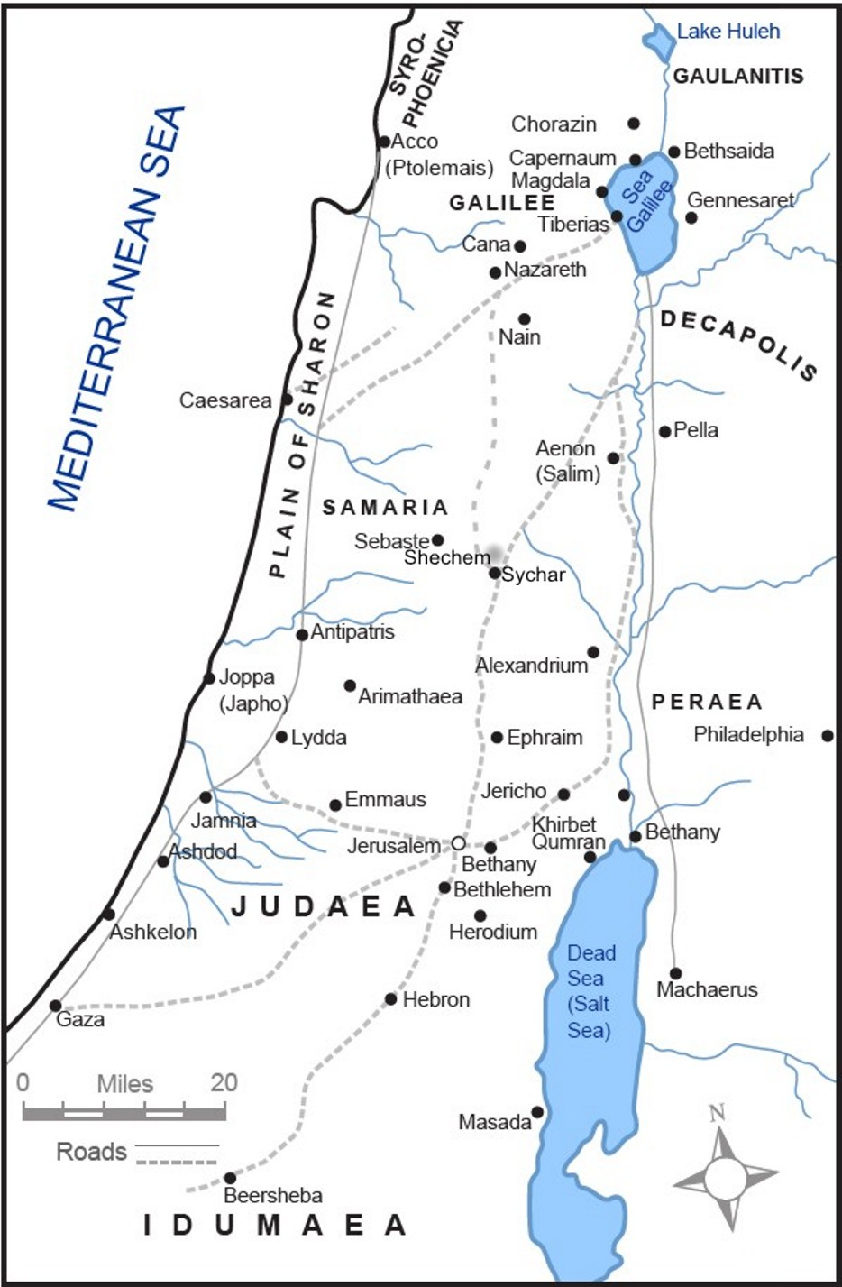
Where were Jesus and His Disciples in Chap. 14 and why?

Slide 12
Jerusalem
(Upper Room) for
Passover

Slide 13
John 15:1-25 (ESV)
Jesus’ Continuing Discourse
with His Disciples
Observation
Where does Köstenberger suggest that Jesus and His disciples may be at the start of John 15?
Why may this be important in Jesus’ metaphors in John 15?

Slide 14
John 15:1-25 (ESV)
Jesus’ Continuing Discourse
with His Disciples
Observation
Who is with Jesus at this time?
Who is no longer present with Jesus at this time? (see John 13:30)
Who was often referred to as the “vine” in the Old Testament?

Slide 15
John 15:1-25 (ESV)
Jesus’ Continuing Discourse
with His Disciples
Interpretation
Who is now the “vine” in John 15?
What is meant by abiding or remaining (Greek “meno”) in Jesus in John 15:4-10?
Who or what is symbolized by the branches thrown into the fire in John 15:6?
Does Jesus promise that all prayers will be answered in John 15:7?

Slide 16
John 15:1-25 (ESV)
Jesus’ Continuing Discourse
with His Disciples
Interpretation
What is Jesus’ key commandment to His disciples?
Did He given them the same commandment previously in John?
What is the key contrast that Jesus makes in calling the disciples “friends” in lieu of “slaves”? (John 15)

Slide 17
John 15:1-25 (ESV)
Jesus’ Continuing Discourse
with His Disciples
Interpretation
Why would the world hate the disciples? (John 15:18-20)
Was there cause for this hatred? (John 15:25)
Should we invite suffering as Christians?

Slide 18
John 15:1-25 (ESV)
Jesus’ Continuing Discourse
with His Disciples
Application & Discussion
How can you continue to “bear fruit” in your Christian walk?
How can we follow Jesus’ new commandment from John 14 and re-emphasized in John 15?
How can we use John 15 to encourage us to be Christian witnesses when others criticize us for our views?

Slide 19
Closing
Questions?
Comments?
Closing Prayer

