Slide 1
WELCOME TO THE MOB!
All Scripture is breathed out by God and profitable for teaching, for reproof, for correction, and for training in righteousness, that the man of God may be complete, equipped for every good work.
2 Timothy 3:16-17 (ESV)

Slide 2
Announcements
MOB Website & Resources: www.ibcmob.net

Slide 3
Invocation/Prayer
Hymn:
I Sing the Mighty Power of God
Notes:
I prayed that my teaching would change the lives of my students, encourage them, give them more confidence, and help them make an impact on the world. – Jim Plueddemann

Slide 4
I Sing the Mighty Power of God
By Isaac Watts, Verse 1 of 3
I sing the mighty power of God,
that made the mountains rise,
That spread the flowing seas abroad,
and built the lofty skies.
I sing the wisdom that ordained
the sun to rule the day;
The moon shines full at His command,
and all the stars obey.

Slide 5
I Sing the Mighty Power of God
By Isaac Watts, Verse 2 of 3
I sing the goodness of the Lord,
Who filled the earth with food,
Who formed the creatures through the Word,
and then pronounced them good.
Lord, how Thy wonders are displayed,
where’er I turn my eye,
If I survey the ground I tread,
or gaze upon the sky.

Slide 6
I Sing the Mighty Power of God
By Isaac Watts, Verse 3 of 3
There’s not a plant or flower below,
but makes Thy glories known,
And clouds arise, and tempests blow,
by order from Thy throne;
While all that borrows life from Thee
is ever in Thy care;
And everywhere that we can be,
Thou, God art present there.

Slide 7
Memory Verse
Isaiah 40:31 (ESV)
but they who wait for the Lord shall renew their strength;
they shall mount up with wings like eagles;
they shall run and not be weary;
they shall walk and not faint.
Unless otherwise noted, all Scripture quotations are from NASB95

Slide 8
Our Study of Isaiah
Last Meeting:
Isaiah 40:1-20, The Consolation of Zion
Memory Verse: Isaiah 40:8
Dr. Constable’s Notes, 2022 Ed., pp. 255-267; Motyer, pp. 298-305
This Meeting:
Isaiah 40:21-31, God is Over All
Memory Verse: Isaiah 40:31
Dr. Constable’s Notes, 2022 Ed., pp. 267-272; Motyer, pp. 305-308
Refreshment Host: Group B

Slide 9
Isaiah Outline
Focus | Prophecies of Condemnation |  |  |  |  |  |  |  | Historical Parenthesis |  | Prophecies of Comfort
 | 1:1 |  |  |  |  |  |  | 35:10 | 36:1 | 39:8 | 40:1 |  |  |  |  |  | 66:24
Divisions | Prophecies Against Judah |  | Prophecies Against the Nation |  | Prophesies Against the Day of the Lord |  | Prophesies of Judgement and Blessing |  | Sickness and Sin | Hezekiah’s Salvation | Israel’s Deliverance |  |  | Israel’s Deliverer |  | Israel’s Glorious Future
 | 1:1 | 12:6 | 13:1 | 23:18 | 24:1 | 27:13 | 28:1 | 35:10 | 36:1 | 39:8 | 40:1 | 48:22 |  | 49:1 | 57:21 | 58:1 | 66:24
Topics | Prophetic |  |  |  |  |  |  |  | Historic |  | Messianic
 | Judgement |  |  |  |  |  |  |  | Transition |  | Hope
Place | Israel & Judah
Time | 740 - 680 B.C.
We are here!
Bruce Wilkinson and Kenneth Boa, Talk Thru the Bible (Nashville: T. Nelson, 1983), 189.

Slide 10
Isaiah 40:21-24
?
²¹ Do you not know? Have you not heard? Has it not been declared to you from the beginning? Have you not understood from the foundations of the earth?
What am I supposed to know, Isaiah?
This sounds like it should be common knowledge, but apparently it is not.
Tell us, Isaiah – we want to know!
Notes:
Do you ever “talk to” the Bible authors? It can be a good way of interacting with them and with God

Slide 11
Isaiah 40:21-24
²² It is He who sits above the circle of the earth, And its inhabitants are like grasshoppers, Who stretches out the heavens like a curtain And spreads them out like a tent to dwell in.
²³ He it is who reduces rulers to nothing, Who makes the judges of the earth meaningless.
²⁴ Scarcely have they been planted, Scarcely have they been sown, Scarcely has their stock taken root in the earth, But He merely blows on them, and they wither, And the storm carries them away like stubble.
Do you not know? Have you not heard?
Notes:
The heavens are telling of the glory of God; And their expanse is declaring the work of His hands. (Psalm 19:1)
“It is He who changes the times and the epochs; He removes kings and establishes kings; He gives wisdom to wise men And knowledge to men of understanding. (Daniel 2:21)

Slide 12
Isaiah 40:21-24 God Is Above All Human Rulers
Some Lessons
- Remember – He is God, and I am not
- My time on this earth is under His control
- Don’t get impressed with my own headlines and highlight films
Implication
- I am dependent on God, so think and act like it
Notes:
To be the chief grasshopper isn’t a very high ambition
40.21-24 Clearly, we have become masters of ignoring the obvious. We have gotten so impressed with ourselves, so focused on our own activities, that we avoid even considering God and His sovereignty. We don’t want Him to interfere with our choices or plans (JDB)
A test – God knows all the stars by name – billions of them. Can you write down the names of even half of the people in this room?

Slide 13
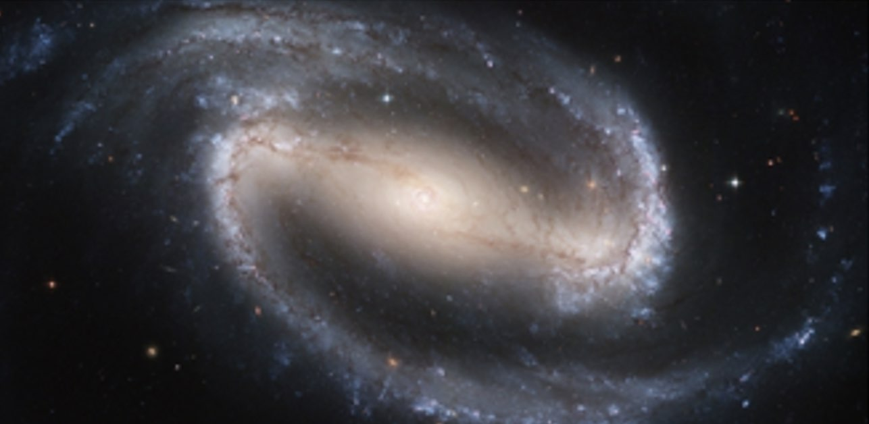
Isaiah 40:25-26
Since God is above all -
²⁵ To whom then will you liken Me
That I would be his equal?” says the Holy One.
²⁶ Lift up your eyes on high
And see who has created these stars,
The One who leads forth their host by number,
He calls them all by name;
Because of the greatness of His might and the strength of His power, Not one of them is missing.
Notes:
Lift up your eyes – our problem is that we are looking in all the wrong places!
He named all the stars – and remembers all their names! With the most powerful telescopes and satellites in history, we can’t even see them all, much less count them.
While estimates among different experts vary, an acceptable range is between 100 billion and 200 billion galaxies, said Mario Livio, an astrophysicist at the Space Telescope Science Institute in Baltimore, Maryland.
Galaxies, averaging an estimated 100 million stars, range in size from dwarfs with less than a hundred million stars, to the largest galaxies known – supergiants with one hundred trillion stars, each orbiting its galaxy's center of mass. - Wikipedia

Slide 14
Isaiah 40:25-26
“Holy One” is the killing blow to any thought of a comparison!
It is not only his power (12), wisdom (13–14), dignity (15–17), sovereignty (22–23) and authority (24) that put him beyond compare.
Of far more significance is his unattainable, unassailable moral perfection.
Motyer
Notes:
None of the idols have ever been claimed as holy in this sense of moral perfection

Slide 15
Isaiah 40:25-26
How many stars does God call by name?
Between 100 billion and 200 billion galaxies
That is 100,000,000,000
And notice the 100% margin of error!
A ‘dwarf’ galaxy has less than 100 million stars
A ‘supergiant’ galaxy has 100 trillion stars
50
Notes:
None of the idols has claimed to create a single star
While estimates among different experts vary, an acceptable range is between 100 billion and 200 billion galaxies, said Mario Livio, an astrophysicist at the Space Telescope Science Institute in Baltimore, Maryland.
Galaxies, averaging an estimated 100 million stars, range in size from dwarfs with less than a hundred million stars, to the largest galaxies known – supergiants with one hundred trillion stars, each orbiting its galaxy's center of mass. - Wikipedia

Slide 16
Isaiah 40:25-26
Some Lessons
- There is NONE comparable to the Holy One of Israel
- Besides that, He is the great Creator God who made the stars - again there is NONE comparable
Implication
- If this God is INCOMPARABLE, I had better
pay attention.

Slide 17
Isaiah 40:27-31
²⁷ Why do you say, O Jacob, and assert, O Israel, “My way is hidden from the Lord, And the justice due me escapes the notice of my God”?
Really? You think that the God (who has never lost a star) will forget you, His special chosen people?
²⁸ Do you not know? Have you not heard?
?
Tell me, Isaiah

Slide 18
Isaiah 40:27-31
²⁸ Do you not know? Have you not heard?
The Everlasting God, the Lord, the Creator of the ends of the earth
Does not become weary or tired.
His understanding is inscrutable.
Notes:
(Re 40.28) Oh, the depth of the riches both of the wisdom and knowledge of God! How unsearchable are His judgments and unfathomable His ways! (Romans 11:33)
40.28 The people needed to open their eyes and ears to what they already knew about their God (cf. v. 21). He is eternal, not bound to the present, as human beings are. He is Yahweh, the covenant-keeping God. He is the Creator of all the earth, not restricted to only one locale at a time. He does not grow tired, because He is omnipotent. He is inscrutable (impossible to understand completely), because He is omniscient. This is why we cannot always understand why He allows things to happen as they do. He is unlimited by time, space, power, and understanding. (Constable)
40.28 Everything that matters in life hangs on who God is. (Ortlund, quoted in Constable)

Slide 19
Isaiah 40:27-31
The Everlasting God, the Lord, the Creator of the ends of the earth …
²⁹ He gives strength to the weary, And to him who lacks might He increases power.
³⁰ Though youths grow weary and tired, And vigorous young men stumble badly,
³¹ Yet those who wait for the Lord …
Notes:
(Re 40.29) And He has said to me, “My grace is sufficient for you, for power is perfected in weakness.” Most gladly, therefore, I will rather boast about my weaknesses, so that the power of Christ may dwell in me. (2 Corinthians 12:9)
40.28 When you remember who God really is, it does not make sense to complain about His actions or the functioning of His creation – so don’t
40.28 When you recognize that God’s understanding is inscrutable, don’t even think of second-guessing Him
40.29 God is the source of our strength and power – so ask Him and depend on Him

Slide 20
Isaiah 40:27-31
Do you ever get weary?
Do you ever feel powerless?
Do you ever get exhausted?
A secret for you young men –
us older guys have a lot less endurance than you
All of us men are physically limited – we need something MORE
Notes:
Young men – Aaron Rogers, primed to be the hero of a great season to take the NY Jets to the next level – lasted for 5 minutes!

Slide 21
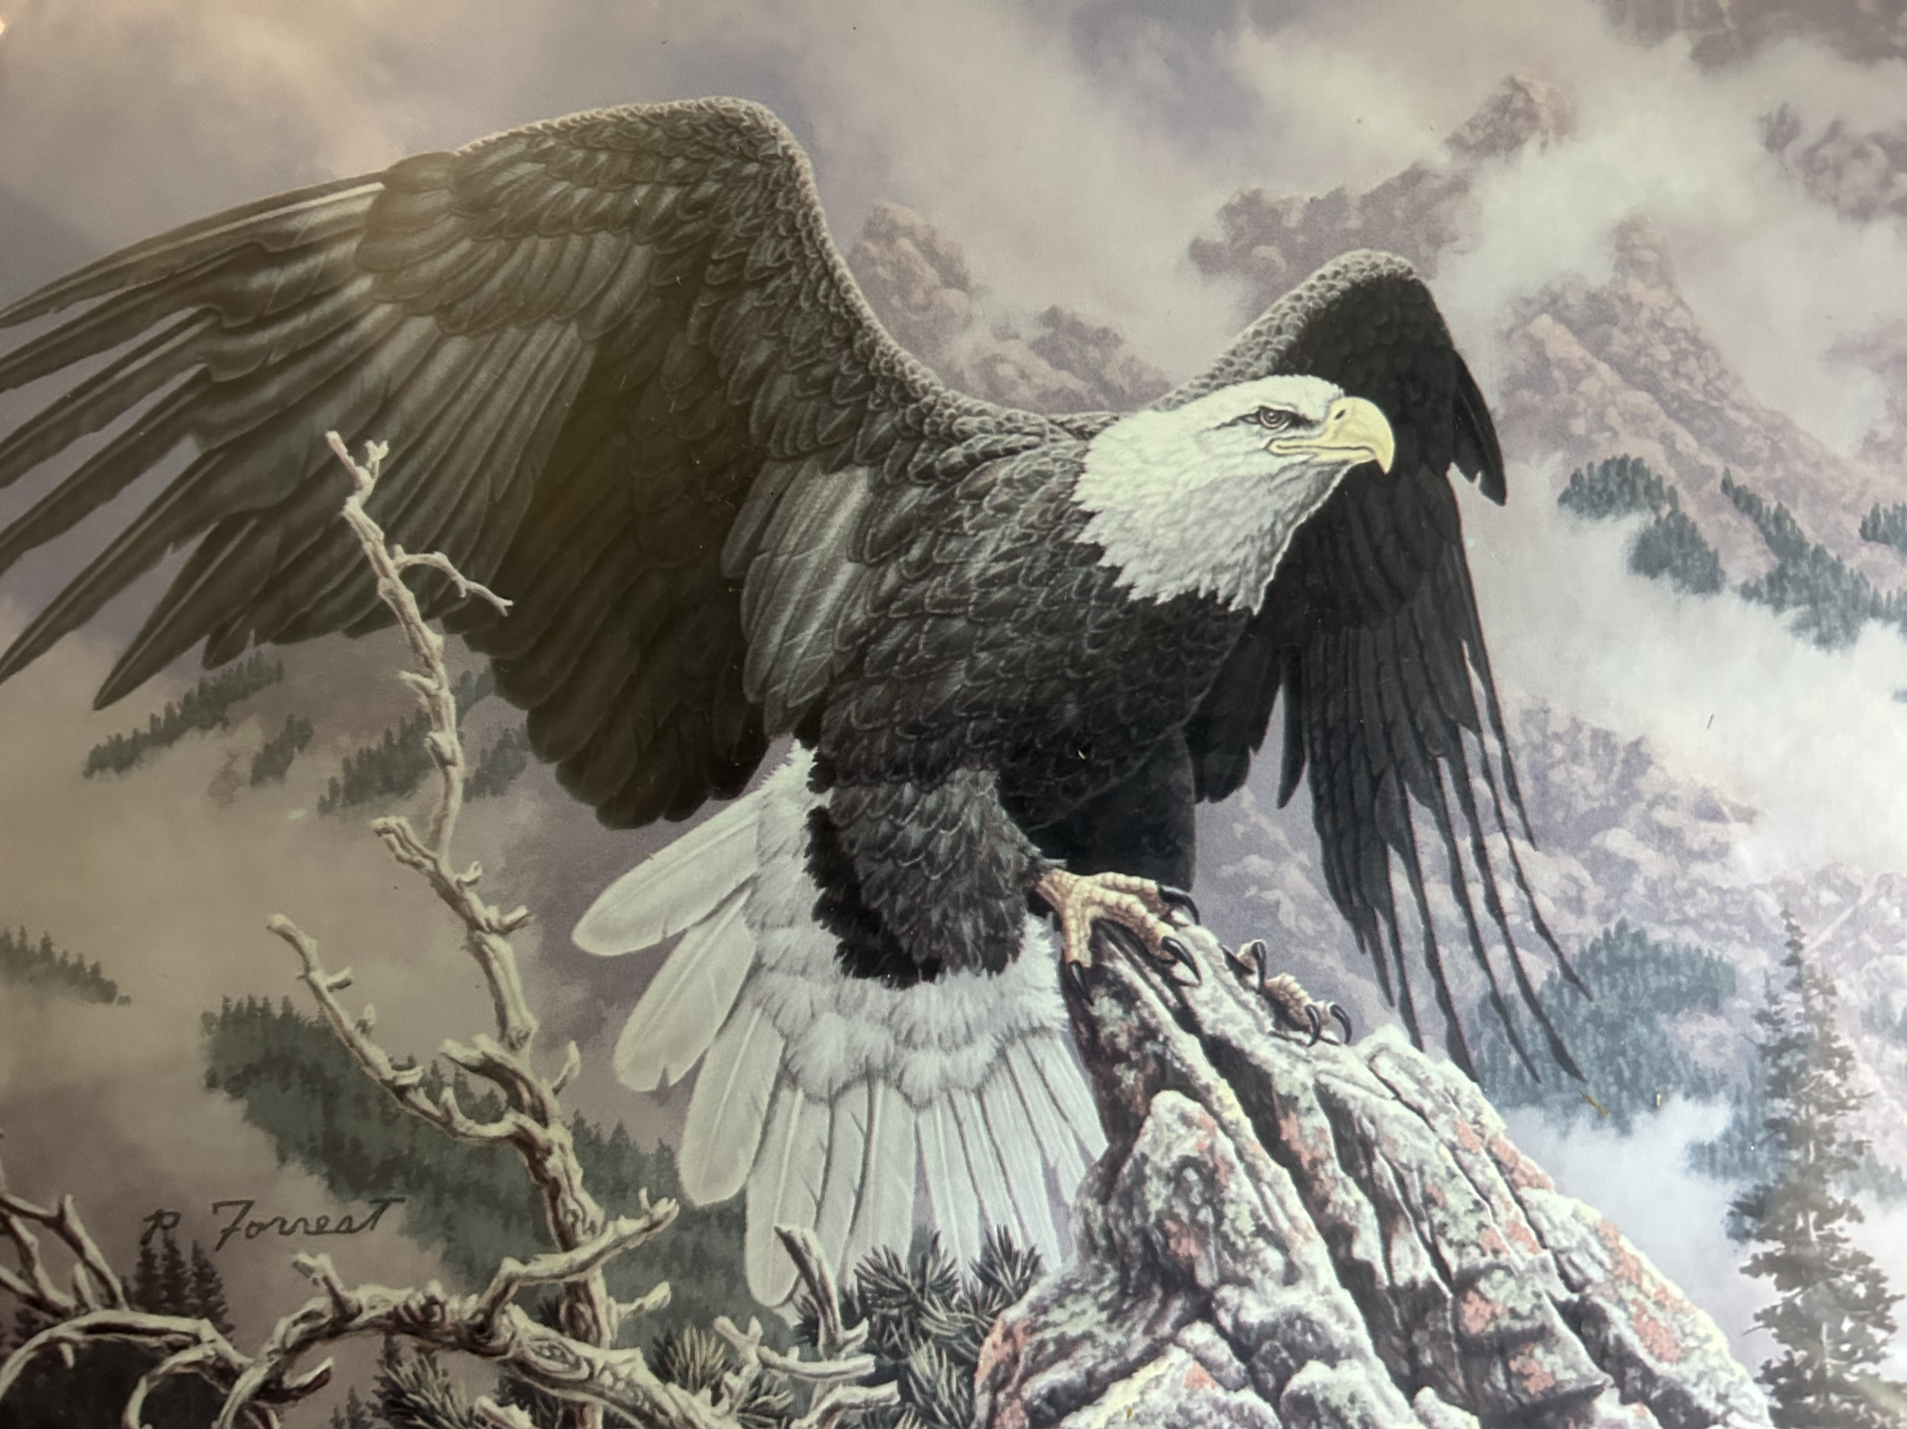
Isaiah 40:27-31
³¹ YET
those who wait for the Lord …
Will gain new strength;
They will mount up with wings like eagles,
Notes:
They that wait upon the Lord – how do you do that? Pause, pray, listen, obey
(Re 40.31) Who satisfies your years with good things, So that your youth is renewed like the eagle. (Psalm 103:5)

Slide 22
Isaiah 40:27-31
Yet, those who wait for the Lord …
They will run and not get tired,
They will walk and not become weary.
Notes:
They that wait upon the Lord – how do you do that? Pause, pray, listen, obey
(Re 40.31) Who satisfies your years with good things, So that your youth is renewed like the eagle. (Psalm 103:5)

Slide 23
Isaiah 40:21-31
If the INCOMPARABLE, EVERLASTING Creator God of the universe would give me strength, why would I ignore it? Why would I refuse?

Slide 24
Discussion Questions
1. What do you learn about God and His character from Isaiah 40:21-31?
2. Isaiah presents God as sovereign over all. How does he illustrate this?
3. Based on this passage, how should we as men view our place in this world?
4. I am dependent on God. How do I think and act like it?
5. Verse 31 lists benefits of waiting on the Lord. How does a person wait on the Lord?

Slide 25
Our Study of Isaiah
This Meeting:
Isaiah 40:21-31
Memory Verse: Isaiah 40:31
Dr. Constable’s Notes, 2022 Ed., pp. 267-272; Motyer, pp. 305-308
Next Meeting:
Isaiah 41:1-20
Memory Verse: Isaiah 41:10
Dr. Constable’s Notes, 2022 Ed., pp. 272-279; Motyer, pp. 308-312
Refreshment Host: Group C

Slide 26
Isaiah 40:21-31
Extra Slides

Slide 27
Isaiah 40:21-31
An example of “On Eagle’s Wings” – what is it like?
‘You yourselves have seen what I did to the Egyptians, and how I bore you on eagles’ wings, and brought you to Myself. (Exodus 19:4)

Slide 28
Isaiah’s Great God
vv. 12-14 Who measured the waters in the hollow of His hand
vv. 15-17 All nations are as nothing before Him
vv. 18-20 Idols are only castings by craftsmen
vv. 21-24 God is above all human rulers
vv. 25-26 None is equal to the Creator
vv. 27-31 God does not become weary or tired
Notes:
²⁰ For since the creation of the world His invisible attributes, His eternal power and divine nature, have been clearly seen, being understood through what has been made, so that they are without excuse. (Romans 1:20)

