Slide 1
Announcements
Welcome to MOB!
“One Holy Lamb” Easter Pageant, March 18 - 26
No MOB meeting next Tuesday, March 22, 2016 (Fairfax County Public School Spring Break)
Website: www.ibcmob.net

Slide 2
Memory Verse
Daniel 4:3 (ESV)
"How great are his signs,
how mighty his wonders!
His kingdom is an everlasting kingdom,
and his dominion endures
from generation to generation."
Daniel 4:3 (ESV)

Slide 3
Daniel
Outline
Focus | Daniel’s History | Prophetic Plan for the Gentiles |  |  |  | Prophetic Plan of Israel
Reference | 1 | 2 - 4 | 5 | 6 | 7 | 8 | 9 | 10 - 12
Division | Personal Life of Daniel | Visions of Nebuc-hadnezzar | Visions of Balshazzar | Decree of Darius | Four Beasts | Vision of Ram and Male Goat | Vision of Seventy Weeks | Vision of Israel’s Future
Topic | Daniel’s Background | Daniel Interprets Others’ Dreams |  |  |  | Angel Interprets Daniel’s Dreams
 | Hebrew | Aramaic |  |  |  | Hebrew
Time | Written in Babylon or Persia around 605 – 536 BC

Slide 4
Last Week
Nebuchadnezzar's Daniel 3:1-7
Golden Image
The Fiery Furnace Daniel 3:8-30

Slide 5
Daniel 3:28 (ESV)
Nebuchadnezzar Praises God
²⁸ Nebuchadnezzar answered and said, “Blessed be the God of Shadrach, Meshach, and Abednego, who has sent his angel and delivered his servants, who trusted in him, and set aside the king's command,* and yielded up their bodies rather than serve and worship any god except their own God.”
* literally and changed the king’s word

Slide 6
This Week
Nebuchadnezzar Praises God Daniel 4:1-3
Nebuchadnezzar's Second Dream Daniel 4:4-18
Daniel Interprets Second Dream Daniel 4:19-27
Nebuchadnezzar's Humiliation Daniel 4:28-33
Nebuchadnezzar Restored Daniel 4:34-37

Slide 7
Daniel 4:1-3 (ESV)
Nebuchadnezzar Praises God
¹ King Nebuchadnezzar to all peoples, nations, and languages, that dwell in all the earth: Peace be multiplied to you! ² It has seemed good to me to show the signs and wonders that the Most High God has done for me.
³ How great are his signs, how mighty his wonders! His kingdom is an everlasting kingdom, and his dominion endures
from generation to generation.

Slide 8
Daniel 4:4-18 (ESV)
Nebuchadnezzar 2nd Dream
⁴ I, Nebuchadnezzar, was at ease in my house and prospering in my palace. ⁵ I saw a dream that made me afraid. As I lay in bed the fancies and the visions of my head alarmed me. ⁶ So I made a decree that all the wise men of Babylon should be brought before me, that they might make known to me the interpretation of the dream. ⁷ Then the magicians, the enchanters, the Chaldeans, and the astrologers came in, and I told them the dream, but they could not make known to me its interpretation. ⁸ At last Daniel came in before me - he who was named Belteshazzar after the name of my god, and in whom is the spirit of the holy gods ⁻ and I told him the dream, saying, ⁹ “O Belteshazzar, chief of the magicians, because I know that the spirit of the holy gods is in you and that no mystery is too difficult for you, tell me the visions of my dream that I saw and their interpretation. ¹⁰ The visions of my head as I lay in bed were these: I saw, and behold, a tree in the midst of the earth, and its height was great. ¹¹ The tree grew and became strong, and its top reached to heaven, and it was visible to the end of the whole earth. ¹² Its leaves were beautiful and its fruit abundant, and in it was food for all. The beasts of the field found shade under it, and the birds of the heavens lived in its branches, and all flesh was fed from it.

Slide 9
Daniel 4:4-18 (ESV)
Nebuchadnezzar 2nd Dream
¹³ “I saw in the visions of my head as I lay in bed, and behold, a watcher, a holy one, came down from heaven. ¹⁴ He proclaimed aloud and said thus: ‘Chop down the tree and lop off its branches, strip off its leaves and scatter its fruit. Let the beasts flee from under it and the birds from its branches. ¹⁵ But leave the stump of its roots in the earth, bound with a band of iron and bronze, amid the tender grass of the field. Let him be wet with the dew of heaven. Let his portion be with the beasts in the grass of the earth. ¹⁶ Let his mind be changed from a man's, and let a beast's mind be given to him; and let seven periods of time pass over him. ¹⁷ The sentence is by the decree of the watchers, the decision by the word of the holy ones, to the end that the living may know that the Most High rules the kingdom of men and gives it to whom he will and sets over it the lowliest of men.’ ¹⁸ This dream I, King Nebuchadnezzar, saw. And you, O Belteshazzar, tell me the interpretation, because all the wise men of my kingdom are not able to make known to me the interpretation, but you are able, for the spirit of the holy gods is in you.”

Slide 10
Daniel 4:19-27 (ESV)
Daniel Interprets 2nd Dream
¹⁹ Then Daniel, whose name was Belteshazzar, was dismayed for a while, and his thoughts alarmed him. The king answered and said, “Belteshazzar, let not the dream or the interpretation alarm you.” Belteshazzar answered and said, “My lord, may the dream be for those who hate you and its interpretation for your enemies! ²⁰ The tree you saw, which grew and became strong, so that its top reached to heaven, and it was visible to the end of the whole earth, ²¹ whose leaves were beautiful and its fruit abundant, and in which was food for all, under which beasts of the field found shade, and in whose branches the birds of the heavens lived - ²² it is you, O king, who have grown and become strong. Your greatness has grown and reaches to heaven, and your dominion to the ends of the earth. ²³ And because the king saw a watcher, a holy one, coming down from heaven and saying, ‘Chop down the tree and destroy it, but leave the stump of its roots in the earth, bound with a band of iron and bronze, in the tender grass of the field, and let him be wet with the dew of heaven, and let his portion be with the beasts of the field, till seven periods of time pass over him,’

Slide 11
Daniel 4:19-27 (ESV)
Daniel Interprets 2nd Dream
²⁴ this is the interpretation, O king: It is a decree of the Most High, which has come upon my lord the king, ²⁵ that you shall be driven from among men, and your dwelling shall be with the beasts of the field. You shall be made to eat grass like an ox, and you shall be wet with the dew of heaven, and seven periods of time shall pass over you, till you know that the Most High rules the kingdom of men and gives it to whom he will. ²⁶ And as it was commanded to leave the stump of the roots of the tree, your kingdom shall be confirmed for you from the time that you know that Heaven rules. ²⁷ Therefore, O king, let my counsel be acceptable to you: break off your sins by practicing righteousness, and your iniquities by showing mercy to the oppressed, that there may perhaps be a lengthening of your prosperity.”

Slide 12
Daniel 4:28-33 (ESV)
Nebuchadnezzar's Humiliation
²⁸ All this came upon King Nebuchadnezzar. ²⁹ At the end of twelve months he was walking on the roof of the royal palace of Babylon, ³⁰ and the king answered and said, “Is not this great Babylon, which I have built by my mighty power as a royal residence and for the glory of my majesty?” ³¹ While the words were still in the king's mouth, there fell a voice from heaven, “O King Nebuchadnezzar, to you it is spoken: The kingdom has departed from you, ³² and you shall be driven from among men, and your dwelling shall be with the beasts of the field. And you shall be made to eat grass like an ox, and seven periods of time shall pass over you, until you know that the Most High rules the kingdom of men and gives it to whom he will.” ³³ Immediately the word was fulfilled against Nebuchadnezzar. He was driven from among men and ate grass like an ox, and his body was wet with the dew of heaven till his hair grew as long as eagles' feathers, and his nails were like birds' claws.

Slide 13
Daniel 4:34-37 (ESV)
Nebuchadnezzar Restored
³⁴ At the end of the days I, Nebuchadnezzar, lifted my eyes to heaven, and my reason returned to me, and I blessed the Most High, and praised and honored him who lives forever,
for his dominion is an everlasting dominion, and his kingdom endures from generation to generation;
³⁵ all the inhabitants of the earth are accounted as nothing, and he does according to his will among the host of heaven and among the inhabitants of the earth; and none can stay his hand or say to him, “What have you done?”
³⁶ At the same time my reason returned to me, and for the glory of my kingdom, my majesty and splendor returned to me. My counselors and my lords sought me, and I was established in my kingdom, and still more greatness was added to me. ³⁷ Now I, Nebuchadnezzar, praise and extol and honor the King of heaven, for all his works are right and his ways are just; and those who walk in pride he is able to humble.

Slide 14
Daniel 4
Observation
Introduction: Proclamation (Daniel 4:1-3)
Agitation: The King’s Dream (Daniel 4:4-18)
Interpretation: The King’s Danger (Daniel 4:19-26)
Exhortation: The King’s Decision (Daniel 4:27)
Humiliation: The King’s Discipline (Daniel 4:28-33)
Restoration: The King’s Deliverance (4:34-37,1-3)

Slide 15
Daniel 4
Observation
1. Introduction: Proclamation (Daniel 4:1-3)
¹ King Nebuchadnezzar to all peoples, nations, and languages, that dwell in all the earth: Peace be multiplied to you!
Common Salutation
Timing of the Event
Is this first person account unusual for the introduction of a chapter?

Slide 16
Israel’s SOVEREIGN GOD

Slide 17
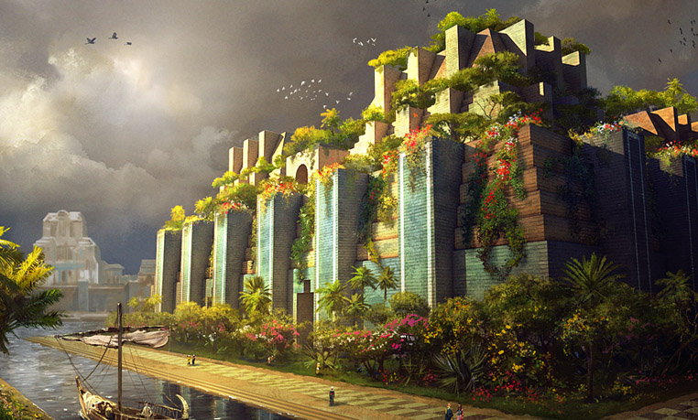
Daniel 4
Observation
2. Agitation: The King’s Dream (Daniel 4:4-18)
⁴ “I, Nebuchadnezzar, was at ease in my house and flourishing in my palace.”
Both of Daniel’s names referenced show familiarity
Flourishing: literally “growing green”
Why a dream to communicate the message?

Slide 18
Historical Inscriptions
Babylonian King Nebuchadnezzar inscribed the details on-site in stone:
I cut through steep mountains, I split rocks, opened passages and [thus] I constructed a straight road for the [transport of the] cedars. I made the Arahtu float [down] and carry to Marduk, my lord, mighty cedars, high and strong, of precious beauty and of excellent dark quality, the abundant yield of Lebanon, as [if they be] reed stalks carried by the river.
[as quoted by Mikesell, p.13]

Slide 19
Daniel 4:11-12
The Tree
¹¹ The tree grew and became strong, and its top reached to heaven, and it was visible to the end of the whole earth. ¹² Its leaves were beautiful and its fruit abundant, and in it was food for all. The beasts of the field found shade under it, and the birds of the heavens lived in its branches, and all flesh was fed from it.

Slide 20
Daniel 4
Observation
3. Interpretation: The King’s Danger (4:19-26)
¹⁹ “Then Daniel, whose name is Belteshazzar, was appalled for a while as his thoughts alarmed him.
and your majesty has become great…
an angelic watcher, a holy one…
let him share with the beasts of the field until seven periods of time…
until you recognize that the Most High is ruler…

Slide 21
Daniel 4
Observation
4. Exhortation: The King’s Decision (Daniel 4:27)
²⁷ Therefore, O king, let my counsel be acceptable to you: break off your sins by practicing righteousness, and your iniquities by showing mercy to the oppressed, that there may perhaps be a lengthening of your prosperity.”
What sins is he guilty of?
Proverbs 29:14
How are we to behave?
2 Peter 3:11-18
And yet the faithful prophet must proclaim the Word and leave the consequences with the Lord
-- Wiersbe

Slide 22
Daniel 4
Observation
5. Humiliation: The King’s Discipline (4:28-33)
³⁰ and the king answered and said, “Is not this great Babylon, which I have built by my mighty power as a royal residence and for the glory of my majesty?”
What is the timespan given between the warning and the result? Why?
What was his ultimate sin?

Slide 23
Daniel 4
Observation
6. Restoration: The King’s Deliverance (4:34-37,1-3)
³⁴ At the end of the days I, Nebuchadnezzar, lifted my eyes to heaven, and my reason returned to me, and I blessed the Most High, and praised and honored him who lives forever,”
When did his perilous state end? Why?
What did he acknowledge?

Slide 24
Daniel 4
Interpretation
^{34b} For His dominion is an everlasting dominion,
And His kingdom endures from generation to generation. ³⁵ All the inhabitants of the earth are accounted as nothing, But He does according to His will in the host of heaven And among the inhabitants of earth; And no one can ward off His hand Or say to Him, “What have You done?”

Slide 25
Daniel 4
Application
Now, most men quarrel with this [the sovereignty of God]. But mark, the thing that you complain of in God is the very thing that you love in yourselves. Every man likes to feel that he has a right to do with his own as he pleases. We all like to be little sovereigns. …
Oh! for a spirit that bows always before the sovereignty of God.
-- Charles Haddon Spurgeon, Sermons, Vol. III, The Two Talents

Slide 26
Daniel 4
Application
Read Psalm 2:1-6. How does that apply to the lessen of Nebuchadnezzar in Daniel 4?
What does the king’s stubborn reluctance to repent say about his heart? Why, after seeing the truth of God’s power (give examples), would he continue? How is this similar to the way believers today sometimes respond to God? (Wiersbe Question #7)
For what benefit is the restoration portion of Daniel 4? Was it necessary?
What might be a, “time in the wilderness,” that was in your past? Could wisdom (or wise counsel) have helped you avoid it?

Slide 27
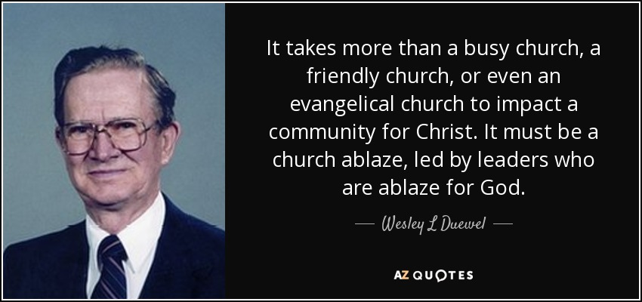
Wesley L. Duewel 1916 - 2016
From early childhood, Dr. Duewel had a deep love for the Word of God. His writings and poems on the Holy Spirit, revival, and soul winning call God's people back to prayer, the source of all power for ministry and express his hunger and passion.

Slide 28
Closing
Questions?
Comments?
Closing Prayer

Slide 29
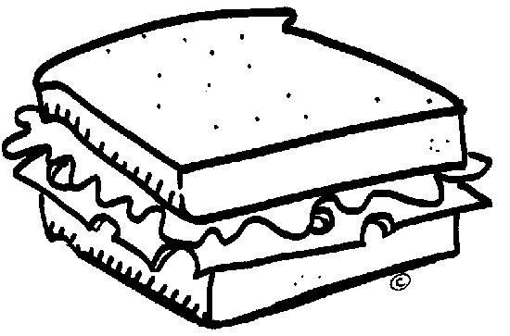
NoLiGHtS
Good
@
½

Slide 30
Scripture Interpretation
Normal - understanding the words of Scripture in their common usage unless otherwise indicated by the context.
Literal - understanding the meaning of Scripture in its ordinary sense unless the context requires a figurative interpretation.
Grammatical - using the recognized rules of grammar to interpret the text.
Historical - understanding the words of Scripture in the context of the times in which they were written.
Systematic - categorizing and comparing the teaching of the Scriptures with the whole of Scripture in view.
http://immanuelbible.net/discover/teach

