Slide 1
Announcements
Welcome to the MOB!
Website: www.ibcmob.net
Season of Service, Nov 8-9, 2014
Urban Immersion, Nov 6-9, 2014

Slide 2
Memory Verse
John 1:29 (ESV)
The next day he saw Jesus
coming toward him, and said,
“Behold, the Lamb of God,
who takes away the sin of the world!

Slide 3
John’s Purpose
John 20:30-31
³⁰ Now Jesus did many other signs in the presence of the disciples, which are not written in this book; ³¹ but these are written so that you may believe that Jesus is the Christ, the Son of God, and that by believing you may have life in his name.

Slide 4
The Gospel
According to John
Outline
Focus | Incarnation of the Son of God | Presentation of the Son of God | Opposition to the Son of God | Preparation of the Disciples | Crucifixion and Resurrection of the Son of God
Reference | 1:1-18 | 1:19 - 4:54 | 5:1 - 12:50 | 13:1 - 17:26 | 18:1 - 21:25
Division | Introduction to Christ | Revelation of Christ | Rejection of Christ | Revelation of Christ | Rejection of Christ
Topic | Seven Miracles |  |  | Upper Room Discourse | Supreme Miracle
 | That you might believe |  |  | That you might have life
Time | A Few Years |  |  | A Few Hours | A Few Weeks

Slide 5
Last Week
John 1:1-18
The Incarnation of the Son of God
John 1:1-2 The Deity of Christ
John 1:3-5 The Pre-incarnate Work of Christ
John 1:6-8 The Forerunner of Christ
John 1:9-11 The Rejection of Christ
John 1:12-13 The Acceptance of Christ
John 1:14-18 The Incarnation of Christ

Slide 6
This Week
John 1:19-34
John the Baptist’s Witness
John 1:19-28 John the Baptist’s Witness to the Priests and Levites
John 1:29-34 John the Baptist’s Witness at Christ’s Baptism

Slide 7
John 1:19-28
¹⁹ And this is the testimony of John, when the Jews sent priests and Levites from Jerusalem to ask him, “Who are you?” ²⁰ He confessed, and did not deny,
but confessed, “I am not the Christ.”
²¹ And they asked him, “What then?
Are you Elijah?” He said, “I am not.” “Are you the Prophet?” And he answered, “No.”

Slide 8
John 1:21
Who was Elijah?
Why did “the Jews” ask this question?
Who is the Prophet?
Why did “the Jews” ask this question?

Slide 9
John 1:19-28
²² So they said to him, “Who are you?
We need to give an answer to those who sent us. What do you say about yourself?”
²³ He said, “I am the voice of one crying out in the wilderness, ‘Make straight the way of the Lord,’ as the prophet Isaiah said.”

Slide 10
John 1:23
²³ He said, “I am the voice of one crying out in the wilderness, ‘Make straight the way of the Lord,’ as the prophet Isaiah said.”
What is significant about this claim?

Slide 11
John 1:19-28
²⁴ (Now they had been sent from the Pharisees.) ²⁵ They asked him, “Then why are you baptizing, if you are neither the Christ, nor Elijah, nor the Prophet?”
²⁶ John answered them, “I baptize with water, but among you stands one you do not know, ²⁷ even he who comes after me, the strap of whose sandal I am not worthy to untie.” ²⁸ These things took place in Bethany across the Jordan, where John was baptizing.

Slide 12
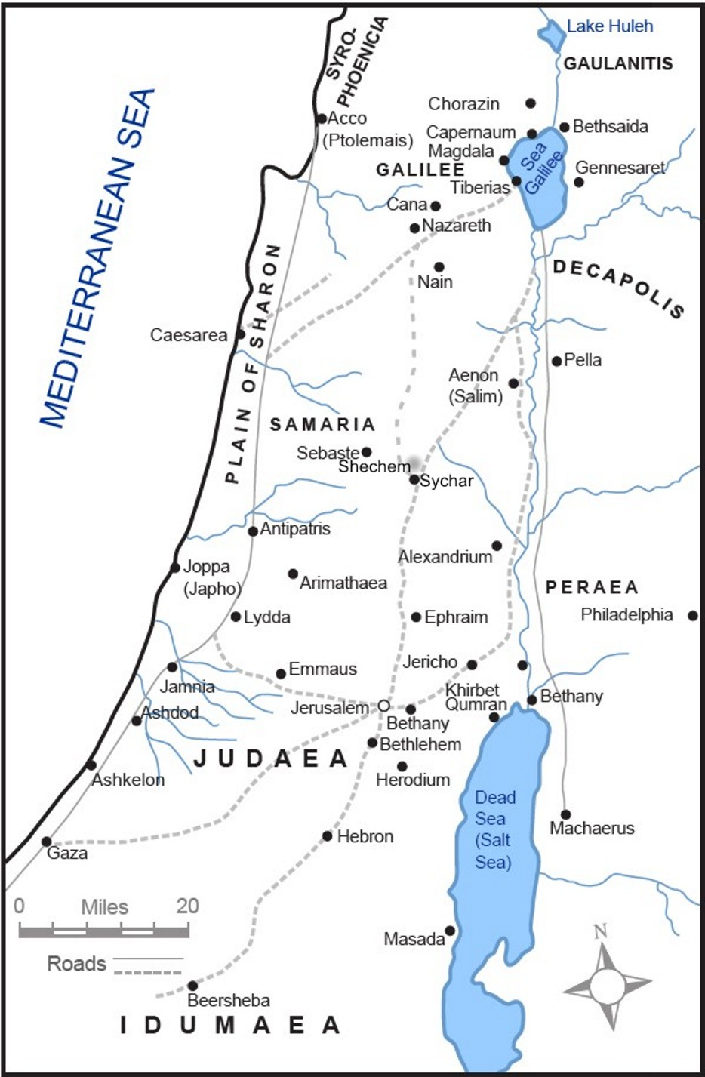
Bethany
across the Jordan

Slide 13
John 1:19-28
John’s Witness to the Priests and Levites
John confessed he is not the Christ
John confirmed he is not Elijah
John confirmed he is not the Prophet
John identified himself as the (OT) voice of “one calling in the desert” (Isaiah 40:3)
Witnesses to the presence of the Christ

Slide 14
John 1:29-34
²⁹ The next day he saw Jesus coming toward him, and said, “Behold, the Lamb of God, who takes away the sin of the world!
³⁰ This is he of whom I said, ‘After me comes a man who ranks before me, because he was before me.’ ³¹ I myself did not know him,
but for this purpose I came baptizing with water, that he might be revealed to Israel.”

Slide 15
John 1:29-34
³² And John bore witness: “I saw the Spirit descend from heaven like a dove, and it remained on him. ³³ I myself did not know him, but he who sent me to baptize with water said to me, ‘He on whom you see the Spirit descend and remain, this is he who baptizes with the Holy Spirit.’ ³⁴ And I have seen and have borne witness that this is the Son of God.”

Slide 16
John 1:29-34
John’s Witness at Christ’s Baptism
John declares that Jesus is the Lamb of God
John is moved by the Spirit to reveal Jesus
John testified that he saw the Spirit come down from heaven and remain on Jesus
Conclusion: Jesus is God’s Chosen One

Slide 17
Small Group Discussion
& Application
Give 2 examples in which John and the Synoptic Gospels agree about John the Baptist (Kostenberger, p. 52)
Why send Priests/Levites to question John the Baptist when the Jewish religious leaders didn’t believe in John’s ministry?
John the Baptist played his role in the Bible mission. How do we find and fulfill our role?

Slide 18
Discussion Questions
John 1:10 says that the world did not recognize Jesus. How then did John the Baptist recognize Jesus and subordinate his mission to the ministry of Jesus?
The Jewish reps demanded of John the Baptist, “What do you say about yourself?” How would we answer that question about our own life and our own roles and responsibilities?

Slide 19
Closing
Questions?
Comments?
Closing Prayer

Slide 20
John 1:19-28
John’s Witness to the Priests and Levites
Jesus is the Light (John 1:7-8)
Jesus is preeminent (John 1:15)
Jesus is God’s Chosen One (John 1:32-34)
John gave testimony to the truth (John 5:33-36)
John’s testimony was completely true (John 10:41)

