Slide 1
Announcements
Welcome to MOB!
Max McLean, Fellowship for Performing Arts, "C.S. Lewis Onstage: The Most Reluctant Convert," Apr 20 – May 8, 2016, Lansburgh Theatre, 450 7th Street NW, Washington, DC
Pray for MOB Fall 2016 – Spring 2017 planning
Website: www.ibcmob.net

Slide 2
Memory Verse
Daniel 7:14 (ESV)
And to him was given dominion and glory and a kingdom, that all peoples, nations, and languages should serve him; his dominion is an everlasting dominion, which shall not pass away, and his kingdom one that shall not be destroyed.
Daniel 7:14 (ESV)
( Daniel’s dream in which One “like the Son of Man” (Jesus) appears )

Slide 3
Daniel
Outline
Focus | Daniel’s History | Prophetic Plan for the Gentiles |  |  |  | Prophetic Plan of Israel
Reference | 1 | 2 - 4 | 5 | 6 | 7 | 8 | 9 | 10 - 12
Division | Personal Life of Daniel | Visions of Nebuc-hadnezzar | Visions of Balshazzar | Decree of Darius | Four Beasts | Vision of Ram and Male Goat | Vision of Seventy Weeks | Vision of Israel’s Future
Topic | Daniel’s Background | Daniel Interprets Others’ Dreams |  |  |  | Angel Interprets Daniel’s Dreams
 | Hebrew | Aramaic |  |  |  | Hebrew
Time | Written in Babylon or Persia around 605 – 536 BC

Slide 4
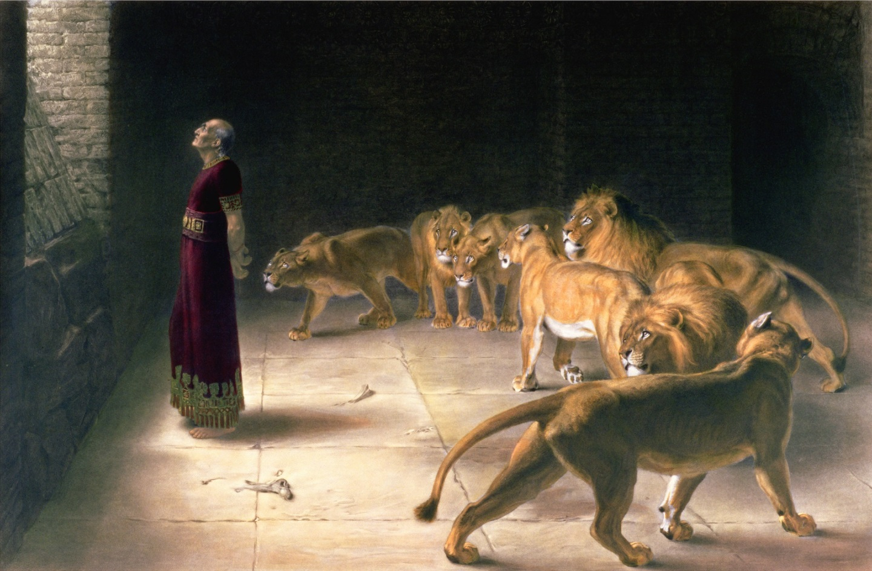
Last Week
Daniel and the Lions' Den Daniel 6:1-28
Daniel's Answer to the King by Briton Rivière, 1892 (25 x 35 in)

Slide 5
This Week
Daniel's Vision of the Four Beasts Daniel 7:1-8
The Ancient of Days Reigns Daniel 7:9-12
Son of Man Given Dominion Daniel 7:13-14
Daniel's Vision Interpreted Daniel 7:15-28

Slide 6
Daniel 7:1-8 (ESV)
Vision of the Four Beasts
¹ In the first year of Belshazzar king of Babylon, Daniel saw a dream and visions of his head as he lay in his bed. Then he wrote down the dream and told the sum of the matter. ² Daniel declared, “I saw in my vision by night, and behold, the four winds of heaven were stirring up the great sea. ³ And four great beasts came up out of the sea, different from one another. ⁴ The first was like a lion and had eagles' wings. Then as I looked its wings were plucked off, and it was lifted up from the ground and made to stand on two feet like a man, and the mind of a man was given to it. ⁵ And behold, another beast, a second one, like a bear. It was raised up on one side. It had three ribs in its mouth between its teeth; and it was told, ‘Arise, devour much flesh.’

Slide 7
Daniel 7:1-8 (ESV)
Vision of the Four Beasts
⁶ After this I looked, and behold, another, like a leopard, with four wings of a bird on its back. And the beast had four heads, and dominion was given to it. ⁷ After this I saw in the night visions, and behold, a fourth beast, terrifying and dreadful and exceedingly strong. It had great iron teeth; it devoured and broke in pieces and stamped what was left with its feet. It was different from all the beasts that were before it, and it had ten horns. ⁸ I considered the horns, and behold, there came up among them another horn, a little one, before which three of the first horns were plucked up by the roots. And behold, in this horn were eyes like the eyes of a man, and a mouth speaking great things.

Slide 8
Daniel 7:9-12 (ESV)
The Ancient of Days Reigns
⁹ “As I looked,
thrones were placed, and the Ancient of Days took his seat; his clothing was white as snow, and the hair of his head like pure wool; his throne was fiery flames; its wheels were burning fire. ¹⁰ A stream of fire issued and came out from before him; a thousand thousands served him, and ten thousand times ten thousand stood before him; the court sat in judgment, and the books were opened.
¹¹ “I looked then because of the sound of the great words that the horn was speaking. And as I looked, the beast was killed, and its body destroyed and given over to be burned with fire. ¹² As for the rest of the beasts, their dominion was taken away, but their lives were prolonged for a season and a time.

Slide 9
Daniel 7:13-14 (ESV)
Son of Man Given Dominion
¹³ “I saw in the night visions,
and behold, with the clouds of heaven there came one like a son of man, and he came to the Ancient of Days and was presented before him. ¹⁴ And to him was given dominion and glory and a kingdom, that all peoples, nations, and languages should serve him; his dominion is an everlasting dominion, which shall not pass away, and his kingdom one that shall not be destroyed.

Slide 10
Daniel 7:15-28 (ESV)
Daniel's Vision Interpreted
¹⁵ “As for me, Daniel, my spirit within me was anxious, and the visions of my head alarmed me. ¹⁶ I approached one of those who stood there and asked him the truth concerning all this. So he told me and made known to me the interpretation of the things. ¹⁷ ‘These four great beasts are four kings who shall arise out of the earth. ¹⁸ But the saints of the Most High shall receive the kingdom and possess the kingdom forever, forever and ever.’
¹⁹ “Then I desired to know the truth about the fourth beast, which was different from all the rest, exceedingly terrifying, with its teeth of iron and claws of bronze, and which devoured and broke in pieces and stamped what was left with its feet, ²⁰ and about the ten horns that were on its head, and the other horn that came up and before which three of them fell, the horn that had eyes and a mouth that spoke great things, and that seemed greater than its companions. ²¹ As I looked, this horn made war with the saints and prevailed over them, ²² until the Ancient of Days came, and judgment was given for the saints of the Most High, and the time came when the saints possessed the kingdom.

Slide 11
Daniel 7:15-28 (ESV)
Daniel's Vision Interpreted
²³ “Thus he said: ‘As for the fourth beast,
there shall be a fourth kingdom on earth, which shall be different from all the kingdoms, and it shall devour the whole earth, and trample it down, and break it to pieces. ²⁴ As for the ten horns, out of this kingdom ten kings shall arise, and another shall arise after them; he shall be different from the former ones, and shall put down three kings. ²⁵ He shall speak words against the Most High, and shall wear out the saints of the Most High, and shall think to change the times and the law; and they shall be given into his hand for a time, times, and half a time.

Slide 12
Daniel 7:15-28 (ESV)
Daniel's Vision Interpreted
²⁶ But the court shall sit in judgment, and his dominion shall be taken away, to be consumed and destroyed to the end. ²⁷ And the kingdom and the dominion and the greatness of the kingdoms under the whole heaven shall be given to the people of the saints of the Most High; his kingdom shall be an everlasting kingdom, and all dominions shall serve and obey him.’
²⁸ “Here is the end of the matter. As for me, Daniel, my thoughts greatly alarmed me, and my color changed, but I kept the matter in my heart.”

Slide 13
Daniel 7
Observation
5 W’s - Who, What, When, Where, Why
Who is involved?
When does this event occur?
Where does this event occur?
What happens?
Why? (Interpretation)

Slide 14
Daniel 7
Observation
Who is involved?
Daniel
Four Beasts
First: Like a Lion with Eagle’s Wings
Second: Like a Bear with 3 Ribs in its Mouth
Third: Like a Leopard with 4 Wings on its back and 4 Heads
Fourth: Terrifying, Dreadful, Strong, Iron Teeth, 10 Horns + 1 - 3
The Ancient of Days / Most High
“a thousand thousands” who serve Him
10,000 x 10,000 who stood before Him
One like a Son of Man
Bystander / Interpreter
Saints of the Most High
When does this event occur?
In the first year of Belshazzar King of Babylon (c. 556 – 550 BC)
Where does this event occur? Babylon (city)

Slide 15
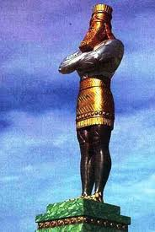
Nebuchadnezzar
605 – 562 BC
1st Invasion 605 BC = King Jehoiakim
2nd Invasion 597 BC = King Jehoiachin
3rd Invasion 586 BC = King Zedekiah
602 B.C.
1st
Dream
Chapter 2
Golden Image
Chapter 3
Belshazzar, et.al.
561 – 539 BC
2nd
Dream
Chapter 4
553 B.C.
Vision of the
Four Beasts
Chapter 7
551 B.C.
Vision of the
Ram & Goat
Chapter 8
Cyrus / Darius
539 BC & on
539 B.C.
Hand Writing
On The Wall
Chapter 5
539/538 B.C.
70 Weeks
Chapter 9
Lion’s Den
Chapter 6
Vision of a Man
Kings of the South and the North
Chapters 10 & 11
536 B.C.
Notes:
Nabonidus

Slide 16
Daniel 7
Observation
What happens?
Daniel has a dream and visions while lying in his bed
Daniel wrote down the dream, summarizing the matter
Daniel saw 4 great “beasts” come up out of “the great sea” in succession
The 4th beast had 10 horns
1 little horn came up, before which 3 of the horns were plucked up
The little horn had eyes like a man’s & mouth speaking great things
Daniel saw the Ancient of Days on his throne
“A thousand thousands” served Him & 10,000 x 10,000 stood by Him
God’s court sat in judgement and the books were opened
The 4th beast “wears out” the saints of the Most High
The 4th beast is killed and given over to be burned with fire
The other 3 beasts lose their power, but allowed to live a little while longer
Daniel saw one like a Son of Man presented to the Ancient of Days
Ancient of Days gives Son of Man dominion, glory, and eternal kingdom
The saints of the Most High reign with the Son of Man forever and ever

Slide 17
Daniel 7
Interpretation
² the four winds of heaven = 4 is the number of the Earth; 4 is symbolic of the “Four Corners of the Earth” - North, South, East, West; the winds of heaven stir up the whole Earth (Daniel 7:2)
the great sea = Humanity; all of the people of the Earth (Daniel 7:2 and Daniel 7:17); also perhaps the Mediterranean Sea (see also Isaiah 17:12-13,57:20,60:5; Ezekiel 26:3; Revelation 13:1,17:15)
³ four great beasts = ¹⁷ four kings who shall arise out of the earth (compare Daniel 7:2 and Daniel 7:17)
⁴ first was like a lion … eagles' wings = Neo-Babylonian Empire led by Nebuchadnezzar II
wings were plucked off = Nebuchadnezzar’s humiliation (Daniel 4:4-33)
then lifted up from the ground and made to stand on two feet like a man, and the mind of a man was given to it = Nebuchadnezzar’s restoration (Daniel 4:34-37,1-3)

Slide 18
Daniel 7
Interpretation
⁵ another beast, a second one, like a bear = Medo-Persian Empire led by Cyrus II, the Great and then his son Cambyses II
raised up on one side = older, more passive Median Empire led by the newer, more aggressive Persian Empire
three ribs in its mouth between its teeth = the three Kingdoms conquered by Cyrus the Great and his son Cambyses II:
Lydia (Western Asia Minor; 547 BC)
Babylon (539 BC)
Egypt (525 BC)
it was told, ‘Arise, devour much flesh.’ = see Isaiah 44:24-45:13

Slide 19
Daniel 7
Interpretation
⁶ another, like a leopard, with four wings of a bird on its back = Macedonian (Greek) Empire led by Alexander III of Macedon (the Great)
four heads = 4 generals (diadochi = successors) who divided the empire after of Alexander the Great’s death in 323 BC:
Macedonia ruled by Alexander IV and then Philip III of Macedon
Ptolemaic Egypt ruled by Ptolemy I Soter
Seleucid Empire (Syria, Babylon, Persia) ruled by Seleucus I Nicator
Antiochus IV Epiphanes (175–164 BC) – persecuted Jews
Attalid Kingdom (Asia Minor; Pergamon) ruled by Lysimachus

Slide 20
Daniel 7
Interpretation
⁷ a fourth beast, terrifying and dreadful and exceedingly strong. It had great iron teeth; it devoured and broke in pieces and stamped what was left with its feet. It was different from all the beasts that were before it… ¹⁹ the fourth beast, different from all the rest, exceedingly terrifying, with its teeth of iron and claws of bronze, and which devoured and broke in pieces and stamped what was left with its feet… ²³ fourth beast, different from all the kingdoms, shall devour the whole earth, trample it down, and break it to pieces = Roman Empire; complete domination with severe consequences for those who resist

Slide 21
Daniel 7
Middle Eastern History
Ur c. 3800 - 500 BC & Sumer c. 3500 BC
Egypt 3100 – 332 BC
Assyrian Empire c. 2400 – 612 BC & Akkadian Empire c. 2334 – c. 2154 BC (Nimrod, Genesis 10)
Babylonia 1894 BC (Hammurabi 1810 – 1750 BC)
Kingdom of Israel 1050 – 931 BC (Saul c. 1190 – 1010, David 1010 – 970, Solomon 970 – 931 BC)
Kingdom of Israel 931 – 722 BC (northern 10 tribes), Kingdom of Judah 931 – 586 BC (southern)
Neo-Assyrian Empire 911 – 605 BC (Jonah c. 760 BC) & Median Kingdom c. 678 – 549 BC
Neo-Babylonian Empire 626 – 539 BC (Nebuchadnezzar II –Daniel – Nabonidas & Belshazzar)
Achaemenid (First Persian) Empire 550 – 330 BC (Cyrus II of Persia 559 – 530 BC “The Great”)
Macedonian (Greek) Empire 336 –323 BC (Alexander III of Macedon 356 – 323 BC “The Great”)
Kingdoms of the Diadochi (“Successors” to Alexander The Great) c. 301/281 BC:
- Seleucid Empire 312 BC – 63 BC (Seleucus I Nicator) – Mesopotamia and Central Asia
- Ptolemaic Kingdom 305 BC – 30 BC (Ptolemy I Soter) – Egypt
- Kingdom of Lysimachus (Thrace, Asia Minor, Macedon) 306 - 281 BC (Lysimachus)
Kingdom of Pergamon 282 BC – 133 BC – Attalid Anatolia / Asia Minor
- Kingdom of Macedon 305 – 297 BC (Cassander)
Antigonid Macedon 306 – 168 BC (Antigonus I Monophthalmus)
Parthian (Arsacid or Persian) Empire 247 BC – 224 AD
Roman Republic 509 – 27 BC & Roman Empire 27 BC – 285/395 – 476 AD
Byzantine Empire 330 – 1453 AD & Sasanian (Sassanid or Neo-Persian) Empire 224 AD – 651 AD
Islamic Empires 632 AD – 1923 AD (Muhammed c. 570 AD – June 8, 632 AD)

Slide 22
Daniel 7
Daniel’s Vision: Four Beasts
Ur c. 3800 - 500 BC & Sumer c. 3500 BC
Egypt 3100 – 332 BC
Assyrian Empire c. 2400 – 612 BC & Akkadian Empire c. 2334 – c. 2154 BC (Nimrod, Genesis 10)
Babylonia 1894 BC (Hammurabi 1810 – 1750 BC)
Kingdom of Israel 1050 – 931 BC (Saul c. 1190 – 1010, David 1010 – 970, Solomon 970 – 931 BC)
Kingdom of Israel 931 – 722 BC (northern 10 tribes), Kingdom of Judah 931 – 586 BC (southern)
Neo-Assyrian Empire 911 – 605 BC (Jonah c. 760 BC) & Median Kingdom c. 678 – 549 BC
Neo-Babylonian Empire 626 – 539 BC (Nebuchadnezzar II –Daniel – Nabonidas & Belshazzar)
Achaemenid (First Persian) Empire 550 – 330 BC (Cyrus II of Persia 559 – 530 BC “The Great”)
Macedonian (Greek) Empire 336 –323 BC (Alexander III of Macedon 356 – 323 BC “The Great”)
Kingdoms of the Diadochi (“Successors” to Alexander The Great) c. 301/281 BC:
- Seleucid Empire 312 BC – 63 BC (Seleucus I Nicator) – Mesopotamia and Central Asia
- Ptolemaic Kingdom 305 BC – 30 BC (Ptolemy I Soter) – Egypt
- Kingdom of Lysimachus (Thrace, Asia Minor, Macedon) 306 - 281 BC (Lysimachus)
Kingdom of Pergamon 282 BC – 133 BC – Attalid Anatolia / Asia Minor
- Kingdom of Macedon 305 – 297 BC (Cassander)
Antigonid Macedon 306 – 168 BC (Antigonus I Monophthalmus)
Parthian (Arsacid or Persian) Empire 247 BC – 224 AD
Roman Republic 509 – 27 BC & Roman Empire 27 BC – 285/395 – 476 AD
Byzantine Empire 330 – 1453 AD & Sasanian (Sassanid or Neo-Persian) Empire 224 AD – 651 AD
Islamic Empires 632 AD – 1923 AD (Muhammed c. 570 AD – June 8, 632 AD)

Slide 23
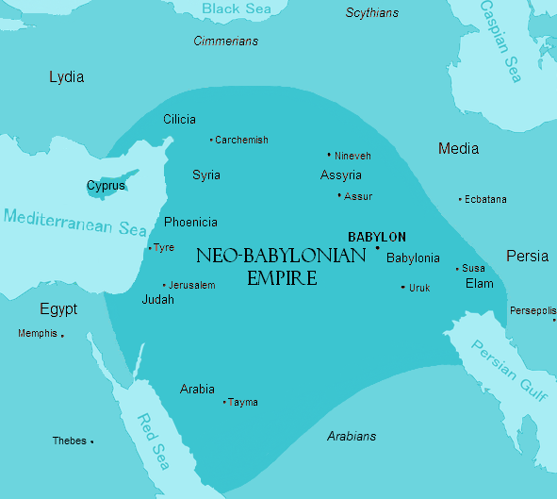
Neo-Babylonian Empire

Slide 24
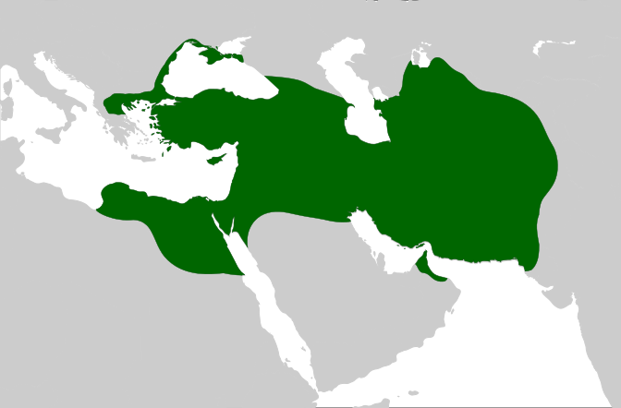
Persian Empire

Slide 25
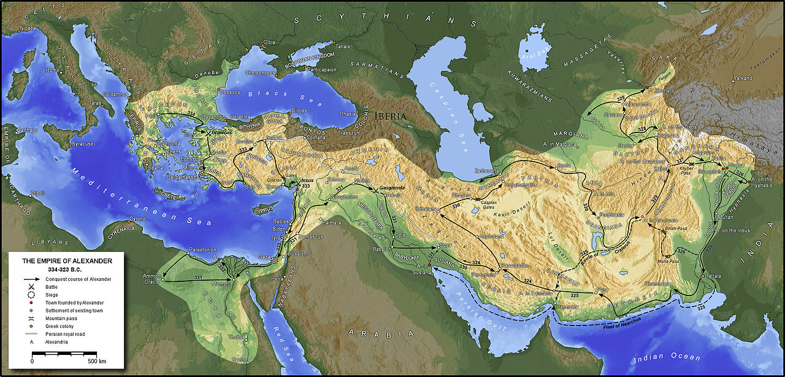
Greek Empire

Slide 26
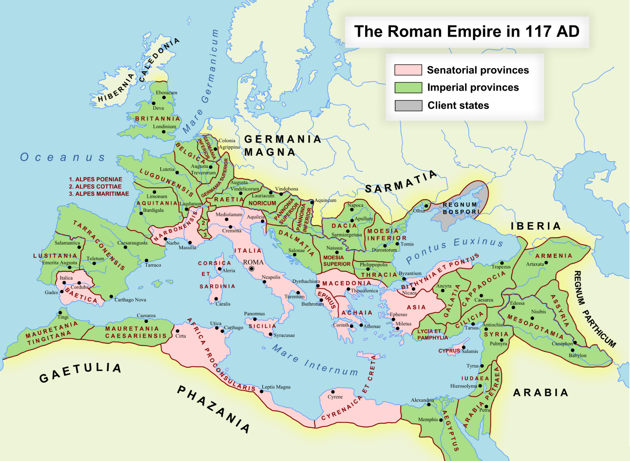
Roman Empire

Slide 27
Daniel 7
Interpretation
(4th Beast, continued) ⁷ …it had ten horns… ²⁰ ten horns on its head… ²⁴ As for the ten horns, out of this kingdom ten kings shall arise = 10 kingdoms that grow out of the Roman Empire; much speculation about the identification of these 10 kingdoms
⁸ …there came up among them another horn, a little one… another shall arise after them; different from the former ones = Antichrist will be more powerful than all of the kings and kingdoms that came before (2 Thessalonians 2:1-12, Revelation 13:1-10)
three of the first horns were plucked up by the roots = 3 kingdoms destroyed / absorbed by the kingdom of the Antichrist
in this horn were eyes like the eyes of a man = Intelligence; Worldly wisdom; Man’s wisdom – NOT God’s wisdom
and a mouth speaking great things = Proclaiming Worldly wisdom; not the Truth of the One True, Triune God

Slide 28
Daniel 7
Interpretation
²¹ …this horn made war with the saints and prevailed over them… ²⁵ He shall… wear out the saints of the Most High… and they shall be given into his hand = Antichrist establishes himself as god on Earth and persecutes God’s saints during the Great Tribulation (Revelation 11:7,13:1-10,17:14)
²⁵ He shall speak words against the Most High… and shall think to change the times and the law; = Antichrist will abolish God’s religious observances / holidays and God’s laws / worship of the One True God (Matthew 24)
for a time, times, and half a time = 3.5 years; the second half of the Tribulation (Matthew 24)

Slide 29
Daniel 7
Interpretation
⁹ the Ancient of Days took his seat; clothing white as snow, hair like pure wool = God (God the Father); perfect righteousness; morally pure
Throne… fiery flames; wheels… burning fire. ¹⁰ stream of fire… came out from before him = God’s judgement (Isaiah 30:33,66:15)
“a thousand thousands” = 1M served him = God’s angelic host
10,000 x 10,000 = 100M stood before him = Angels + Saints (Revelation 7)
¹³ with the clouds of heaven… came one like a son of man = Jesus Christ (Matthew 24:29-31, Mark 13:26, Revelation 1:7)
and he came to the Ancient of Days and was presented before him = Jesus, the Messiah, God the Son presented before God the Father
¹⁴ to him was given dominion and glory and a kingdom that all peoples, nations, and languages should serve him = God the Father gives God the Son (Jesus, Messiah) His kingdom

Slide 30
Daniel 7
Interpretation
¹¹ the (little) horn… on the 4th beast was killed, its body destroyed and given over to be burned with fire… ²² the Ancient of Days came, and judgment was given for the saints of the Most High… ²⁶ But the court shall sit in judgment, and his dominion shall be taken away, to be consumed and destroyed to the end = God judges and punishes the Antichrist (Revelation 20)
¹² the rest of the beasts’ dominion was taken away, but lives prolonged for a season and a time = God allows the people of the earth and their earthly governments to continue for a time

Slide 31
Daniel 7
Interpretation
¹⁸ the saints of the Most High receive the kingdom and possess the kingdom forever, forever and ever… ²² the time came when the saints possessed the kingdom his dominion is an everlasting dominion, which shall not pass away, and his kingdom one that shall not be destroyed… ²⁷ And the kingdom and the dominion and the greatness of the kingdoms under the whole heaven shall be given to the people of the saints of the Most High; his kingdom shall be an everlasting kingdom and all dominions shall serve and obey him = God the Father gives God the Son (Jesus Christ) His eternal kingdom and the saints rule with Him forever and ever (Daniel 2:44, Luke 1:33)

Slide 32
Daniel 7
Interpretation
Daniel 2 | Daniel 7 | Meaning
Nebuchadnezzar (Man’s View) | Daniel (God’s View) | Kingdoms
Head of fine Gold | Lion with Eagle’s Wings | Babylonian
Chest & Arms of Silver | Bear with 3 Ribs in Mouth | Medo-Persian
Middle & Thighs of Bronze | Leopard with 4 Wings, 4 Heads | Greek
Legs of Iron; Feet partly of Iron and partly of Clay | 4th Beast with Iron Teeth | Roman
 | 10 Horns | 10 that grow out of Roman
 | 1 (new) Horn (becomes greatest) | Antichrist
Stone cut out by no human hand (Psalm 118:22, Matthew 21:42, Acts 4:11) | Son of Man (Jesus Christ) presented to the Ancient of Days (God the Father) | Christ and His eternal kingdom

Slide 33
Daniel 7
Application
After seeing these visions, Daniel was very concerned. (Daniel 7:15,28) What worries you? Why?
Why is it important that history confirms Daniel’s prophetic dreams and visions? What does this suggest about the rest of Daniel’s unfulfilled prophetic dreams and visions?
If the “Ancient of Days” controls and directs the earth’s kingdoms, what happens, and when; the “Son of Man” will ultimately have dominion over all kingdoms; and “the saints of the Most High” will reign with the “Son of Man” forever; how should this affect how you think about, speak about, and act (your actions) concerning current and future events in our nation and world?
If the “Ancient of Days” controls everything, should you be concerned about local and national (US) politics? Should you be politically active? Should you vote? Why or why not? Explain.
What have you learned by studying the book of Daniel so far that gives you hope? When and how will you share this with others?

Slide 34
Closing
Questions?
Comments?
Closing Prayer

