Slide 1
Announcements
Welcome to MOB!
Max McLean, Fellowship for Performing Arts, "C.S. Lewis Onstage: The Most Reluctant Convert," Apr 20 – May 8, 2016, Lansburgh Theatre, 450 7th Street NW, Washington, DC
Discovering Immanuel Class, May 8, 8:00 Rm 206
Pray for MOB Fall 2016 – Spring 2017 planning
Website: www.ibcmob.net

Slide 2
Memory Verse
Daniel 8:27 (ESV)
Then I, Daniel, was exhausted and sick for days. Then I got up again and carried on the king’s business; but I was astounded at the vision, and there was none to explain it.
Daniel 8:27 (ESV)
( Daniel’s response to the dream about the ram and the male goat )

Slide 3
Last Week
Daniel's Vision of the Four Beasts Daniel 7:1-8
The Ancient of Days Reigns Daniel 7:9-12
Son of Man Given Dominion Daniel 7:13-14
Daniel's Vision Interpreted Daniel 7:15-28

Slide 4
This Week
Daniel's Vision of the Ram and the Goat
Daniel 8:1-14
The Interpretation of the Vision
Daniel 8:15-27

Slide 5
Daniel
Outline
Focus | Daniel’s History | Prophetic Plan for the Gentiles |  |  |  | Prophetic Plan of Israel
Reference | 1 | 2 - 4 | 5 | 6 | 7 | 8 | 9 | 10 - 12
Division | Personal Life of Daniel | Visions of Nebuc-hadnezzar | Visions of Belshazzar | Decree of Darius | Four Beasts | Vision of Ram and Male Goat | Vision of Seventy Weeks | Vision of Israel’s Future
Topic | Daniel’s Background | Daniel Interprets Others’ Dreams |  |  |  | Angel Interprets Daniel’s Dreams
 | Hebrew | Aramaic |  |  |  | Hebrew
Time | Written in Babylon or Persia around 605 – 536 BC

Slide 6
Israel’s SOVEREIGN GOD

Slide 7
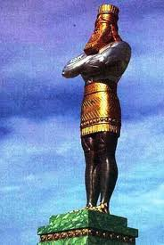
Nebuchadnezzar
605 BC to 562 BC
1st Invasion 605 BC = King Jehoiakim
2nd Invasion 597 BC = King Jehoiachin
3rd Invasion 586 BC = King Zedekiah
602 B.C.
1st
Dream
Chapter 2
Golden Image
Chapter 3
Belshazzar, et.al.
561 BC to 539 BC
2nd
Dream
Chapter 4
553 B.C.
Vision of the
Four Beasts
Chapter 7
551 B.C.
Vision of the
Ram & Goat
Chapter 8
Cyrus / Darius
539 BC & on
539 B.C.
Hand Writing
On The Wall
Chapter 5
539/538 B.C.
70 Weeks
Chapter 9
Lion’s Den
Chapter 6
Vision of a Man
Kings of the South and the North
Chapters 10 & 11
536 B.C.
Notes:
Nabonidus

Slide 8
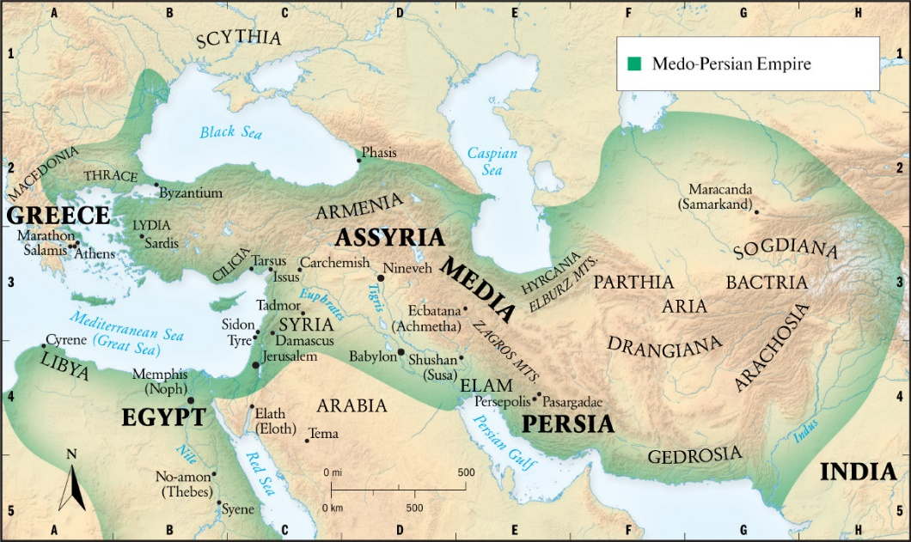
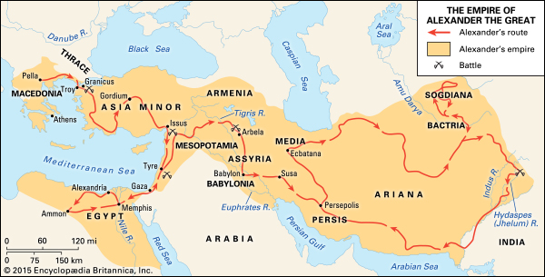
Persian & Greek Empires
Medo-Persian Empire
550 – 330 BC
480 BC 50M people
Capitals were Persepolis and Susa
http://wol.jw.org/en/wol/ml/r1/lp-e/23
Alexander the Great
356 – 323 BC (died age 33)
Succeeded Philip II of Macedon
Tutored by Aristotle until 16
http://media.web.britannica.com/eb-media/54/64954-004-B050D47D.jpg

Slide 9
Daniel 8:1-14 (ESV)
Vision of Ram and Goat
¹ In the third year of the reign of King Belshazzar a vision appeared to me, Daniel, after that which appeared to me at the first. ² And I saw in the vision; and when I saw, I was in Susa the citadel, which is in the province of Elam. And I saw in the vision, and I was at the Ulai canal. ³ I raised my eyes and saw, and behold, a ram standing on the bank of the canal. It had two horns, and both horns were high, but one was higher than the other, and the higher one came up last. ⁴ I saw the ram charging westward and northward and southward. No beast could stand before him, and there was no one who could rescue from his power. He did as he pleased and became great.

Slide 10
Daniel 8:1-14 (ESV)
Vision of Ram and Goat
⁵ As I was considering, behold, a male goat came from the west across the face of the whole earth, without touching the ground. And the goat had a conspicuous horn between his eyes. ⁶ He came to the ram with the two horns, which I had seen standing on the bank of the canal, and he ran at him in his powerful wrath. ⁷ I saw him come close to the ram, and he was enraged against him and struck the ram and broke his two horns. And the ram had no power to stand before him, but he cast him down to the ground and trampled on him. And there was no one who could rescue the ram from his power. ⁸ Then the goat became exceedingly great, but when he was strong, the great horn was broken, and instead of it there came up four conspicuous horns toward the four winds of heaven.

Slide 11
Daniel 8:1-14 (ESV)
Vision of Ram and Goat
⁹ Out of one of them came a little horn, which grew exceedingly great toward the south, toward the east, and toward the glorious land. ¹⁰ It grew great, even to the host of heaven. And some of the host and some of the stars it threw down to the ground and trampled on them. ¹¹ It became great, even as great as the Prince of the host. And the regular burnt offering was taken away from him, and the place of his sanctuary was overthrown. ¹² And a host will be given over to it together with the regular burnt offering because of transgression, and it will throw truth to the ground, and it will act and prosper. ¹³ Then I heard a holy one speaking, and another holy one said to the one who spoke, “For how long is the vision concerning the regular burnt offering, the transgression that makes desolate, and the giving over of the sanctuary and host to be trampled underfoot?” ¹⁴ And he said to me, “For 2,300 evenings and mornings. Then the sanctuary shall be restored to its rightful state.”

Slide 12
Daniel 8:15-27 (ESV)
Interpretation of the Vision
¹⁵ When I, Daniel, had seen the vision, I sought to understand it. And behold, there stood before me one having the appearance of a man. ¹⁶ And I heard a man's voice between the banks of the Ulai, and it called, “Gabriel, make this man understand the vision.”
¹⁷ So he came near where I stood. And when he came, I was frightened and fell on my face. But he said to me, “Understand, O son of man, that the vision is for the time of the end.”

Slide 13
Daniel 8:15-27 (ESV)
Interpretation of the Vision
¹⁸ And when he had spoken to me, I fell into a deep sleep with my face to the ground. But he touched me and made me stand up. ¹⁹ He said, “Behold, I will make known to you what shall be at the latter end of the indignation, for it refers to the appointed time of the end. ²⁰ As for the ram that you saw with the two horns, these are the kings of Media and Persia. ²¹ And the goat is the king of Greece. And the great horn between his eyes is the first king. ²² As for the horn that was broken, in place of which four others arose, four kingdoms shall arise from his nation, but not with his power. ²³ And at the latter end of their kingdom, when the transgressors have reached their limit, a king of bold face, one who understands riddles, shall arise.

Slide 14
Daniel 8:15-27 (ESV)
Interpretation of the Vision
²⁴ His power shall be great - but not by his own power; and he shall cause fearful destruction and shall succeed in what he does, and destroy mighty men and the people who are the saints. ²⁵ By his cunning he shall make deceit prosper under his hand, and in his own mind he shall become great. Without warning he shall destroy many. And he shall even rise up against the Prince of princes, and he shall be broken - but by no human hand. ²⁶ The vision of the evenings and the mornings that has been told is true, but seal up the vision, for it refers to many days from now.”
²⁷ And I, Daniel, was overcome and lay sick for some days. Then I rose and went about the king's business, but I was appalled by the vision and did not understand it.

Slide 15
Mapping Chapters 2, 7 and 8
Empire / Ruler | Chapter 2 | Chapter 7 | Chapter 8
Neo-Babylonian / Nebuchadnezzar II | Head of Gold | Lion with eagles wings
Medo-Persian / Cyrus II & Cambyses II | Chest and Arms of Silver | Bear with 3 ribs in its mouth | Ram with 2 horns v3 Shattered v7
Greek / | Belly and Thighs of Brass | Swift Leopard with 4 heads | Angry Goat from the west v5 magnified exceedingly v8
1st King of Greece Alexander the Great |  |  | Larger horn that was broken into 4 horns v8
Antiochus IV Epiphanes |  | 1 of the 4 heads: Seleucid Empire | Small horn from the south v9
Roman | Legs of Iron | Dreadful Beast
Antichrist |  |  | King - insolent and skilled in intrigue v23

Slide 16
Daniel 8
Observation
Daniel the Prophet (Daniel 8:1-2, 15-19, 26-27)
Receiving the vision
Requesting the meaning of the vision
Cyrus II, The Great, King of Persia (Daniel 8:3-4, 20)
Righteous Man (Isaiah 44:28)
The Lord’s anointed (Isaiah 45:1)
Alexander III of Macedon, The Great (8:5-8, 21-22)
He-goat from the west over the surface of the whole earth
Antiochus IV Epiphanes (Daniel 8:9-14)
A king emerges of unusual significance
The Antichrist (Daniel 8:23-27)

Slide 17
Daniel 8:1-14 (ESV)
Vision of Ram and Goat
¹ In the third year of the reign of King Belshazzar a vision appeared to me, Daniel, after that which appeared to me at the first. ² And I saw in the vision; and when I saw, I was in Susa the citadel, which is in the province of Elam. And I saw in the vision, and I was at the Ulai canal. ³ I raised my eyes and saw, and behold, a ram standing on the bank of the canal. It had two horns, and both horns were high, but one was higher than the other, and the higher one came up last. ⁴ I saw the ram charging westward and northward and southward. No beast could stand before him, and there was no one who could rescue from his power. He did as he pleased and became great.
Cyrus II, The Great, King of Persia

Slide 18
Daniel 8:1-14 (ESV)
Vision of Ram and Goat
⁵ As I was considering, behold, a male goat came from the west across the face of the whole earth, without touching the ground. And the goat had a conspicuous horn between his eyes. ⁶ He came to the ram with the two horns, which I had seen standing on the bank of the canal, and he ran at him in his powerful wrath. ⁷ I saw him come close to the ram, and he was enraged against him and struck the ram and broke his two horns. And the ram had no power to stand before him, but he cast him down to the ground and trampled on him. And there was no one who could rescue the ram from his power. ⁸ Then the goat became exceedingly great, but when he was strong, the great horn was broken, and instead of it there came up four conspicuous horns toward the four winds of heaven.
Alexander III of Macedon, The Great

Slide 19
Daniel 8:1-14 (ESV)
Vision of Ram and Goat
⁹ Out of one of them came a little horn, which grew exceedingly great toward the south, toward the east, and toward the glorious land. ¹⁰ It grew great, even to the host of heaven. And some of the host and some of the stars it threw down to the ground and trampled on them. ¹¹ It became great, even as great as the Prince of the host. And the regular burnt offering was taken away from him, and the place of his sanctuary was overthrown. ¹² And a host will be given over to it together with the regular burnt offering because of transgression, and it will throw truth to the ground, and it will act and prosper. ¹³ Then I heard a holy one speaking, and another holy one said to the one who spoke, “For how long is the vision concerning the regular burnt offering, the transgression that makes desolate, and the giving over of the sanctuary and host to be trampled underfoot?” ¹⁴ And he said to me, “For 2,300 evenings and mornings. Then the sanctuary shall be restored to its rightful state.”
Antiochus IV Epiphanes

Slide 20
Antiochus Epiphanes
Known as one of the cruelest tyrants in history
Gave himself the name Epiphanes; Illustrious, manifest god
Dec 14, 168 BC – Alter used to sacrifice a pig
The abomination that makes desolate
Dec 14, 165 BC – Temple purified, burnt offering restored
Judas Maccabeus defeated the Seleucids
Festival of Lights and Feast of Dedication: Hanukkah
Timing:
2300 “evenings and mornings”
6 year advocates: High Priest Deposed -> Temple re-consecrated
3 year advocates: Pagan alter -> Temple re-consecrated
What did Antiochus IV foreshadow?

Slide 21
The Antichrist The King of Fierce Countenance
An angel awakened Daniel from his deep sleep and told him there was yet more prophetic truth for him to hear, and it related to latter “the final period of the indignation for it pertains to the appointed time of the end” (v19) - NASB
“In the latter period of their rule, When the transgressors have run their course, A king will arise, insolent and skilled in intrigue”
- When sinful actions have reached a boiling point (Gen 15:16; Matt 23:32; 1 Thess 2:16)
“His power will be mighty, but not by his own power, and he will destroy to an extraordinary degree”
- Literally: he will destroy wonderfully
“He will even oppose the Prince of princes, but he will be broken without human agency”
- Antiochus = Prince of Hosts (v11, ESV); this more like King of Kings, Lord of Lords

Slide 22
Similarities of Little Horn and Antichrist
Both begin modestly, but increase in power and influence.
Both blaspheme God with mouths that speak great things.
Both persecute the Jewish people.
Both claim to be god and put image in the temple.
Both impose their own religion on the people.
Both are opposed by a believing remnant that knows God.
Both are energized by the devil and are great deceivers.
Both appear to succeed marvelously and seem to be invincible.
Both are finally defeated by the coming of a redeemer (Judas Maccabeus and Jesus Christ).

Slide 23
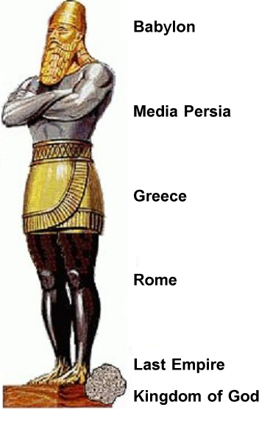
How They Fit In
Zadok Priesthood
Alexander the Great
4 Rival Generals
Hellenization
Diadochi
Egypt
Ptolemy
Syria
Seleucid
Antiochus Epiphanes
164 BC
Hasmonians
(Maccabees)
Sadducees
Written Torah
AD70
63 BC
Pharisees
Hasidim
(pious)
Essenes
(Sons of Light)
Romans
AD70
Written Torah
Oral Commandments
Rabbinic Judaism

Slide 24
Daniel 8
Application
Daniel seems more troubled by the visions of 19 – 25. Why would he be troubled more by these? (Wiersbe #9)
Compare verses 23 – 27 with 9 – 14. In what ways do the characteristics of Antiochus IV parallel those of the Antichrist?
In what ways are Daniel’s actions as a prophet a good model for us as students of Scripture? What can we learn from his methods that can help us mature as believers and be better prepared to answer questions posed by non-believers? (Wiersbe #10)
What questions or fears do you have about the end times? In what ways are Daniel’s visions encouraging to you? Confusing? Inspiring? How do you think we are meant to live in light of them? (Wiersbe #11)
What are some of the ways God chooses to speak to you? What sort of burden do we carry for all both believers and non-believers today? (Wiersbe #12)

Slide 25
Closing
Questions?
Comments?
Closing Prayer

